Slide 1


NoN-Toxic Communication
Using Natural Language Processing to identify toxic speech
WARNING: Offensive Language Identified

Slide 2
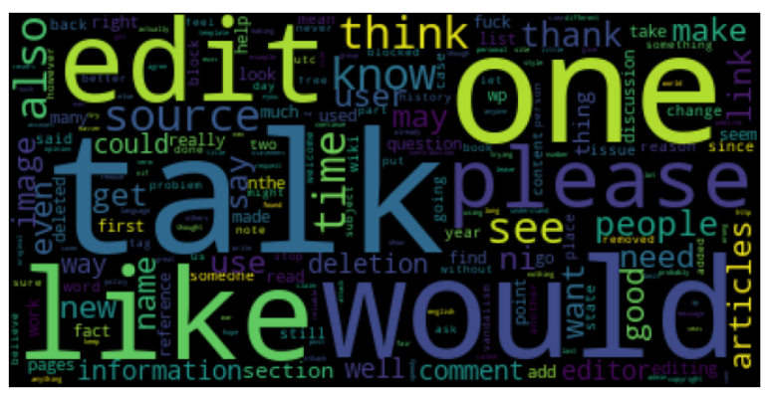
28
Background:
Let’s talk…. in a constructive way

Slide 3

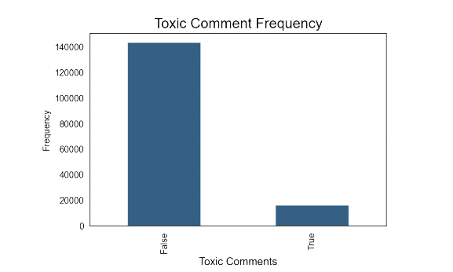
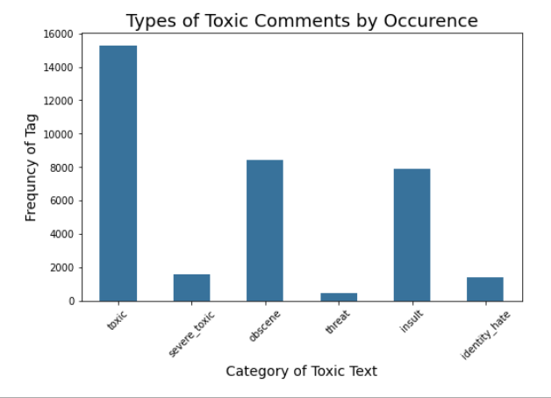
Problem: Freedom of speech is … sometimes toxic
The dataset was provided by Conversation AI in hopes to improve online discussion.
Wikipedia Talk Pages 150K + samples rated by humans for toxic effect varying in range from
Toxic
Severe Toxic
Obscene
Threat
Insult
Identity Hate
Notes:
Conversation AI Dataset: https://conversationai.github.io/
From Kaggle:
Discussing things you care about can be difficult. The threat of abuse and harassment online means that many people stop expressing themselves and give up on seeking different opinions. Platforms struggle to effectively facilitate conversations, leading many communities to limit or completely shut down user comments.
The Conversation AI team, a research initiative founded by Jigsaw and Google (both a part of Alphabet) are working on tools to help improve online conversation. One area of focus is the study of negative online behaviors, like toxic comments (i.e. comments that are rude, disrespectful or otherwise likely to make someone leave a discussion). So far they’ve built a range of publicly available models served through the Perspective API, including toxicity. But the current models still make errors, and they don’t allow users to select which types of toxicity they’re interested in finding (e.g. some platforms may be fine with profanity, but not with other types of toxic content).

Slide 4

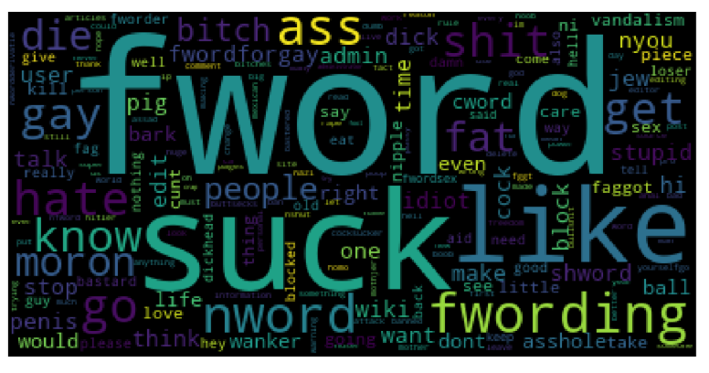
Examples:
Word Clouds display words in a collection. The larger the word, the more frequently used the word is.
Toxic
Clean

Slide 5
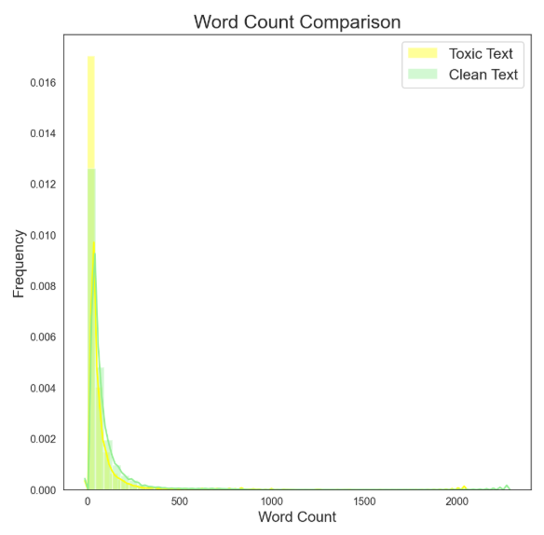


Are toxic comments longer than non-toxic?
No… focus more on the words…..

Slide 6
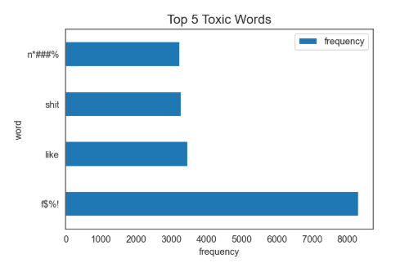
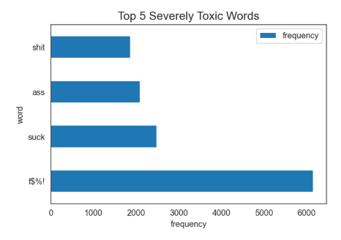
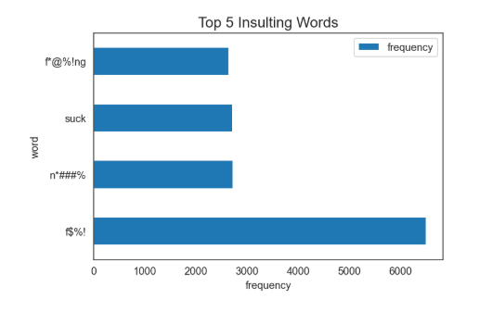
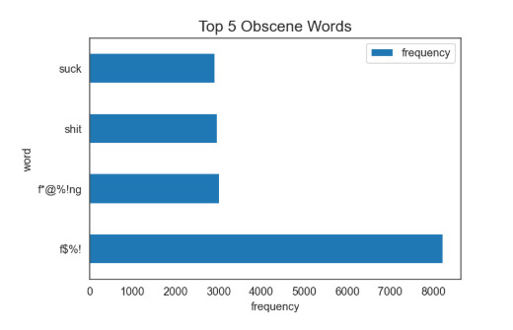
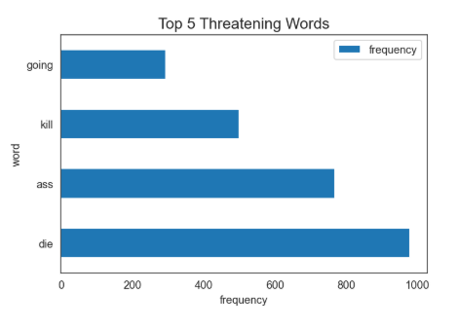
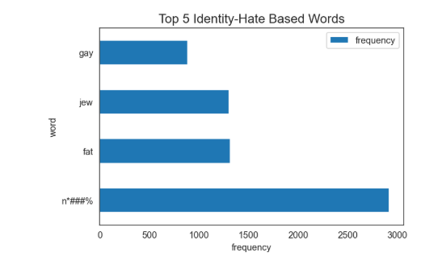
Top 5 Words Per Category:
Patterns Emerged
The same words appeared in 4 categories:
Toxic, Severely Toxic, Insulting & Obscene
Two categories had more distinct top 5 words:
Threatening & Identity-Based Hate
4/4
3/4
3/4

Slide 7
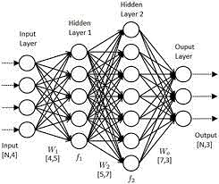





Methodology:
Toxic = 1
“You are a $@^%!”
[1 4 8 6]
dataset
Comment labels
Comments
Word Vectors
Padded
Vector
Deep Learning using
Natural Language Processing and Neural Networks
Recurrent Neural Network
N L P
Neural Network
Natural Language Processing (NLP):
“Tokenizes” text
Uses resulting tokens to create vectors as data
Neural Networks:
multilayer perceptron
Neurons
Synapses
Input and output
Recurrent Neural Networks
Added ‘weights’ to maintain state
Long Short Term Memory LSTM

Slide 8

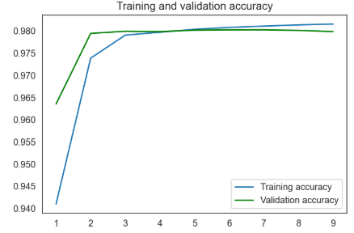
Results:
98% Accuracy Rate
99- 100% of the time identified
clean text
Better at predicting classes where there is more data… a lot better.
Category | Rate of Predicting Cases or ‘Recall”
Toxic | 68
Severe toxic | 39
Obscene | 78
Threat | not enough samples
Insult | 65
Identity Hate | not enough samples
Accuracy
Epoch # (Round of training)

Slide 9






Recommendations
Use model to identify comments that are toxic in nature.
Develop metrics and actionable plans for varying levels of toxicity
So now what?:
Invest in future work to further develop existing models to specifically identify severe forms, targeting threats and identity based hate specifically
Research and implement best practices so that everyone feels comfortable sharing thoughts.

Slide 10


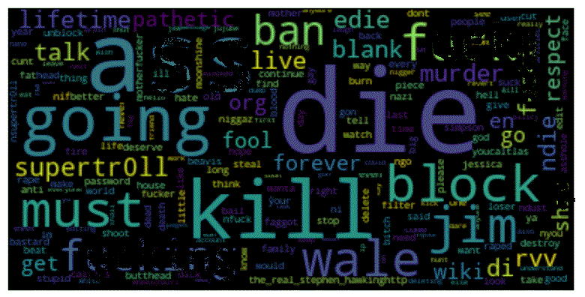
Future Work:
Collect more data around these more severe types of toxic comments to improve recognition.
Make threatening content main target
THREATS &
SENTIMENT ANALYSIS
Hopefully collective work can help everyone express themselves in more meaningful.
Thankfully the most severe types of toxic comments are less frequent. In some situations, speech can constitute a crime, such as in the case of criminal threats.
Comparative analysis on sentence sentiment rather than word.

Slide 11




Photo Collage
Thank you

Slide 12
Appendix:

Slide 13
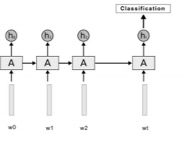
LSTM

Slide 14
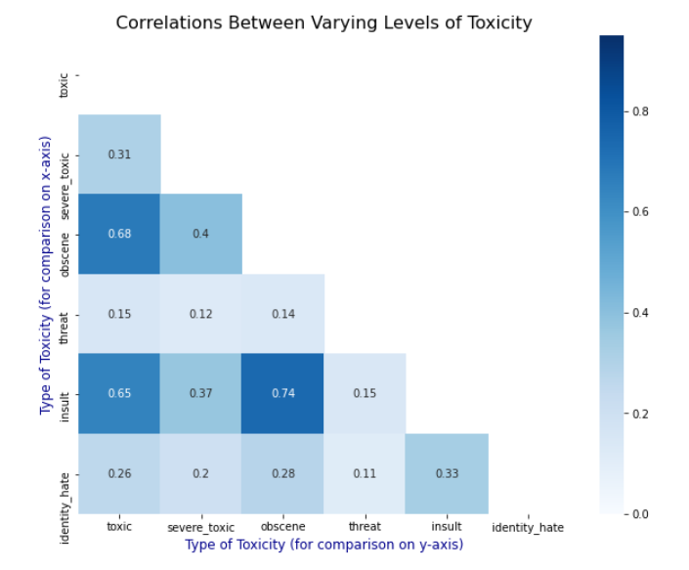
Correlations:

