Slide 1


NoN-Toxic Communication
Using Natural Language Processing to help keep sharing ideas healthy

Slide 2
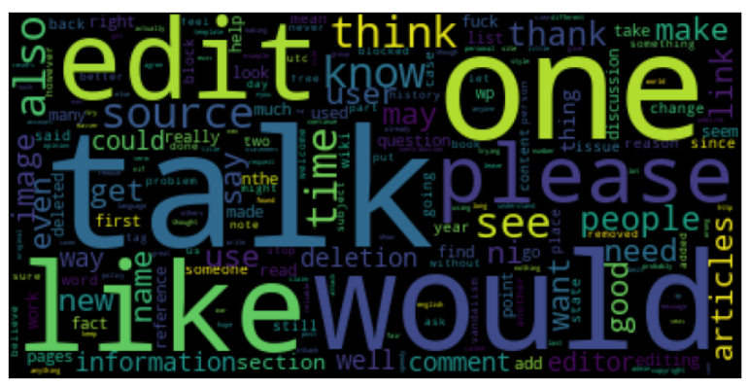
28
Background:
Let’s talk…. in a constructive way

Slide 3

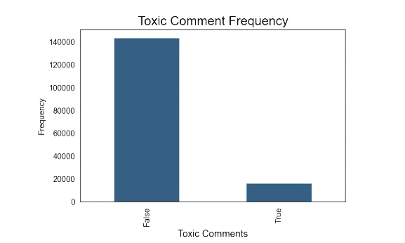
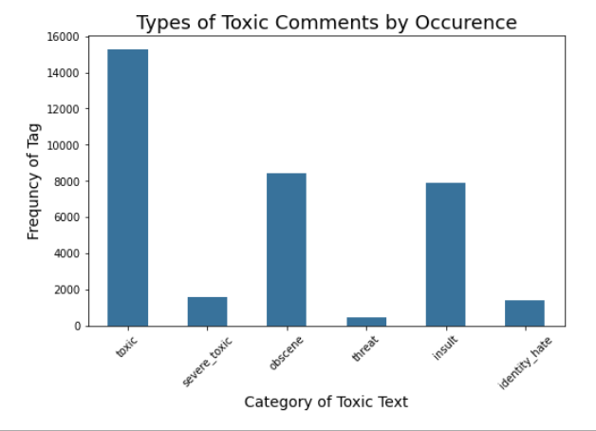
Problem: Freedom of speech is … sometimes toxic
The dataset was provided by Conversation AI in hopes to improve online discussion.
Wikipedia Talk Pages 150K + samples rated by humans for toxic effect varying in range from
Toxic
Severe Toxic
Obscene
Threat
Insult
Identity Hate

Slide 4
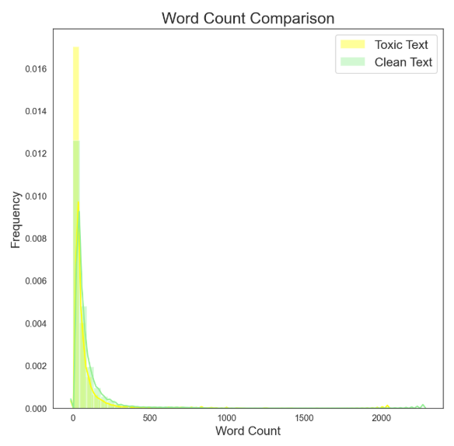


Are toxic comments longer than non-toxic?
No… focus more on the words…..

Slide 5
Examples:
Word Clouds display words in a collection. The larger the word, the more frequently used the word is.
Toxic
Clean

Slide 6
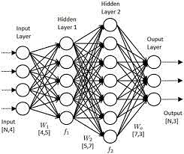





Methodology:
Toxic = 1
“You are a $@^%!”
[1 4 8 6]
dataset
Comment labels
Comments
Word Vectors
Padded
Vector
Deep Learning using
Natural Language Processing and Neural Networks
Recurrent Neural Network
N L P
Neural Network
Natural Language Processing (NLP):
“Tokenizes” text
Uses resulting tokens to create vectors as data
Neural Networks:
multilayer perceptron
Neurons
Synapses
Input and output
Recurrent Neural Networks
Added ‘weights’ to maintain state
Long Short Term Memory LSTM

Slide 7

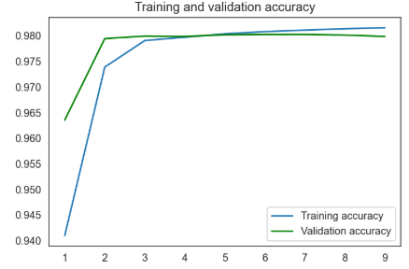
Results:
98% Accuracy Rate
100% of the time identified clean
text
Better at predicting classes where there is more data… a lot better.
Category | Rate of Predicting Cases or ‘Recall”
Toxic | 67
Severe toxic | not enough samples
Obscene | 76
Threat | not enough samples
Insult | 65
Identity Hate | not enough samples
Accuracy
Epoch # (Round of training)

Slide 8






Recommendations
Use model to identify comments that are toxic in nature.
Develop metrics and actionable plans for varying levels of toxicity
So now what?:
Invest in future work to further develop existing models to identify severe forms of targeting threats
Research and implement best practices so that everyone feels comfortable sharing thoughts.

Slide 9


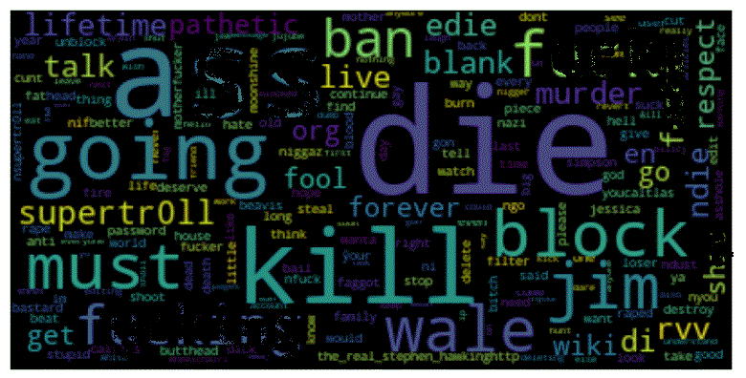
Future Work:
Collect more data around these more severe types of toxic comments to improve recognition.
Make threatening content main target
THREATS &
SENTIMENT ANALYSIS
Hopefully collective work can help everyone express themselves in more meaningful.
Thankfully the most severe types of toxic comments are less frequent. In some situations, speech can constitute a crime, such as in the case of criminal threats.
Comparative analysis on sentence sentiment rather than word.

Slide 10




Photo Collage
Thank you

Slide 11
Appendix:

Slide 12
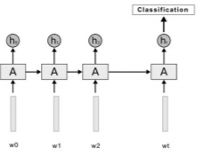
LSTM

