Slide 1


NoN-Toxic Communication
Using Natural Language Processing to help keep sharing ideas healthy

Slide 2
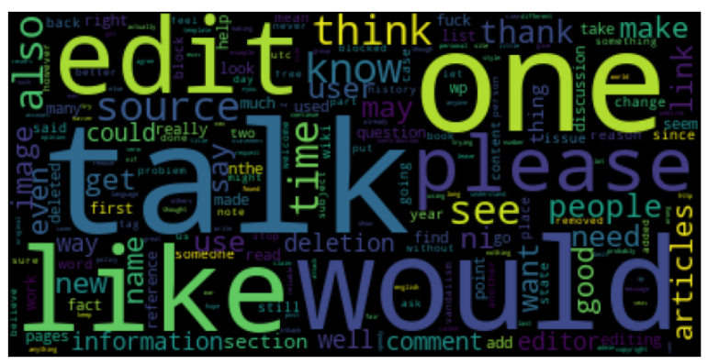
28
Background:
Let’s talk…. in a constructive way

Slide 3

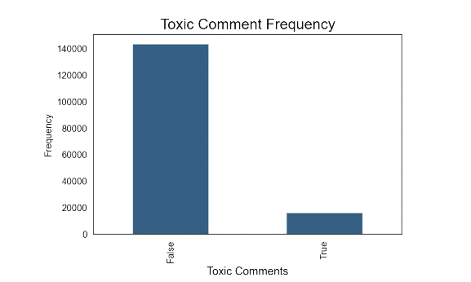
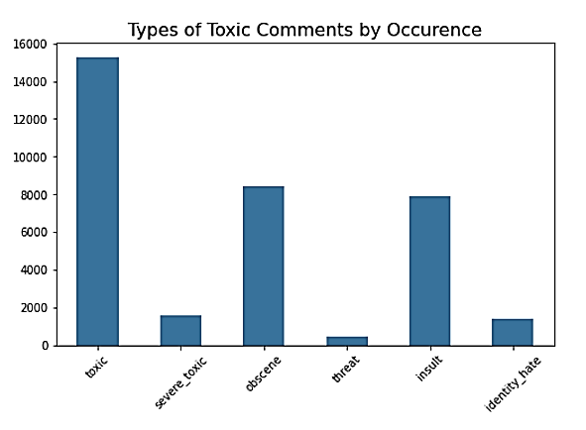
Problem: Freedom of speech is … sometimes toxic
The dataset was provided by Conversation AI in hopes to improve online discussion.
Wikipedia Talk Pages 150K + samples rated by humans for toxic effect varying in range from
Toxic
Severe Toxic
Obscene
Threat
Insult
Identity Hate

Slide 4
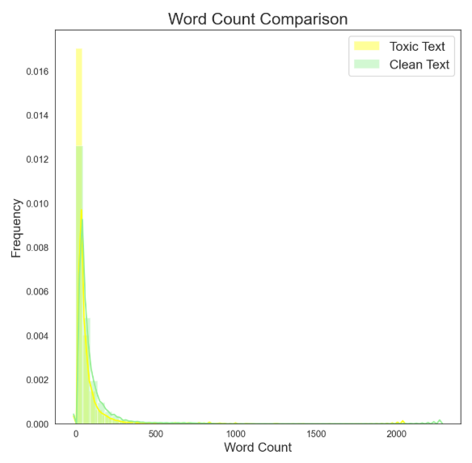
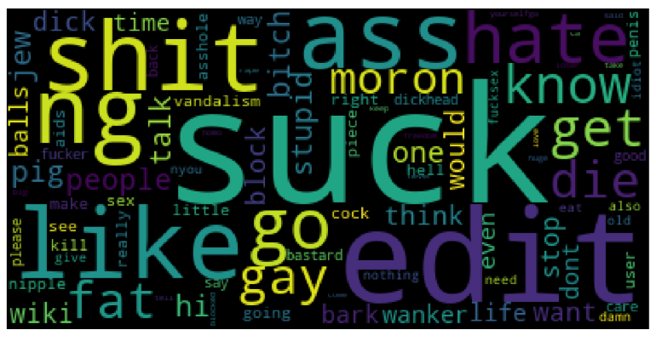
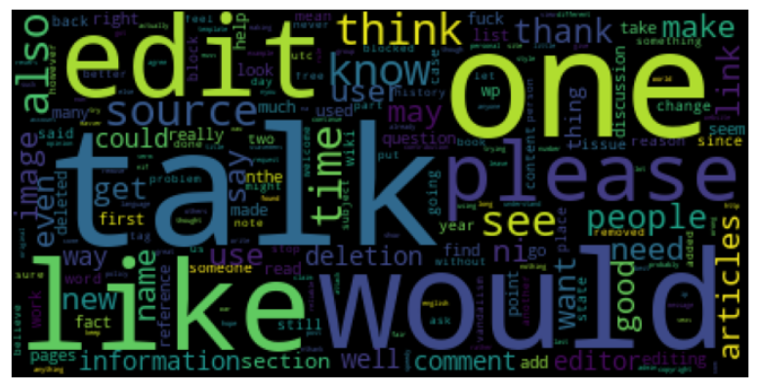


Are toxic comments longer than non-toxic?
No… focus more on the words…..

Slide 5
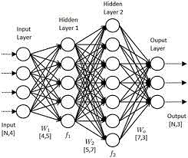





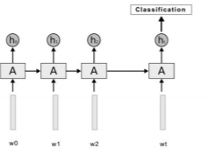
Methodology:
dataset
Comment labels
Comments
Word Vectors
Padded
Vector
Deep Learning using Neural Networks
Recurrent Neural Network
Neural Networks:
multilayer perceptron
Neurons
Synapses
Input and output
Recurrent Neural Networks
Added ‘weights’ to maintain state
Long Short Term Memory LSTM
LSTM

Slide 6


Results:

Slide 7
1

Slide 8

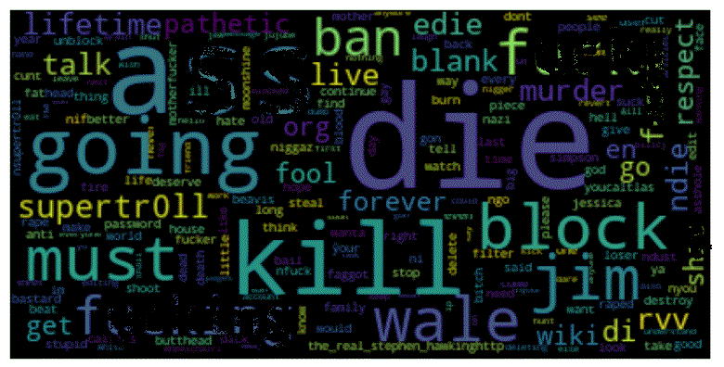
Future Work:
Collect more data around these more severe types of toxic comments to improve recognition.
Make threatening content main target
THREATS &
SENTIMENT ANALYSIS
Thankfully the most severe types of toxic comments are less frequent. In some situations, speech can constitute a crime, such as in the case of criminal threats.
The focus of this round of evaluation was specifically on words – in some cases sentiment is lost.

Slide 9




Photo Collage
Thank you

