Slide 1
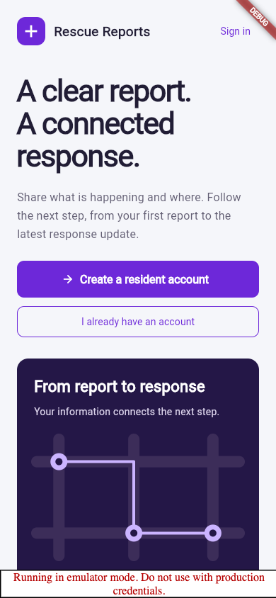
Rescue Reports
01
Report clearly.
Respond together.
User guide · web and mobile · 20 October 2026
A clear report.
A connected response.
Notes:
The guide uses real Flutter Chrome captures from isolated local emulators with fictional accounts. Debug ribbons and emulator warnings are intentional evidence. This is not a physical-device or signed-release certification. A report does not guarantee immediate rescue.

Slide 2
Rescue Reports
02
Choose your workspace
One system; each role has a focused workspace.
Role | Entry | Work
Resident | Flutter or web /my | Report and follow your own incidents
Responder | Flutter or web /assignments | Current-team assignments and progress
Dispatcher | Web /dashboard | Review, prioritize and coordinate
DMO | Web /monitor | Read-only monitoring and analytics
Admin | Web /admin | Account, team and staff administration
Notes:
The supplied general brief requires web and mobile, not every staff workspace duplicated natively. Preserve resident/responder mobile scope. Route permissions remain authoritative. Admin is not API-only.

Slide 3
Rescue Reports
03
Start with the welcome screen
Create a resident account, or sign in with an existing account.
01
Create a resident account for personal reporting.
02
Use shared sign-in for residents and assigned responders.
03
Staff administration stays in the web workspace.
04
Read the safety notice before reporting.
Notes:
Walk through the real welcome actions. It uses a conceptual route illustration, not live incident counts. Required account fields show asterisks. Do not show real passwords in a presentation.

Slide 4
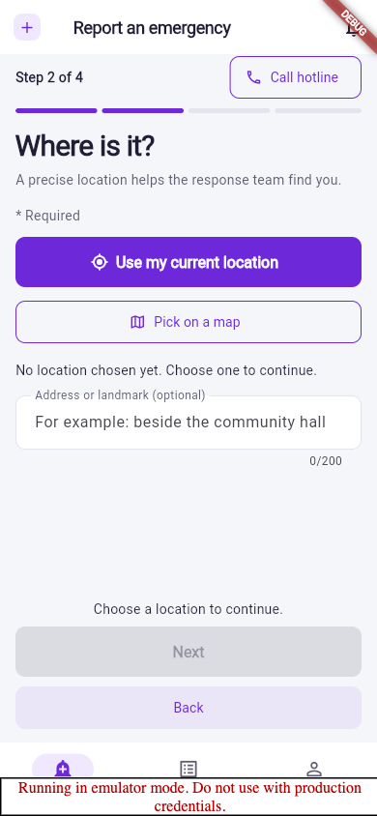
Rescue Reports
04
Send a resident report
Four steps keep the location and details together.
01
Choose the emergency type.
02
Use GPS or choose a point on the map.
03
Describe the situation; add contact details and optional photos.
04
Review, submit, and keep the confirmed reference.
Notes:
Photo delivery requires configured Cloudinary. Do not present mock coverage as real provider evidence. A failed location permission leaves manual map selection available. The screenshot shows an unselected location and disabled Next with an explanation.

Slide 5
Rescue Reports
05
A lost reply is an uncertain result
Check before creating another report or update.
Keep your entries
Retry the same attempt
Review the history
A timeout may occur after the server saved the action.
The existing key protects retries of unchanged content.
Confirm what was received before explicitly discarding uncertain attempts.
Notes:
Read storage-failure notices. Do not promise retry protection survives every restart. Native responder attempts remain in memory and are cleared on access/identity loss. Five unresolved payloads are retained per report; the sixth is blocked. Discard is explicit and removes protection.

Slide 6
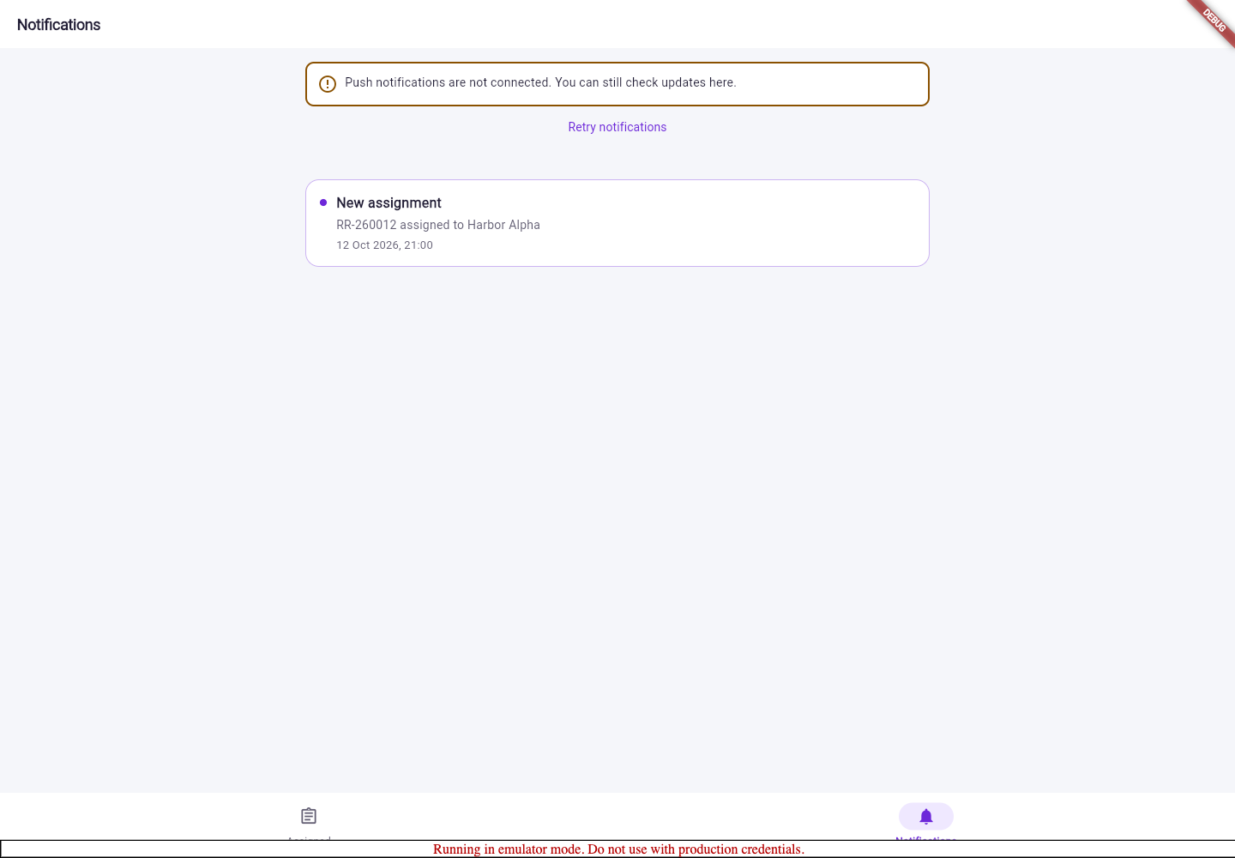
Rescue Reports
06
Follow reports and notifications
Status history and in-app notifications explain the next step.
01
My Reports separates active and historical reports.
02
Open a report for status and progress history.
03
Use the bell to open resident notifications.
04
Push failure does not remove in-app notifications.
Notes:
This desktop capture shows the shared notification layout bounded to a reading column and an honest push-not-connected notice. This local environment does not certify push delivery.

Slide 7
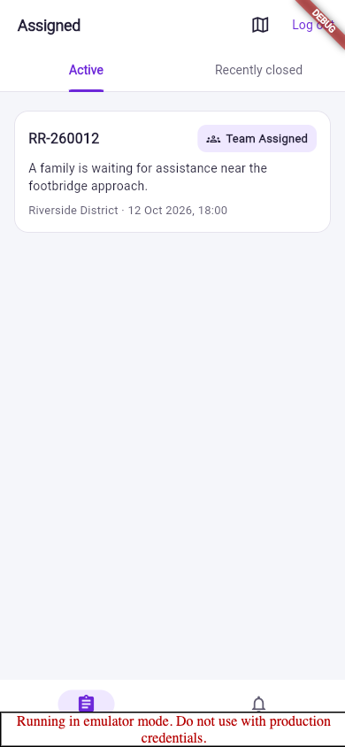
Rescue Reports
07
Review and acknowledge assignments
Responders see work assigned to their current team.
01
Open Assigned → Active.
02
Review the incident and its location.
03
Acknowledge the assignment.
04
Open the map handler when needed.
Notes:
Recently closed is read-only. A notification alone grants no access. Team and account permissions are checked by server and Firestore rules.

Slide 8
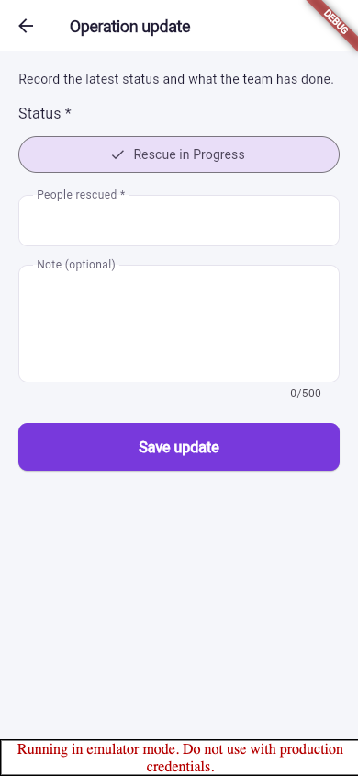
Rescue Reports
08
Record an operation update
Use required fields, then wait for confirmation.
01
Choose an allowed status.
02
Enter the number of people rescued.
03
Add an optional factual note.
04
Save and confirm the new progress-history entry.
Notes:
People rescued and Status are marked required. A local emulator save in this pass stored an update and the live history showed it. The screenshot is before submission. Avoid a new key when the outcome is uncertain.

Slide 9
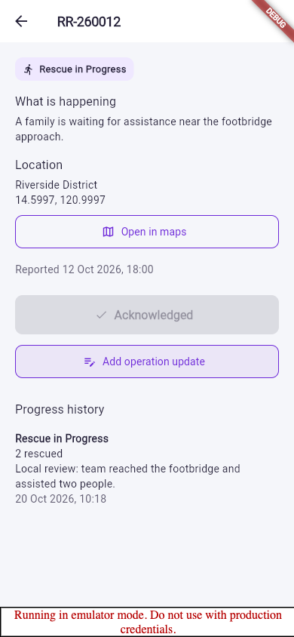
Rescue Reports
09
Read progress history
Show more reveals entries; Load older fetches the next window.
01
The newest 20 entries are fetched first.
02
Five entries are initially displayed.
03
Recently closed remains read-only.
04
Access changes clear protected history and drafts.
Notes:
This image is responder report detail with progress history, not the resident My Reports list. A local test operation assisted two fictional people; this is fixture data. An offline page cannot discover remote revocation instantly.

Slide 10
Rescue Reports
10
Coordinate from the web
Staff workspaces remain complete web routes.
Dispatcher
DMO
Admin
Queue → review/verify → prioritize → assign → close.
Monitor incidents and trends; inspect analytics and exports.
Manage accounts and teams, and use granted staff routes.
Notes:
Use current deployment addresses from HANDOFF. Demonstrate real permitted actions only in isolated test data. DMO has no operational mutation controls. Admin has a real /admin screen. Current routes are documented in outline.md and web/src/App.tsx.

Slide 11
Rescue Reports
11
One backend, two clients
Operational writes use the API; reads follow Firestore permissions.
React web
Auth / Firestore
Express API
Flutter
Cloudinary / FCM
Notes:
See schema.md for reports, updates, users, teams, notifications, audits and server-only recovery ledgers. The diagram abstracts authenticated reads. API Admin SDK owns operational writes; direct client Firestore writes are denied. Do not describe Firestore as SQL.

Slide 12
Rescue Reports
12
Before the final presentation
Keep claims tied to evidence and real ownership.
01
Open the PowerPoint and review the final rendering.
Verified locally
02
Combine web/mobile footage with architecture and group narration.
Chrome preview
Widget and golden tests
Android debug compilation
03
Each member records their actual contribution.
04
Approve hotline, policy, support and native signing details.
Notes:
The preview is not the final group video. Native permissions, push delivery, restart, TalkBack/VoiceOver and signed iOS/Android releases remain distinct gates. Use current dated test counts from the finish record. Do not invent members, official authority or policy approval.

