Slide 1

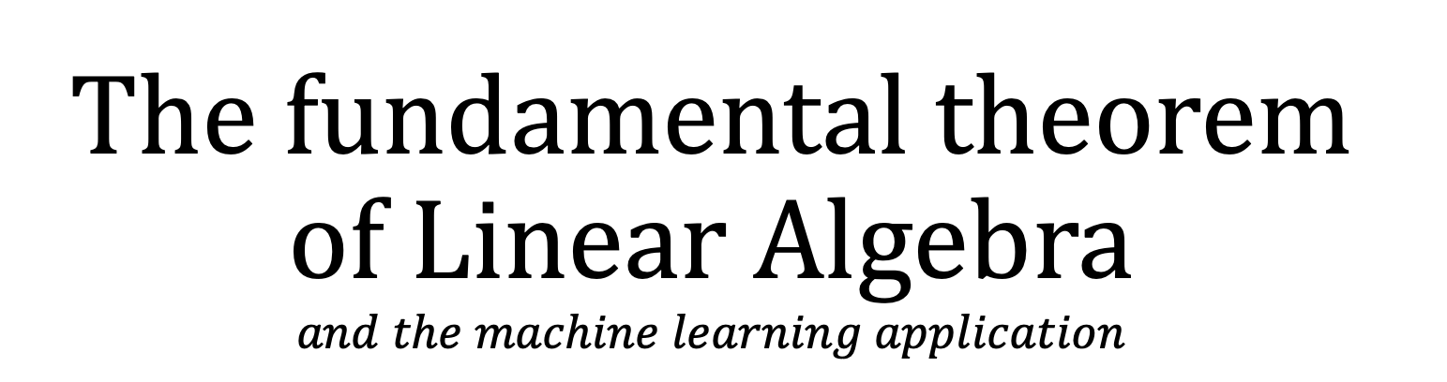
The fundamental theorem of Linear Algebra $$and the machine learning application$$

Slide 2
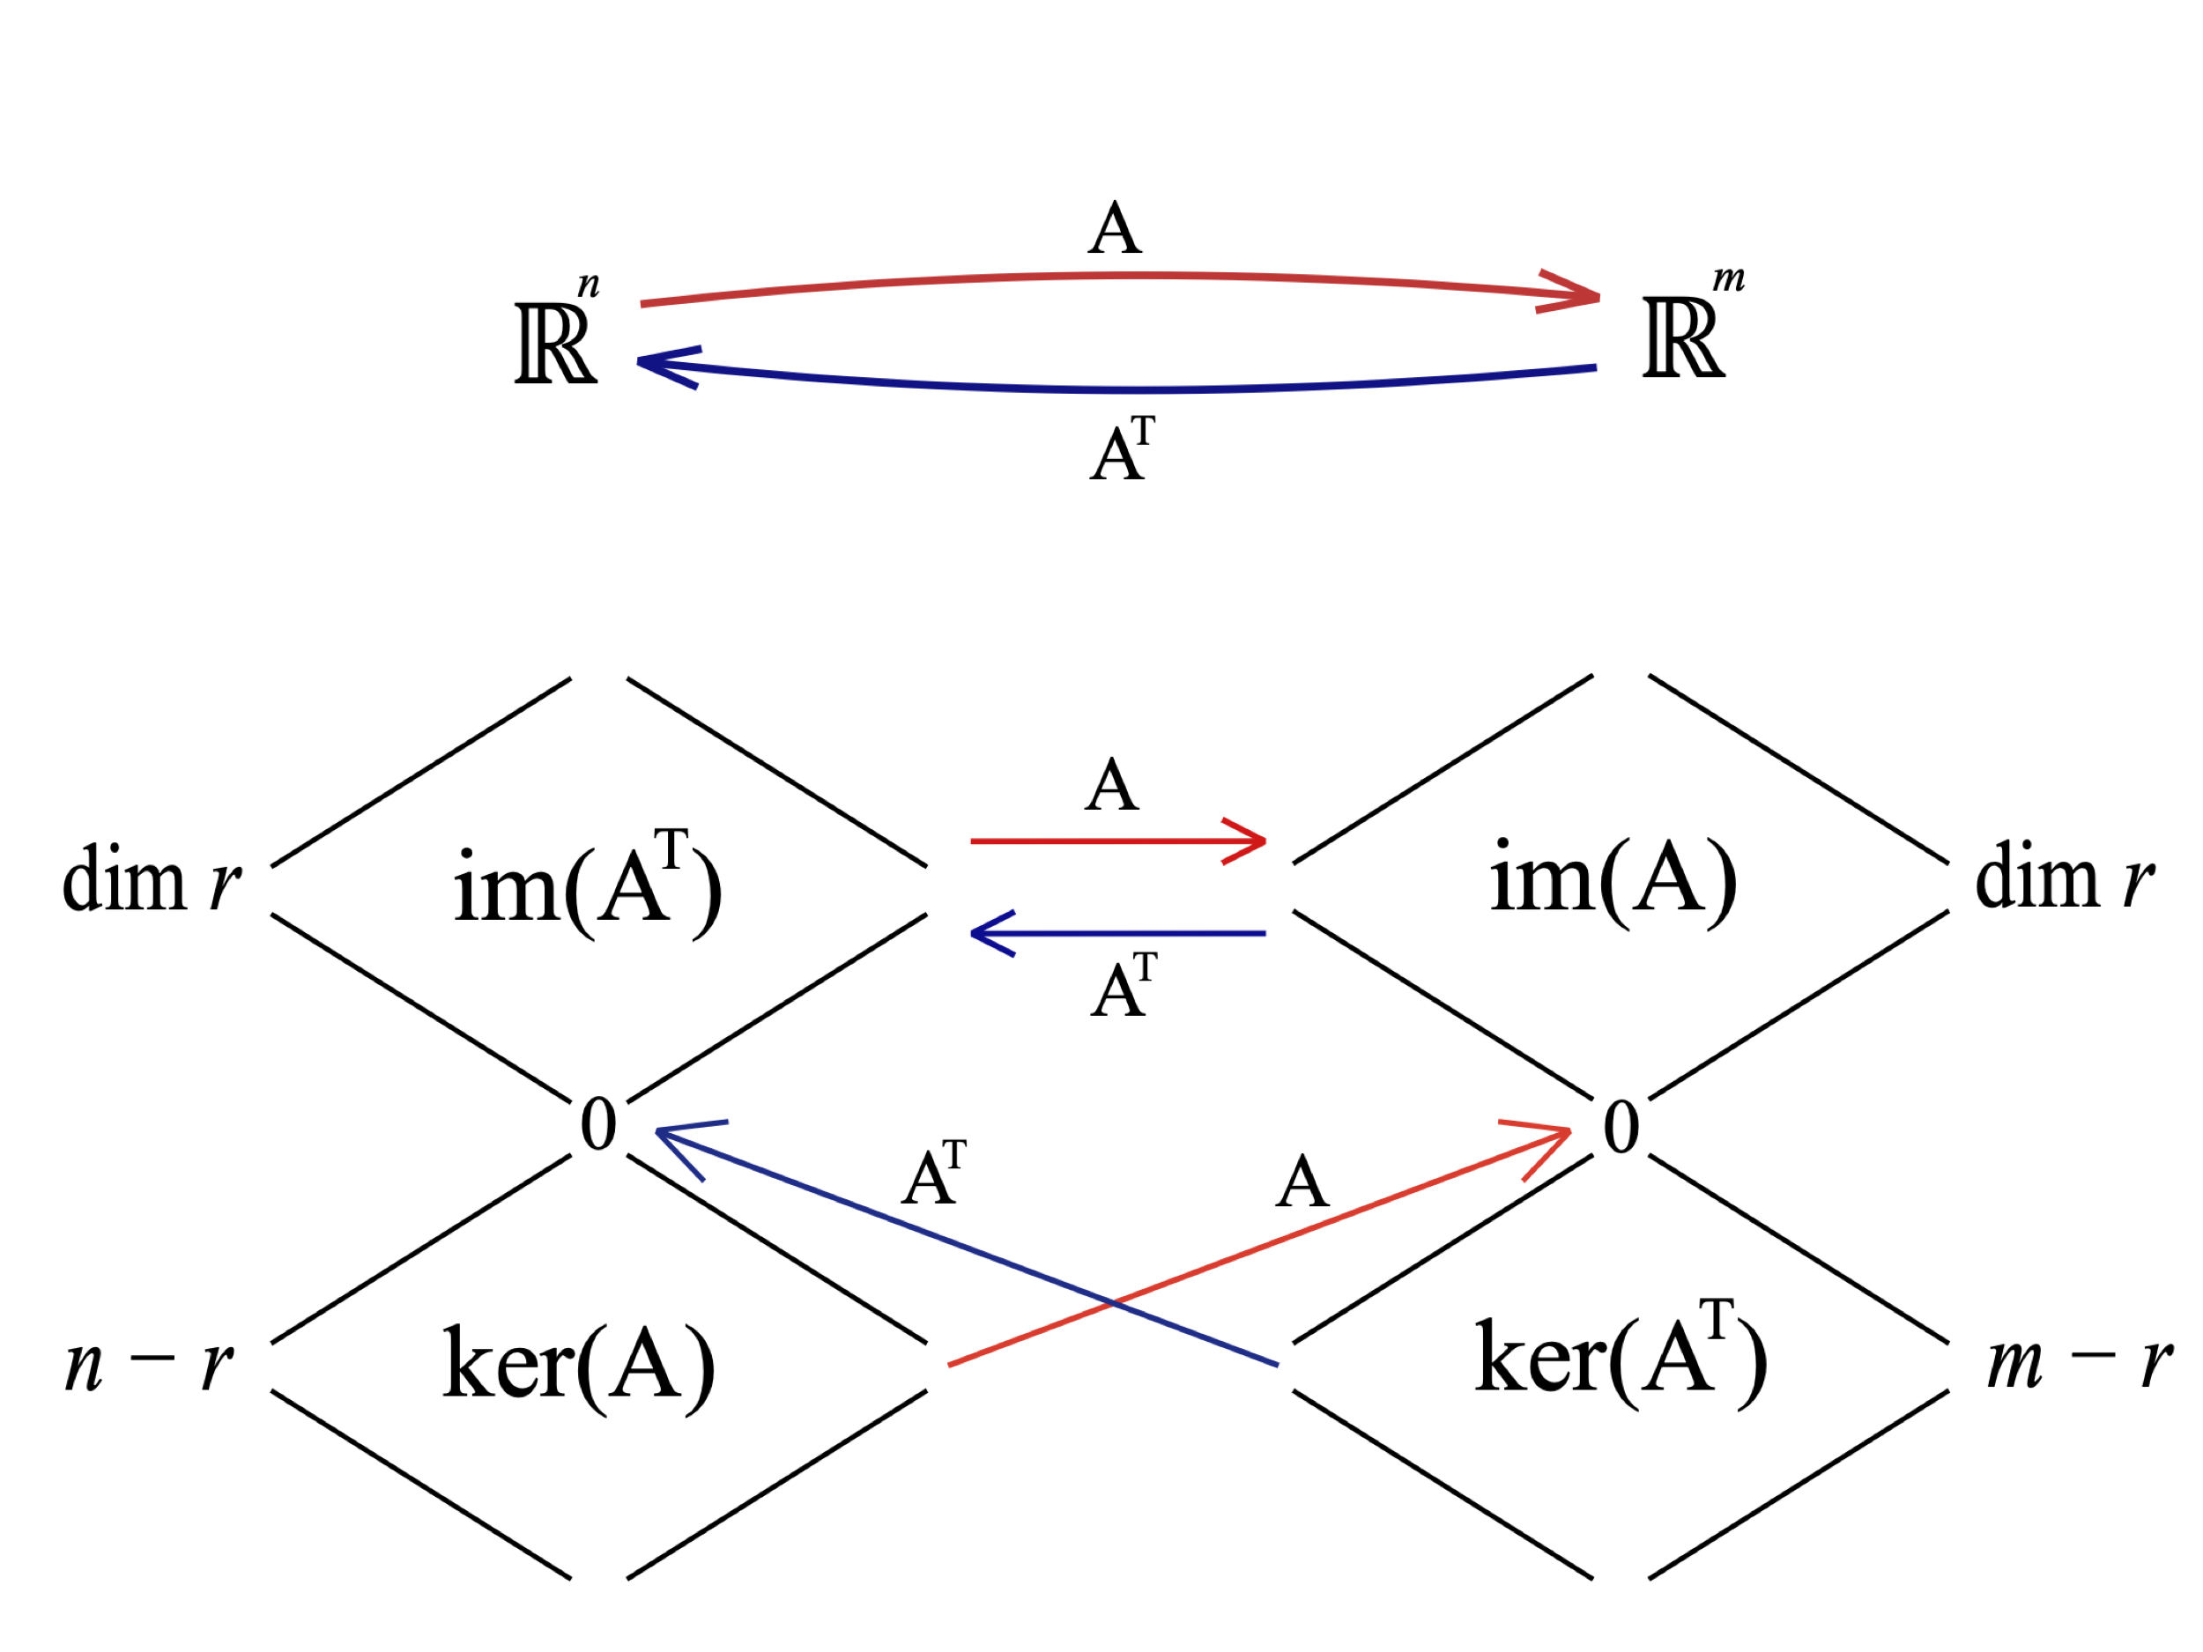
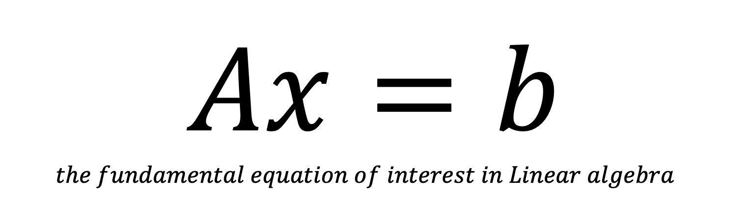
$Ax=b$ $$the fundamental equation of interest in Linear algebra$$

Slide 3
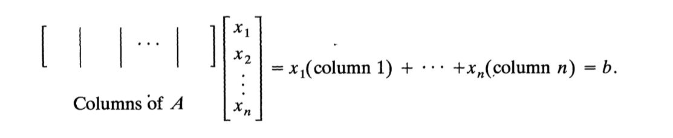
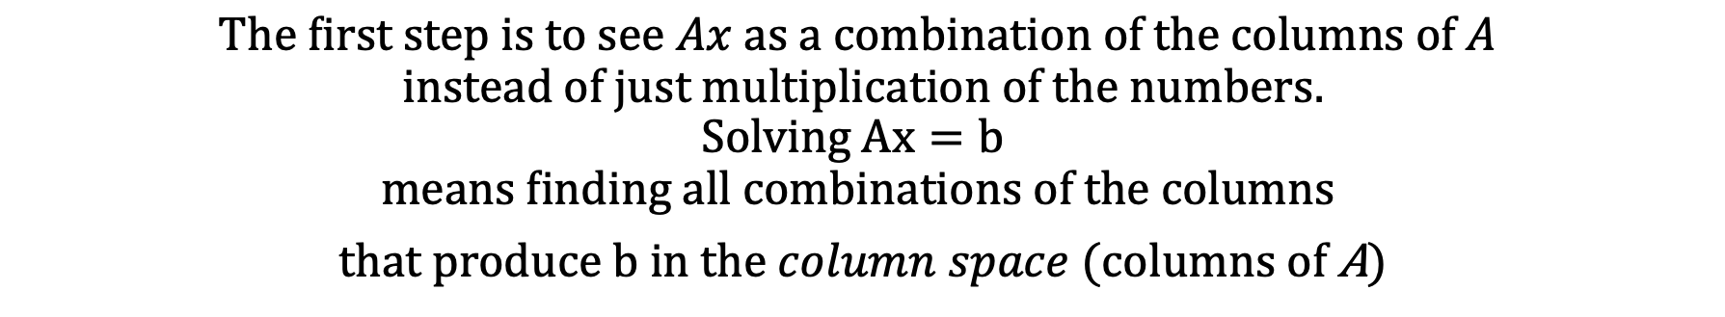
$$The first step is to see Ax as a combination of the columns of A$$
$$instead of just multiplication of the numbers.$$
$$Solving Ax=b$$
$$means finding all combinations of the columns$$
$that produce b in the column space$ (columns of A)

Slide 4
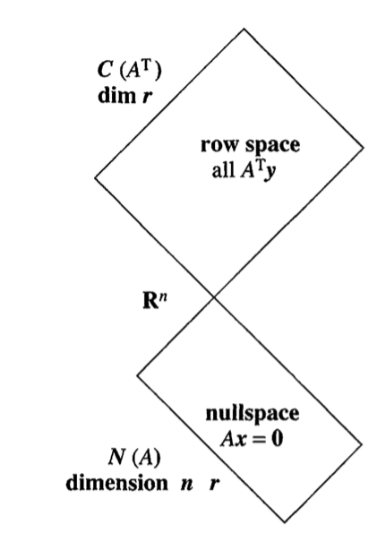
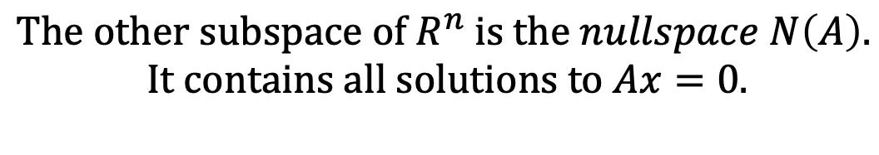
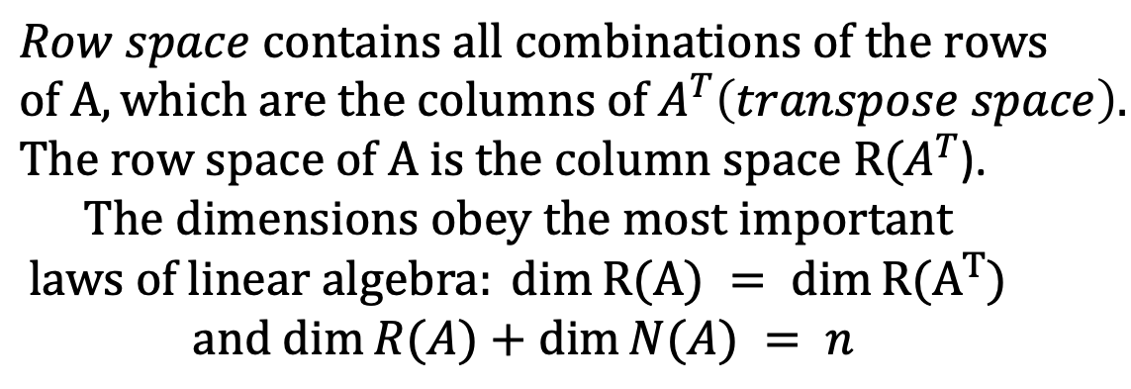
$$Row space contains all combinations of the rows$$
$$of A, which are the columns of A^{T}\left(transpose space\right).$$
$The row space of A is the column space R{(A}^{T}$).
$$The dimensions obey the most important$$
$$laws of linear algebra: dim⁡R(A) = dim⁡R{(A}^{T})$$
$$and dim⁡R(A)+dim⁡N(A) = n$$
$The other subspace of R^{n}$ $is the nullspace N\left(A\right).$
$$It contains all solutions to Ax=0.$$

Slide 5
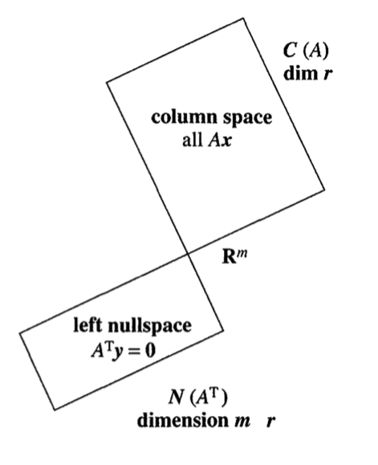
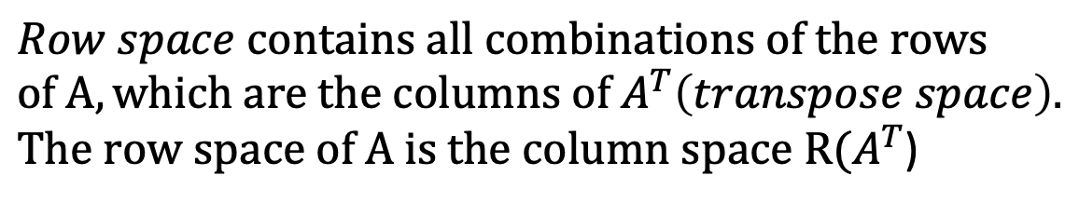
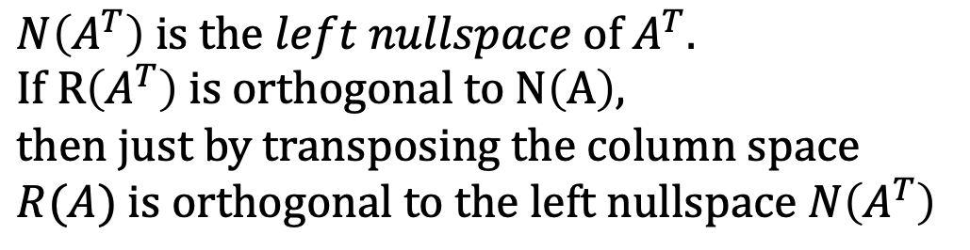
$$Row space contains all combinations of the rows$$
$$of A, which are the columns of A^{T}\left(transpose space\right).$$
$The row space of A is the column space R{(A}^{T}$)
$$N\left(A^{T}\right) is the left nullspace of{ A}^{T}.$$
$$If R\left(A^{T}\right) is orthogonal to N\left(A\right),$$
$$then just by transposing the column space$$
$$R(A) is orthogonal to the left nullspace N\left(A^{T}\right)$$

Slide 6
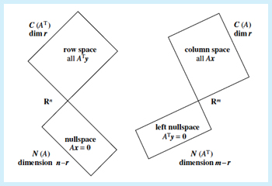
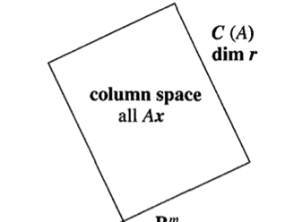
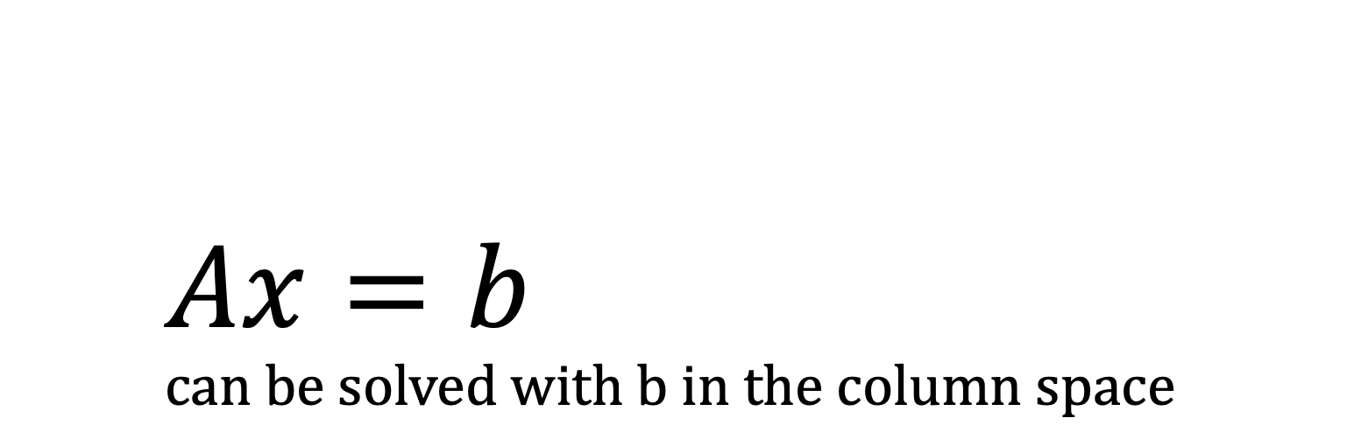
$$Ax=b \\ can be solved with b in the column space$$

Slide 7
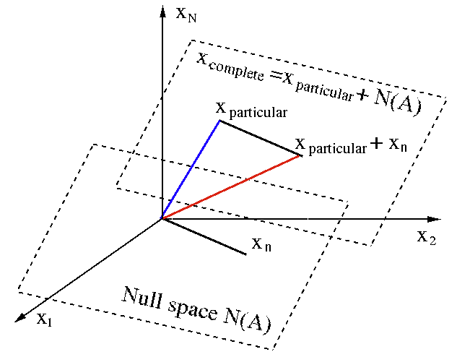
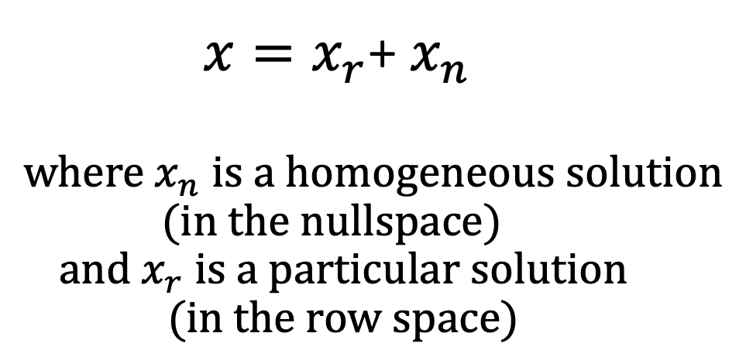
$$x=x_{r}\text{+} x_{n}$$ $$where{ x}_{n} is a homogeneous solution \\ (in the nullspace)$$ $and x_{r}$ $is a particular solution$ $$(in the row space)$$

Slide 8
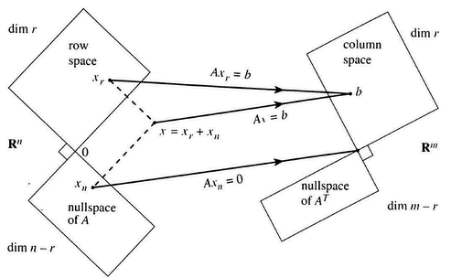

Slide 9
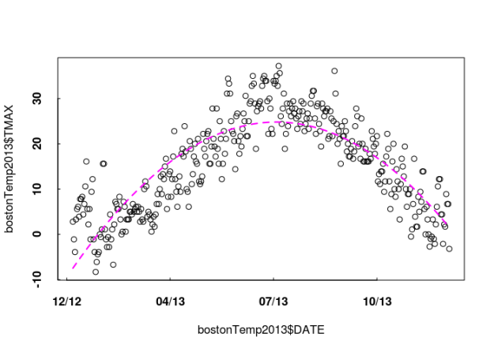
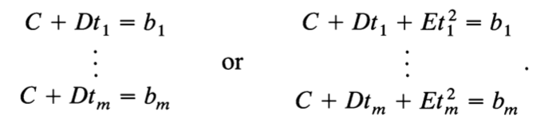
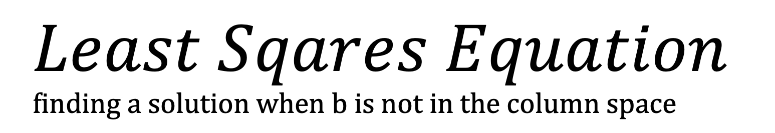
$$Least Sqares Equation \\ finding a solution when b is not in the column space$$
$$It is extremely common in machine learning to have more equations than unknowns.$$
The data may lay close to the line $b=C+Dt, but a parabola C+Dt+Et^{2} may come closer.$

Slide 10
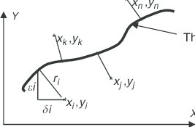
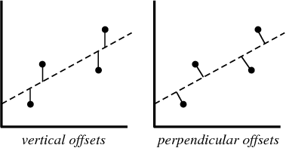
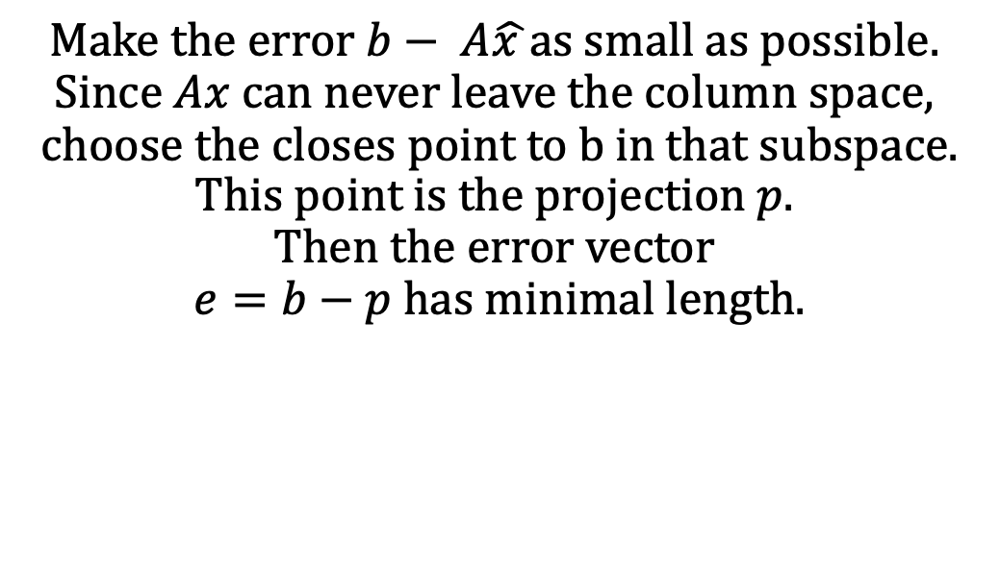


$$The solution$$
$$minimizing the error$$
$$Make the error b− A\hat{x }as small as possible.$$
$$Since Ax can never leave the column space,$$
$$choose the closes point to b in that subspace.$$
$$This point is the projection p.$$
$$Then the error vector$$
$$e=b−p has minimal length.$$

Slide 11
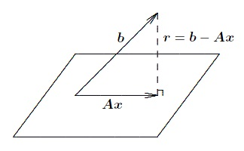
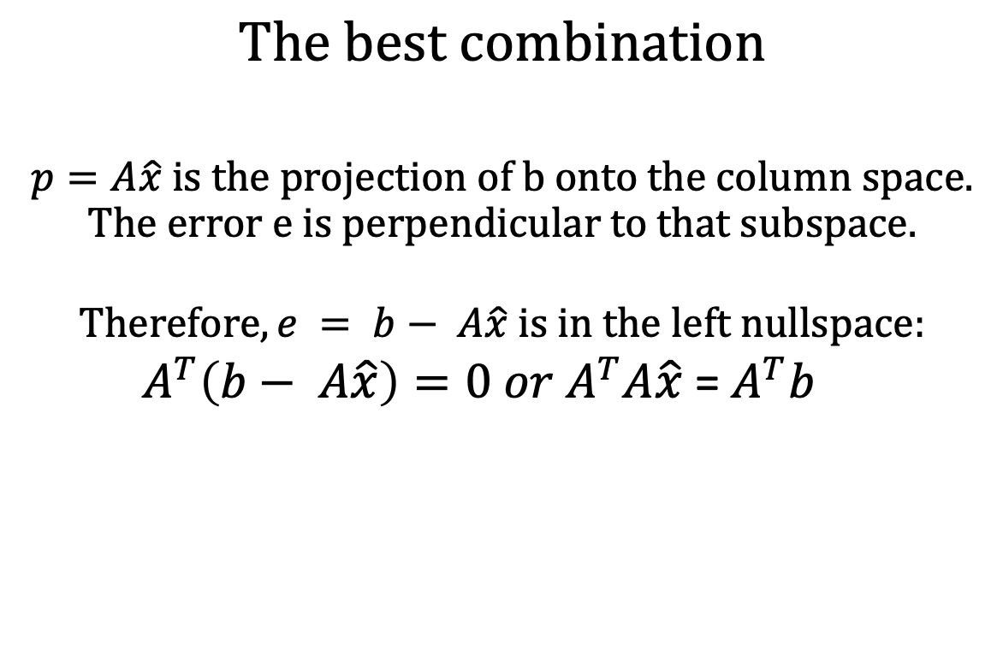

$$The best combination$$
$$p=A\hat{x} is the projection of b onto the column space.$$
$$The error e is perpendicular to that subspace.$$
$$Therefore, e = b− A\hat{x} is in the left nullspace:$$
$A^{T}\left(b− A\hat{x}\right)=0 or A^{T}A\hat{x}$ = $A^{T}b$
Calculus reaches the same linear equation by minimizing the quadratic ${\left\|b− A\hat{x}\right\|}^{2}$.
The chain rule just multiplies both sides by $A^{T}$.

Slide 12
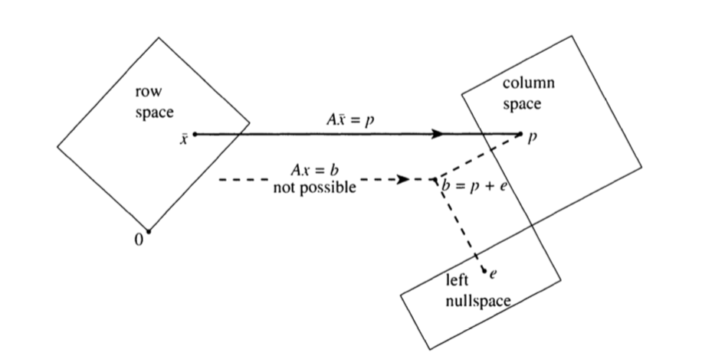
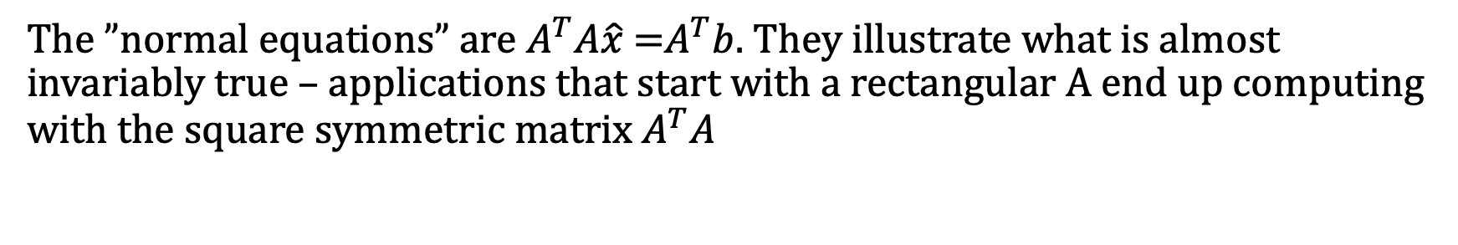
The ”normal equations” are $A^{T}A\hat{x}$ =$A^{T}b$. They illustrate what is almost invariably true – applications that start with a rectangular A end up computing with the square symmetric matrix $A^{T}A$

Slide 13
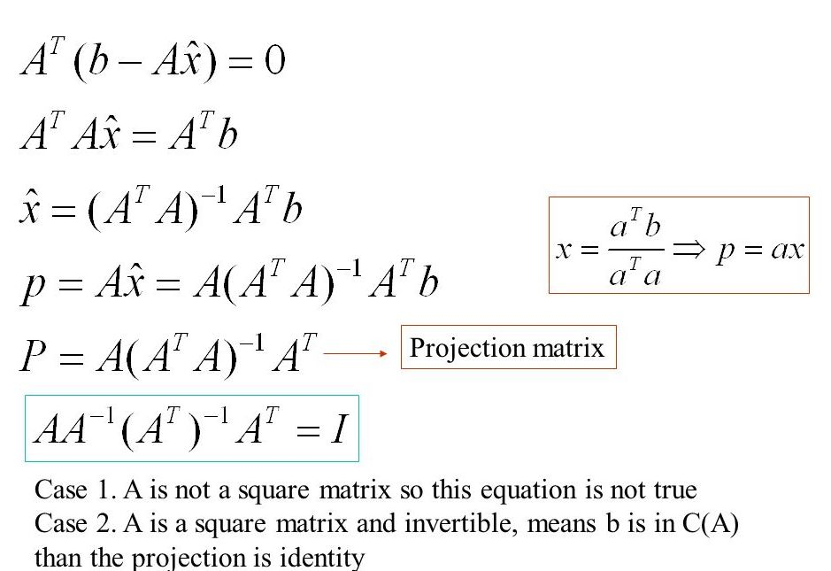

Slide 14
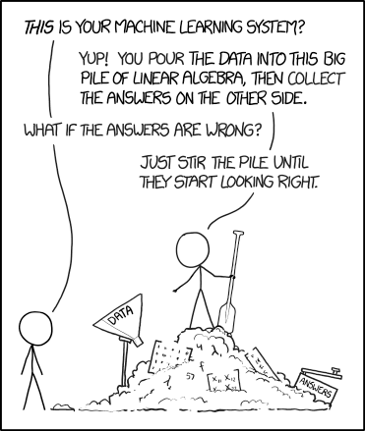

The practical example in machine learning
$$Multiple linear regression$$

Slide 15
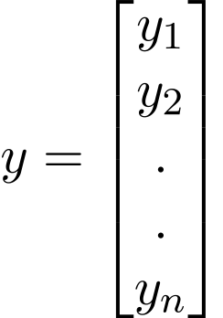
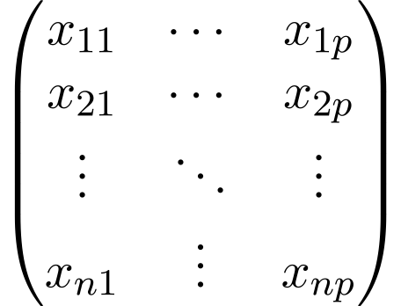


Consider a dataset with p features (or independent variables) and one response (or a dependent variable).
Also, the dataset contains n rows (observations)
$$X−feature matrix nxp$$
$$Y−response vector$$

Slide 16
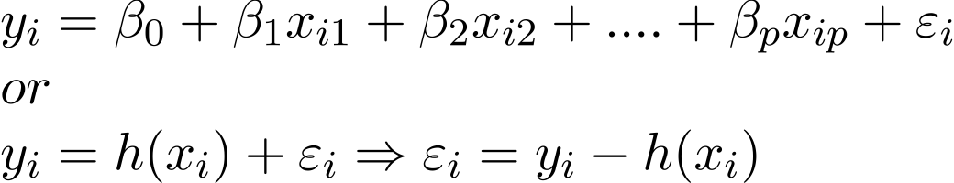




$$\text{The} \text{regression} \text{line} \text{for} \text{p} \text{features} \text{is} \text{represented} \text{as}\text{:}$$
$$Also, we can write:$$
$$regression coeficients$$
$$residual errors$$

Slide 17



Using the derivation from the least squares equation, we can now minimize the total residual error, and write:
$$\text{Knowing} \text{the} \text{least} \text{square} \text{estimates}\text{, }\text{the} \text{multiple} \text{linear} \text{regression} \text{model} \text{can} \text{now} \text{be} \text{estimated} \text{as}\text{:}$$
$$estimation response vector$$

