Slide 1
Trajectories of Religious Involvement
Press F5
Visions of multilevel models fitting NLSY-97 data
click here to begin
assembled by koval.andrey@gmail.com

Slide 2
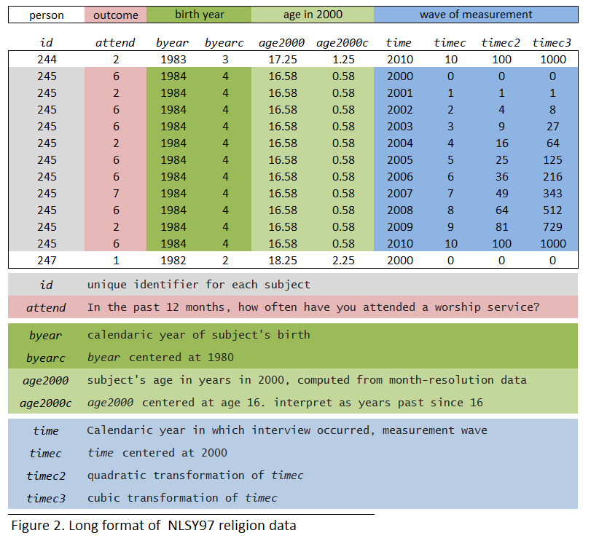
wave of measurement, centered at 2000 - timec
age in years at 2000, centered at 16 - agec
Worship Attendance Scale |0
Everyday |8
>1/week|7
~ 1/week |6
~ 2/month |5
~ 1/month |4
< 1/month |3
Once -Twice |2
Never |1
0
1
2
3
4
5
6
7
8
9
10
11
12
Notes:
The slide to duscuss data structure and variable definition

Slide 3
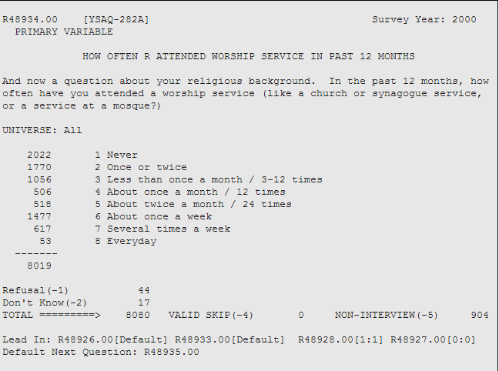
Worship Attendance Scale |0
Everyday |8
>1/week|7
~ 1/week |6
~ 2/month |5
~ 1/month |4
< 1/month |3
Once -Twice |2
Never |1

Slide 4

m00<- lm(attend ~ 1 )
MIXED attend
/FIXED= INTERCEPT
0
1
2
3
4
5
6
7
8
9
10
11
12

Slide 5
m0 <- lmer (attend ~ 1 + (1 | id)
MIXED attend
/FIXED= INTERCEPT
/Random= INTERCEPT | SUBJECT(ID).
0
1
2
3
4
5
6
7
8
9
10
11
12
Notes:
Average person attends a place of worship less than once a month (3.03). People vary on church attendance by an average of 1.57 attendance points.

Slide 6
m1 <- lmer (attend ~ 1 + timec + (1 | id)
MIXED attend WITH timec
/FIXED= INTERCEPT timec
/Random= INTERCEPT | SUBJECT(ID)
0
1
2
3
4
5
6
7
8
9
10
11
12
Notes:
Average person in 2000 attends church on average of 3.33 attendance points with a standard deviation of 1.58. With every year after 2000, subjects are expected to decrease their religious attendance by .059 points.

Slide 7
m2 <- lmer (attend ~ 1 + timec+ (1 + timec| id))
MIXED attend WITH timec
/FIXED= INTERCEPT timec
/Random= INTERCEPT timec| SUBJECT(ID) COVTYP(UN)
0
1
2
3
4
5
6
7
8
9
10
11
12
Notes:
Typical attenance in 2000, without controlling for age, is 3.33 with a standard deviation of 1.78 ( this is by .2 larger than when we ddidn’t allow for random slopes of time).
Every year since 2000, subjects are expected to decrease their religious attendance by an average of .46 points, varying among themselves by .17 in the slope of the decrease. Initial religiosity in 2000 correlated negatively with the rate of decrease after 2000 (-.46): the higher the initial religious attendance, the steeper the slope of decrease.

Slide 8
m2 <- lmer (attend ~ 1 + timec+ timec ² + (1 + timec+ timec ² | id))
0
1
2
3a
4
5
6
7
8
9
10
11
12
Notes:
Adding a fixed quadratic term of timec does not seem to be affecting the model. What if this term were random?

Slide 9
m2 <- lmer (attend ~ 1 + timec+ timec ² + (1 + timec+ timec ² | id))
0
1
2
3b
4
5
6
7
8
9
10
11
12

Slide 10
m2 <- lmer (attend ~ 1 + timec + timec² + timec3 + (1 + timec + timec² + timec³ | id))

Slide 11
0
1
2
3
4
5
6
7
8
9
10
11
12

Slide 12
0
1
2
3
4
5
6
7
8
9
10
11
12

Slide 13
0
1
2
3
4
5
6
7
8
9
10
11
12

Slide 14
0
1
2
3
4
5
6
7
8
9
10
11
12

Slide 15
0
1
2
3
4
5
6
7
8
9
10
11
12

Slide 16
wave of measurement, centered at 2000 - timec
age in years at 2000, centered at 16 - agec
Worship Attendance Scale |y_{ij}
Everyday | 8
>1/week| 7
~ 1/week | 6
~ 2/month | 5
~ 1/month | 4
< 1/month | 3
Once -Twice | 2
Never | 1
m10 <- lmer (attend ~ 1 + timec+ timec2+ timec3+
(1 + timec + timec2+ timec3 | id))
MIXED attend WITH timec timec2 timec3
/FIXED= INTERCEPT timec timec2 timec3
/Random= INTERCEPT timec timec2 timec3 | SUBJECT(ID) COVTYP(UN)
0
1
2
3
4
5
6
7
8
9
10
11
12

Slide 17
0
1
2
3
4
5
6
7
8
9
10
11
12
Notes:
Nominal Maximus complexity

Slide 18
wave of measurement, centered at 2000 - timec
age in years at 2000, centered at 16 - agec
Worship Attendance Scale |0
Everyday |8
>1/week|7
~ 1/week |6
~ 2/month |5
~ 1/month |4
< 1/month |3
Once -Twice |2
Never |1
m2 <- lmer (attend ~ 1 + timec+ timec2+ timec3+
(1 + timec + timec2+ timec3 | id))
MIXED attend WITH timec timec2 timec3
/FIXED= INTERCEPT timec timec2 timec3
/Random= INTERCEPT timec timec2 timec3 | SUBJECT(ID) COVTYP(UN)
0
1
2
3
4
5
6
7
8
9
10
11
12
Notes:
Winning model 1

Slide 19
0
1
2
3
4
5
6
7
8
9
10
11
12
Notes:
The winning model 2

Slide 20
0
1
2
3
4
5
6
7
8
9
10
11
12
Notes:
Null Model

Slide 21
0
1
2
3
4
5
6
7
8
9
10
11
12

Slide 22
0
1
2
3
4
5
6
7
8
9
10
11
12

Slide 23
0
1
2
3
4
5
6
7
8
9
10
11
12

Slide 24
0
1
2
3
4
5
6
7
8
9

Slide 25
0
1
2
3
4
5
6
7
8
9
10
11
12

Slide 26
0
1
2
3
4
5
6
7
8
9
10
11
12

Slide 27
0
1
2
3
4
5
6
7
8
9
10
11
12

Slide 28
0
1
2
3
4
5
6
7
8
9
10
11
12

Slide 29
0
1
2
3
4
5
6
7
8
9
10
11
12

Slide 30
0
1
2
3
4
5
6
7
8
9
10
11
12

Slide 31
0
1
2
3
4
5
6
7
8
9
10
11
12

Slide 32
k - class
j - person
i - time
0
1
2
3
4
5
6
7
8
9
10
11
12
200000
20000
19000

