Slide 1
Trajectories of Religious Involvement
Press F5
Visions of multilevel models fitting NLSY-97 data
click here to begin
assembled by koval.andrey@gmail.com

Slide 2
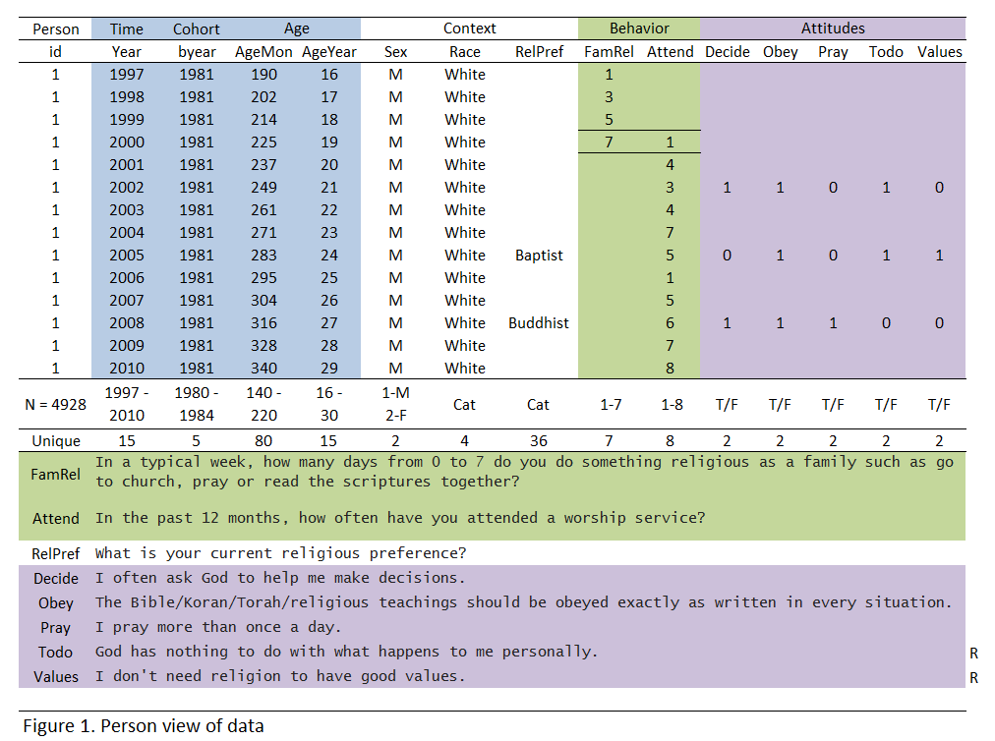
NLSY97 Religiosity 3 level model
Y – worship attendance (1-8)
YEAR– years since 2000, first year of observing religiosity
AGE– age in months, at the time of the interview
C(lass) – class assignment proportions from trajectory mixture
What we model
i - time
0
1
2
3
4
5
6
7
8
9
10
11
12
Notes:
The slide to duscuss data structure and variable definition

Slide 3

m00<- lm(attend ~ 1 )
MIXED attend
/FIXED= INTERCEPT
0
1
2
3
4
5
6
7
8
9
10
11
12

Slide 4
m0 <- lmer (attend ~ 1 + (1 | id)
MIXED attend
/FIXED= INTERCEPT
/Random= INTERCEPT | SUBJECT(ID).
0
1
2
3
4
5
6
7
8
9
10
11
12

Slide 5
m1 <- lmer (attend ~ 1 + AgeMon + (1 | id)
MIXED attend WITH AgeMon
/FIXED= INTERCEPT AgeMon
/Random= INTERCEPT | SUBJECT(ID)
0
1
2
3
4
5
6
7
8
9
10
11
12
Notes:
Use 0 if you don’t want to estimate an intercept

Slide 6
m2 <- lmer (attend ~ 1 + AgeMon + (1 + AgeMon | id))
MIXED attend WITH AgeMon
/FIXED= INTERCEPT AgeMon
/Random= INTERCEPT AgeMon | SUBJECT(ID) COVTYP(UN)
0
1
2
3
4
5
6
7
8
9
10
11
12
Notes:
To the left the pipe are the level-1 components

Slide 7
m2 <- lmer (attend ~ 1 + AgeMon + AgeMon² + (1 + AgeMon + AgeMon² | id))
0
1
2
3
4
5
6
7
8
9
10
11
12

Slide 8
m2 <- lmer (attend ~ 1 + AgeMon + AgeMon² + AgeMon3 + (1 + AgeMon + AgeMon² + AgeMon³ | id))

Slide 9
m4 <- lmer (attend ~ 1 + AgeMon +BYear +(1 + Age | id))
0
1
2
3
4
5
6
7
8
9
10
11
12

Slide 10
m4 <- lmer (attend ~ 1 + AgeMon +Byear + Byear*Age +(1 + Age | id))
0
1
2
3
4
5
6
7
8
9
10
11
12

Slide 11
0
1
2
3
4
5
6
7
8
9
10
11
12

Slide 12
0
1
2
3
4
5
6
7
8
9
10
11
12

Slide 13
0
1
2
3
4
5
6
7
8
9
10
11
12

Slide 14
0
1
2
3
4
5
6
7
8
9
10
11
12

Slide 15
NLSY97 Religiosity 3 level model
Y – worship attendance (1-8)
BYEAR– years since birth, centered at 1980
AGE– age in months, at the time of the interview
0
1
2
3
4
5
6
7
8
9
10
11
12
Notes:
Nominal Maximus complexity

Slide 16
0
1
2
3
4
5
6
7
8
9
10
11
12
Notes:
Winning model 1

Slide 17
0
1
2
3
4
5
6
7
8
9
10
11
12
Notes:
The winning model 2

Slide 18
0
1
2
3
4
5
6
7
8
9
10
11
12
Notes:
Null Model

Slide 19
0
1
2
3
4
5
6
7
8
9
10
11
12

Slide 20
0
1
2
3
4
5
6
7
8
9
10
11
12

Slide 21
0
1
2
3
4
5
6
7
8
9
10
11
12

Slide 22
0
1
2
3
4
5
6
7
8
9

Slide 23
0
1
2
3
4
5
6
7
8
9
10
11
12

Slide 24
0
1
2
3
4
5
6
7
8
9
10
11
12

Slide 25
0
1
2
3
4
5
6
7
8
9
10
11
12

Slide 26
0
1
2
3
4
5
6
7
8
9
10
11
12

Slide 27
0
1
2
3
4
5
6
7
8
9
10
11
12

Slide 28
0
1
2
3
4
5
6
7
8
9
10
11
12

Slide 29
0
1
2
3
4
5
6
7
8
9
10
11
12

Slide 30
k - class
j - person
i - time
0
1
2
3
4
5
6
7
8
9
10
11
12
200000
20000
19000

