Slide 1
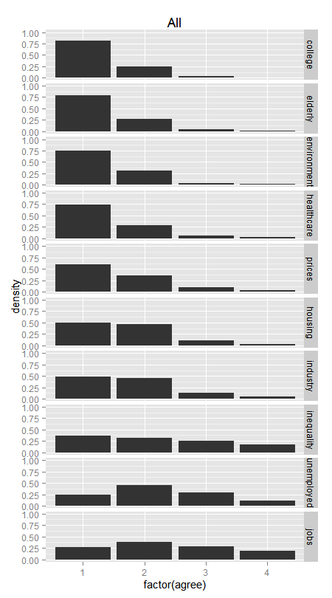
On the whole, do you think it should or should not be the government's responsibility to...
give financial assistance to college students from low-income families?
provide a decent standard of living for the old?
impose strict laws to make industry do less damage to the environment?
provide health care for the sick?
keep prices under control?
provide decent housing for those who can't afford it?
provide industry with the help it needs to grow?
reduce income differences between the rich and poor?
provide a decent standard of living for the unemployed?
provide a job for everyone who wants one?
1 Definitely should be
2 Probably should be
3 Probably should not be
4 Definitely should not be

Slide 2
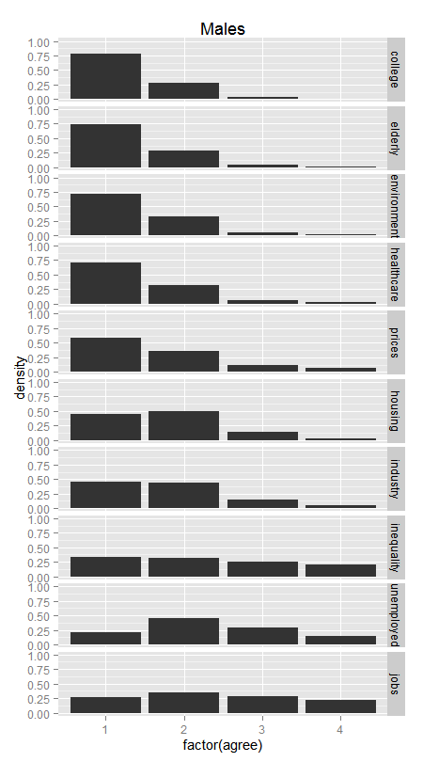
On the whole, do you think it should or should not be the government's responsibility to...
give financial assistance to college students from low-income families?
provide a decent standard of living for the old?
impose strict laws to make industry do less damage to the environment?
provide health care for the sick?
keep prices under control?
provide decent housing for those who can't afford it?
provide industry with the help it needs to grow?
reduce income differences between the rich and poor?
provide a decent standard of living for the unemployed?
provide a job for everyone who wants one?
1 Definitely should be
2 Probably should be
3 Probably should not be
4 Definitely should not be

Slide 3

On the whole, do you think it should or should not be the government's responsibility to...
give financial assistance to college students from low-income families?
provide a decent standard of living for the old?
impose strict laws to make industry do less damage to the environment?
provide health care for the sick?
keep prices under control?
provide decent housing for those who can't afford it?
provide industry with the help it needs to grow?
reduce income differences between the rich and poor?
provide a decent standard of living for the unemployed?
provide a job for everyone who wants one?
1 Definitely should be
2 Probably should be
3 Probably should not be
4 Definitely should not be

Slide 4
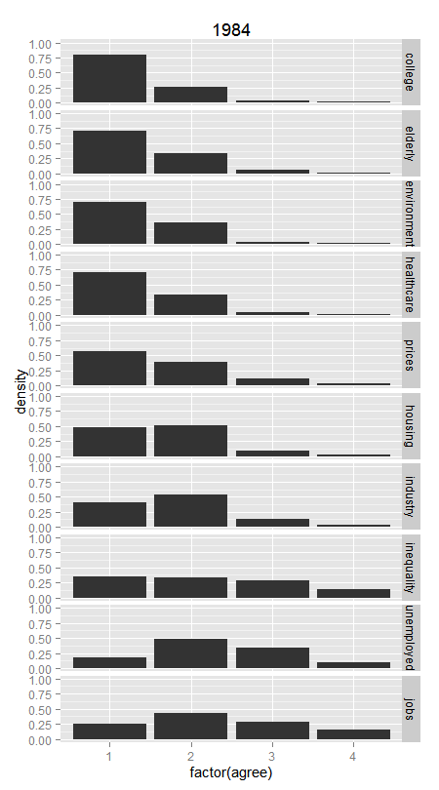
On the whole, do you think it should or should not be the government's responsibility to...
give financial assistance to college students from low-income families?
provide a decent standard of living for the old?
impose strict laws to make industry do less damage to the environment?
provide health care for the sick?
keep prices under control?
provide decent housing for those who can't afford it?
provide industry with the help it needs to grow?
reduce income differences between the rich and poor?
provide a decent standard of living for the unemployed?
provide a job for everyone who wants one?
1 Definitely should be
2 Probably should be
3 Probably should not be
4 Definitely should not be

Slide 5
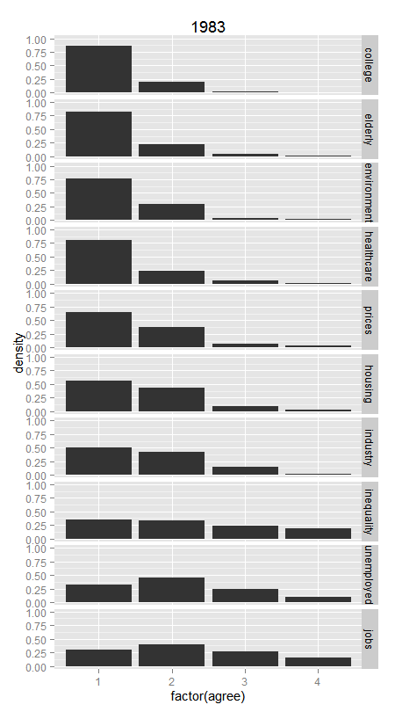
On the whole, do you think it should or should not be the government's responsibility to...
give financial assistance to college students from low-income families?
provide a decent standard of living for the old?
impose strict laws to make industry do less damage to the environment?
provide health care for the sick?
keep prices under control?
provide decent housing for those who can't afford it?
provide industry with the help it needs to grow?
reduce income differences between the rich and poor?
provide a decent standard of living for the unemployed?
provide a job for everyone who wants one?
1 Definitely should be
2 Probably should be
3 Probably should not be
4 Definitely should not be

Slide 6
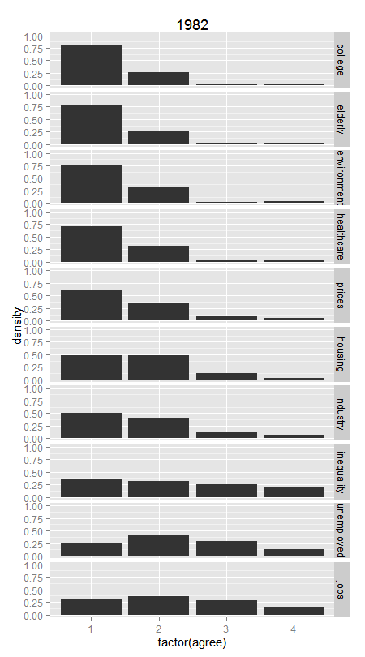
On the whole, do you think it should or should not be the government's responsibility to...
give financial assistance to college students from low-income families?
provide a decent standard of living for the old?
impose strict laws to make industry do less damage to the environment?
provide health care for the sick?
keep prices under control?
provide decent housing for those who can't afford it?
provide industry with the help it needs to grow?
reduce income differences between the rich and poor?
provide a decent standard of living for the unemployed?
provide a job for everyone who wants one?
1 Definitely should be
2 Probably should be
3 Probably should not be
4 Definitely should not be

Slide 7
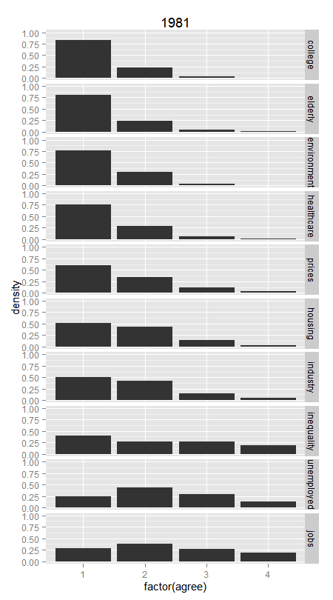
On the whole, do you think it should or should not be the government's responsibility to...
give financial assistance to college students from low-income families?
provide a decent standard of living for the old?
impose strict laws to make industry do less damage to the environment?
provide health care for the sick?
keep prices under control?
provide decent housing for those who can't afford it?
provide industry with the help it needs to grow?
reduce income differences between the rich and poor?
provide a decent standard of living for the unemployed?
provide a job for everyone who wants one?
1 Definitely should be
2 Probably should be
3 Probably should not be
4 Definitely should not be

Slide 8
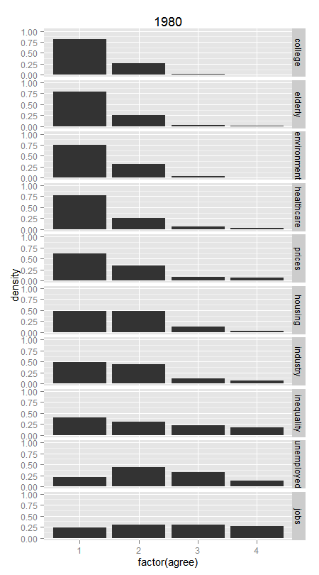
On the whole, do you think it should or should not be the government's responsibility to...
give financial assistance to college students from low-income families?
provide a decent standard of living for the old?
impose strict laws to make industry do less damage to the environment?
provide health care for the sick?
keep prices under control?
provide decent housing for those who can't afford it?
provide industry with the help it needs to grow?
reduce income differences between the rich and poor?
provide a decent standard of living for the unemployed?
provide a job for everyone who wants one?
1 Definitely should be
2 Probably should be
3 Probably should not be
4 Definitely should not be

Slide 9
On the whole, do you think it should or should not be the government's responsibility to...
give financial assistance to college students from low-income families?
provide a decent standard of living for the old?
impose strict laws to make industry do less damage to the environment?
provide health care for the sick?
keep prices under control?
provide decent housing for those who can't afford it?
provide industry with the help it needs to grow?
reduce income differences between the rich and poor?
provide a decent standard of living for the unemployed?
provide a job for everyone who wants one?
1 Definitely should be
2 Probably should be
3 Probably should not be
4 Definitely should not be

Slide 11

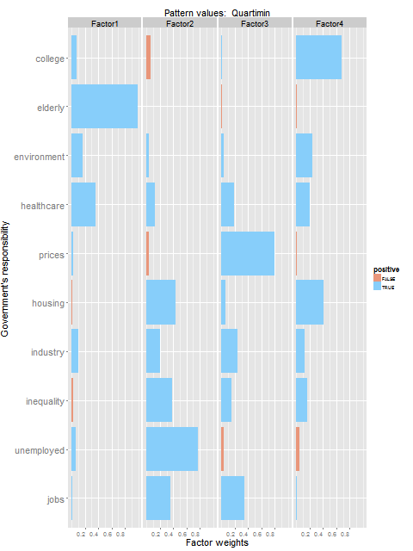
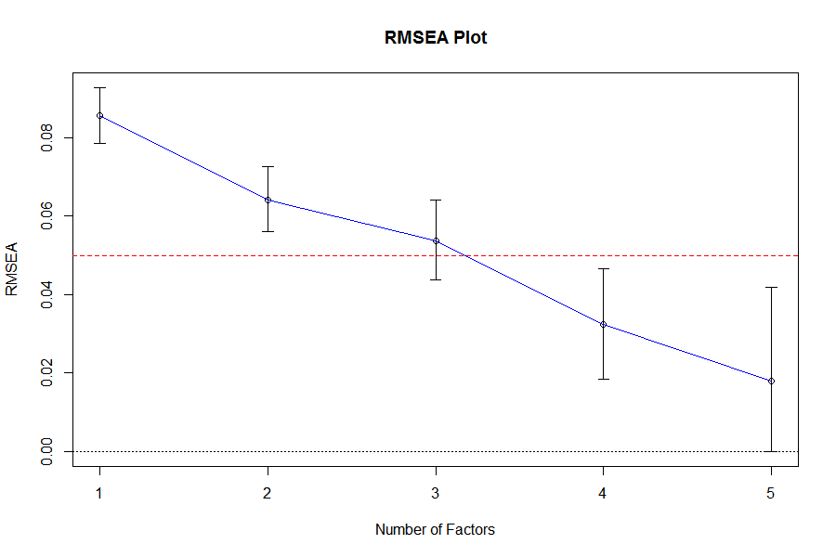
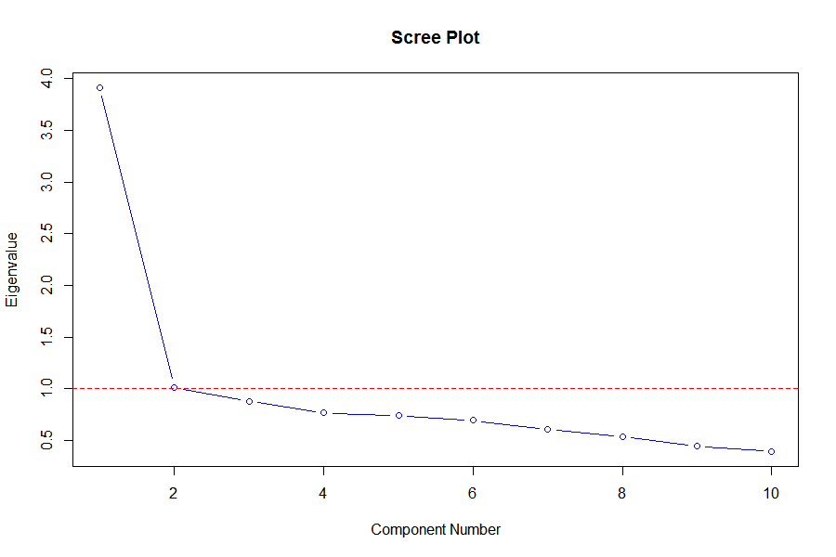
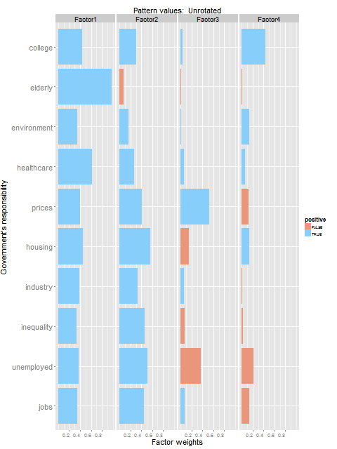
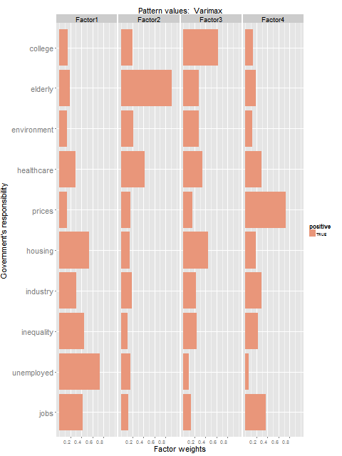
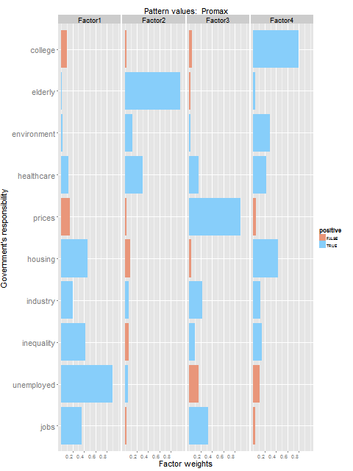
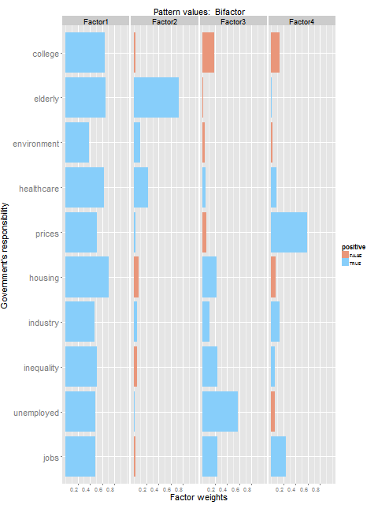
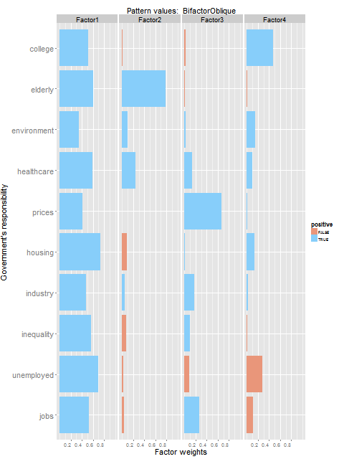
On the whole, do you think it should or should not be the government's
responsibility to...
1 Definitely should be
2 Probably should be
3 Probably should not be
4 Definitely should not be
All
Unrotated
Varimax
Promax
Quartimin
Bifactor
BifactorOblique

