Slide 1
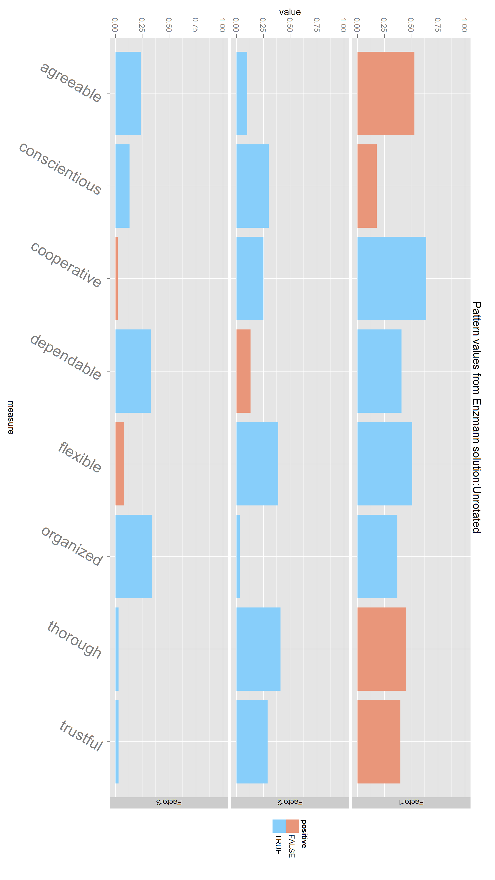
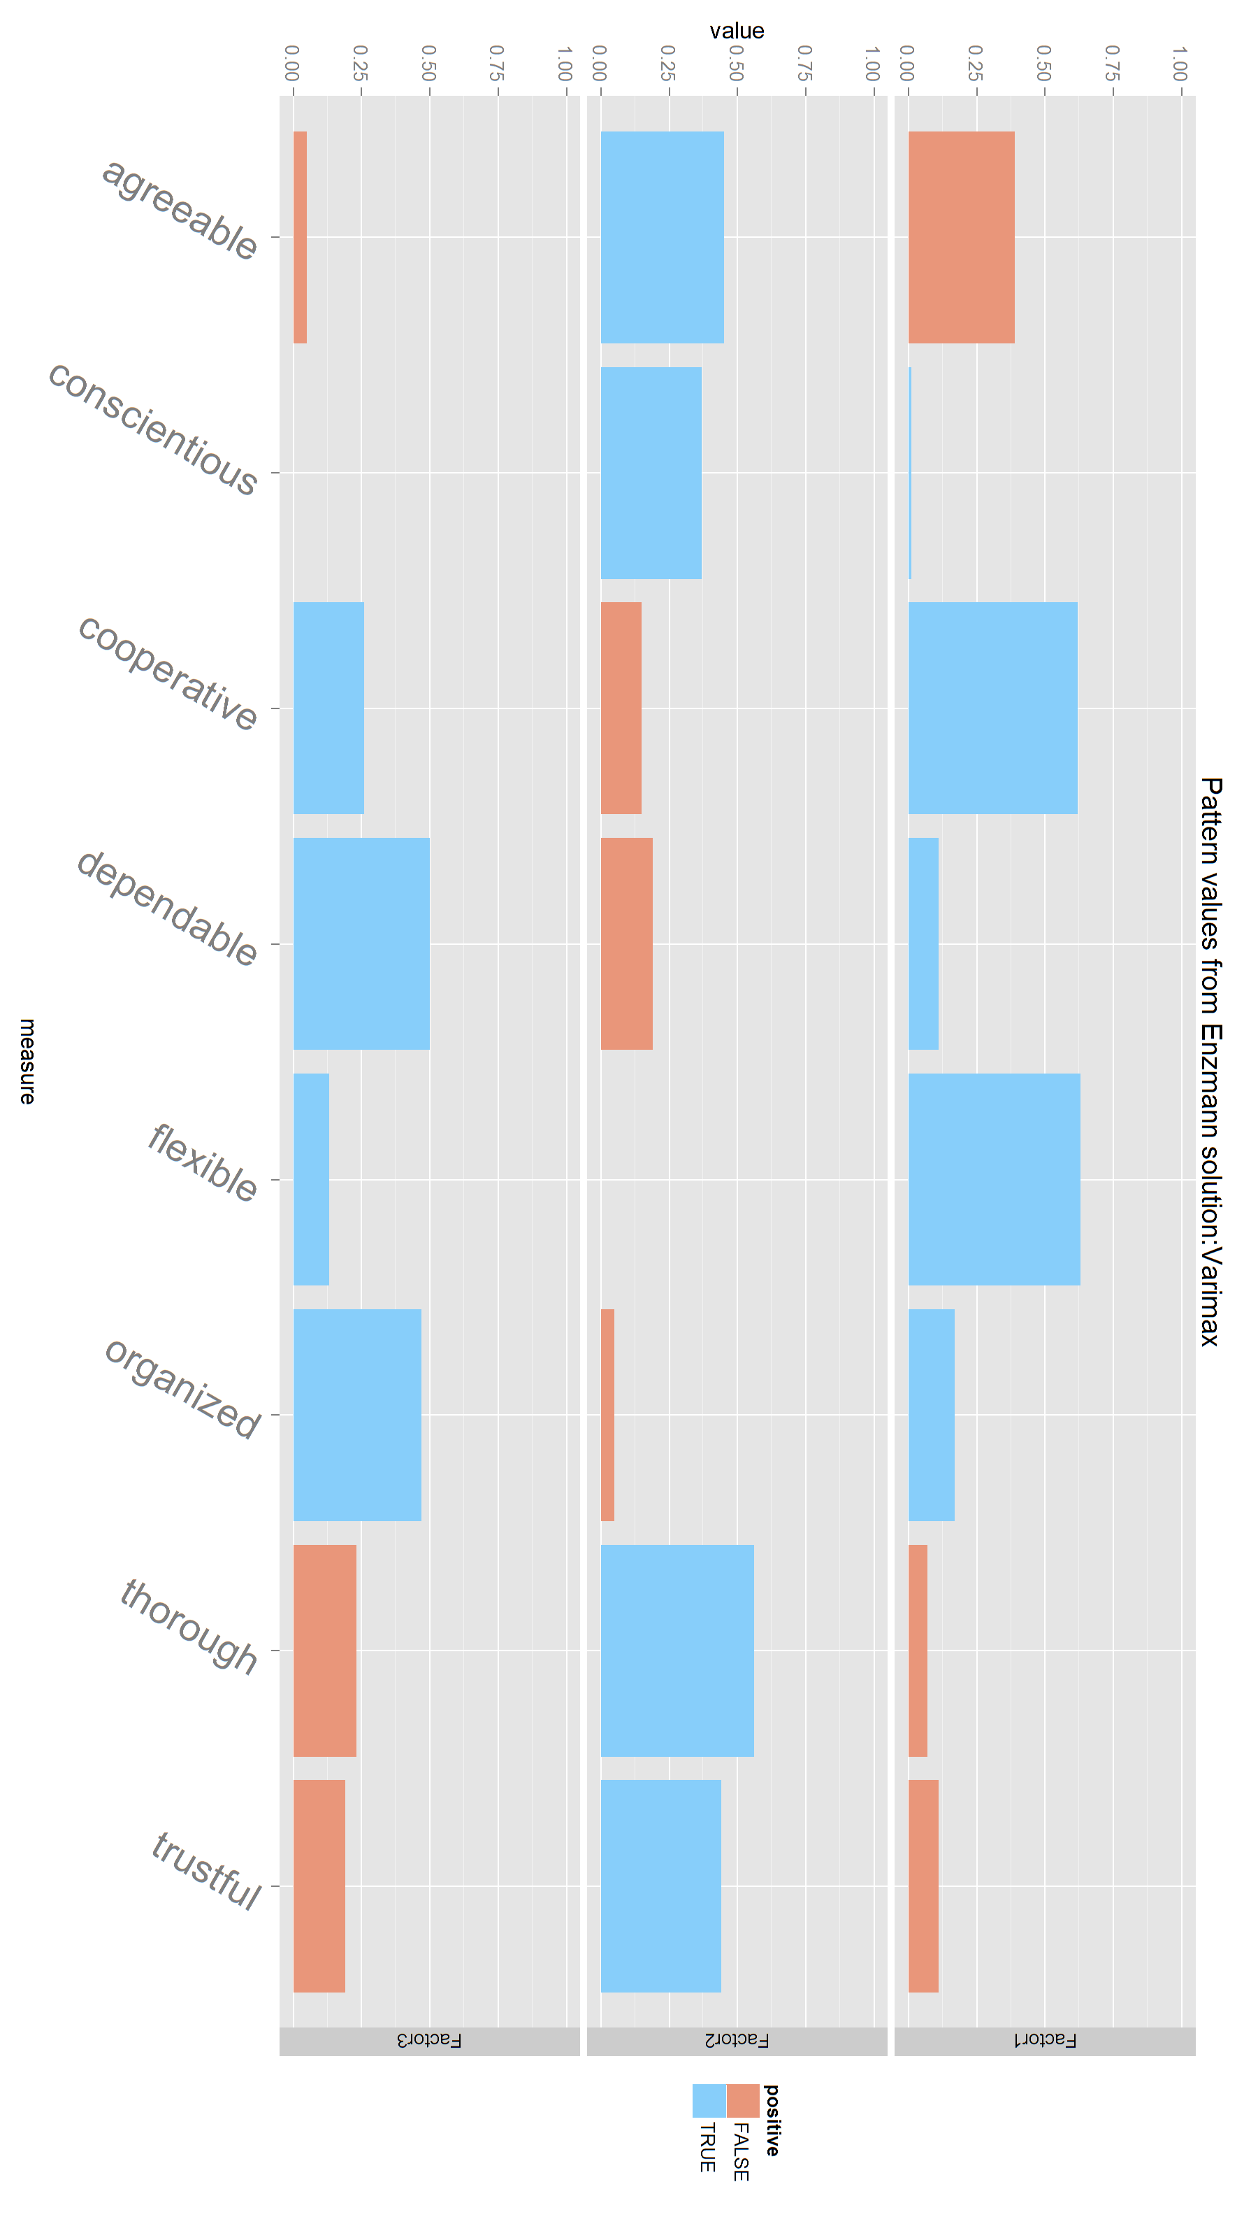
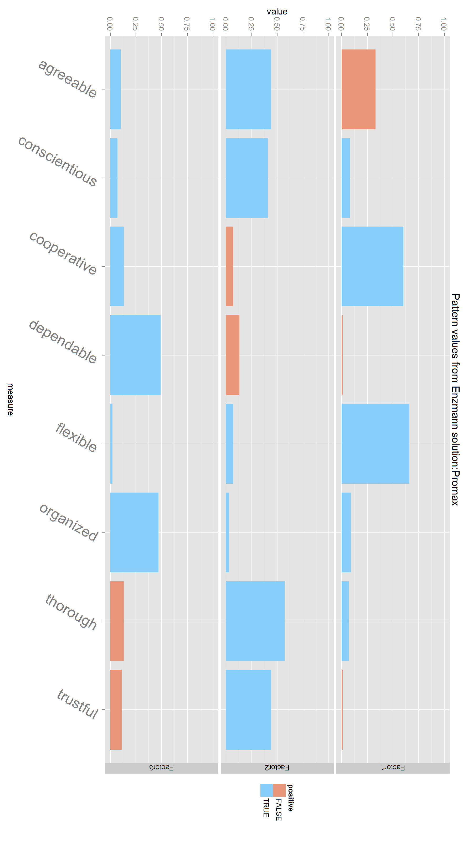
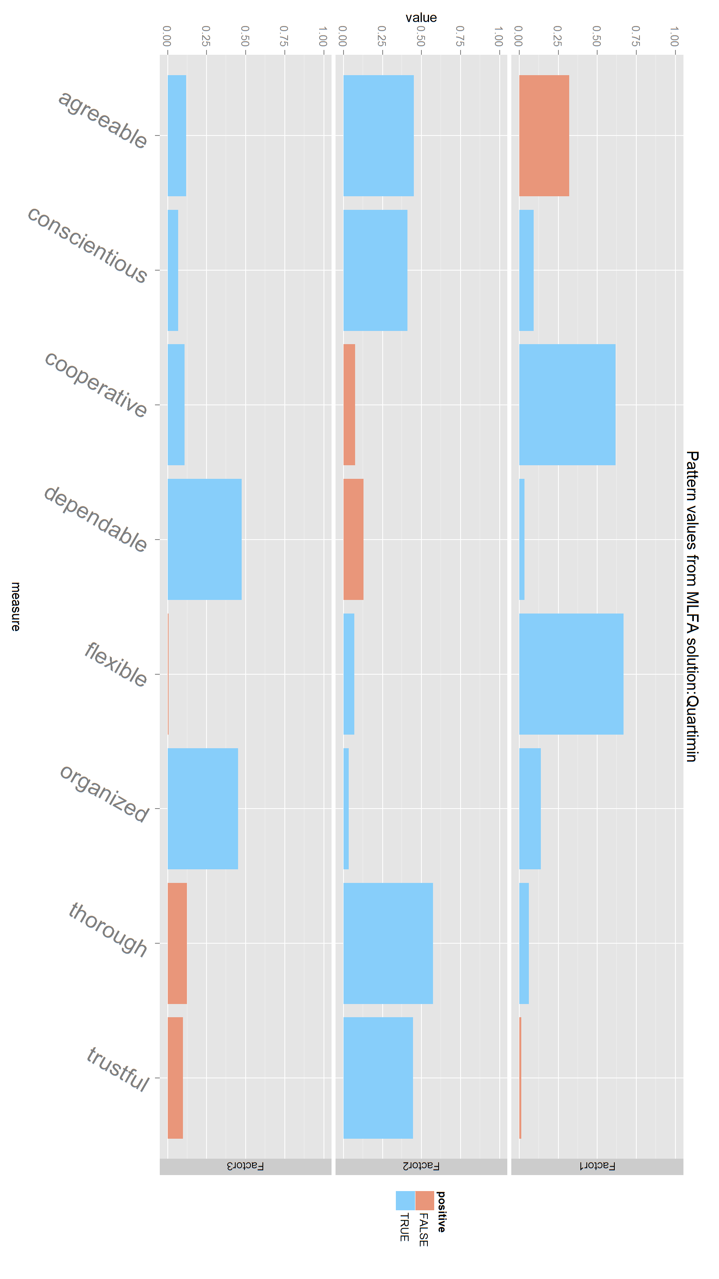


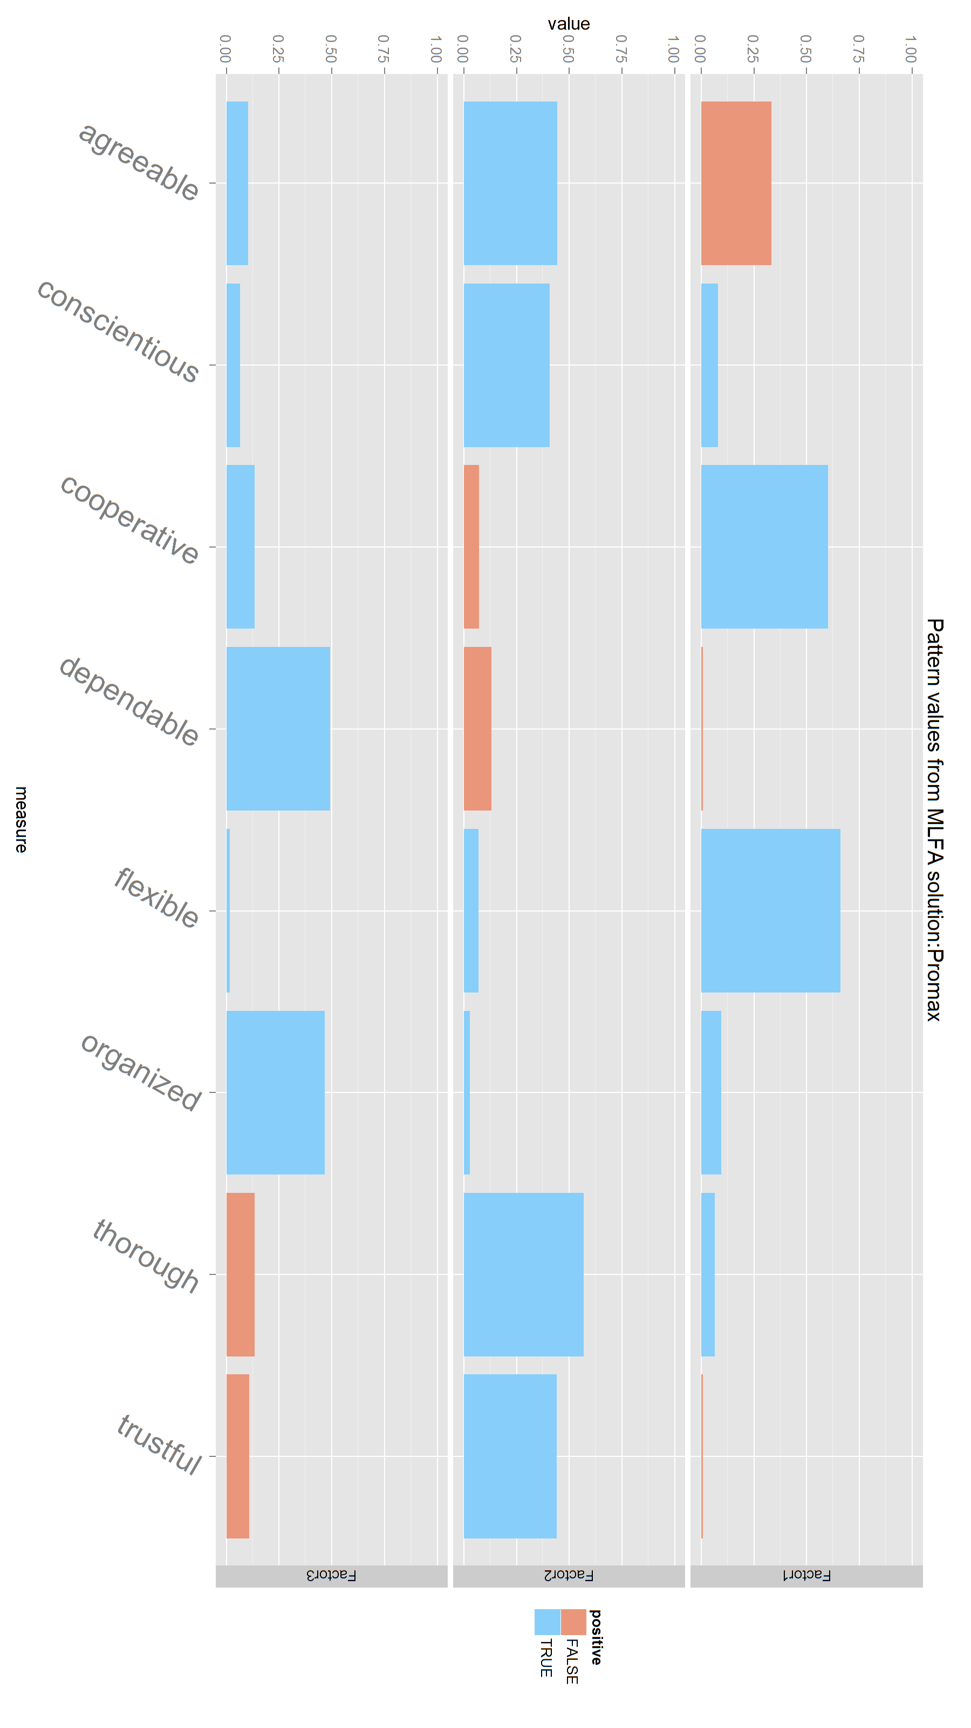
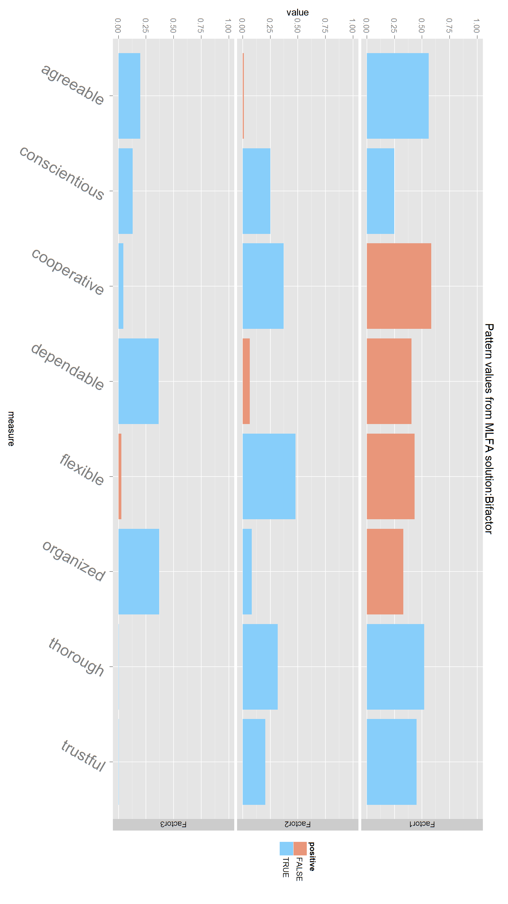
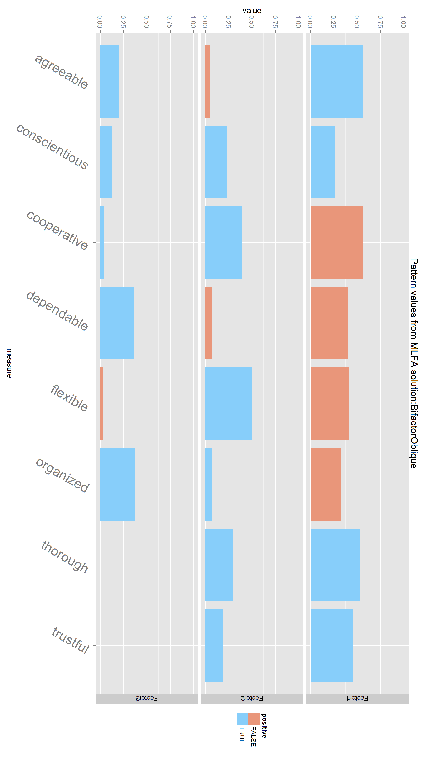
Combined
Quartimin
Enzmann
Unrotated
Varimax
Promax
Unrotated
Varimax
Promax
MLFA
Quartimin
Bifactor
BifactorOblique

Slide 2
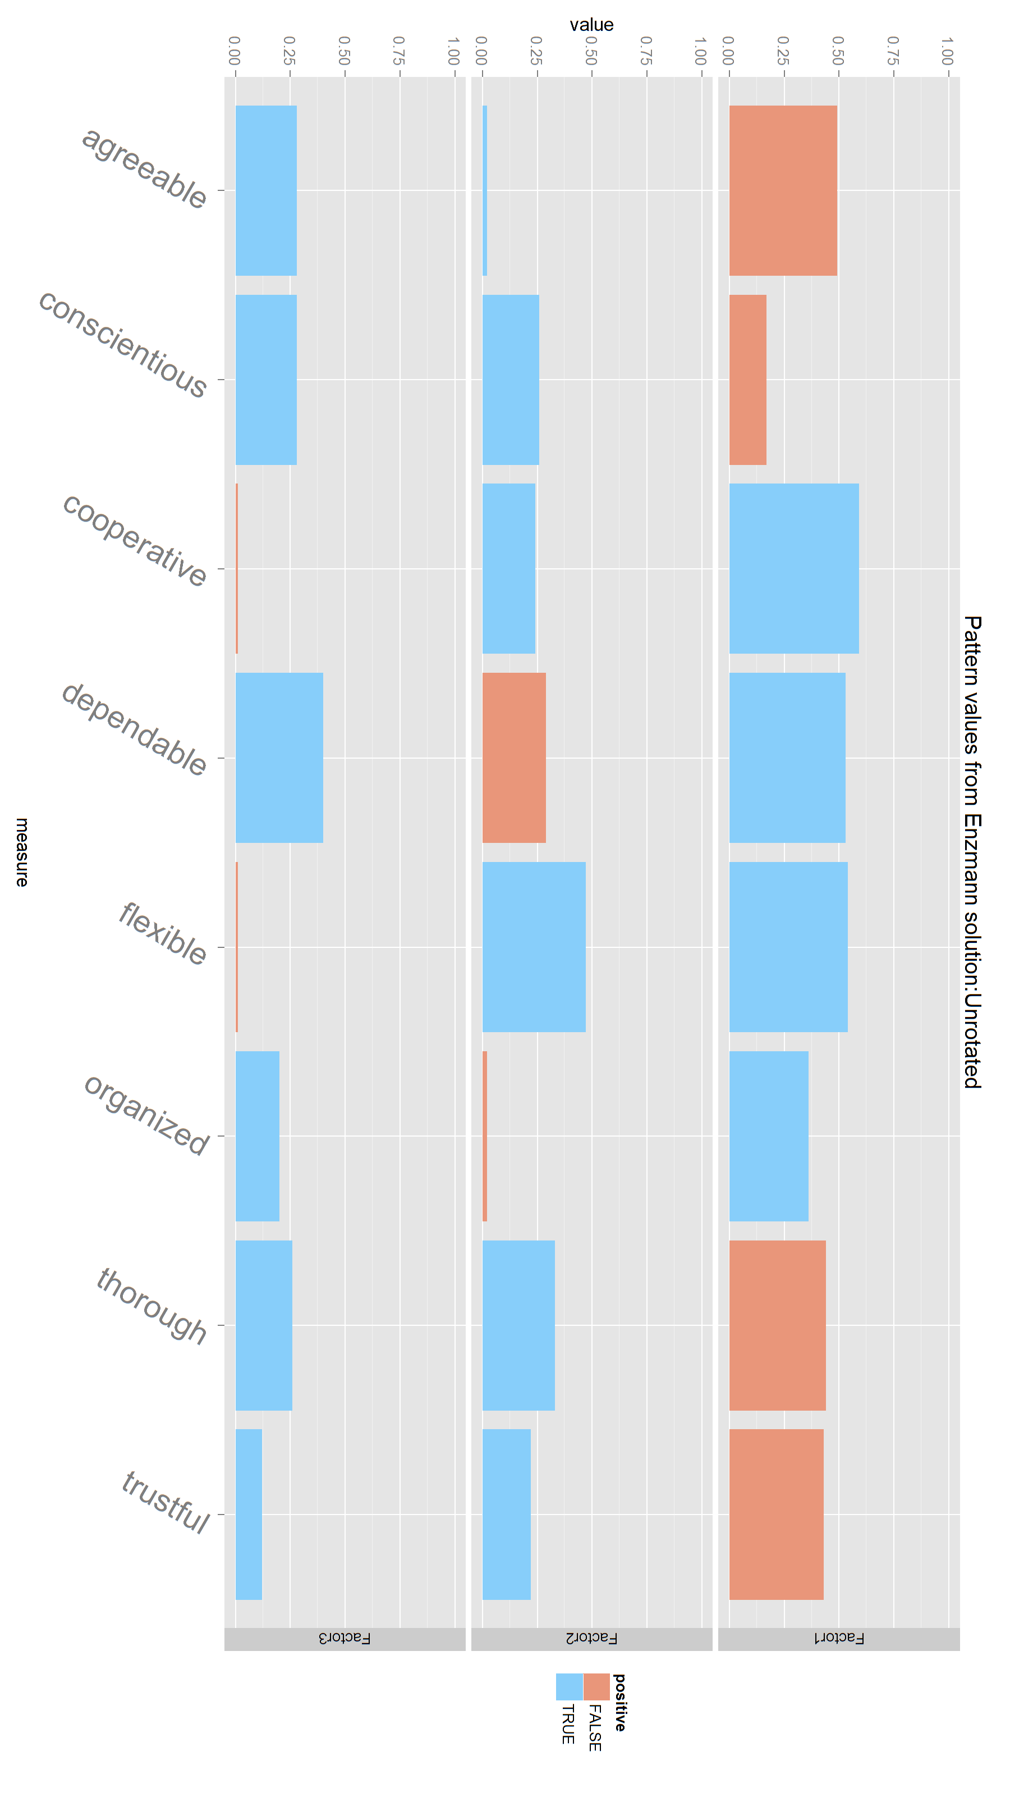
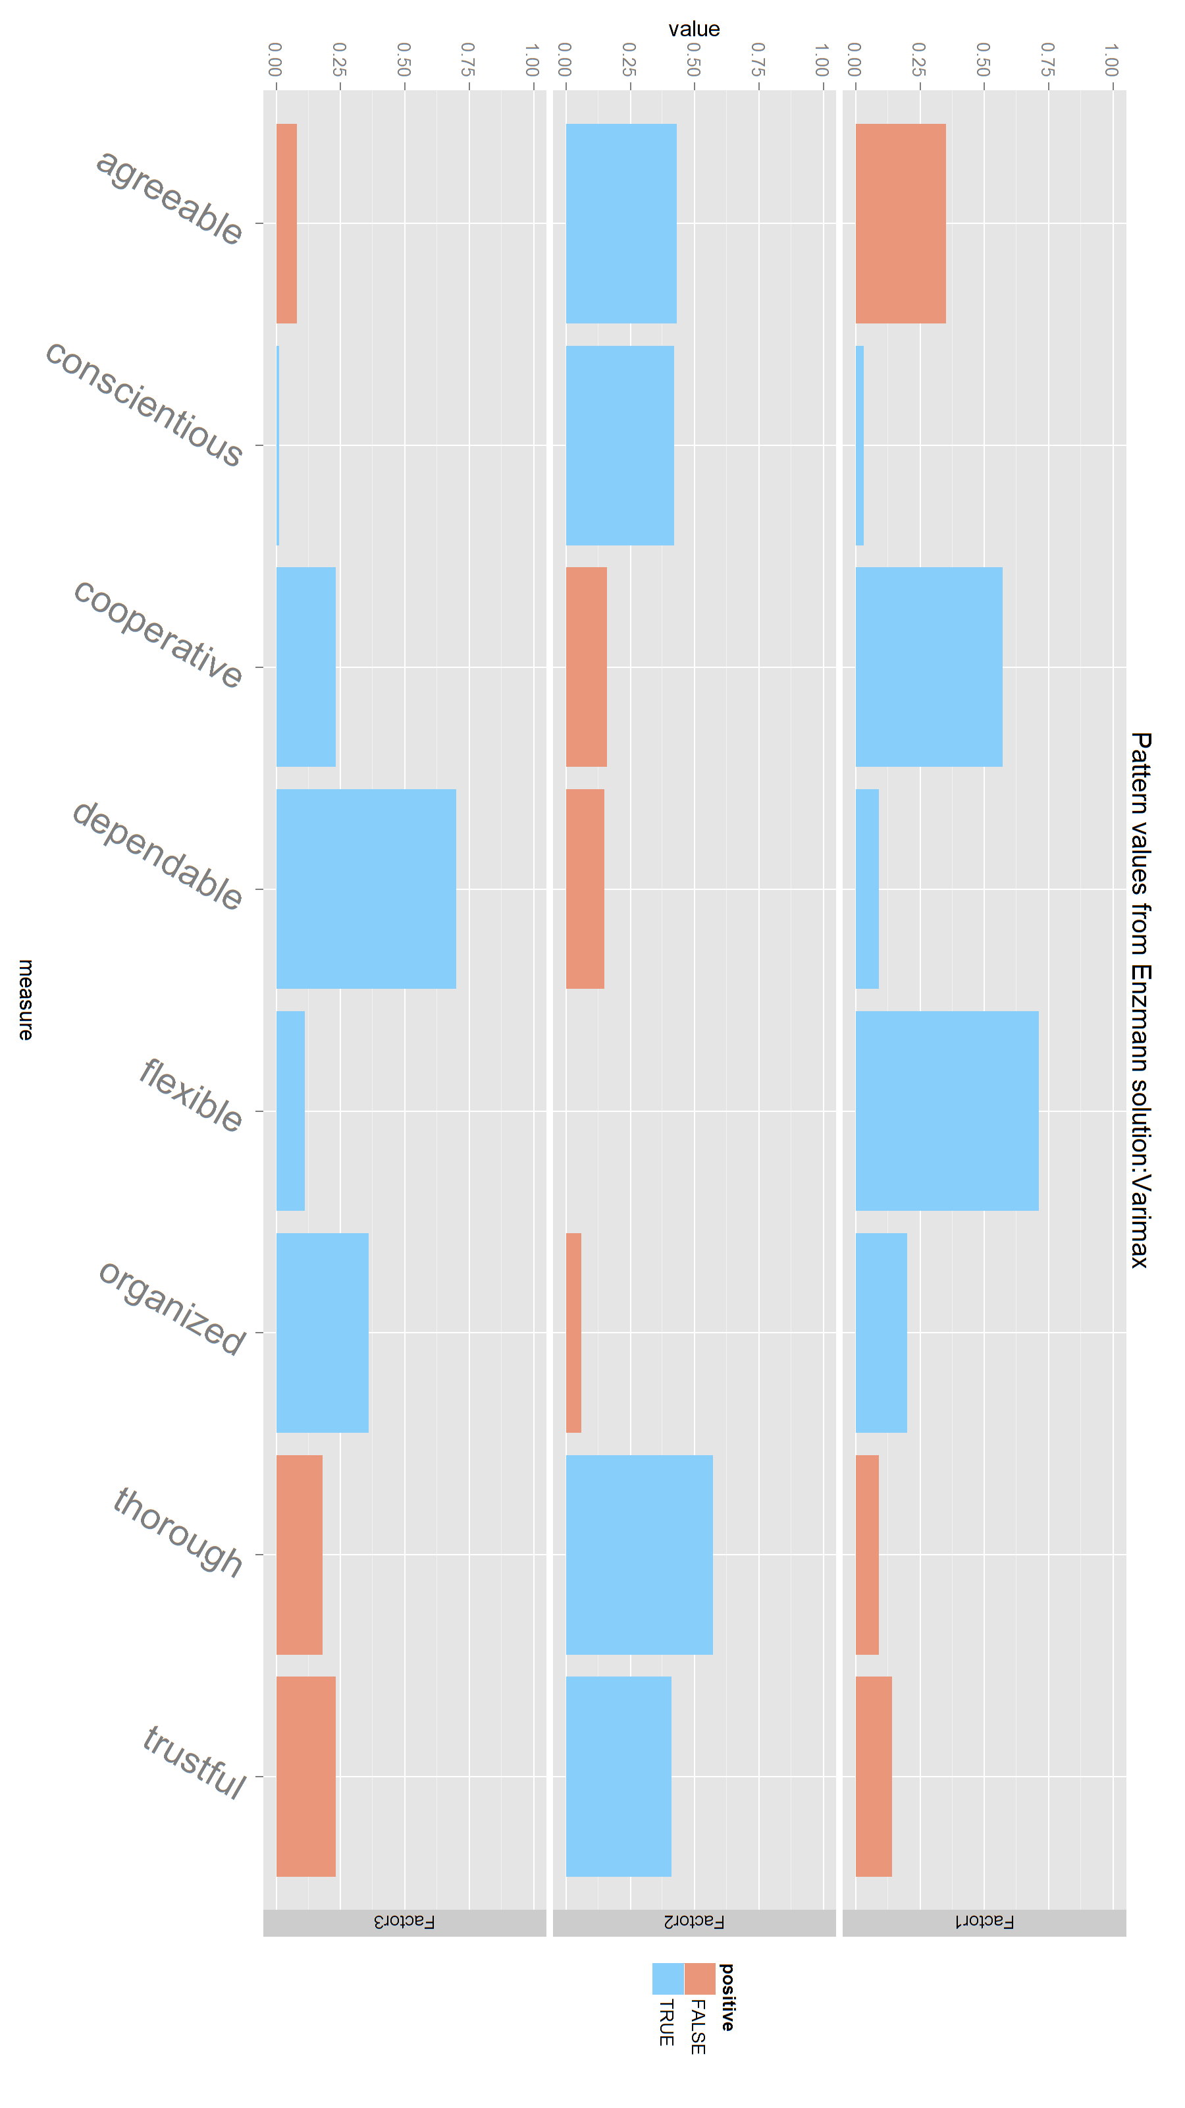
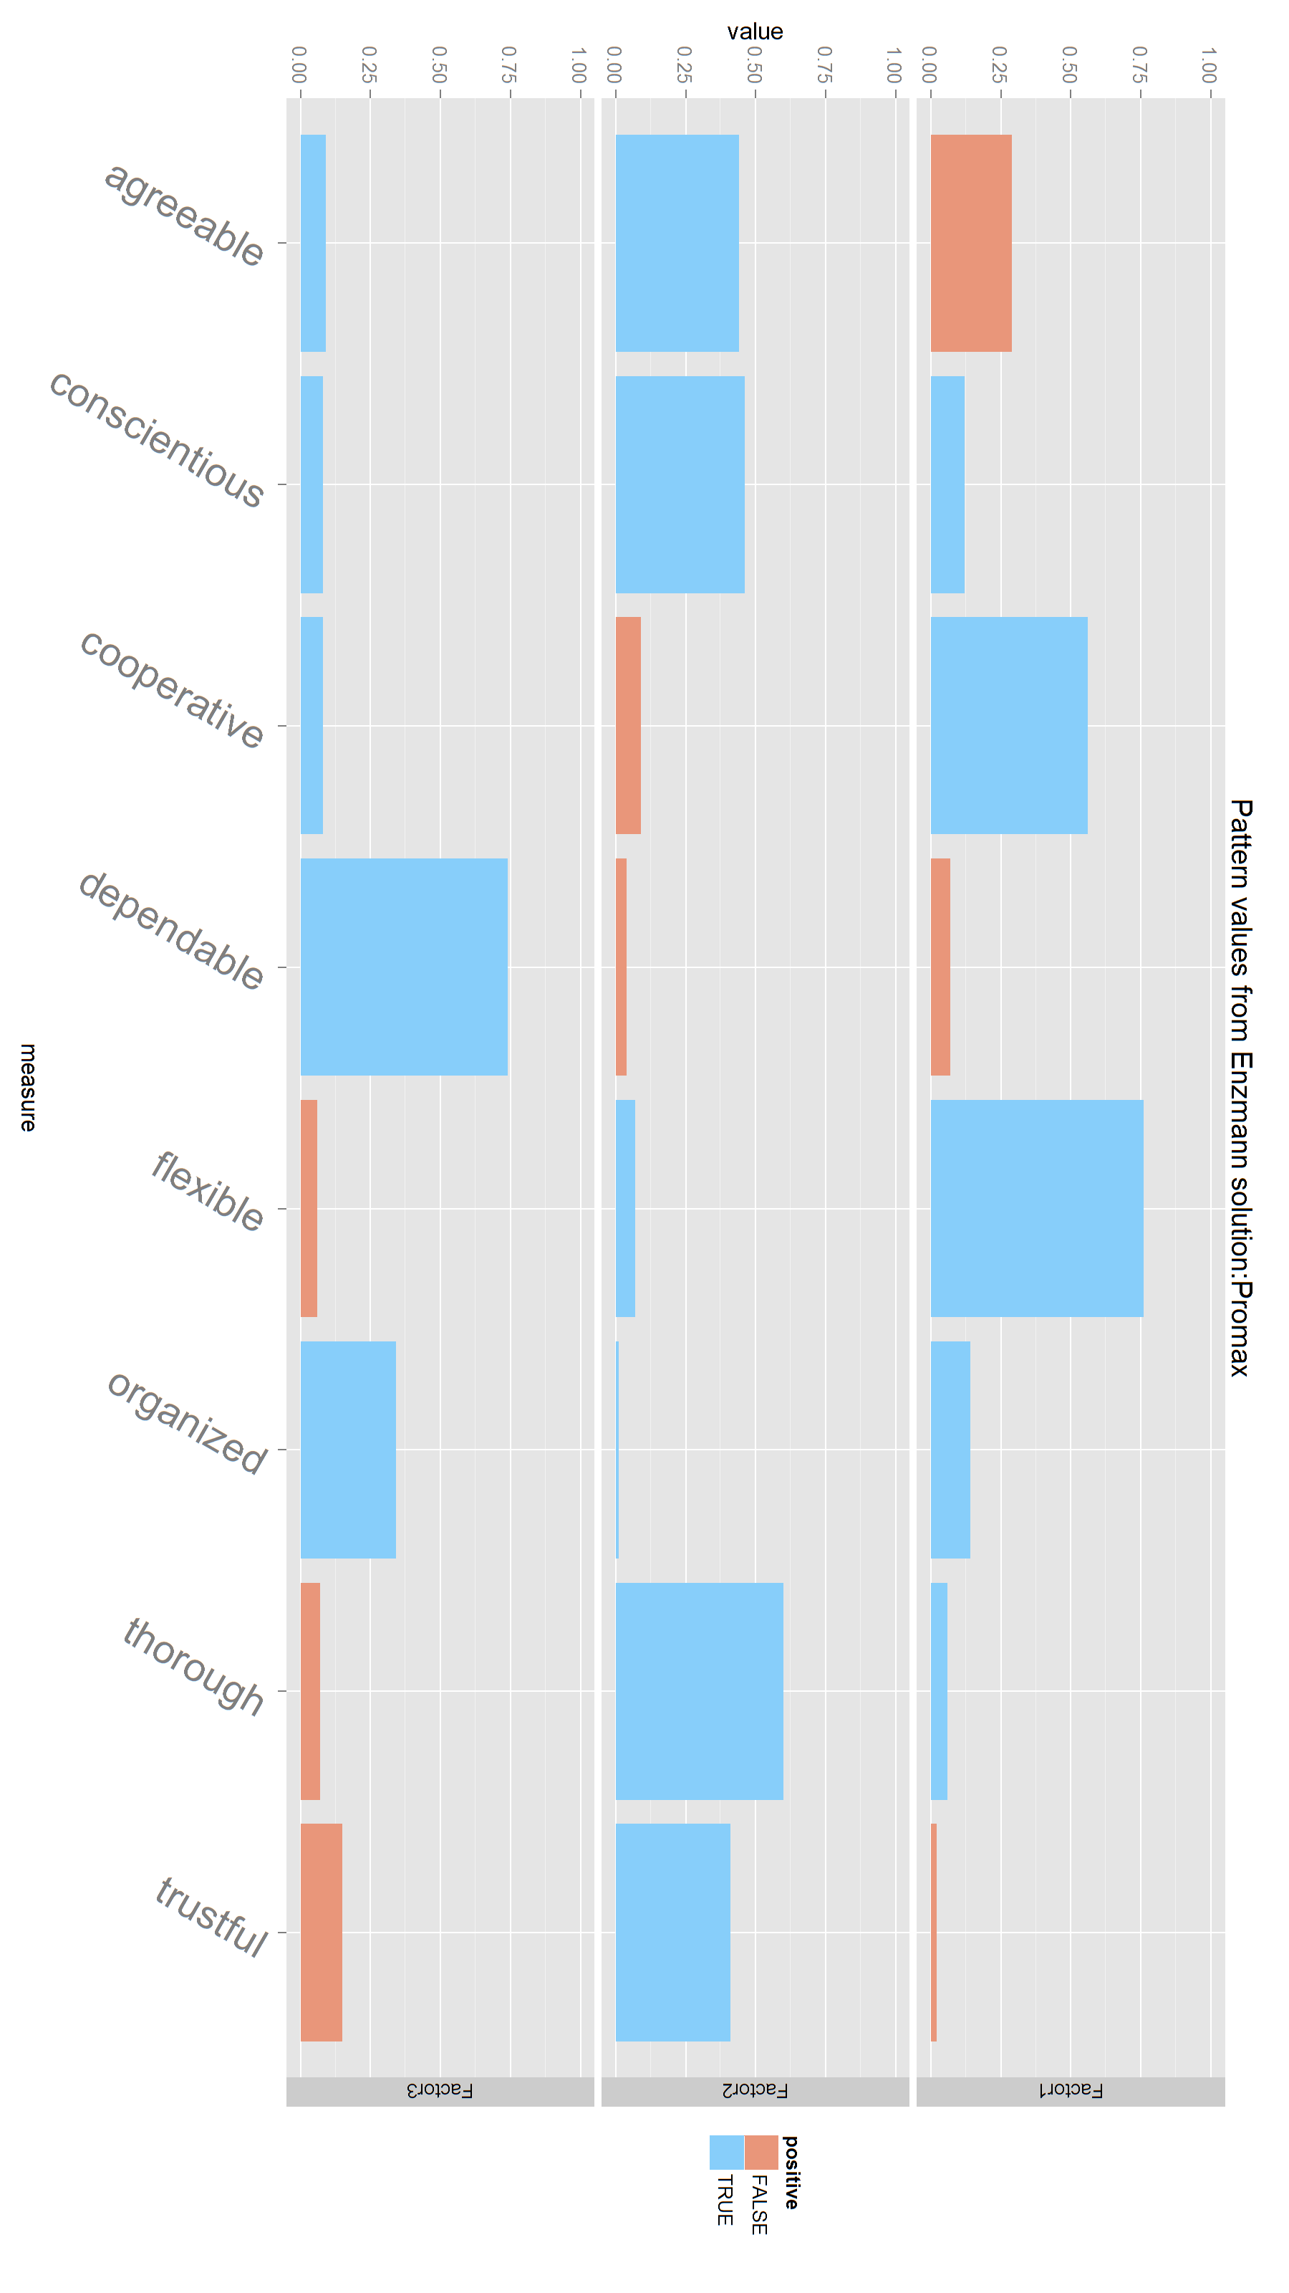




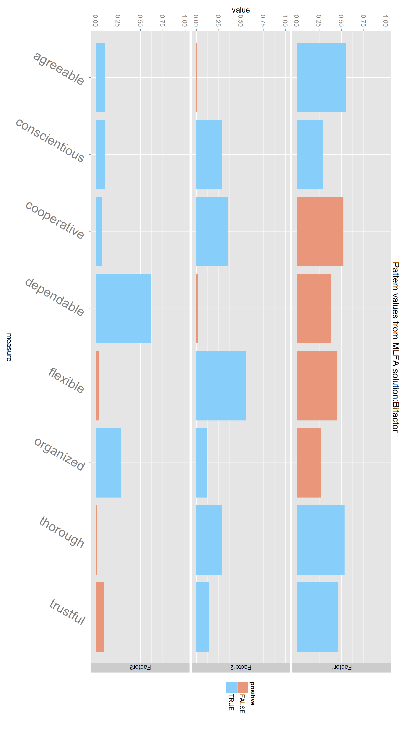
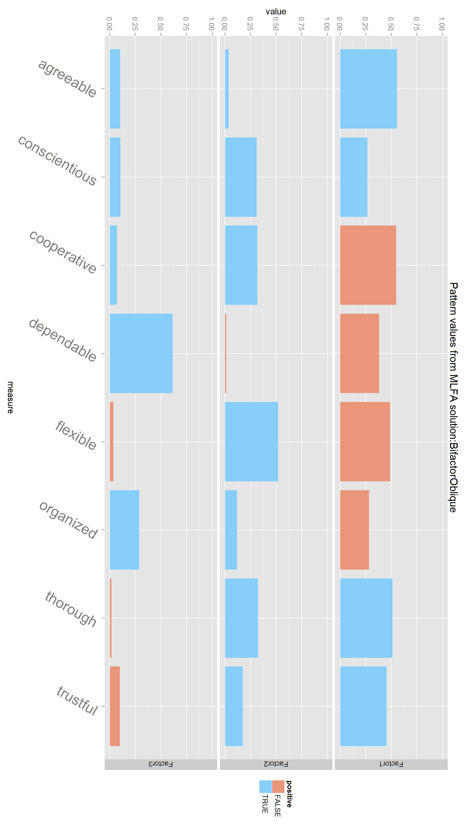
Male
Quartimin
Enzmann
Unrotated
Varimax
Promax
Unrotated
Varimax
Promax
MLFA
Quartimin
Bifactor
BifactorOblique

Slide 3
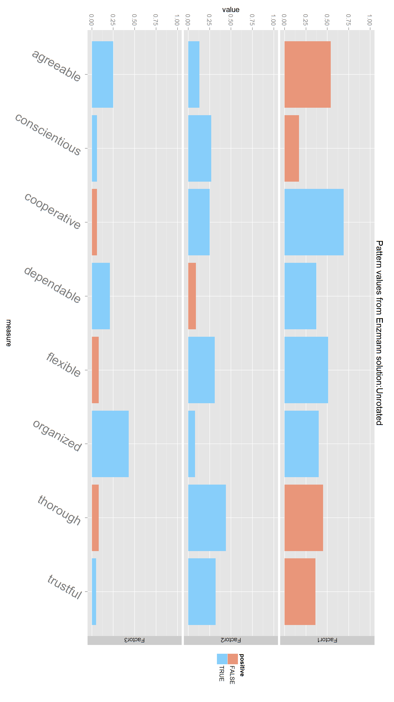
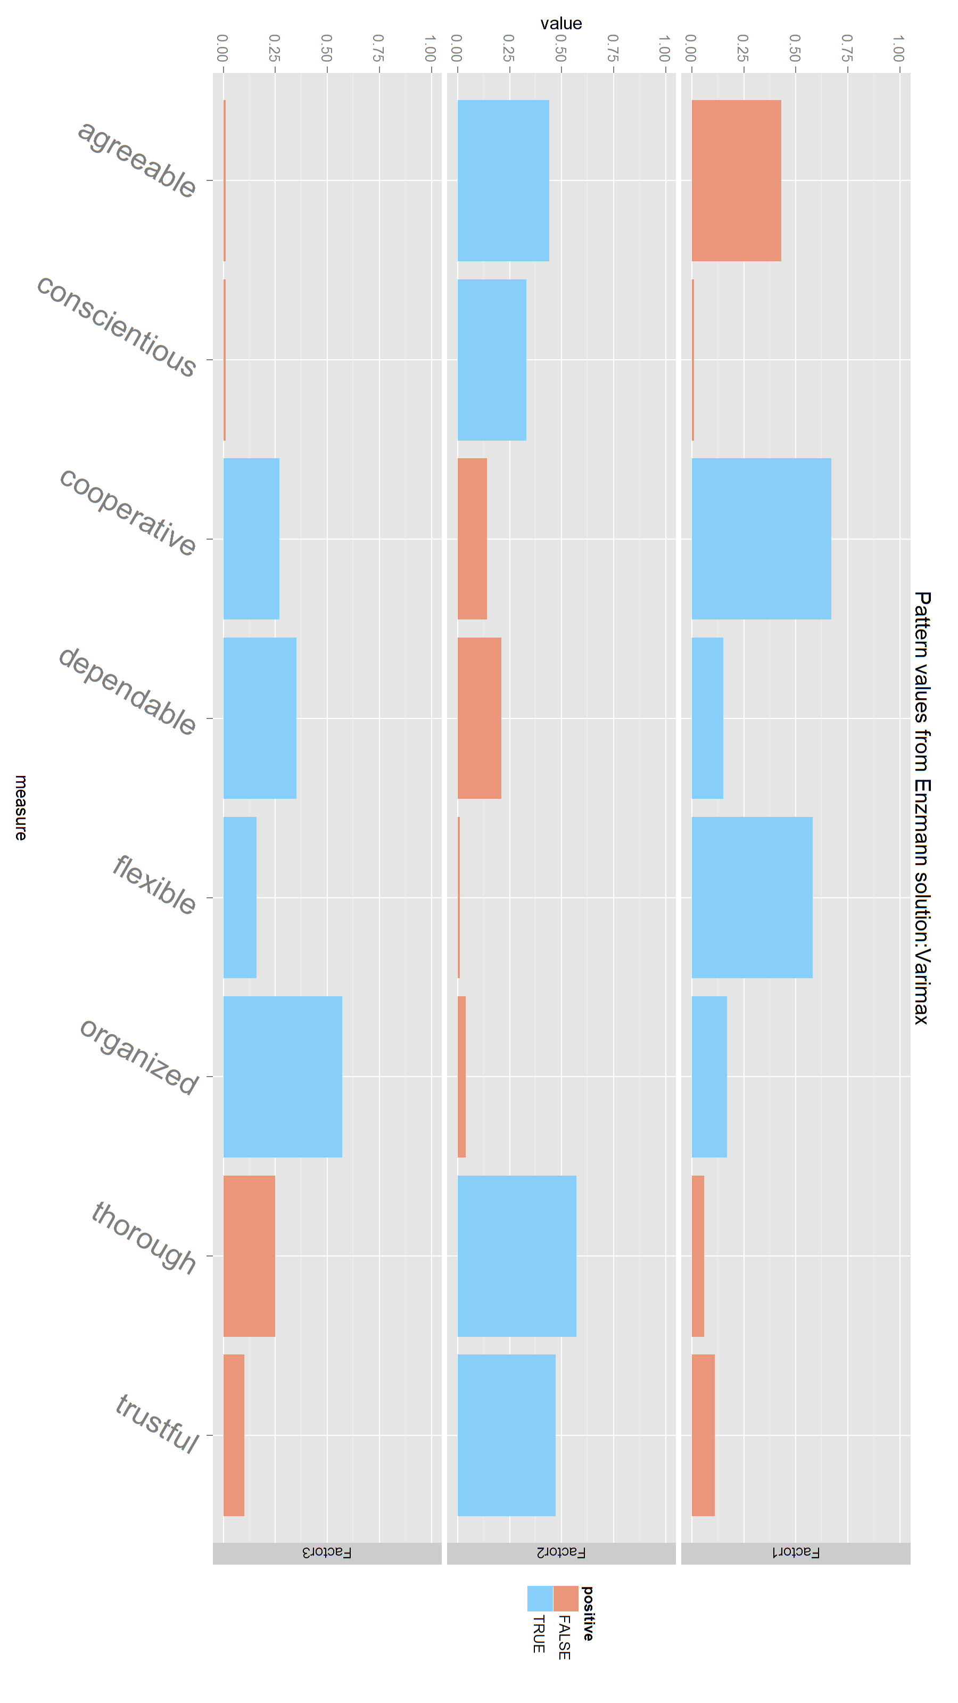
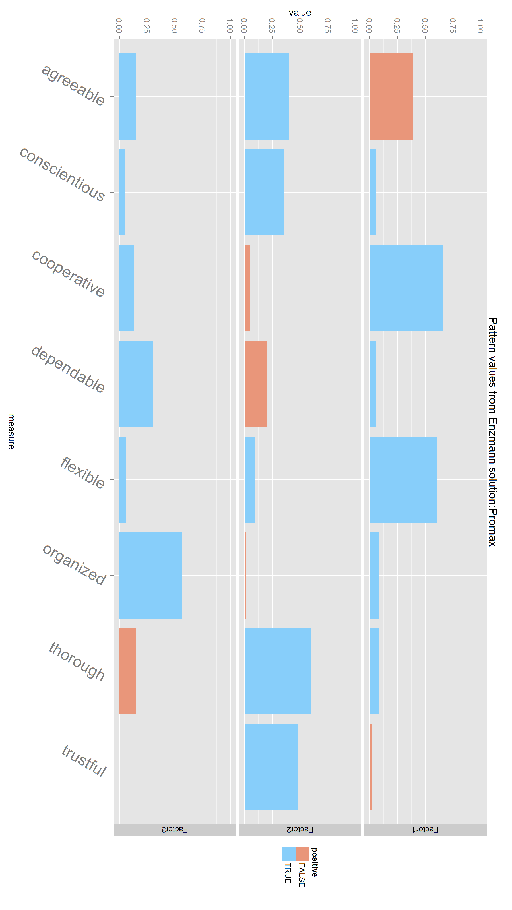
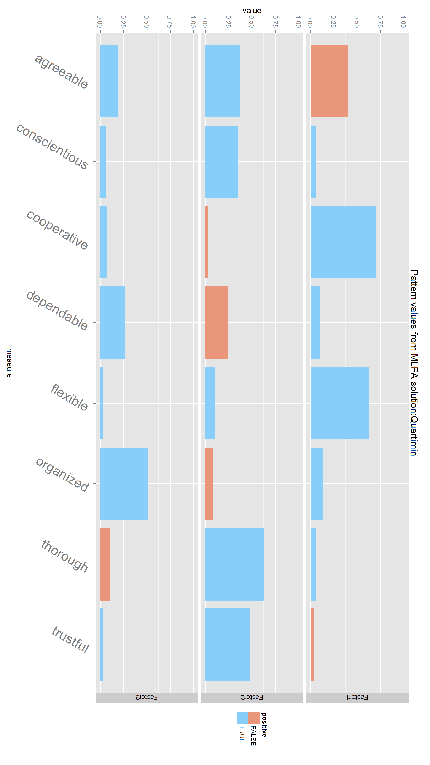
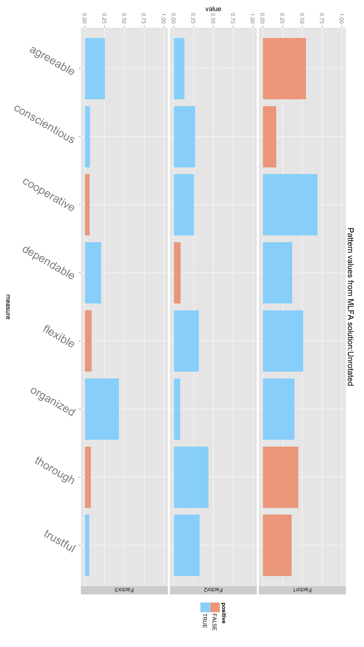

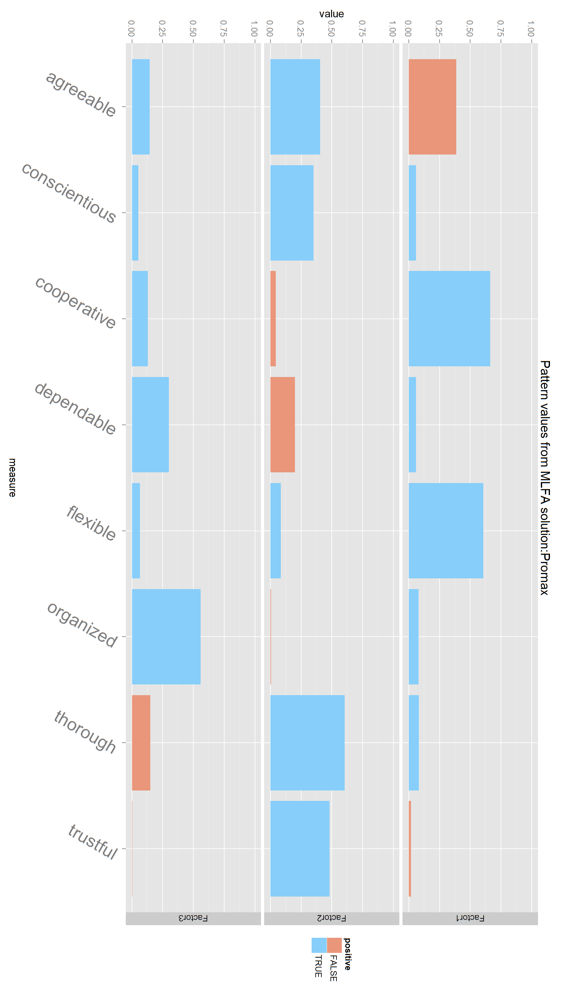
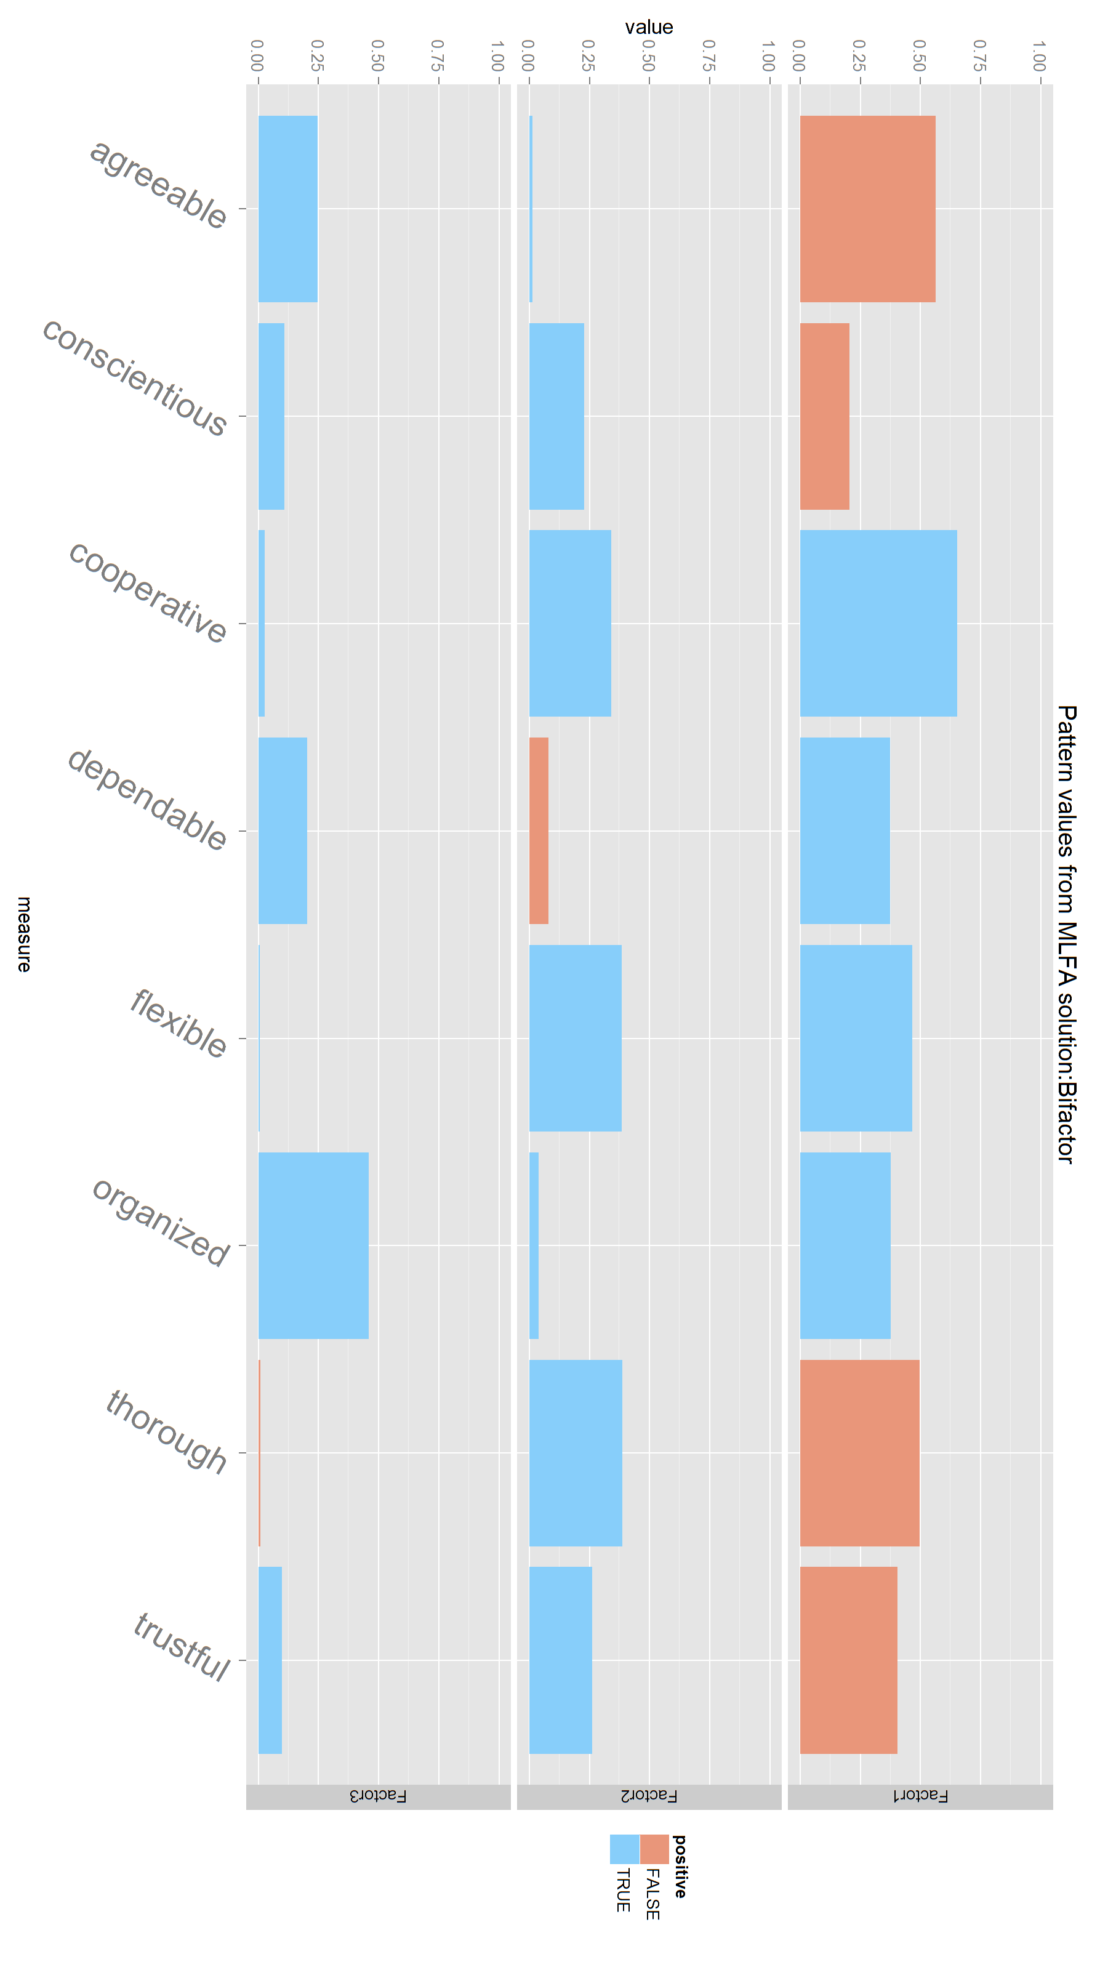
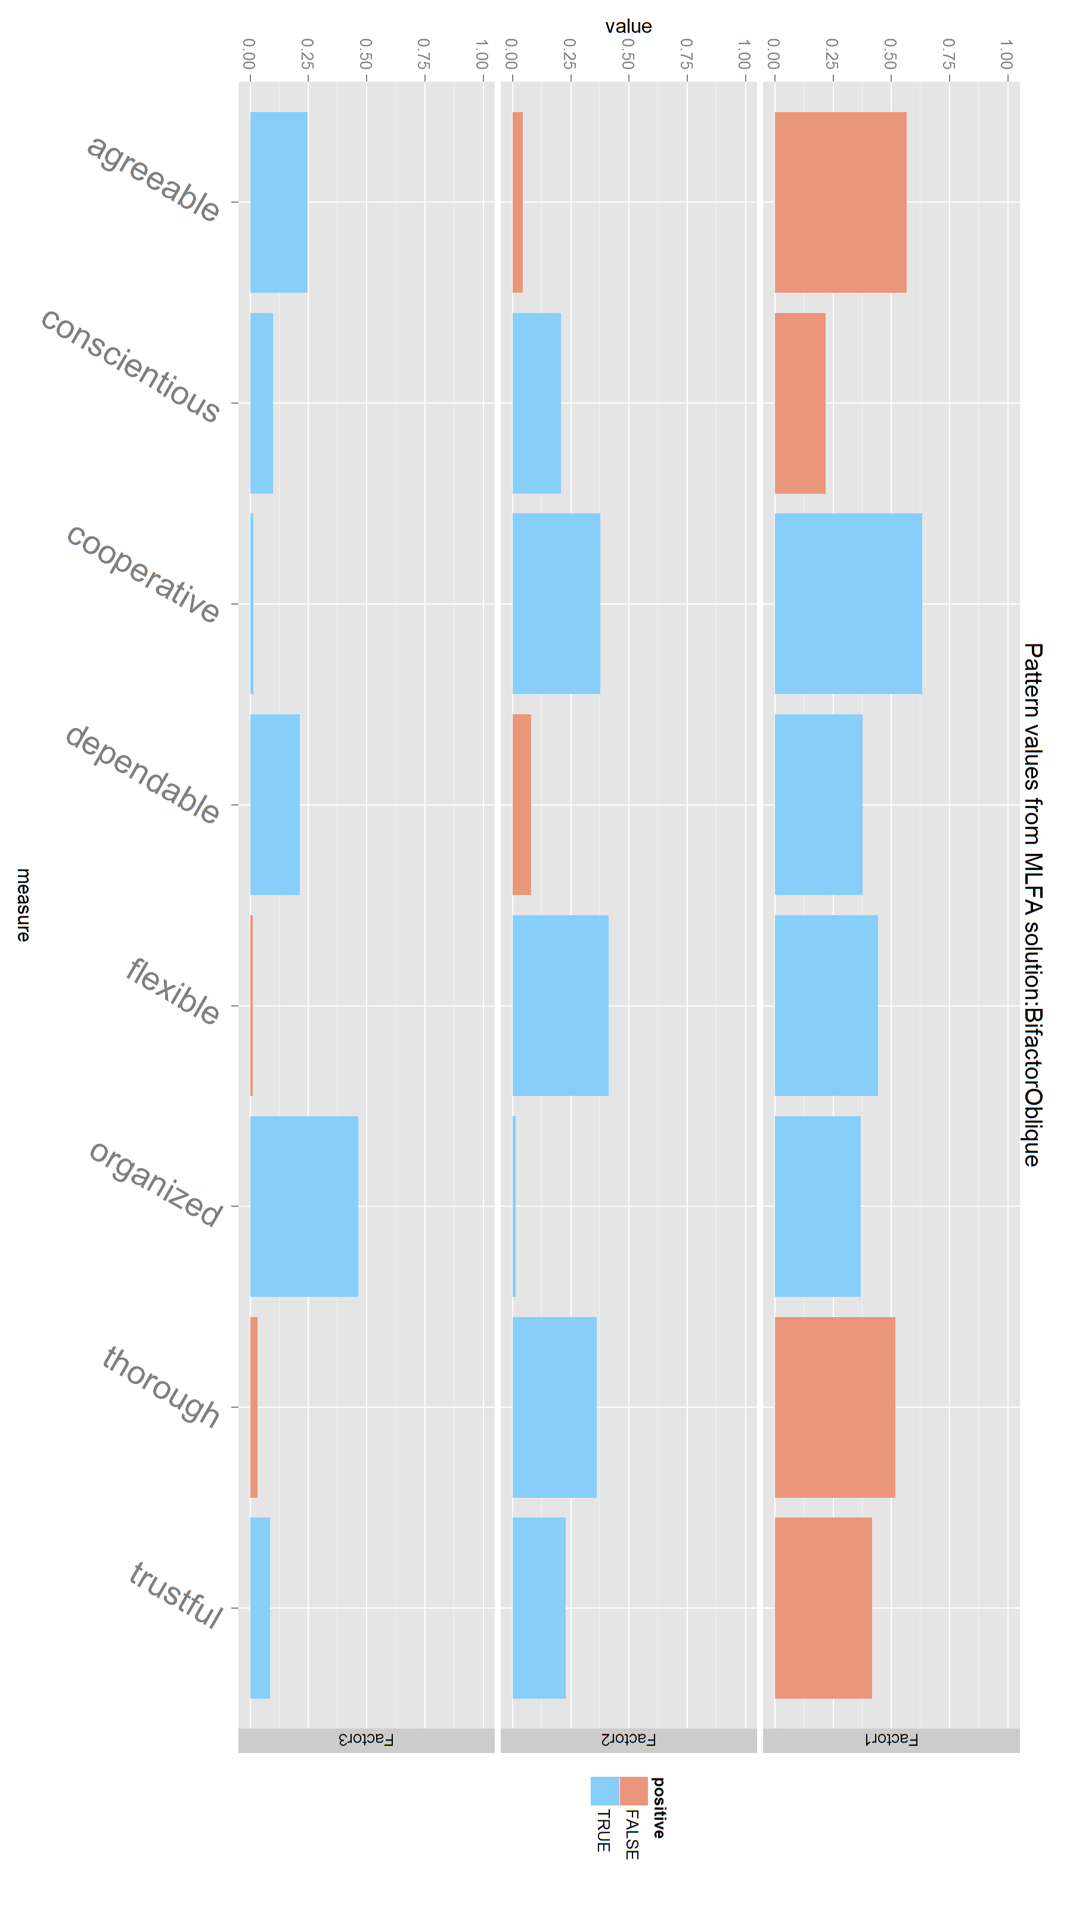
Female
Quartimin
Enzmann
Unrotated
Varimax
Promax
Unrotated
Varimax
Promax
MLFA
Quartimin
Bifactor
BifactorOblique

Slide 4
Combined
Quartimin
Enzmann
Unrotated
Varimax
Promax
Unrotated
Varimax
Promax
MLFA
Quartimin
Bifactor
BifactorOblique

