Slide 1
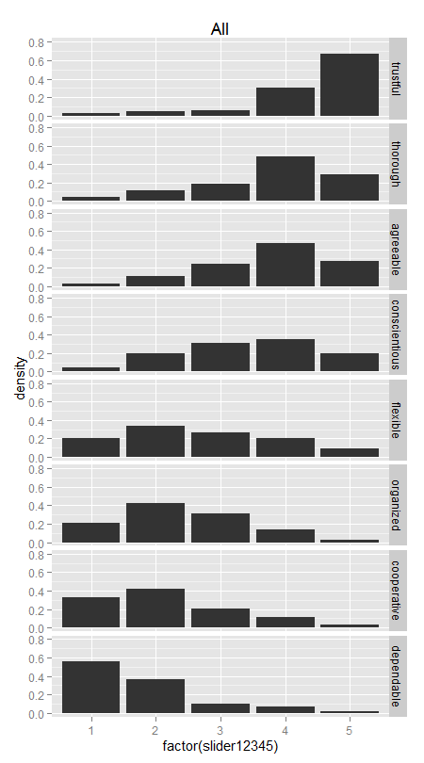
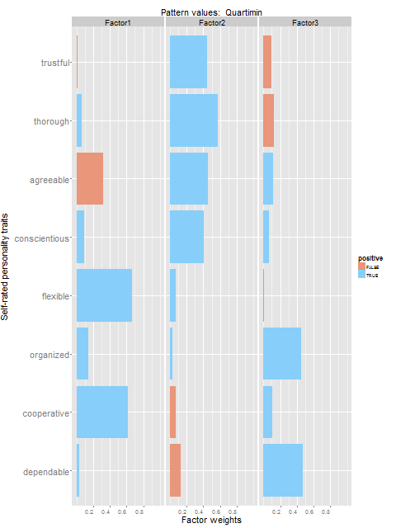
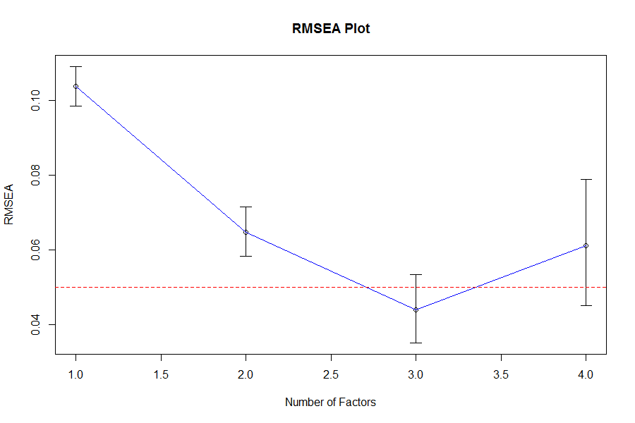
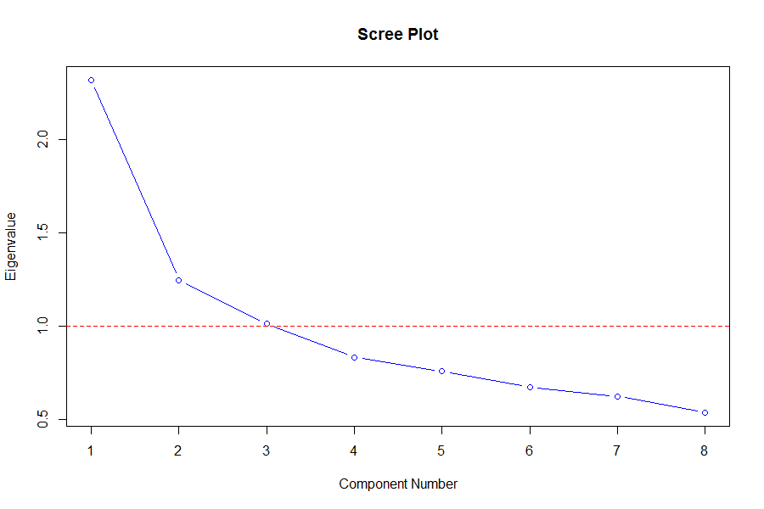
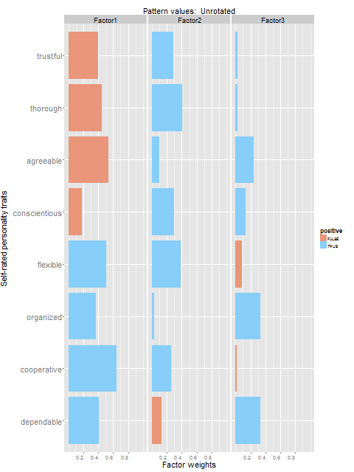
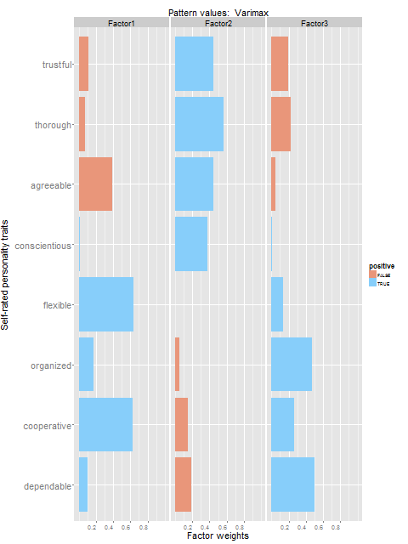
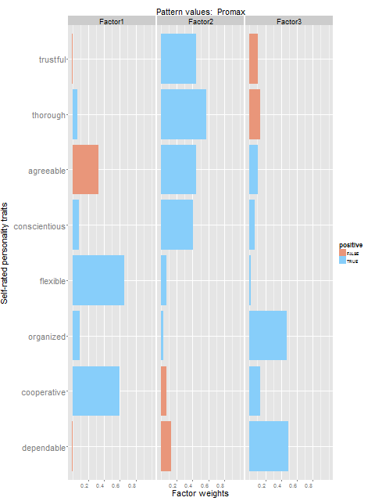
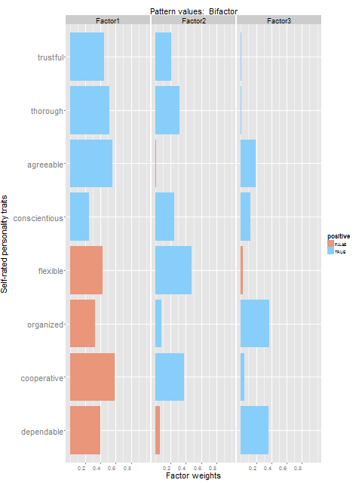
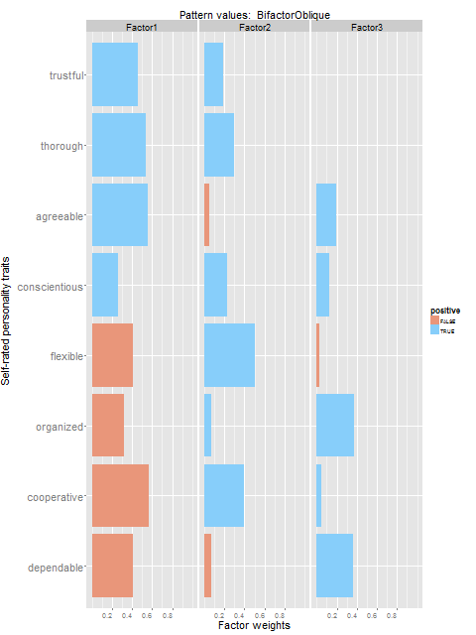
How much do you feel that ______________ describes you as a person?
Low – 1-2-3-4-5 - High
careless
quarrelsome
All
stubborn
difficult
Unrotated
Varimax
Promax
Quartimin
Bifactor
BifactorOblique

Slide 2
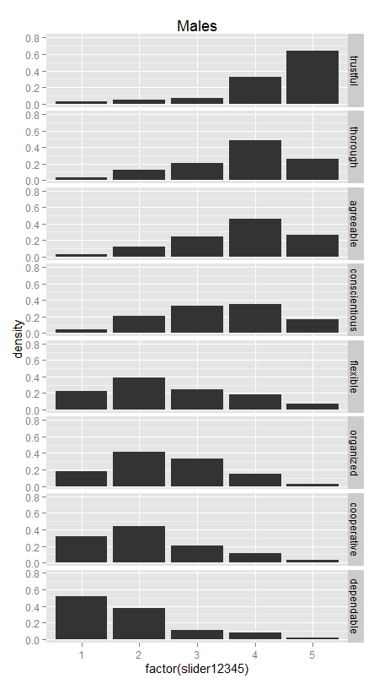
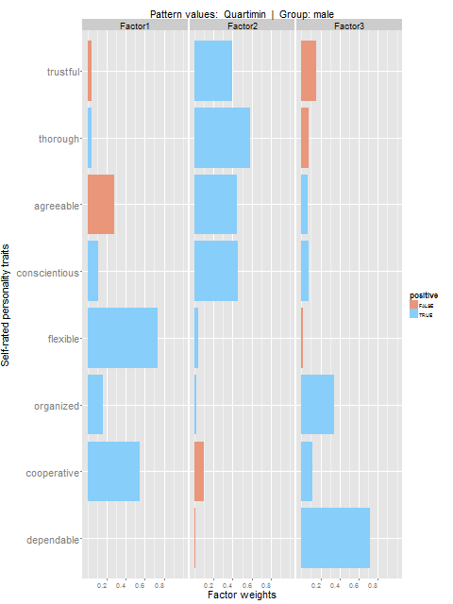
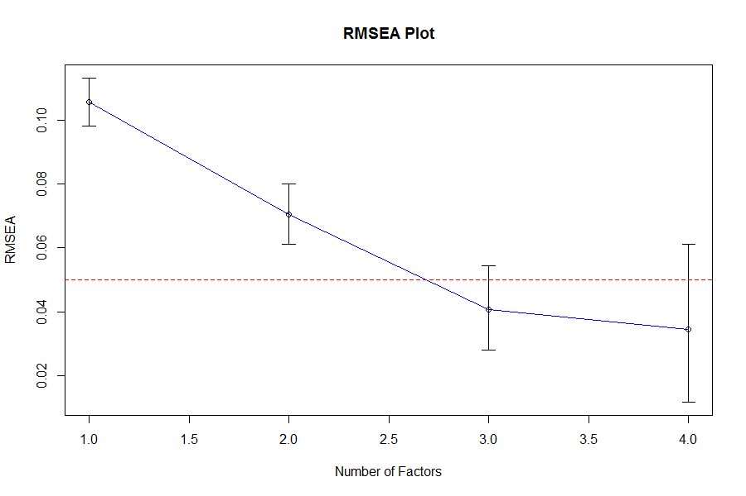
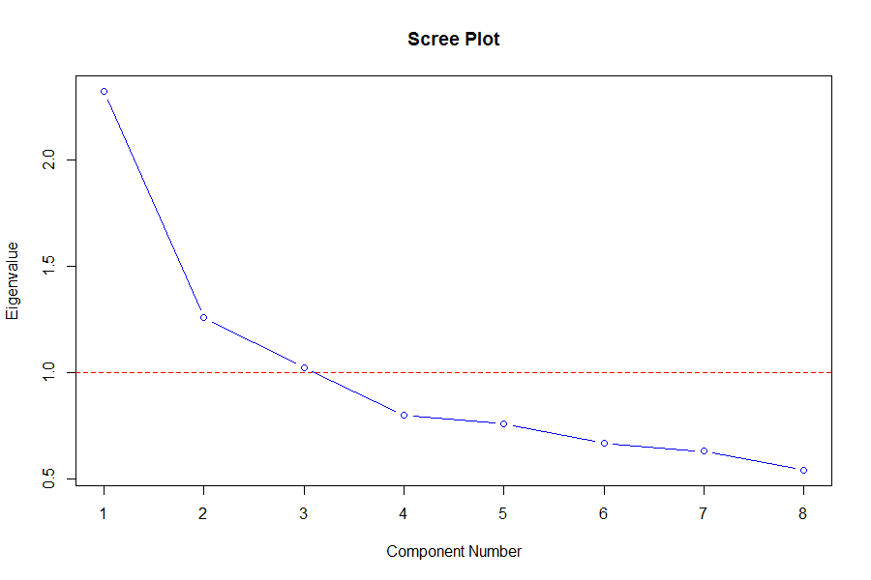
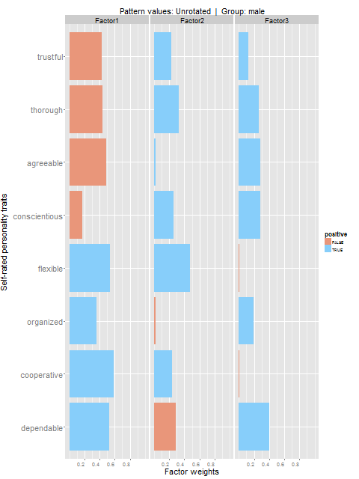
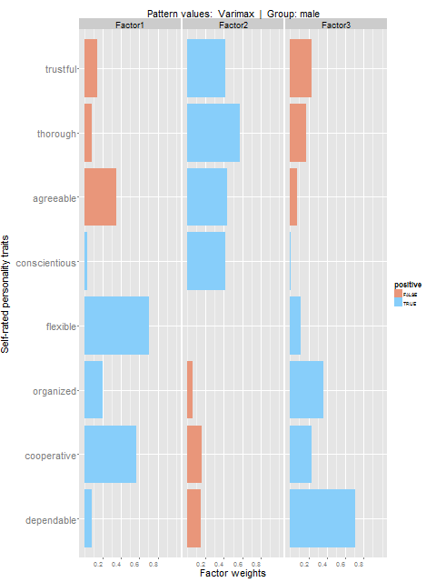

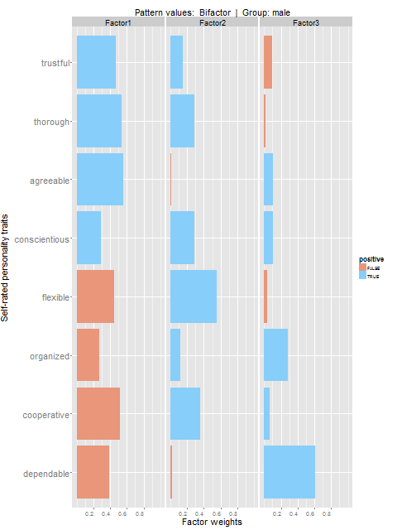
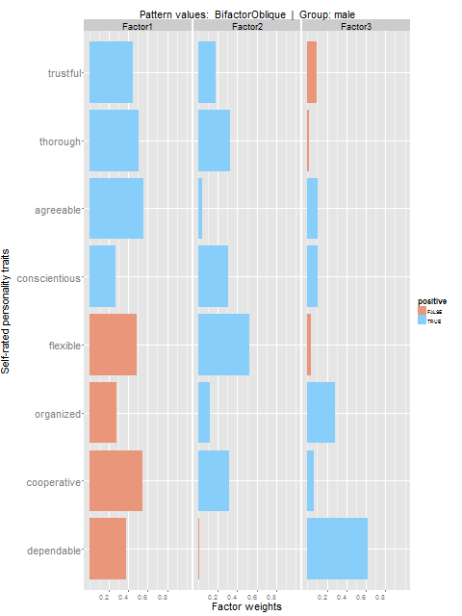
How much do you feel that ______________ describes you as a person?
Low – 1-2-3-4-5 - High
careless
quarrelsome
Males
stubborn
difficult
Unrotated
Varimax
Promax
Quartimin
Bifactor
BifactorOblique

Slide 3
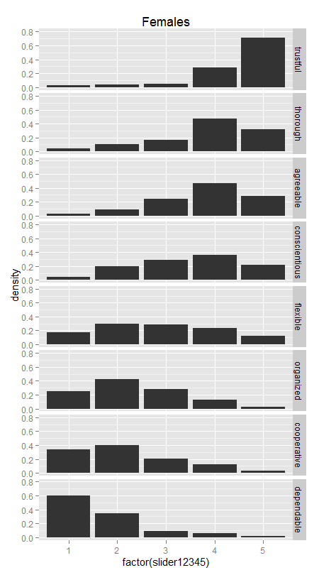
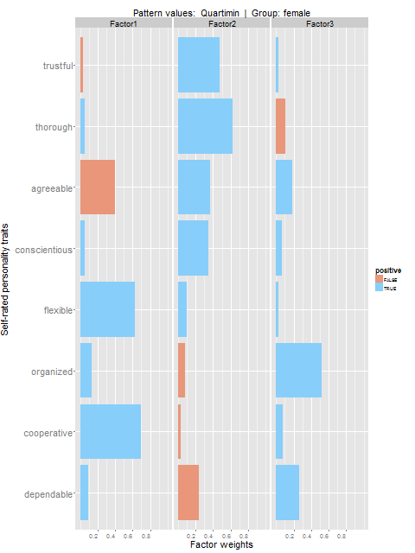
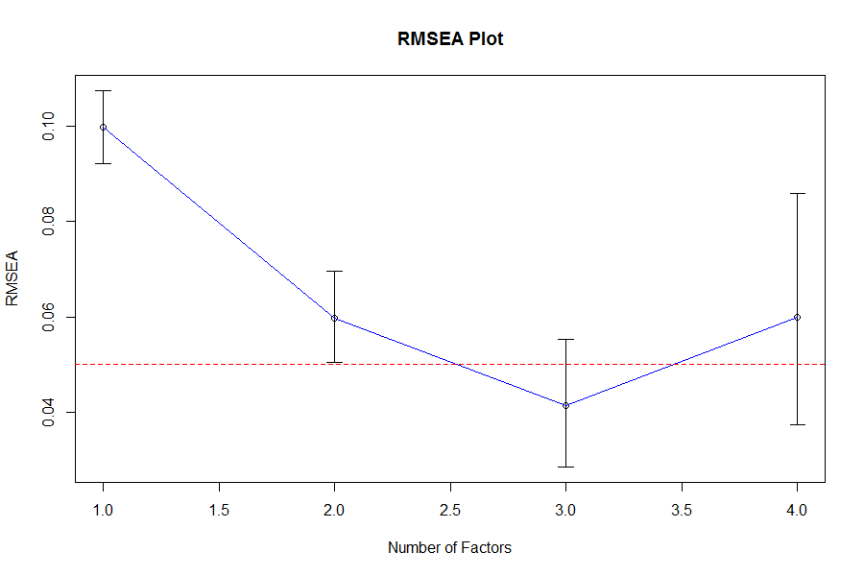
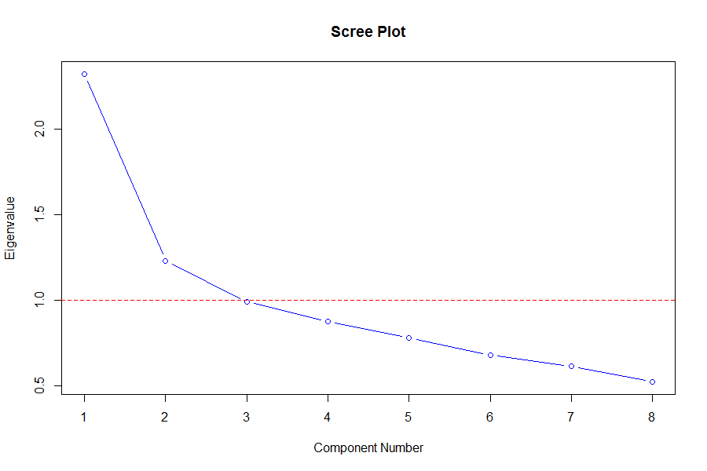
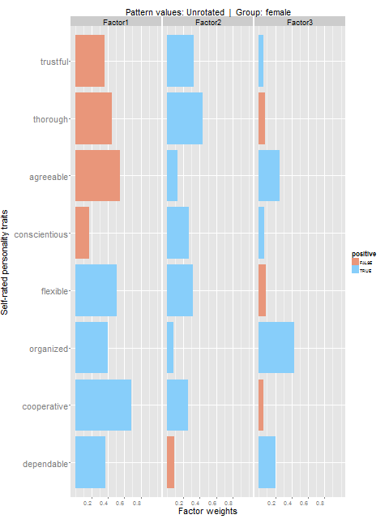
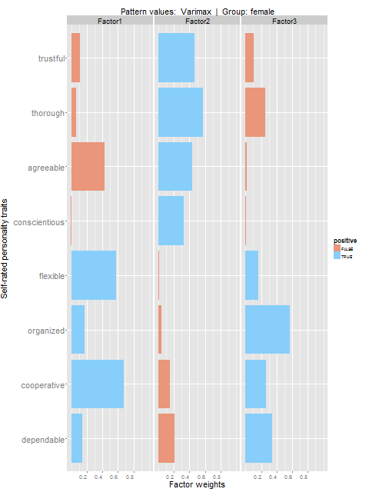
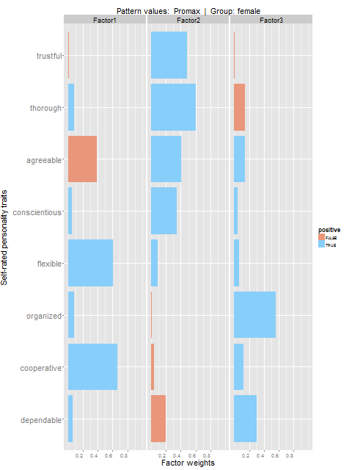
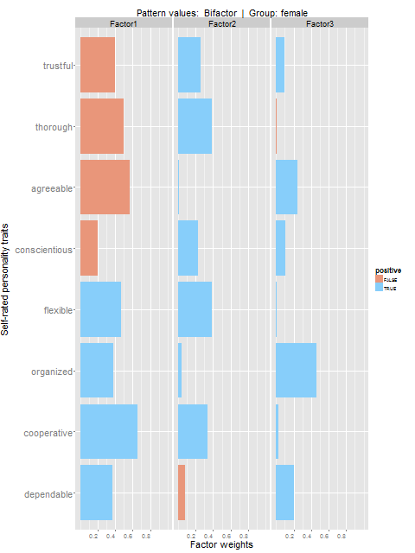
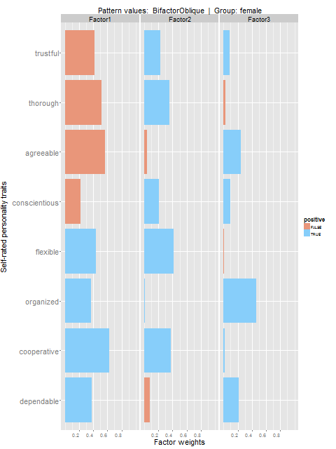
How much do you feel that ______________ describes you as a person?
Low – 1-2-3-4-5 - High
careless
quarrelsome
Females
stubborn
difficult
Unrotated
Varimax
Promax
Quartimin
Bifactor
BifactorOblique

Slide 4
How much do you feel that ______________ describes you as a person?
Low – 1-2-3-4-5 - High
careless
quarrelsome
All
stubborn
difficult
Unrotated
Varimax
Promax
Quartimin
Bifactor
BifactorOblique

Slide 5
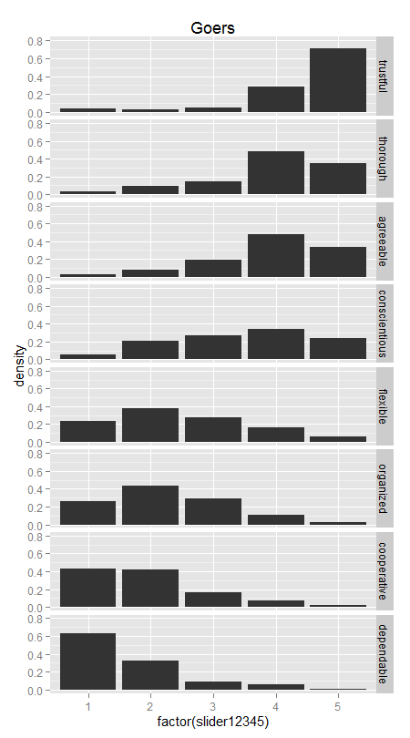
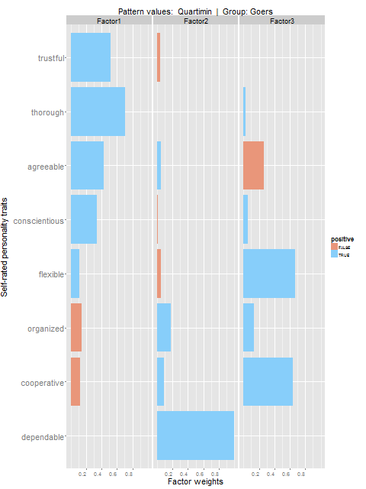
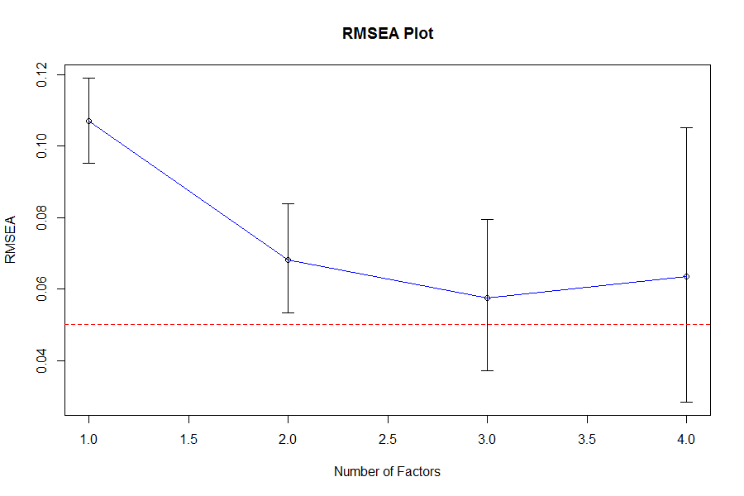
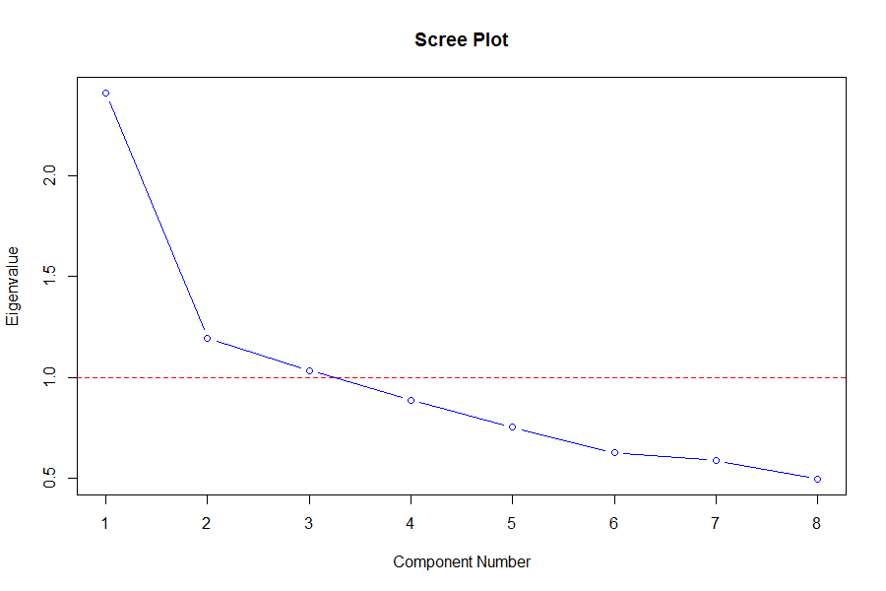
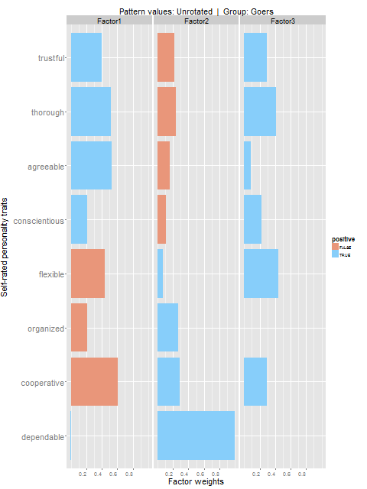
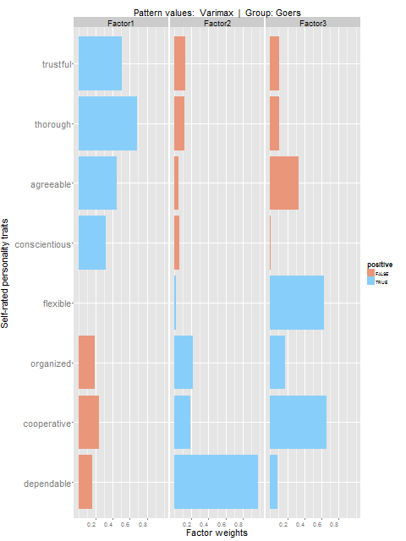
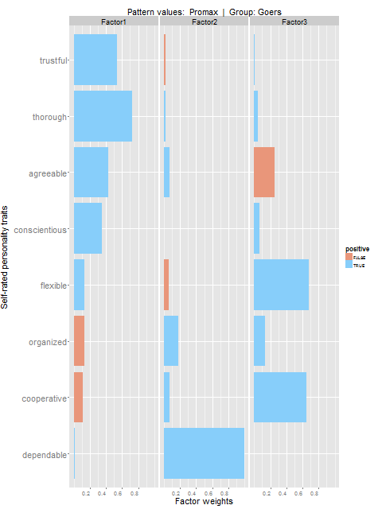
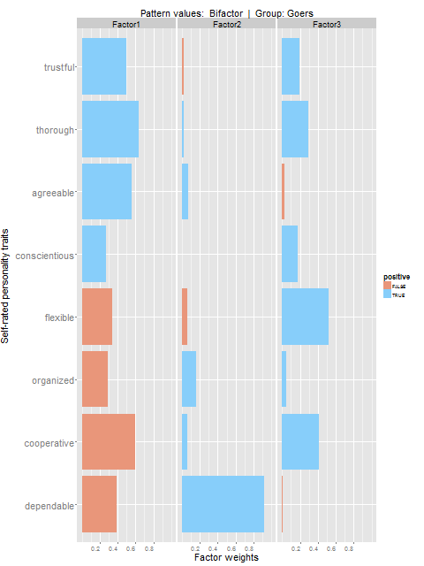
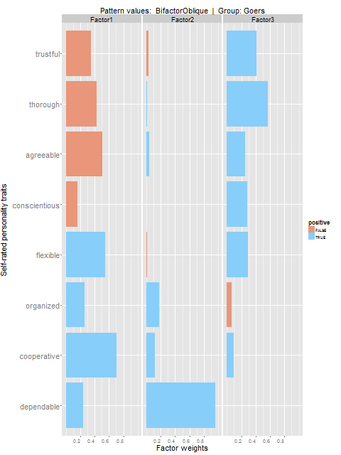
How much do you feel that ______________ describes you as a person?
Low – 1-2-3-4-5 - High
careless
quarrelsome
Goers
stubborn
difficult
Unrotated
Varimax
Promax
Quartimin
Bifactor
BifactorOblique

Slide 6
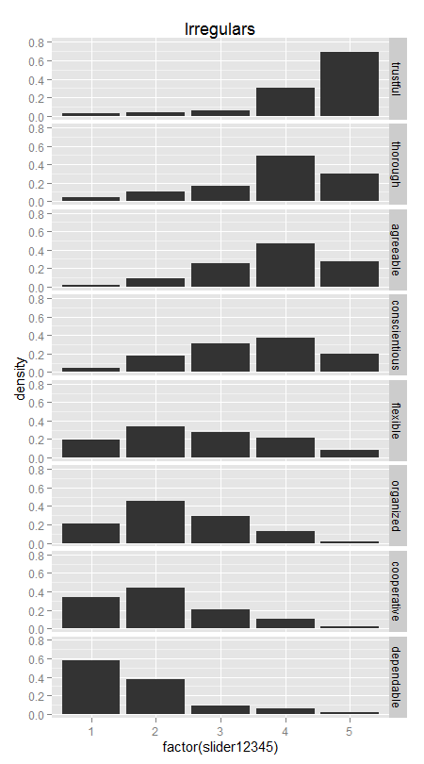
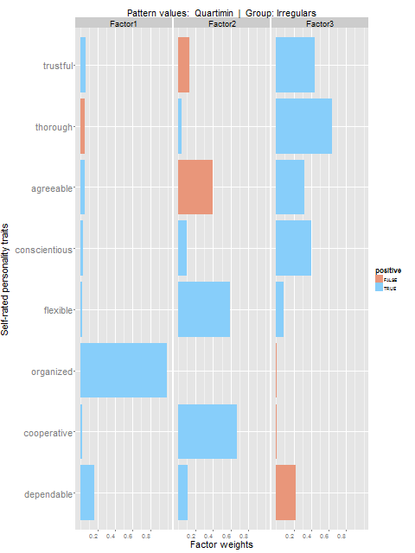
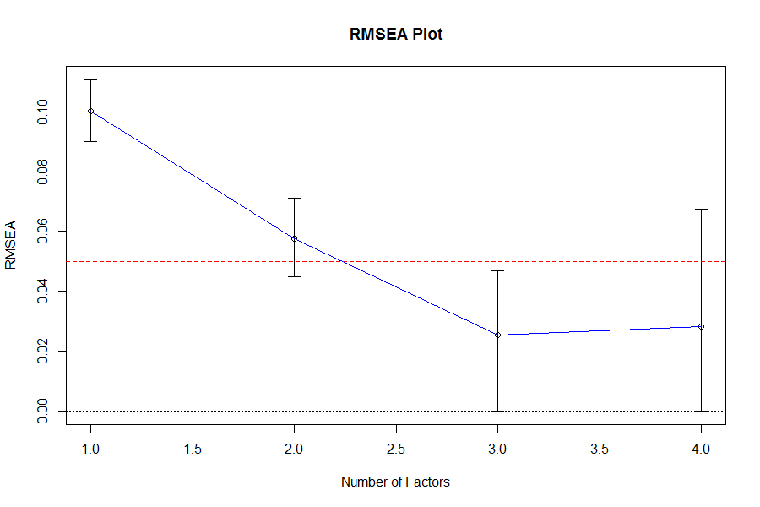
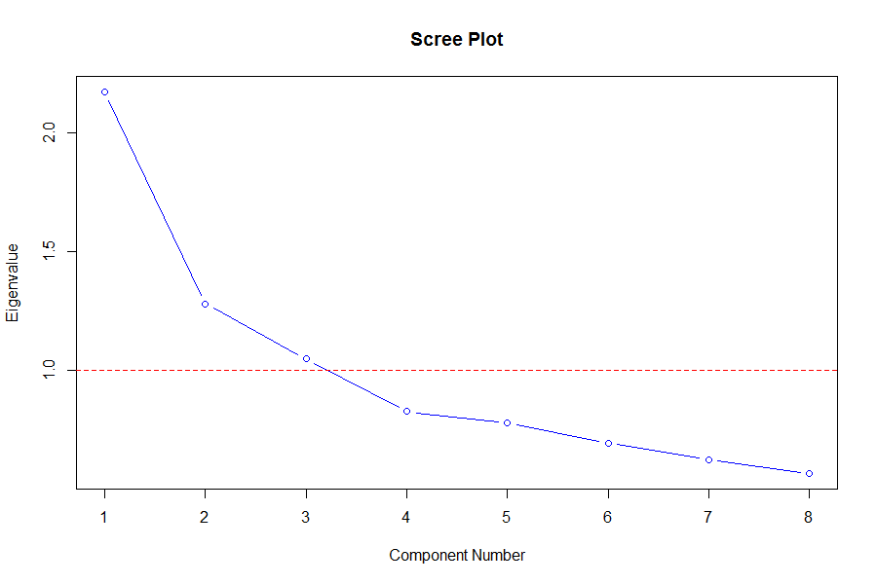
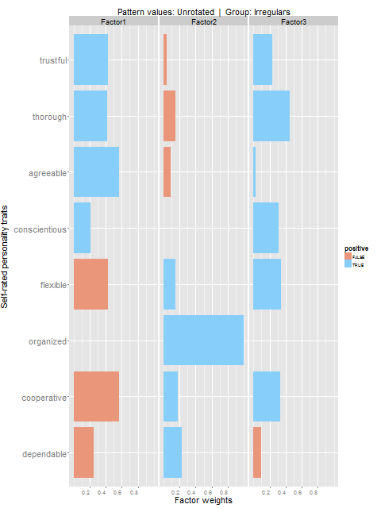
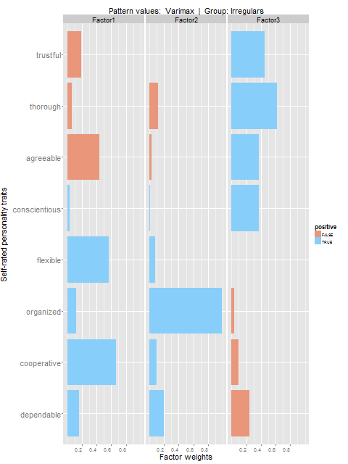
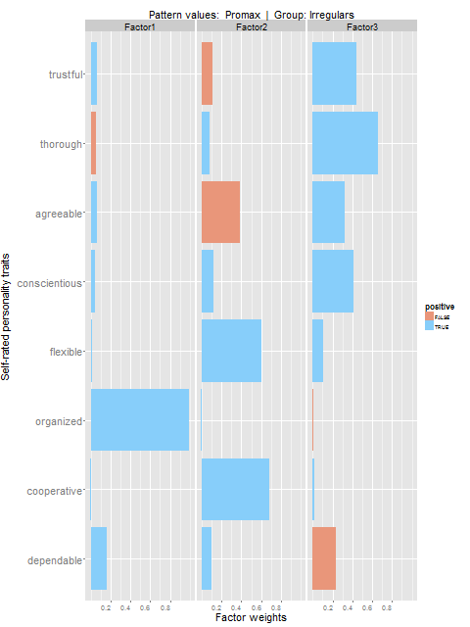
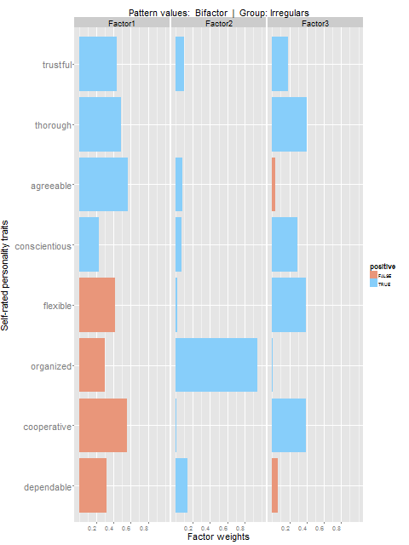
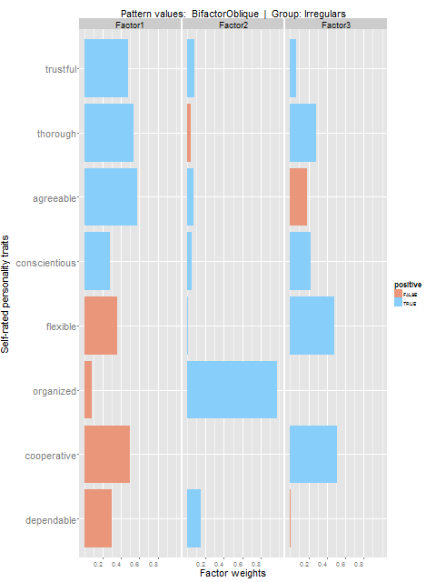
How much do you feel that ______________ describes you as a person?
Low – 1-2-3-4-5 - High
careless
quarrelsome
Irregulars
stubborn
difficult
Unrotated
Varimax
Promax
Quartimin
Bifactor
BifactorOblique

Slide 7
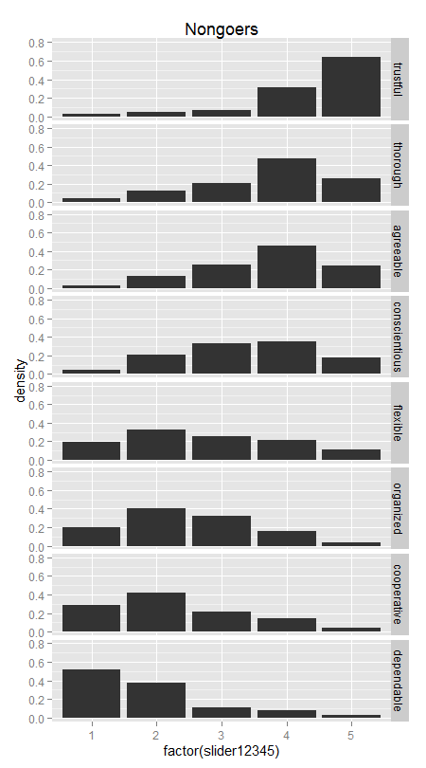
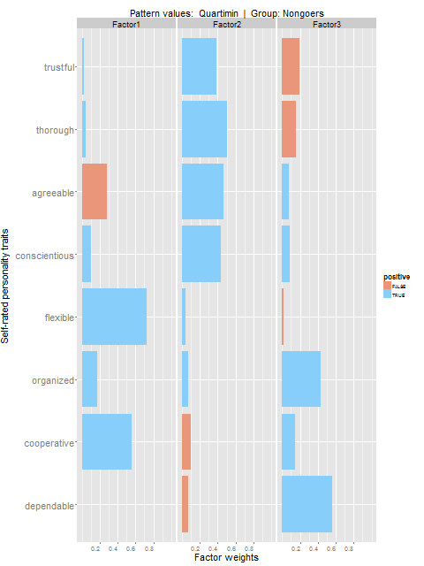
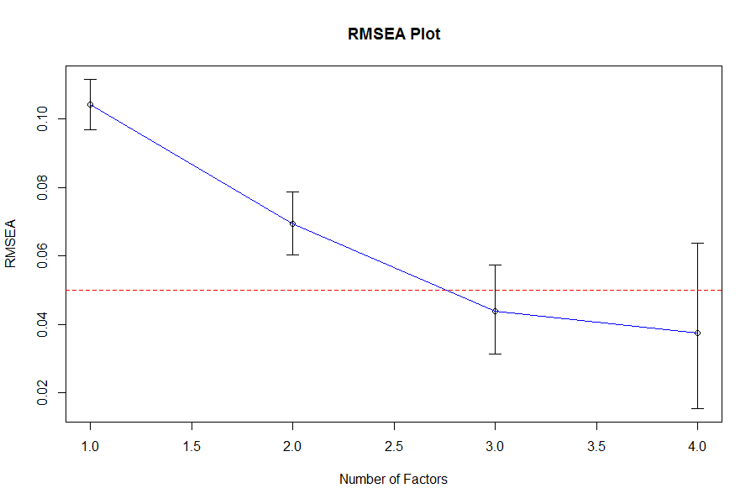

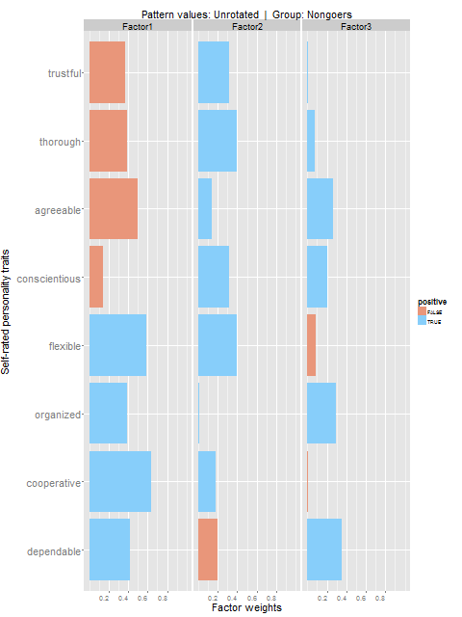
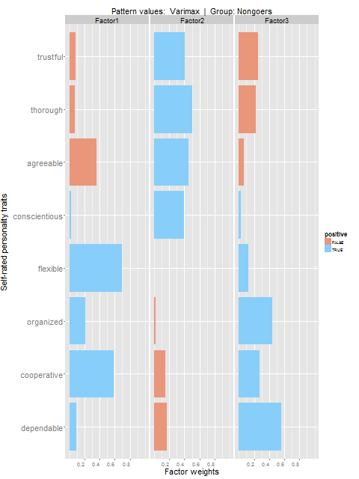
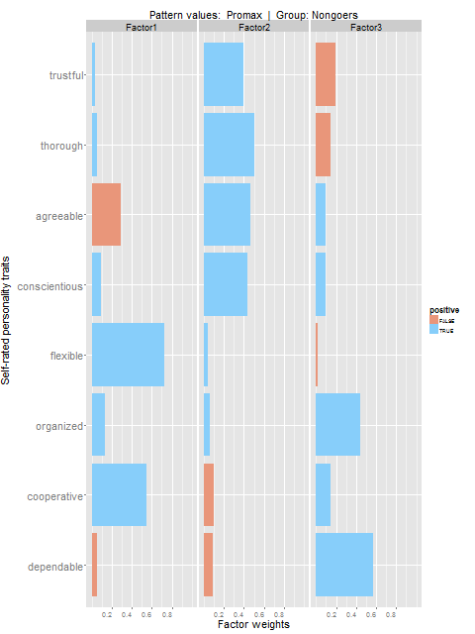


How much do you feel that ______________ describes you as a person?
Low – 1-2-3-4-5 - High
careless
quarrelsome
Nongoers
stubborn
difficult
Unrotated
Varimax
Promax
Quartimin
Bifactor
BifactorOblique

Slide 8
How much do you feel that ______________ describes you as a person?
Low – 1-2-3-4-5 - High
careless
quarrelsome
All
stubborn
difficult
Unrotated
Varimax
Promax
Quartimin
Bifactor
BifactorOblique

