Slide 1
Inside the post
8 x 5.88 inches
Main page
8 x 4.51 inches
Widest during scaling of the page
8 x 2.8 inches

Slide 2
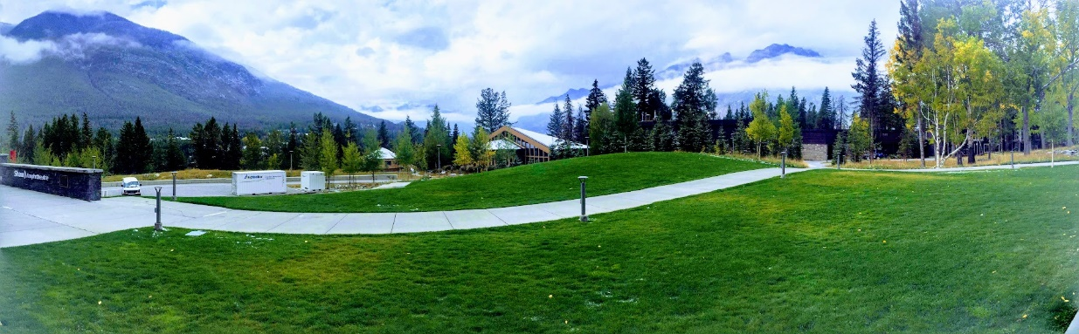
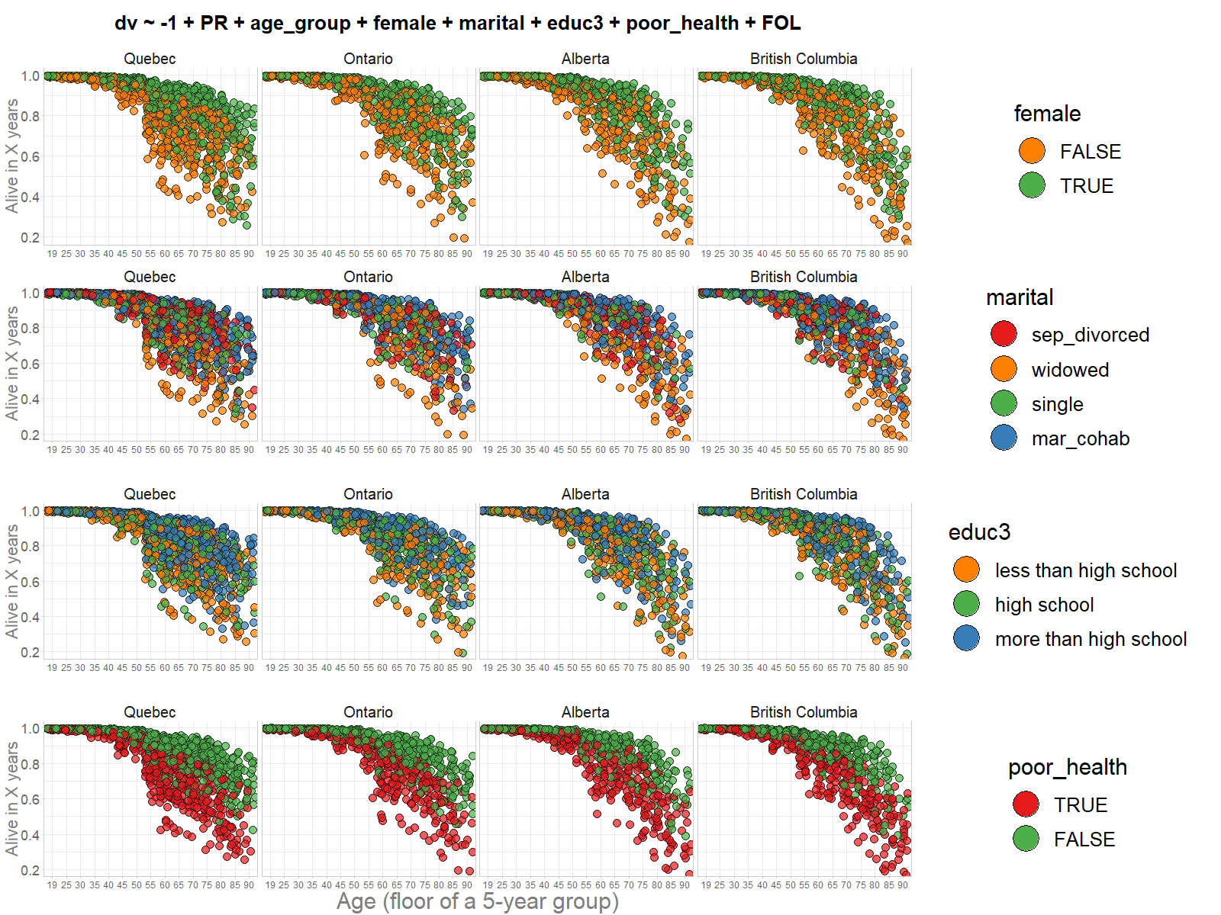
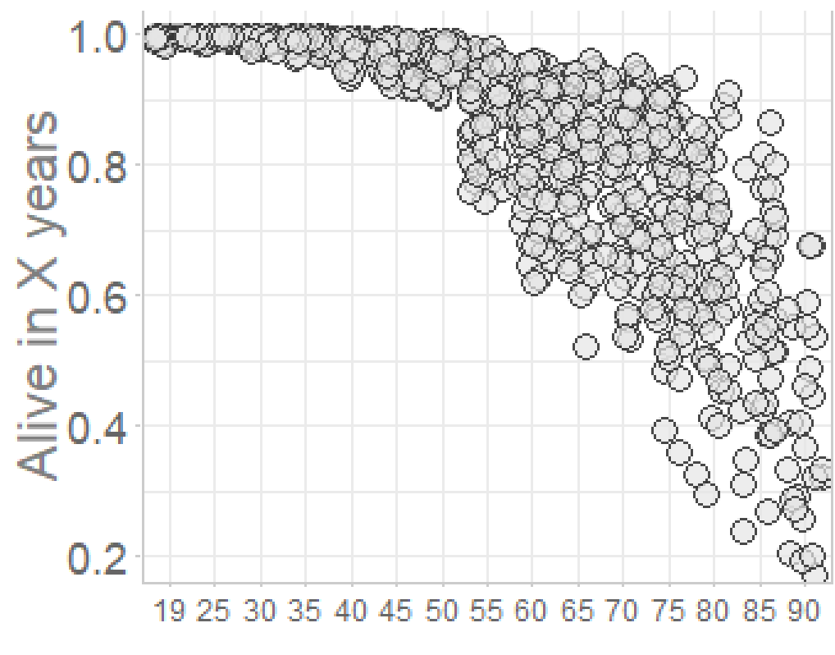
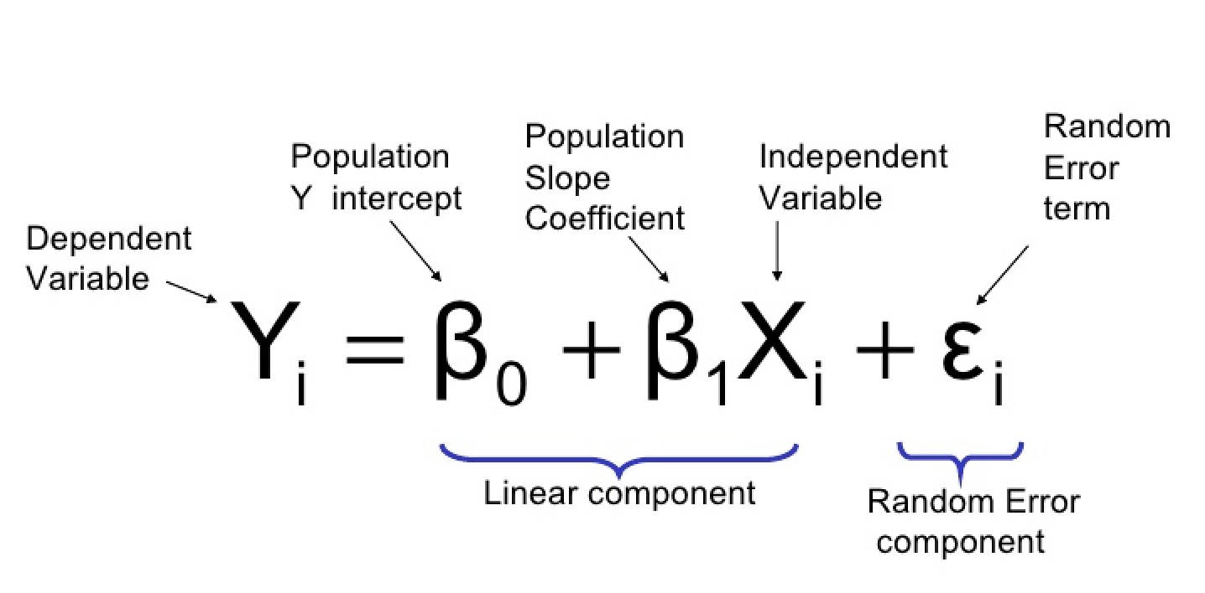


.R + .Rmd = .html
Informed expectation
Substantially increased risk
Moderately increased risk
Reference group
Moderately decreased risk
Substantially decreased risk

Slide 3

Colloquium Series
.R + .Rmd = .html
Informed expectation
Substantially increased risk
Moderately increased risk
Reference group
Moderately decreased risk
Substantially decreased risk

