Slide 1
Encounter Data of VIHA and its emerging role in MHSU surveillance
Public Heath – PACE
2018-03-15
Andriy Koval, Health System Impact Fellow
Anthony Leamon, Regional Epidemiologist, VIHA

Slide 2
Island Health Transactional Encounter Data
Focus on Mental Health and Substance Use
Acute Care + ED
Ambulatory outpatient
Inpatient Detox
Home and Community Care
Not yet
  MSP
  PharmaNet

Slide 3
TTT Cohort Definition
Anybody (in VIHA records) who
had contact with MHSU program and/or
had a contact with any acute care service (acute care admission)
  with an MHSU discharge diagnosis established
  and/or had an MSHU procedure performed
Current size: 170,054 patients
(in future): and/or MHSU CEDIS presenting problem in ED

Slide 4
Reports that describe (sub)cohorts
Cohort 0 - Transitions, Trajectories, Typologies (TTT) Research project cohort.
Cohort 1 - Patients with encounters at hand-picked programs, engaging which was judged to be a sufficient evidence to qualify a person as having a "major substance use"
Cohort 2 - Patients with encounters at hand-picked programs, engaging which was judged to be a sufficient evidence to qualify a person as having a "sever psychotic illness"
Cohort 3 - Union of Cohorts 1 and 2
Cohort 4 - Overlap of Cohorts 1 and 2
HTML reports are identical in form, but each take a subset of the Cohort 0.
Cohort 5 - An experimental report. We are trying to create a cohort on the fly, in this case focusing on Neonatal services.

Slide 5
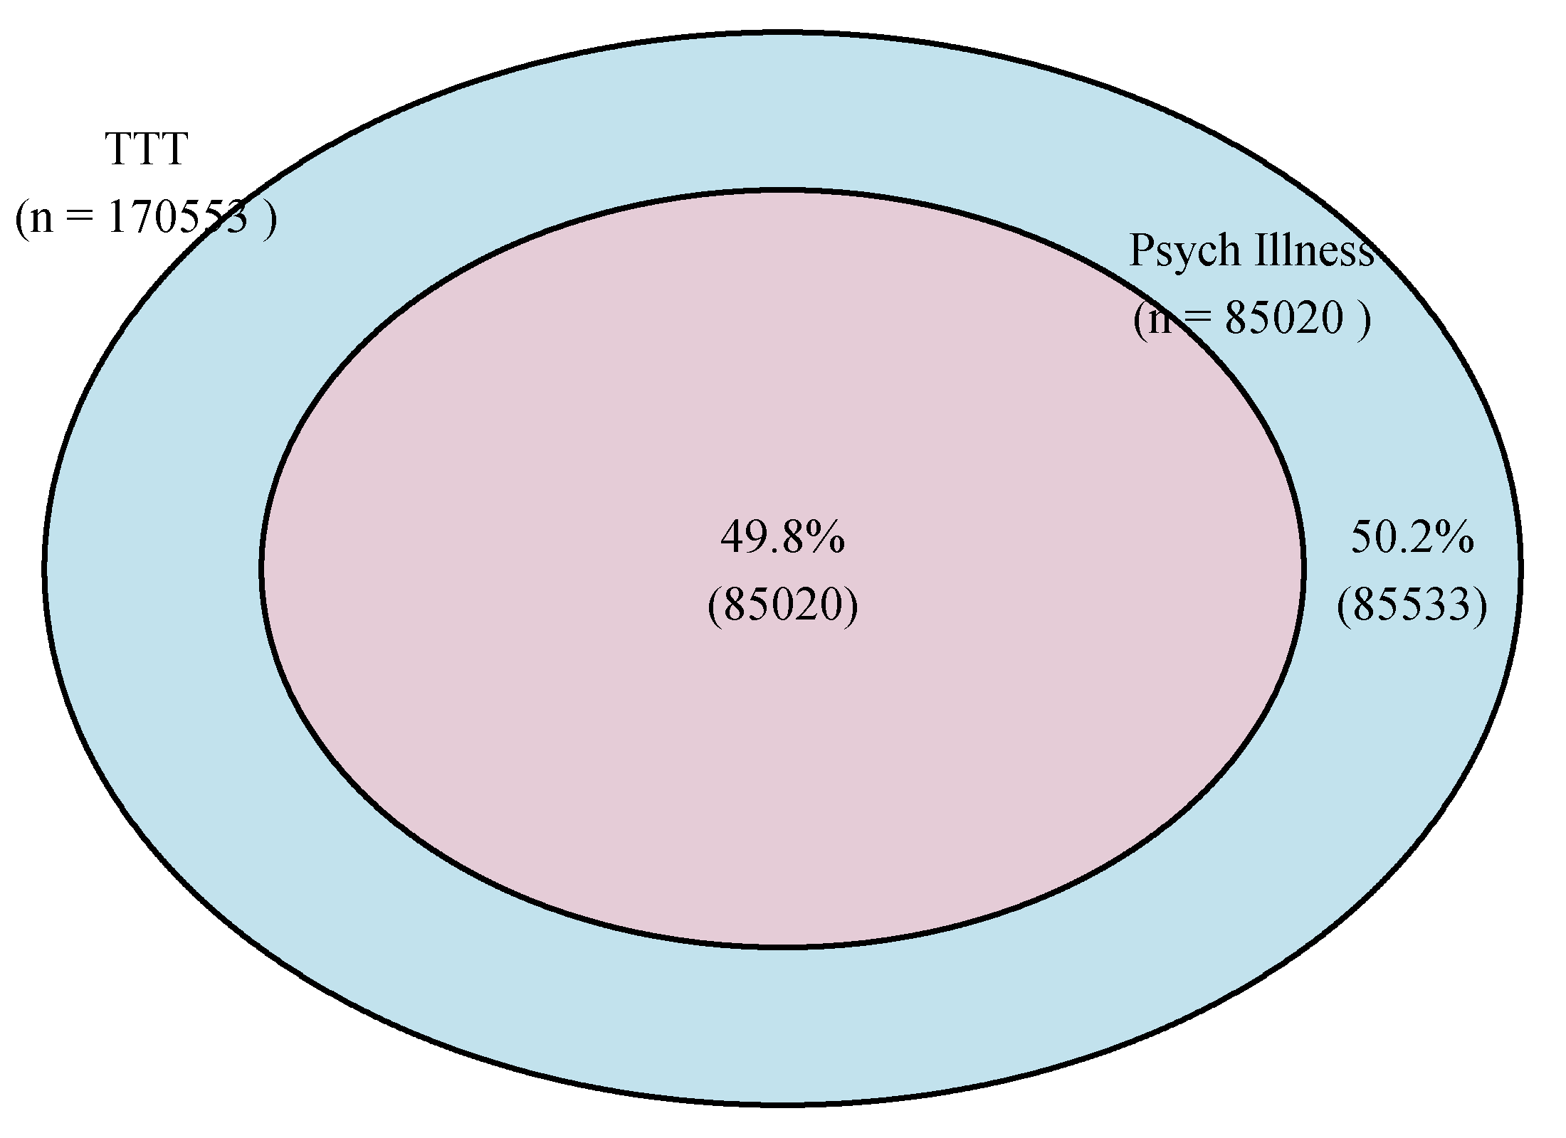
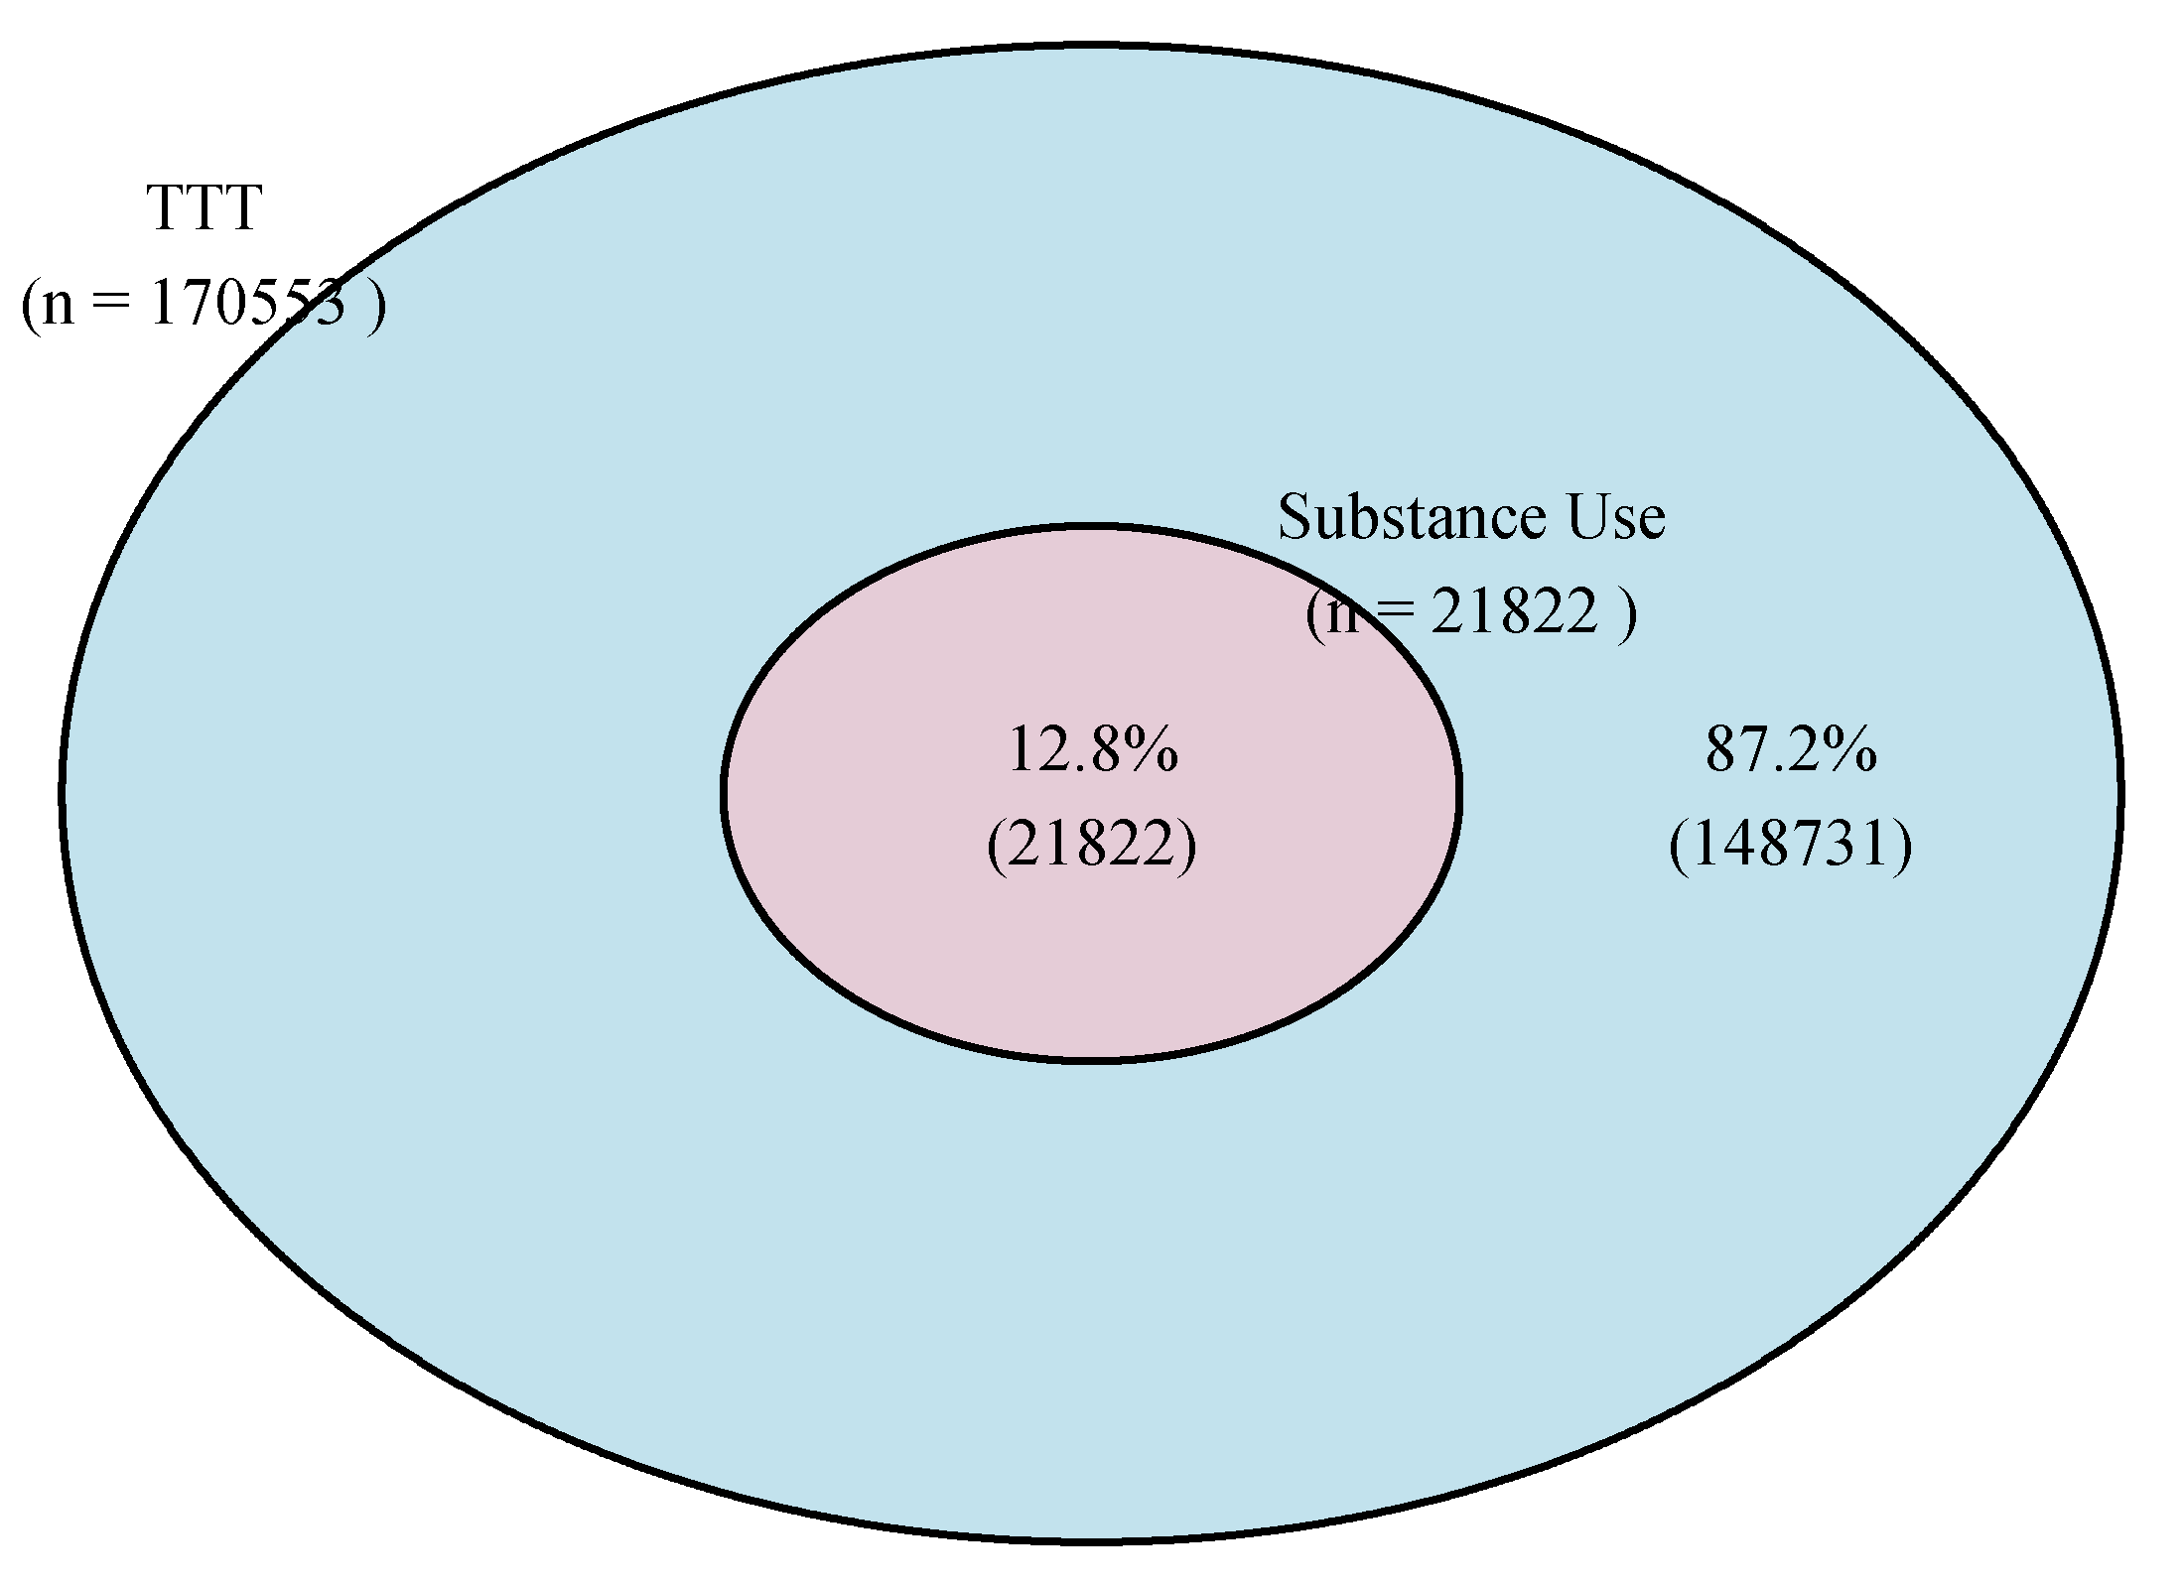
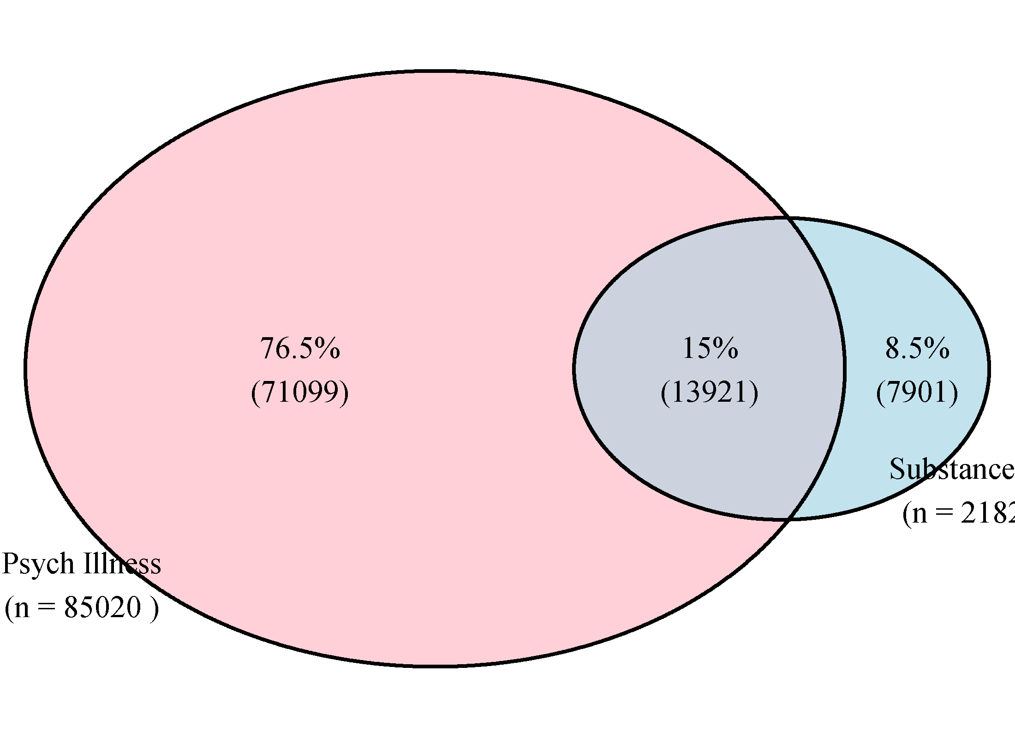
Psychotic Illness
Substance Use
TTT

Slide 6
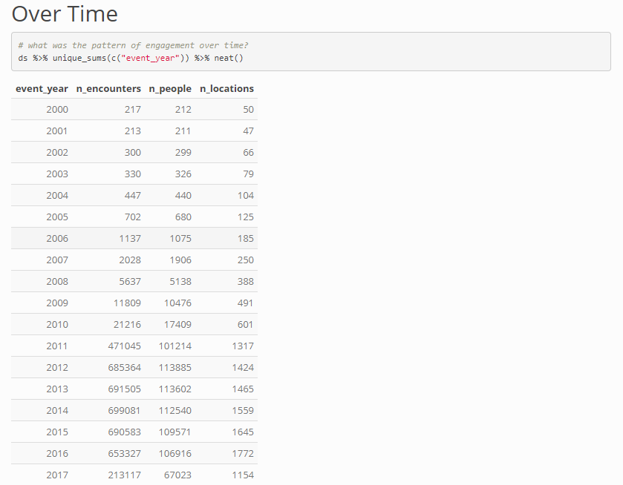
Cohort 0

Slide 7
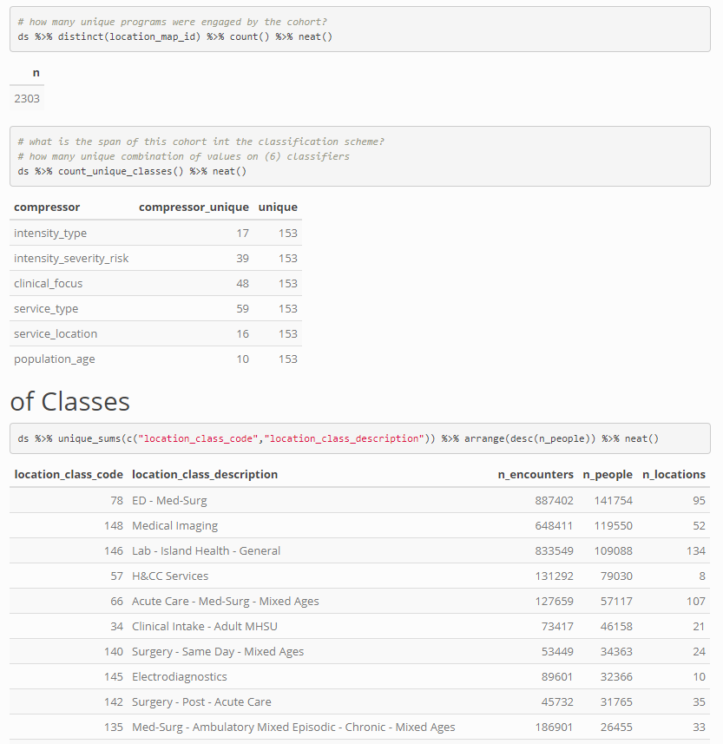
Cohort 0

Slide 8
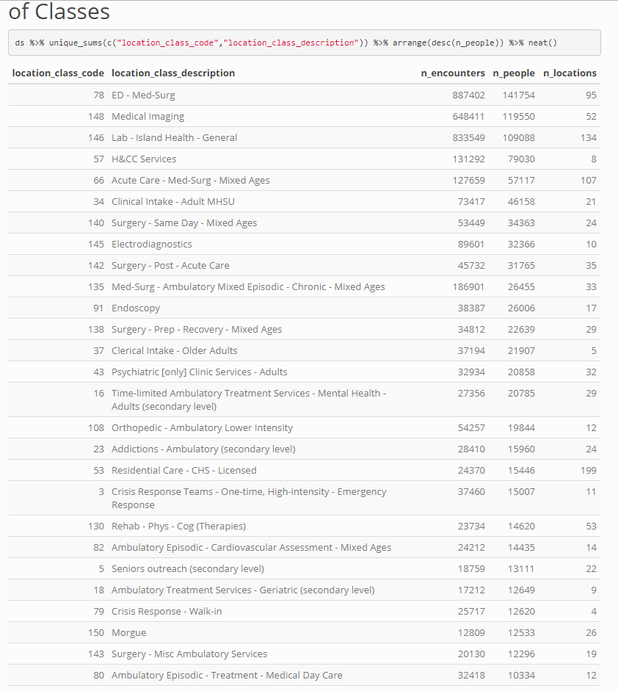
Cohort 0

Slide 9
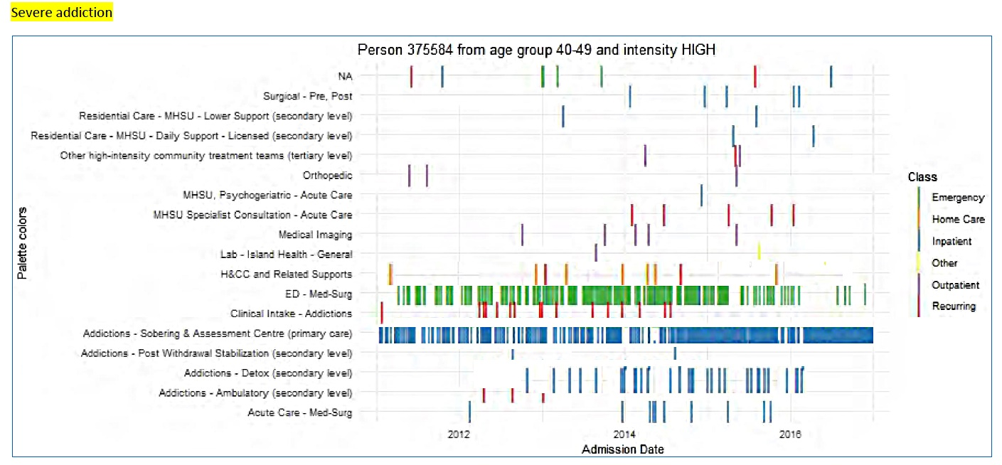
This is a fictional composite visualization based on data from several patients, cut and reassembled (Photoshop) to create an image that is representative of a single individual patient ‘journey’ through the array of secondary and tertiary services, but not actually reflecting at a row level the data of any patient.

Slide 10
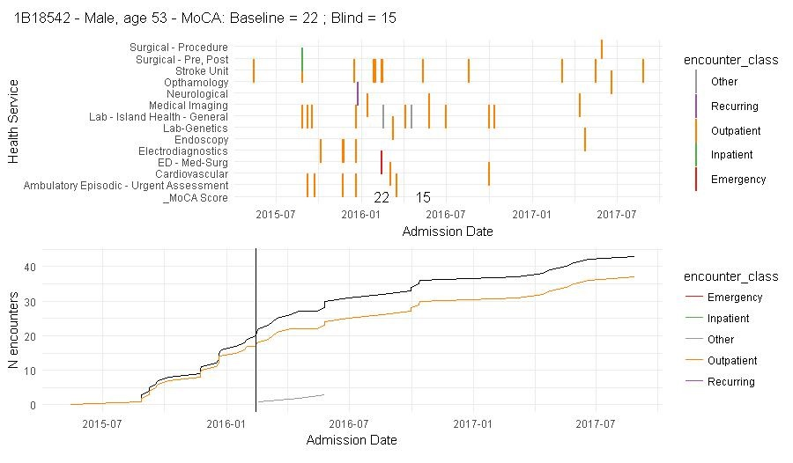
This is a 53 year old male with extensive history of ischemic events, and who scored moderately low on both MoCA time points. Patients’ slope of cumulative number of encounters with the system maintains a steady pattern of service utilization which may indicate that he retains unresolved health issues

Slide 11
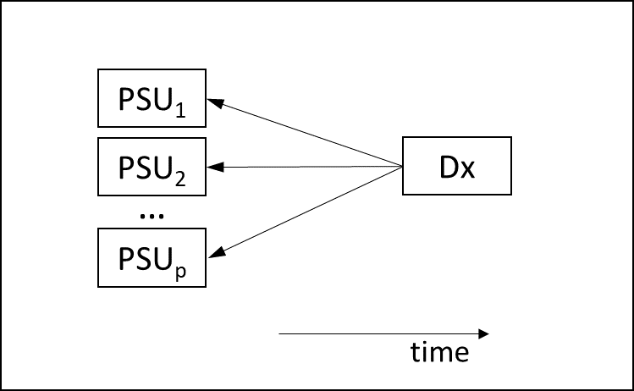
Health System Impact Fellowship: Project 1
Stratifications of Clinical Histories
Question: Do individuals with certain diagnoses/event tend to have similar patterns of service utilization?
Premise: Transactional records of secondary and tertiary health services of Island Health are linked with substance use profile from MHSU-MRR profile, emergency room, and acute care records to assemble a data frame for estimating and training statistical models for identifying patterns of service use (PSU) related to specific health outcomes.
Applied Objective: Demonstrate clinical heterogeneity of diagnostically homogeneous cohorts by describing the variability in their clinical histories.
Methodological Question: How can we stratify patients on severity of condition and burden of disease based on their clinical history?

Slide 12
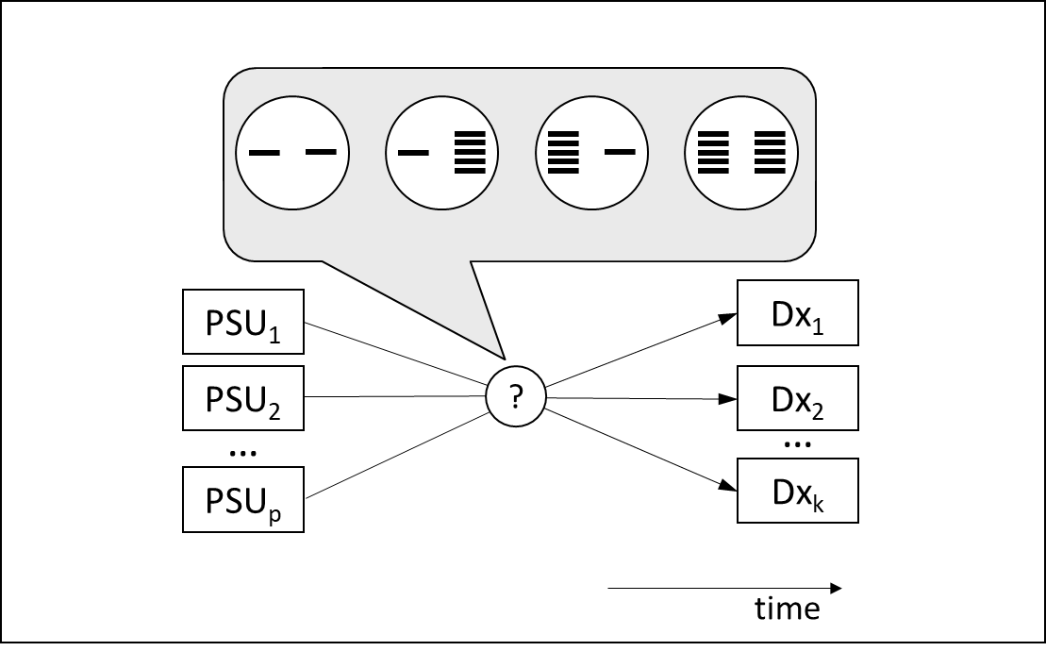
Health System Impact Fellowship: Project 2
Predictive Utility of Service Use
Question: What patterns of service utilization can help identify individuals at risk for an overdose event?
Premise: Using mathematical operationalizations of PSUs generated in Project 1 (“Stratifications of Clinical Histories”) we establish statistical relationship between exhibiting a particular PSU and subsequently experiencing an overdose event(s).
Applied Objective: Identify the features of service use that differentiate individuals who go on to experience an opioid overdose event.
Methodological Question: A conceptualized and operationalized PSU may not have a strong predictive relationship with the outcome, so how do we screen for PSU that would be useful in predicting a particular health outcome?

