Slide 1






Simulating realistic Electronic Health Records using BayesDB
Andriy V. Koval
(Vancouver Island Health Authority)
Veronica Sara Weiner
(MIT Probabilistic Computing Project)

Slide 2
VIHA - ACRU
Vancouver Island Health Authority (aka Island Health)
One of 5 regional health authorities of British Columbia, Canada
Provides health services to ~ 750,000 residents of Vancouver Island
Comprised of ~ 1,700 health service programs; ~18,000 providers & employees
Single EHR implementation dating back to 2001
Applied Clinical Research Unit
Director: Kenneth Moselle
Bridge between Enterprise Data Warehouse and research community
Develops and maintains “semantic layer” translating ~ 1,700 uninterpretable administrative entities into ~150 meaningful classes of health programs

Slide 3
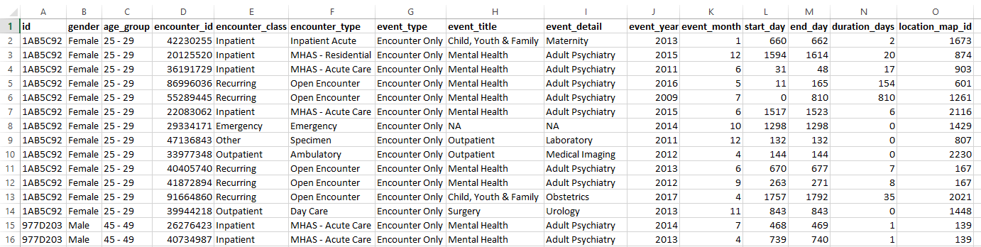
Patient Event Table
Standard data product of ACRU
Universe of records for any given cohort
Fictional data for 10 individuals (325 records total) used to train the model

Slide 4
Patient Event Table:
id
Person identifier

Slide 5
Patient Event Table:
gender, age_group
Basic demographics

Slide 6
Patient Event Table:
encounter_id
Unique identifier of an encounter with a health service program

Slide 7
Patient Event Table:
encounter_class, encounter_type
Data Warehouse tags describing the features of clinical encounter

Slide 8
Patient Event Table:
event_type, event_title, event_detail
A clinical encounter may contain a more granular detail (e.g. procedure, diagnosis, prescription)

Slide 9
Patient Event Table:
event_year, event_month
Absolute dates of the encounter

Slide 10
Patient Event Table:
start_day, end_day
Relative dates of the encounter

Slide 11
Patient Event Table:
duration_days
Length of the clinical event

Slide 12
Patient Event Table:
location_map_id
Foreign key to the external table with descriptive labels of the service programs (“semantic layer”)

Slide 13
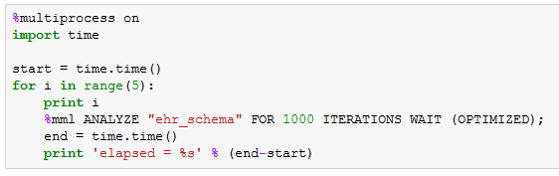
Runtime and CrossCat model
Using fictional data of 10 persons (325 records total) we train the model using BayesDB
View full report

Slide 14
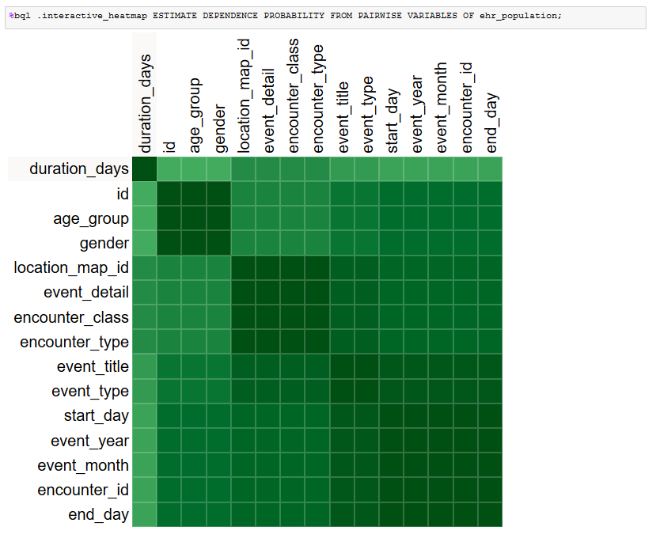
Dependency heat map
Picks up a person cluster
Picks up an encounter cluster

Slide 15
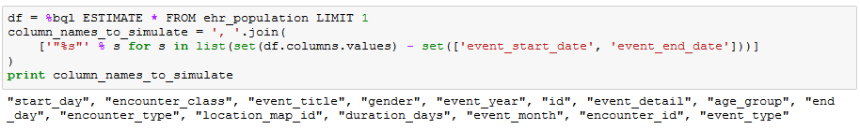
Simulating realistic EHR
All code that is needed to carry out the simulation:
Compare the raw fictional data to the simulated one

Slide 16
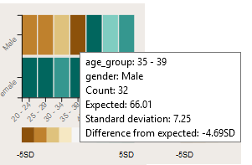
Viewing deviations from expected
Excellent reconstruction of univariate distributions
Acceptable reconstruction of second order relationships

Slide 17
Deviation from expected

Slide 18
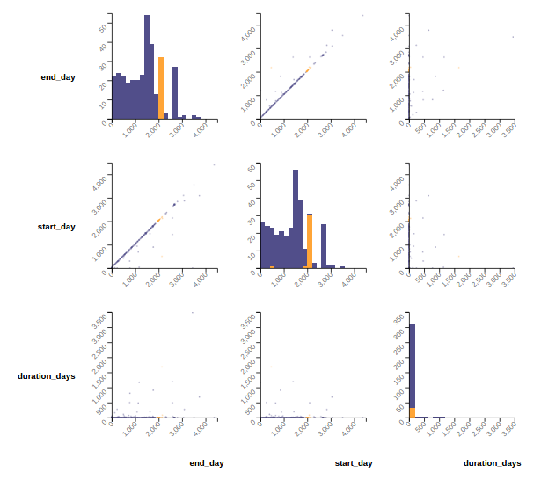
When selecting data from the original data set, it is clear that for the vast majority of records, start day = end day

Slide 19
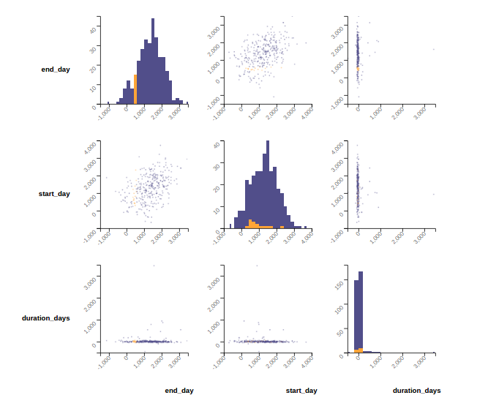
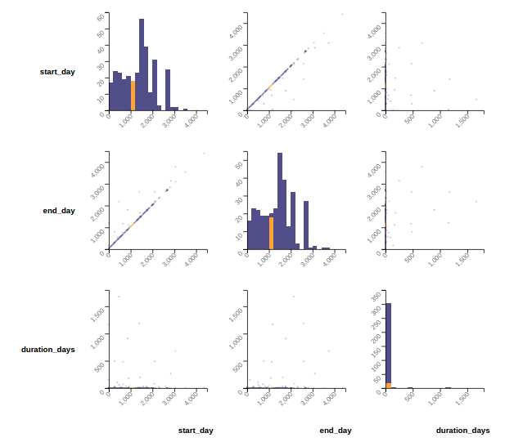
CrossCat learns an approximate of this relationship between start date and end date.
Records with this start date
OBSERVED
SIMULATED
have these values of end date

Slide 20
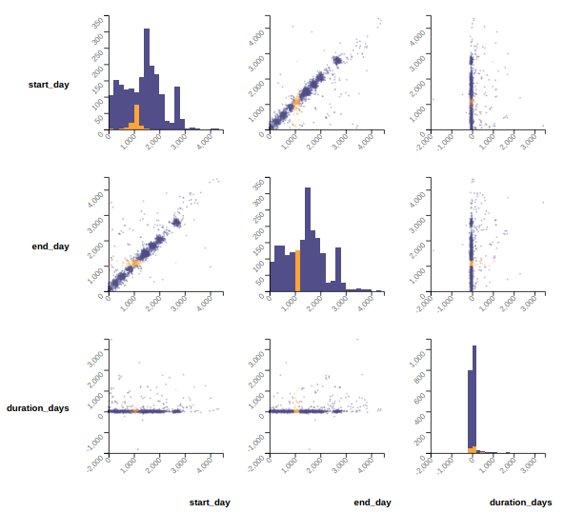
With more iterations, the quality of CrossCat’s model of probability densities and complex joint probability distributions gets better and better, including this relationship between start date and end date.
This simulation is after 5500 iterations of analysis on a separate population of just these three variables).

Slide 21
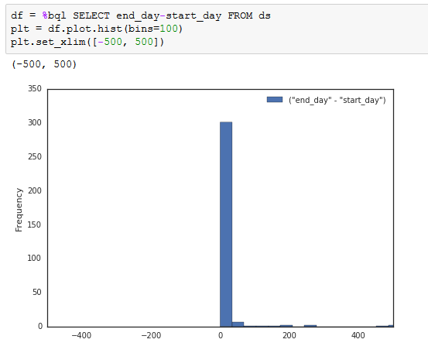
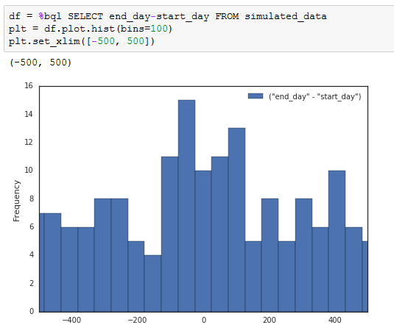
Captures duration_days when simulated directly
Second order relationship preserved (in probability)
Computed after simulation

Slide 22
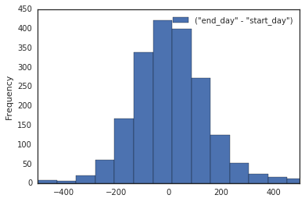
Same result after 5500 CrossCat iterations of just these three variables (improved)
Computed after simulation

Slide 23
Conclusions
Simulation of realistic EHR with BayesDB is possible
Appears to preserve observed frequency distributions
First order (univariate) = very well
Second order (bivariate) = OK
After learning, simulation is easy = 1 line of code
BayesDB is ideally suited to mimic realistic features of clinical data

Slide 24
Next Steps
Force certain variable relationships to take specific functional forms
E.g. single patient ID can only have one gender and one age group
Requires Venture
Longer running time may enhance accuracy of reconstructed features
→ Tradeoff may be made precise with a runtime-accuracy analysis
Ready to be applied against the real data in VIHA’s environment
Can be installed on multi-core machine (e.g. AWS, Azure) for speed

Slide 25
Simulating realistic Electronic Health Records using BayesDB
Andriy V. Koval
(Vancouver Island Health Authority)
Veronica Sara Weiner
(MIT Probabilistic Computing Project)

Slide 26
Reconstructs temporal information well

