Slide 1
Inside the post
8 x 5.88 inches
Main page
8 x 4.51 inches
Widest during scaling of the page
8 x 2.8 inches

Slide 2
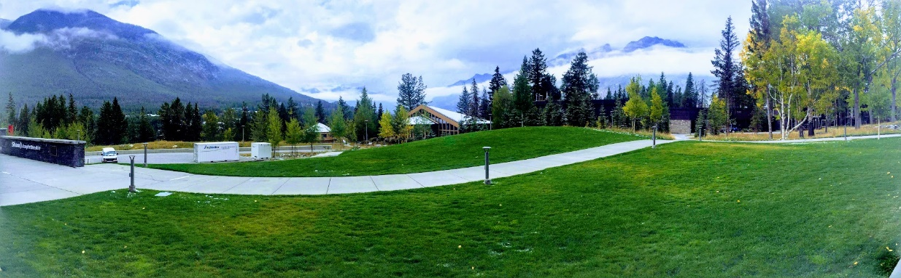
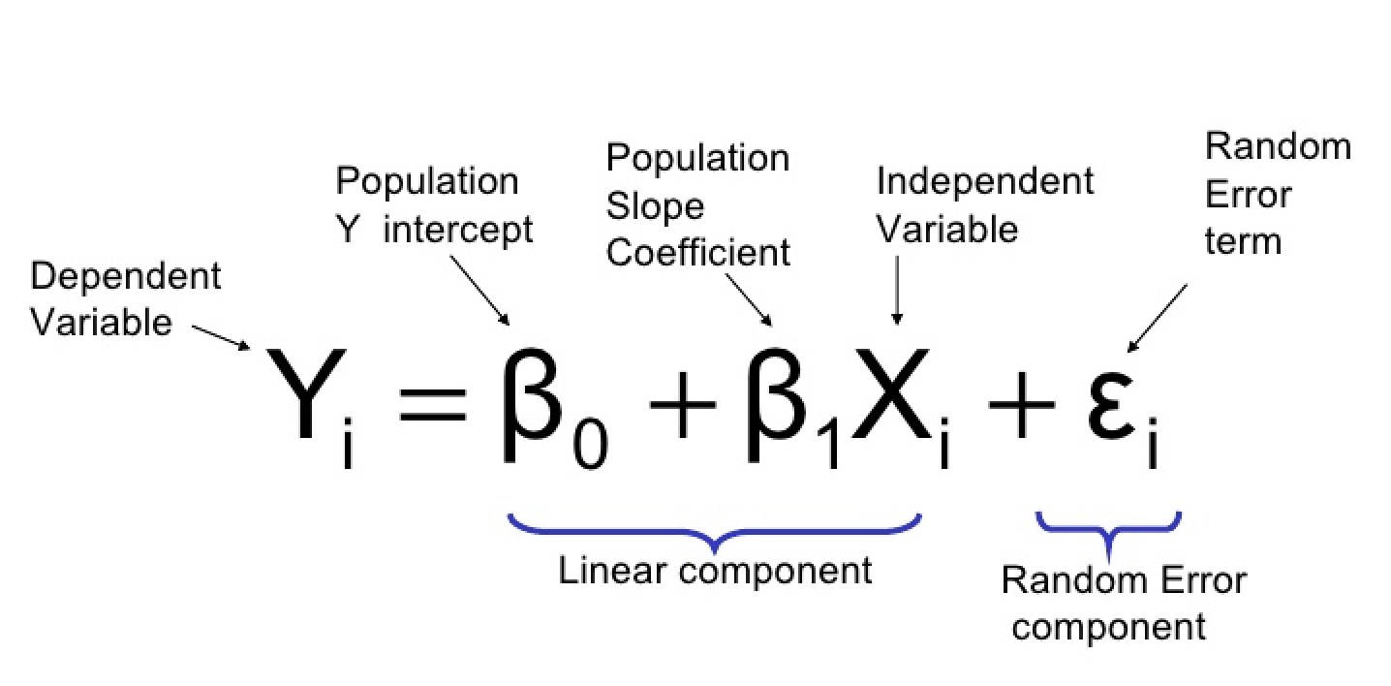
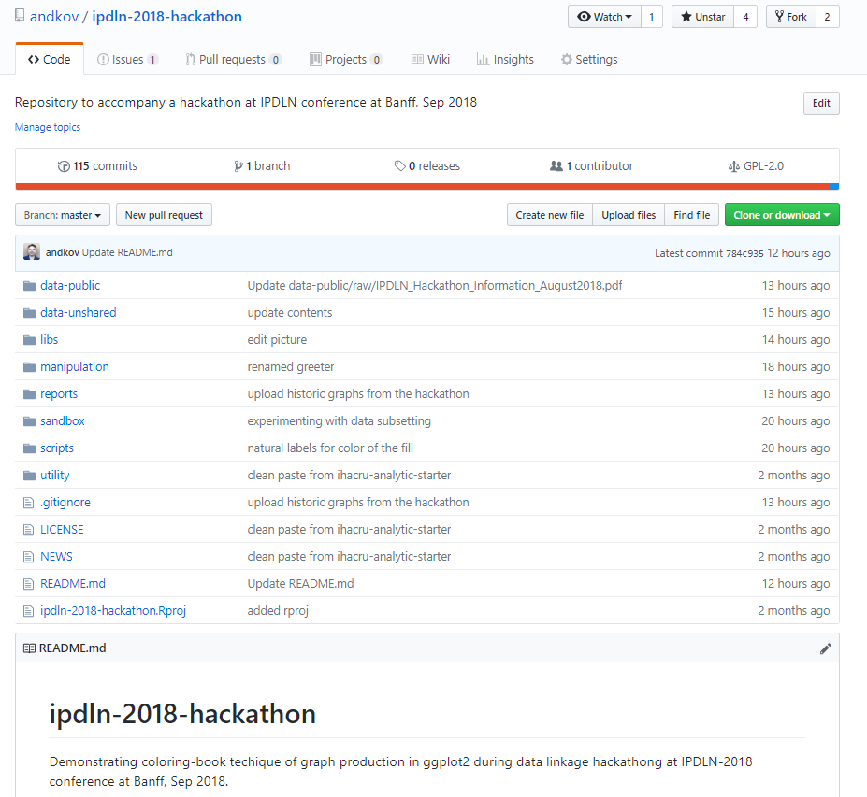

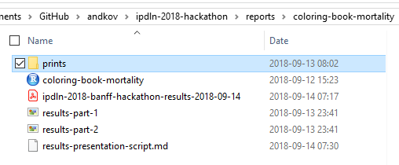

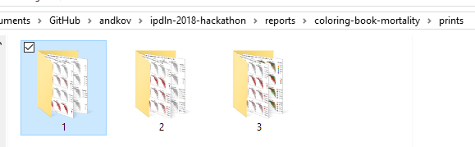
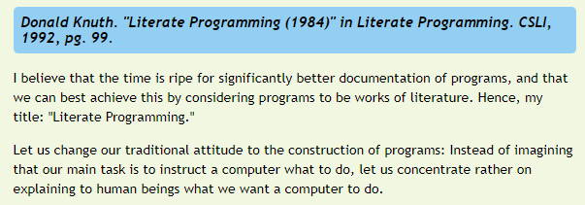
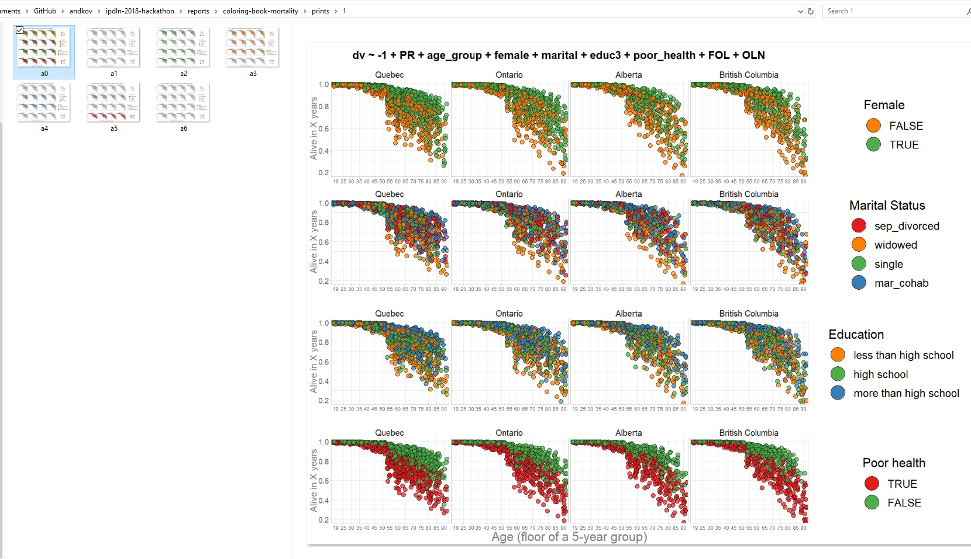
more
ENGINEERING
more
SCIENCE
Statistical Methods
Software Development
Data science

Slide 3
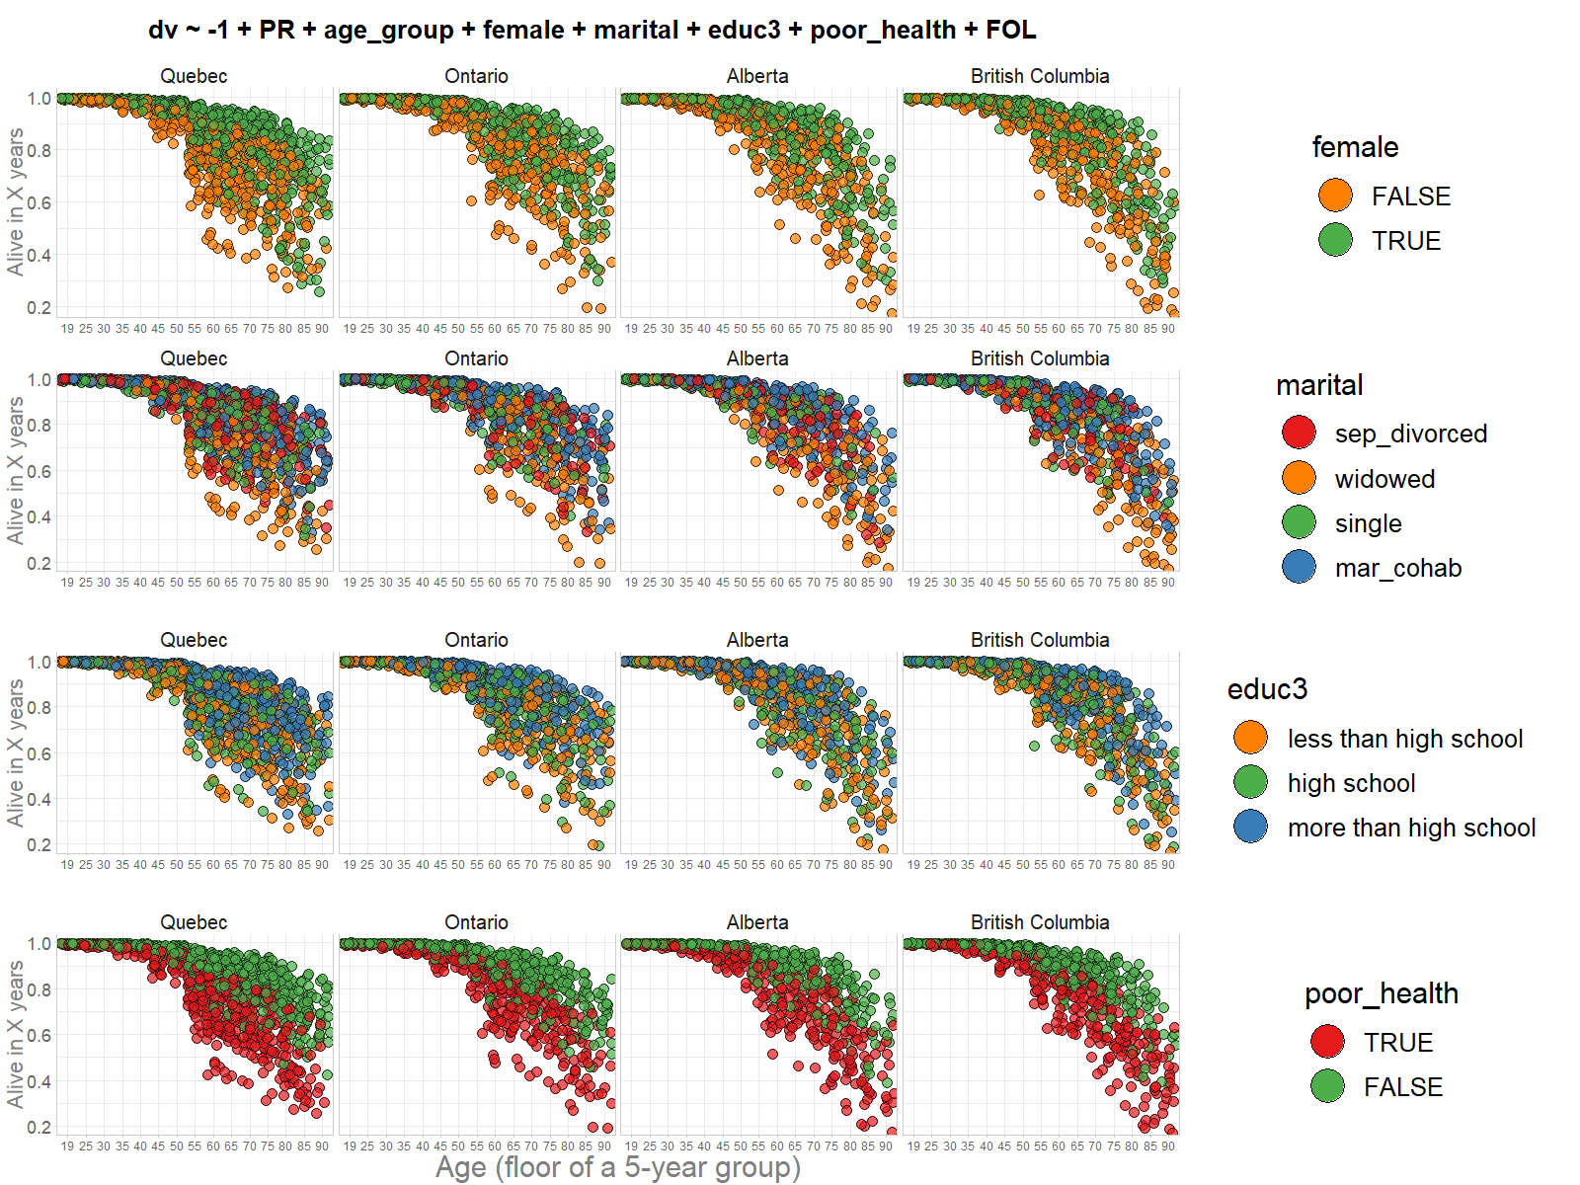
Informed expectation
Substantially increased risk
Moderately increased risk
Reference group
Moderately decreased risk
Substantially decreased risk

