Slide 1
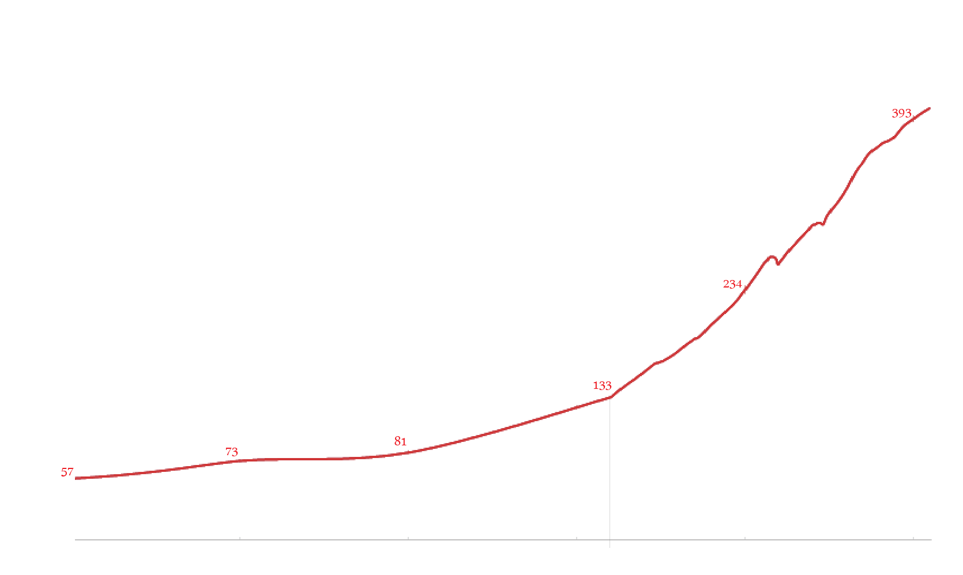

Walter Charleton
Emergence of Social Sciences
Robert Boyle
William Harvey
Francis Bacon
John Locke
political economy
William Petty
sociological
James Hutton
James Harrington
psychological
David Hume
Thomas Hobbes
Adam Smith
Isaac Newton
Henry VIII
Elizabeth I
James I
Charles I
OC
Charles II
W & M
G I
George II
George III
G IV
Queen Victoria Reign
Henry IV
Louis XIII
Louis XIV
Louis XV
Louis XVI
1 Rep
NB
18
10
Louis-Philippe I
2
N 3
Richelieu
Mazarin
absolutism, Sun King
Jean-Baptiste Colbert
Jean-Jacques Rousseau
mercantilism
Joachim Becher
Joseph Lagrange
cameralism
Voltaire
Rene Descartes
Blasé Pascal
Charles-Louis Montesquieu
August Comte
Galileo Galilei
Gottfried Leibniz
Immanuel Kant
Benedictus Spinoza
Denis Diderot
Christian Huygens
20
years
Georg Hegel
Population of Wester Europe, millions
Lavoisier
British
French
Lomonosov
American
Pierre Gassendi
Linnaeus
Other
Saint-Simon
Renaissance
Scientific Revolution
Romanticism
Positivism
Enlightenment
Emergence of Social Sciences

Slide 2
Of Graphs and Models
Johannes Kepler
Frederick Mosteller
Nicola Copernicus
Tyco Brahe
Christian Huygens
John Tukey
Galileo Galilei
Pierre-Simon Laplace
Raymond Cattell
Gottfried Leibniz
Joseph Lagrange
Edward Thorndike
Michael Florent van Langren
L.L. Turnstone
Isaac Newton
Carl Friedric Gauss
Charles Spearman
Rene Descartes
Lambert Quetelet
Blasé Pascal
Voltaire
André-Michel Guerry
Jerzy Neyman
Pierre Gassendi
Egon Pearson
20
years
John Graunt
Philippe Buache
Charles Joseph Minard
cameralism
Ronald Fisher
British
Joachim Becher
Joseph Lagrange
George E.P. Box
French
political economy
Adam Smith
Karl Pearson
American
William Petty
Francis Galton
Other
sociological
Joseph Kruskal
James Harrington
John Stewart Mill
George Snedecor
psychological
Joseph Priestley
Henry Scheffe
Thomas Hobbes
Edmond Halley
Florence Nightingale
William Playfair
Paul Meehl
Jean-Baptiste Colbert
John Snow
Thomas Kuhn
David Hume
August Comte
Karl Popper
Henry VIII
Elizabeth I
James I
Charles I
OC
Charles II
W & M
G I
George II
George III
G IV
Queen Victoria
Population of Wester Europe, millions
Henry IV
Louis XIII
Louis XIV
Louis XV
Louis XVI
1 Rep
NB
18
10
Louis-Philippe I
2
N 3
Richelieu
Mazarin
Renaissance
Scientific Revolution
Romanticism
Positivism
Enlightenment
Emergence of Social Sciences

Slide 3
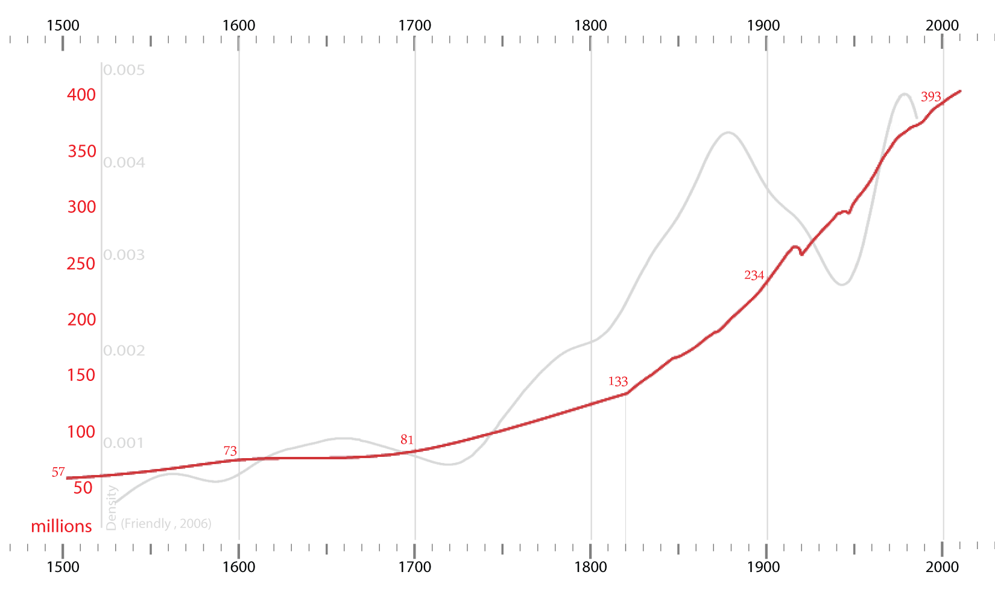
1500
1600
1700
1800
1900
2000
1500
1600
1700
1800
1900
2000

Slide 4
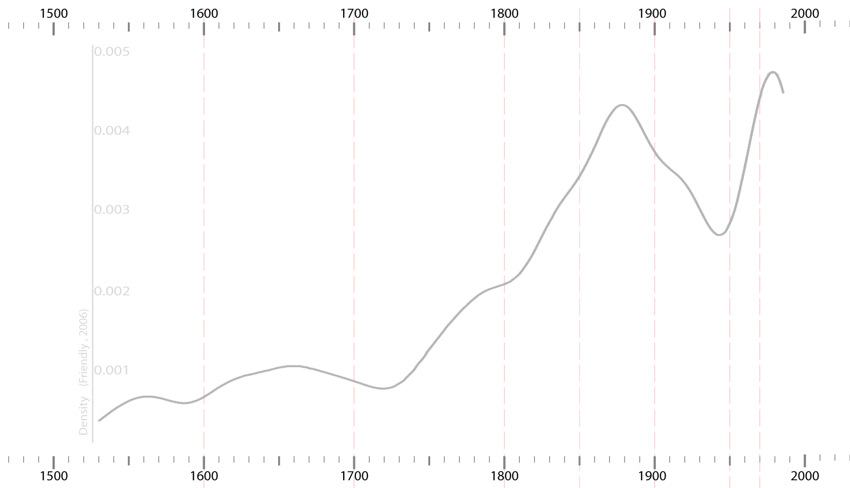
1500
1600
1700
1800
1900
2000
1500
1600
1700
1800
1900
2000

Slide 5
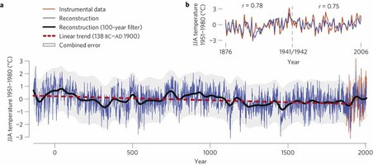

Slide 6
Nicollo Machiavelli
Martin Luther

