Slide 1
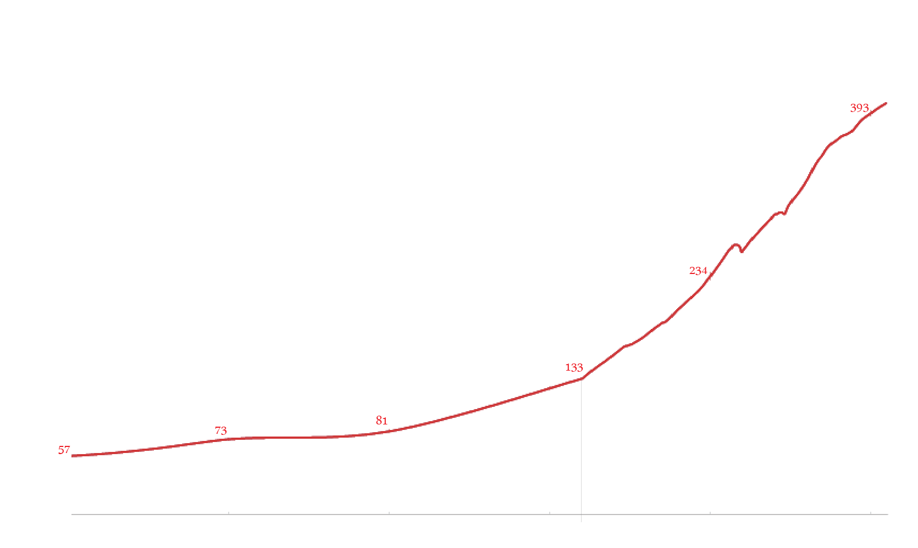

Walter Charleton
Emergence of Social Sciences
Robert Boyle
William Harvey
Francis Bacon
John Locke
political economy
William Petty
sociological
James Hutton
James Harrington
psychological
David Hume
Thomas Hobbes
Adam Smith
Isaac Newton
Henry VIII
Elizabeth I
James I
Charles I
OC
Charles II
W & M
G I
George II
George III
G IV
Queen Victoria Reign
Henry IV
Louis XIII
Louis XIV
Louis XV
Louis XVI
1 Rep
NB
18
10
Louis-Philippe I
2
N 3
Richelieu
Mazarin
absolutism, Sun King
Jean-Baptiste Colbert
Jean-Jacques Rousseau
mercantilism
Joachim Becher
Joseph Lagrange
cameralism
Voltaire
Rene Descartes
Blasé Pascal
Charles-Louis Montesquieu
August Comte
Galileo Galilei
Gottfried Leibniz
Immanuel Kant
Benedictus Spinoza
Denis Diderot
Christian Huygens
Georg Hegel
20
years
Lavoisier
Lomonosov
British
Pierre Gassendi
Linnaeus
French
Saint-Simon
American
Other
Renaissance
Scientific Revolution
Romanticism
Positivism
Enlightenment
Emergence of Social Sciences

Slide 2
Of Graphs and Models
Johannes Kepler
Nicola Copernicus
Tyco Brahe
Christian Huygens
Galileo Galilei
Gottfried Leibniz
Pierre-Simon Laplace
Michael Florent van Langren
Joseph Lagrange
Isaac Newton
Carl Friedric Gauss
Rene Descartes
Blasé Pascal
Lambert Quetelet
Pierre Gassendi
André-Michel Guerry
Voltaire
John Graunt
Philippe Buache
cameralism
Charles Joseph Minard
L.L. Turnstone
Joachim Becher
William Playfair
Charles Spearman
political economy
Raymond Cattell
William Petty
sociological
Florence Nightingale
Joseph Kruskal
James Harrington
David Hume
Henry Scheffe
psychological
Joseph Priestley
John Stewart Mill
George Snedecor
Thomas Hobbes
Francis Galton
Edmond Halley
Karl Pearson
Ronald Fisher
Jean-Baptiste Colbert
Adam Smith
John Snow
John Tukey
Elizabeth I
James I
Charles I
OC
Charles II
W & M
G I
George II
George III
G IV
Queen Victoria
Frederick Mosteller
Henry VIII
Henry IV
Louis XIII
Louis XIV
Louis XV
Louis XVI
1 Rep
NB
18
10
Louis-Philippe I
2
N 3
Richelieu
Mazarin
Renaissance
Scientific Revolution
Romanticism
Positivism
Enlightenment
Emergence of Social Sciences

Slide 3
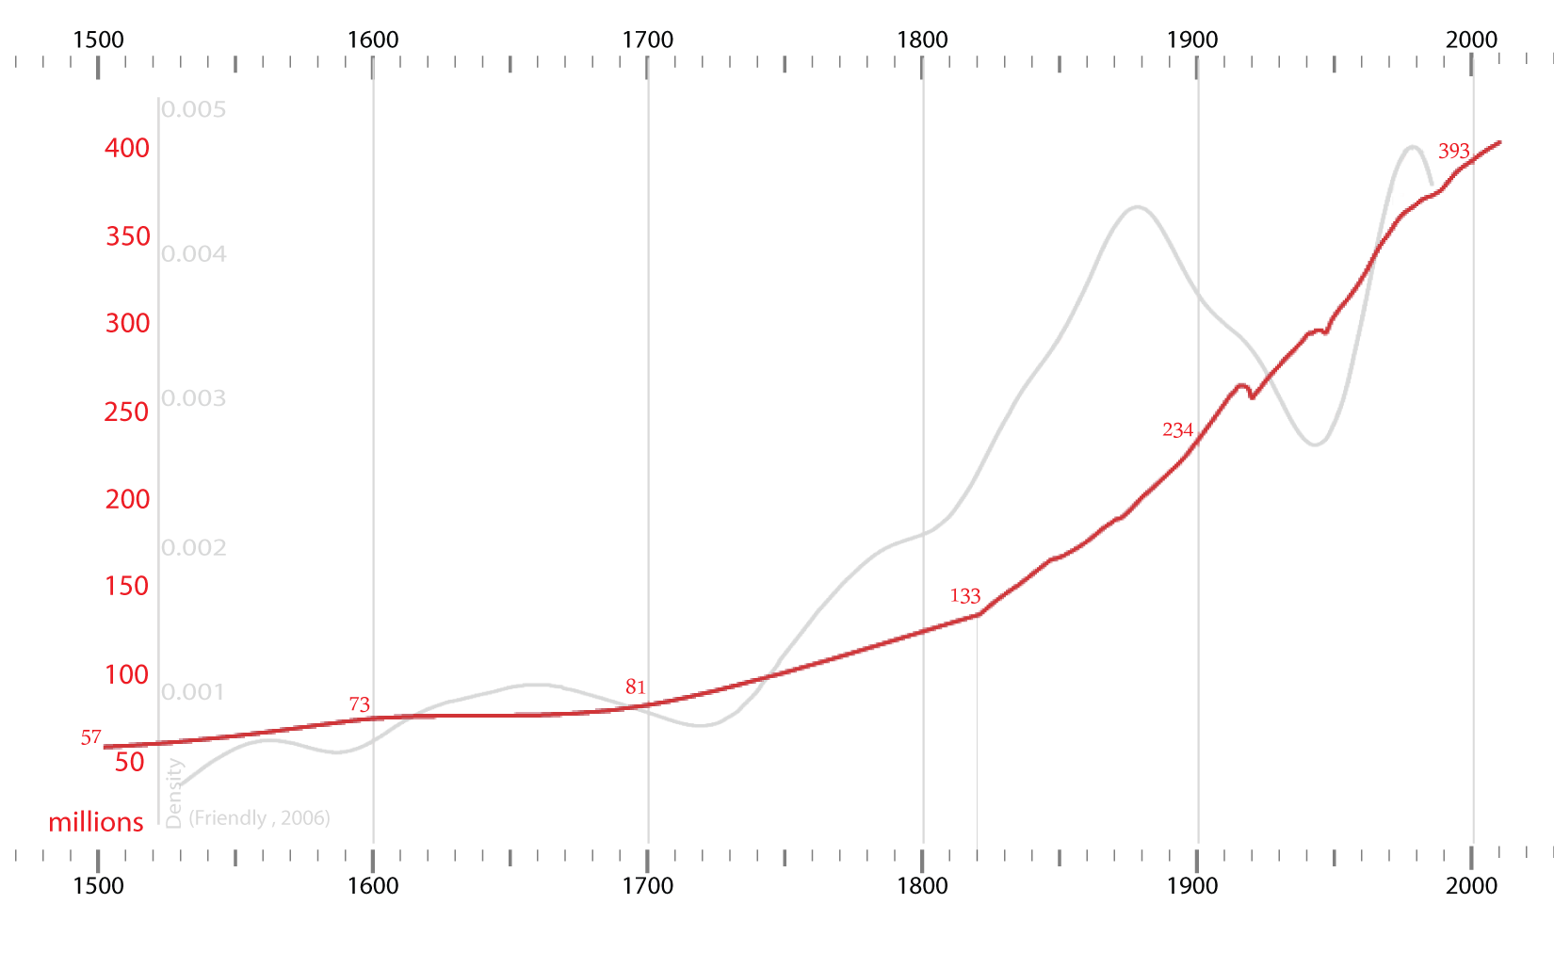
1500
1600
1700
1800
1900
2000
1500
1600
1700
1800
1900
2000

Slide 4
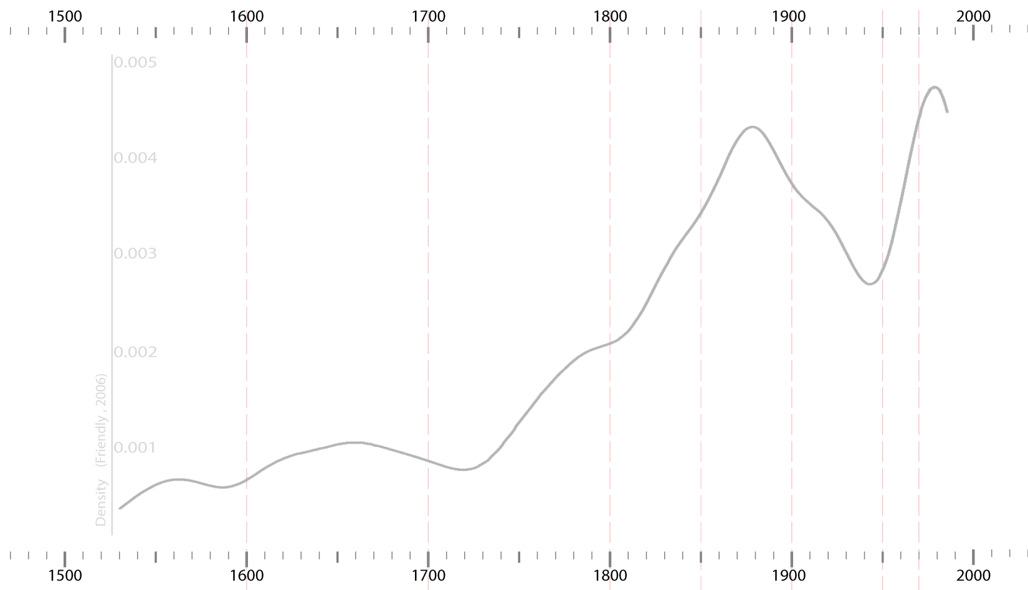
1500
1600
1700
1800
1900
2000
1500
1600
1700
1800
1900
2000

Slide 5
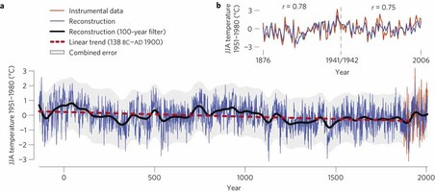

Slide 6
Nicollo Machiavelli
Martin Luther

