Slide 1
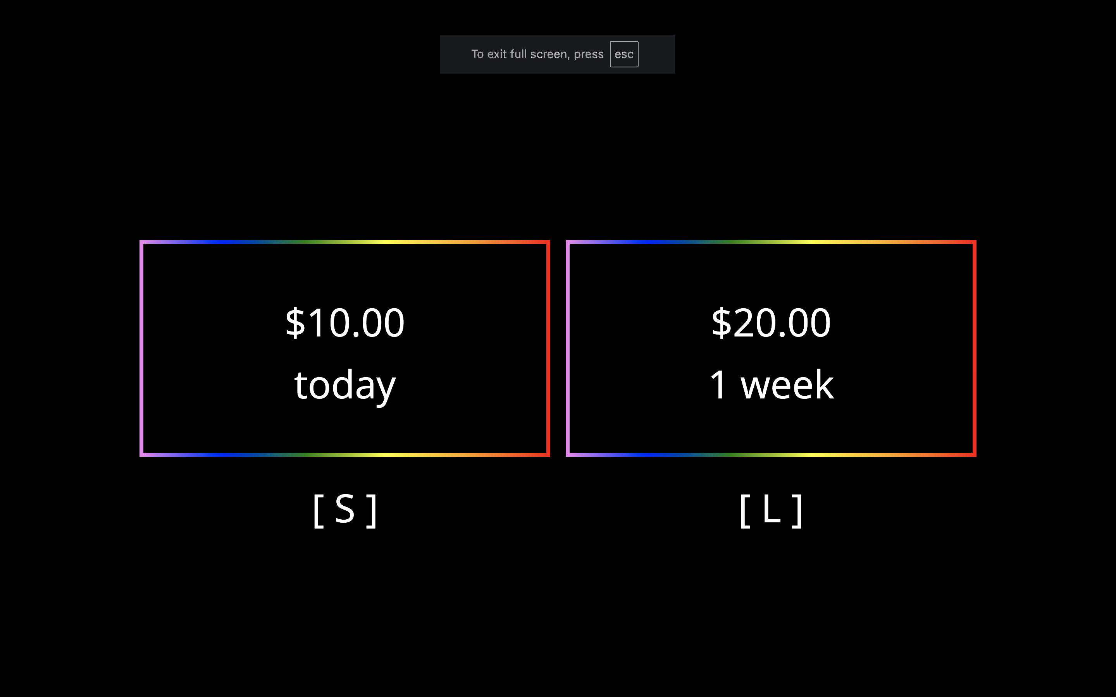
(A) Sample Choice Screen
(B) Schematic of Convergence on Indifference Point for $20 in 1 week Decisions
Screen 1
Screen 2
Screen 3
Screen 4
Screen 5
Screen 6
Hypothetical 7
$20.00
1 week
$20.00
1 week
$20.00
1 week
$20.00
1 week
$20.00
1 week
$20.00
1 week
$20.00
1 week
$10.00
today
$20.00
1 week
$17.50
today
$16.25
today
$16.88
today
$17.19
today
$17.34
today
$15.00
today
$10.00
today
[ S ]
[ L ]
Indifference Point: $17.34 ÷ $20.00 = 0.867
Chose Smaller Sooner
Chose Larger Later
Notes:
Figure 1

Slide 2
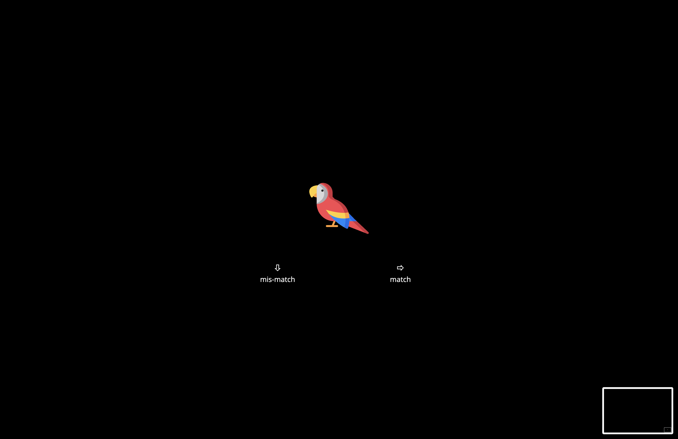
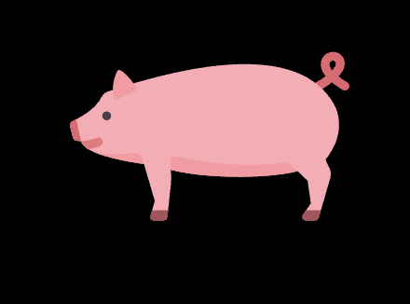
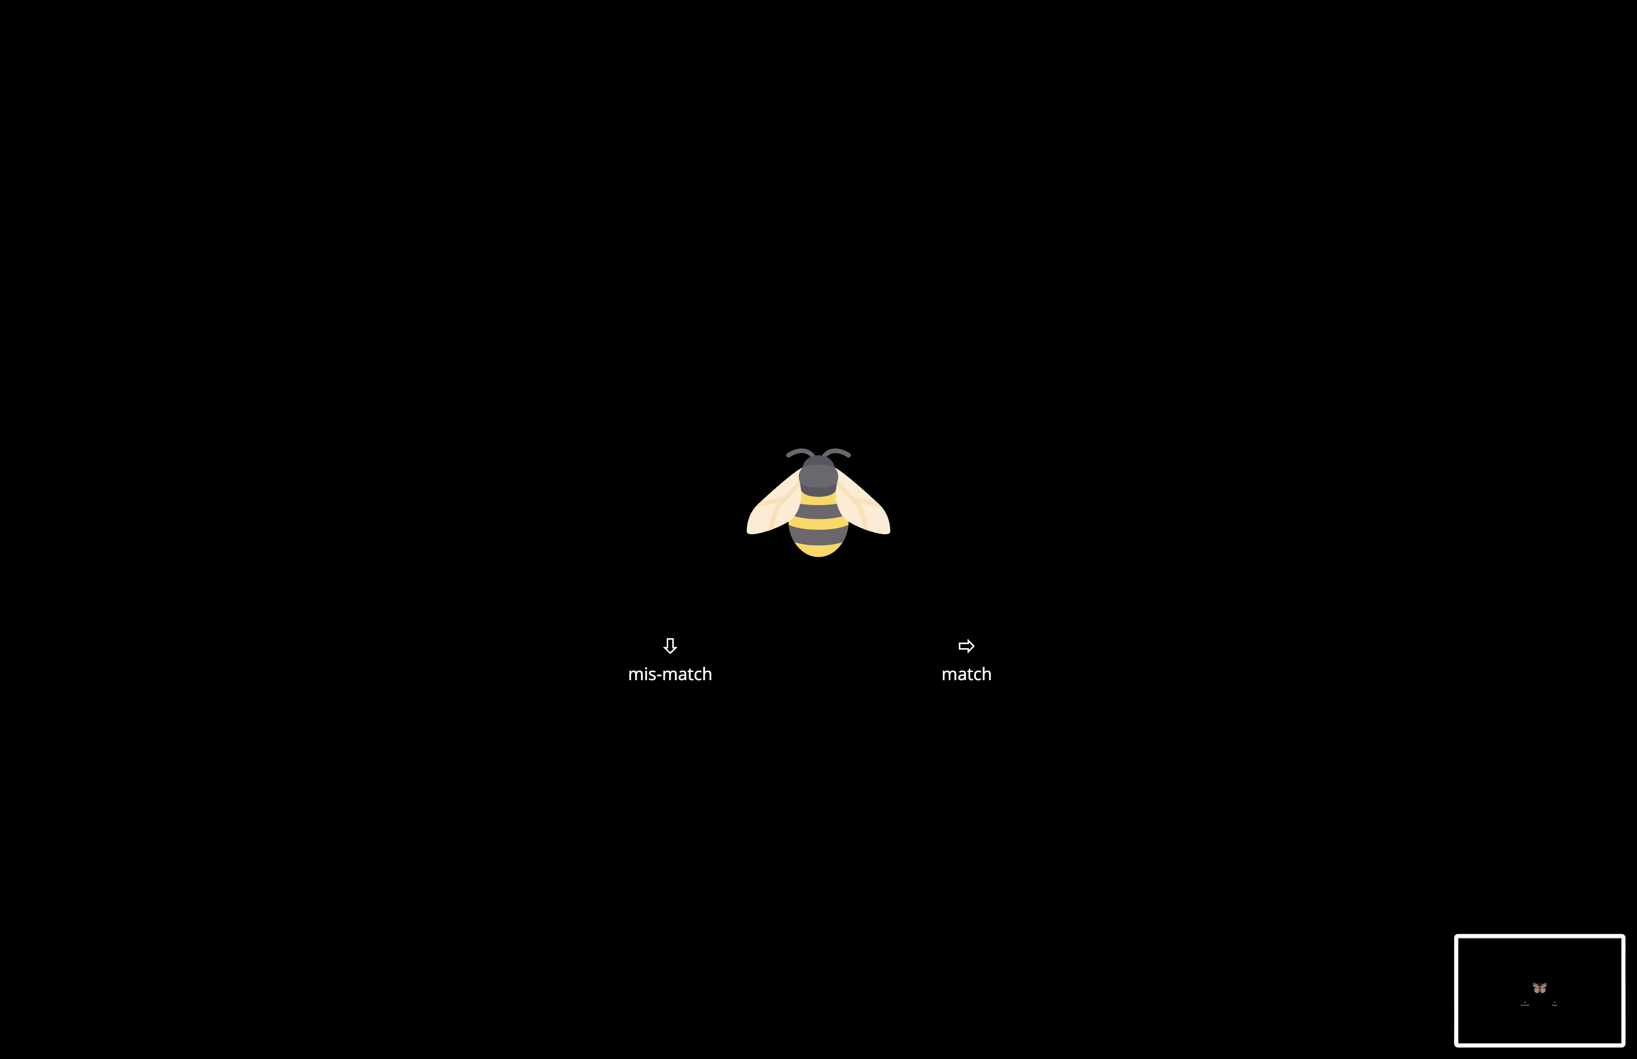
(A) Example Stroop Trial Sequence
ORANGE
WHITE
ORANGE
WHITE
...
Congruent
Incongruent
Incongruent
Congruent
(B) Example 2-Back Trial Sequence
...
Match
Mismatch
Notes:
Figure 2

Slide 3
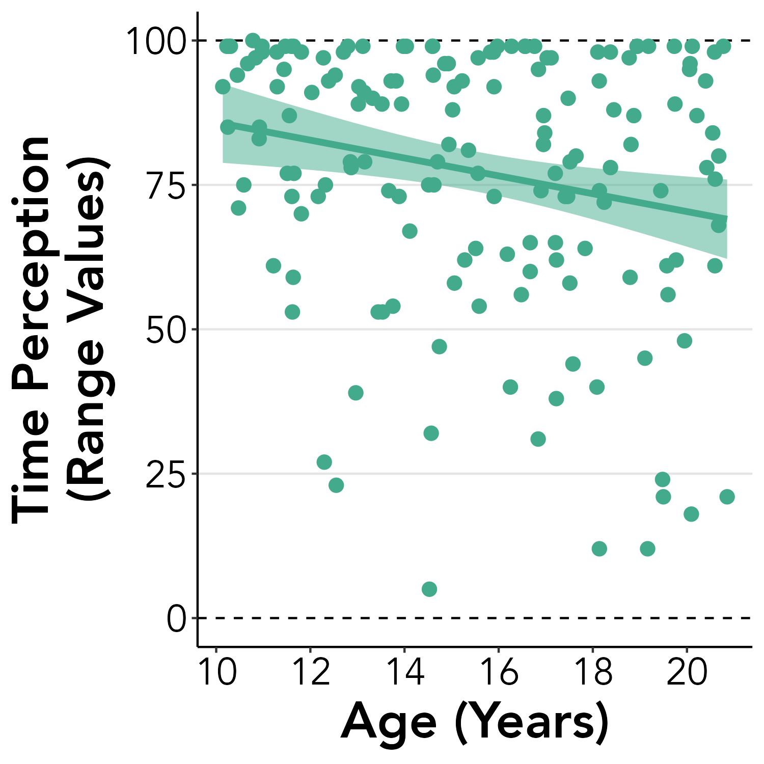
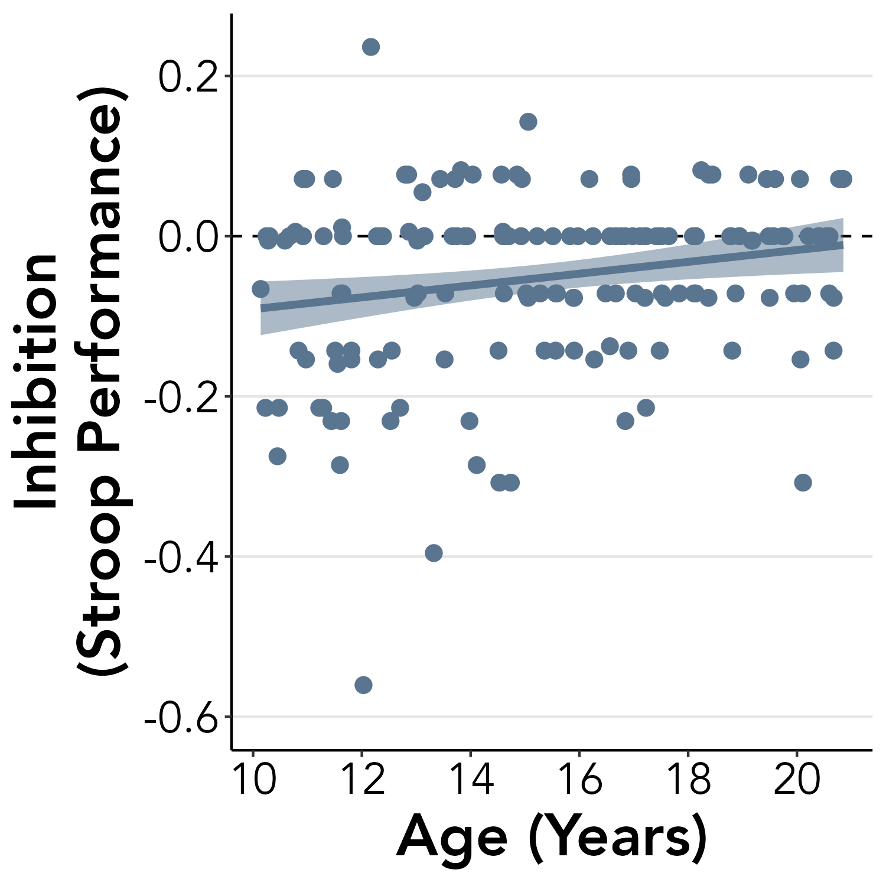
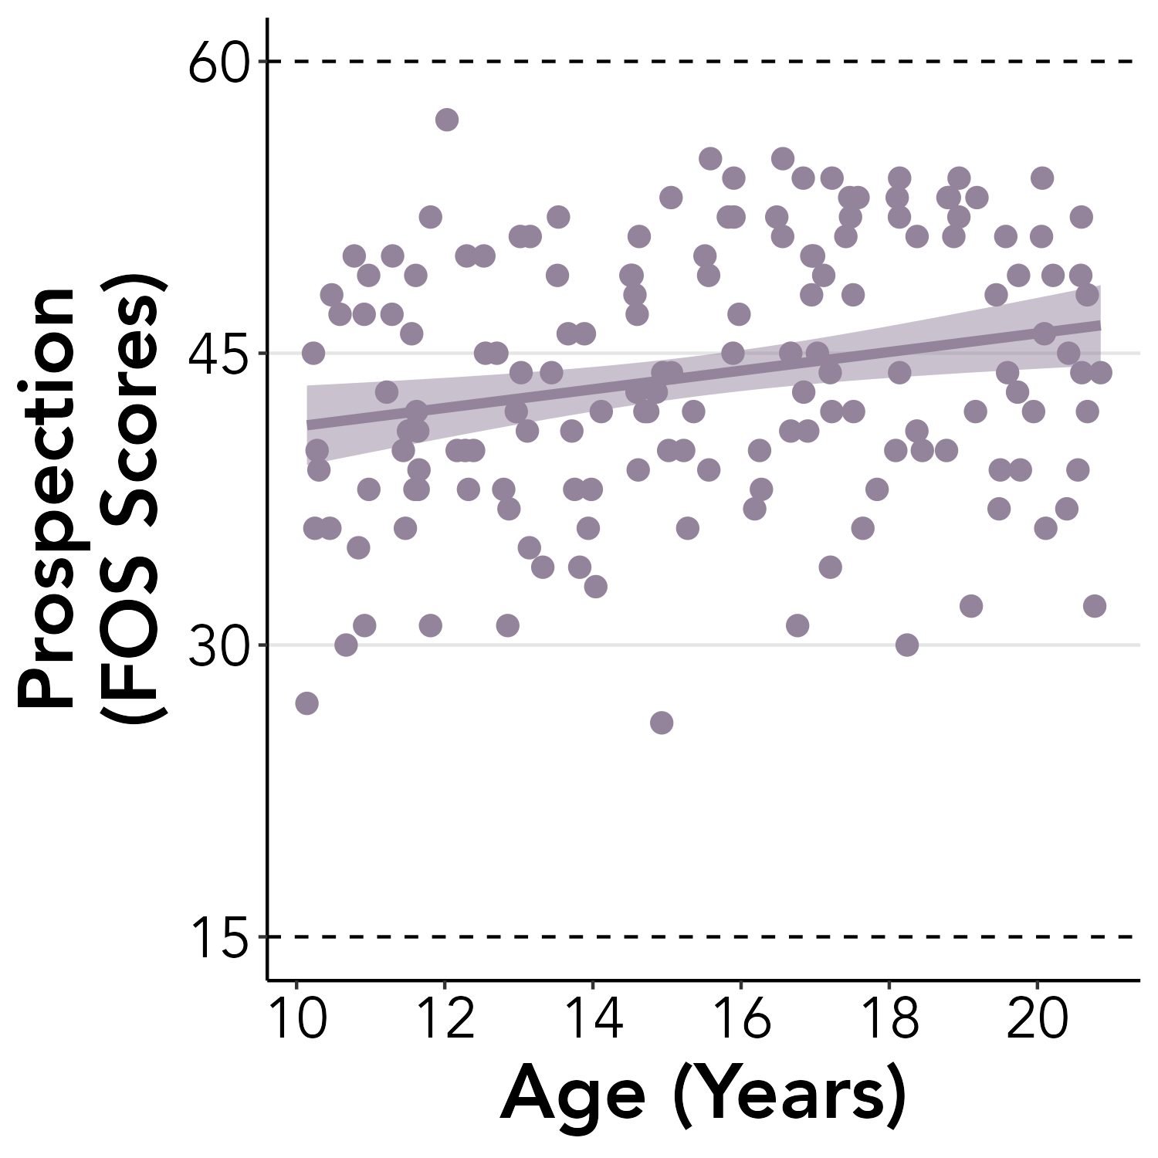
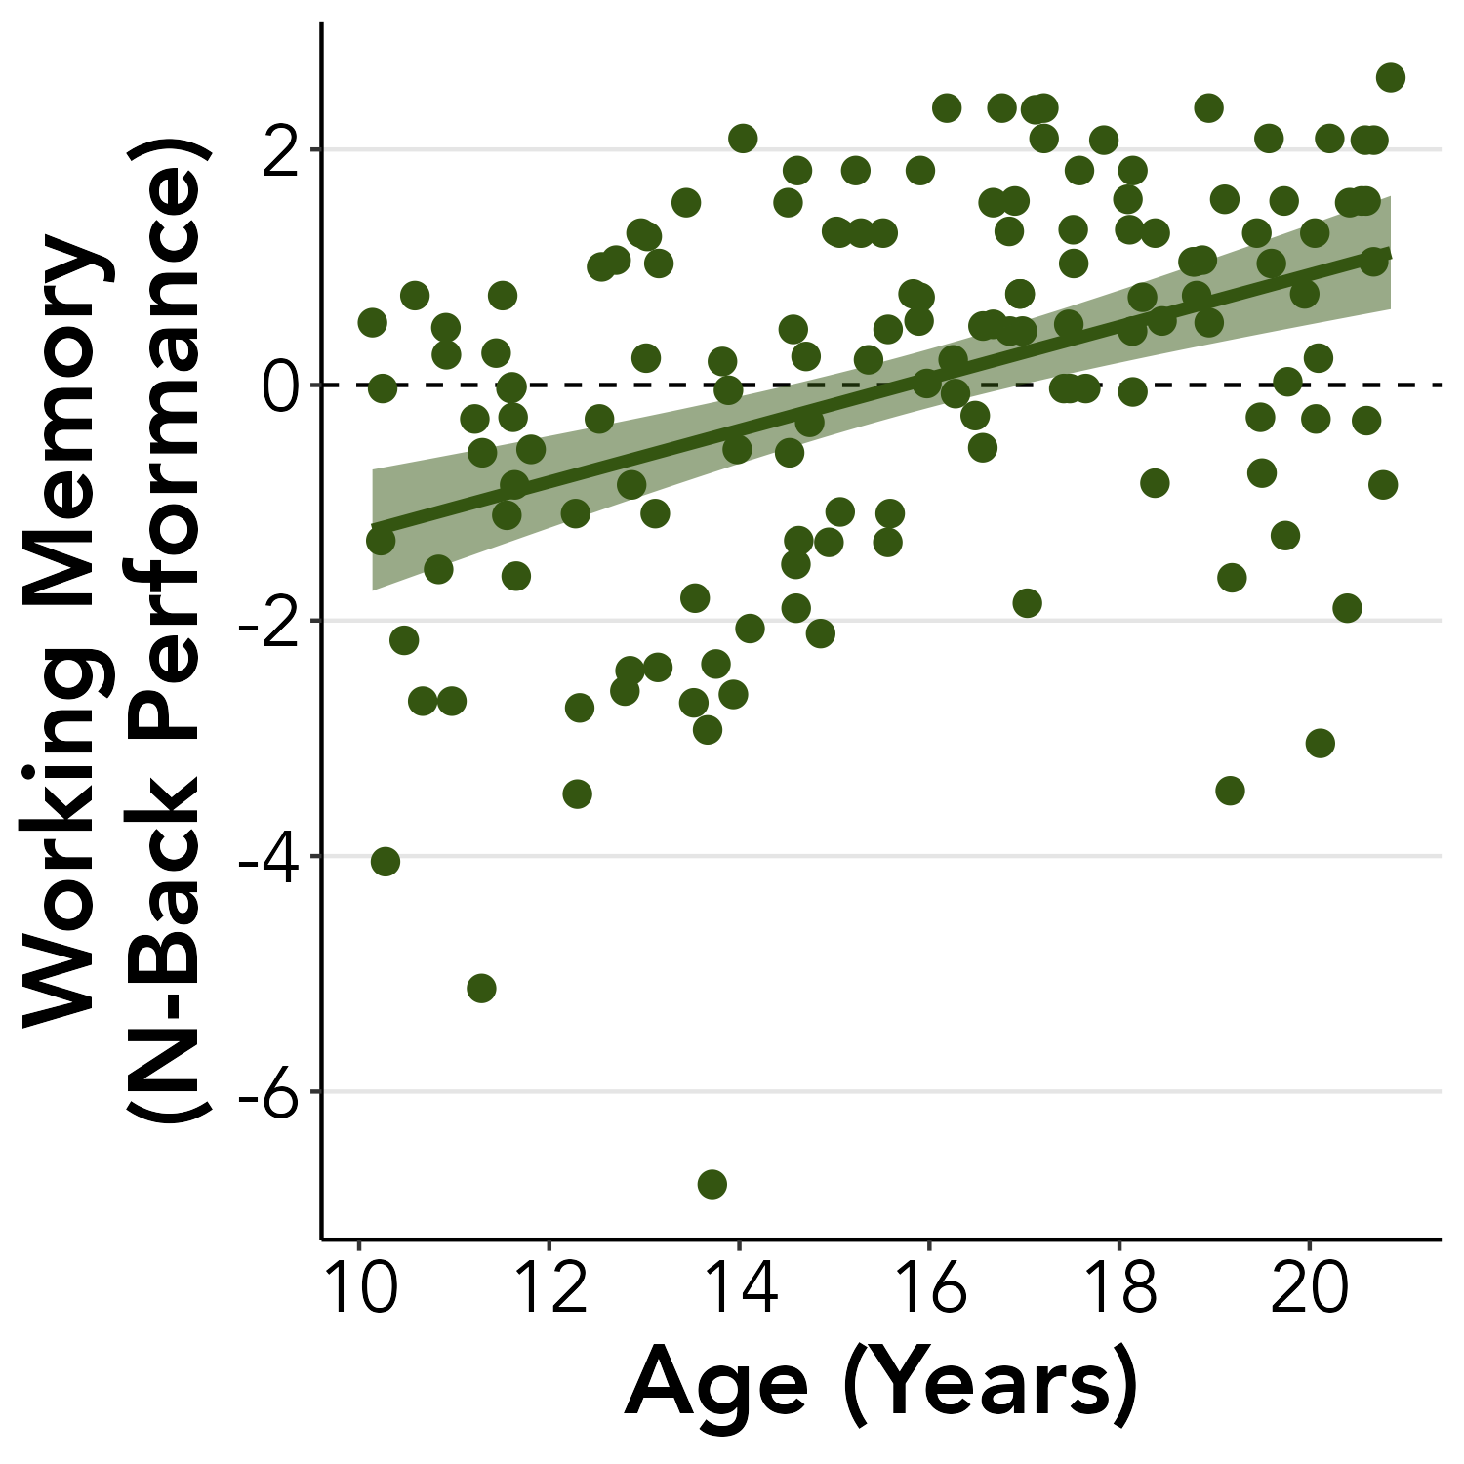
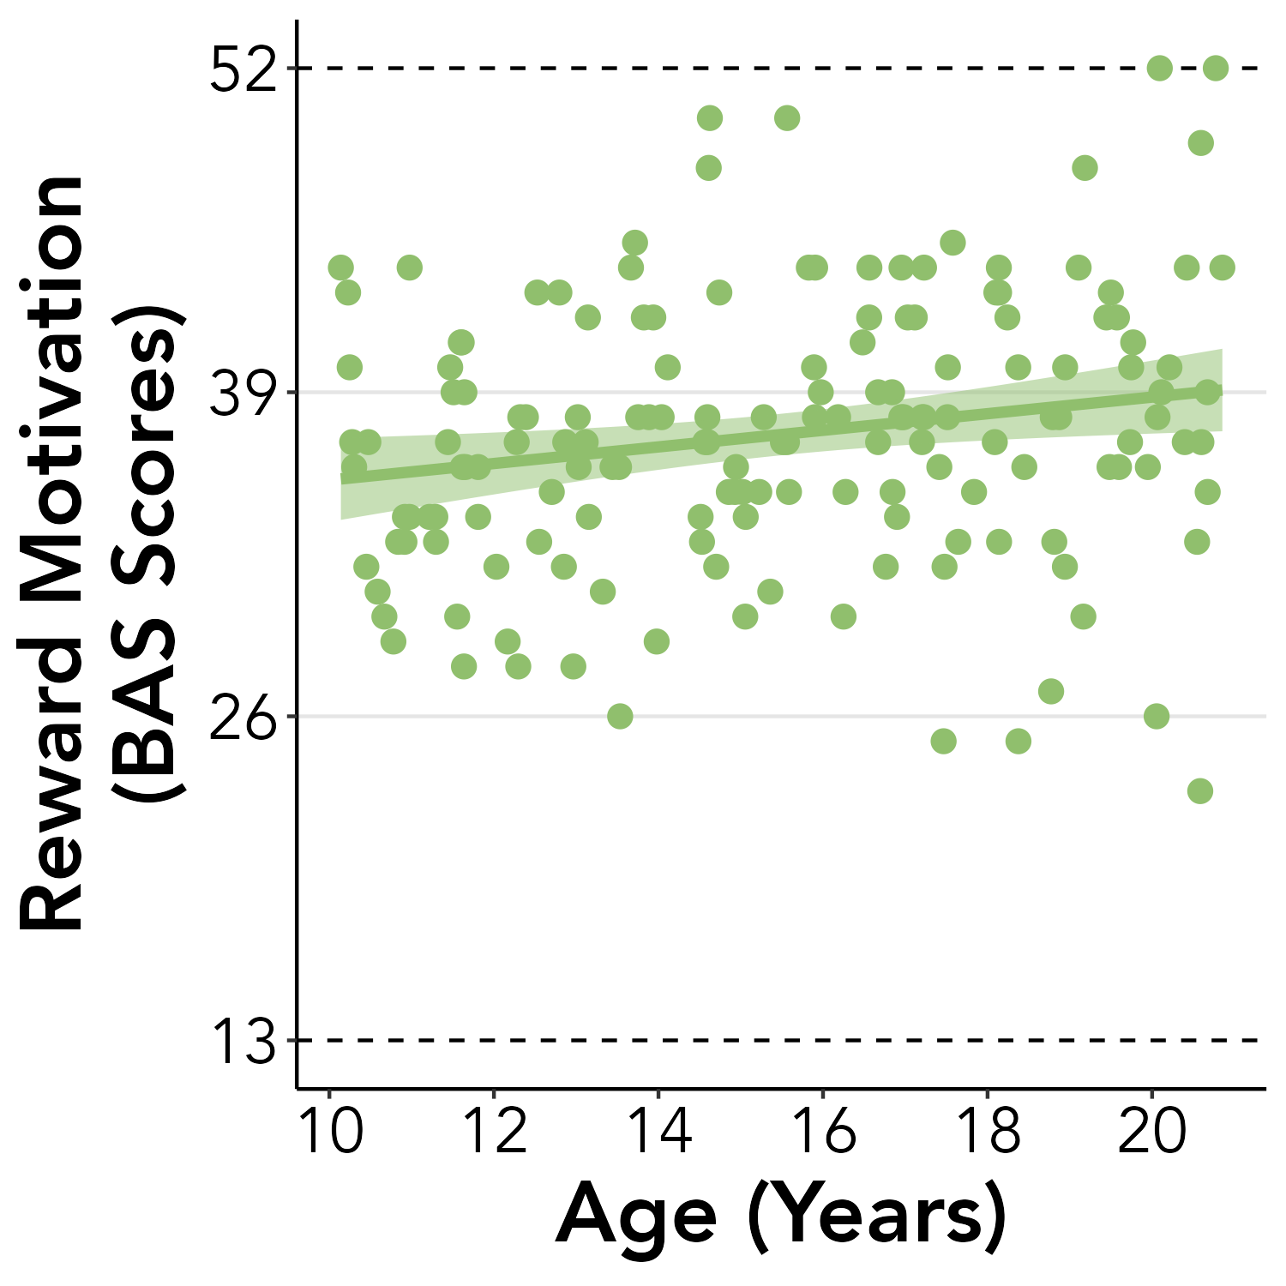
(A)
(B)
(C)
(D)
(E)
Notes:
Figure 4

Slide 4
Age
FOS
Stroop
Time Perception
BAS
N-Back
$20 Decision AUC
$200 Decision AUC
Notes:
Figure 5

Slide 5
Age
FOS
Stroop
Time Perception
BAS
N-Back
$20 Decision AUC
$200 Decision AUC
Notes:
Supplemental Figure S4

