Slide 1

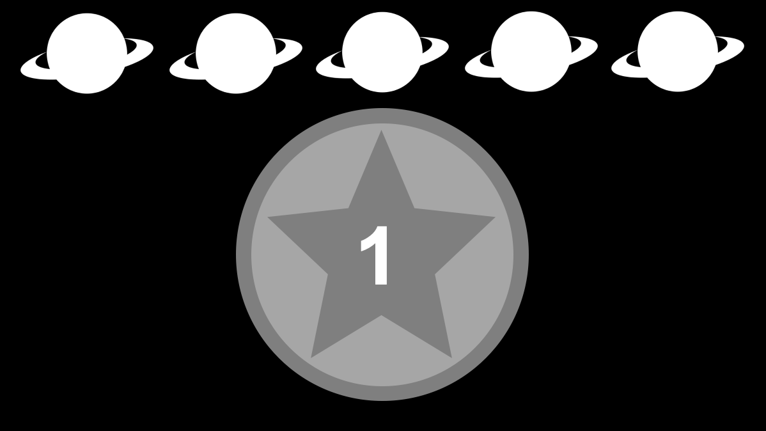





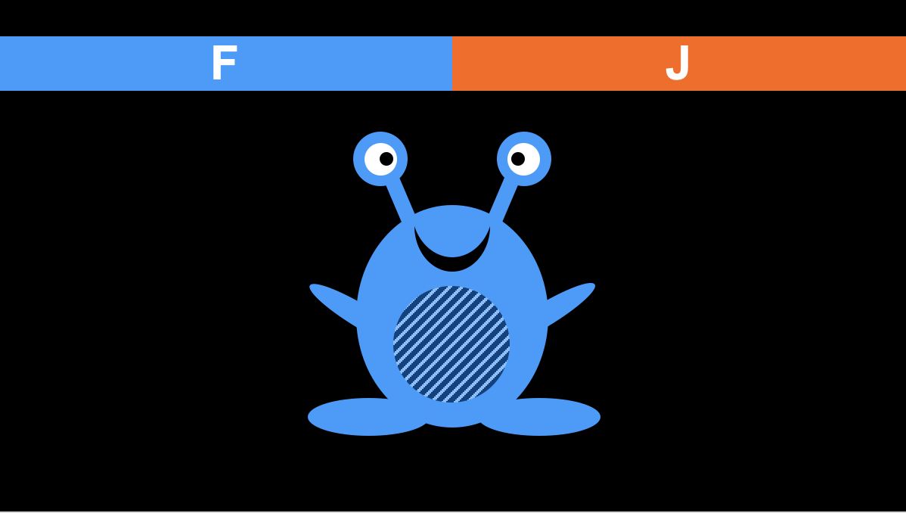
CUE SCREENS
High incentive
(10 cents)
Low incentive
(1 cent)
Difficulty context (easy vs. hard)
TRIAL SEQUENCE
2000 ms
1000 ms
3000 ms
Pattern trial
500 ms
…
1000 ms
1000 ms
3000 ms
Color trial

Slide 2
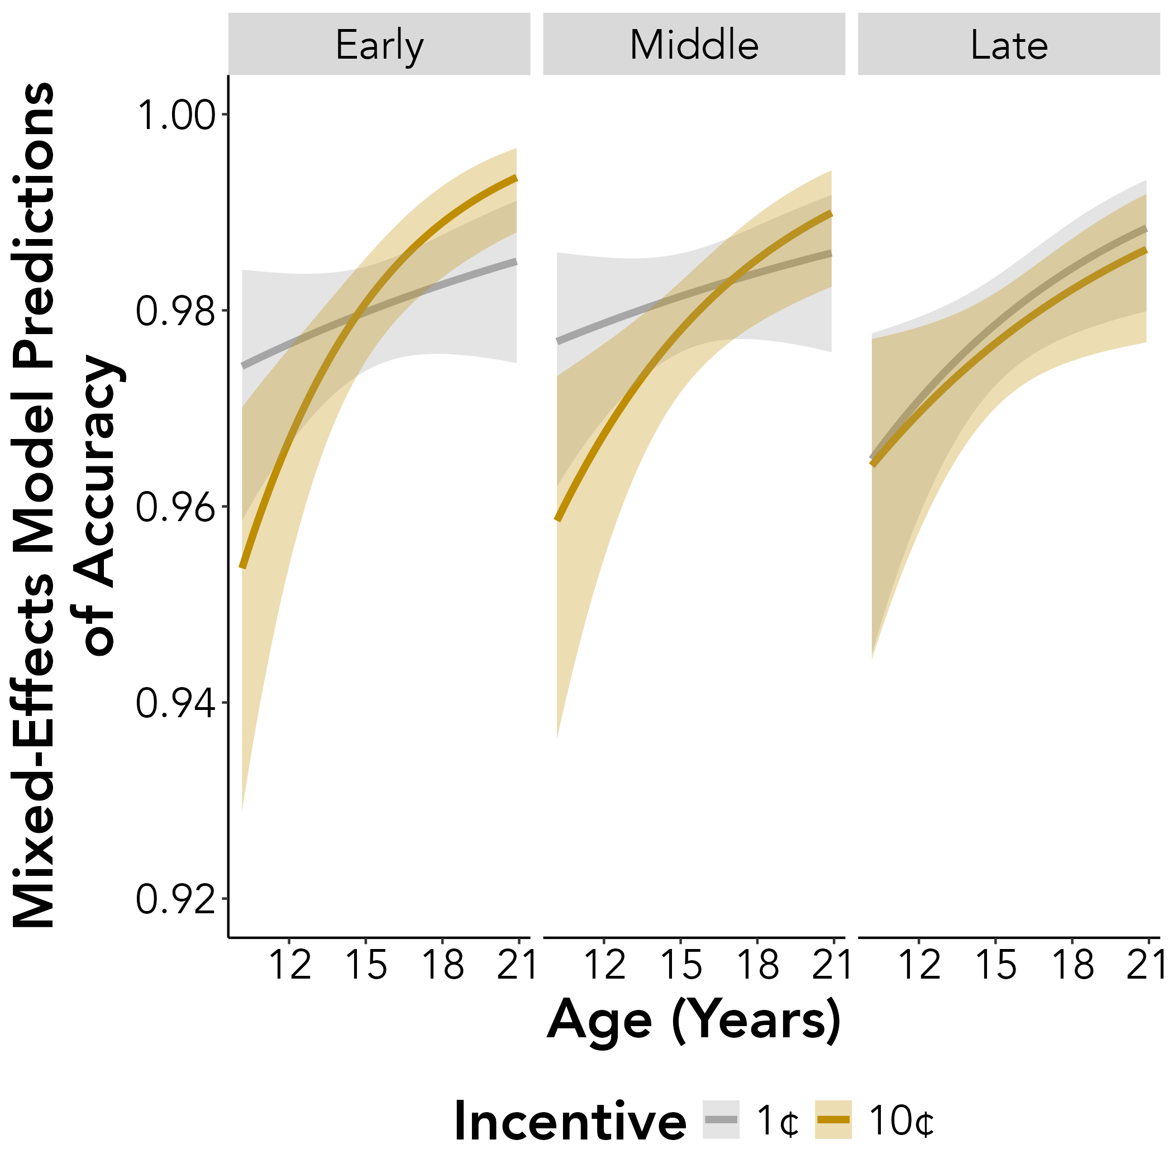
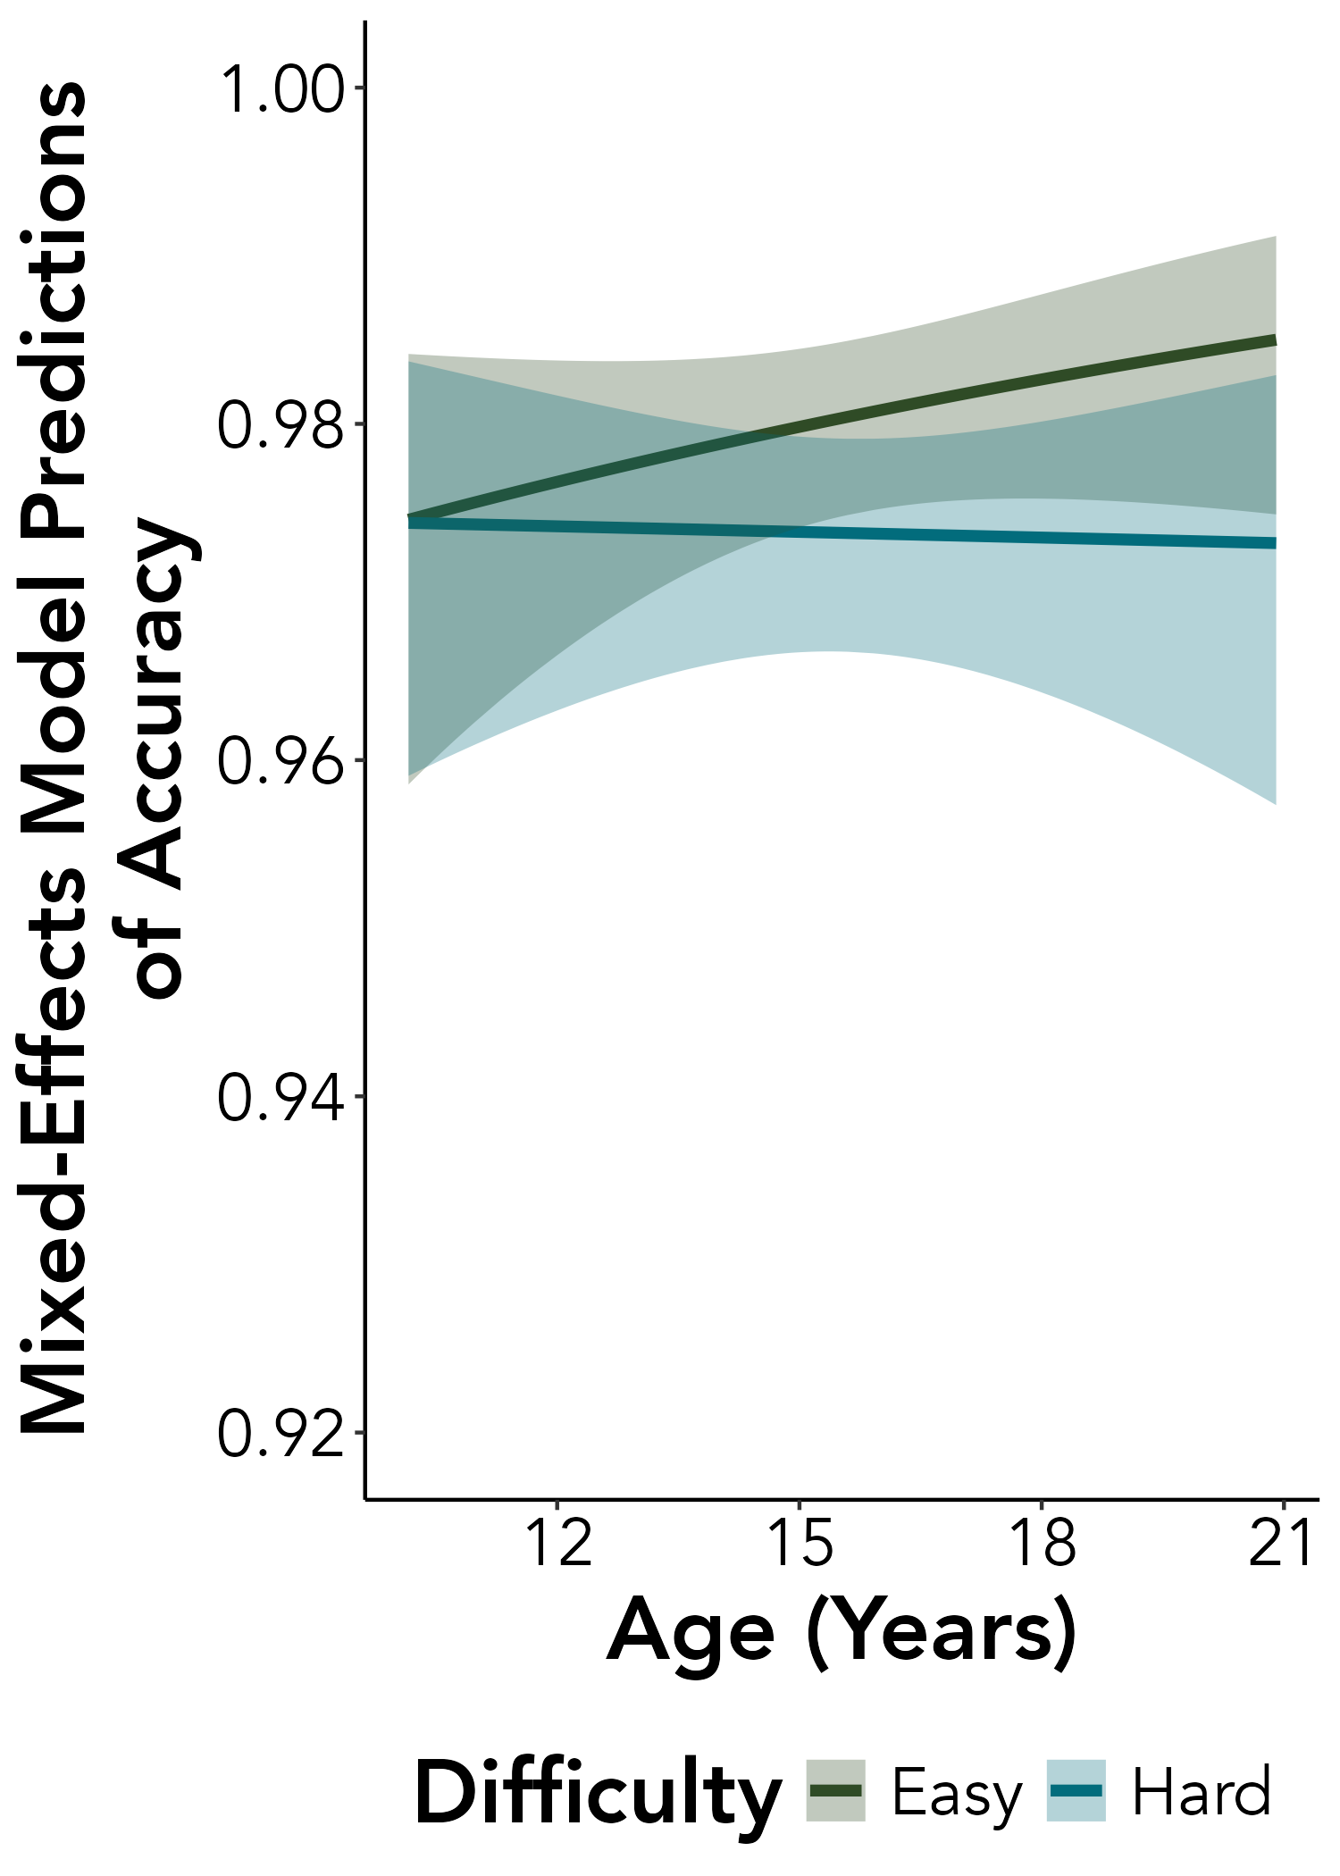
A.
B.

Slide 3
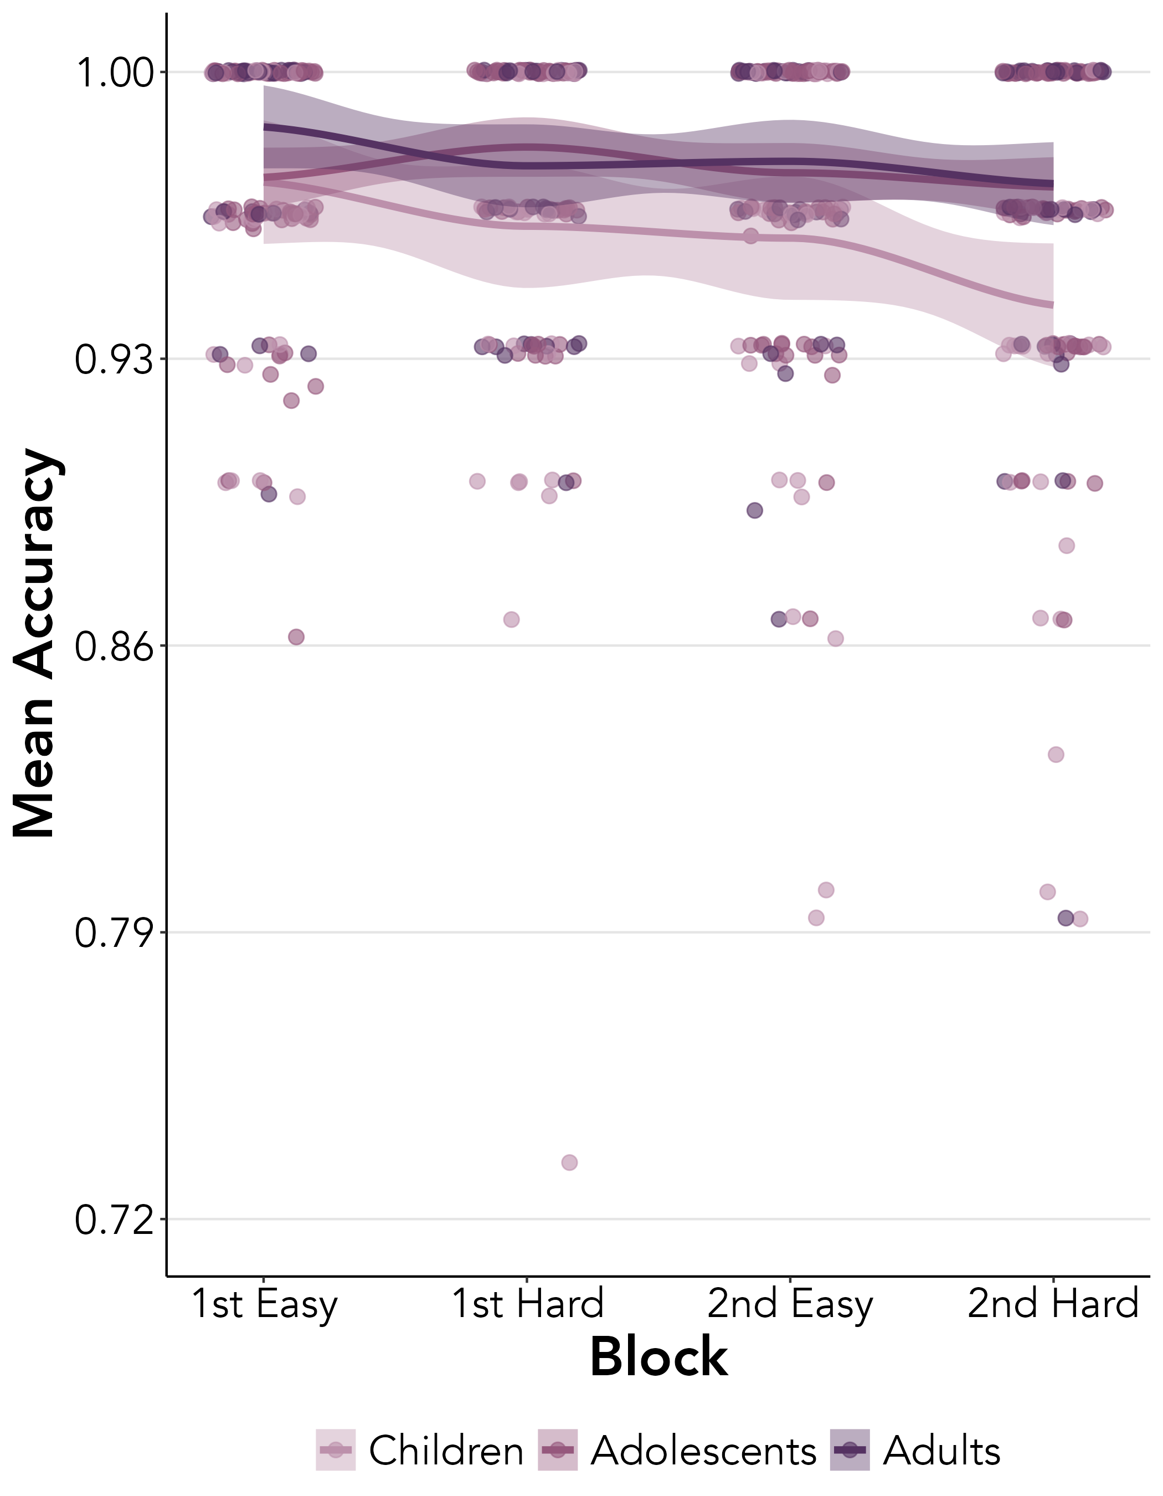
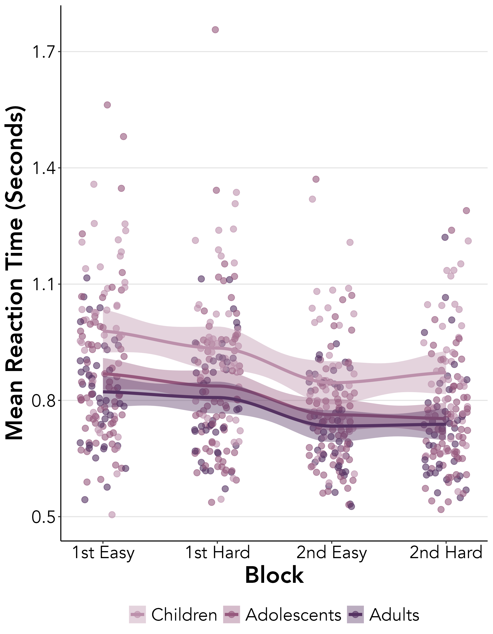
A.
B.

Slide 4
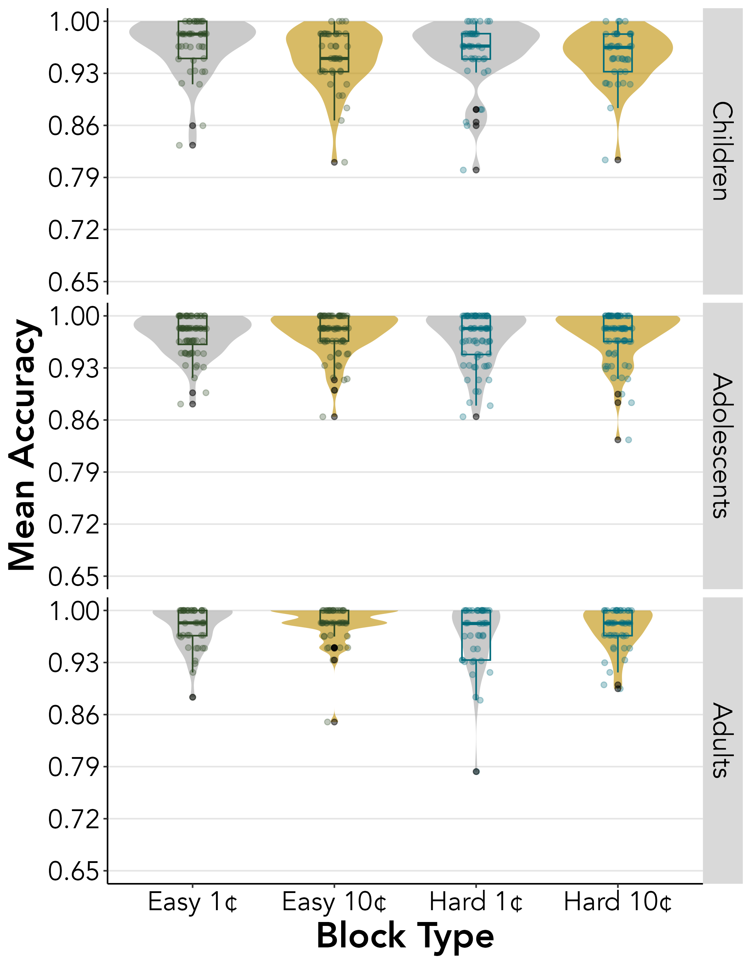
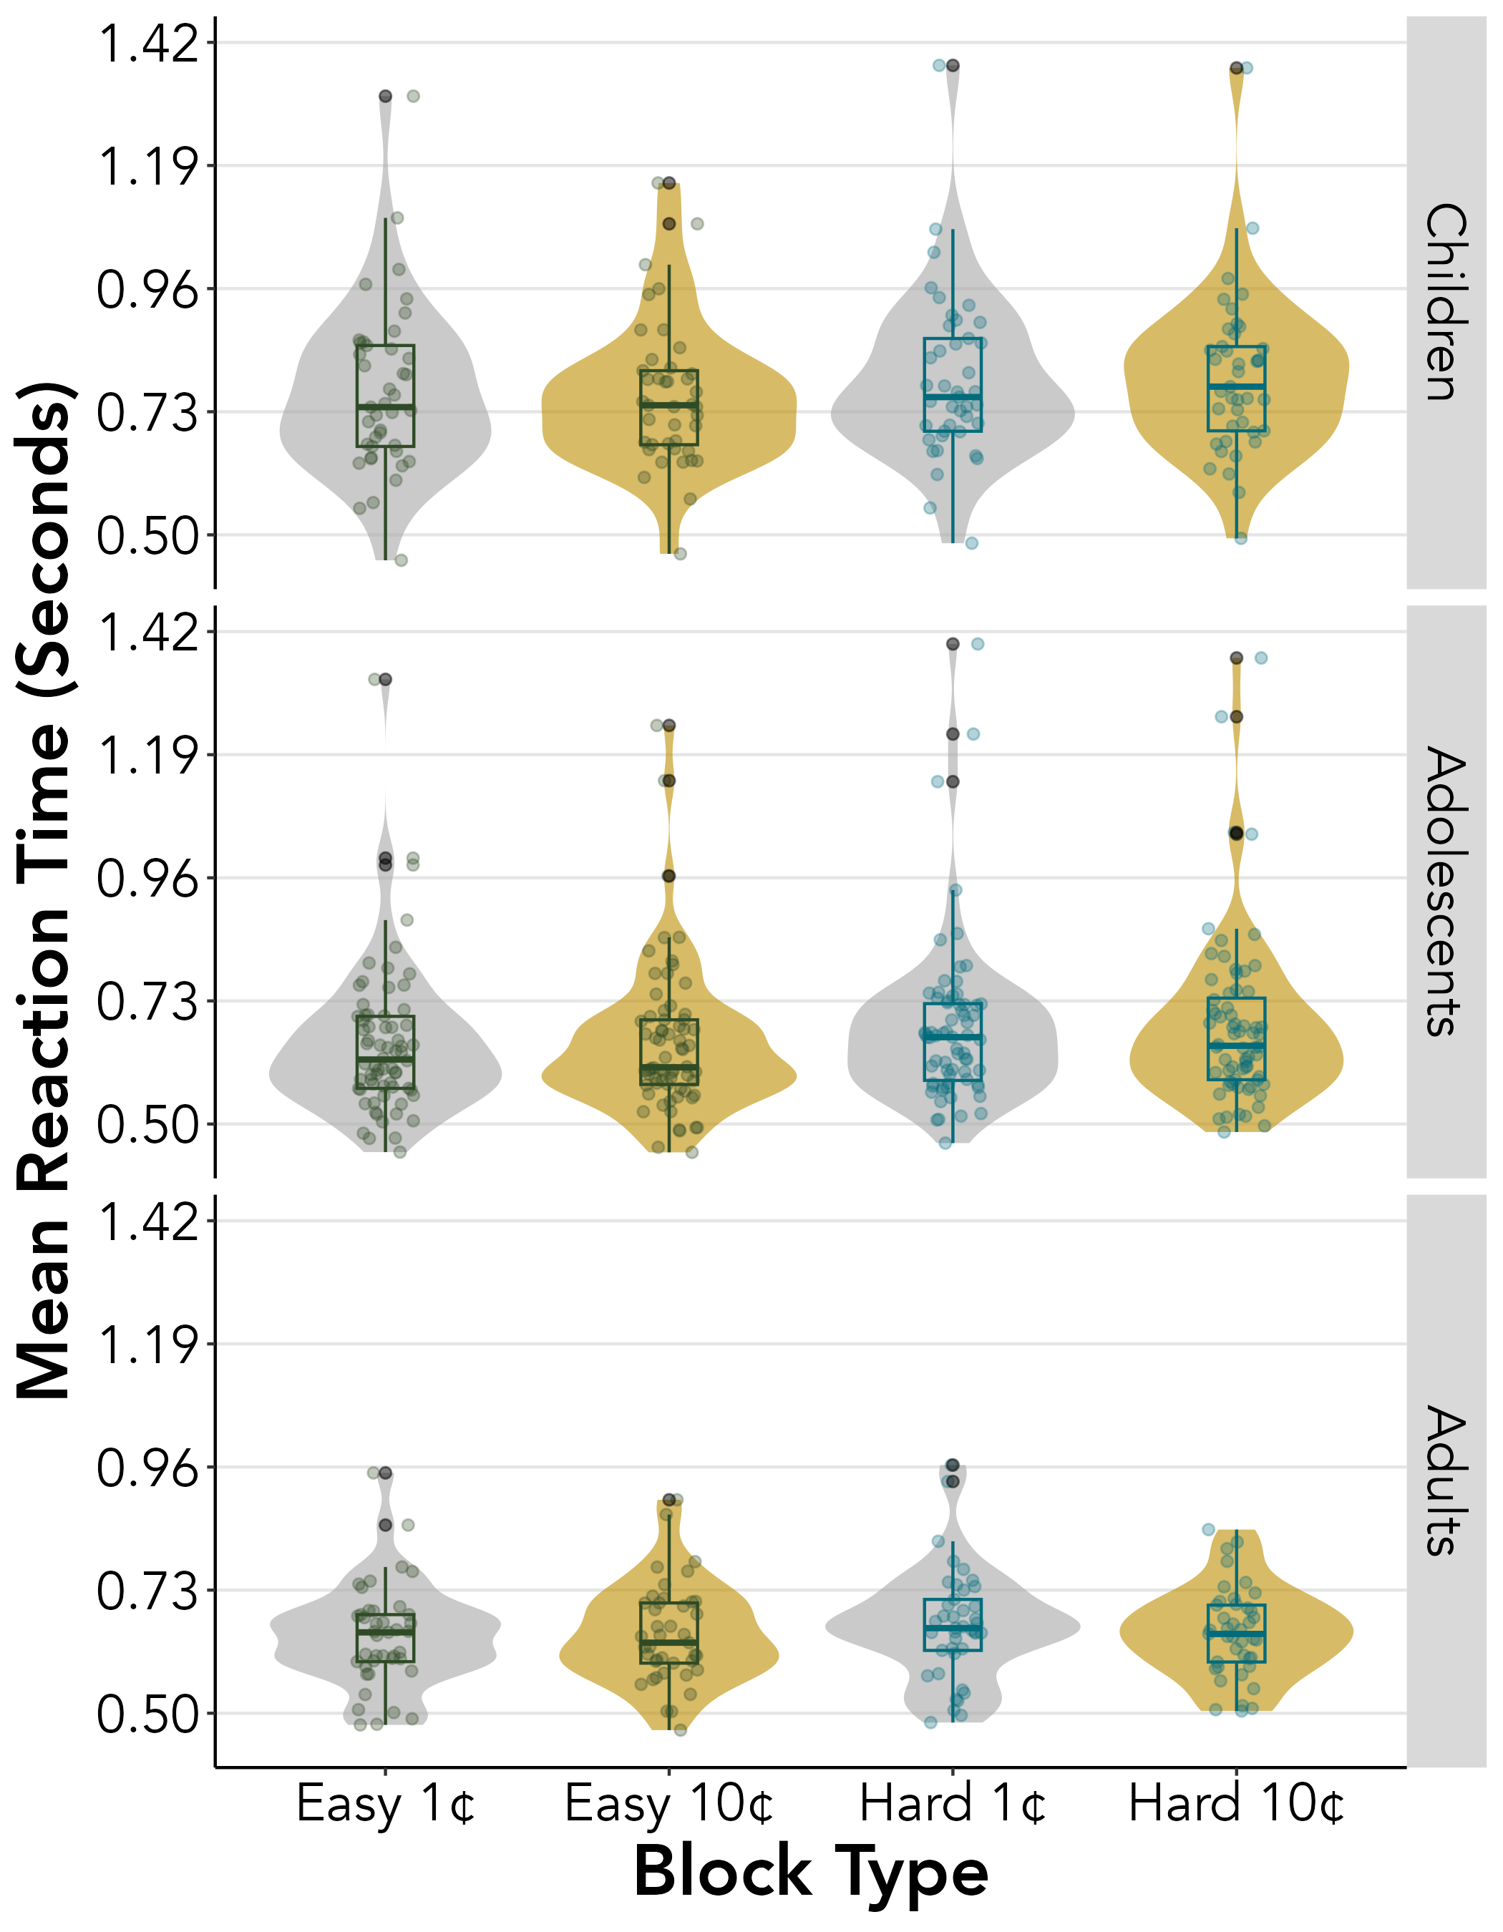
A.
B.

Slide 5
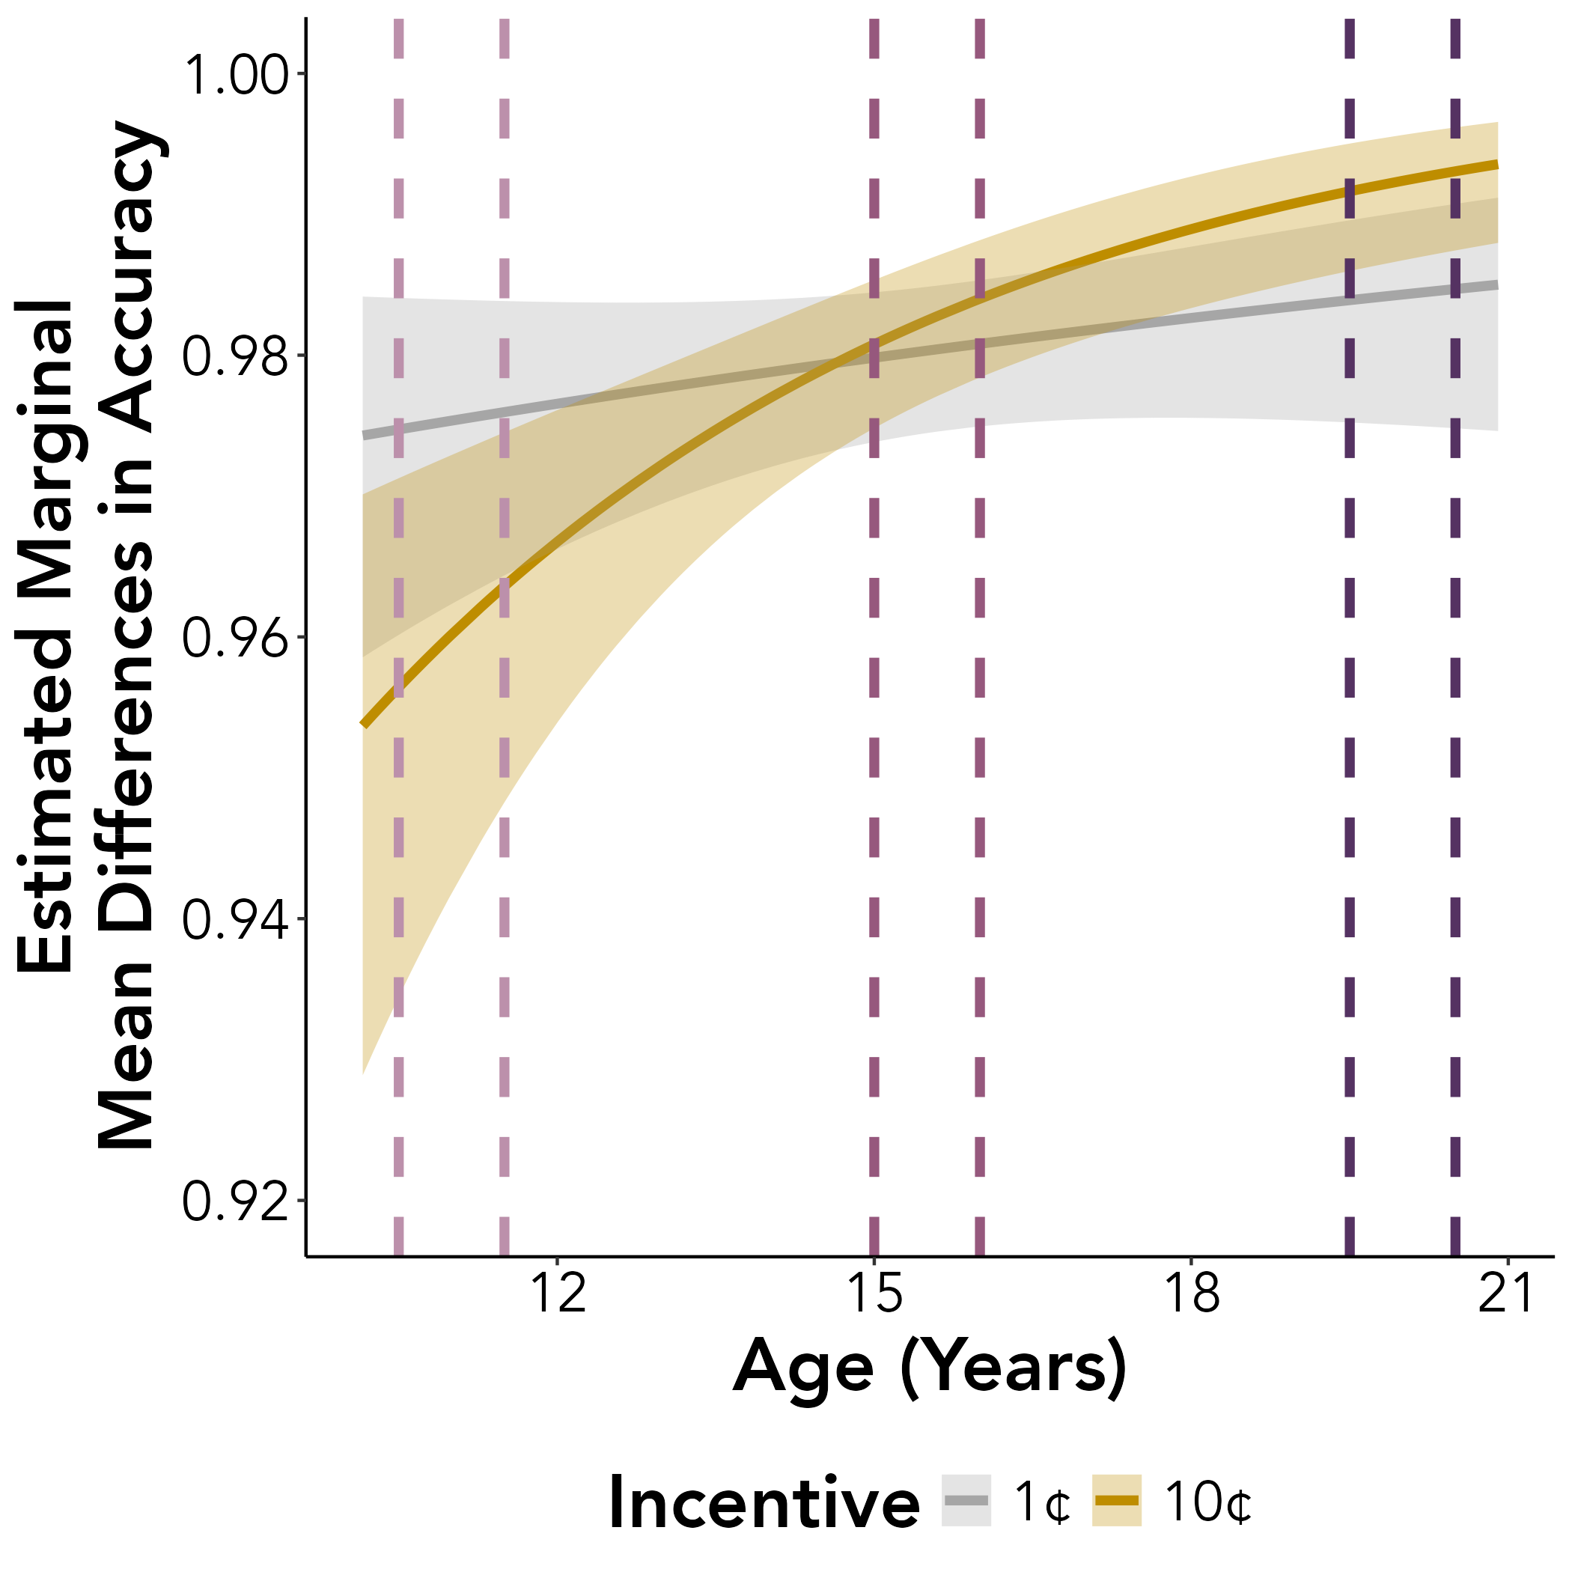
^
*
n.s.
n.s.
^
^
10.5
11.5
15
16
19.5
20.5

Slide 6
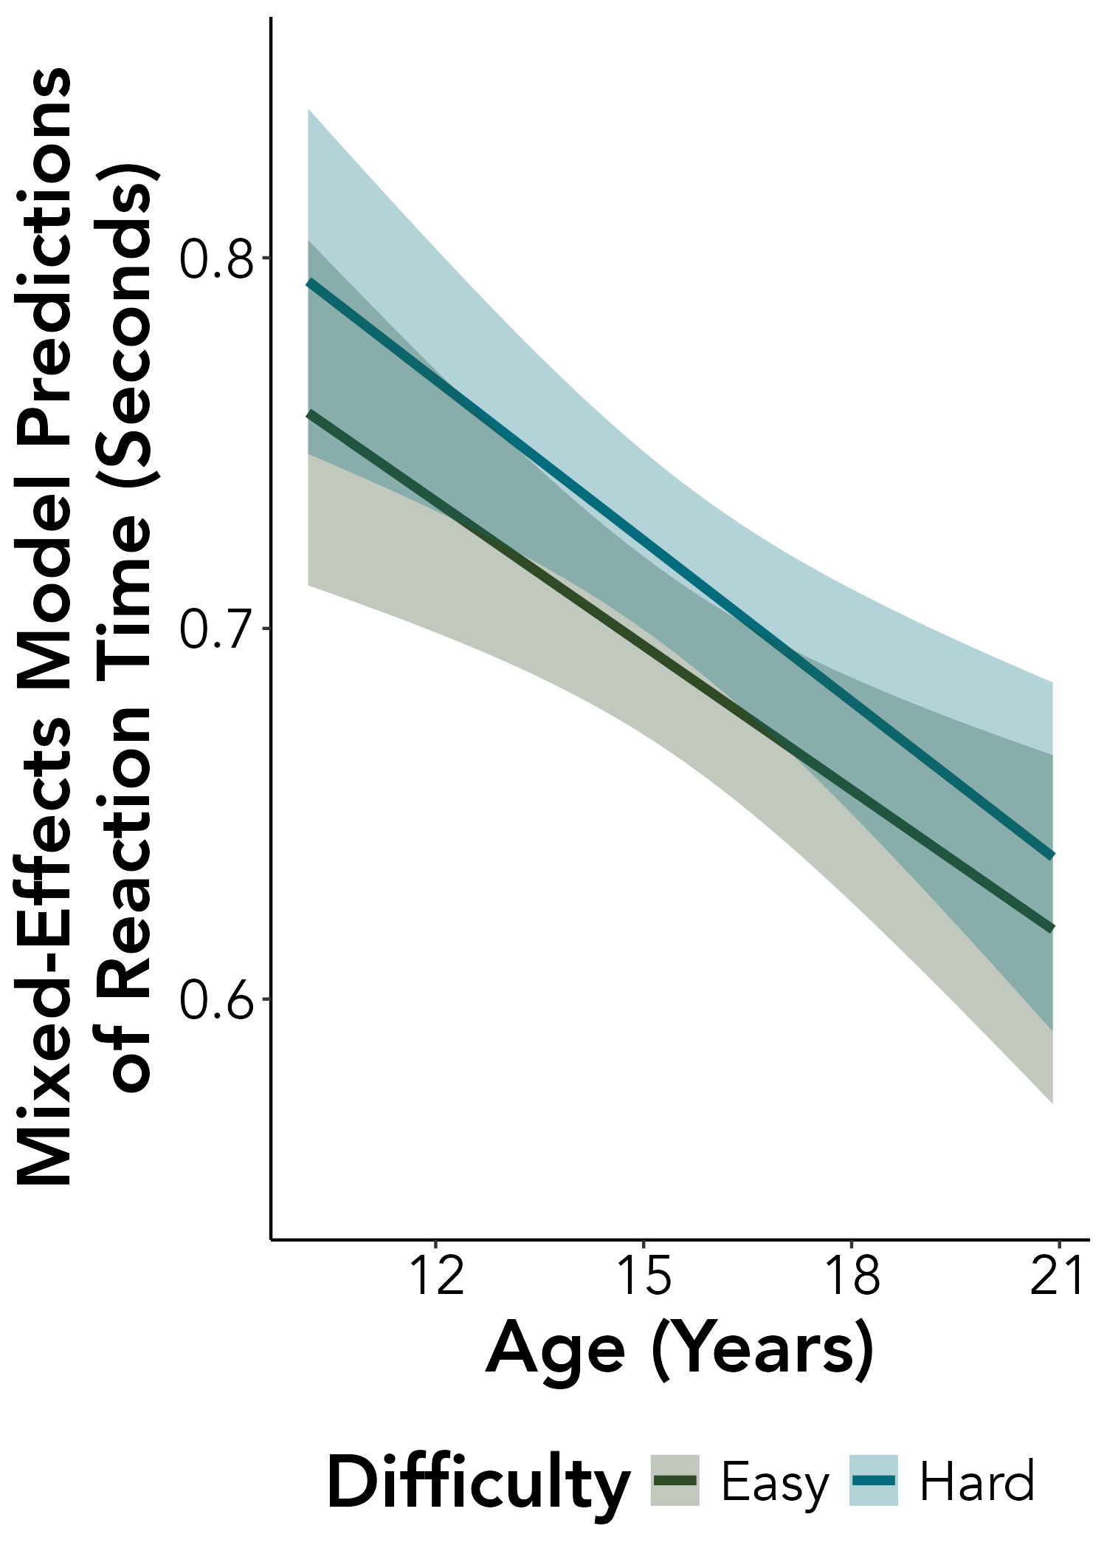
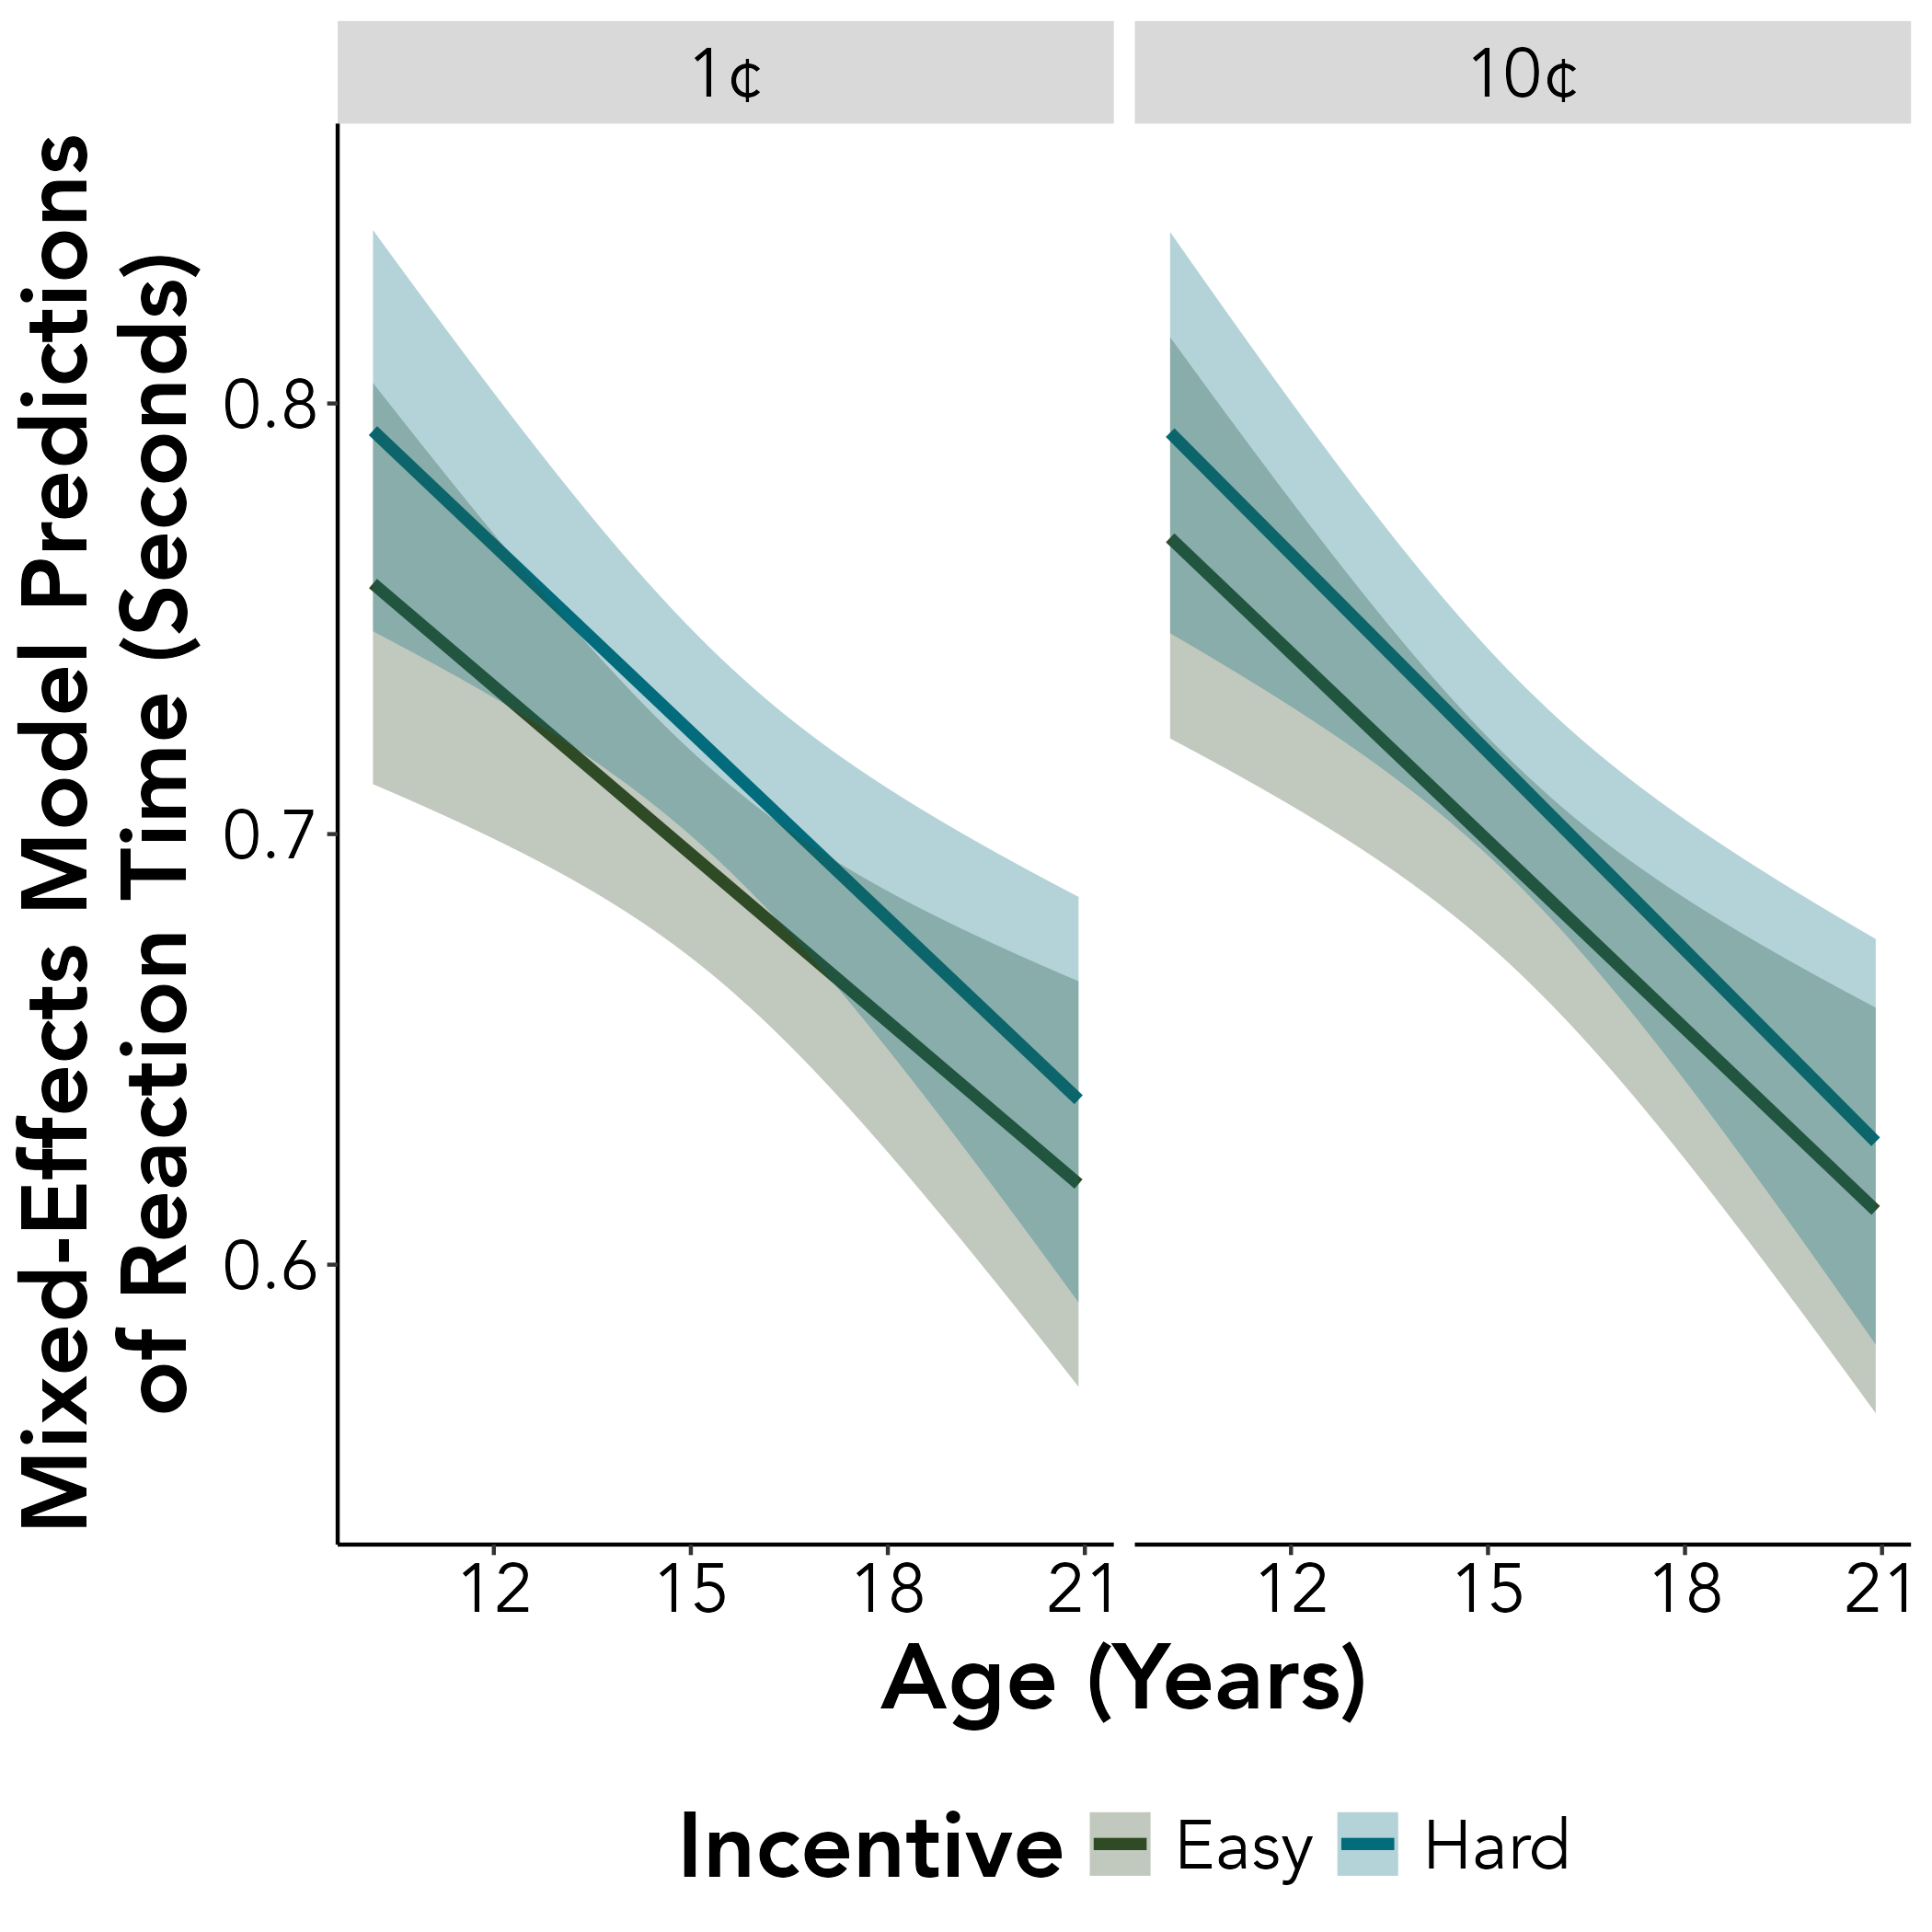
A.
B.

Slide 7



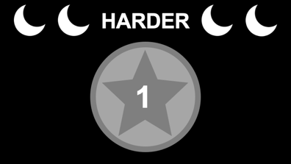
CUE SCREENS
High incentive
(10 cents)
Low incentive
(1 cent)
Easy
Hard

