Slide 1
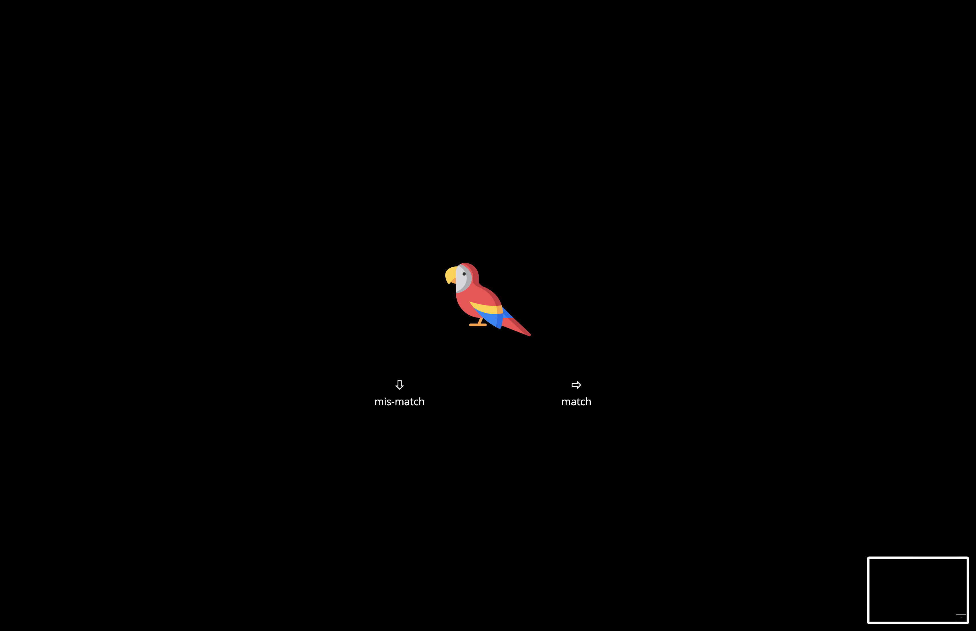
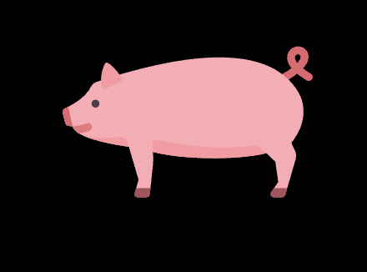

(A) Example Stroop Trial Sequence
ORANGE
WHITE
ORANGE
WHITE
...
Congruent
Incongruent
Incongruent
Congruent
(B) Example 2-Back Trial Sequence
...
Match
Mismatch

Slide 2
Age
Prospection
Inhibition
Working Memory
Situation Selection
Suppression
Reappraisal
significant edges
non-significant edges
hypothesized pathways

Slide 3
Age
Prospection
Inhibition
Working Memory
Situation Selection
Suppression
Reappraisal

