Slide 1
Some figures were manually re-drawn in Powerpoint to maximize font size and minimize white space.
Some figures were manually annotated in Powerpoint to add further data labels.
Some figures were created in Powerpoint by combining individual plots.

Slide 2
Main Text

Slide 3
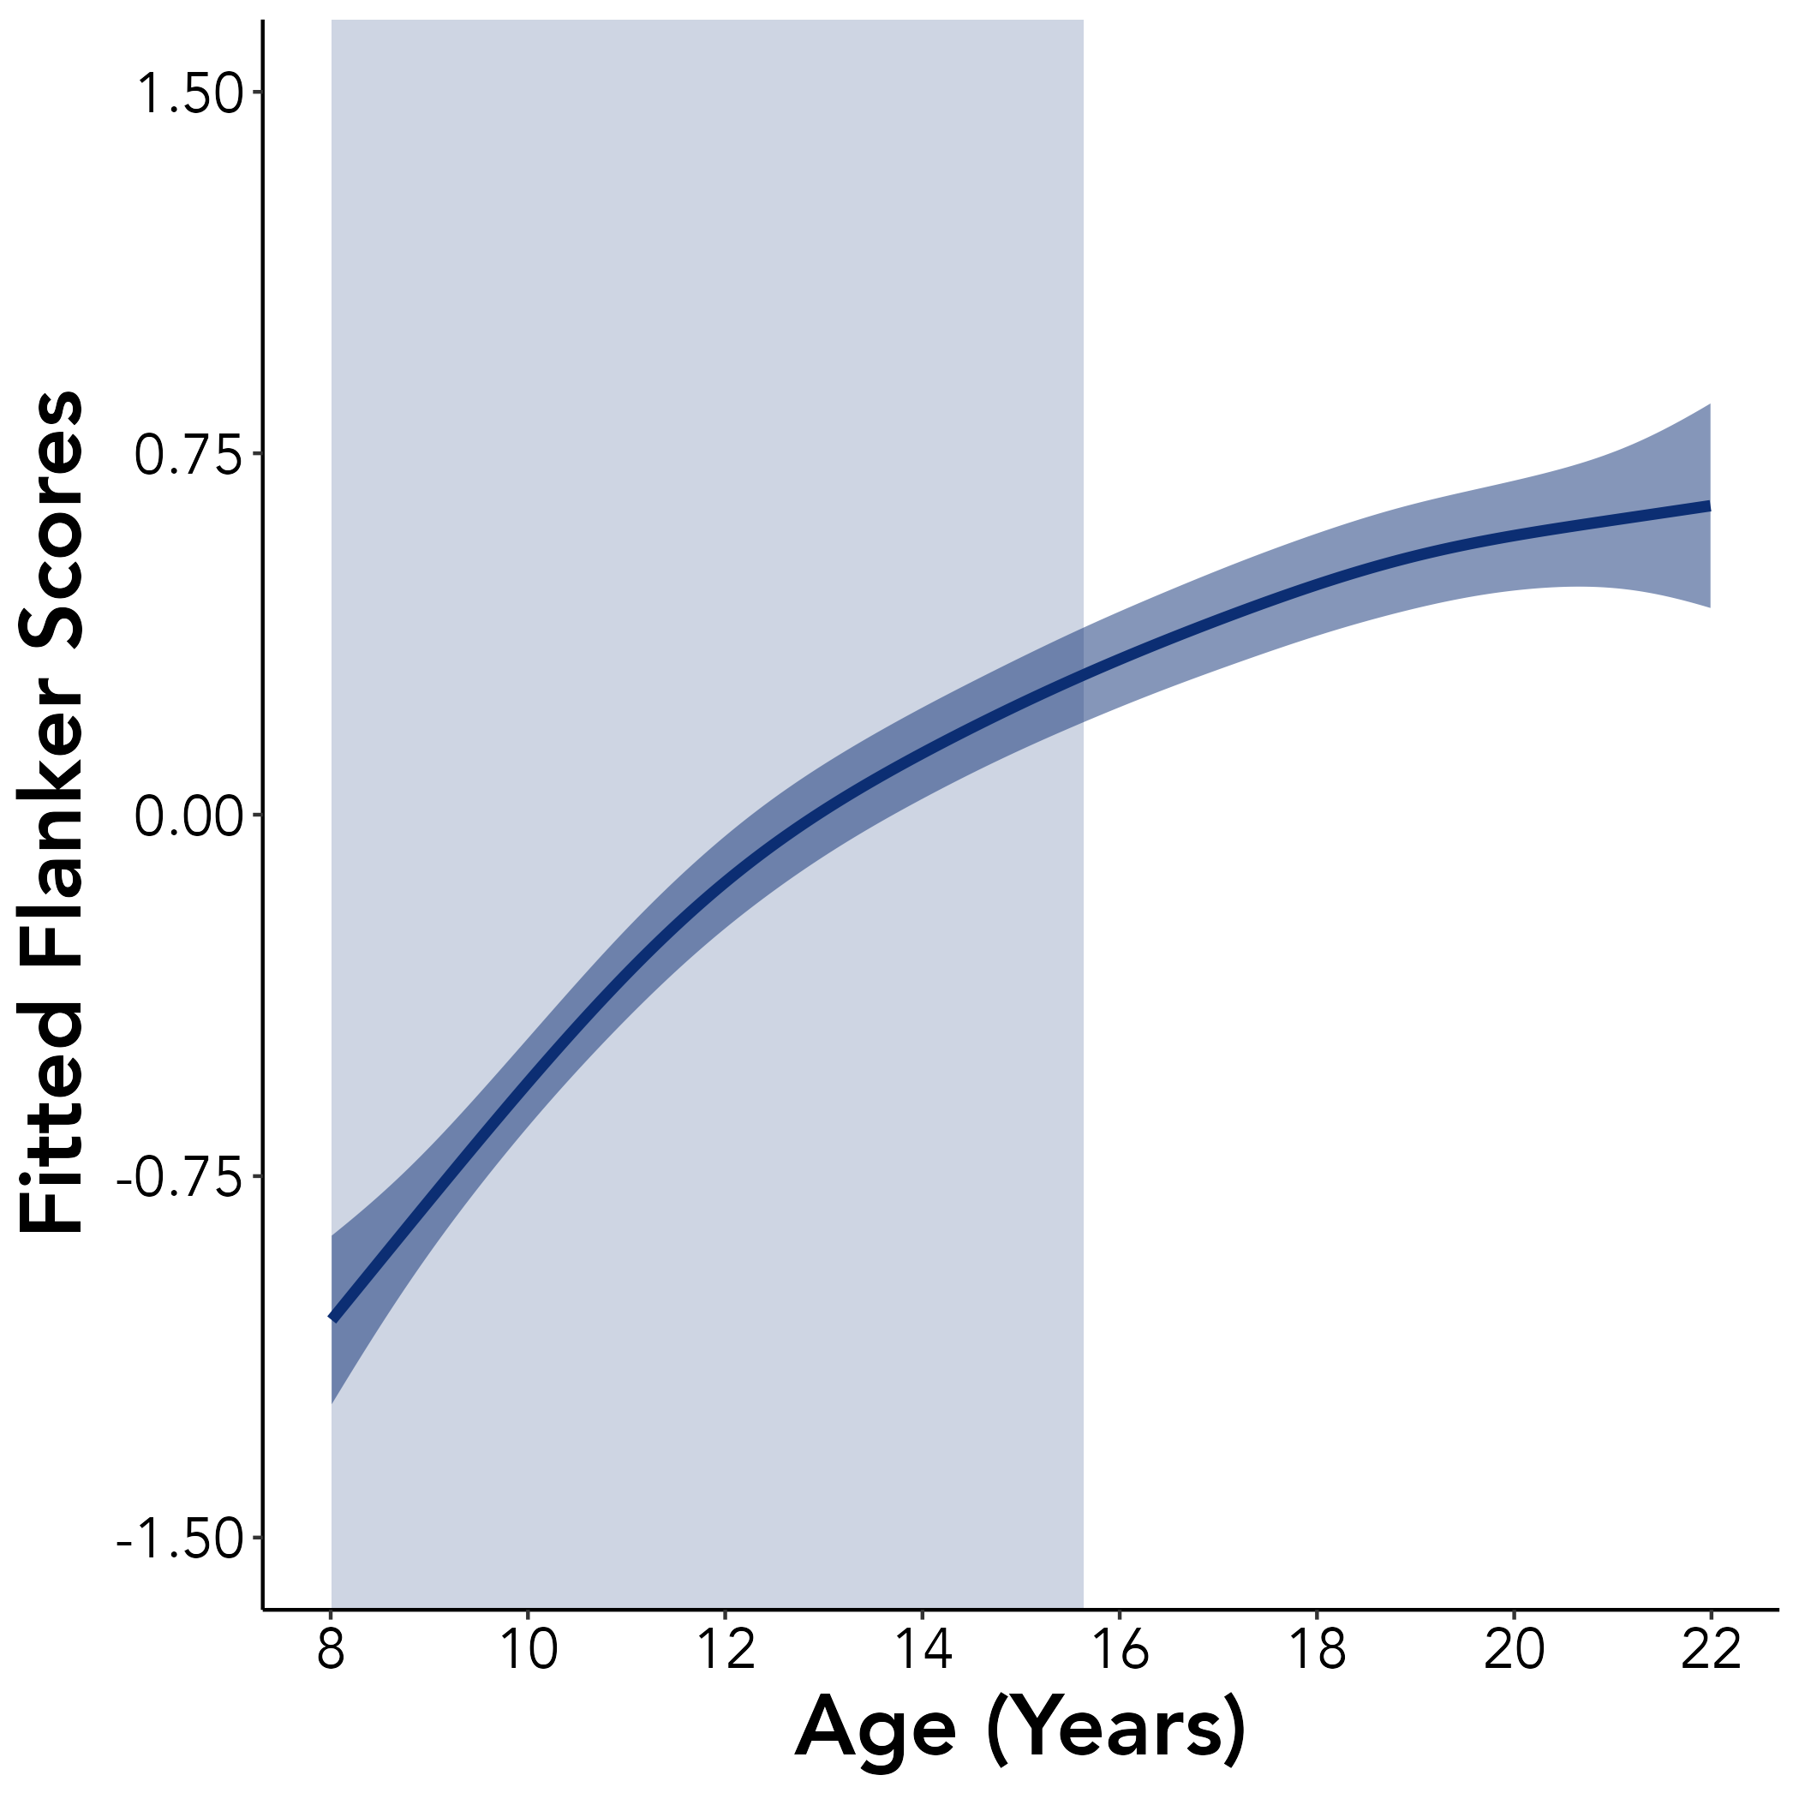
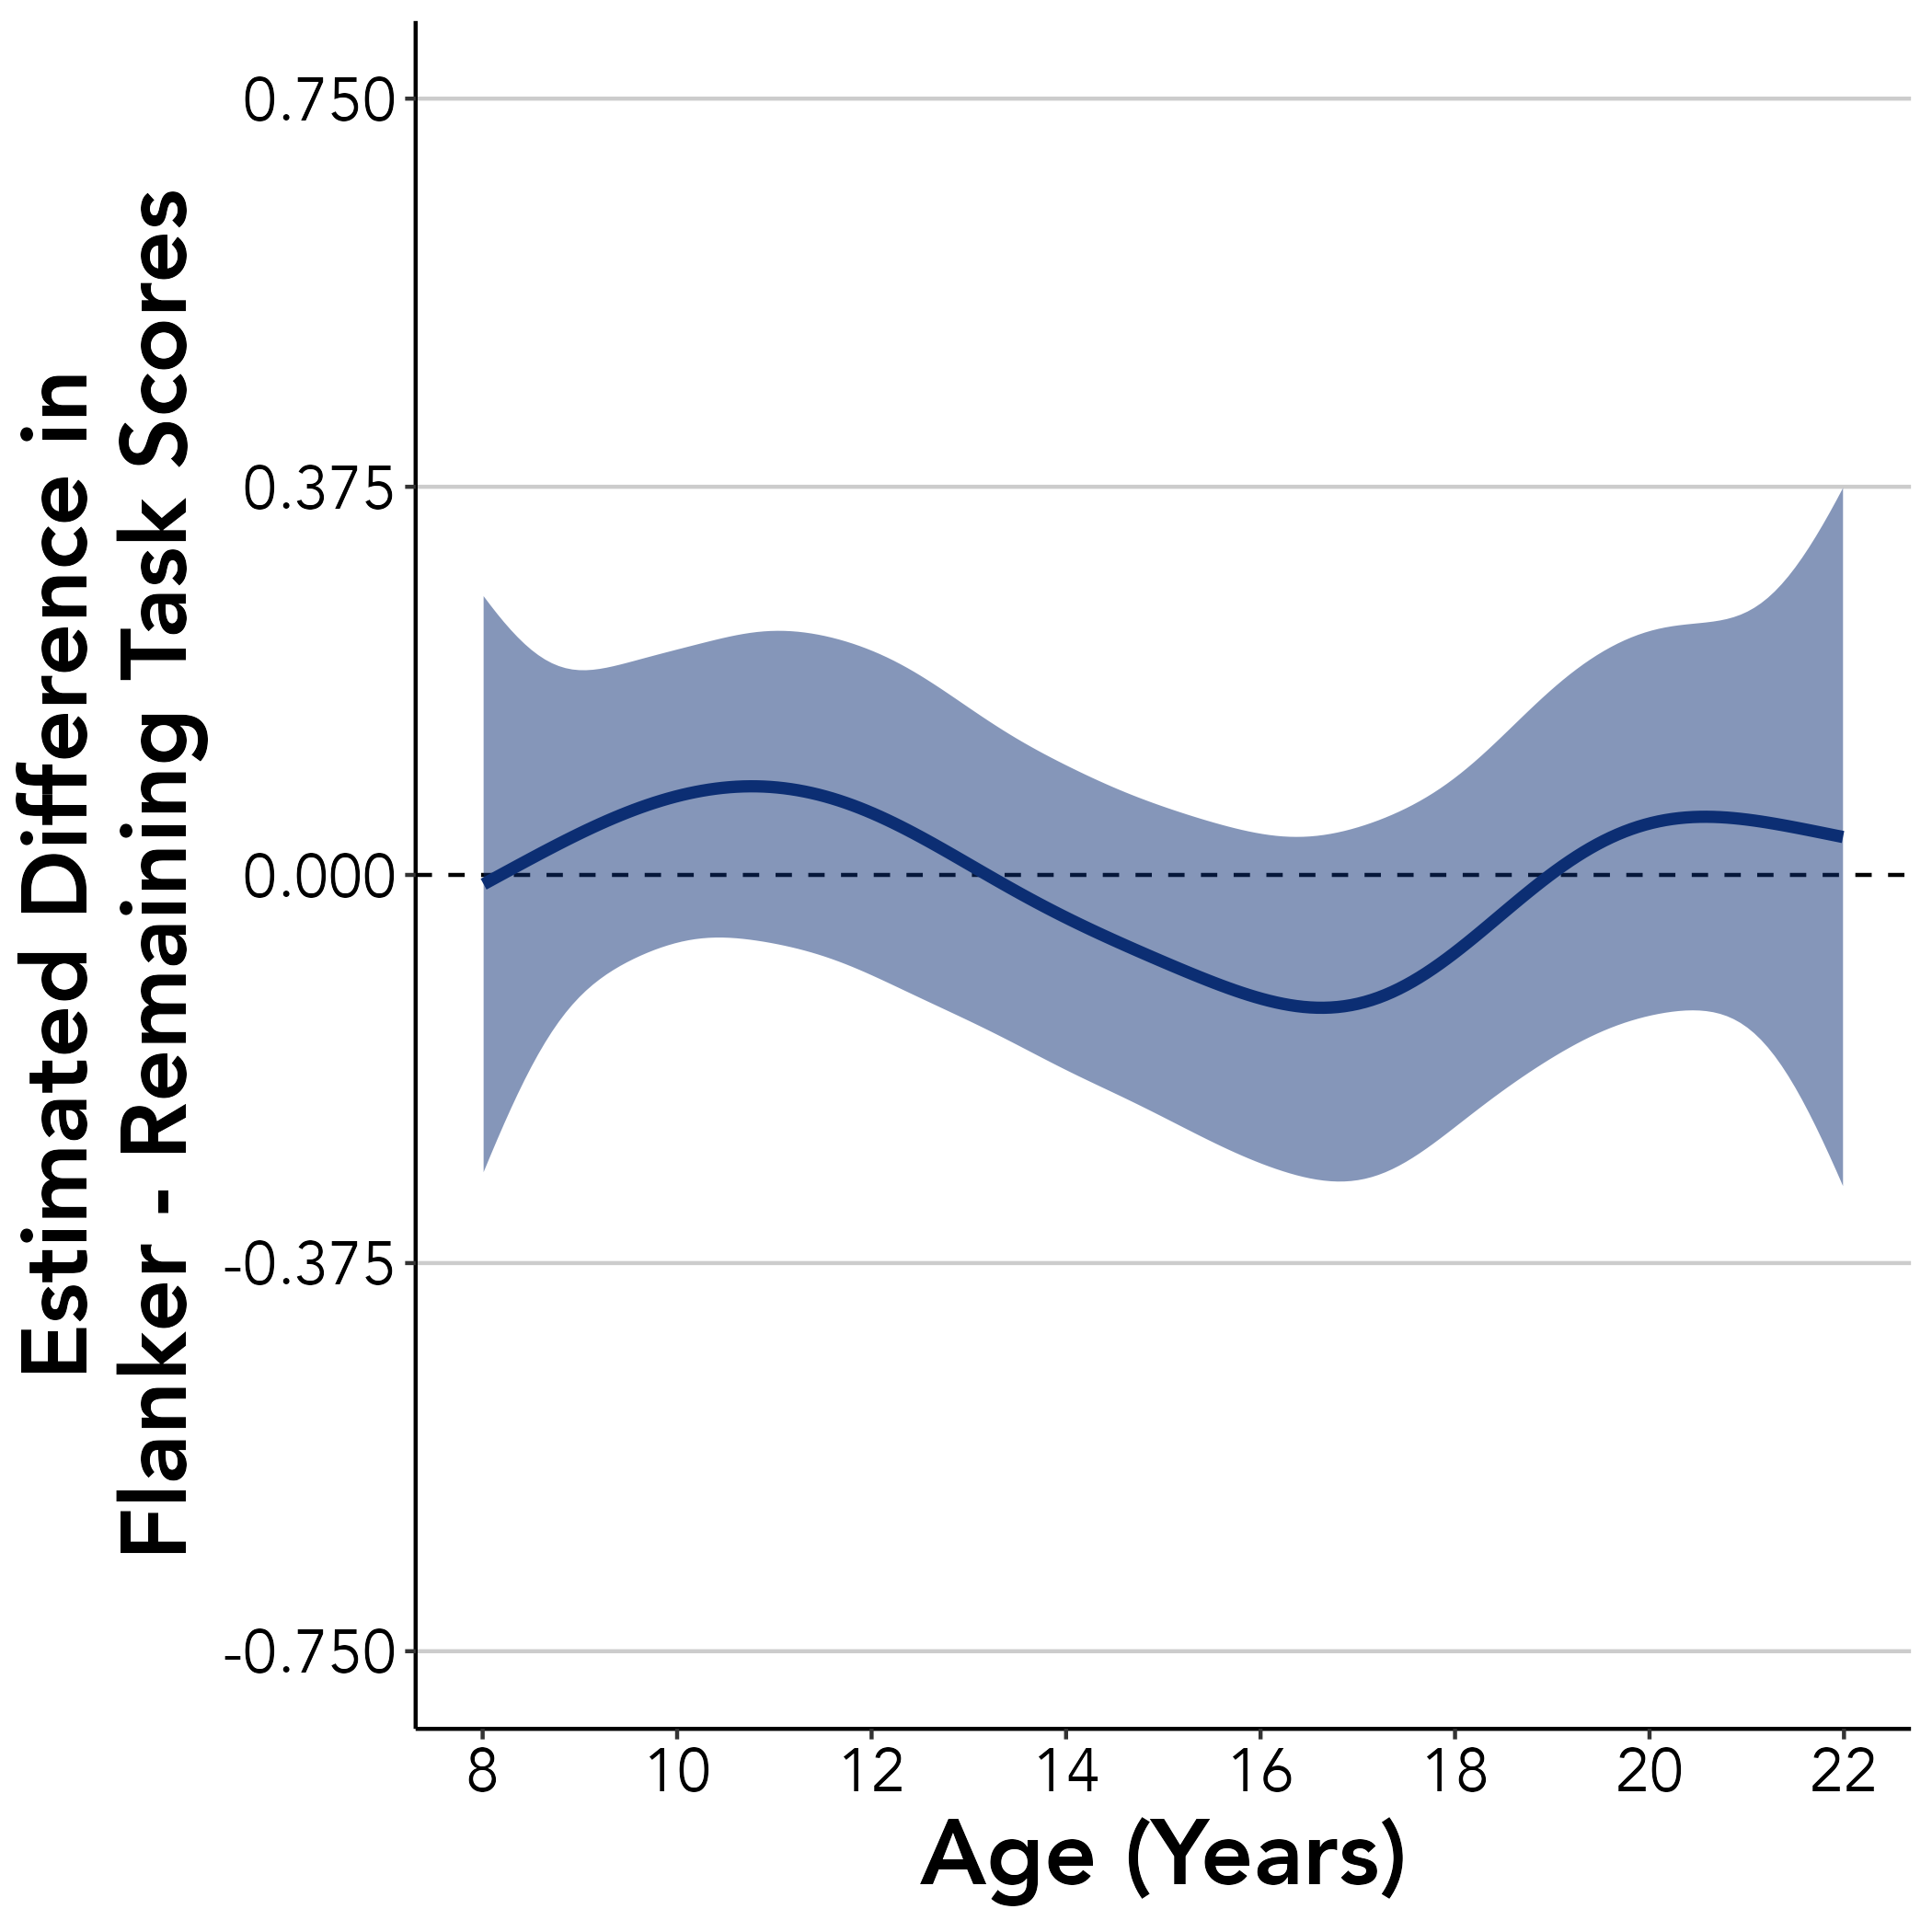
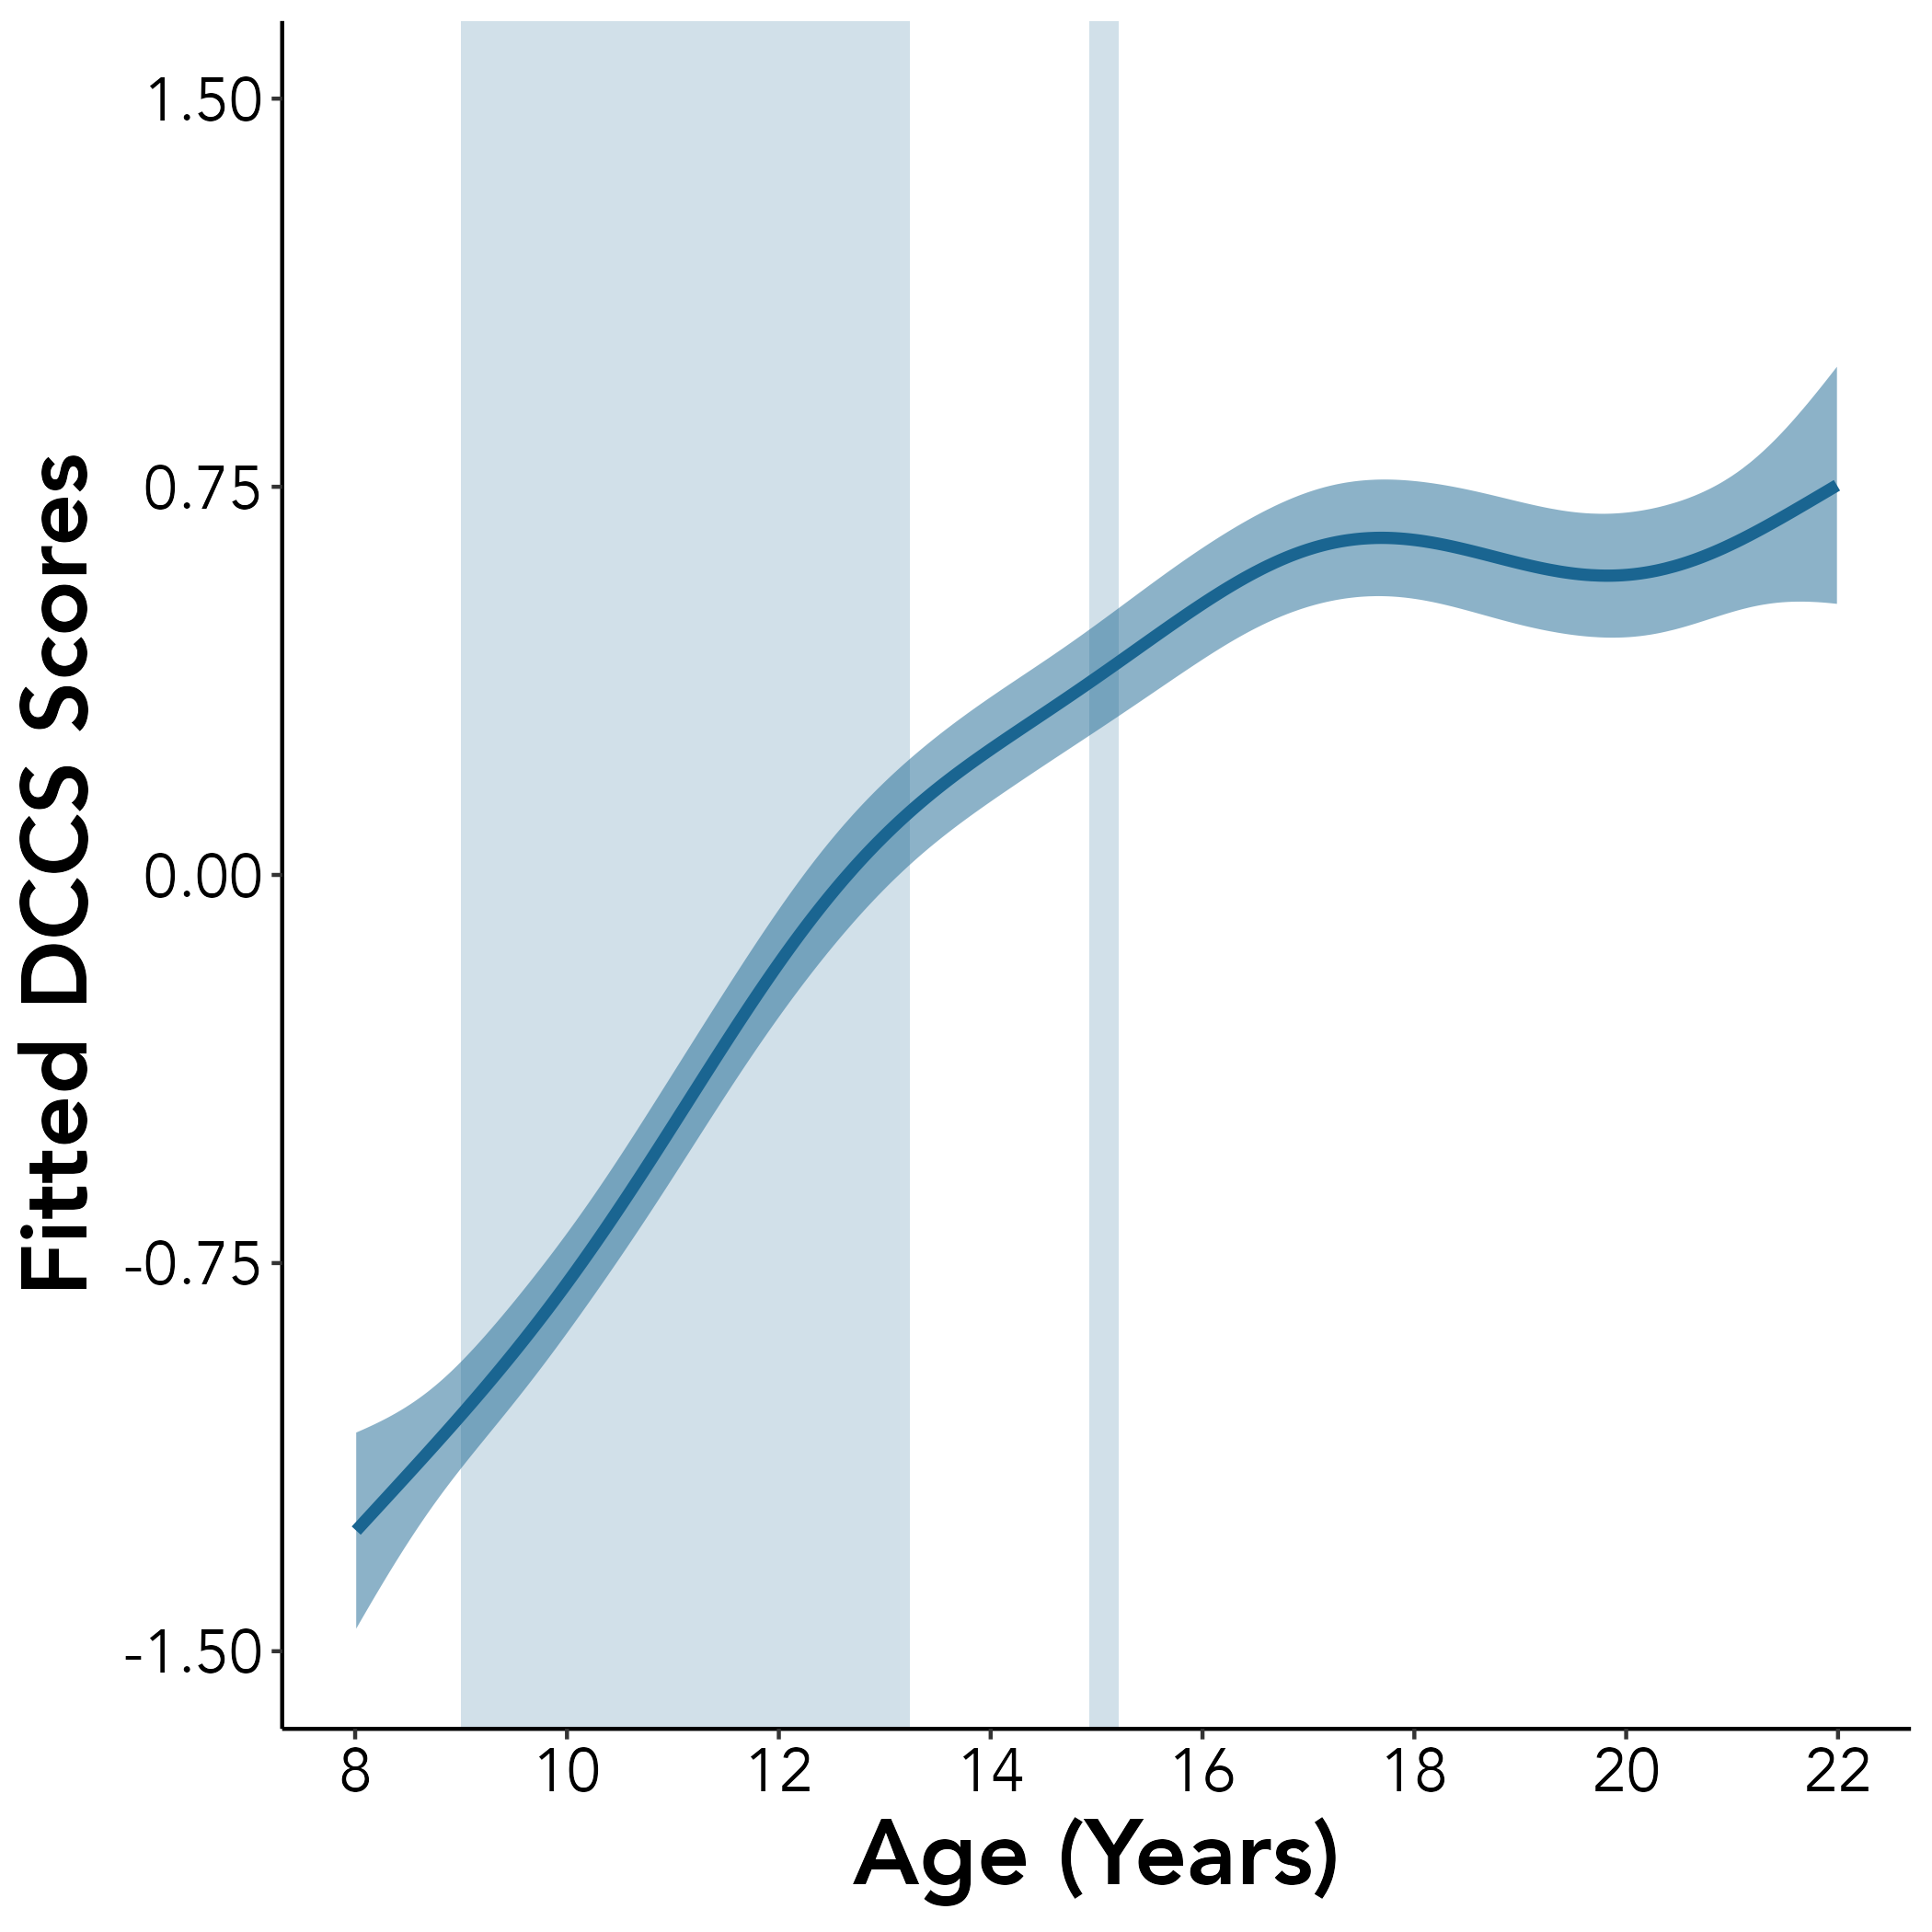
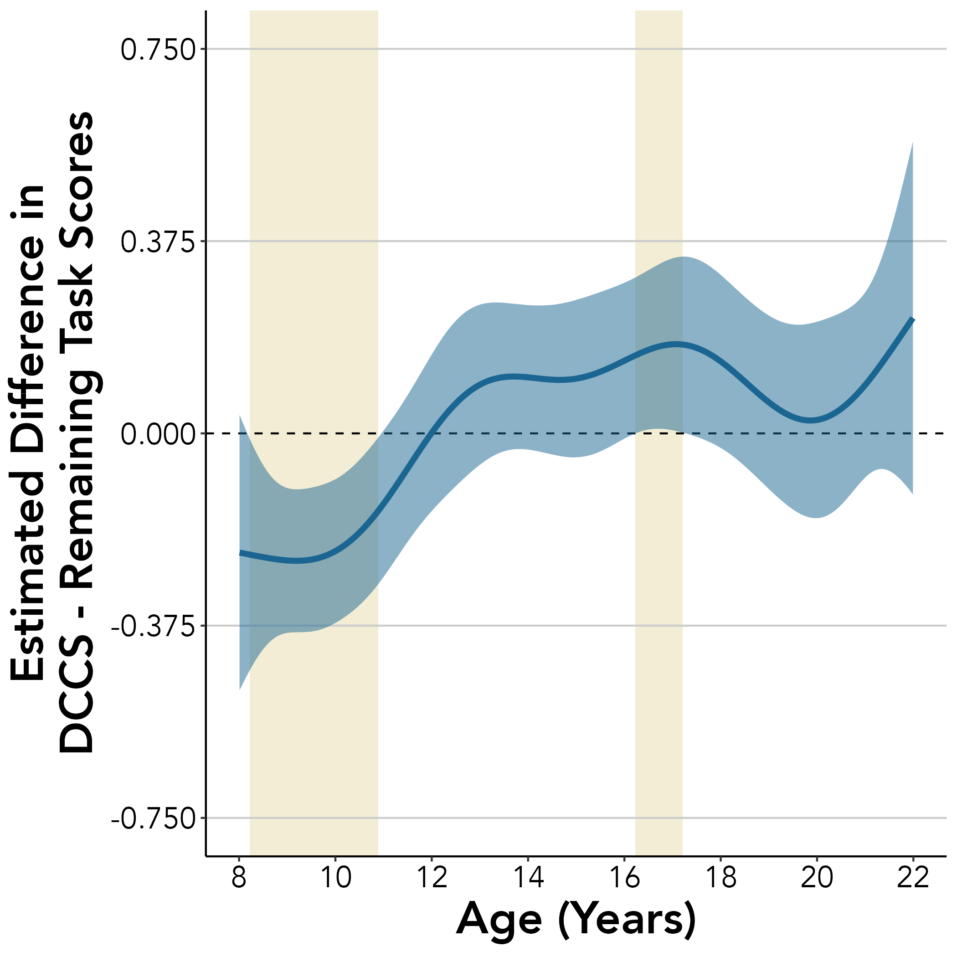
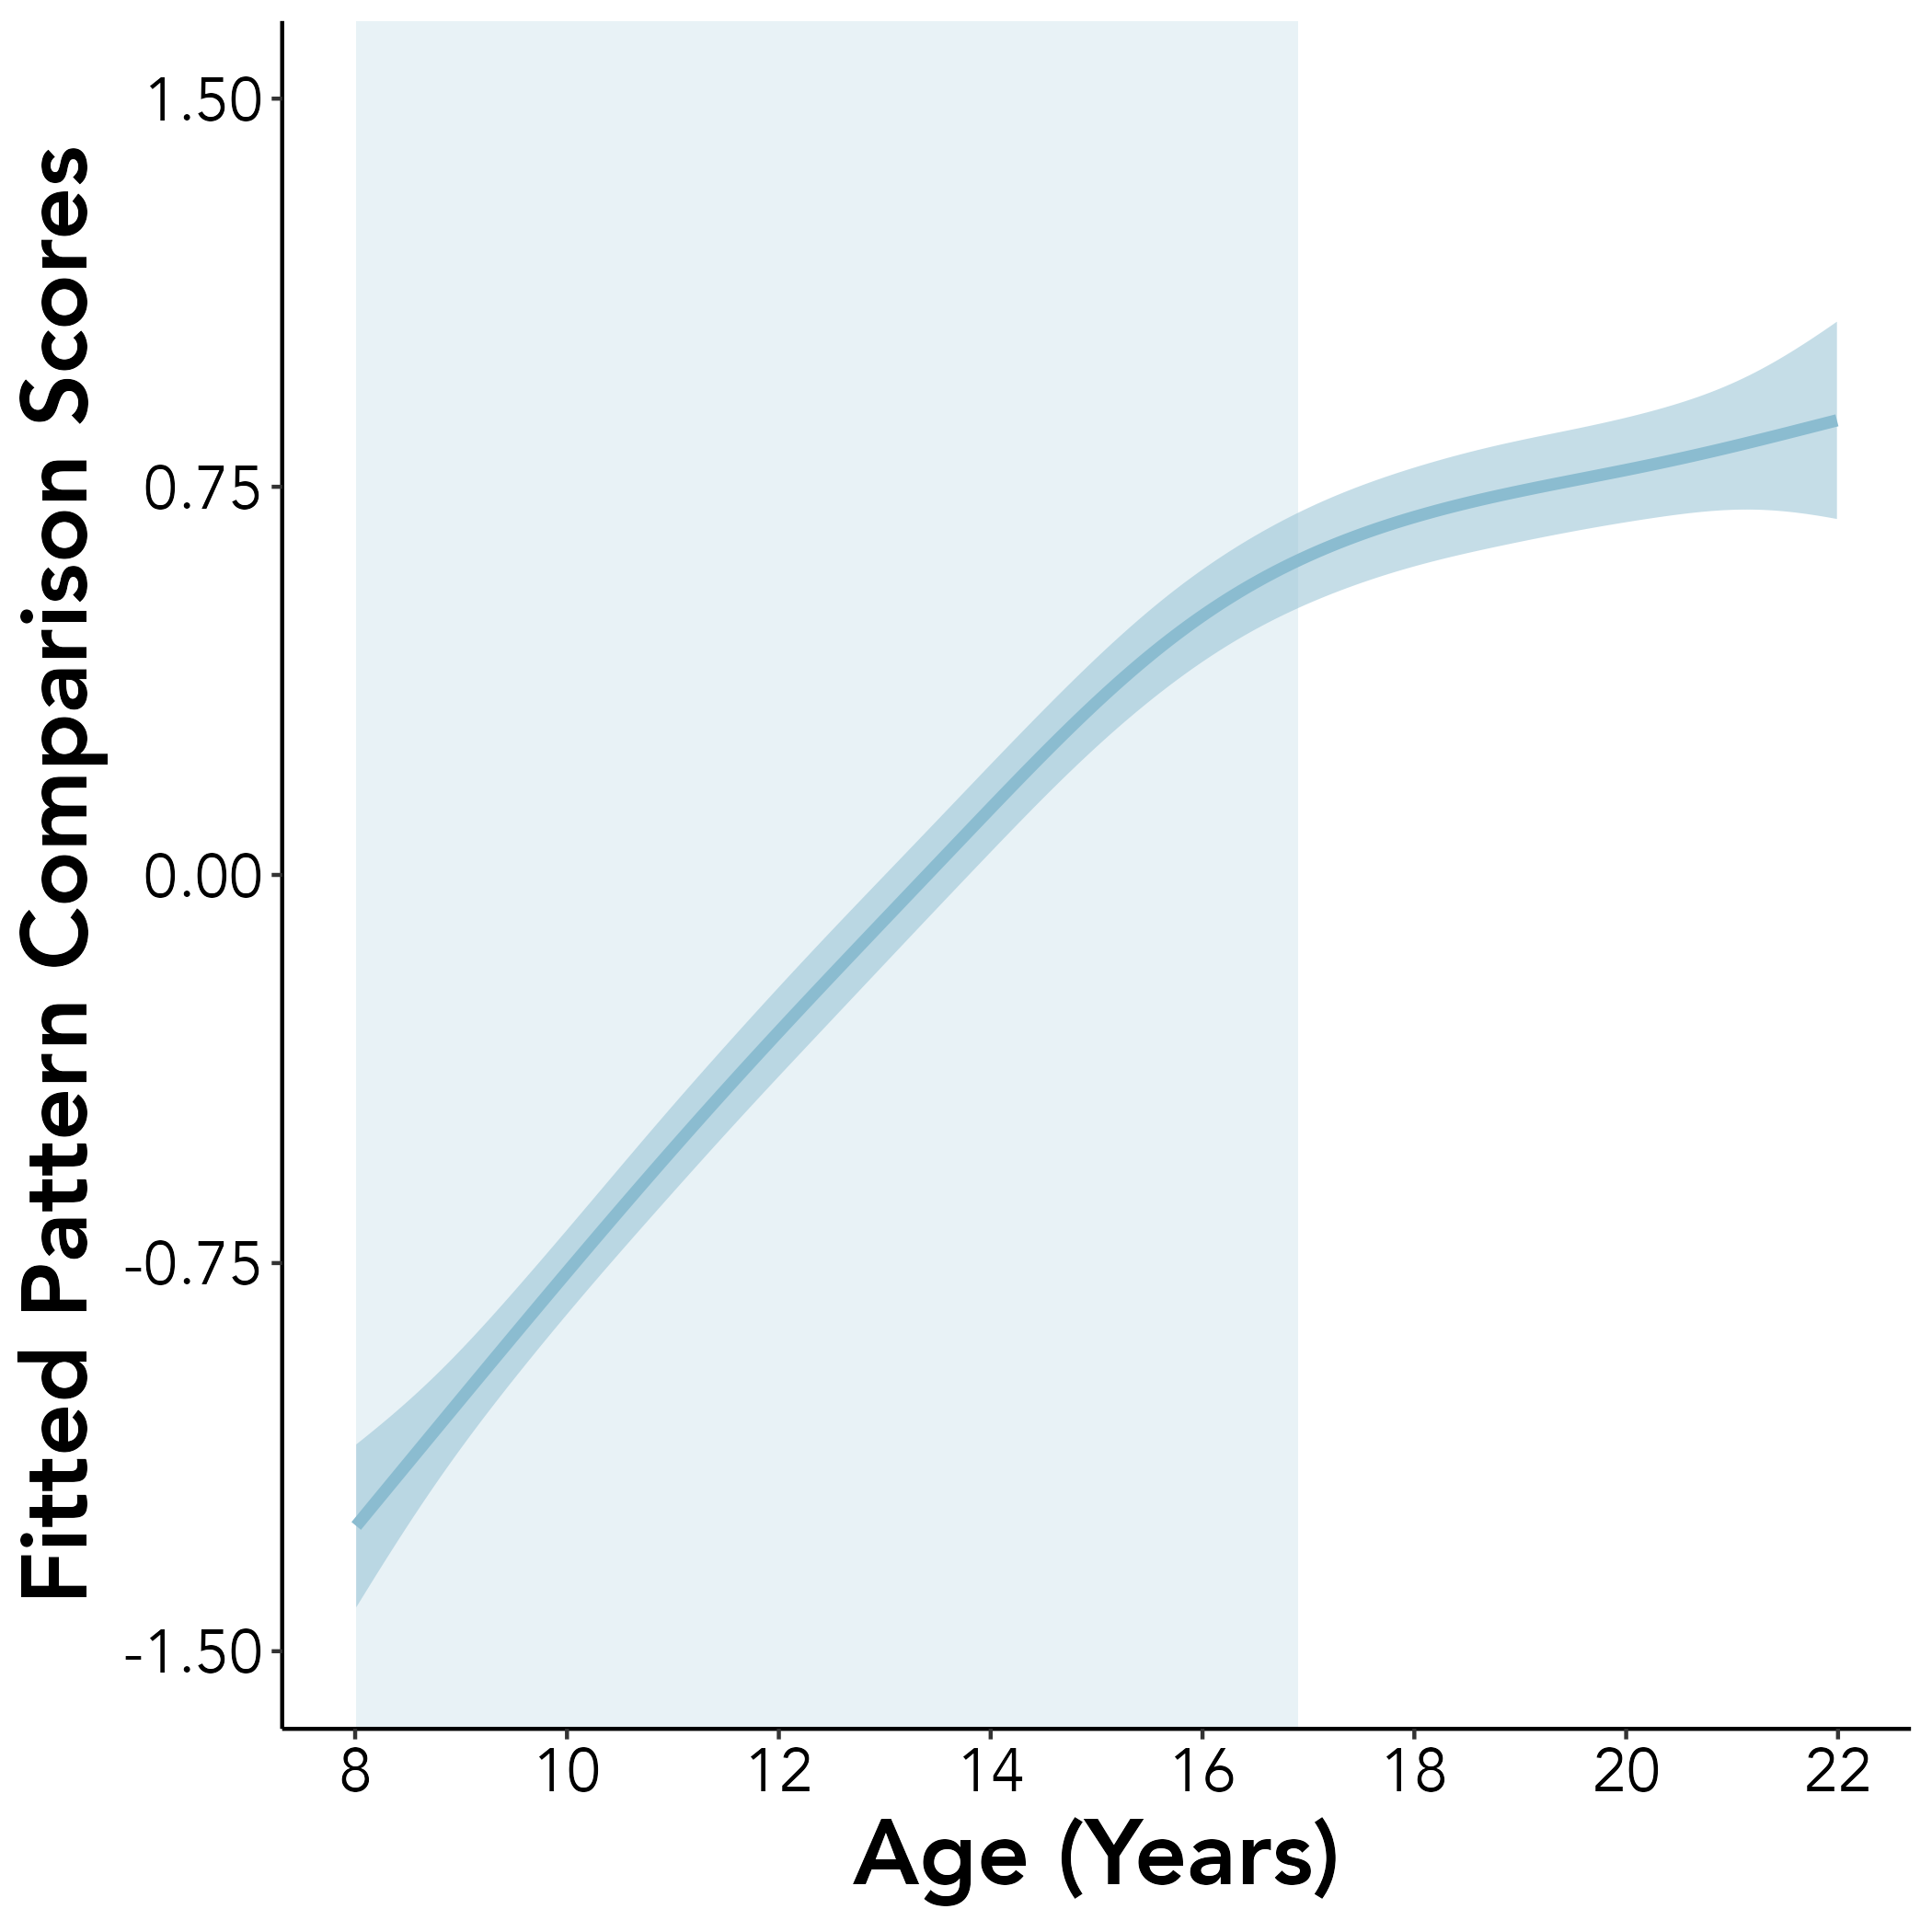
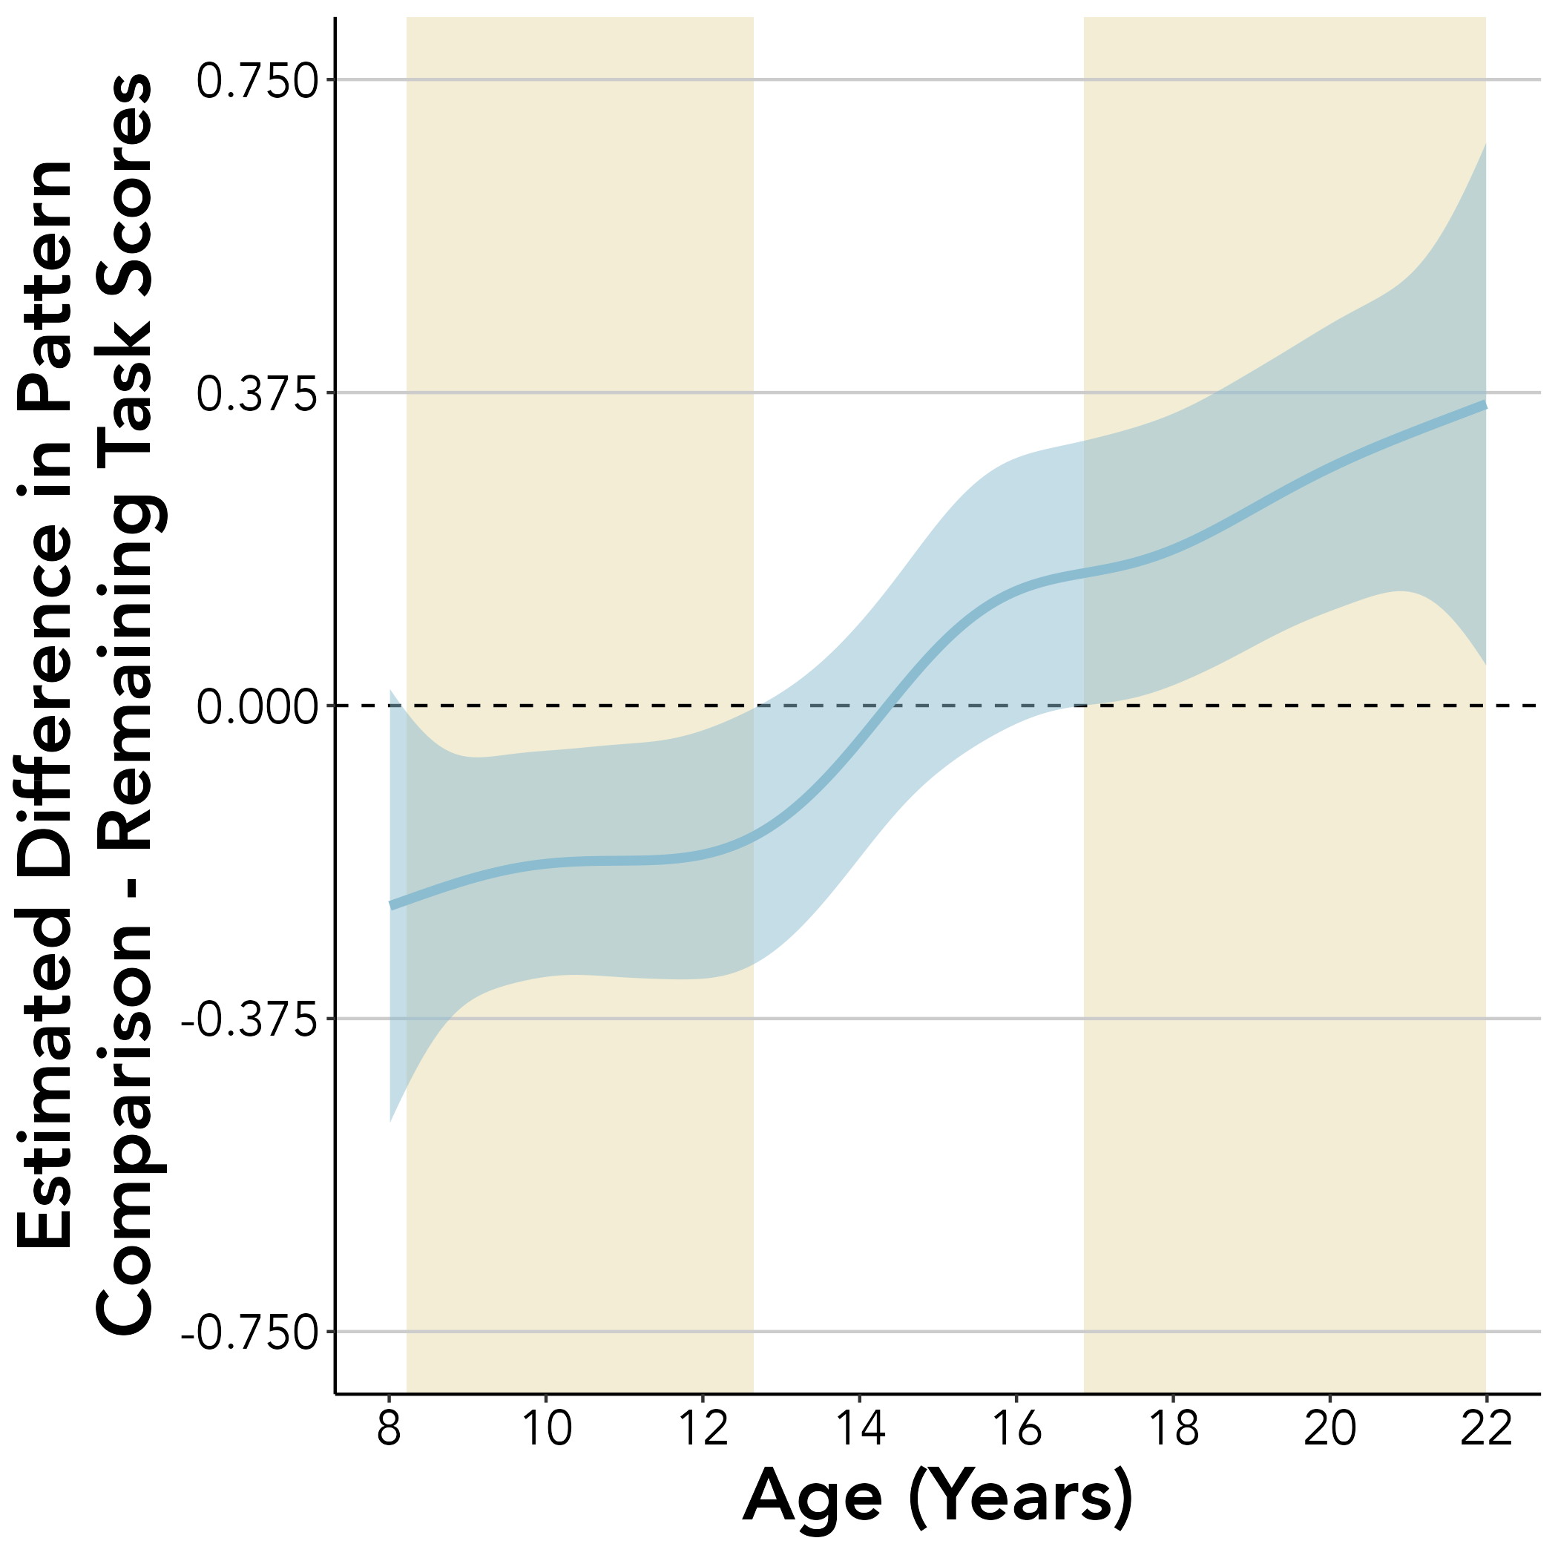
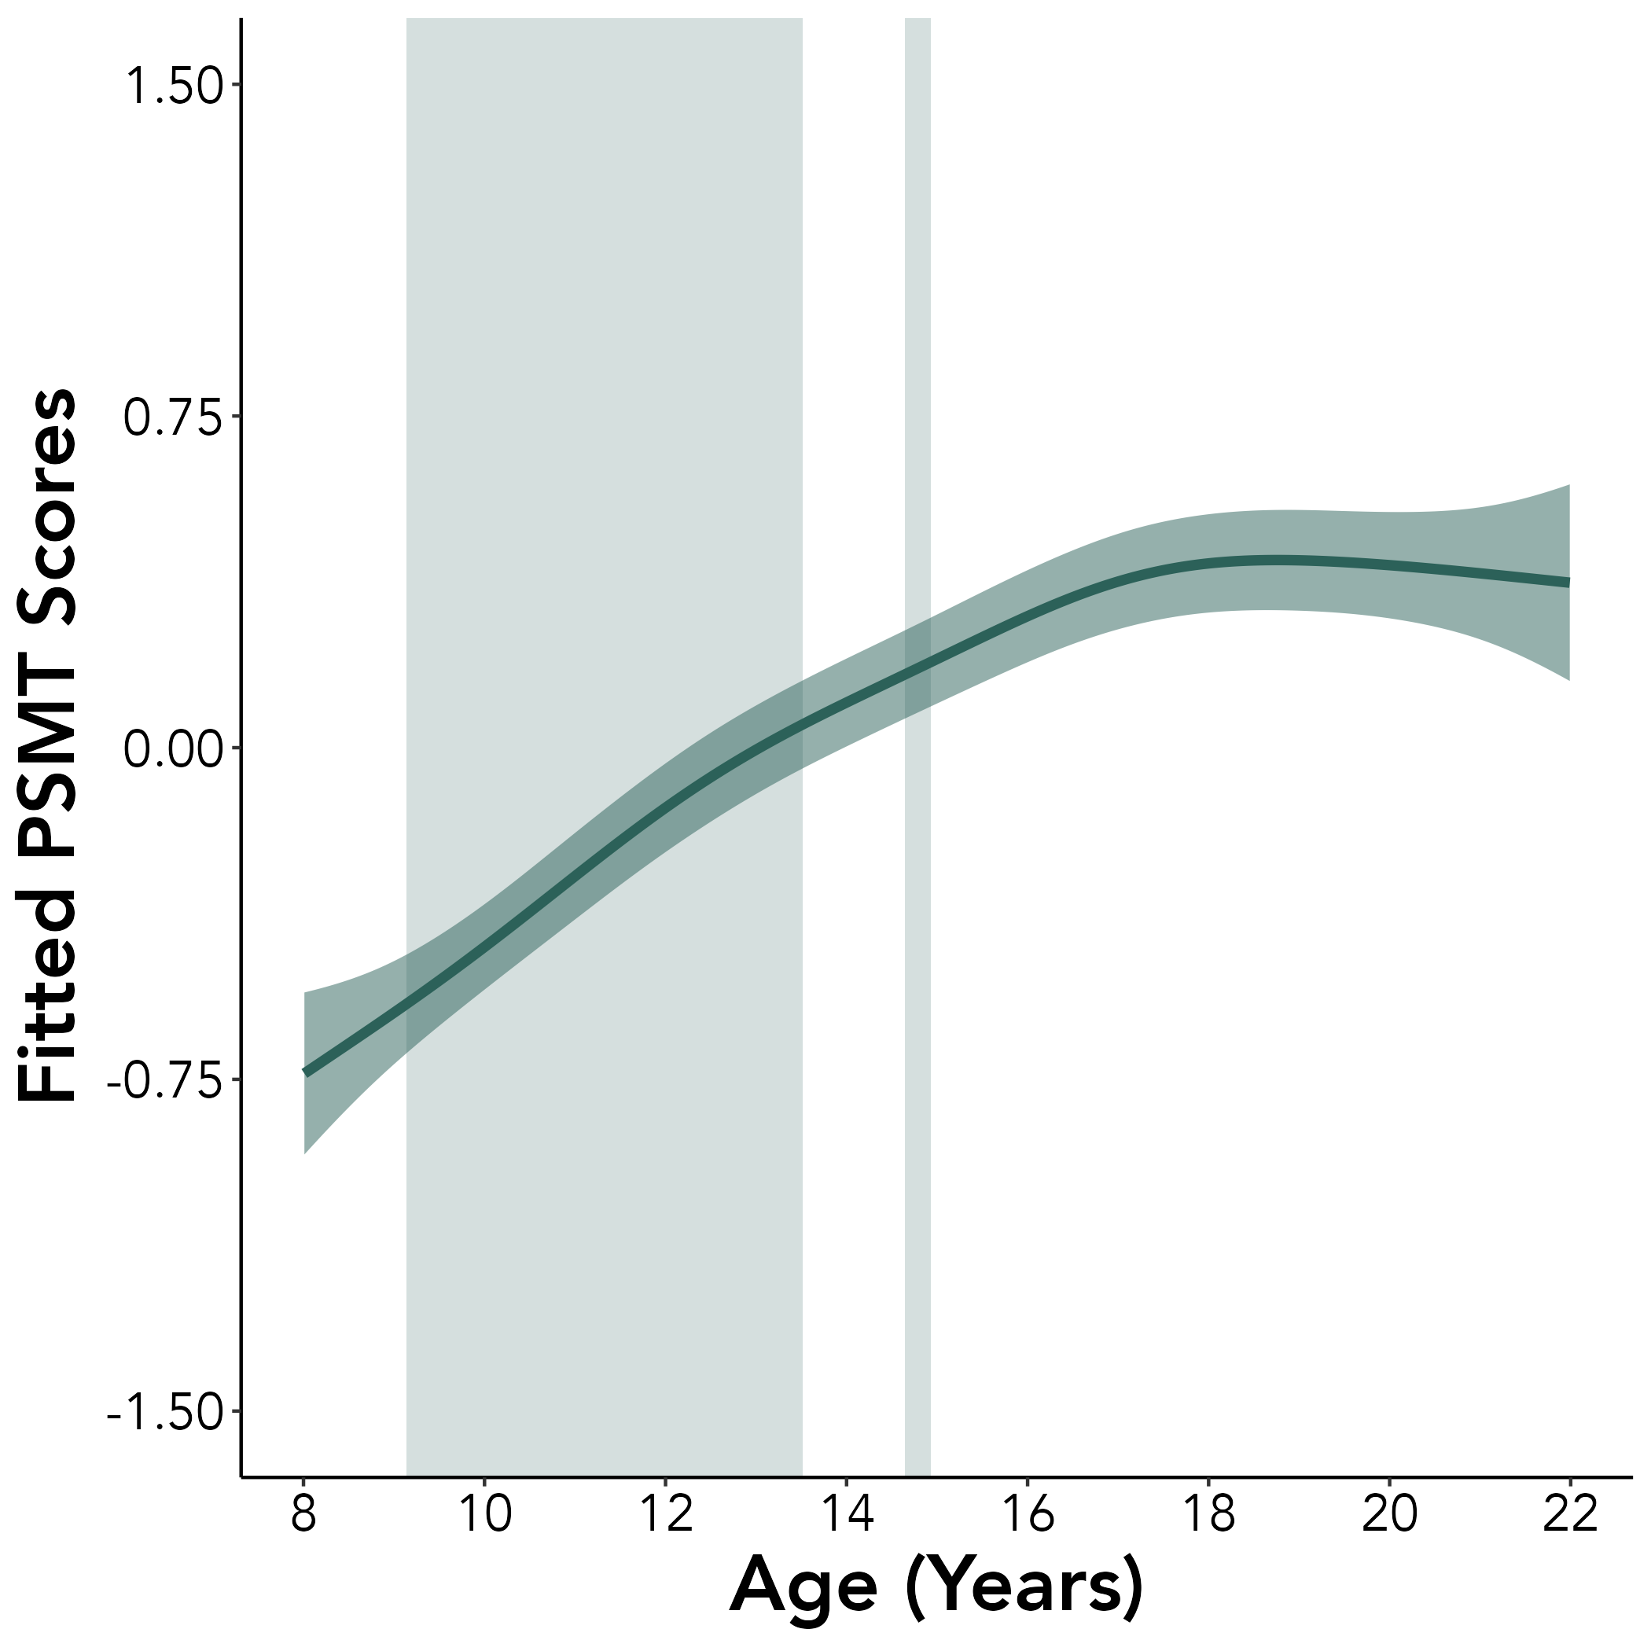
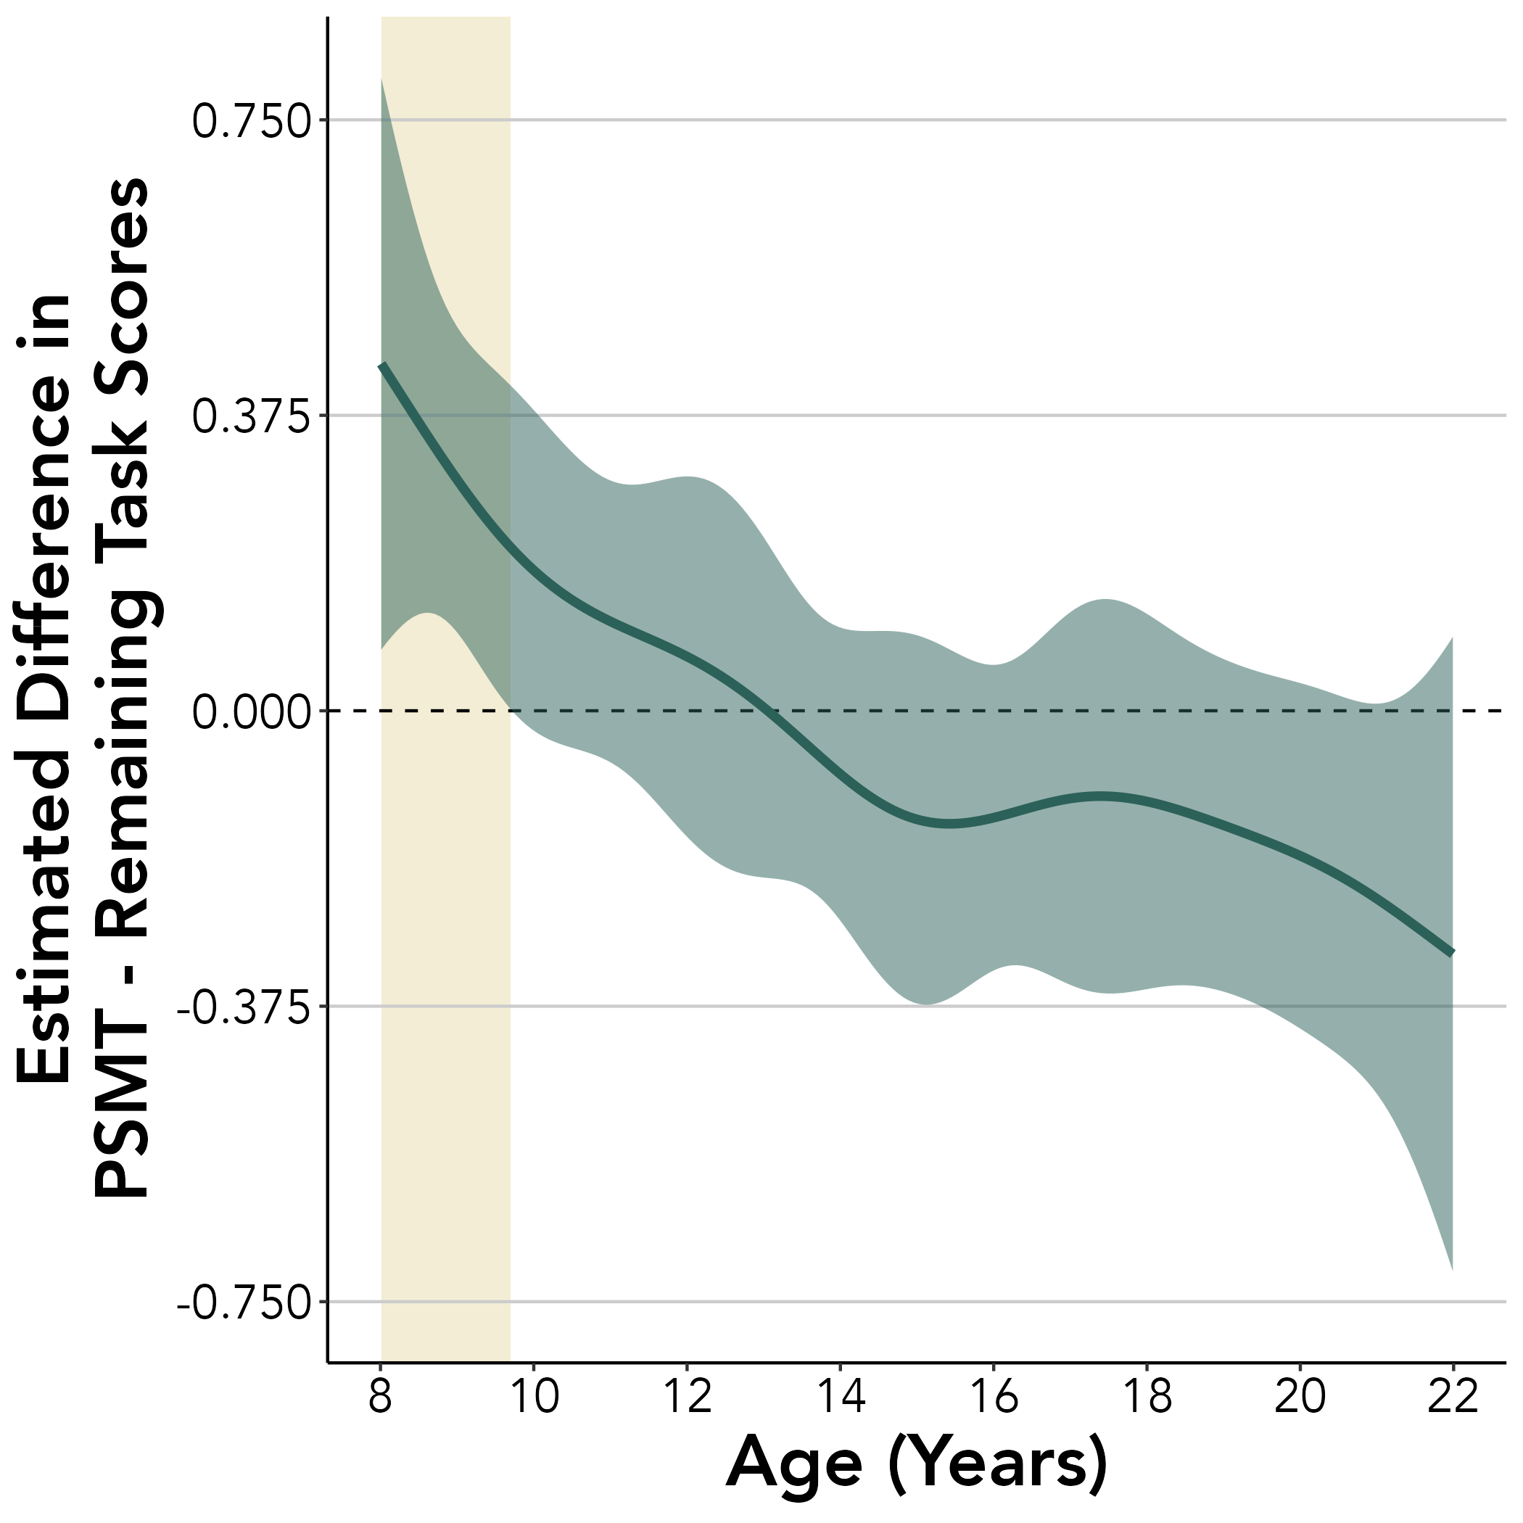
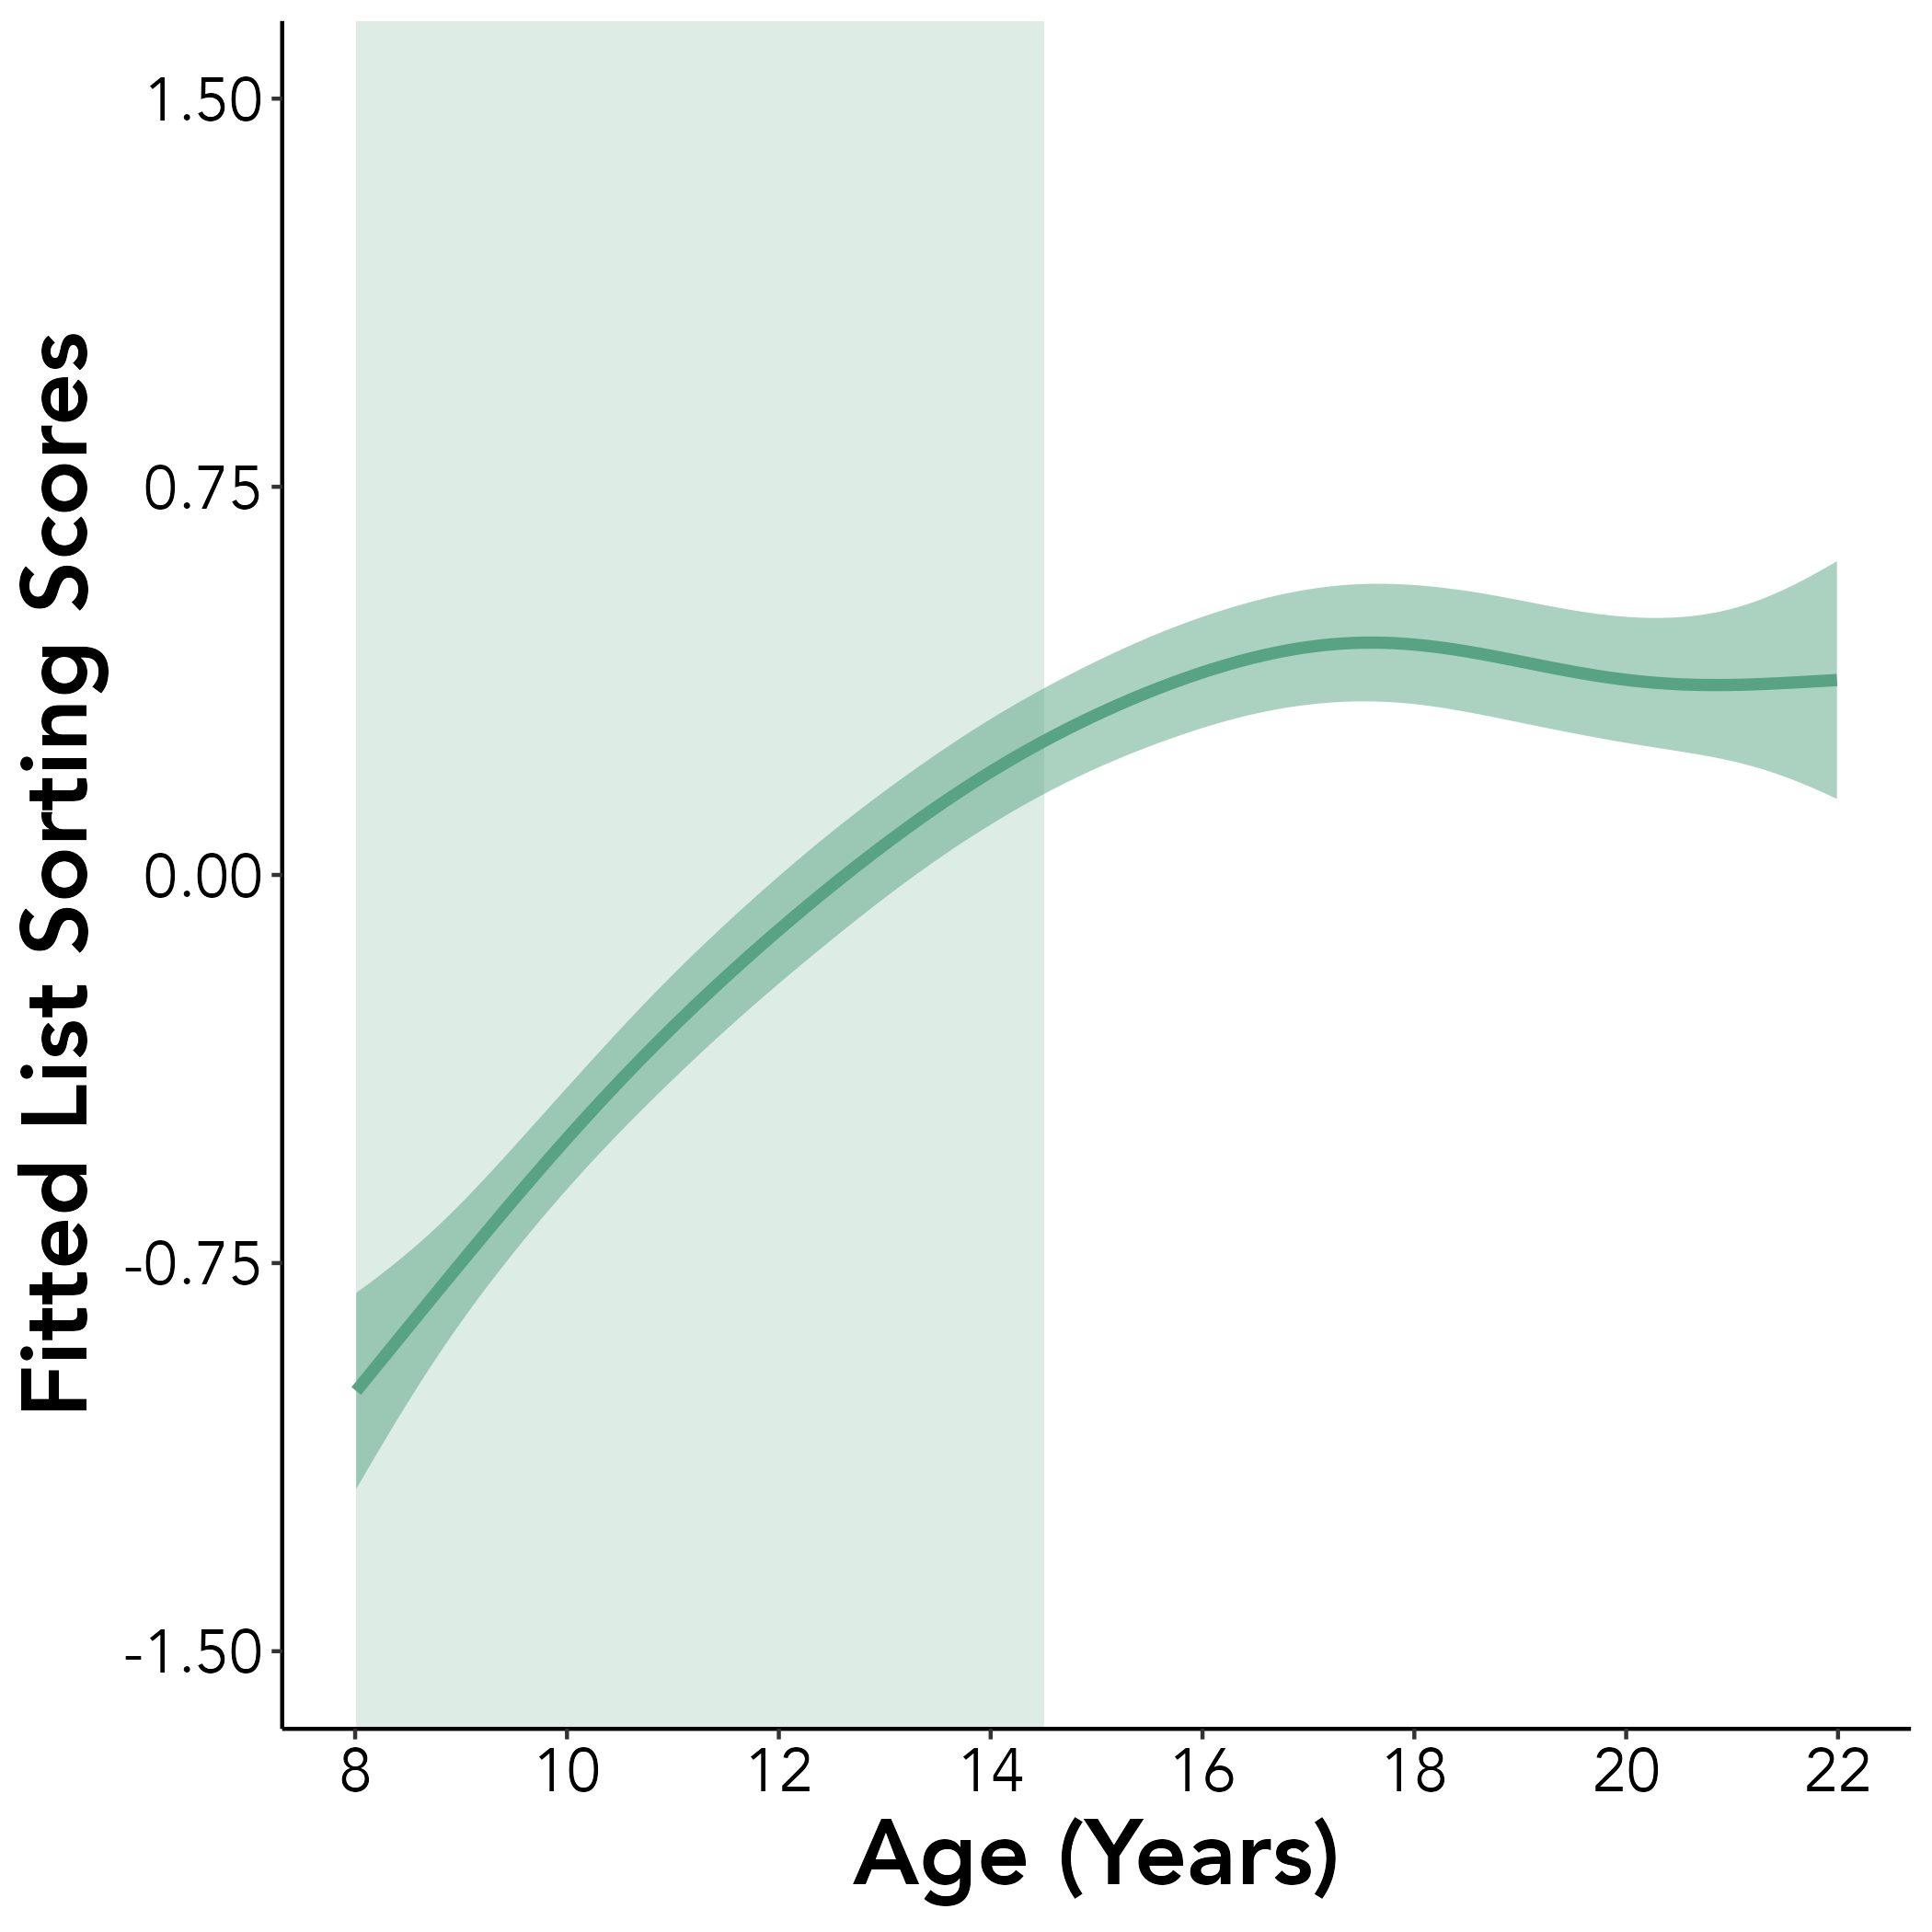
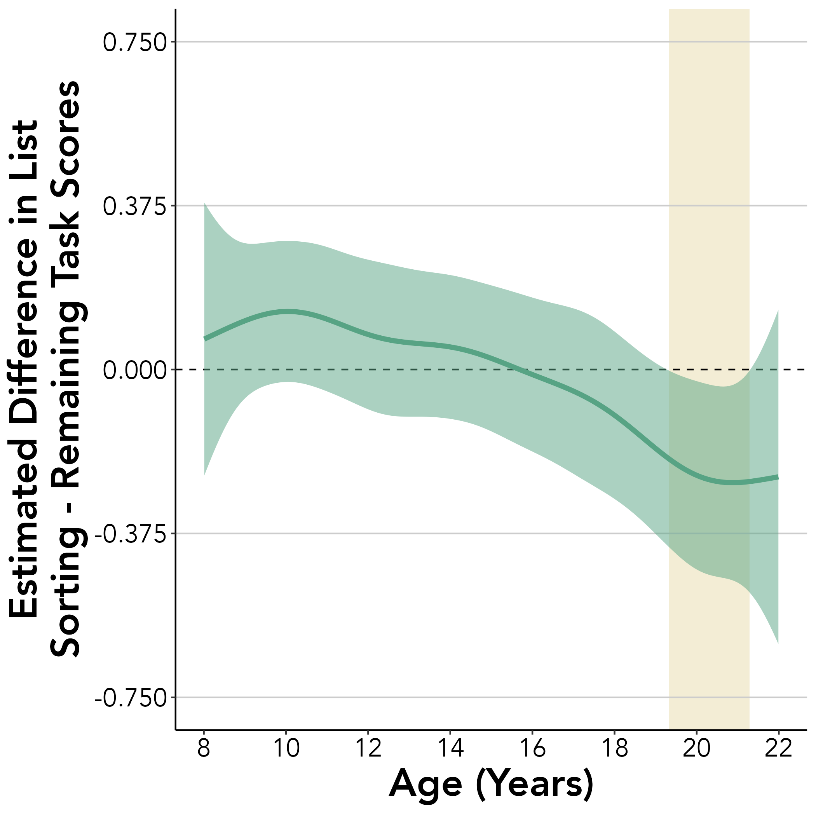
A.
B.
Flanker
DCCS
Pattern Comparison
PSMT
List Sorting
Notes:
Figure 1

Slide 4
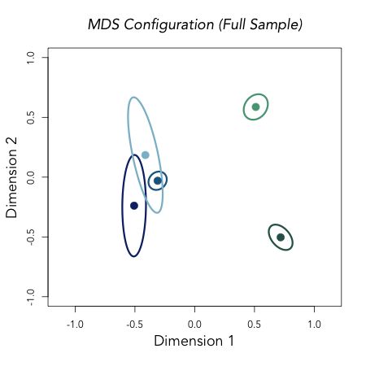
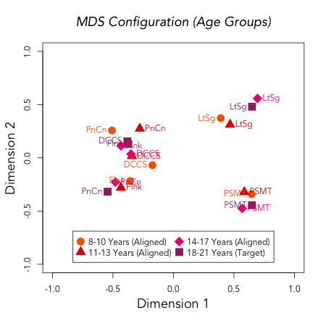
A.
B.
PnCn
LtSg
DCCS
PSMT
Flnk
Notes:
Figure 2

Slide 5
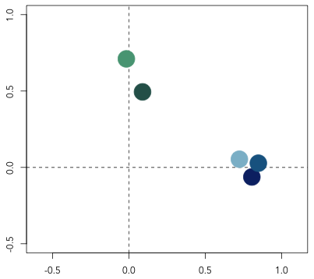
2-Factor EFA Loadings
LtSg
PSMT
Factor 2: Memory
PnCn
DCCS
Flnk
Factor 1: Cognitive Control
Notes:
Figure 3

Slide 6
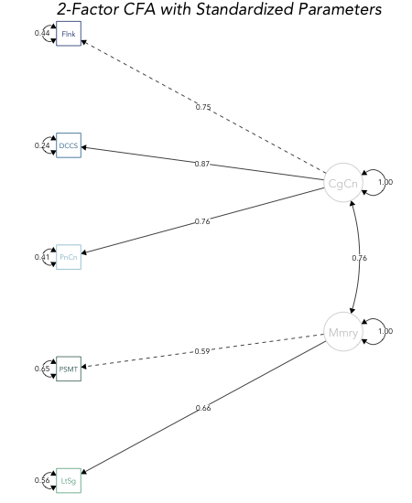
2-Factor CFA with Standardized Parameters
Flnk
0.44
0.75
DCCS
0.24
CgCn
0.87
1.00
PnCn
0.76
0.41
0.76
Mmry
PSMT
0.59
1.00
0.65
0.66
LtSg
0.56
Notes:
Figure 4

Slide 7
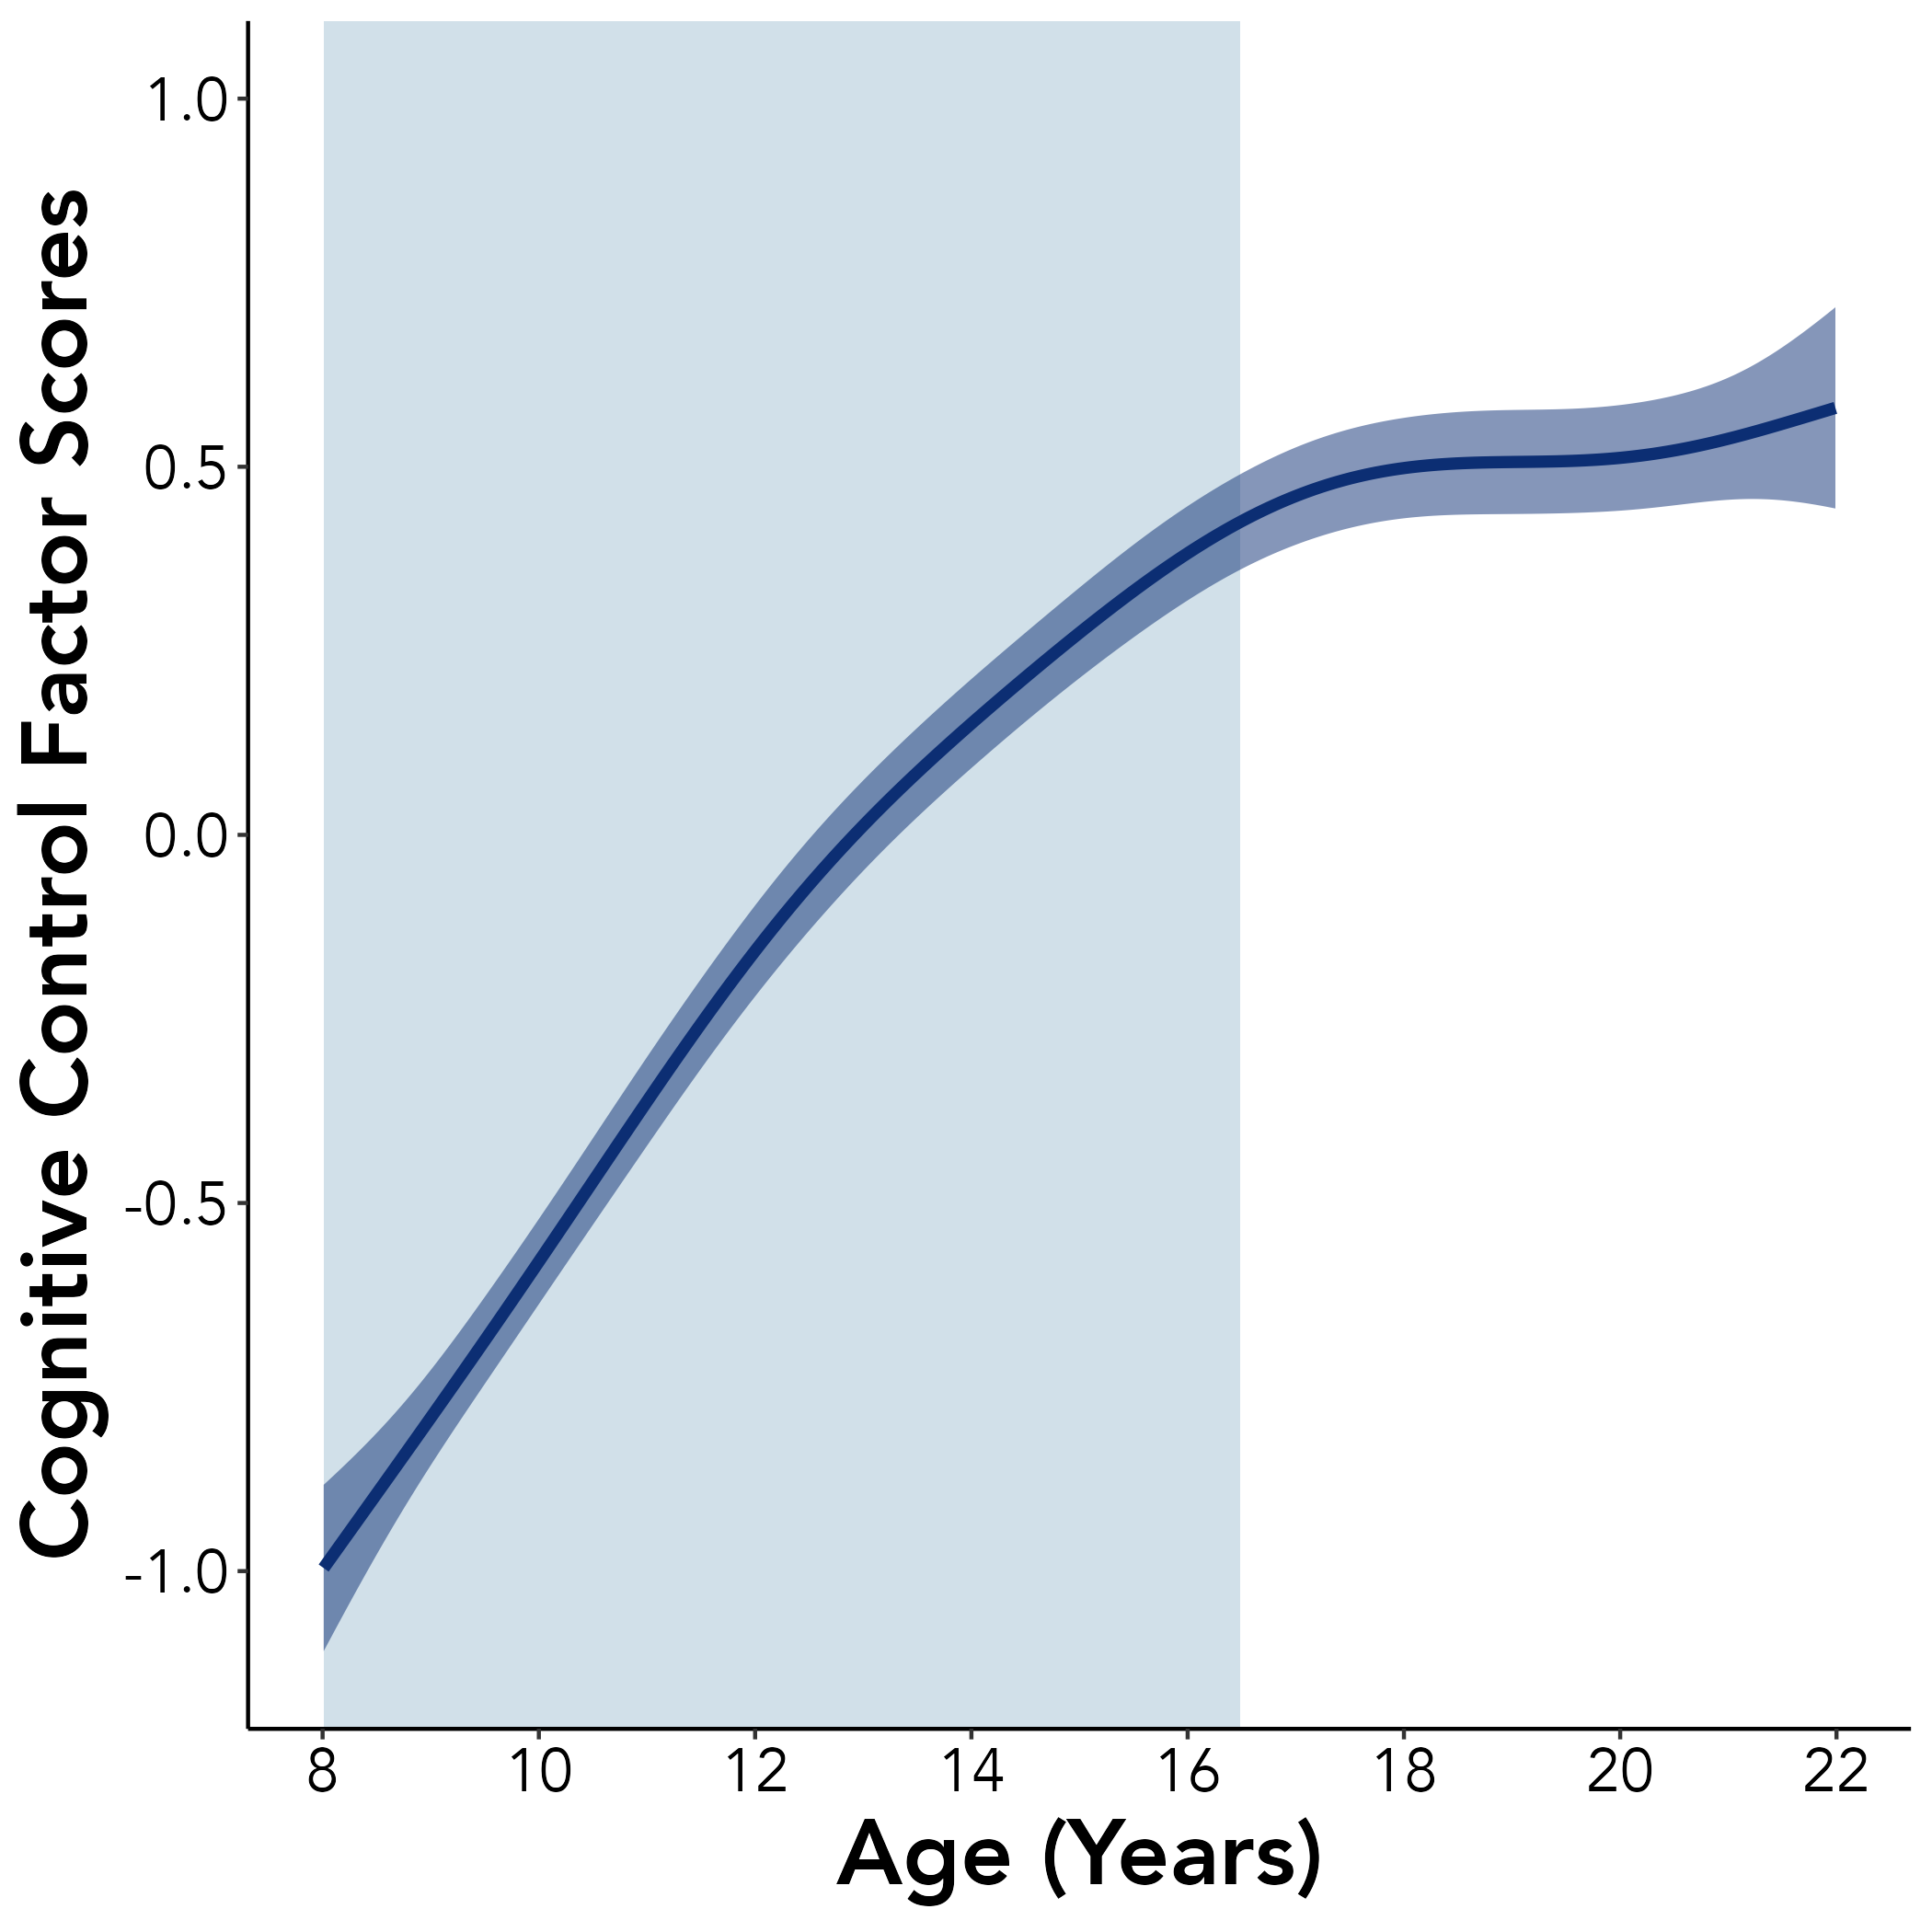
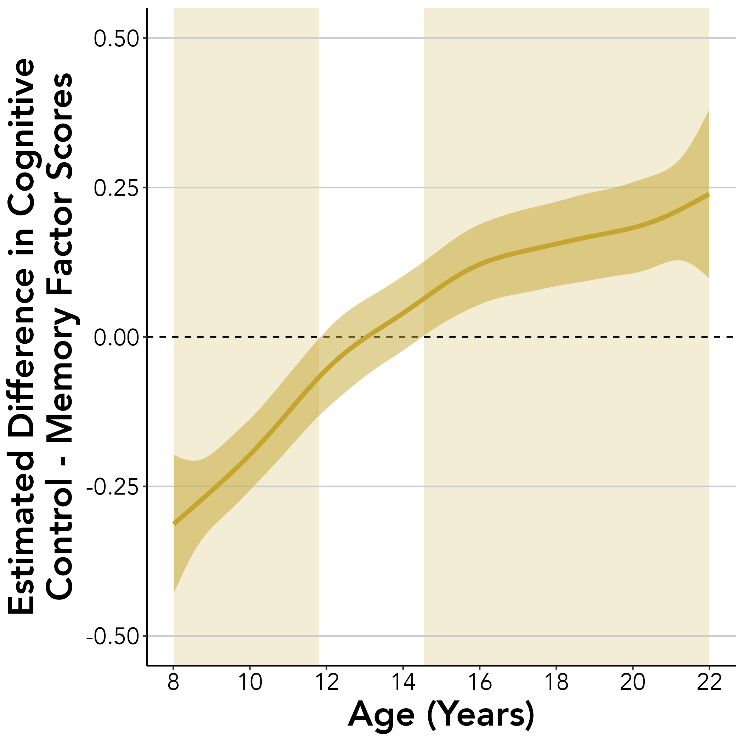
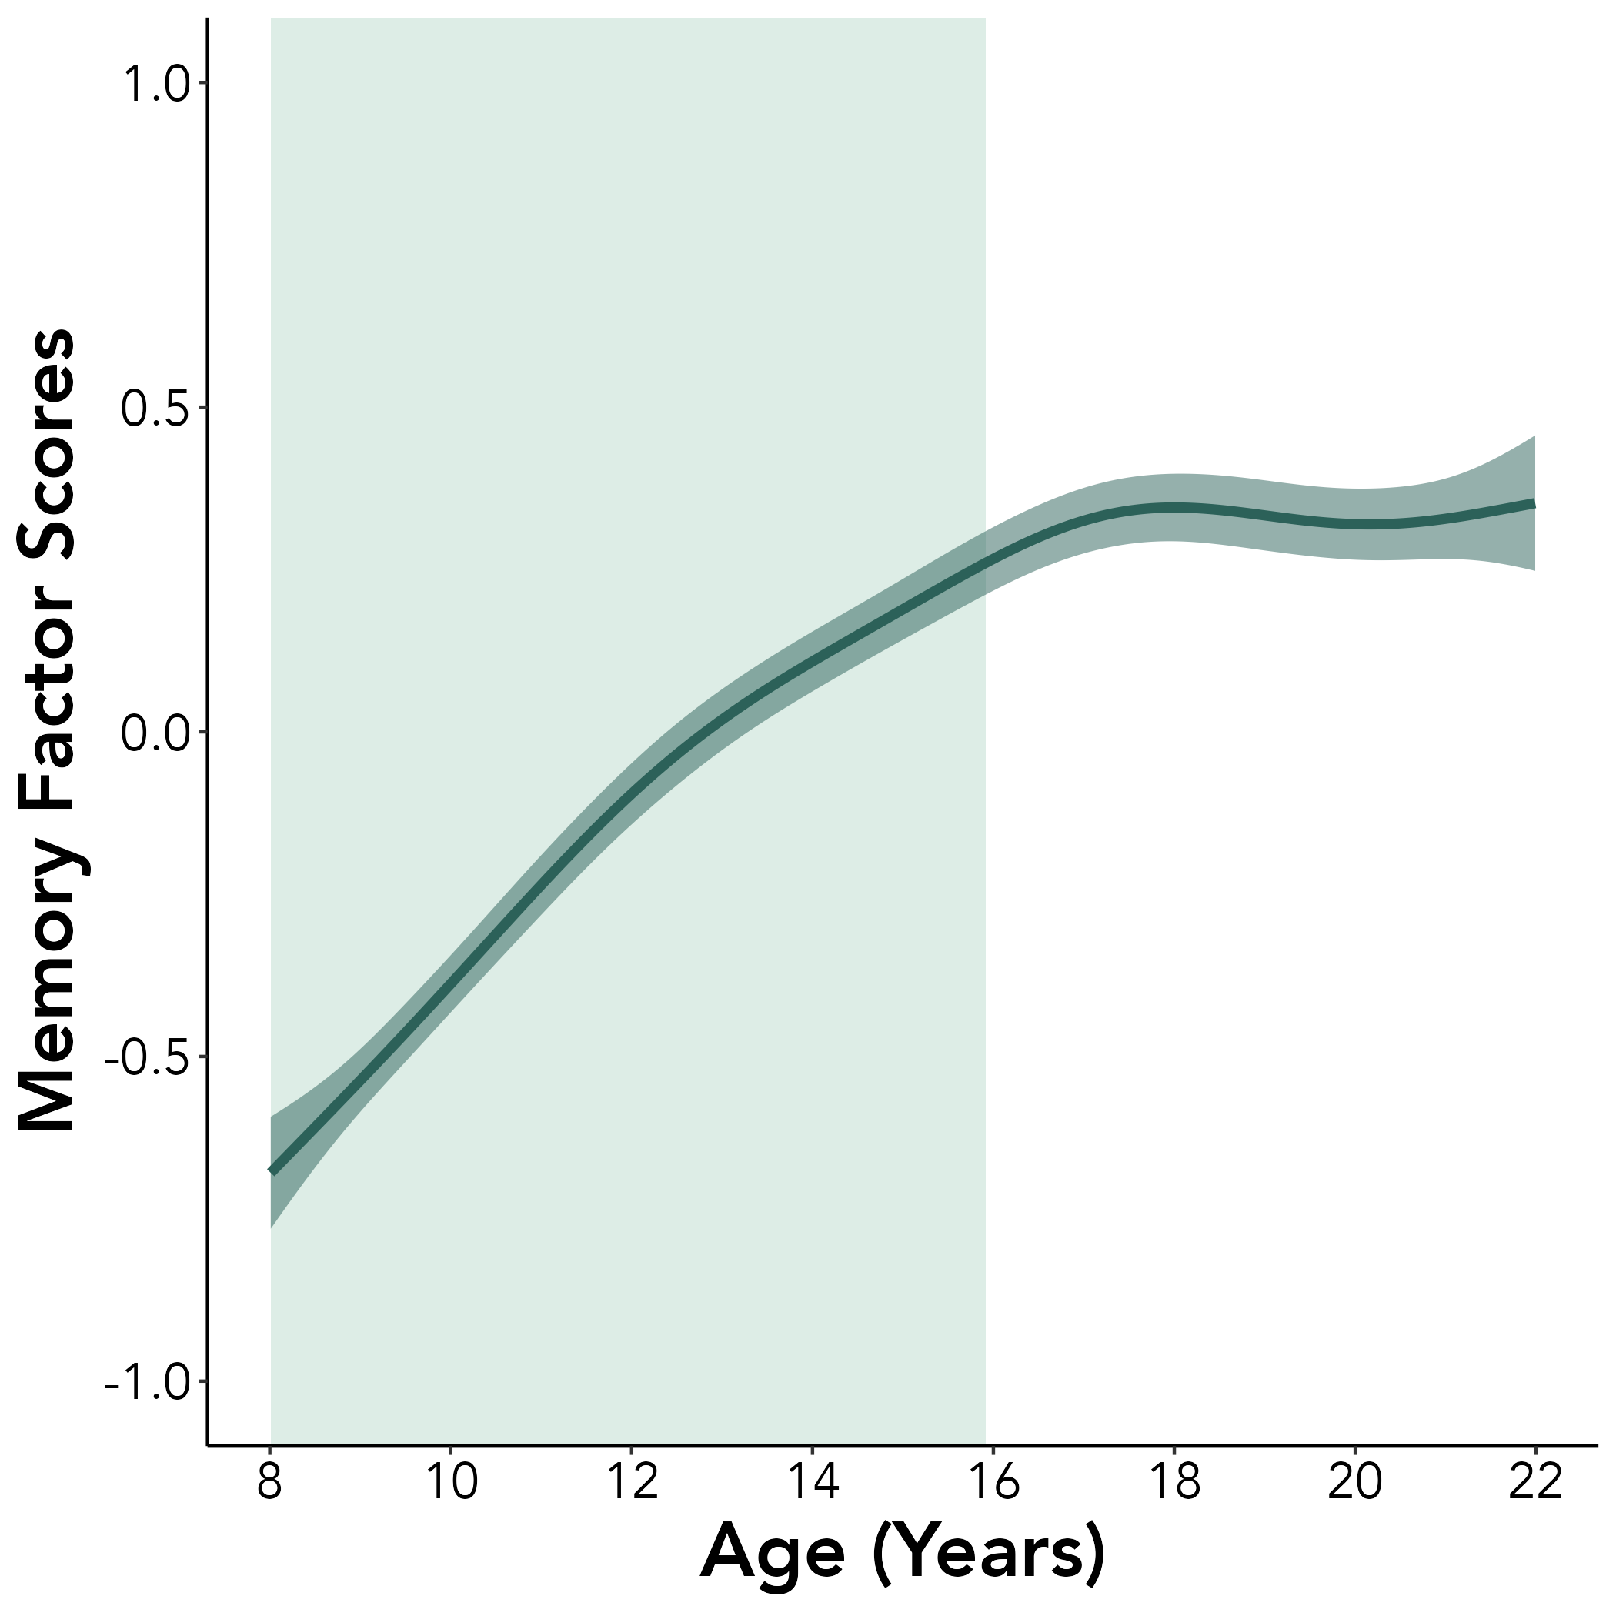
A.
C.
B.
Notes:
Figure 5

Slide 8
Supplemental Materials

Slide 9
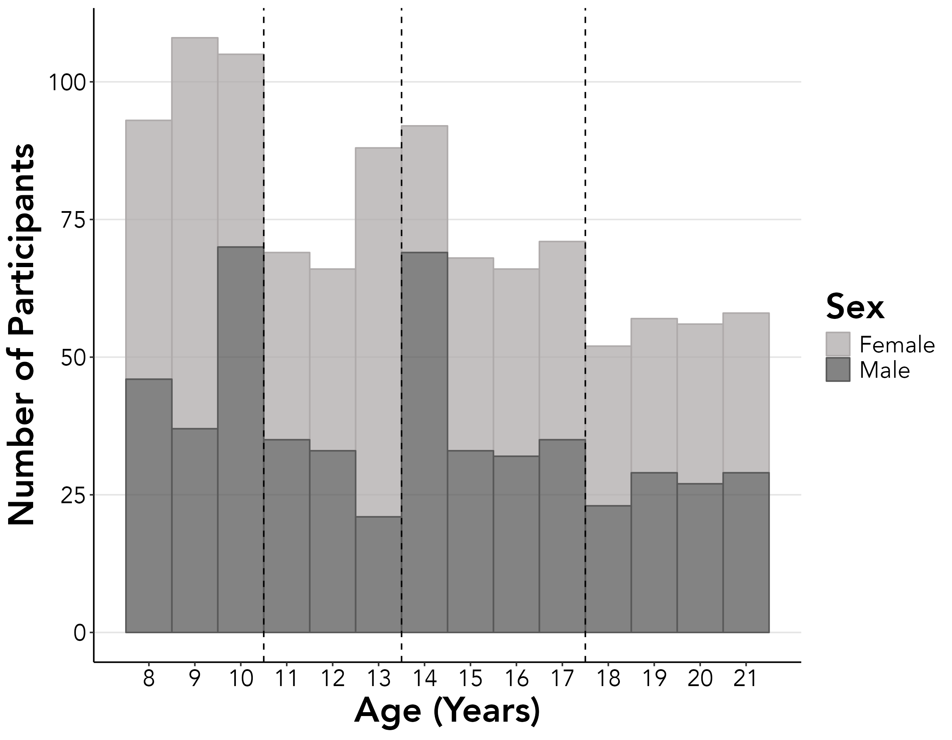
N₈₋₁₀ = 306
N₁₁₋₁₃ = 223
N₁₄₋₁₇ = 297
N₁₈₋₂₁ = 223
Notes:
Supplemental Figure S1

Slide 10
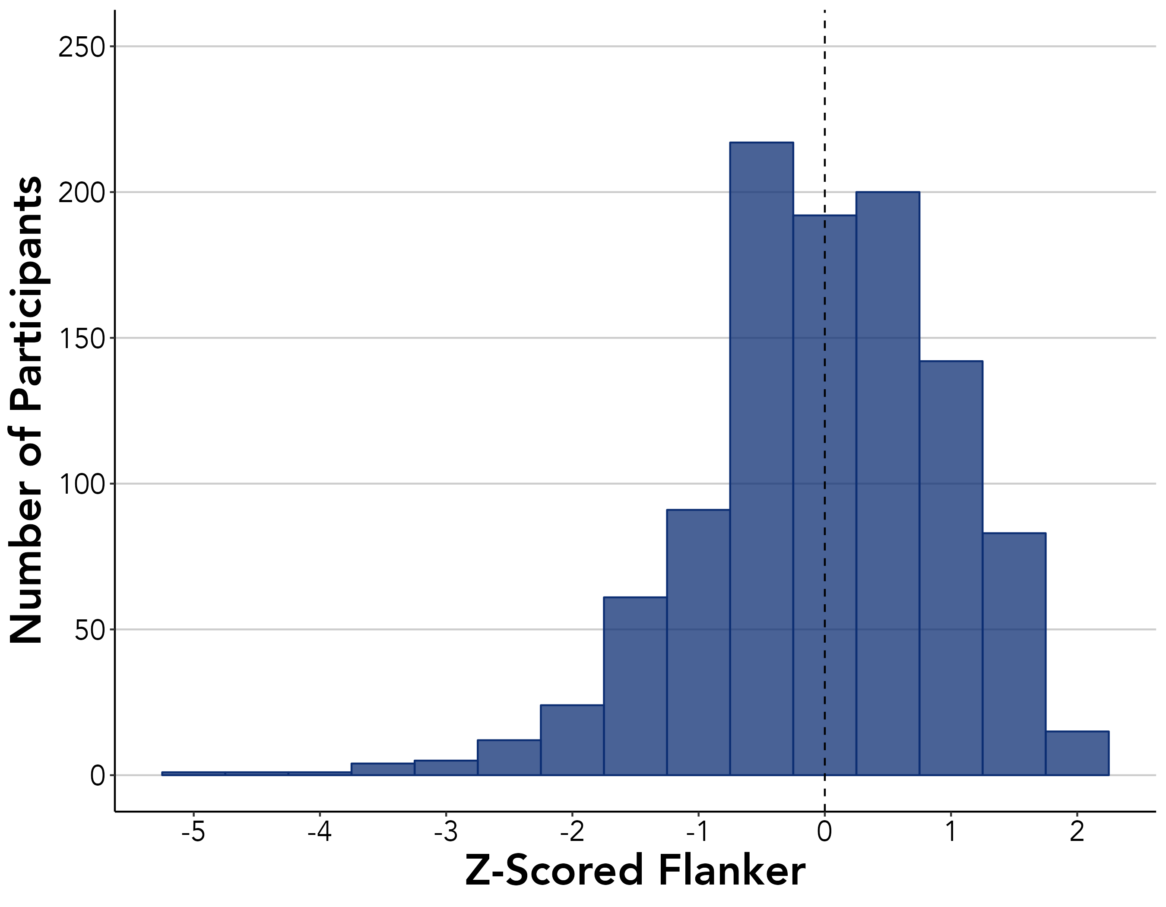
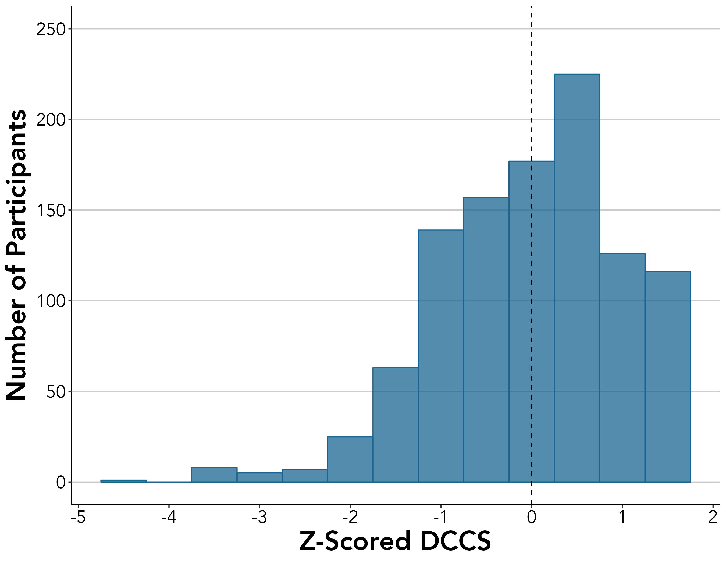
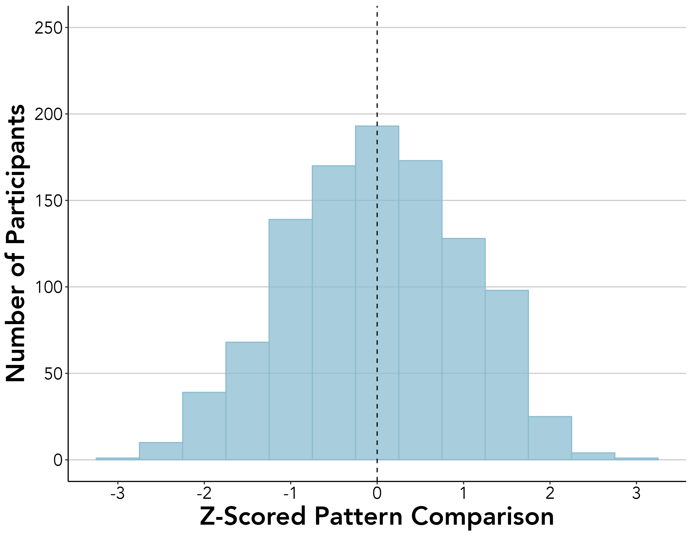
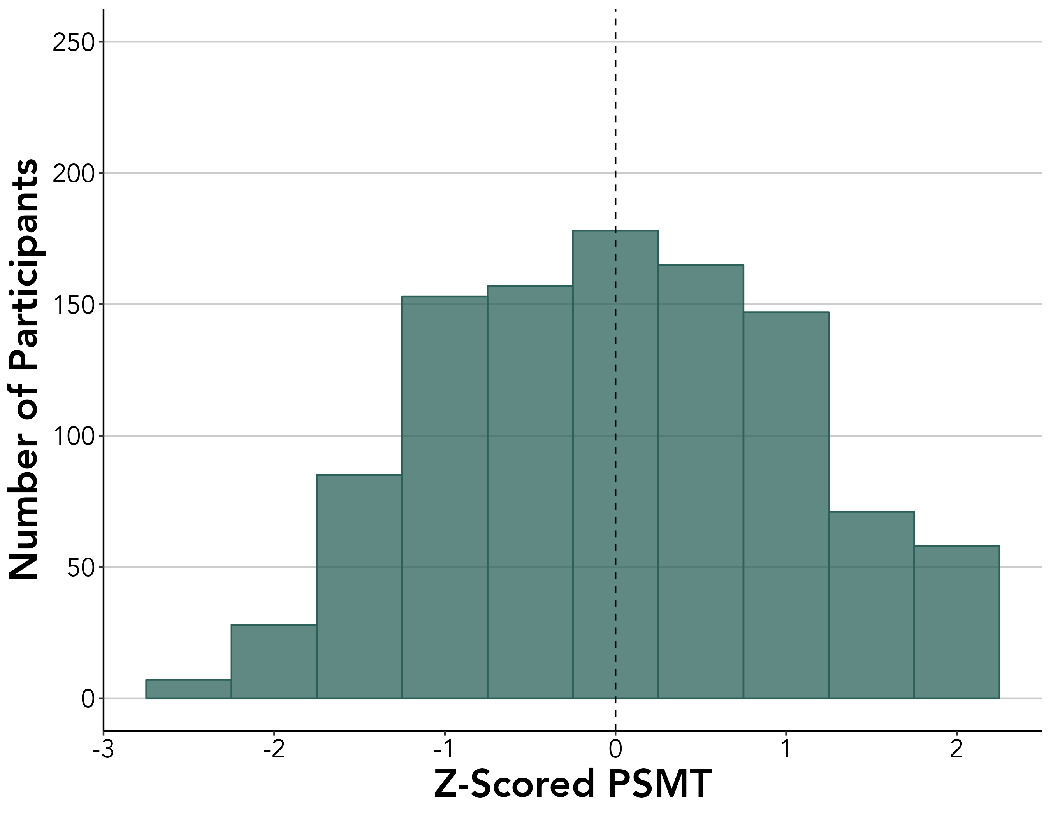
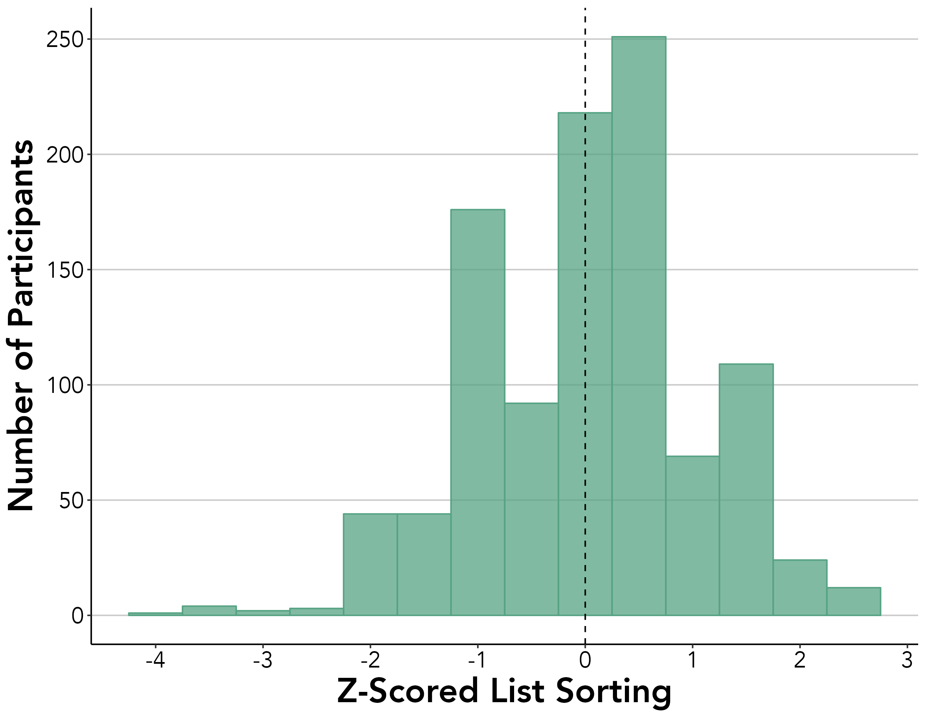
Notes:
Supplemental Figure S2

Slide 11
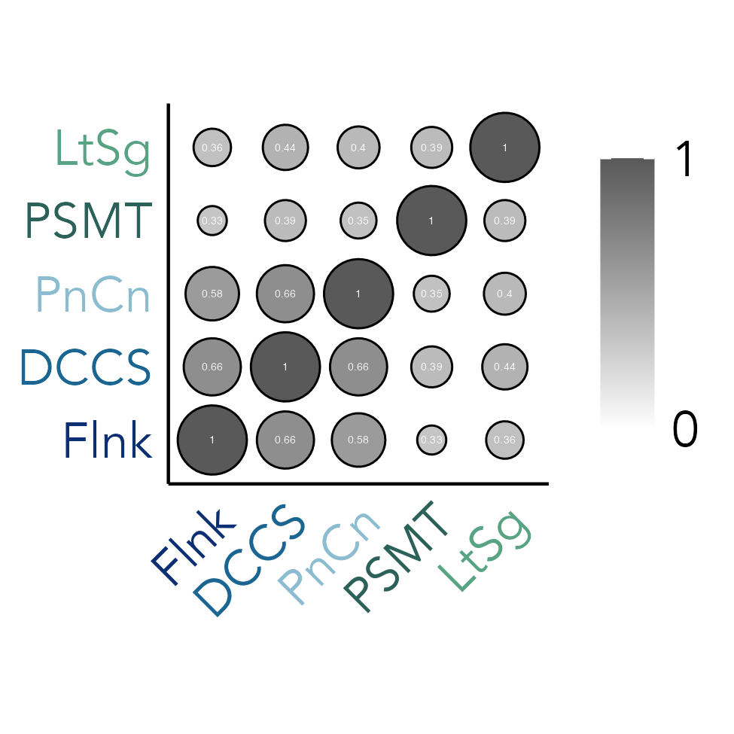
Notes:
Supplemental Figure S3

Slide 12
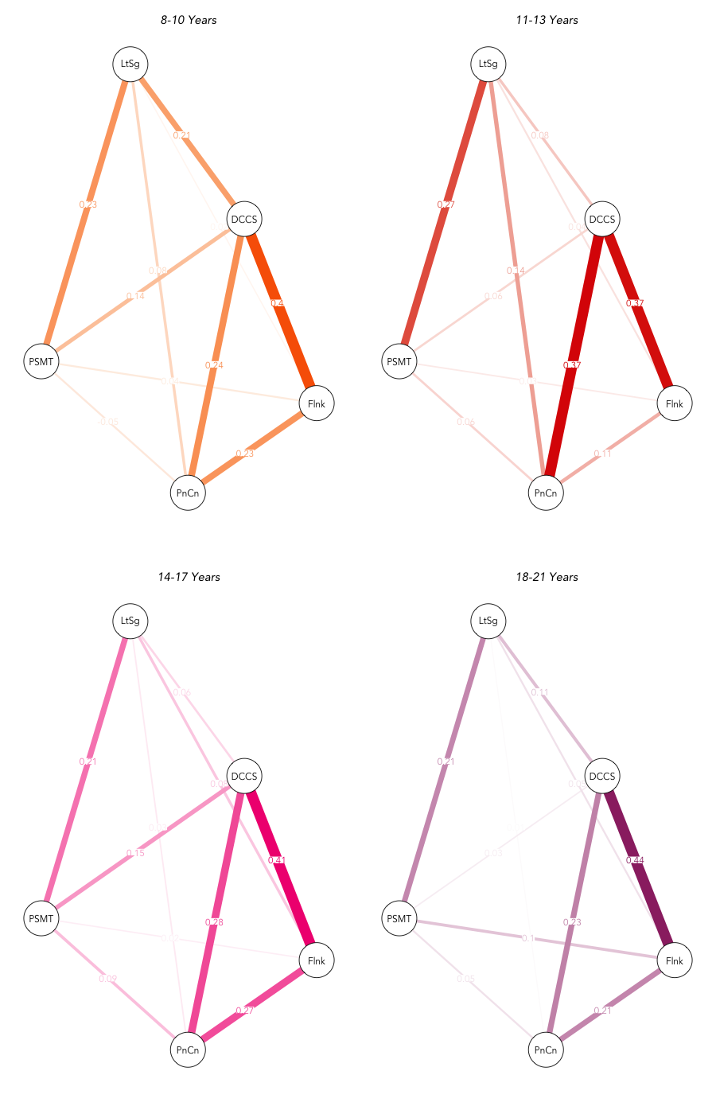
8-10 Years
11-13 Years
LtSg
LtSg
DCCS
DCCS
PSMT
PSMT
.44
Flnk
Flnk
PnCn
PnCn
14-17 Years
18-21 Years
LtSg
LtSg
0
DCCS
DCCS
PSMT
PSMT
Flnk
Flnk
PnCn
PnCn
Notes:
Supplemental Figure S4

Slide 13
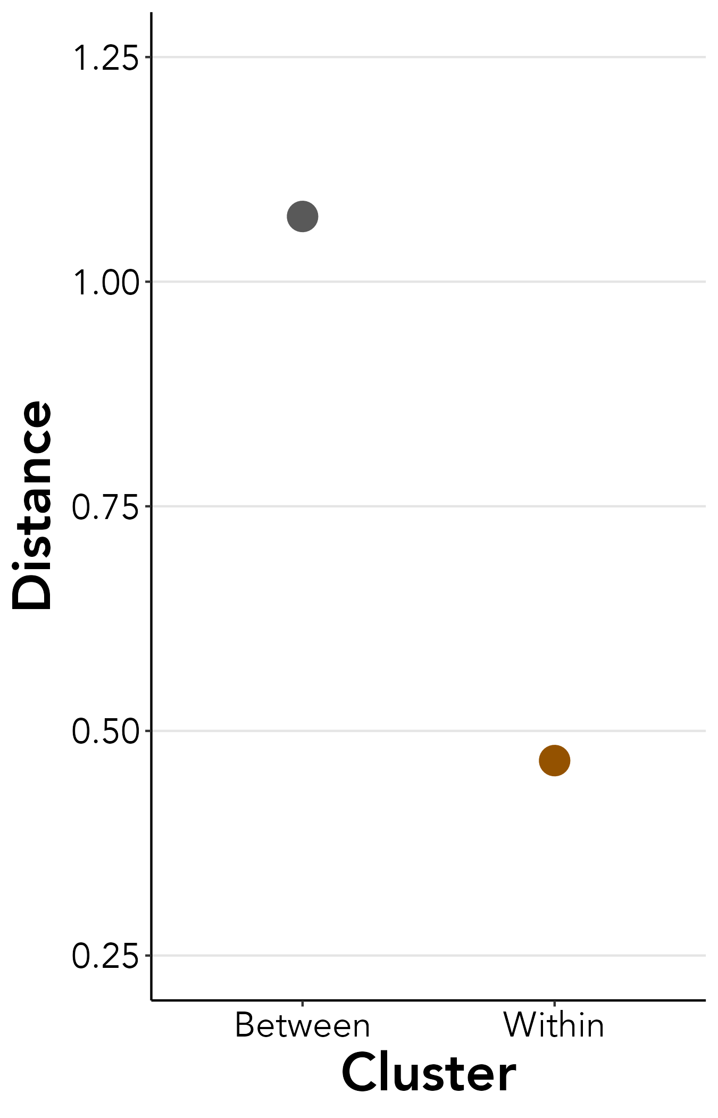
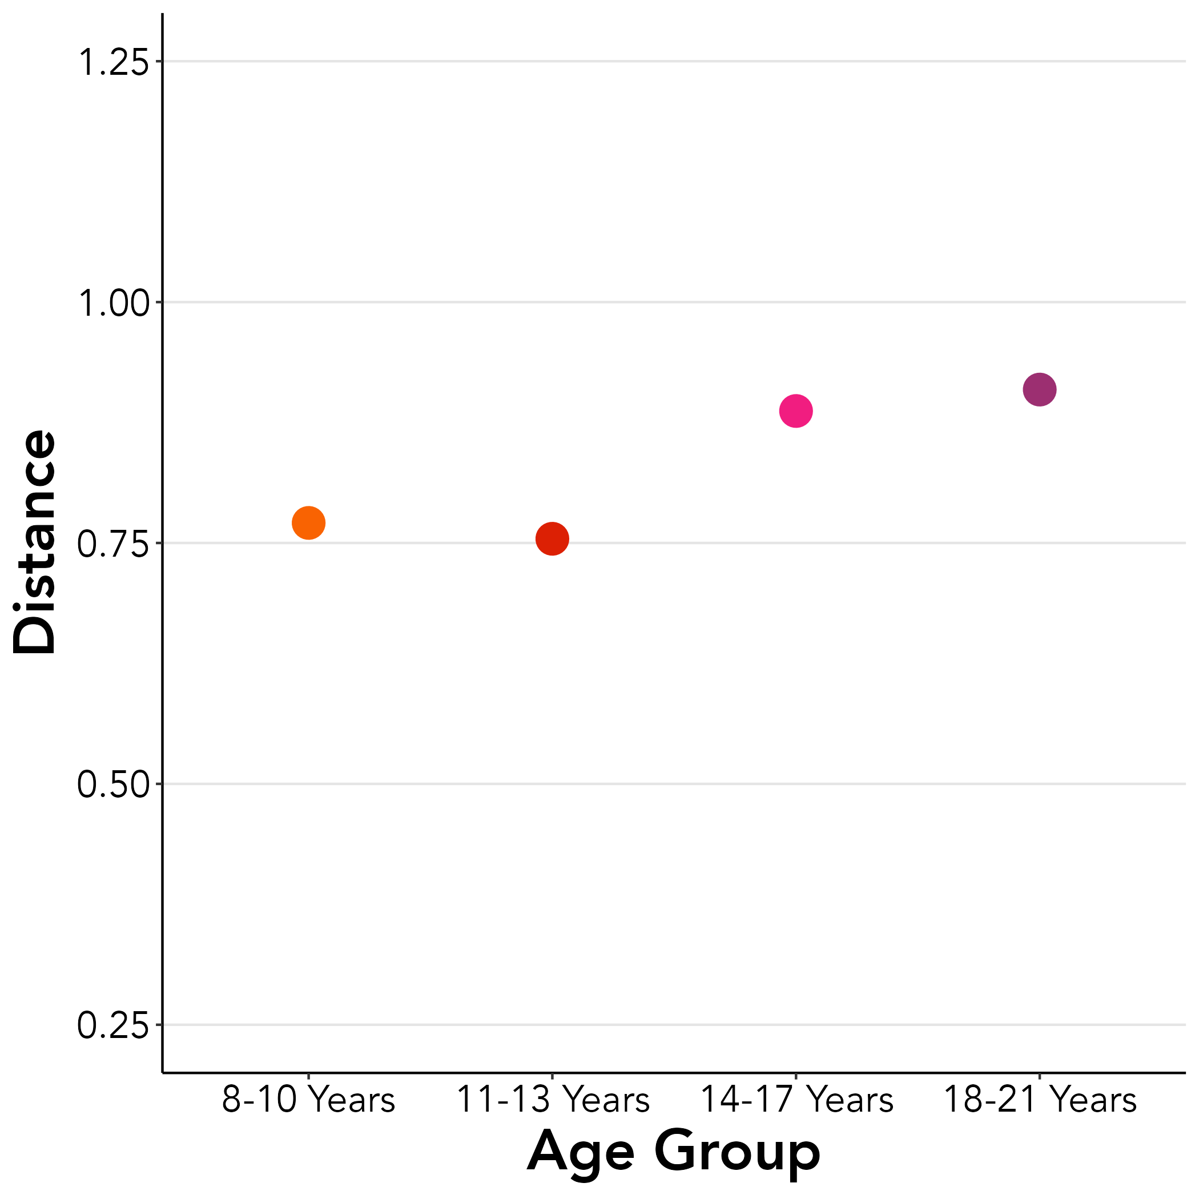
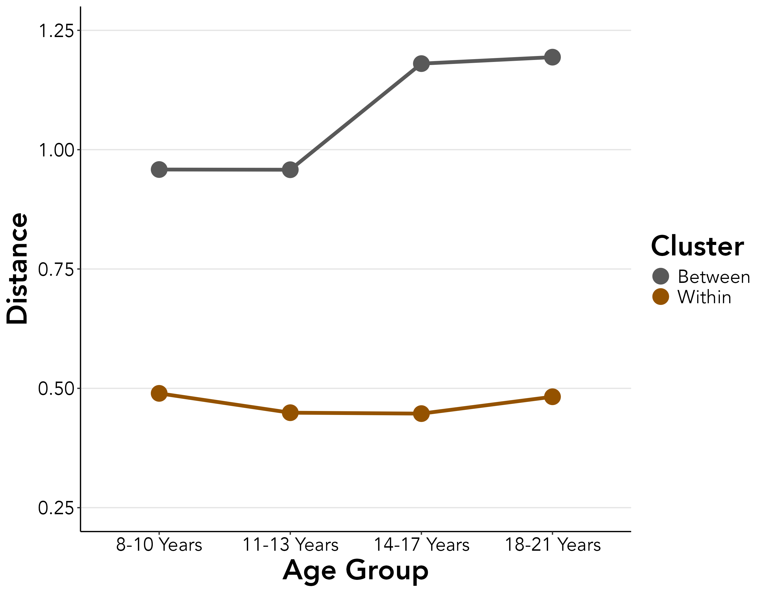
A.
B.
C.
Notes:
Supplemental Figure S5

