Slide 1
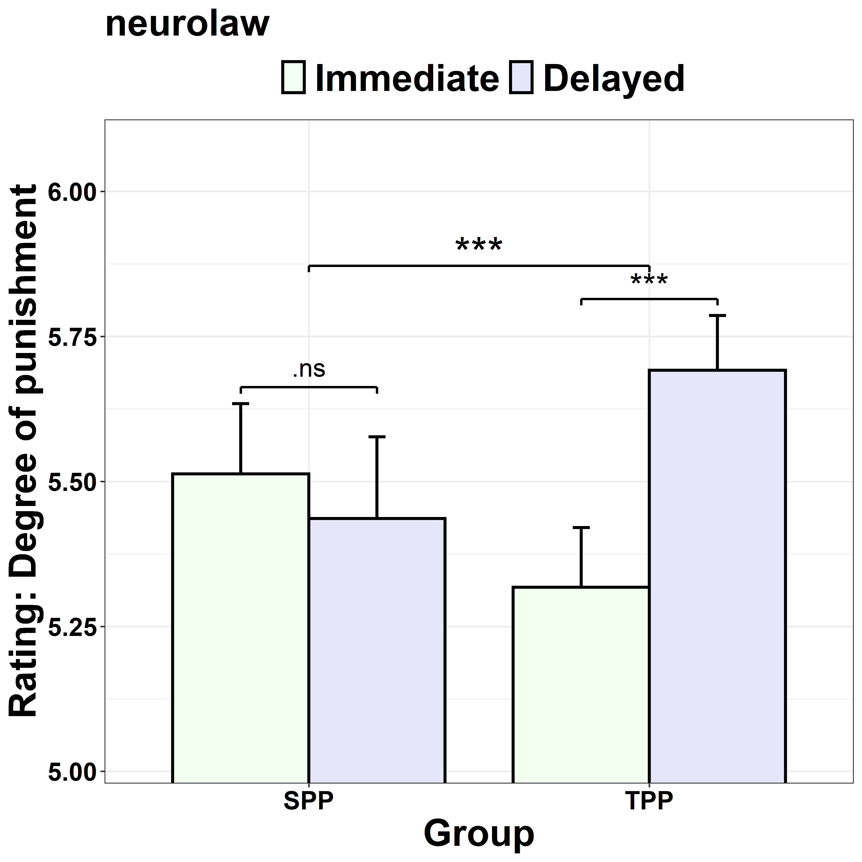
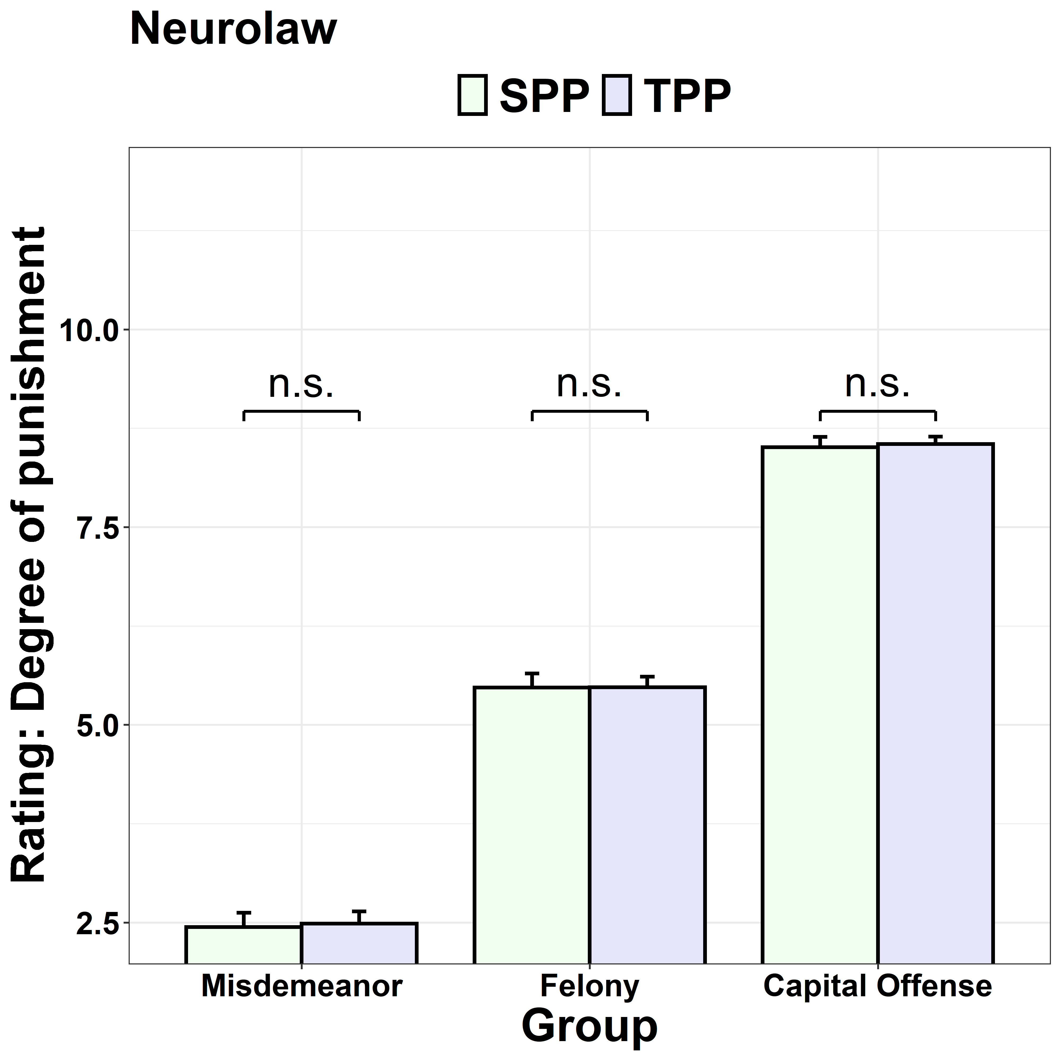
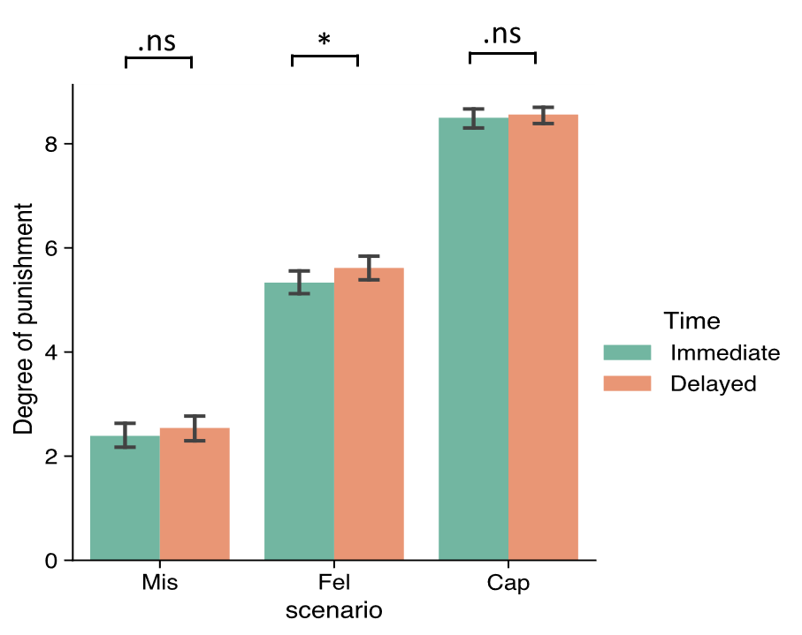
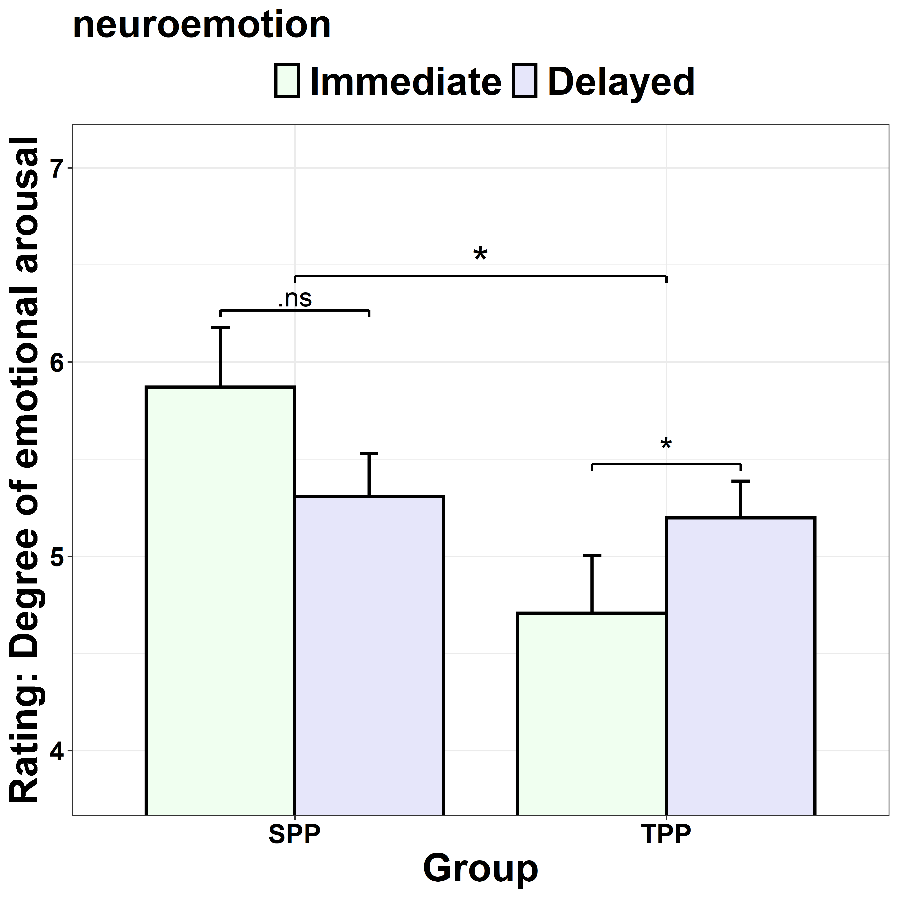
1-1
1-2
1-3
1-4
1-5
1-6

Slide 2
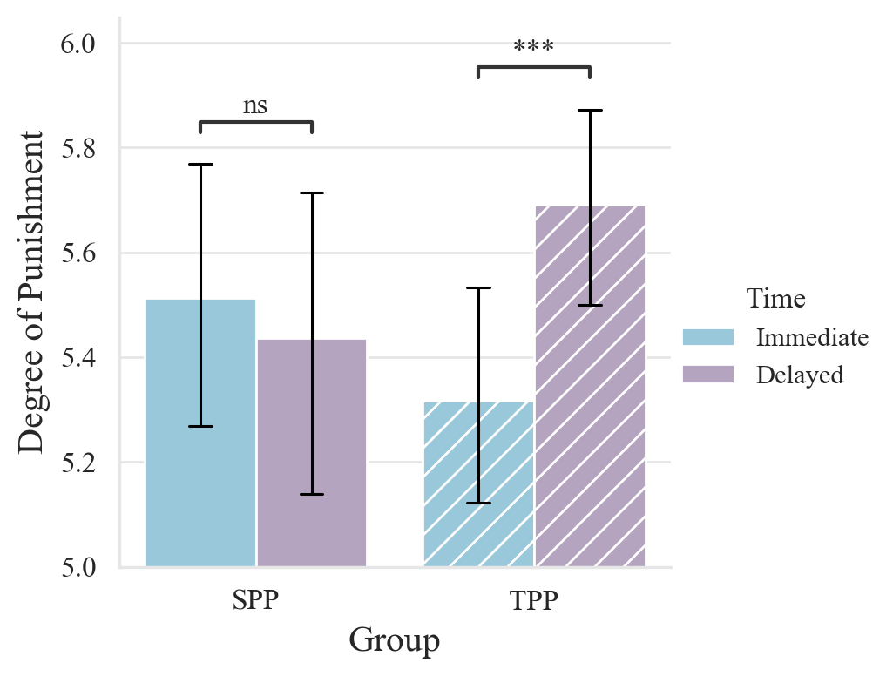
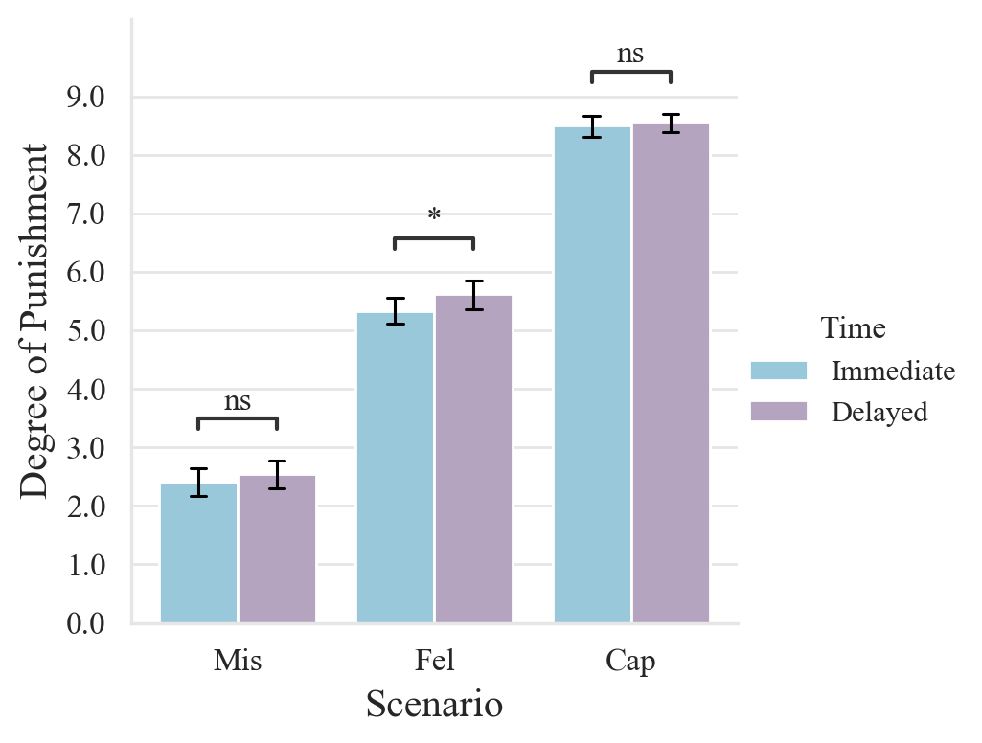
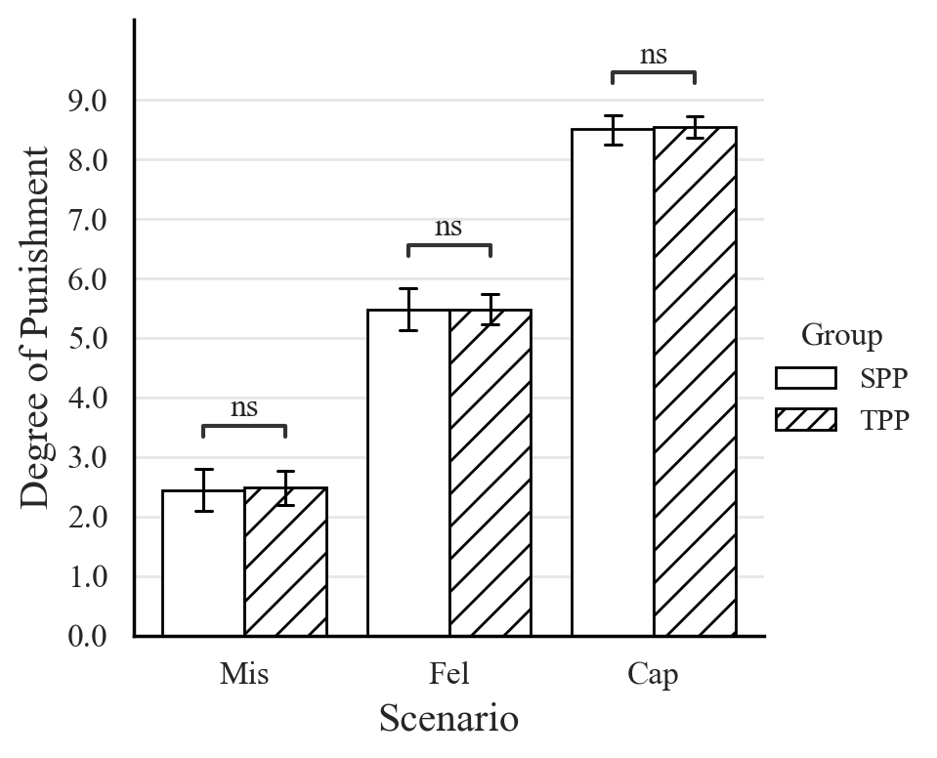
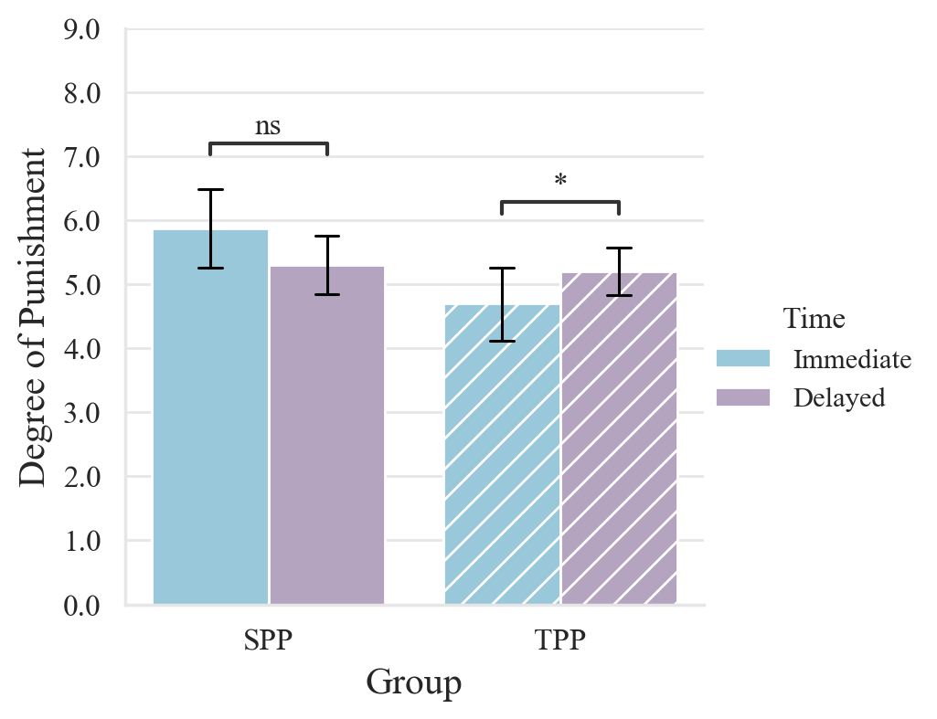
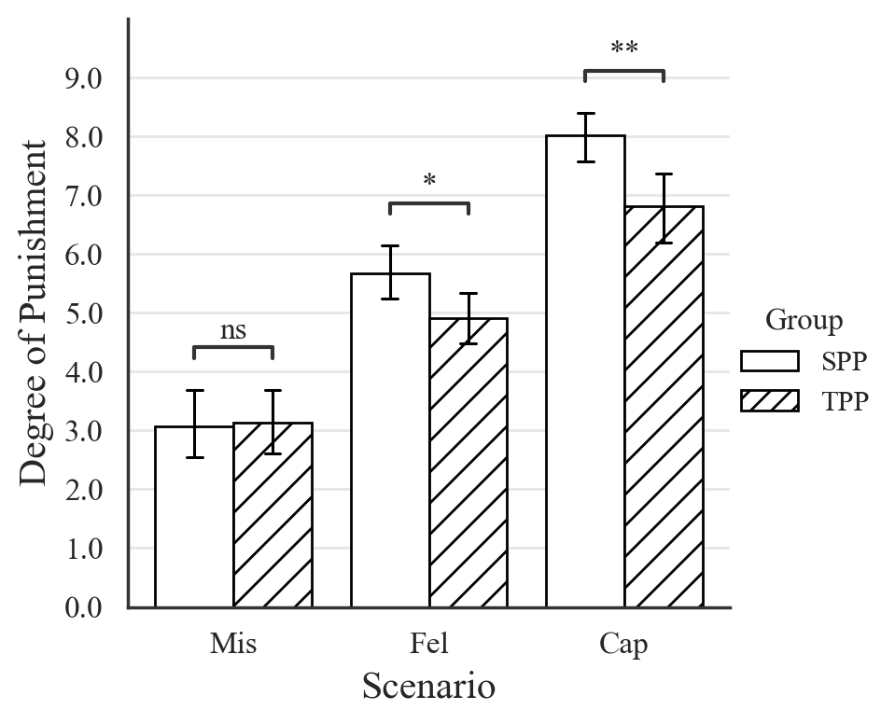
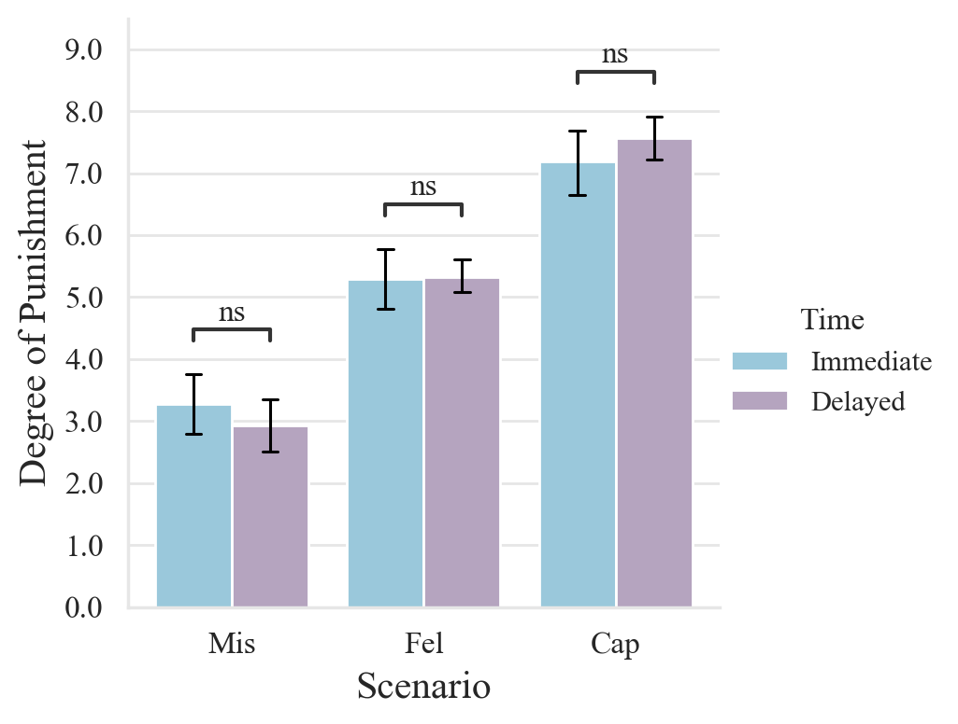
1-1
1-2
1-3
1-4
1-5
1-6

Slide 3
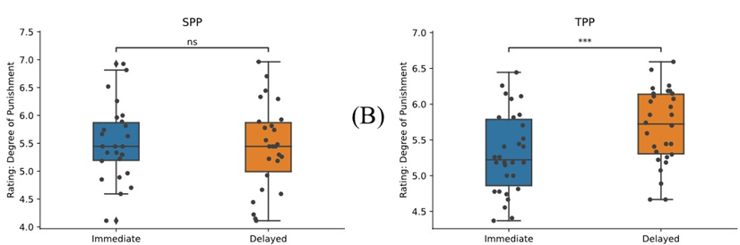
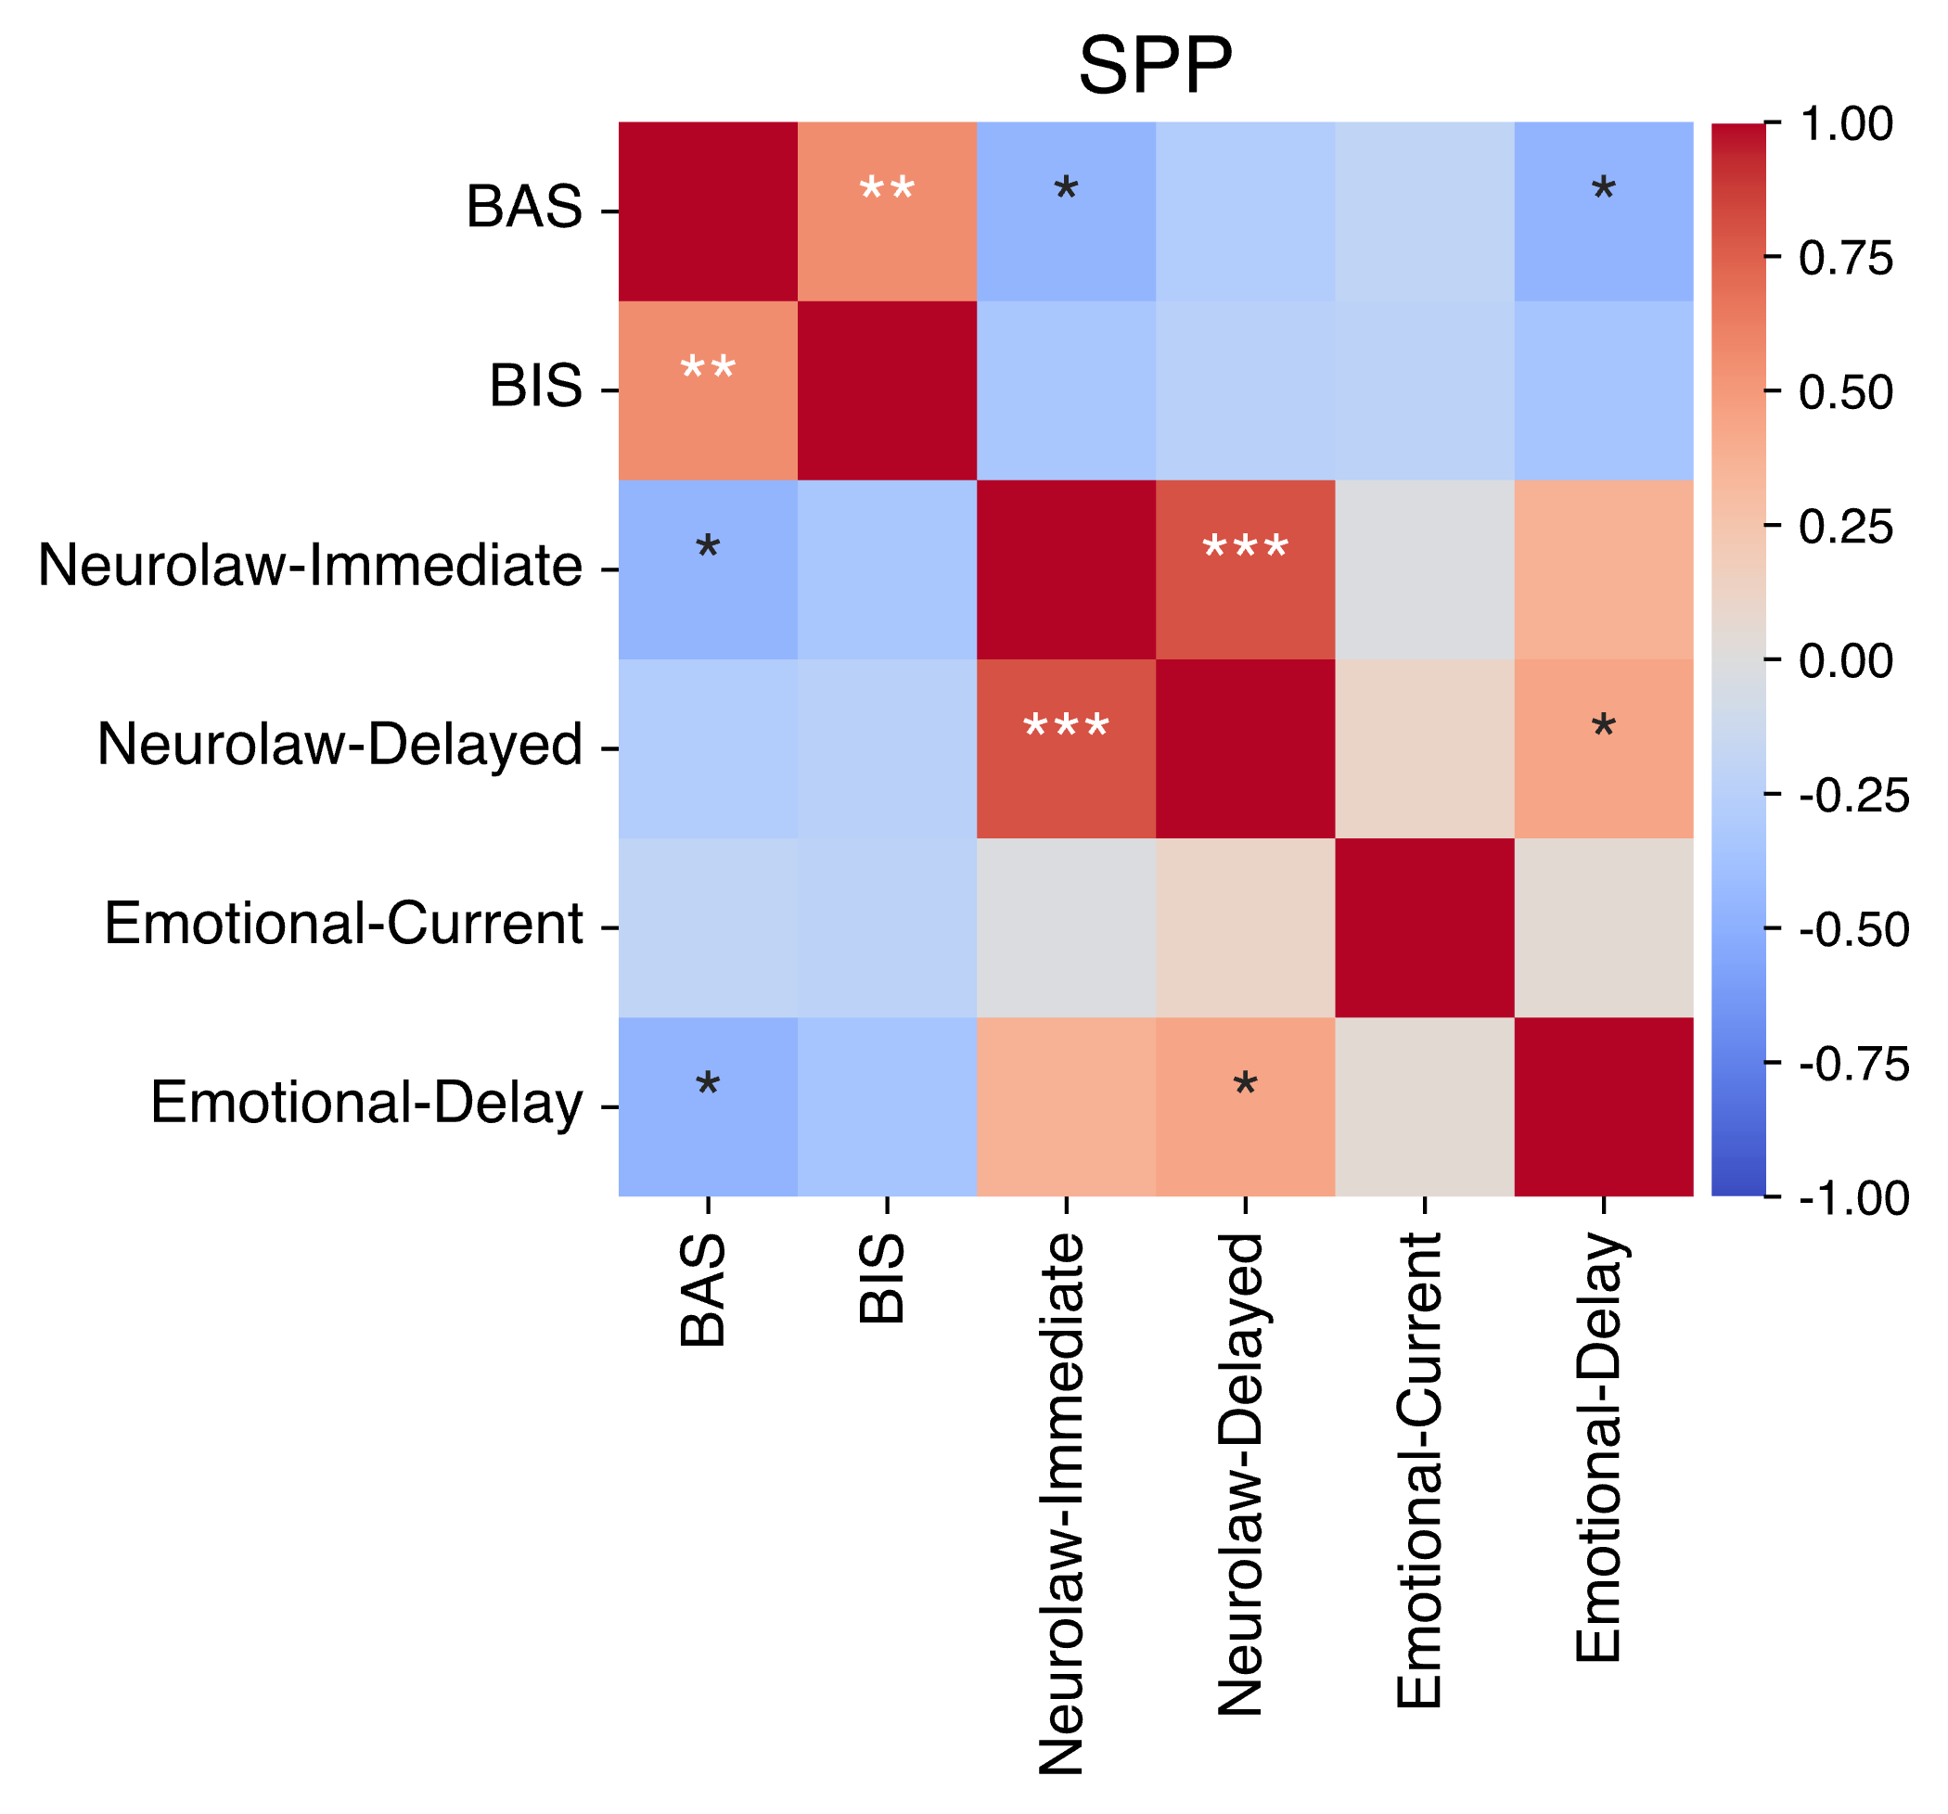
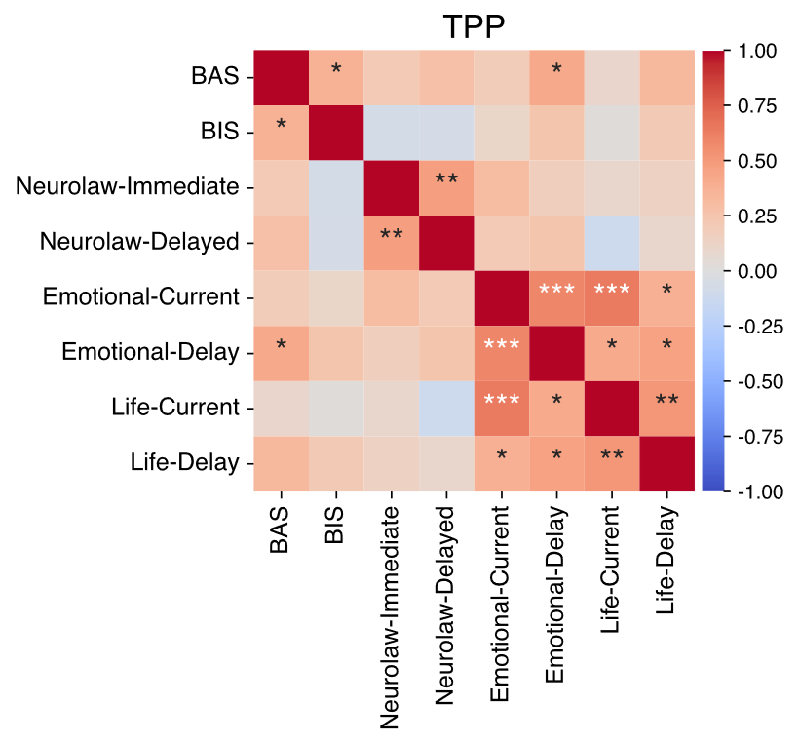
2-1
2-2
2-3
2-4

Slide 4
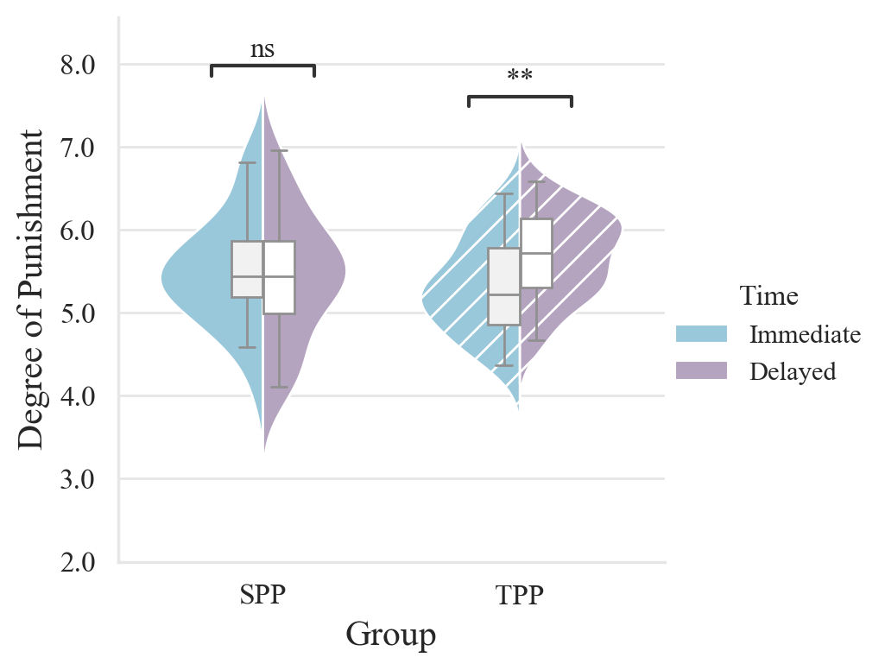
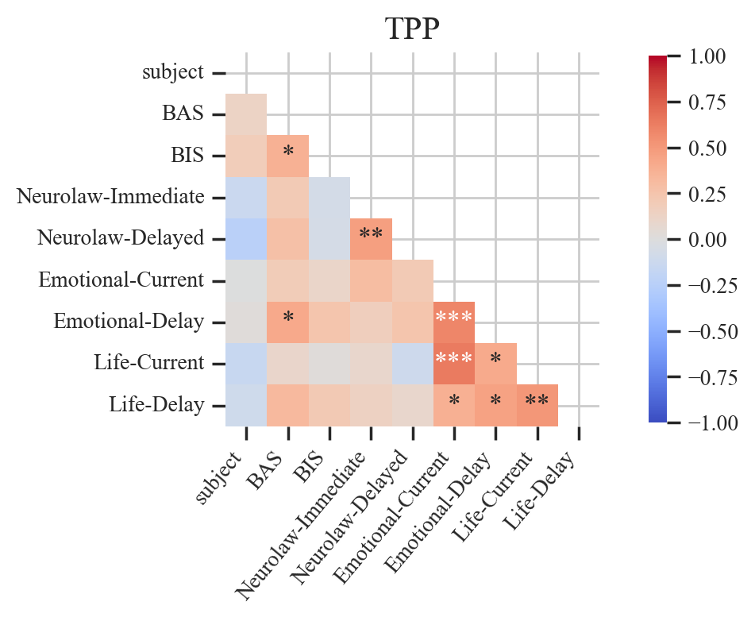
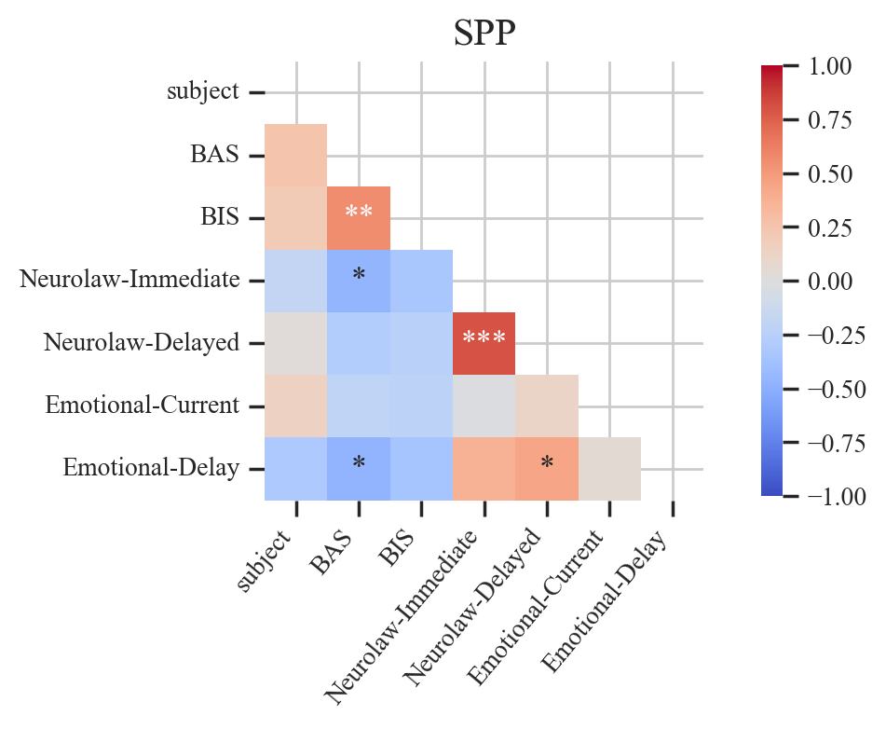
2-1
2-2
2-3
2-4

Slide 5
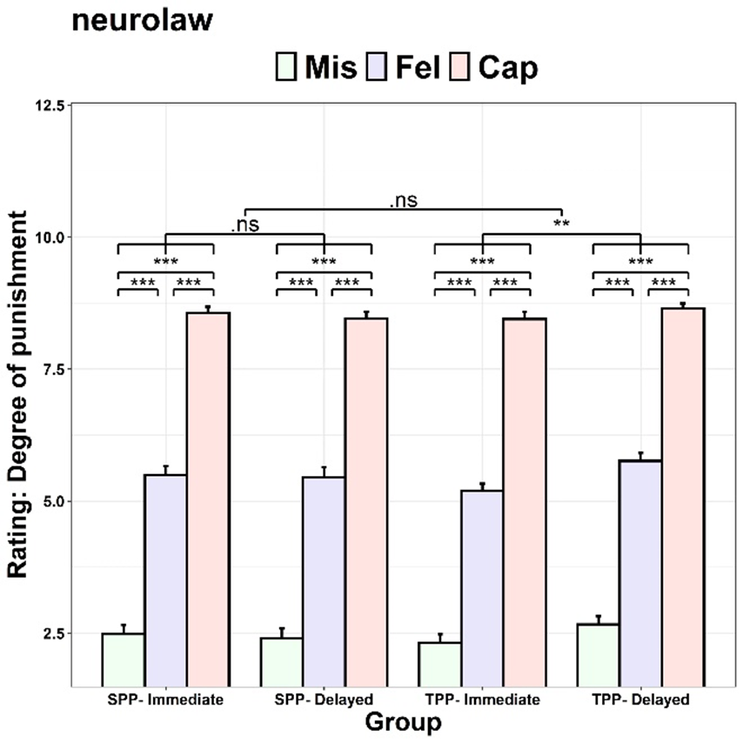
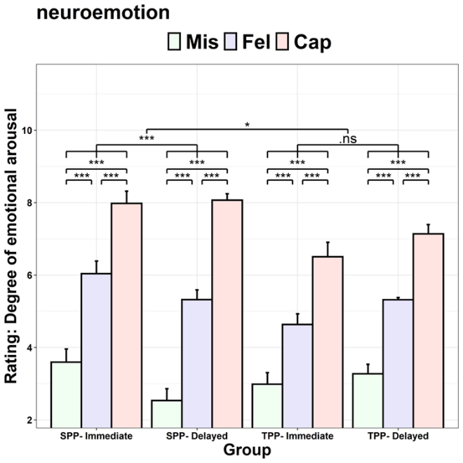
3-1
3-2

Slide 6
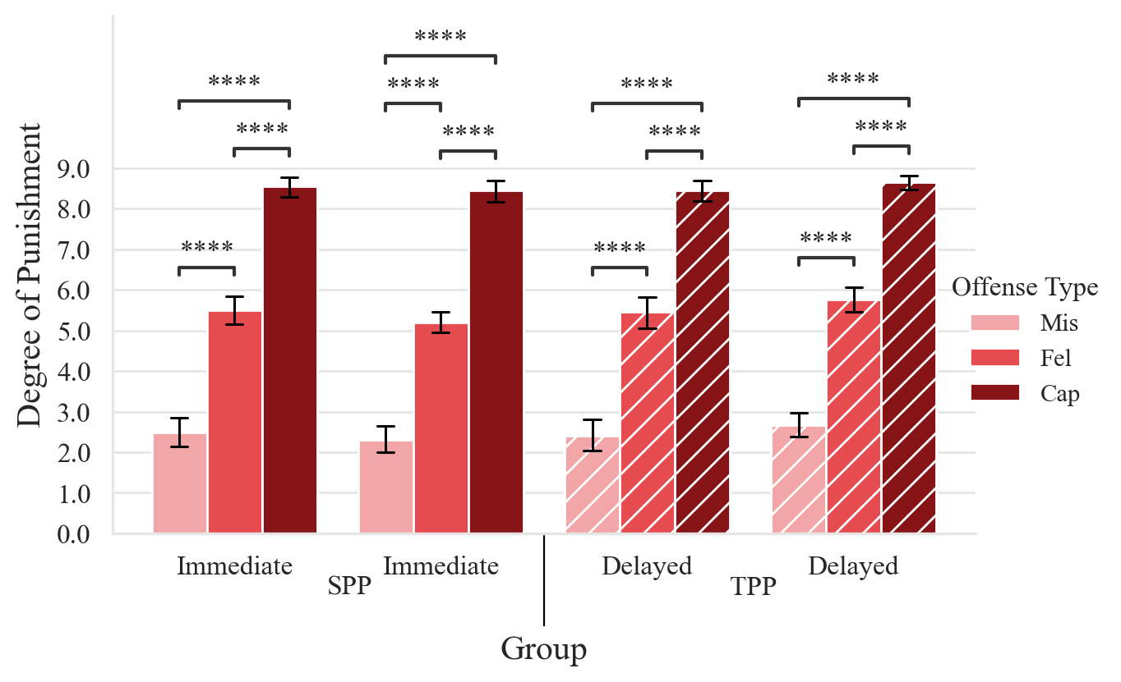
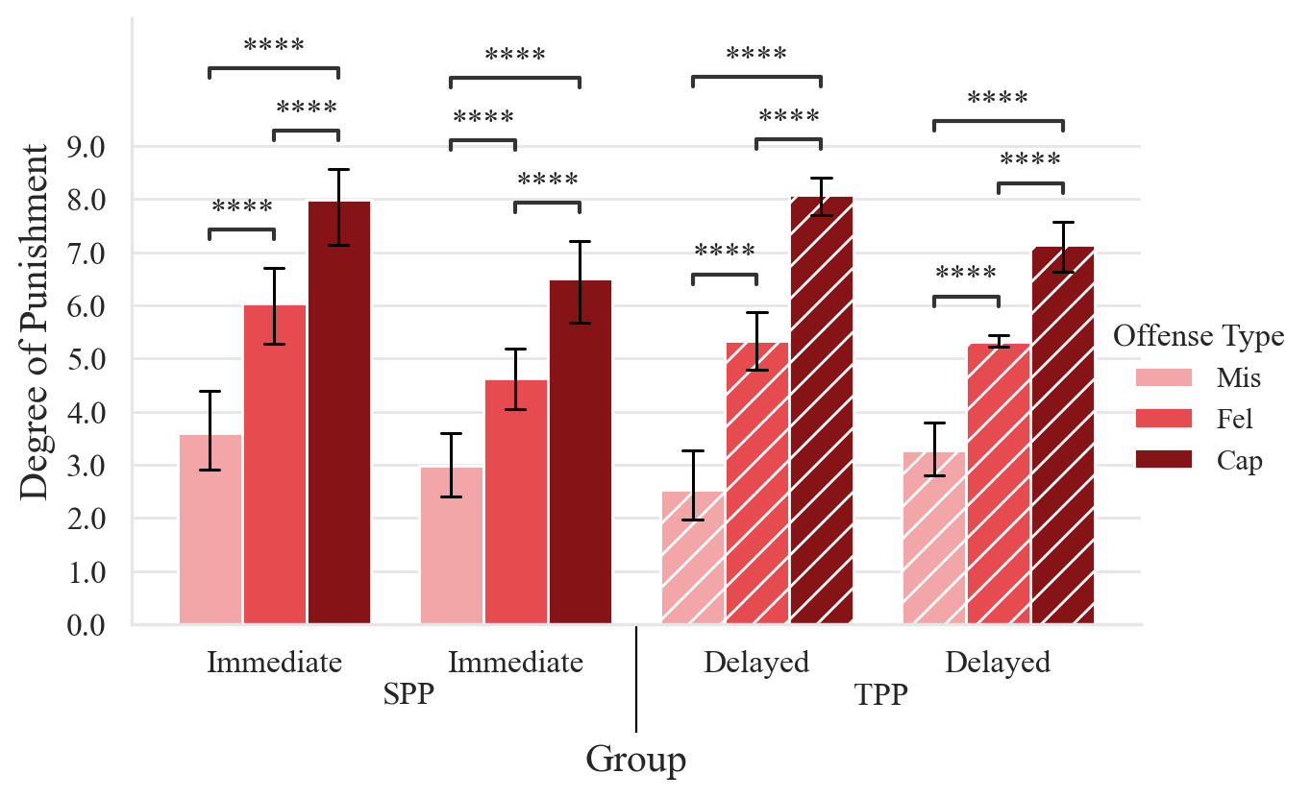
3-1
3-2

Slide 7
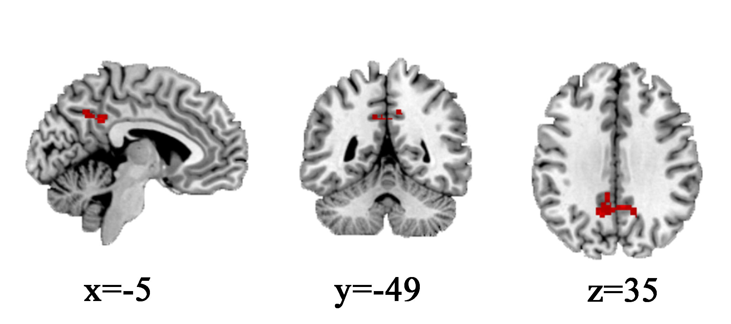
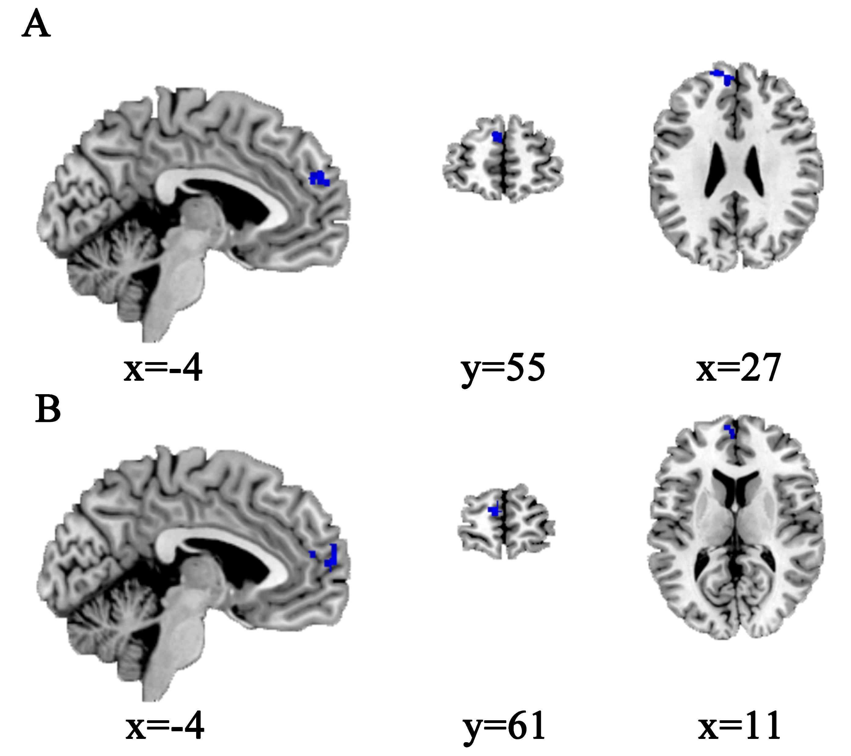
Figure 4
Different brain activations comparing second-party and third-party punishment
4-1
Different brain activations comparing immediate arrest and delayed arrest conditions in third-party punishment
4-2
A: left dmPFC displayed reduced activations in immediate arrest condition when compared to delayed arrest condition across all case severity levels; B: left dmPFC displayed reduced activations in immediate arrest condition when compared to delayed arrest condition in felony ( with mercy merits) category.
Notes:
v

Slide 8
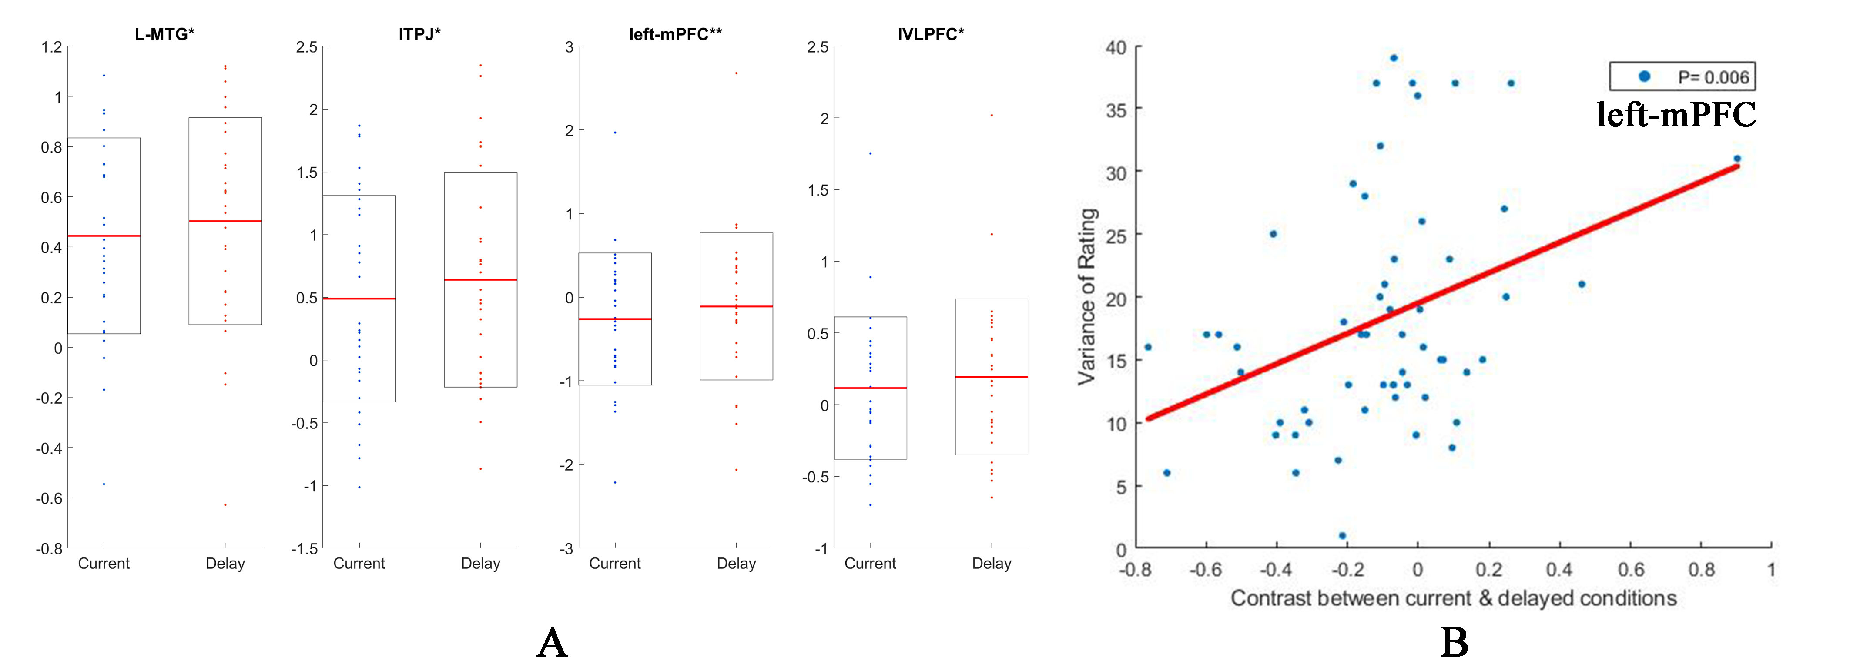
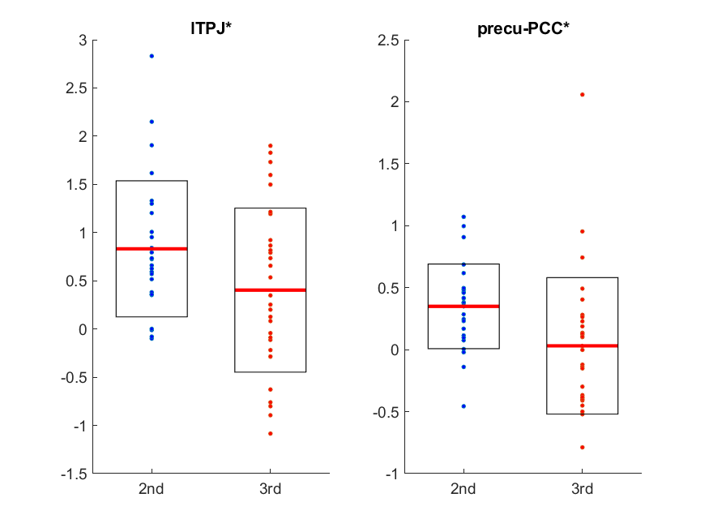
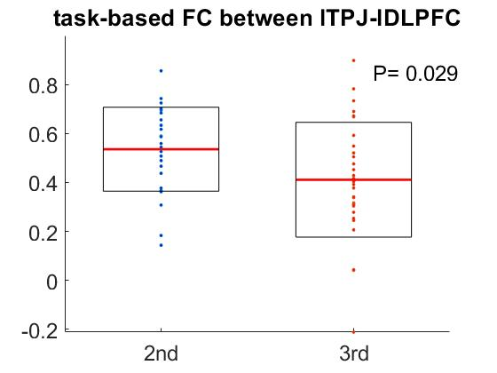
Figure 5
ROI results showing temporal effects and their relationship to the temporal variability of punishment ratings
5-1
5-2
5-3
5-4
5-5
A: four brain regions showing temporal effects; B: The temporal variance of activation in left dmPFC correlates with the temporal variability of punishment ratings
(b) ROI results showing emotion effects and their relationship to the arousal ratings
5-6
5-7
5-8
Notes:
显示时间效应的ROI结果及其与惩罚评级的时间变化性的关系

Slide 9
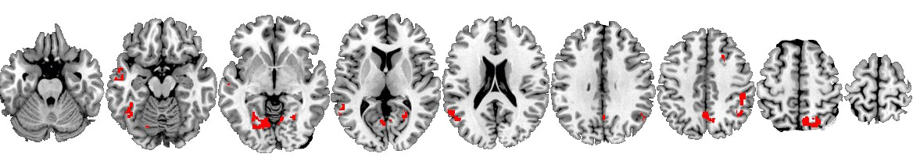
Figure 6
Category effects
6-1
6-2
Cat2：重罪：SPP-TPP ITPJ, Precu--PCC
6-3
在cat3-cat2：SPP-TPP IDLPFC
6-4
S3rd_c3在TPP组cat2：current-delay ACC-L, L-Amygdala, R-Amygdala, left-mPFC,
6-5
Sall_c3在所有被试组cat2：current-delay ACC-L, ACC-R, L-Amygdala, L-MTG, left-mPFC,R-TPJ
Notes:
类别效应

