Slide 1
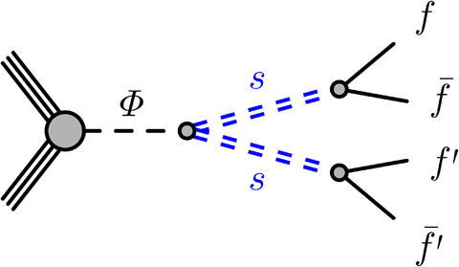
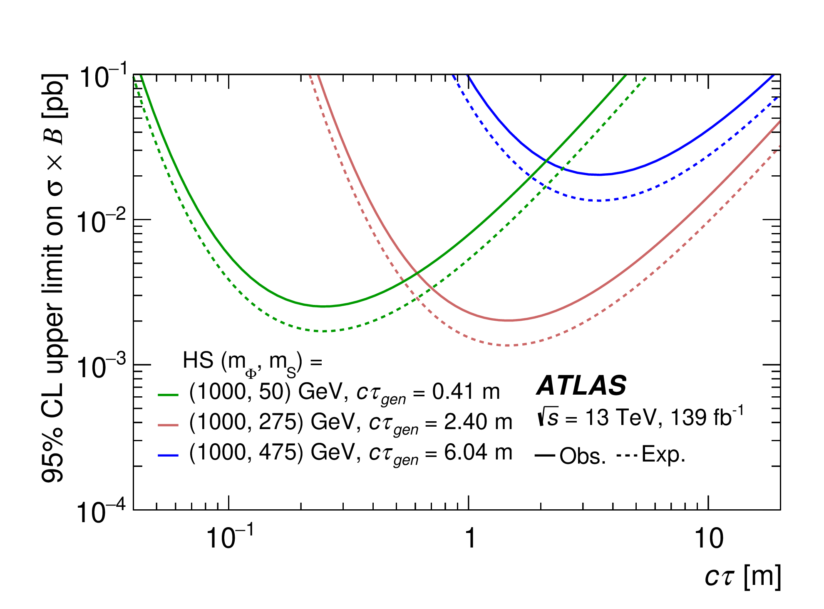
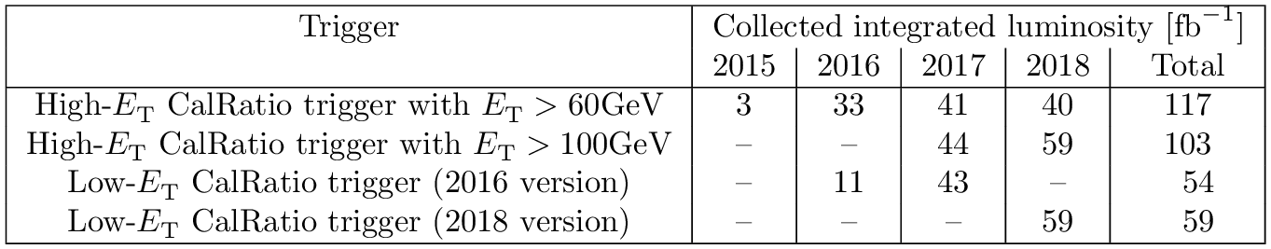

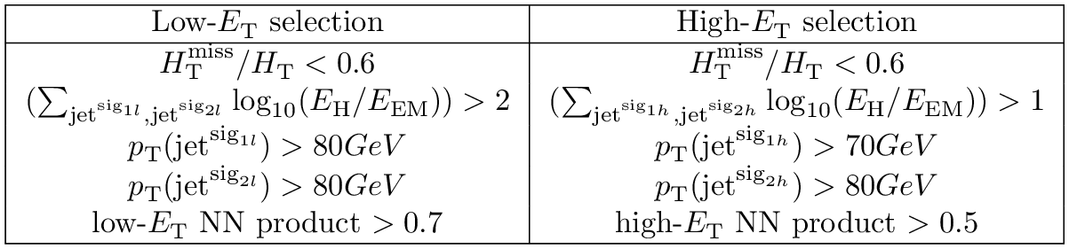
Other LLP Searches
CalRatio (ATLAS-EXOT-2019-23)
Dedicated CalRatio trigger:
JHEP 06 (2022) 005
Low ET: ET > 30 GeV (with ET < 3 GeV in ECAL)
Event Selection:
Trackless jet:

Slide 2
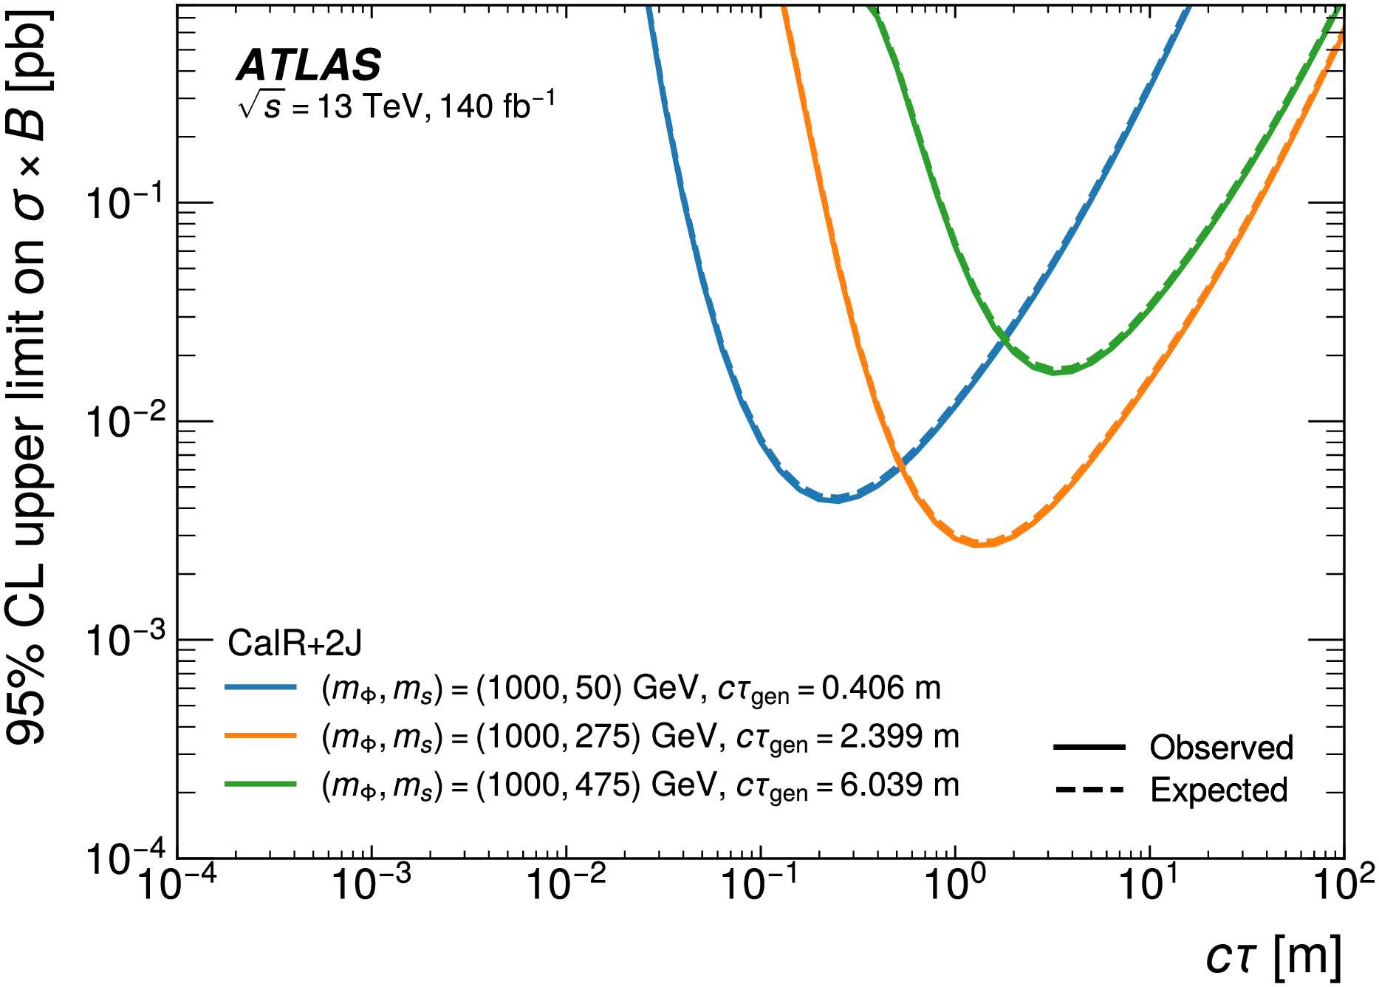
Displaced Jets + Jets or leptons (ATLAS-EXOT-2022-04)
The analysis is split into three channels. The CalRatio + two jets (CalR+2J) channel targets LLPs resulting from gluon–gluon fusion production of the mediator particle in an HS model, leading to two LLPs in the event. One LLP decays in the calorimeter, with its decay products merged into a single displaced jet. The other LLP decays with a short enough decay length and low enough boost to produce two resolved jets from its decay products.
JHEP 11 (2024) 036

Slide 3
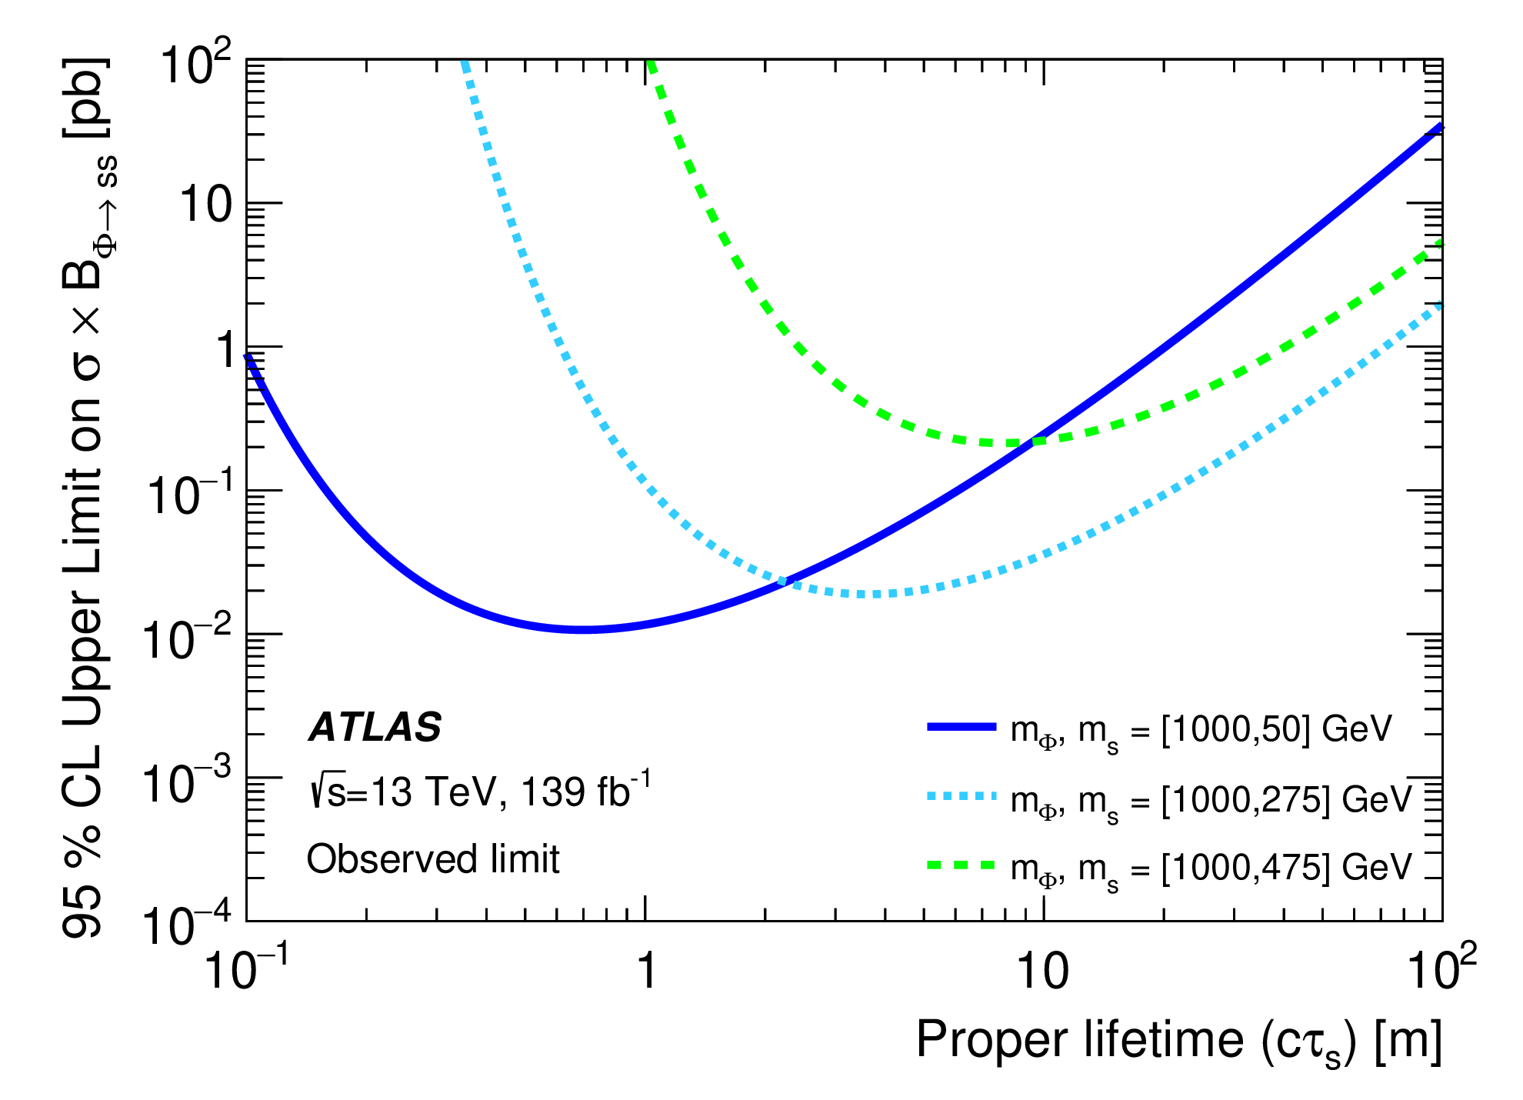
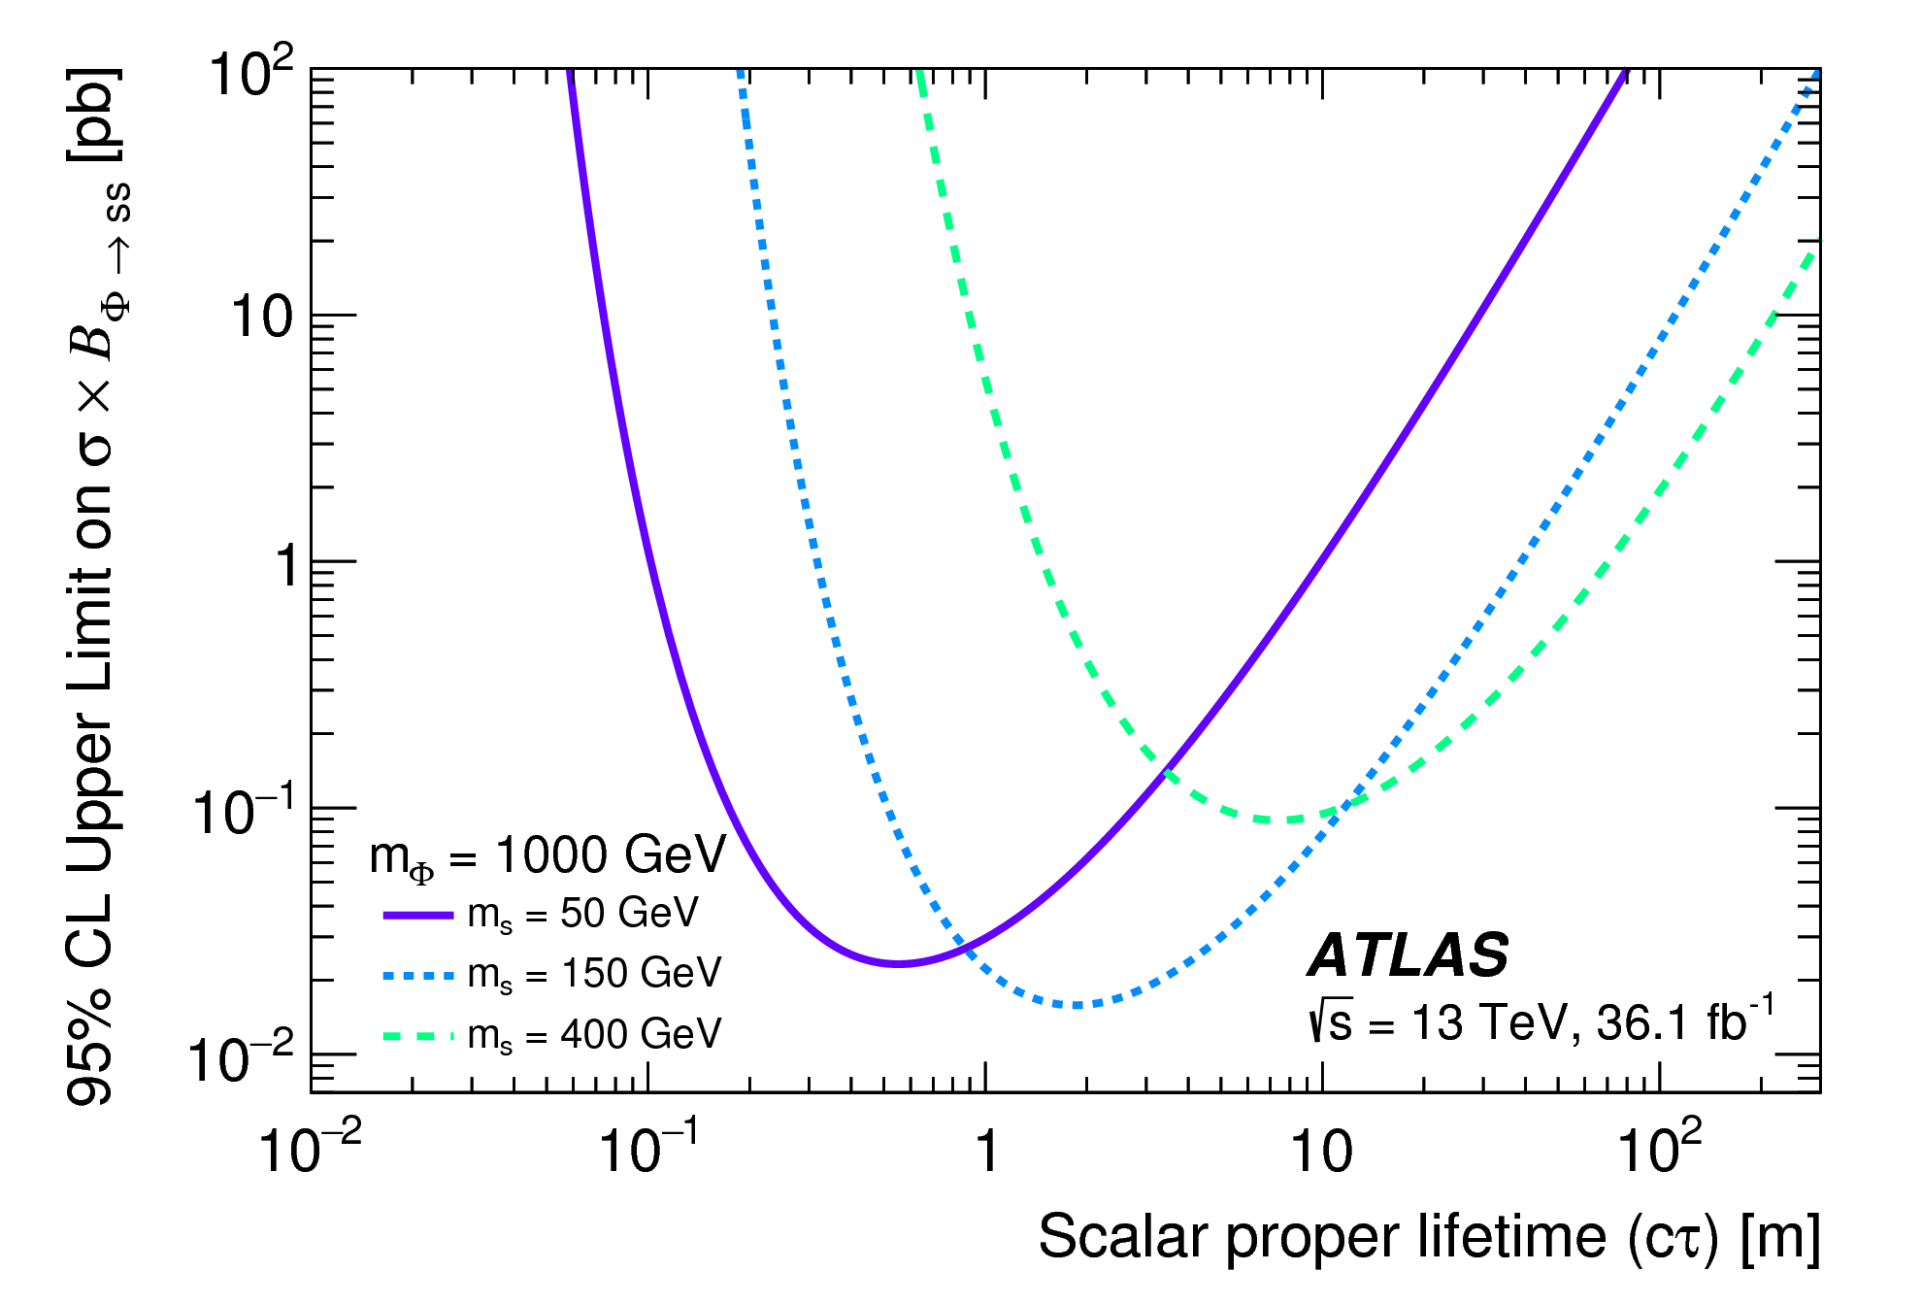
Displaced Jets in the Muon System (ATLAS-EXOT-2019-24)
Displaced Jets in the Muon System (ATLAS-EXOT-2017-05)
Phys. Rev. D 106 (2022) 032005
Phys. Rev. D 99 (2019) 052005

Slide 4
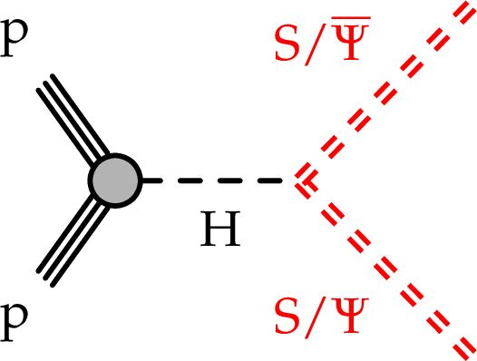
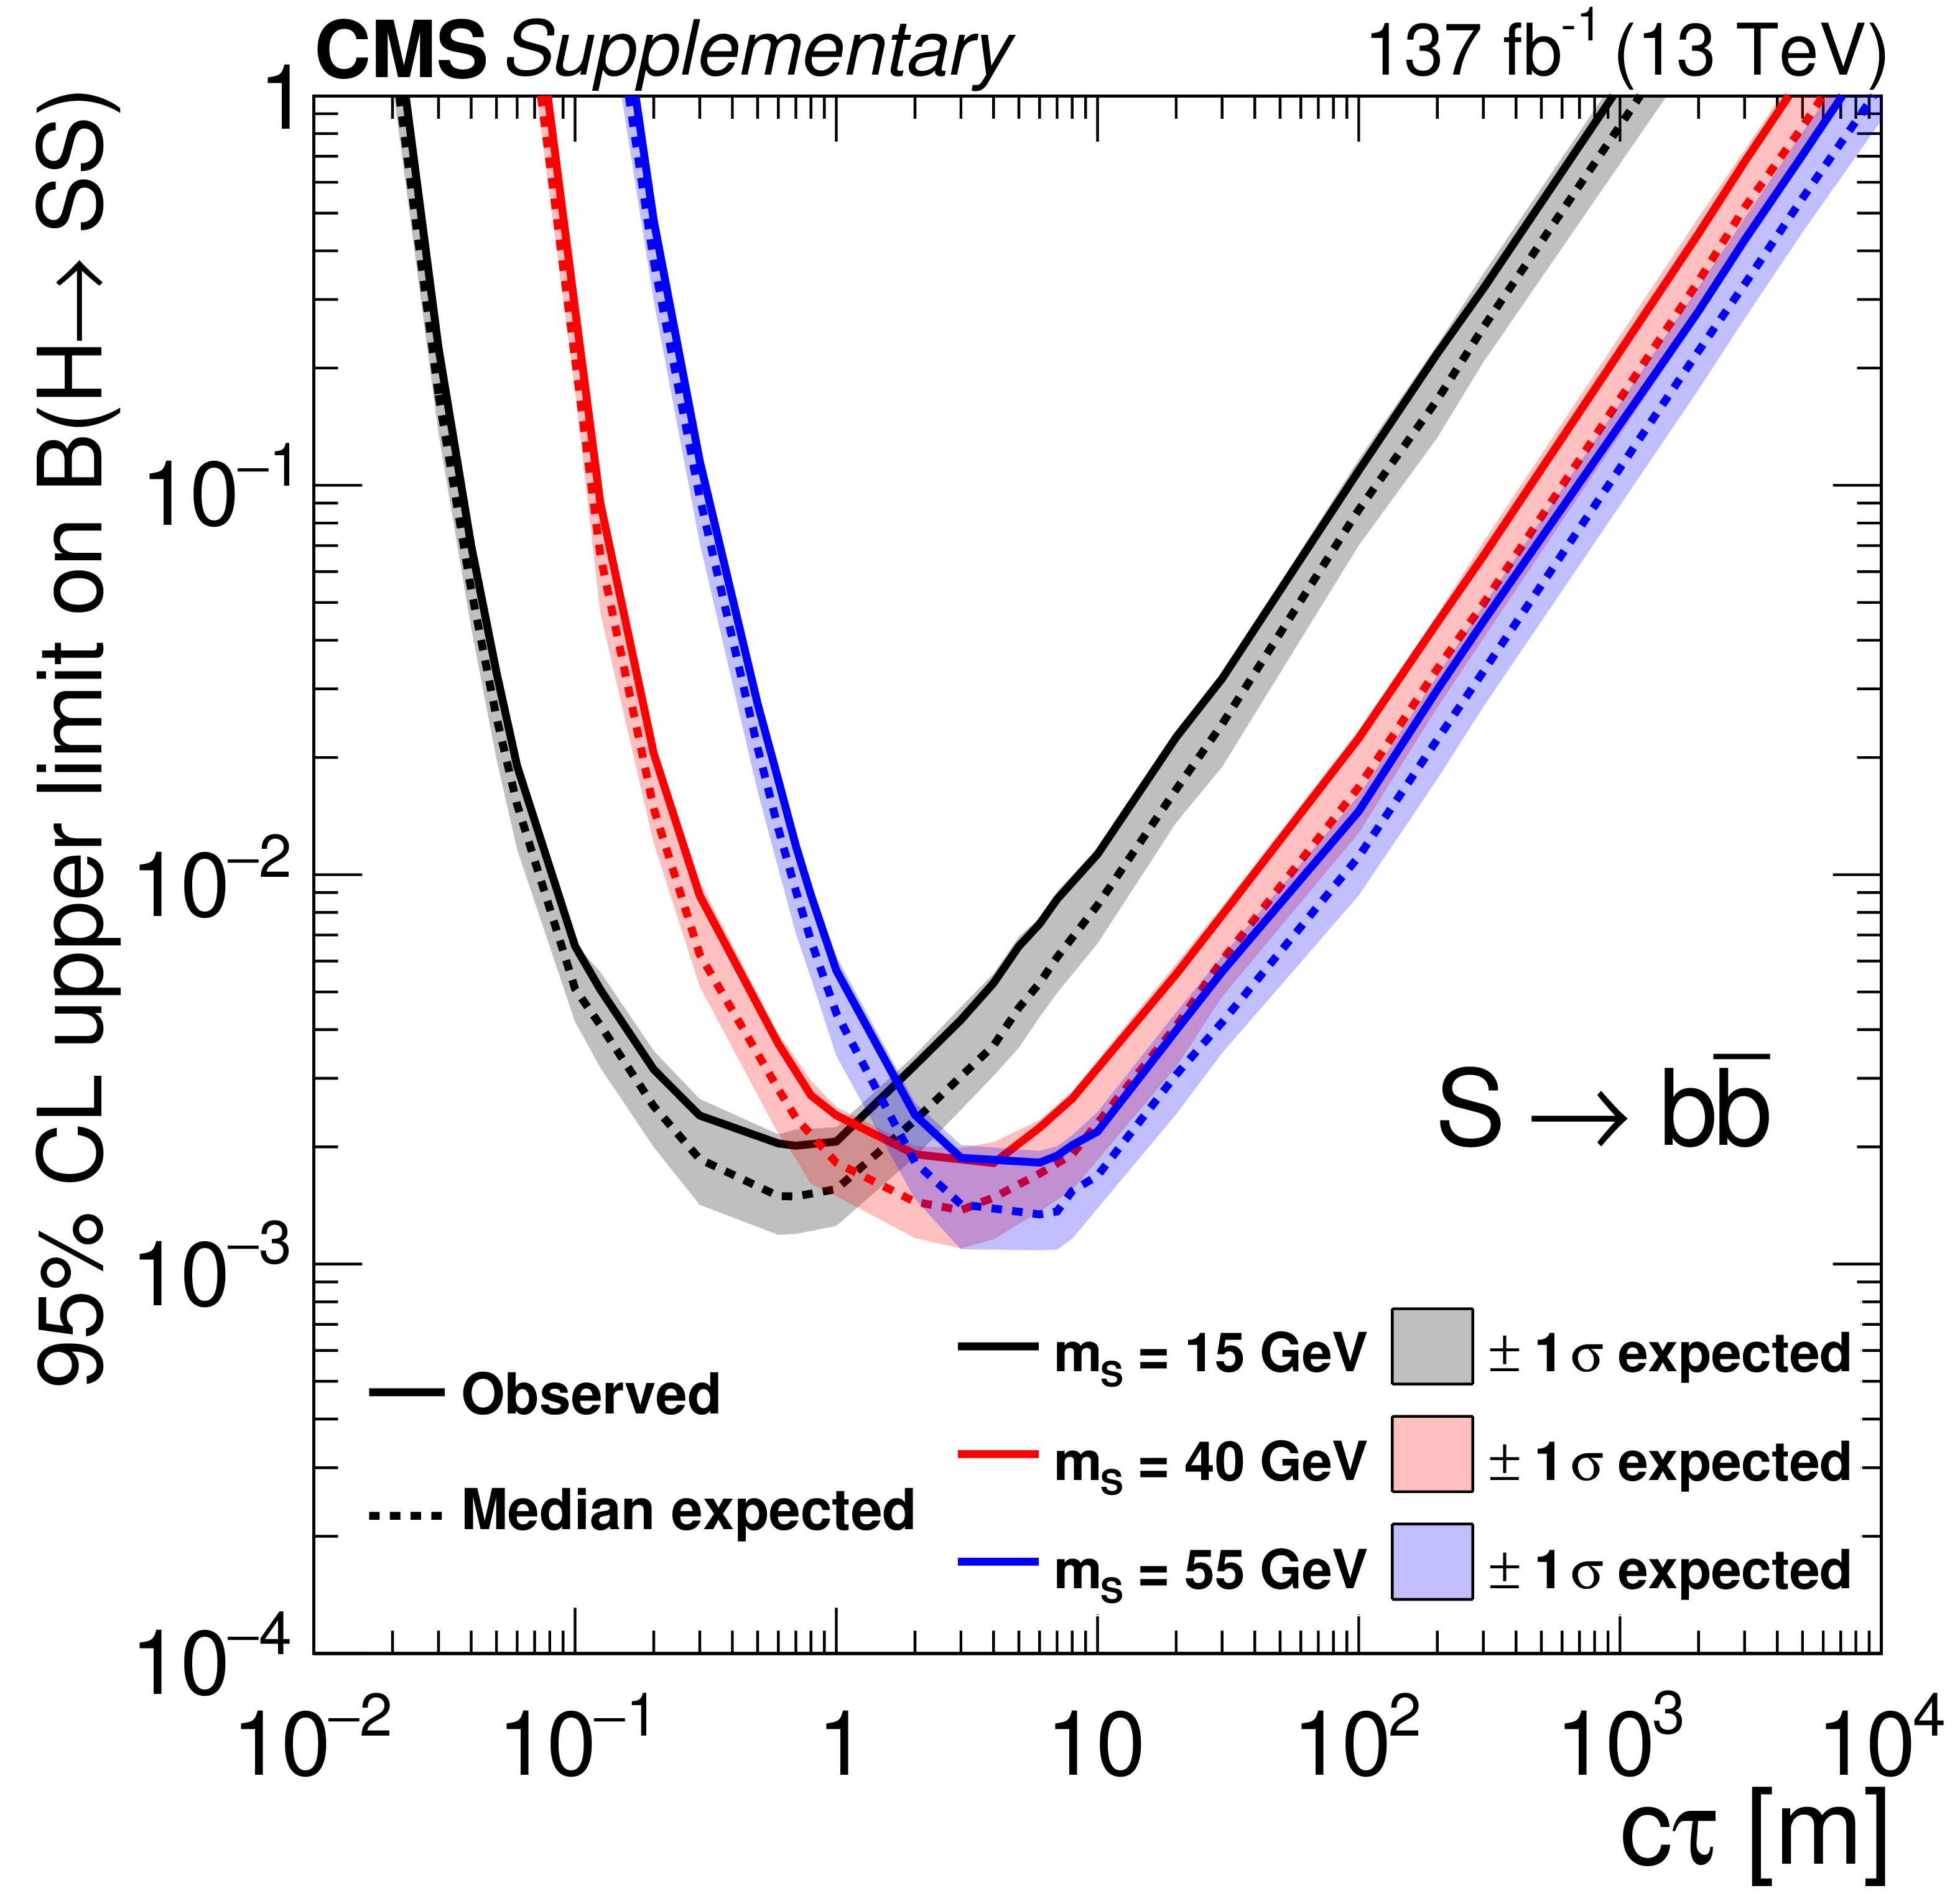
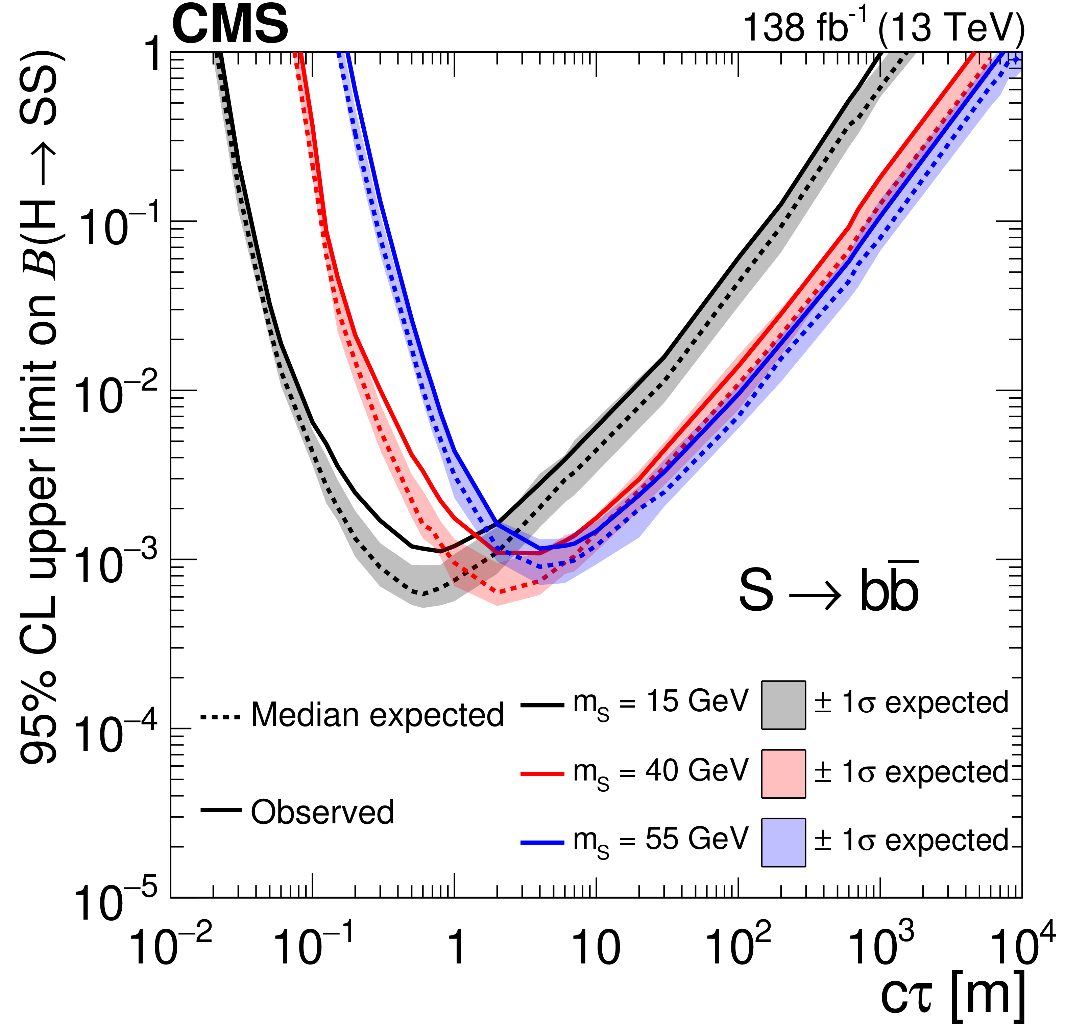
Displaced Jets in the Muon System (CMS-EXO-20-015)
Displaced Jets in the Muon System
(CMS-EXO-21-008)
A novel technique is employed to reconstruct decays of LLPs in the endcap muon detectors
The decays of LLPs are reconstructed as high multiplicity clusters of hits in the muon detectors
Phy. Rev. Lett. 127 (2021) 261804
Phys. Rev. D 110 (2024) 032007

Slide 5
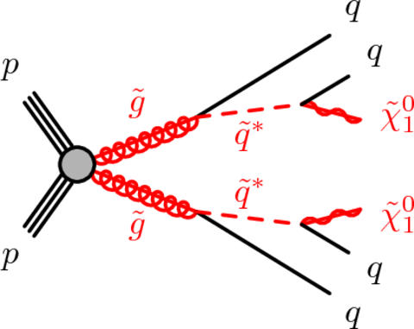
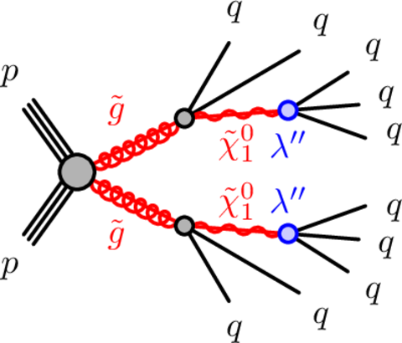
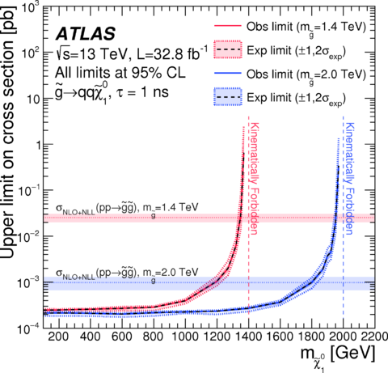
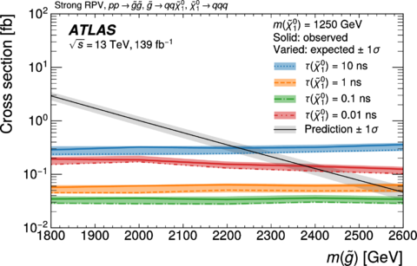
Displaced Jets +MET (ATLAS-SUSY-2016-08)
Displaced Jets (ATLAS-SUSY-2018-13)
Phys. Rev. D 97 (2018) 052012
JHEP 06 (2023) 200

