Slide 1
Dipole Dark Matter (v2)
The Dipole DM model extends the SM by adding three Dirac Fermions and a real scalar, all singlets under the SM gauge group:
The Lagrangian of the model is given by:

Slide 2
Dipole Dark Matter (v2)
Mass eigenstates:
We assume the following mass hierarchy:
Vertices:

Slide 3
Dipole Dark Matter (v2)
Minimal “12”-Model:
“Leading” Production:

Slide 4
Dipole Dark Matter (v2)
Minimal “12”-Model:
“Leading” Decays:
Note that chi2 → chi0+h dominates over chi2→chi1+h, if mchi2 ~ mchi1

Slide 5
Dipole Dark Matter (v2)
Leading channels:
Prompt
Prompt
Displaced

Slide 6
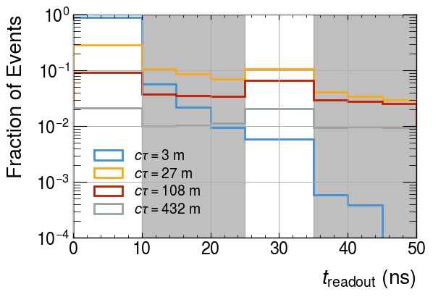
Dipole Dark Matter (v2)
Benchmark:

Slide 7
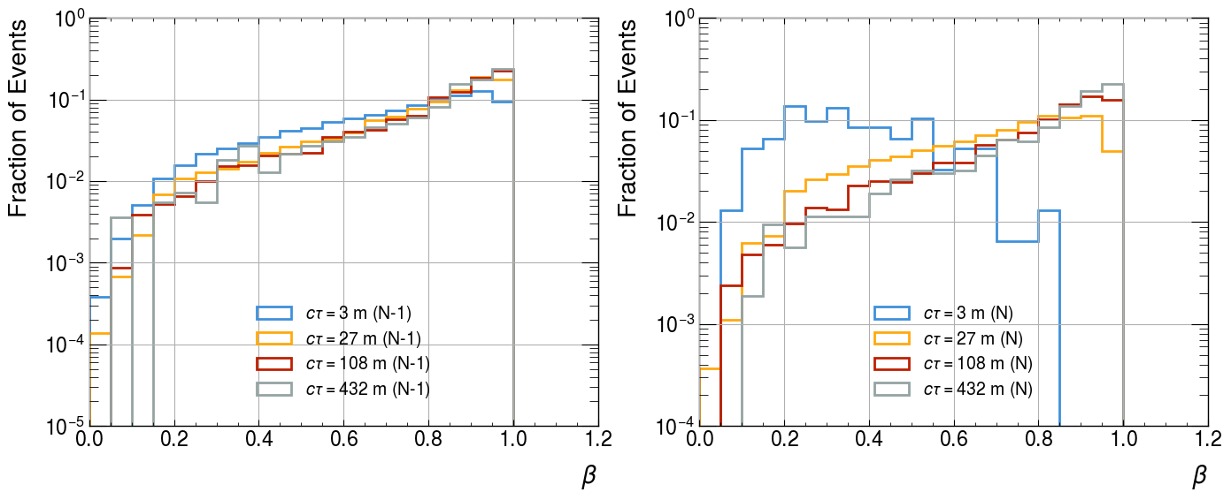
Dipole Dark Matter (v2)
The above behavior for the small lifetime in N events is due to the requirement that the readout time is given by:
Hence for small proper lifetime we need a small boost to achieve large readout times.
As a result, decays taking place in the N event record will correspond to small beta and therefore result in smaller traveled distance (when compare to scenarios with larger lifetimes). This enhances the fraction of N-decays within the HCAL.

Slide 8
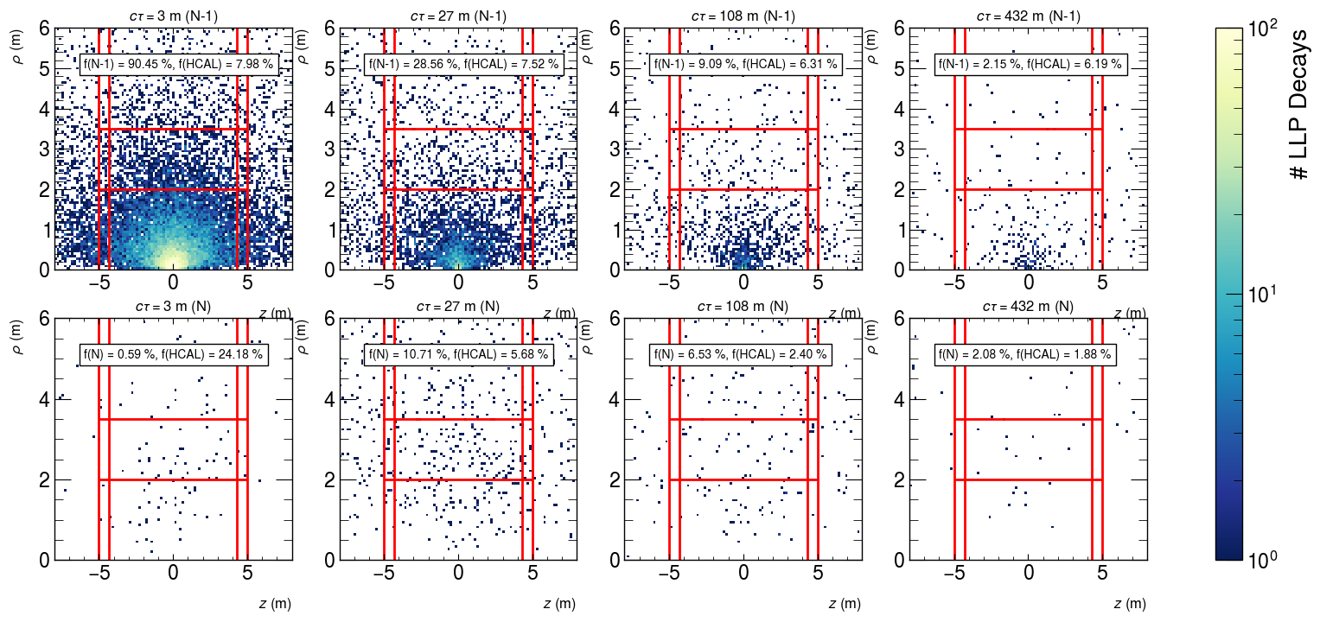
Dipole Dark Matter (v2)
f(N-1) = # Events with the LLP decaying in N/(Total # Events)
f(HCAL) = # Events with the LLP decaying in the HCAL/(f(N) or f(N-1))

