Slide 1
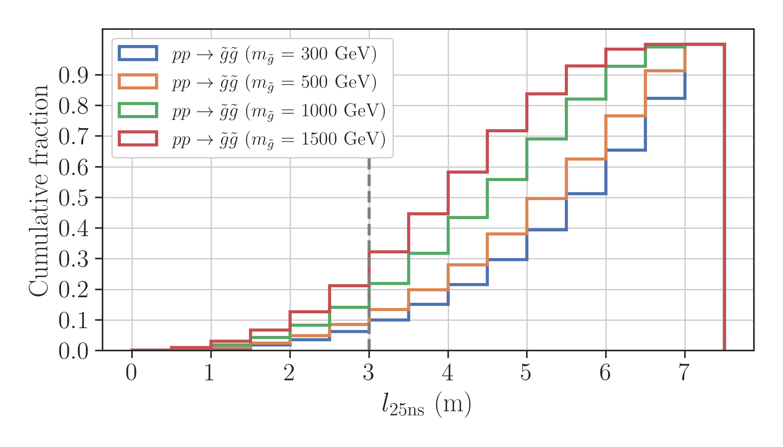
LLP - Boost

Slide 2
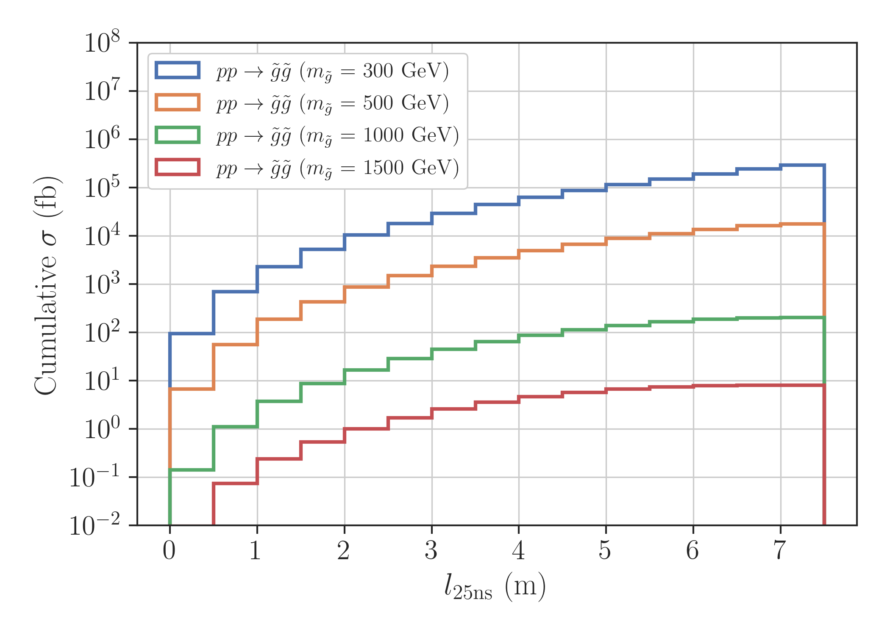
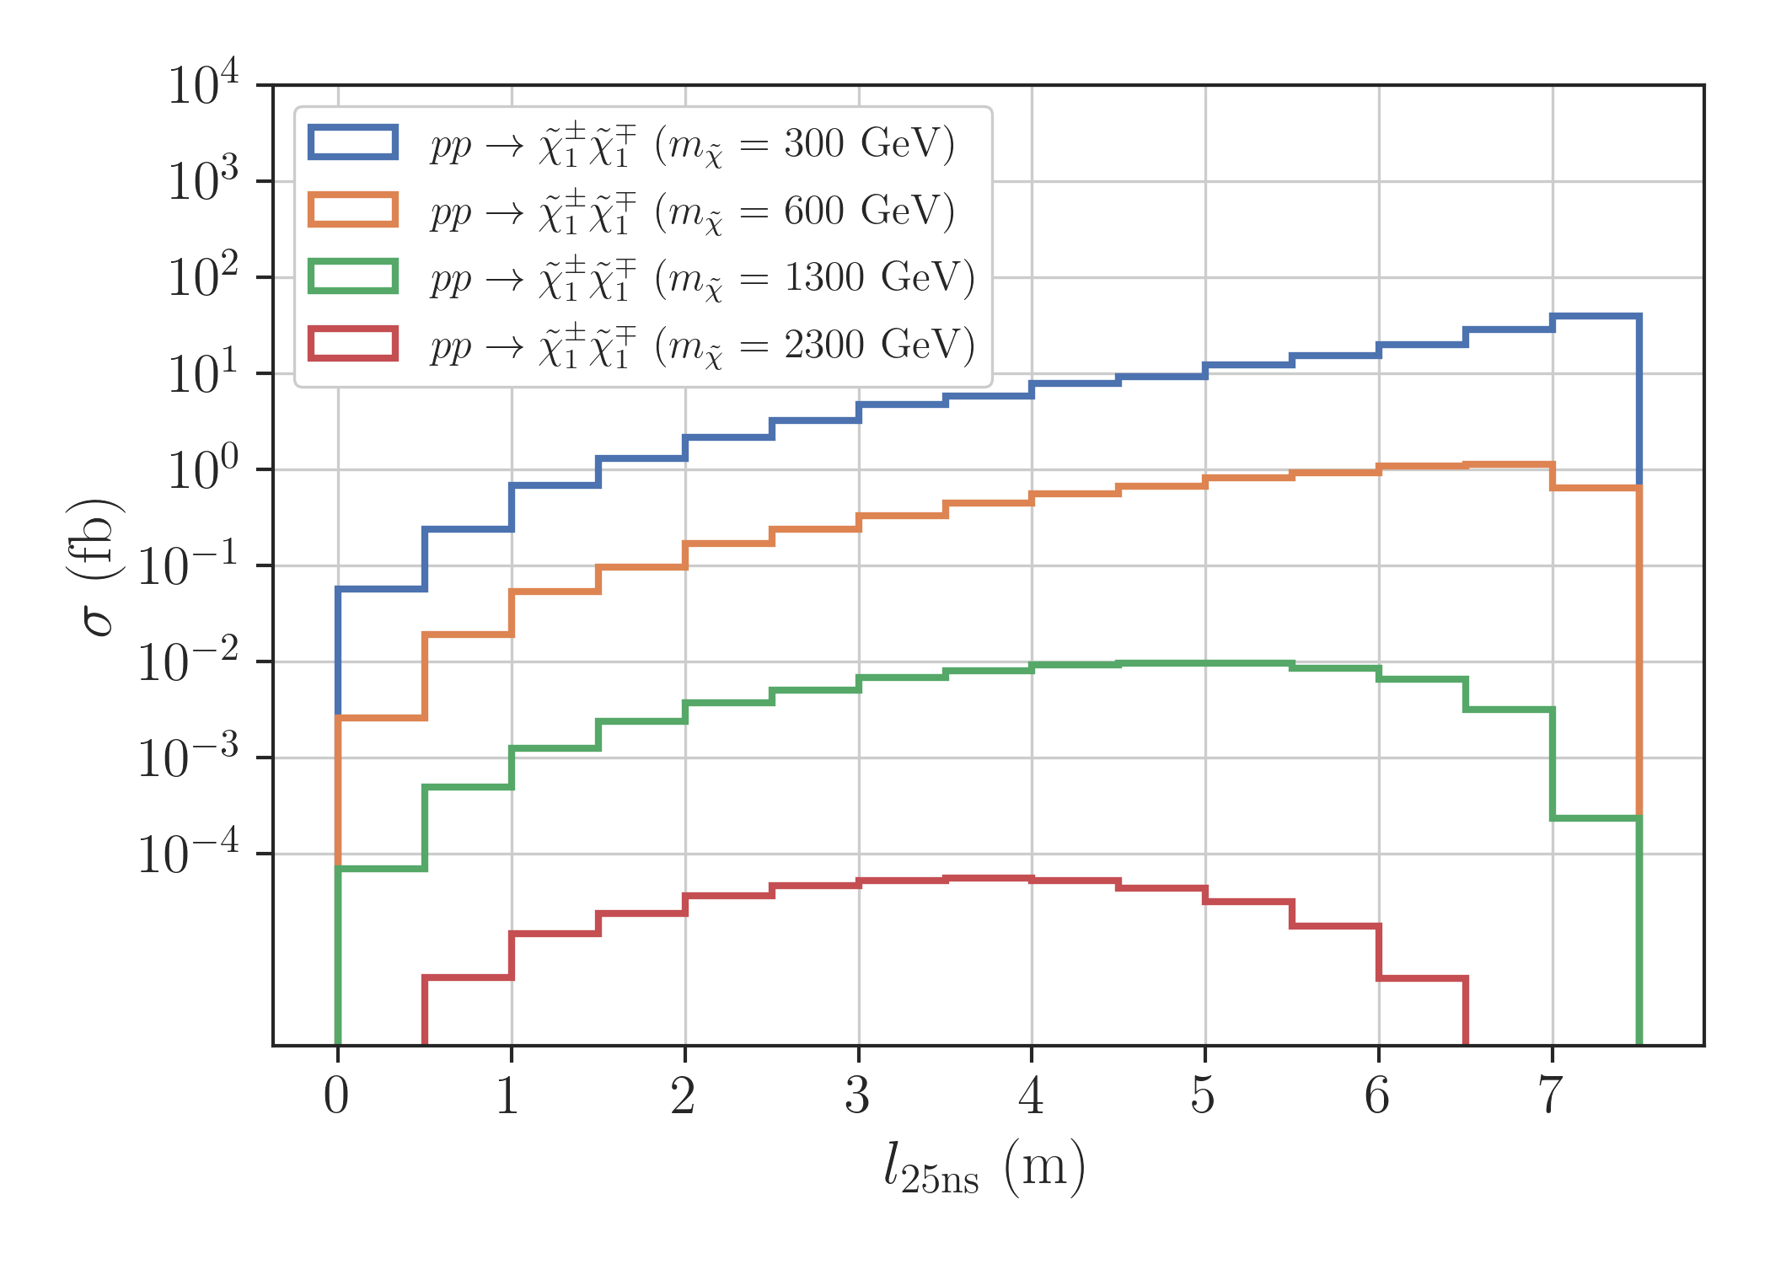
LLP - Boost

Slide 3
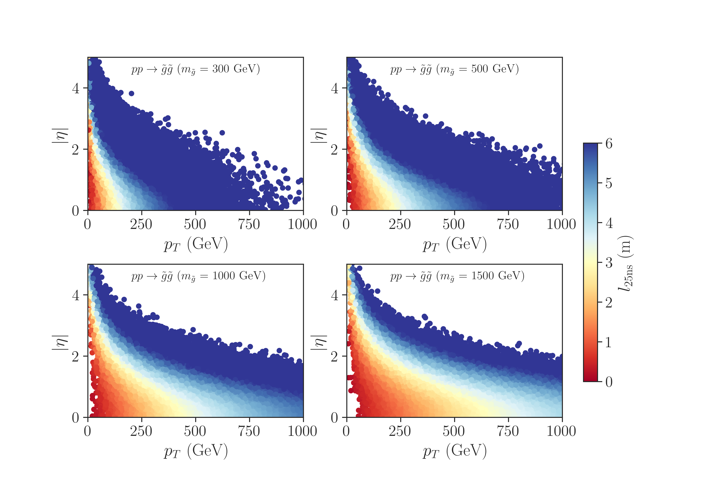
LLP - Boost

Slide 4
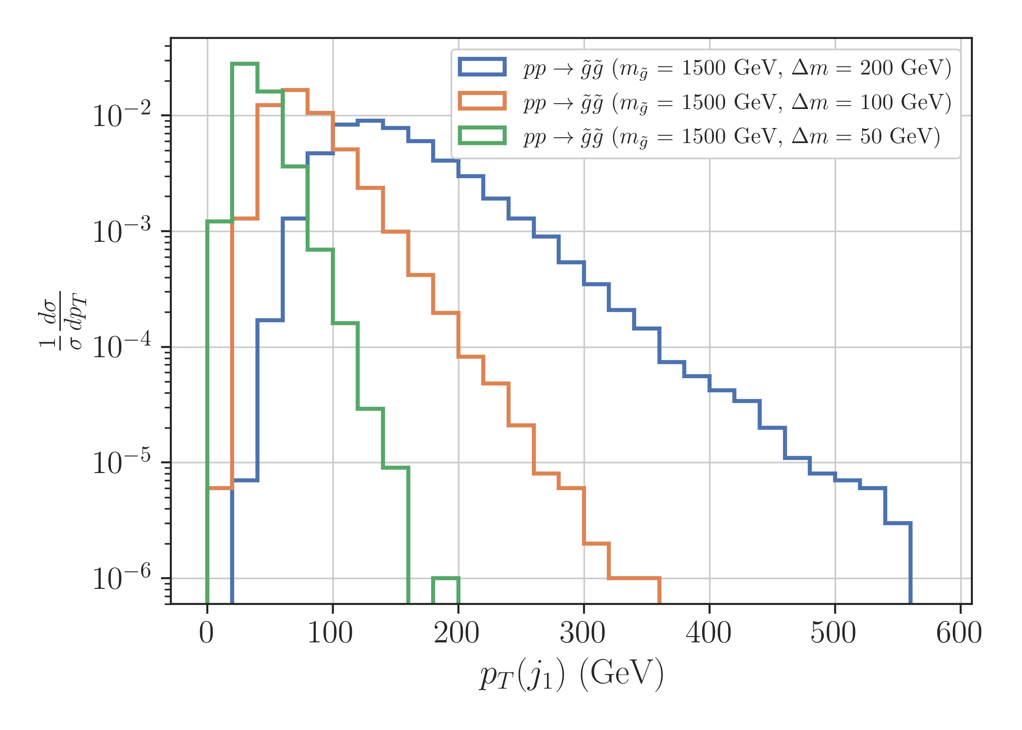
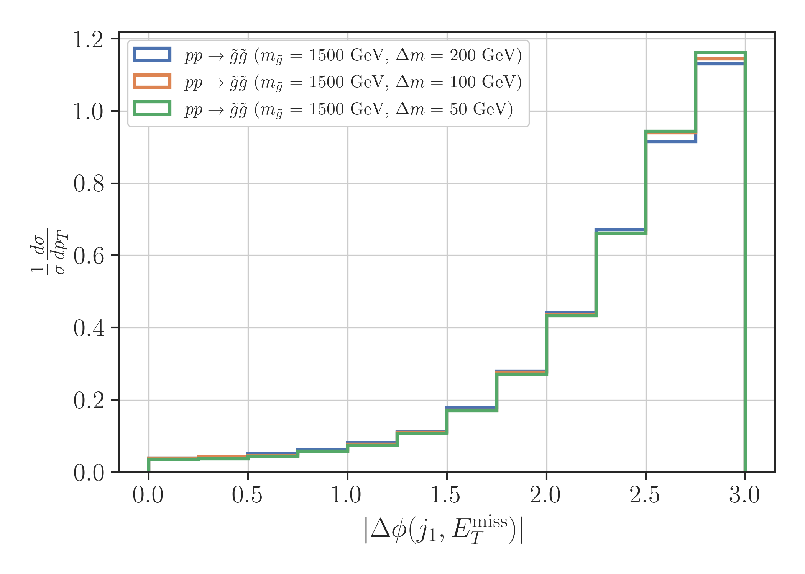
LLP - Boost

Slide 5
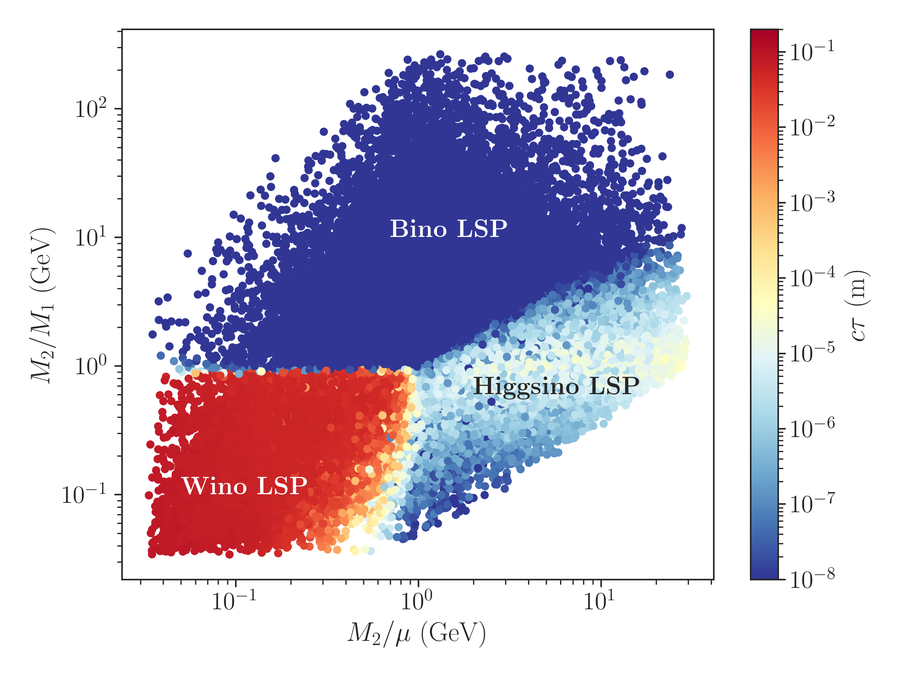
LLP - Lifetime

Slide 6
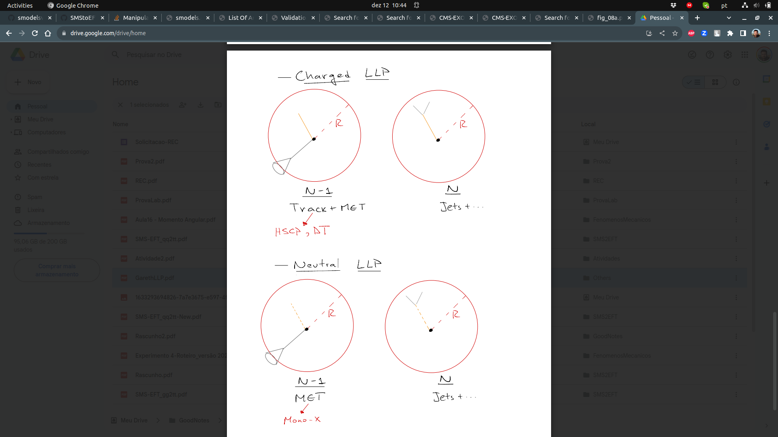
LLP - Constraints
Given that a fraction of LLP decay within the

Slide 7
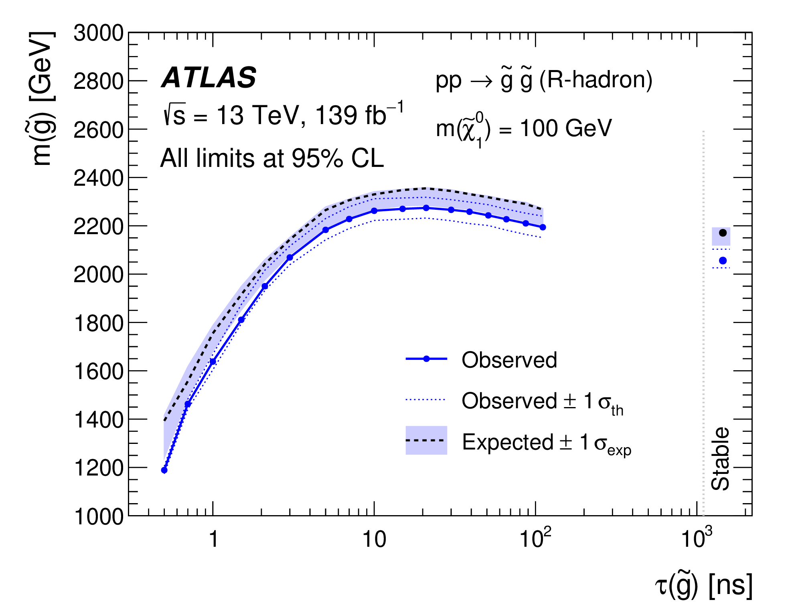
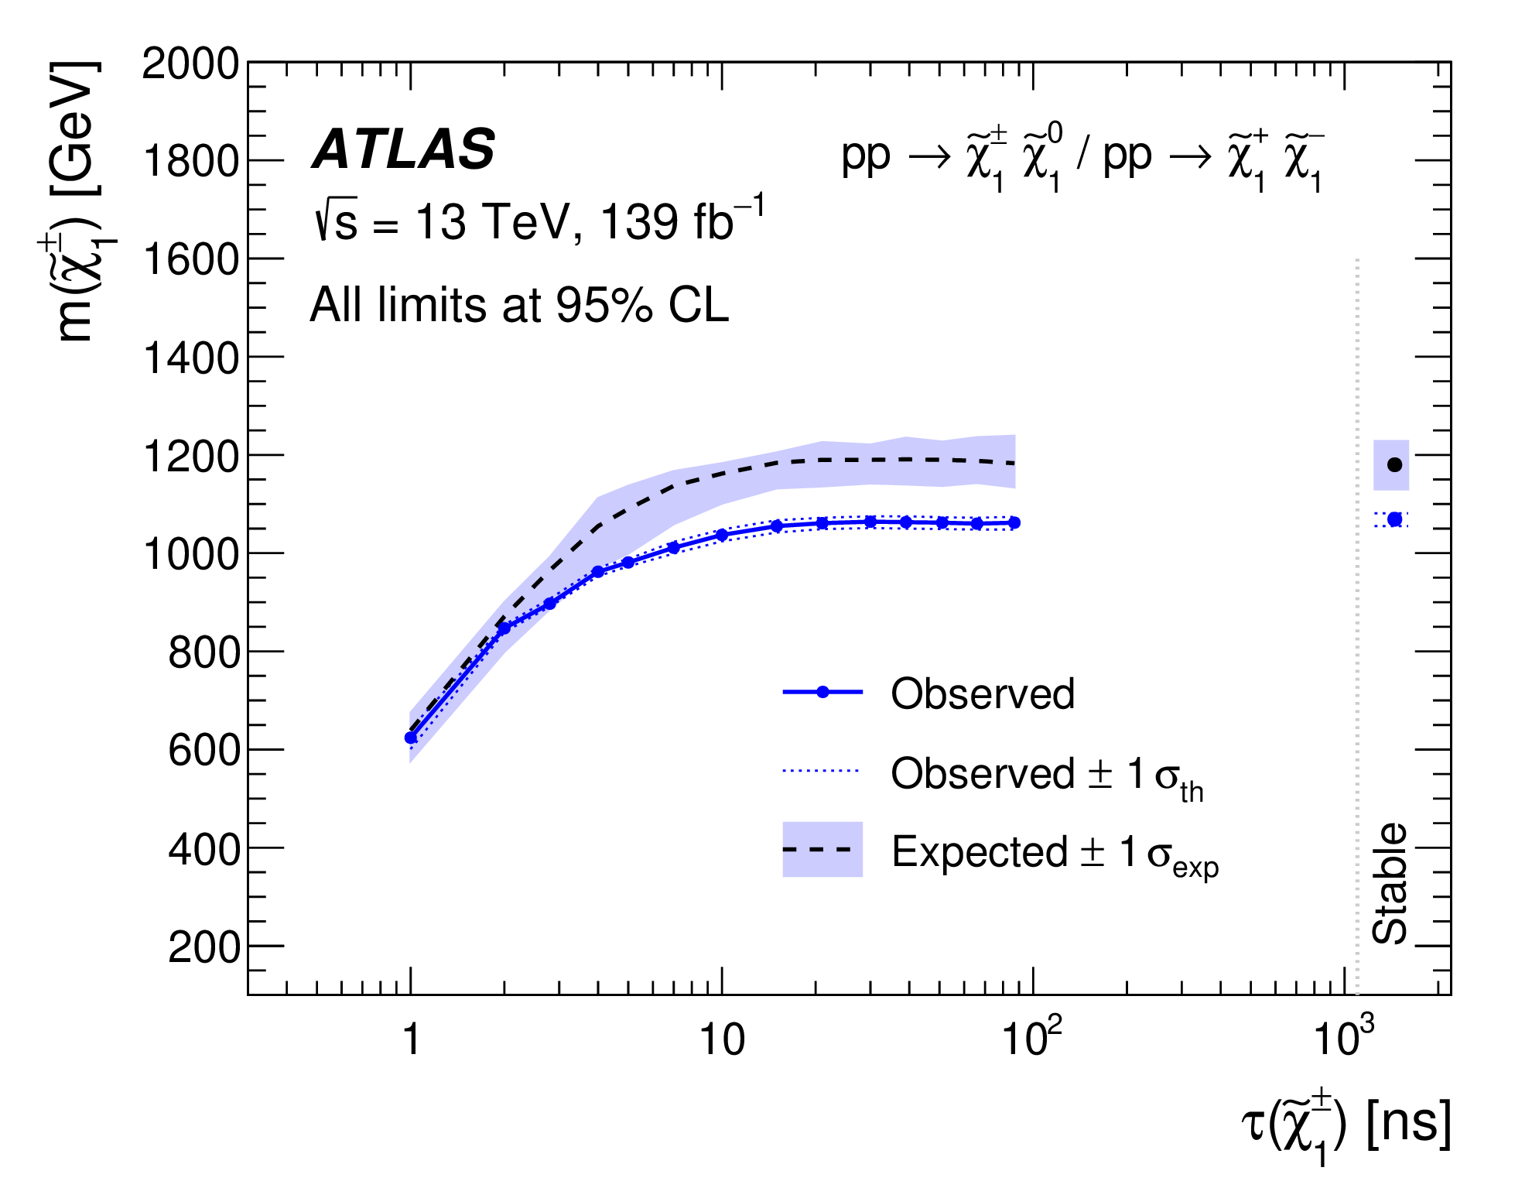
LLP - Constraints
SUSY-2018-42 (HSCP)

Slide 8
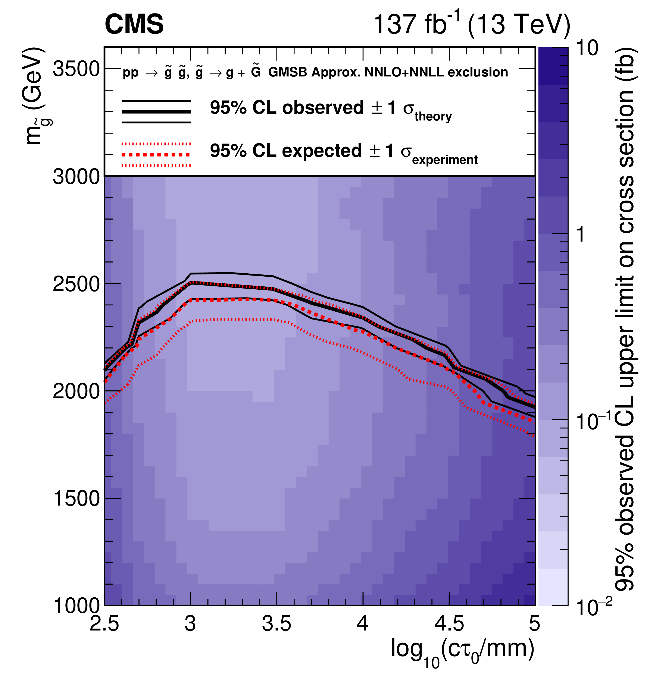
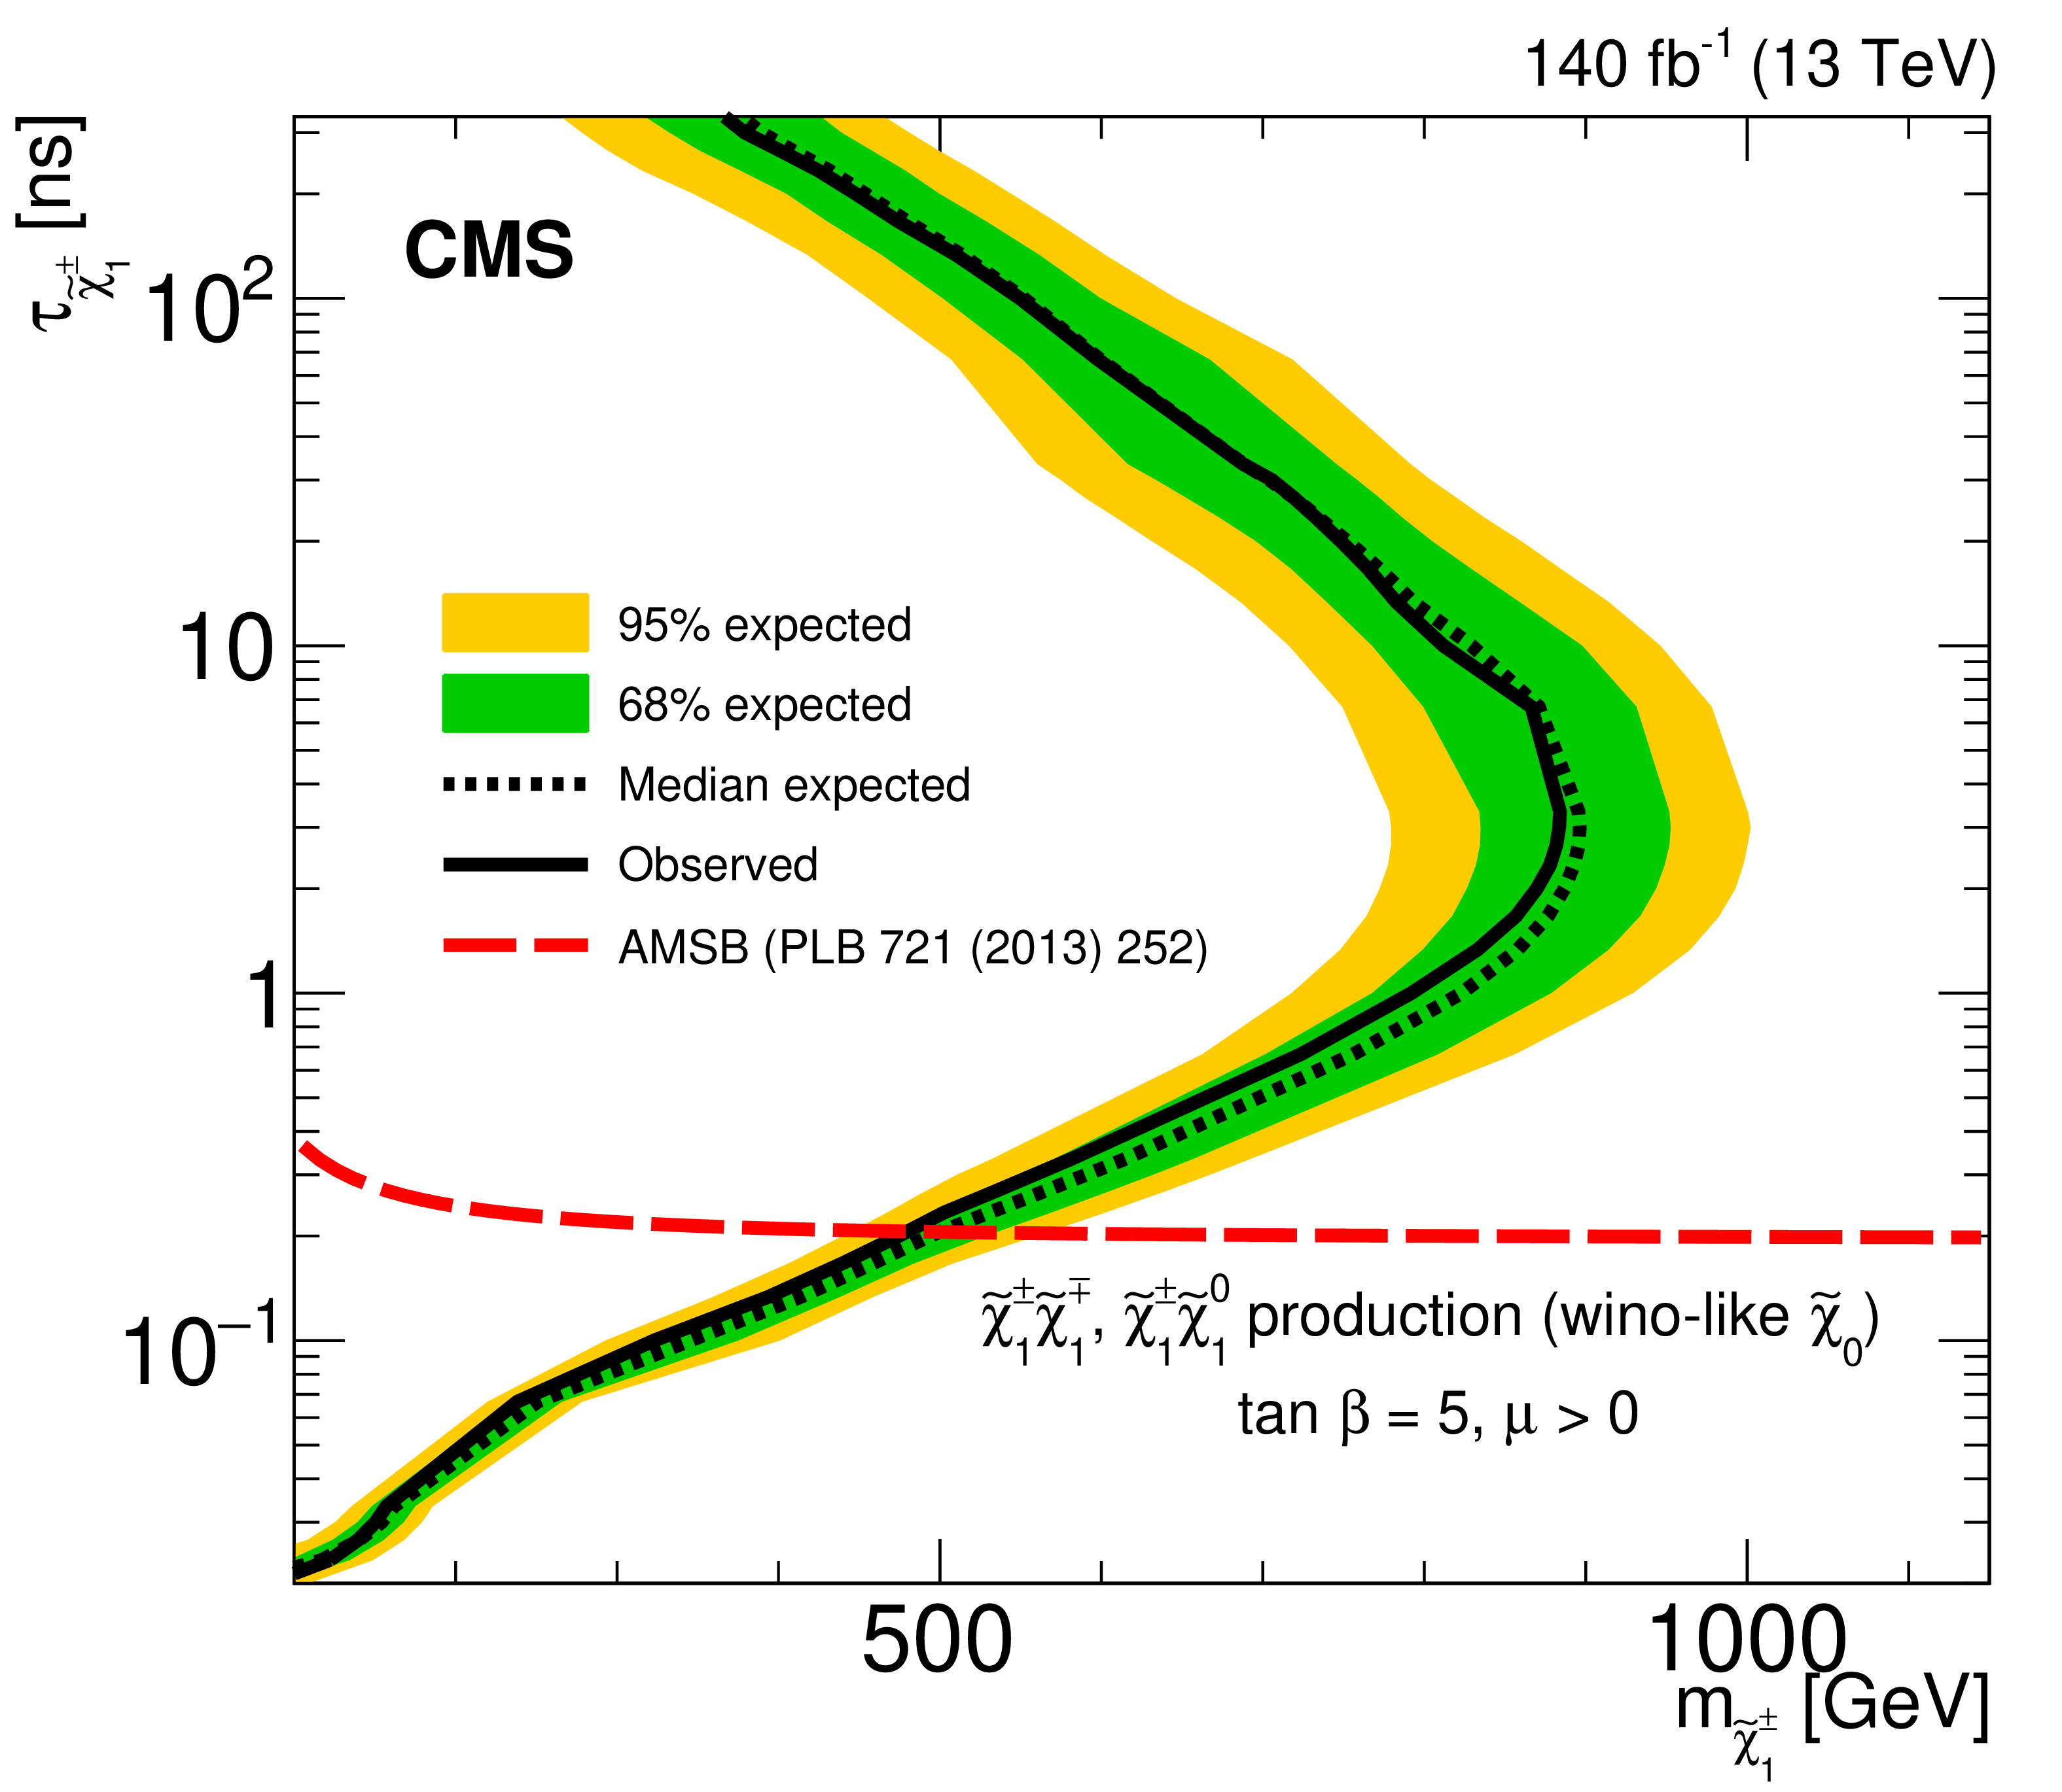
LLP - Constraints
CMS-EXO-19-010 (DT)
CMS-EXO-19-001 (Disp. jets+MET)

Slide 9
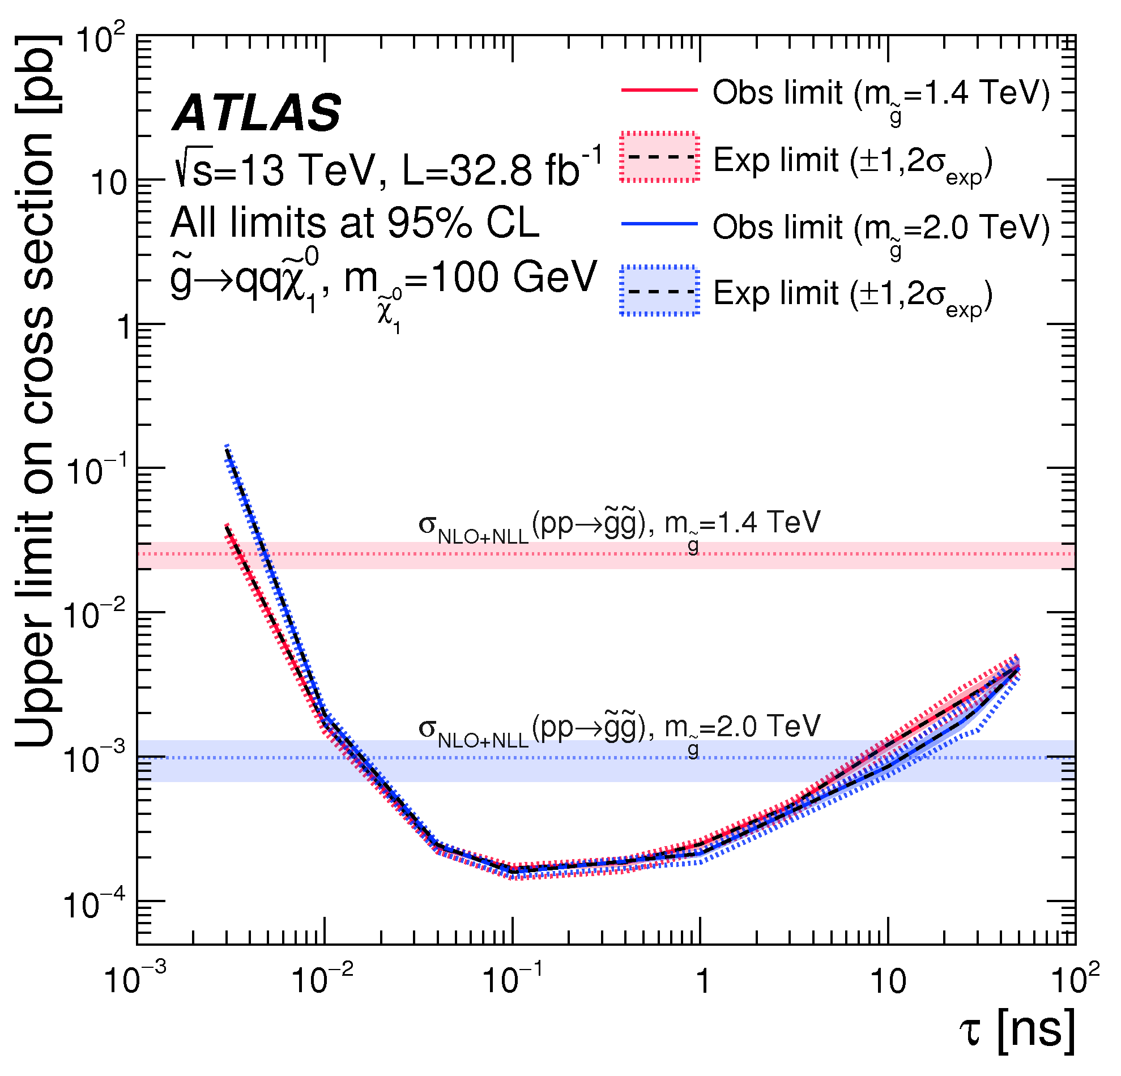
LLP - Constraints
SUSY-2016-08 (DV+MET)

Slide 10
LLP - Constraints
SUSY-2018-42 (HSCP)

Slide 11
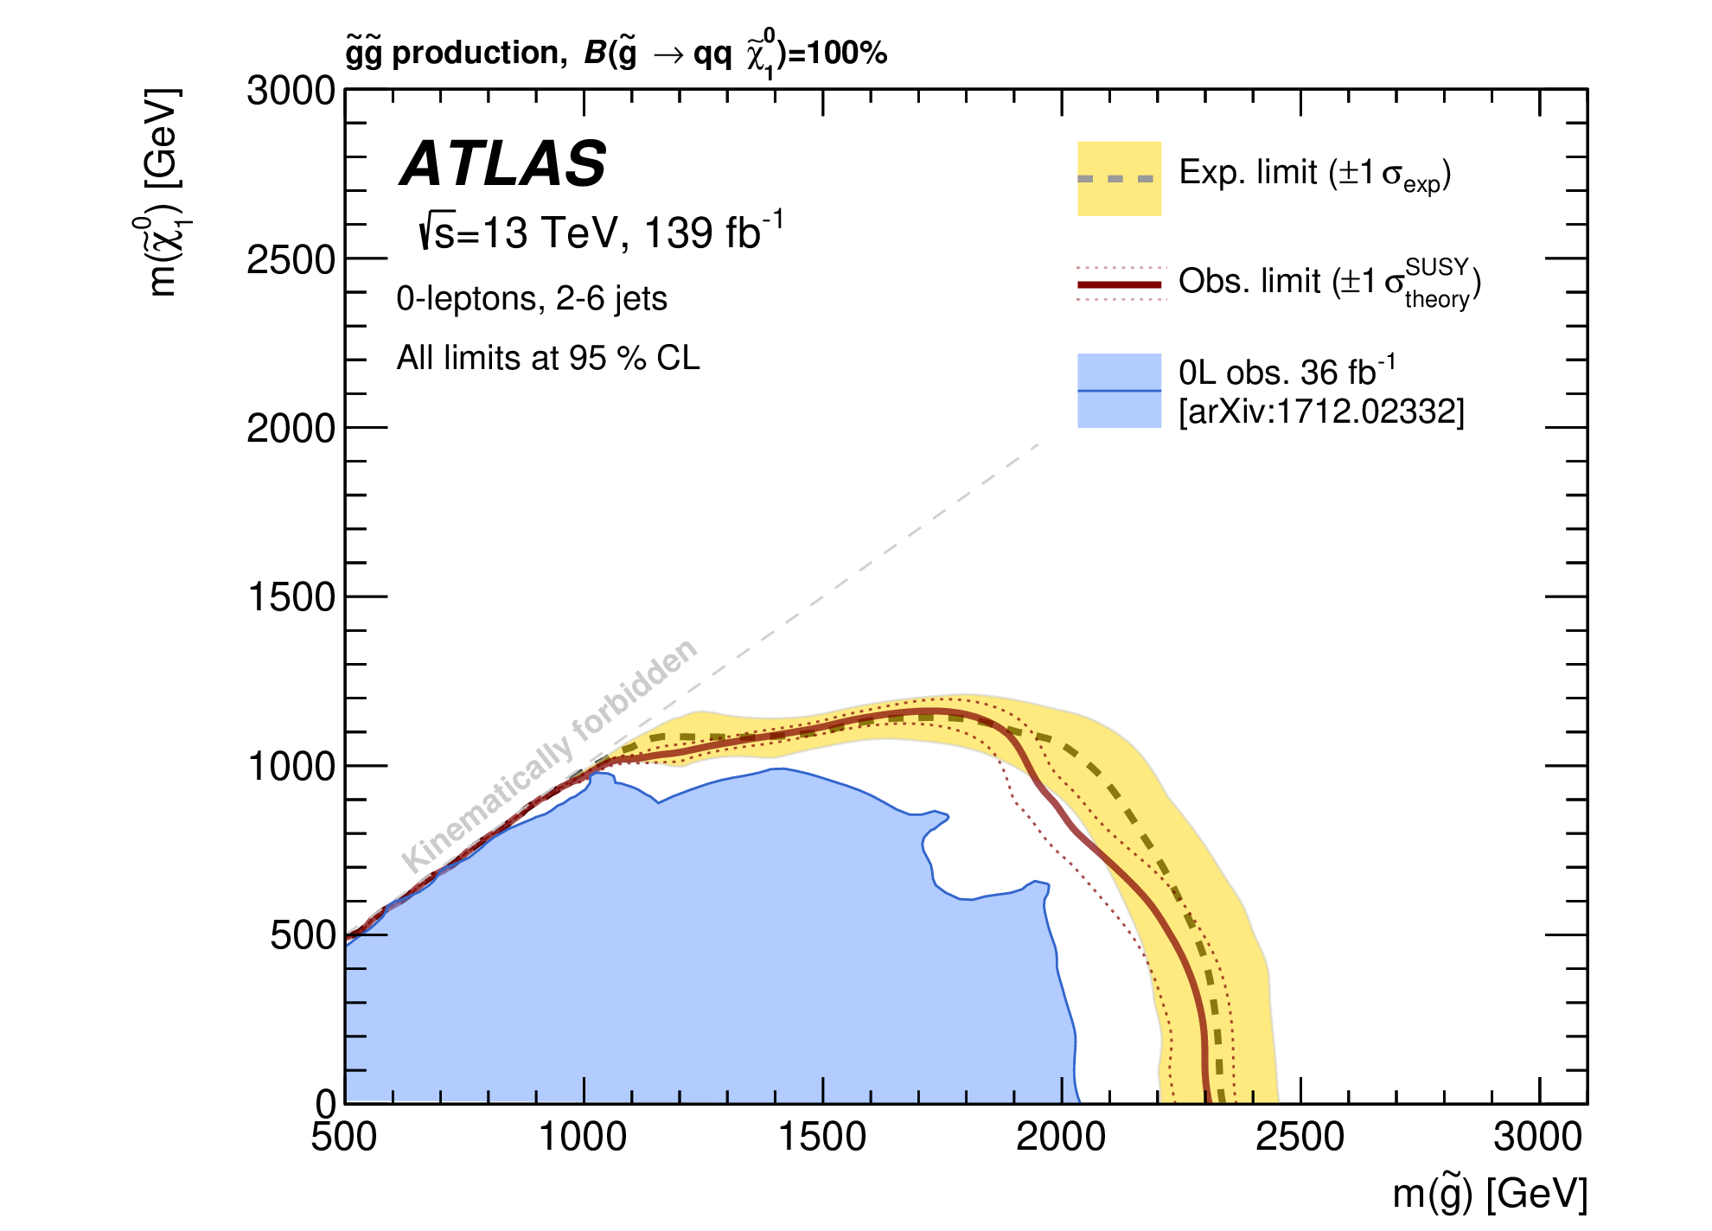
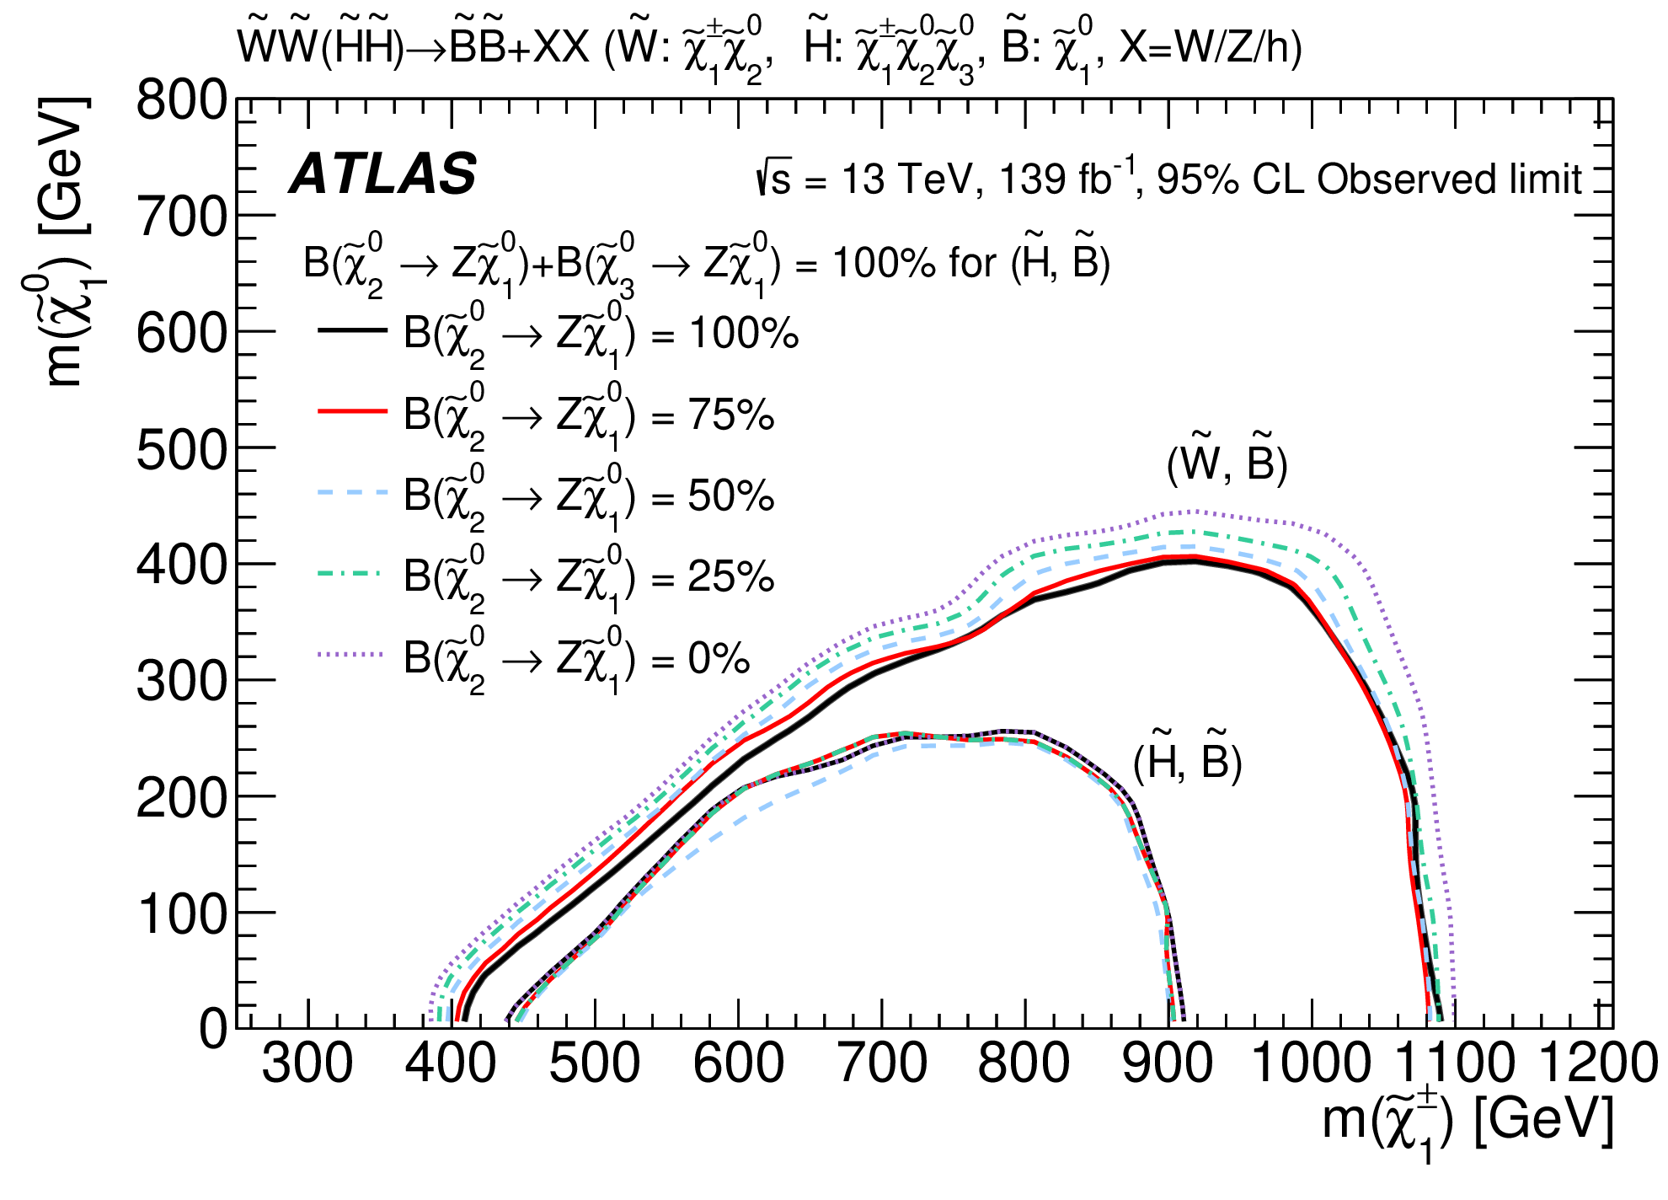
Prompt - Constraints
SUSY-2018-22 (MET+jets)
SUSY-2018-41 (MET+boosted Vs)

