Slide 1
DUNGEON ESCAPE
Java 2D Game — Technical Write-Up
Programming in Java | ICT 2132
Student: Andile Nhlanhla Makuyana Reg No: 25016 Facilitator: Ms. Viola Jows
Notes:
Good morning. My name is Andile Nhlanhla Makuyana, registration number 25016. Today, I'll be presenting Dungeon Escape, a 2D Java game developed as a technical demonstration for ICT 2132. This project showcases the integration of core Java principles with game development mechanics.

Slide 2
Presentation Agenda
01
Project Overview
05
Data & Persistence
What Dungeon Escape is & key technical goals
ScoreEntry, ScoreManager, Tile
02
Core Java Classes
06
ArcherBoss & GamePanel
Main, GameMenu, KeyHandler, Player
Boss AI, attacks, game loop & timers
03
AI & Algorithms
07
System Architecture
Enemy A*, Node, Map generation
Component overview table
04
Game Mechanics
08
Workflow & Debugging
Arrow, ExplosionTracker, Crystal
Game flow & debug key-binds
Notes:
Our agenda for today covers the entire system lifecycle. We'll start with a project overview, then dive into core classes, AI algorithms, game mechanics, and data persistence. We'll conclude with a look at the ArcherBoss logic and the overall system architecture.

Slide 3
Project Overview
Dungeon Escape is a 2D tile-based Java Swing game — featuring enemy AI, boss battles, procedural map generation, a JavaFX menu, and a persistent high-score system. Built entirely from first principles with no game engine.
15
2
10
4
Java Source Files
Game Modes
Boss Levels
Design Patterns
Technologies: Java Swing • JavaFX • Java 2D / AWT • A* Pathfinding • File I/O • OOP Design Patterns
Notes:
Dungeon Escape is built entirely from first principles with no external game engine. It features a complex 16-class architecture, supporting two distinct game modes: Casual and Escape. We've implemented advanced features like A* pathfinding, procedural map generation, and a hybrid Swing-JavaFX UI system.

Slide 4
Core Java Classes
Main · GameMenu · KeyHandler · Player
SECTION 02
Notes:
Section 2 focuses on our core Java classes: Main, GameMenu, KeyHandler, and Player. These classes form the backbone of the game's startup, menu interface, and user control systems.

Slide 5
Main.java & GameMenu.java
Main.java
GameMenu.java
ENTRY POINT
JAVAFX
JFrame Bootstrap
Creates Swing window, adds GamePanel, calls pack() and setLocationRelativeTo(null).
Cross-Thread Bridge
quitToMenu() uses Platform.runLater() to hand off from Swing to JavaFX Application Thread.
Property Bindings
Bindings.min() derives scale; bound to a Scale transform for automatic 4:3 aspect ratio.
FadeTransition
INDEFINITE blink animation with setAutoReverse(true) — decoupled from game loop.
String mode = (args != null && args.length > 0)
? args[0] : "casual";
window.pack();
window.setLocationRelativeTo(null);
FadeTransition blink =
new FadeTransition(Duration.seconds(1), introText);
blink.setCycleCount(FadeTransition.INDEFINITE);
blink.setAutoReverse(true); blink.play();
Notes:
In Main.java, we use a standard JFrame bootstrap to initialize the Swing window. A unique feature here is the 'Cross-Thread Bridge' in quitToMenu(), which uses Platform.runLater to safely transition from the Swing game loop to the JavaFX UI thread. For the Menu, we use JavaFX property bindings to ensure the UI scales correctly while maintaining a 4:3 aspect ratio.

Slide 6
KeyHandler.java & Player.java
KeyHandler.java
Player.java
INPUT
PLAYER
Polling Model
Boolean flags toggled in keyPressed/Released. Game loop reads every frame for smooth multi-key input.
Mapped Keys
W/A/S/D + Arrow · R (restart) · P/G/L/O (debug) · ESC / ENTER
Axis-Independent Collision
X and Y movement tested separately — player slides along walls rather than stopping dead.
Aspect-Ratio Rendering
ratio = imgWidth/imgHeight computed per frame; drawImage centered over 30×30 hitbox.
public boolean upPressed, downPressed,
leftPressed, rightPressed;
// keyPressed(): if(code==VK_W||VK_UP) upPressed=true;
if (!checkCollision(newX, y)) x = newX;
if (!checkCollision(x, newY)) y = newY;
// ratio = img.getWidth() / img.getHeight();
Collision: X & Y tested independently → wall-sliding enabled | Tile 4=stagger Tile 5=spikes
Sprite loaded via getResourceAsStream() — IOException caught, colour-rect fallback applied
Notes:
KeyHandler.java uses a polling model with boolean flags to handle multi-key input smoothly. For the Player, we've implemented axis-independent collision. As you can see in the code snippet, we test X and Y movement separately. This is crucial for 'wall-sliding'—if a player moves diagonally against a wall, they will still slide along it rather than coming to a full stop.

Slide 7
AI & Algorithms
Enemy · Node · Map
SECTION 03
Notes:
Section 3 covers our AI and procedural generation logic, focusing on how we manage complexity in the game world and NPC behavior.

Slide 8
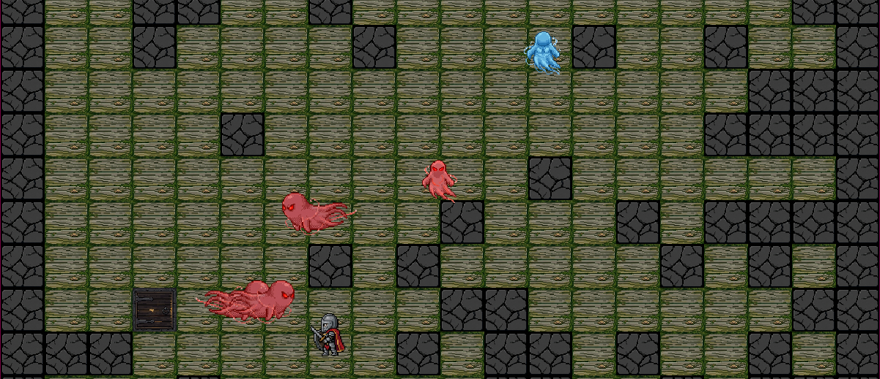
Enemy.java — A* Pathfinding & AI State Machine
A* Pathfinding
Finite State Machine
Performance & Separation
ArrayList open/closed lists. Lowest fCost selected per frame. Manhattan |dx|+|dy| heuristic for 4-directional grid. constructPath() walks parent chain.
enum State { CHASE, WANDER }. CHASE triggers within 10 tiles if among 4 closest. WANDER picks random free tile from Map.
Path recalculated every 15 frames. Slow-motion: skip every 3rd frame (gp.slowTimer). Euclidean distance < 15px triggers repulsion.
for(Node n : openList) {
if(n.fCost < current.fCost) current = n;
}
public enum State { CHASE, WANDER }
Notes:
The Enemy AI uses a custom A* pathfinding implementation. We select the node with the lowest fCost each frame using a Manhattan distance heuristic. The AI is a finite state machine with two modes: CHASE and WANDER. To optimize performance, we recalculate the path every 15 frames rather than every single frame, and we've implemented a repulsion logic to keep enemies from overlapping.

Slide 9
Node.java & Map.java
Node.java
Map.java
POJO
PROCEDURAL GEN
Linked-List Path Chain
parent field chains nodes from goal backwards. Direct field access — no getters — for inner-loop performance.
Open/Closed Principle
calculateFCost() = gCost + hCost — single change point if cost formula evolves.
Wall Scaling
wallChance = 20 + ((level-1)/5)*5, capped at 40%. 3 layouts: normal, arena (4 pillars), chase corridor.
Path Carver
Drunk-walk carves 2×2 corridor from spawn to exit. map[endY][endX] = 2 stamps the exit.
int col, row, gCost, hCost, fCost;
Node parent;
void calculateFCost() { fCost = gCost + hCost; }
int wallChance = 20 + ((level-1)/5)*5;
if (wallChance > 40) wallChance = 40;
map[endY][endX] = 2; // stamp exit tile
Notes:
The Node class is a clean POJO that forms a linked-list path chain. It uses direct field access for performance and adheres to the Open/Closed principle for its cost calculations. For the Map, we use procedural generation where the 'wall chance' scales with the level. We've also implemented a 'Drunk-walk' path carver to ensure there is always a traversable 2x2 corridor from the spawn to the exit.

Slide 10
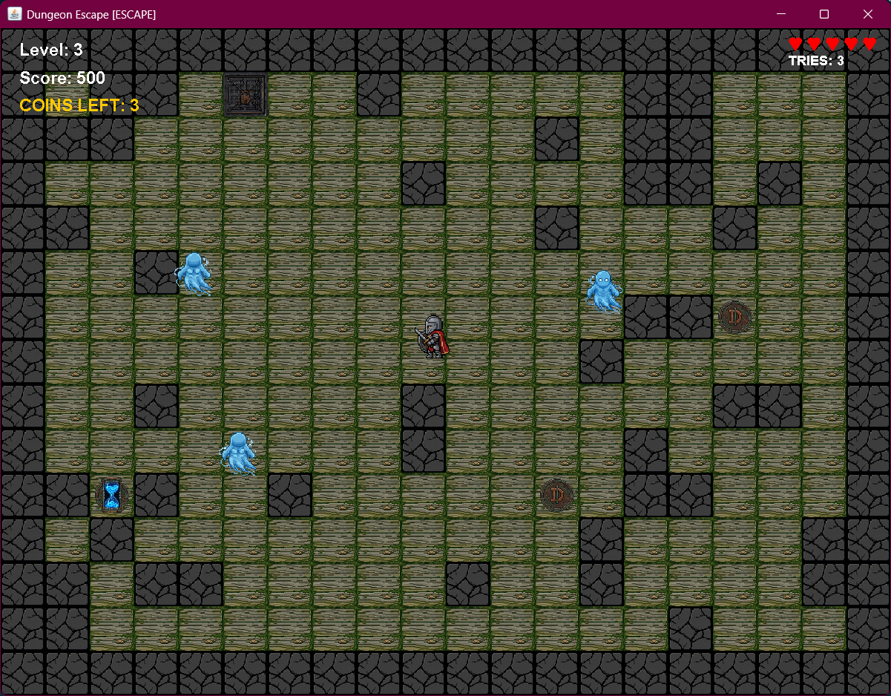

Slide 11
Game Mechanics
Arrow · ExplosionTracker · Crystal
SECTION 04
Notes:
Section 4 details our game mechanics, specifically our projectile system and interactive collectibles.

Slide 12
Arrow.java & ExplosionTracker.java
Arrow.java
ExplosionTracker.java
PROJECTILE
BOSS MECHANIC
Dual Constructors
One takes target (x,y) and computes angle; one takes pre-computed (dx,dy) for Frenzy spread-shots.
Vector Movement
atan2 → angle; cos/sin × speed = dx/dy. Centre tile lookup deactivates on wall hit.
4-Phase State Machine
0=Tracking (red, lerp 3s) → 1=Locked (green 1s) → 2=Exploding → 3=Done
AABB Blast
Rectangle +15px per side. Checks player AND crystals via intersects() — uniform collision for all entity types.
double angle = Math.atan2(targetY-startY,targetX-startX);
this.dx = Math.cos(angle) * speed;
this.dy = Math.sin(angle) * speed;
x += (targetX - x) * 0.05; // lerp
Rectangle boomRect = new Rectangle(
(int)x-15,(int)y-15, size+30, size+30);
Notes:
Arrow.java uses vector movement derived from Math.atan2. It features dual constructors—one for direct targeting and one for pre-computed spread shots. The ExplosionTracker is a 4-phase state machine that lerps from a red 'tracking' state to a green 'locked' state before detonating, using AABB blast rectangles for uniform collision detection across all entity types.

Slide 13
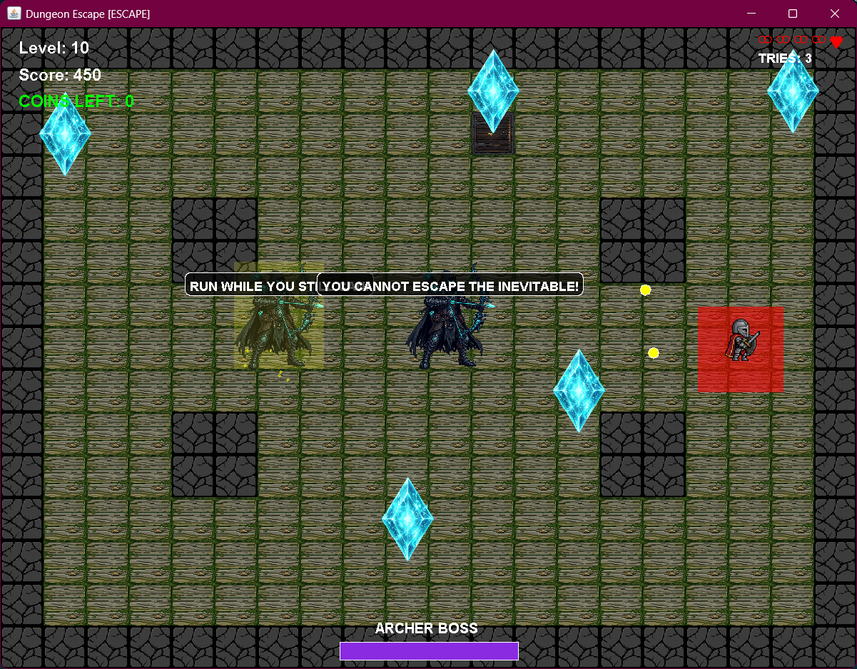

Slide 14
Crystal.java — Collectibles & Game Object Design
Boolean Lifecycle
Expanded Hit Bounds
Dynamic Scaling
active flag controls draw() and all system checks. Avoids ConcurrentModificationException by not mutating the list during iteration.
18px padding per side on getExpandedBounds() — makes pickup feel responsive without changing the visual footprint.
Drawn at 2× tile size. Aspect ratio computed from BufferedImage.getWidth/Height(). Fallback: fillPolygon() diamond.
int leeway = 18;
return new Rectangle(x-leeway, y-leeway,
gp.tileSize+leeway*2, gp.tileSize+leeway*2);
Crystal.java — pure SRP game object holds state, defines bounds and rendering, delegates coordination to GamePanel.
Notes:
The Crystal class demonstrates the Single Responsibility Principle. It manages its own boolean lifecycle and rendering. To make pickup feel more responsive, we've implemented 'Expanded Hit Bounds' where the collision box is 18 pixels larger than the visual sprite on each side, avoiding frustration for the player.

Slide 15
Data & Persistence
ScoreEntry · ScoreManager · Tile
SECTION 05
Notes:
Section 5 covers Data and Persistence, specifically how we handle score saving and efficient map rendering.

Slide 16
ScoreEntry, ScoreManager & Tile.java
ScoreEntry.java — Serializable CSV Encoding
Tile.java
Implements Serializable. toString() encodes as CSV: name,score,level,mode,coins. Used as write format by ScoreManager.
VALUE OBJECT
Flyweight Pattern
Tile[] of 6 entries shared by a 20×15 int[][] map — 300 cells → 6 objects.
Null-Safe Rendering
image != null ? drawImage : fillRect(color). Every tile has a colour fallback.
ScoreManager.java — File I/O, Parsing & Sorting
BufferedWriter(FileWriter(path, true)) — append mode. Try-with-resources auto-closes. Defensive parsing: parts.length guards old save files missing mode/coins fields. Lambda Comparator: sort by score DESC, level DESC; subList(0,10).
try (BufferedWriter w = new BufferedWriter(
new FileWriter(FILE_PATH, true))) {
w.write(name+","+score+","+level+","+mode+","+coins);
}
public BufferedImage image;
public Color color;
public boolean collision;
Notes:
ScoreEntry implements Serializable and uses a custom CSV encoding for storage. ScoreManager handles file I/O with defensive parsing to remain backward compatible with older save files. For Tile.java, we use the Flyweight pattern—instead of 300 unique objects for a 20x15 grid, we use just 6 shared tile instances referenced by an integer array, drastically reducing the memory footprint.

Slide 17
ArcherBoss & GamePanel
Boss AI, Attacks & Game Loop Orchestration
SECTION 06
Notes:
Section 6 brings everything together with the ArcherBoss AI and the central GamePanel orchestrator.

Slide 18
ArcherBoss.java — Attack Phases & Boss AI
Shotgun Spread
Frenzy State
Machine-Gun Burst
Default attack: 3 arrows fired at −15°, 0°, +15° around the player. Speed 8.5. Cooldown 36 frames (lvl 5) or 100 frames (lvl 10).
Triggered on crystal hit. 5s bullet-hell sprinkler: 4 arrows per frame at 90° offsets, rotating 10°/frame. Boss holds still.
10% chance per cooldown cycle. Phase 1: wind-up 2–4s. Phase 2: rapid-fire volleys for 3s. 8s cooldown after. Sprite vibrates during fire.
for (int i = 0; i < 4; i++) {
double angle = frenzyAngle + (i * 90);
double rad = Math.toRadians(angle);
gp.arrows.add(new Arrow(gp,spawnX,spawnY,
Math.cos(rad)*8.5, Math.sin(rad)*8.5)); }
📷
[ SCREENSHOT ]
Boss frenzy state: bullet-hell sprinkler + red trail/particle effect
Notes:
The ArcherBoss has three distinct attack phases: a Shotgun spread, a high-intensity 'Frenzy' sprinkler triggered by crystal hits, and a Machine-Gun burst. You can see the code for the Frenzy phase here, where it spawns arrows at 90-degree offsets while rotating. This creates a challenging 'bullet-hell' experience for the player.

Slide 19
ArcherBoss.java — Advanced Mechanics
A* Movement
Taunts
Boss uses own A* pathfinding to chase player. Retreats fluently if player closes within 3 tiles. Clamped within screen bounds.
Random taunts every 5s displayed in a speech bubble above the boss. Shown for 2s. 5 lines cycle randomly.
Level 10 Twin Bosses
Visual Effects
At level 10, 2 bosses spawn. applySeparation() triggers every 3s — repels twins apart if within 2 tiles for 2s.
Damage flash (white overlay 10 frames). Frenzy: alpha-faded trail of 5 ghost images + red particles. Burst: yellow particles swarm.
if(frameCount%300==0) currentTaunt=taunts[rand.nextInt(taunts.length)]; tauntTimer=120;
// Level 10: applySeparation() repelTimer=120 when twin dist < tileSize*2
Notes:
Advanced boss mechanics include A* movement for retreating, random taunts, and twin-boss separation logic for Level 10. We also use visual effects like white damage flashes and alpha-faded ghost trails to provide immediate feedback to the player during intense combat.

Slide 20
GamePanel.java — Game Loop, Timers & State
GamePanel is the central game loop controller. It owns every entity collection, manages game state transitions, drives all timers, and coordinates rendering — making it the spine of the entire architecture.
slowTimer
ghostFreezeTimer
long — counts down frames of slow-motion. Enemy.update() skips every 3rd frame when > 0.
int — Breathe ability freeze. Enemy.update() returns immediately while > 0.
staggerTimer
GameMode enum
int — Rubble tile effect. Reduces Player moveSpeed to 40% for 2s (120 frames).
CASUAL: enemies chase, exits open.
ESCAPE: boss levels every 5 levels, exit locked until crystals collected.
if(slowTimer>0) slowTimer--; if(ghostFreezeTimer>0) ghostFreezeTimer--;
exitLocked = (currentMode==GameMode.ESCAPE); // locked until all crystals
Notes:
GamePanel.java is the spine of the architecture. It owns every collection and drives all timers, including the slowTimer for power-ups and the ghostFreezeTimer. It manages the GameMode enum to seamlessly switch between Casual and Escape mode logic.

Slide 21
System Architecture — Component Overview
Component
Responsibility
Main / GamePanel
Entry point & game loop. Bootstraps JFrame, manages update/draw cycle, timers (slow/freeze/stagger), entity collections.
GameMenu
JavaFX front-end: menus, mode selection, scoreboard, FadeTransition animations.
Player / KeyHandler
Input polling via KeyListener; axis-independent collision; sprite rendering with fallback.
Enemy / Node
A* pathfinding with CHASE/WANDER FSM. ESCAPE mode forces WANDER. Node is the POJO data model.
ArcherBoss / Arrow
Shotgun + Frenzy + Machine-Gun burst attack phases. Arrow: vector movement, wall-tile deactivation.
ExplosionTracker / Crystal
4-phase lerp-to-detonate mechanic. Crystal: boolean lifecycle, 18px expanded AABB bounds.
Map / Tile
Procedural int[][] world. 3 layouts: normal/arena/chase. Tile is a 6-entry Flyweight.
ScoreEntry / ScoreManager
CSV serialisation, BufferedWriter append, defensive parsing, lambda Comparator sort.
Notes:
This table provides a component overview of the system architecture. It highlights how each class has a specific responsibility, from the JavaFX-based GameMenu to the A* pathfinding in Enemy.java and the CSV serialization in ScoreManager.

Slide 22
System Workflow
1
2
3
4
5
Launch
Map Gen
Explore
Boss Arena
Exit
GameMenu → Mode Select
Procedural tiles + path carve
Move, collect crystals
ArcherBoss + Explosions
Score saved → Scoreboard
Debug Key-Binds (Testing Mode)
📷
[ SCREENSHOT ]
P
G
L
O
GameMenu title screen — workflow starts here (replace with actual screenshot)
Skip to Level 9
God Mode
Level 10 Chase
Skip to Level 5
Notes:
The system workflow starts with the JavaFX menu and leads into procedural map generation. Players explore, collect crystals, and battle bosses before saving their score. We've also included several debug key-binds like 'G' for God Mode and 'L' for skipping to the final chase, which were vital for testing.

Slide 23
Strengths & Possible Improvements
Strengths
Possible Improvements
Modular SRP architecture
Hand-implemented A* (Enemy & ArcherBoss)
Dual-framework UI (Swing + JavaFX)
3 distinct attack phases on ArcherBoss
Graceful asset failure tolerance
Backward-compatible CSV parsing
Procedural level variety (3 map types)
Database Integration (SQLite/H2)
Encrypted Credentials (bcrypt)
Central AssetManager class
Configurable Key Bindings file
Networked REST leaderboard
JUnit test suite for core logic
Soundtracks & SFX per enemy/boss
Notes:
Reflecting on the project, our modular SRP architecture and hand-implemented A* are major strengths. For future improvements, we're looking at moving from CSV to SQLite for score persistence and implementing a centralized AssetManager to further optimize how we handle images and resources.

Slide 24
Conclusion
Dungeon Escape demonstrates that a feature-complete game can be built from first principles in Java — without a game engine — using clean OOP architecture, hand-rolled algorithms, and deliberate design patterns.
The 16-class codebase covers A* pathfinding (Enemy & ArcherBoss), procedural generation, vector mathematics, 3 distinct boss attack phases, cross-framework threading, file I/O, and four design patterns (Flyweight, Composite, Strategy, State Machine).
Identified improvements — database integration, networked leaderboards, JUnit testing, and a central AssetManager — represent clear next steps toward a commercial-grade release.
Andile Nhlanhla Makuyana · Reg. 25016 · ICT 2132 – Programming in Java
Notes:
In conclusion, Dungeon Escape proves that a feature-complete game can be built from scratch in Java using clean OOP architecture and hand-rolled algorithms. The 16-class codebase covers 11 chapters of Java theory and 4 design patterns. Thank you for listening, and I'm happy to take any questions.

