Slide 1
Big Mountain Resort Ticket Prices and Facilities Analysis
Meredith Andersen

Slide 2
Big Mountain Resort is not capitalizing on its assets efficiently
Current strategy is to base ticket price on market mean
Does not account for Big Mountain’s unique combination of facilities and resources

Slide 3
Further improvements being considered to justify increasing ticket prices:
Close 10 least used runs
Increase vertical drop by 150 feet, install chair to make it useable
Increase vertical drop and also add 2 acres of snow-making machine cover
Increase longest run by 0.2 miles, add 4 acres of snow-making machine cover

Slide 4
Recommendation: increase Big Mountain’s ticket prices by at least $10, and increase the vertical drop by 150 feet
Big Mountain’s facilities are top-tier compared to most resorts nationally
Big Mountain is significantly undercharging with respect to its facilities
Facilities and features justify a ticket price between $88 and $108
Already the most expensive resort in Montana so better to stick to low end of range
Increasing the vertical drop would justify raising ticket prices by $2, leading to yearly revenue increase of $3.88 million

Slide 5
Built random forest model using data from 330 resorts in the US
Model predicted ticket price based on wide range of facilities and features at each resort
Resorts in all states were treated the same
Most important features for predicting ticket price were the number of runs, the number of fast quad lifts, the snow-making machine acreage, and the vertical drop

Slide 6
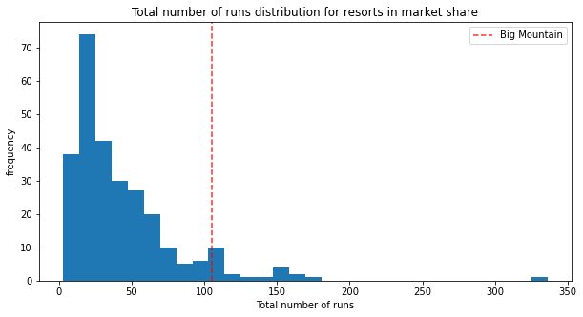
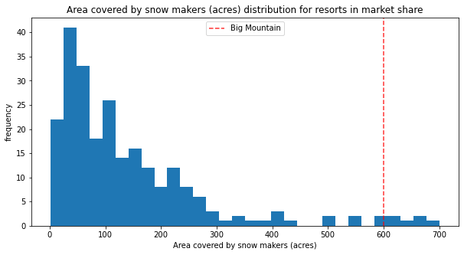
Big Mountain Resort is a top-tier resort with a projected ticket price of $97.96
Model projected ticket price range of $88 to $108
Big Mountain ranks very highly in most features
Representative sample of ranking in resort features shown in graphs

Slide 7
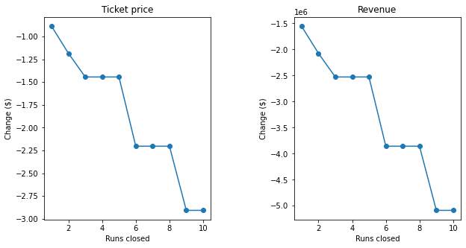
Closing down 10 least-used runs would lead to $2.90 drop in ticket price and revenue loss of about $1.75 million
Gradual stepwise decrease in revenue as number of closed runs increases
Possible that decreased operating costs would offset the loss of revenue

Slide 8
Adding a run to increase the vertical drop and installing a chair lift to service the run would justify adding $2.22 to ticket price
Leads to revenue increase of $3.88 million per season
Increased revenue should offset operating costs of chair ($1.54 million)
Adding more snow-making machine coverage did not impact projected ticket price
Increasing longest run by 0.2 miles did not impact projected ticket price

Slide 9
Big Mountain Resort has plenty of room to increase the ticket price
Adding a run to increase vertical drop would justify increasing ticket price even further
Important to consider:
Operating costs
Big Mountain is already most expensive resort in Montana
Further information that could influence decision:
Local vs national competition: are people traveling far to visit Big Mountain?
What facilities do customers believe are the most important for them?

