Slide 1
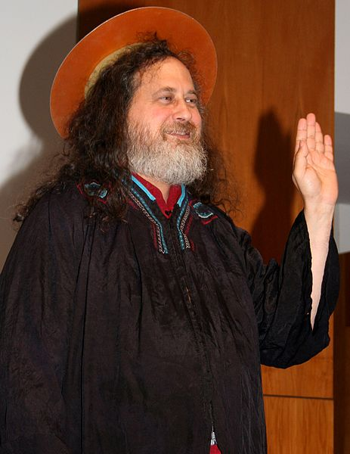
The Word of the Lord
Mikey & Dylan

Slide 2
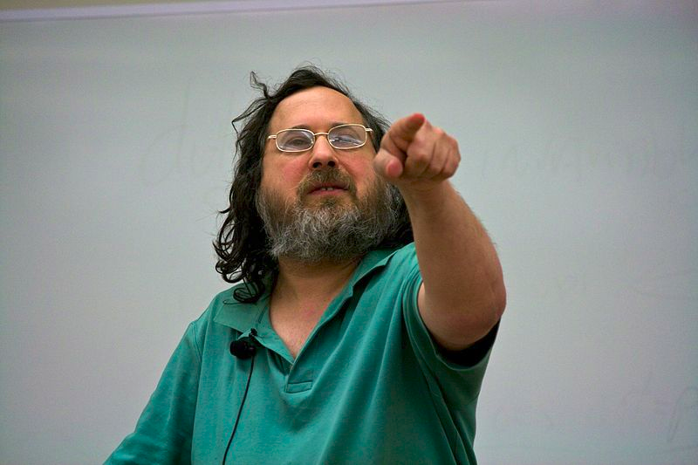
What?
Press the button, get a Richard Stallman quote read to you
“Internet of (Free Software) Things”

Slide 3
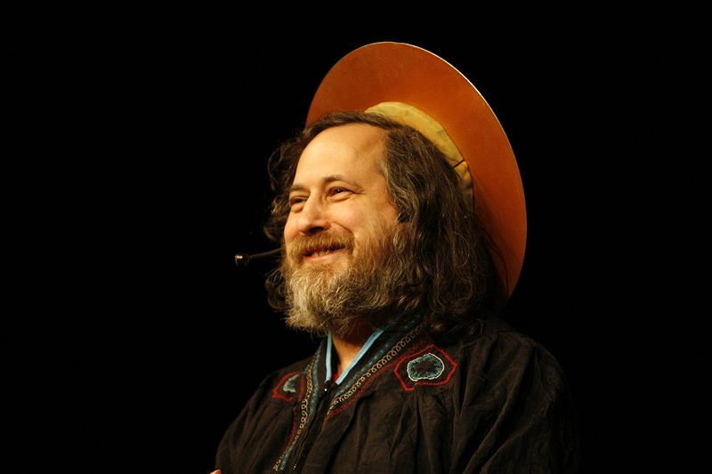
Why?
Share the word of Saint IGNUcius
Provide a welcoming environment for our flat

Slide 4
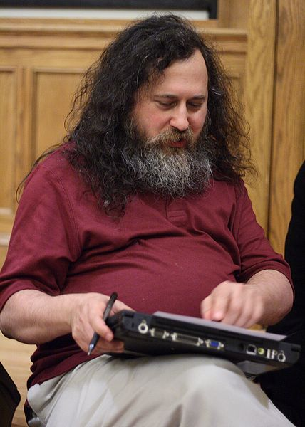
How?
Originally: Microbit
  Not powerful enough
Now: Raspberry Pi
  Sufficiently powerful
  Espeak
  Wikiquote

Slide 5
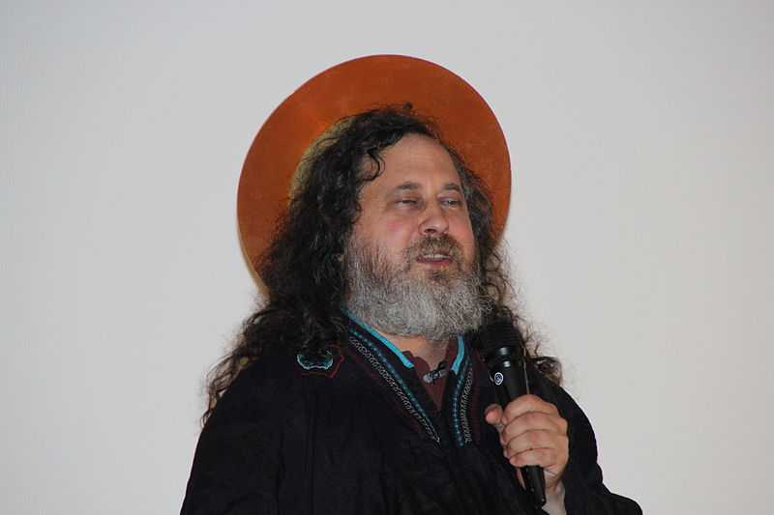
Any questions?

Slide 6
Attributions
All pictures Wikimedia Commons CC-BY

