Slide 1
Chapter VII
Rasterizer

Slide 2
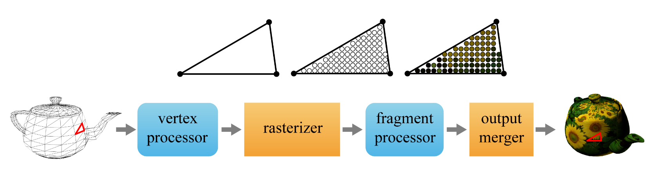

Rasterizer
The vertex shader passes the clip-space vertices to the rasterizer, which performs the following:
  Clipping
  Perspective division
  Back-face culling
  Viewport transform
  Scan conversion (rasterization in a narrow sense)
7-<number>

Slide 3
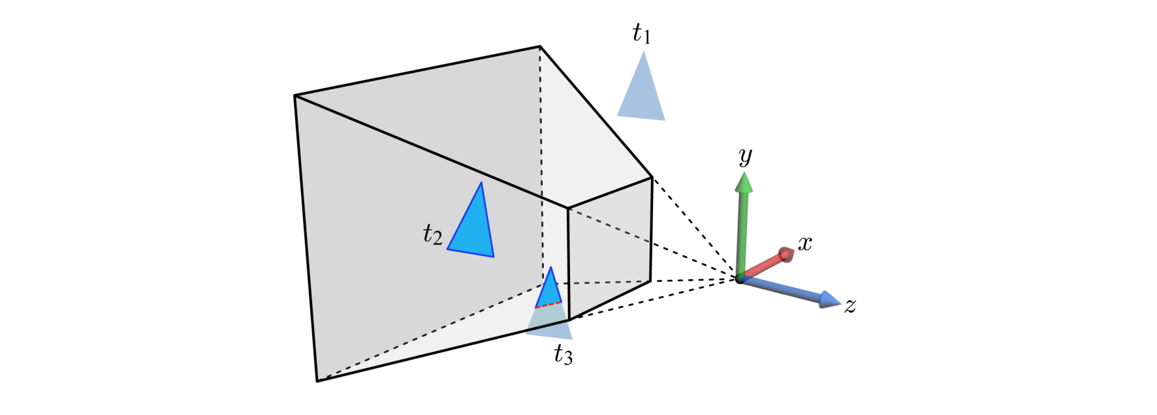
Clipping
Clipping is performed in the clip space, but the following figure presents its concept in the camera space, for the sake of intuitive understanding.
  Triangle t₁ is completely outside of the view frustum and is discarded.
  Triangle t₂ is completely inside and is passed as is to the next step.
  Triangle t₃ intersects the view frustum and is thus clipped.
As a result of clipping, vertices may be added to and deleted from the triangle.
7-<number>

Slide 4
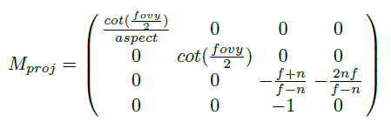
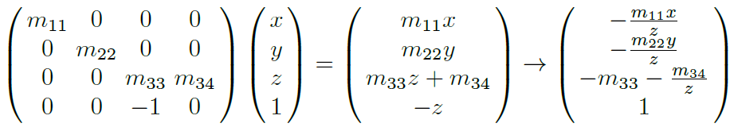
Perspective Division
Unlike affine transforms, the last row of M_{proj} is not (0 0 0 1) but (0 0 -1 0). When M_{proj} is applied to (x,y,z,1), the w-coordinate of the transformed vertex is –z.
In order to convert from the homogeneous (clip) space to the Cartesian space, each vertex should be divided by its w-coordinate (which equals –z).
7-<number>

Slide 5
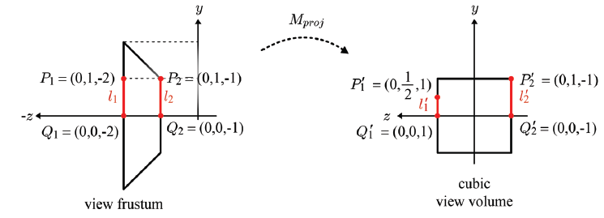
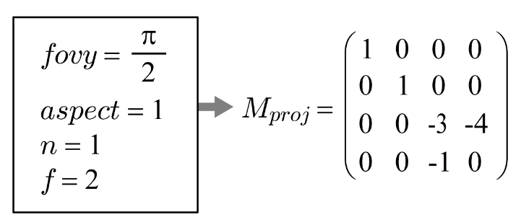
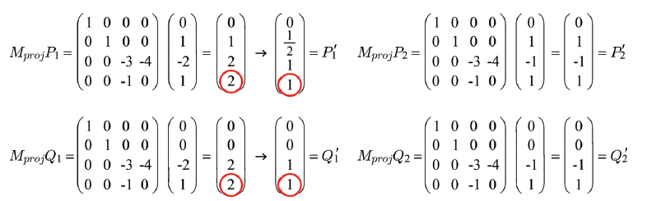
Perspective Division (cont’d)
Note that –z is a positive value representing the distance from the xy-plane of the camera space. Division by –z makes distant objects smaller. It is perspective division. The result is said to be in NDC (normalized device coordinates).
7-<number>

Slide 6
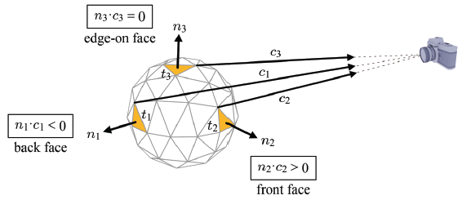
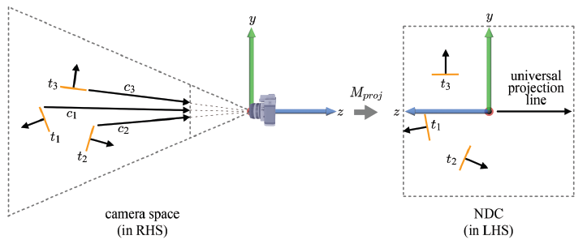
Back-face Culling
The polygons facing away from the viewpoint of the camera are called the back faces. They are culled. The polygons facing the camera are called the front faces. They are preserved.
The projection transform defines a universal projection line parallel to the z-axis.
7-<number>

Slide 7
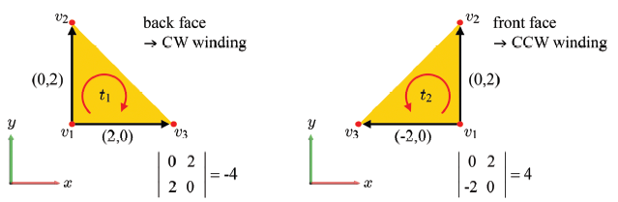
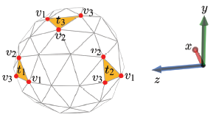

Back-face Culling (cont’d)
Let us conceptually project the triangles along the universal projection line onto the xy-plane. A 2D triangle with CW winding order is a back-face, and a 2D triangle with CCW winding order is a front-face.
Compute the following determinant, where the first row represents the 2D vector connecting v₁ and v₂, and the second row represents the 2D vector connecting v₁ and v₃.
  If negative, CW and so back-face.
  If it is positive, CCW and so front-face.
  If 0, edge-on face.
7-<number>

Slide 8
Back-face Culling (cont’d)
  The back faces are not always culled.
    Consider rendering a hollow translucent sphere. For the back faces to show through the front faces, no face should be culled.
    On the other hand, consider culling only the front faces of the sphere. Then the cross-section view of the sphere will be obtained.
  Various GL capabilities are enabled by glEnable and disabled by glDisable.
void glEnable(GLenum cap) & void glDisable(GLenum cap)
An example is glEnable(GL_CULL_FACE), which enables face culling.
The default value is GL_FALSE.
7-<number>

Slide 9
Back-face Culling (cont’d)
When face culling is enabled, glCullFace() specifies whether front or back faces are culled. It accepts the following symbolic constants:
  GL_FRONT
  GL_BACK
  GL_FRONT_AND_BACK
The default value is GL_BACK, and back faces are culled.
Then, glFrontFace() specifies the vertex order of front faces. It accepts the following:
  GL_CW
  GL_CCW
The default value is GL_CCW.
7-<number>

Slide 10
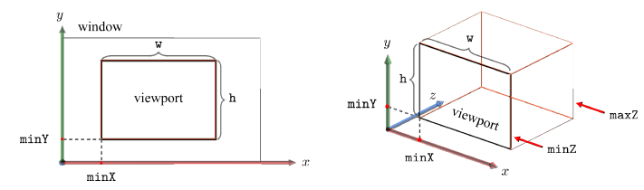
Viewport
A window at the computer screen is associated with its own window space or screen space.
A viewport defines a screen-space rectangle into which the scene is projected. It is not necessarily the entire window, but can be a sub-area of the window.
In reality, the screen space is 3D and so is the viewport.
  void glViewport(GLint minX, GLint minY, GLsizei w, GLsizei h)
  void glDepthRangef(GLclampf minZ, GLclampf maxZ)- The default values of minZ and maxZ are 0.0 and 1.0, respectively
7-<number>

Slide 11
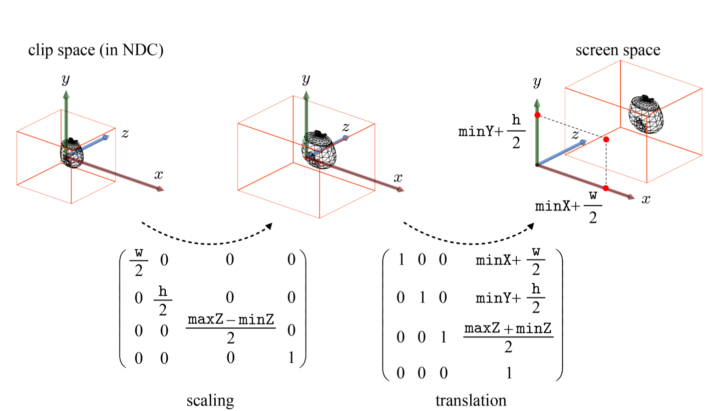
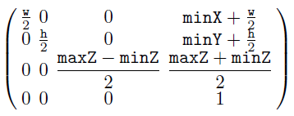
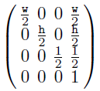
Viewport Transform
The viewport transform is a combination of a scaling and a translation.
In most applications, minZ and maxZ are set to 0.0 and 1.0, respectively, and both of minX and minY are zero.
7-<number>

Slide 12
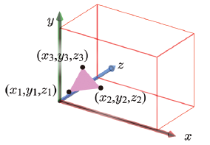
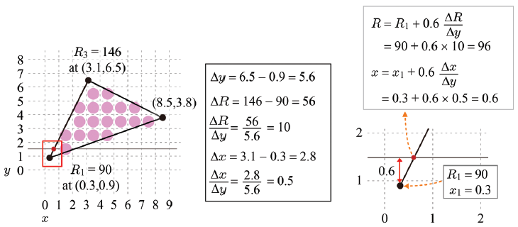
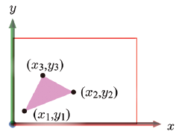
Scan Conversion
Scan conversion breaks up each primitive into a set of fragments. It identifies the pixels covered by the primitive and interpolates the vertex attributes for each pixel location.
The per-vertex attributes usually do not include RGB color but include normals and texture coordinates. Just for the convenience of presentation, however, let’s assume color attributes and use R color for scan conversion.
7-<number>

Slide 13
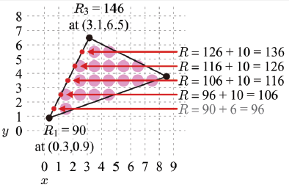
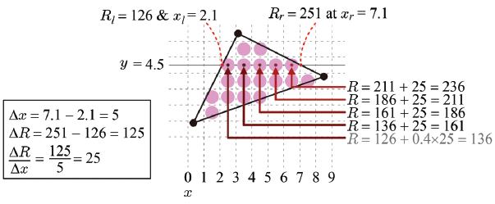
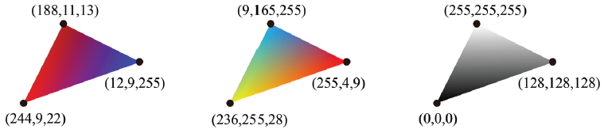
Scan Conversion (cont’d)
Bilinear interpolation – along the edges first, and then along the scan lines
Color interpolation examples
7-<number>

Slide 14
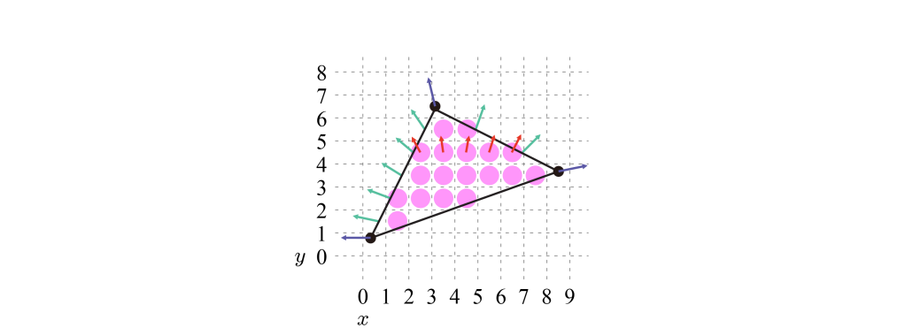
Scan Conversion (cont’d)
In general, what are actually interpolated are not colors but vertex normals and texture coordinates.
Given (n_{x}, n_{y}, n_{z}) per vertex, each of n_{x}, n_{y}, and n_{z} is independently interpolated.
Then we have the following interpolated normals.
7-<number>

