Slide 1

BST260 Final Project

Slide 2
Uber or Lyft: Which is the Better Option from Longwood to Harvard Square?
Kara Higgins and Ray An
BST260

Slide 3
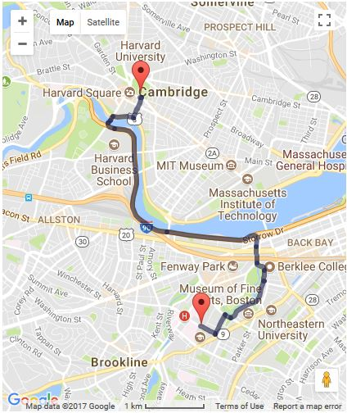
Start and End point

Slide 4
Overview & Motivation
Many Harvard Chan students, staff, and faculty choose to live in Cambridge, and others cross-register for classes or attend events that are offered on the main campus
M2 shuttle: free option but can be unreliable, crowded, inflexible
The MBTA: inefficient and can experience heavy traffic
Uber or Lyft: may save time that could better be spent studying or working

Slide 5
Initial Questions
Which service is cheaper overall for our chosen route?
What do the time of day/day of week trends in fares look like for each service?
Which service is preferable based on cost and wait time during morning and evening rush hour?
Which service has a shorter wait time and/or expectated time to destination?
How does the cost per expected minute of travel compare for each service?

Slide 6
Data Collection & Cleaning
The 4-week collection period ran Monday-Friday from November 6 - December 1.
We aimed to collect a total of 16 data points each day (8 Uber/Lyft pairs) for a total goal of 320 data points.
Each team member used screenshots on his/her phone to collect the data each day: 1 Uber observation and 1 Lyft observation at random times between 8-9am, 9-10am, 5-6pm, and 6-7pm.
Use the Uber and Lyft App to set the position from Vanderbilt Hall to Widener Gate. Then, screenshot of the estimated price, wait time, and duration time.

Slide 7
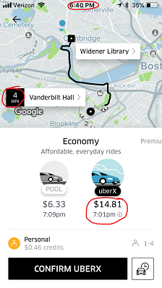
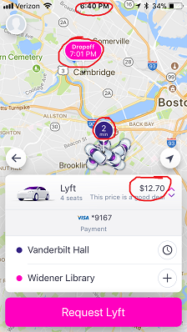
Screenshot Data Collection

Slide 8
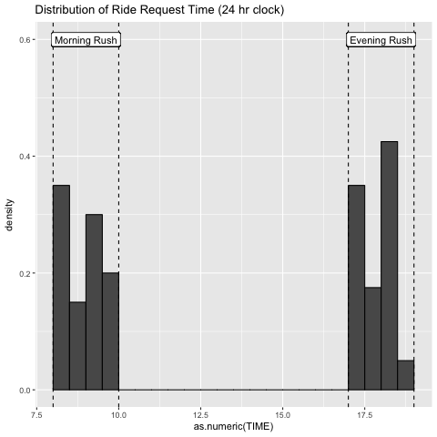
Exploratory Analysis

Slide 9
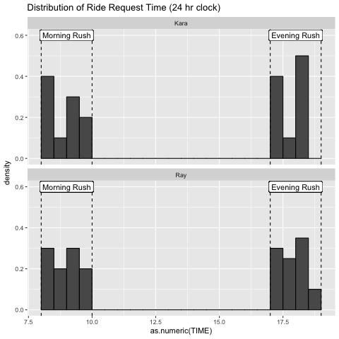
Exploratory Analysis

Slide 10
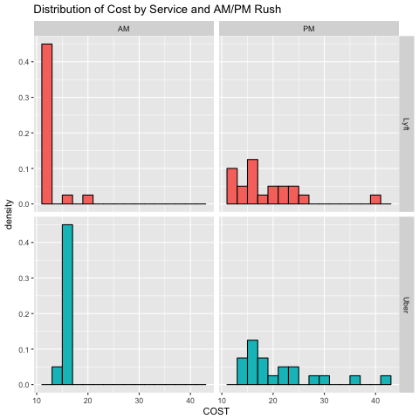
Exploratory Analysis

Slide 11
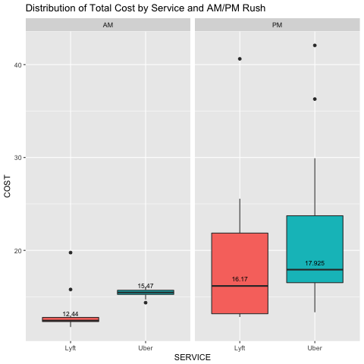
Exploratory Analysis

Slide 12
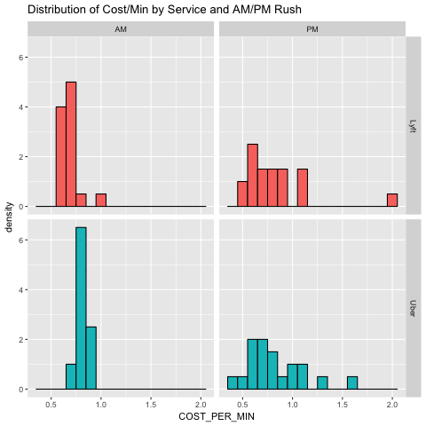
Exploratory Analysis

Slide 13
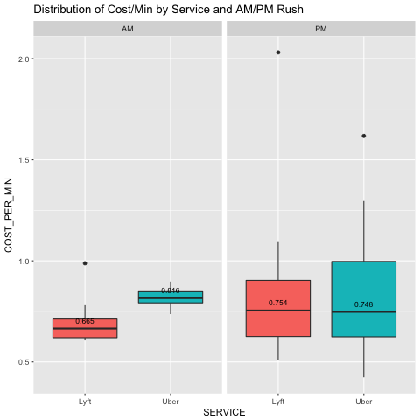
Exploratory Analysis

Slide 14
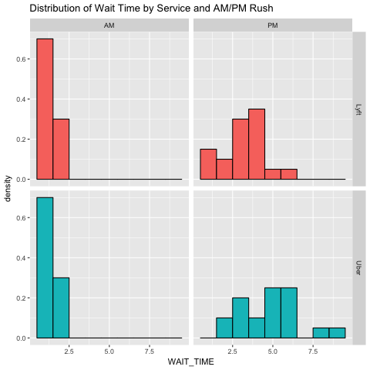
Exploratory Analysis

Slide 15
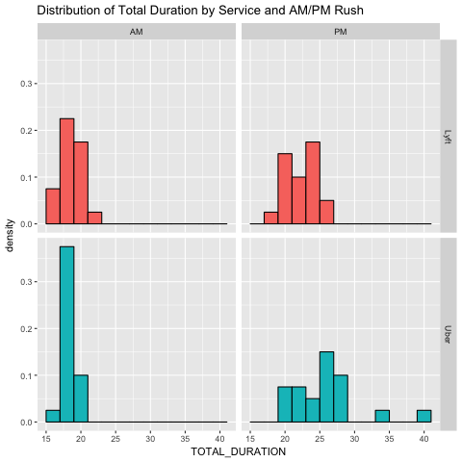
Exploratory Analysis

Slide 16
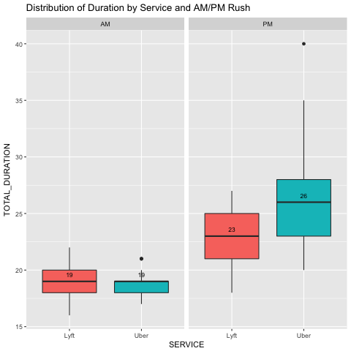
Exploratory Analysis

Slide 17
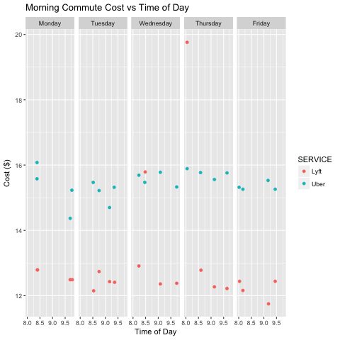
Exploratory Analysis

Slide 18
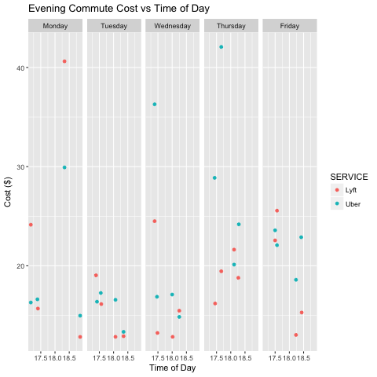
Exploratory Analysis

Slide 19
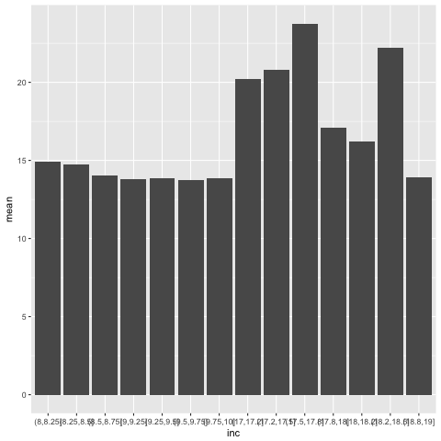
Exploratory Analysis

Slide 20
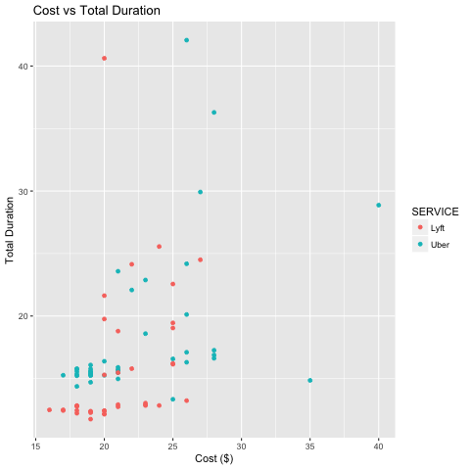
Exploratory Analysis

Slide 21
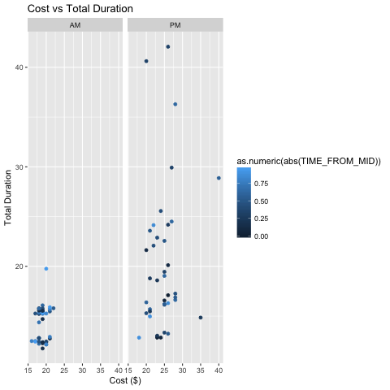
Exploratory Analysis

Slide 22
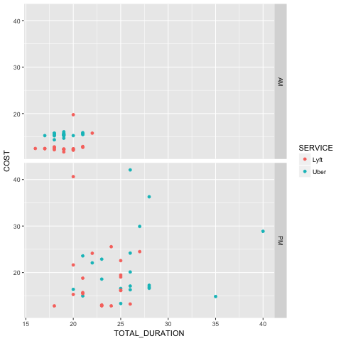
Exploratory Analysis

Slide 23
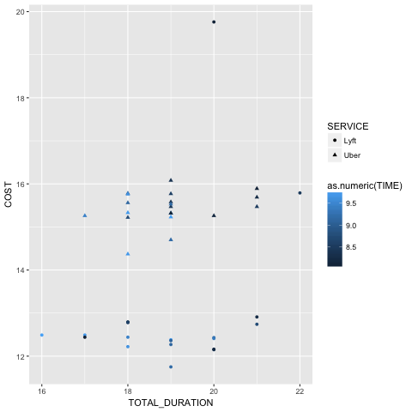
Exploratory Analysis

Slide 24
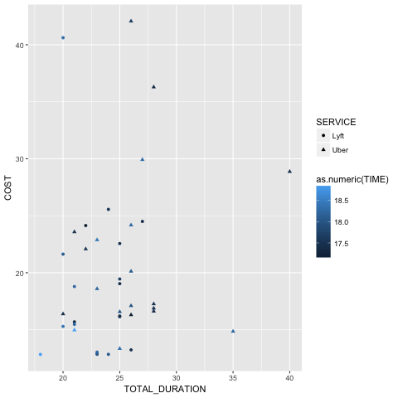
Exploratory Analysis

Slide 25
Final Analysis
We want to know whether total ride duration and total cost are correlated, we decide to use the SPEARMAN AND MANN-WHITNEY U TEST, and based on the result of the tes, we find that the total ride duration and total cost are correlated, the r=0.585. the p-value is less than 0.05.

Slide 26
Final Analysis
We want to know whether whether wait time and total cost are correlated, we decide to use the SPEARMAN AND MANN-WHITNEY U TEST, and based on the result of the tes, we find that the wait time and total cost are correlated, the r=0.528. the p-value is less than 0.05.

Slide 27
Final Analysis
We want to know whether whether wait time and total cost/min are correlated, we decide to use the SPEARMAN AND MANN-WHITNEY U TEST, and based on the result of the tes, we find that the wait time and total cost are not that correlated, the r=-0.0268. the p-value is more than 0.05.

Slide 28
Final Analysis
we want to tests probaility that a randomly selected Uber price is greater than a randomly selected Lyft price, than the test result told us that a randomly selected Uber price is greater than a randomly selected Lyft price.

Slide 29
Final Analysis
we want to tests probaility that a randomly selected Uber price is greater than a randomly selected Lyft price duing the morning rush hour, than the test result told us that a randomly selected Uber price is greater than a randomly selected Lyft price during the morning rush hour.

Slide 30
Final Analysis
we want to tests probaility that a randomly selected Uber price is greater than a randomly selected Lyft price during the evening rush hour, than the test result told us that a randomly selected Uber price is not greater than a randomly selected Lyft price during the evening rush hour.

Slide 31
Final Analysis
we want to tests prob that a randomly selected Uber's cost per minute is greater than a rand selected Lyft's cost per minute, than the test result told us that a randomly selected Uber's cost per minute is greater than a randomly selected Lyft's cost per minute.

