Slide 1

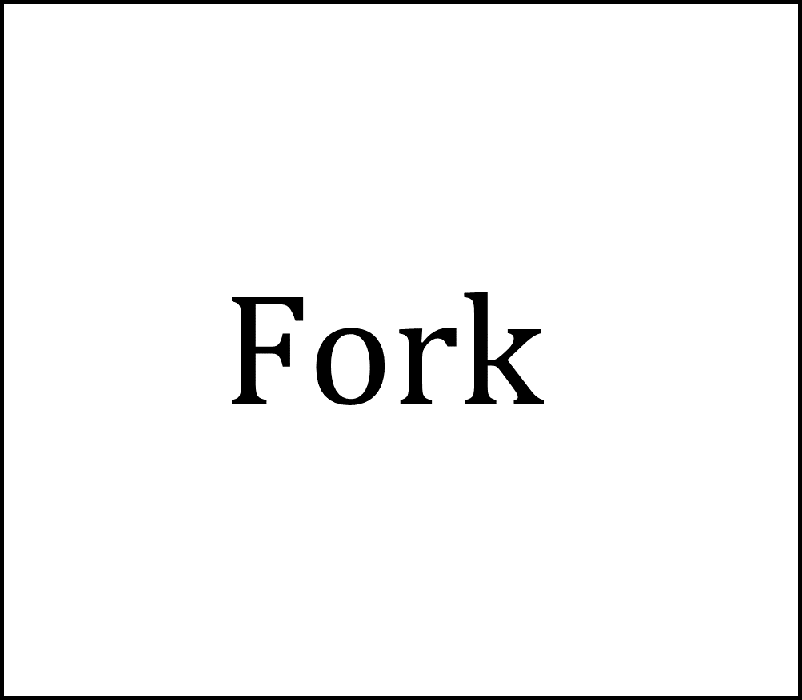


$$Fork$$
$${Output}_{1}=x(t)$$
$$Input=x(t)$$
$${Output}_{2}=x(t)$$

