Slide 1

ML 2024 Project
Authors: Andrea Lepori^{(*)}, Matteo Torchia^{(*)}, Davide Rizzello^{(**)}
LTR Team ^{(*)} Master degree in Computer Science (curriculum AI)
^{(**)} Master degree in Data Science and Business Informatics
Emails:
a.lepori1@studenti.unipi.it
m.torchia1@studenti.unipi.it
d.rizzello@studenti.unipi.it
Pisa, 29/01/2025
Type of project: A

Slide 2
Introduction and objectives
Aim and Background:
The aim of this project is to build a neural network simulator that is able to adress both classification and regression tasks. As machine learning’s course students we have tried to put into practice what we learned during the lessons by providing a working neural network implementation with the hope that the practical implementation and experimentation has increased our knowledge of the subject, in particular of neural networks, better understanding the limits and the potential of this powerful tool.
Brief Description:
We have implemented and trained a neural network (multilayer perceptron), with backpropagation algorithm, on the Monk datasets to solve binary classification tasks and on the ML Cup dataset to solve a regression task.
In the following slides we will delve into some implementation details and the obtained results.

Slide 3
Method
We have implemented a Neural Network simulator from scratch using Python as programming language
Used libraries:
Numpy: support to algebra and matrices
Pandas: exploited for data loading/manipulation and some basic pre-processing
Sklearn: used for K-Fold partitioning
Software Overview and main design choices:
The implementation of the net is defined by the class «NeuralNetwork» which provides a constructor for the initialization that accepts many parameters to configure the istance, in particular the user can specify:
- the architecture ( # levels , # units per level, activation functions for each level,…);
- hyperparameters to configure the training process;
- flag to request the generation of log files to track training/validation error over epochs;
- utilities to perform k-fold cross validation and grid search are also provided.
This structure was designed to guarantee the user maximum flexibility in customizing the neural network instance. The class also offers various public methods to train the network, make predictions with the trained model, retrieve values ​​of interest such as error metrics

Slide 4
Method
Implementation choices
The structure of the net is not predefined but during initialization the user can select:
- The architecture, by passing as a parameter a list of integer with each element representing the number of units for each level of the net;
- The activation functions, by passing a list of string and choosing between (ReLu, TanH, Linear, Sigmoid, LeakyReLu, Elu).
The training algorithm is the backpropagation algorithm that performs a gradient descent on the error surface.
The implementation of the model works with matrices, starting from the input matrix, passing through the internal structures (list of weight matrices, representing the weights between consecutive levels of the net), and exploiting the efficiency of these data structures both for the feed-forward phase both during backpropagation.

Slide 5
Method
Implementation choices
The simulator supports batch/online/mini-batch training. The user can select the preferred modality passing the appropriate parameters to the train method, as well as the size of the mini-batch if used.
The initialization of the weights of the net can be realized with 2 different techniques:
«random» that initializes the weights to random small values and «xavier» that initializes the weights by choosing random values in the interval [-1/sqrt(fan-in), +1/sqrt(fan-in)].
To deal with the presence of multiple local minima, multiple trainings are performed with different starting weights initialization. The number of restart can be selected at initialization time too. The model chooses, among others, the training cycle that minimizes the (TR) error.
The simulator implements two regularization techniques: Ridge/Tikhonov regularization (L2), Lasso Regularization L1. Even the easy application of early stopping has been made possible since support is provided for plotting the error on training and validation as the epochs vary.

Slide 6
Method
Implementation choices
To better control the convergence of the learning algorithm the possibility of using standard momentum technique is provided.
To gain more control and flexibility over the value of the learning rate, the user can enable the «variable learning rate» option which let the user to specify an initial and a final learning rate, and a number of iterations tau during which the learning rate decay linearly until a final fixed value is reached.
The gradient is divided by the number of pattern (size) in batch/mini-batch (gradient averaging) and to keep consistency in case of minibatch eta is tuned as well (to obtain an eta proportional to the batch case).
- As stopping condition our training algorithm use a predetermined number of epochs (specified by the user) or an error threshold (on the training error) that, if achieved, immediately stops the training.

Slide 7
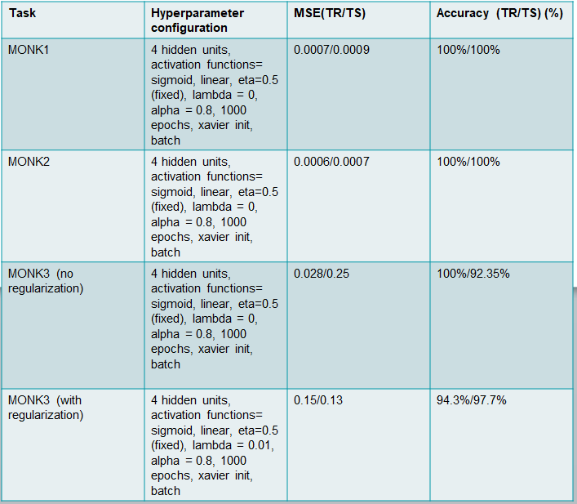
Monk Results
Table 1. Average prediction results obtained for the MONK’s task

Slide 8
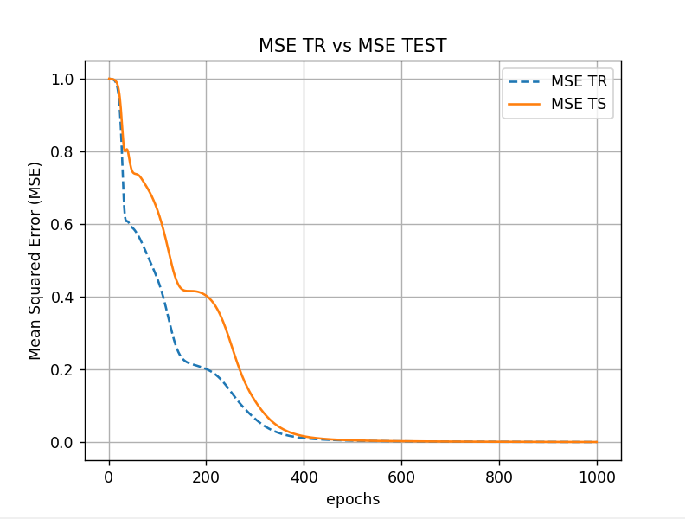
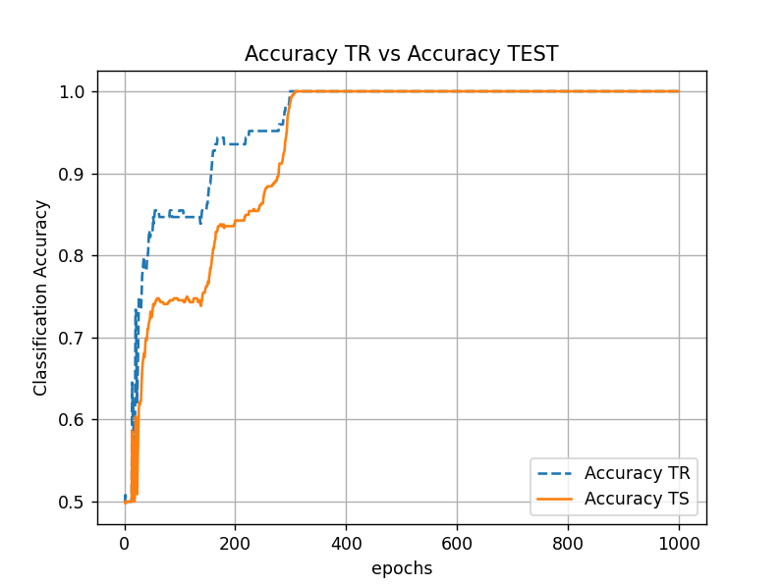
Monk Results – Monk1
Figure 1. Plot of MSE and Accuracy for Monk 1 (Training VS Test)

Slide 9
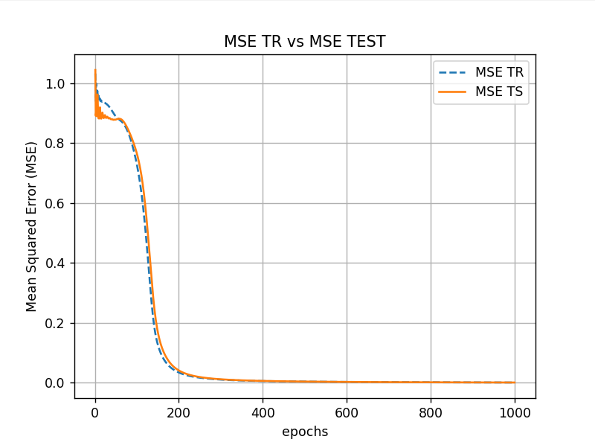
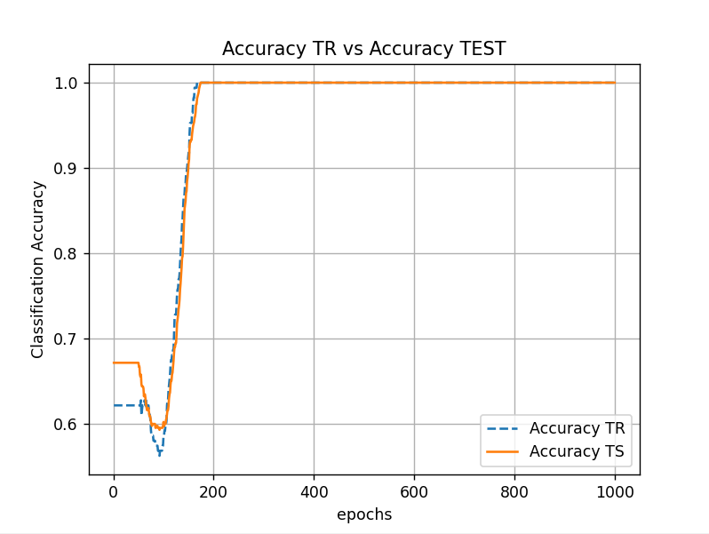
Monk Results – Monk2
Figure 2. Plot of MSE and Accuracy for Monk 2 (Training VS Test)

Slide 10
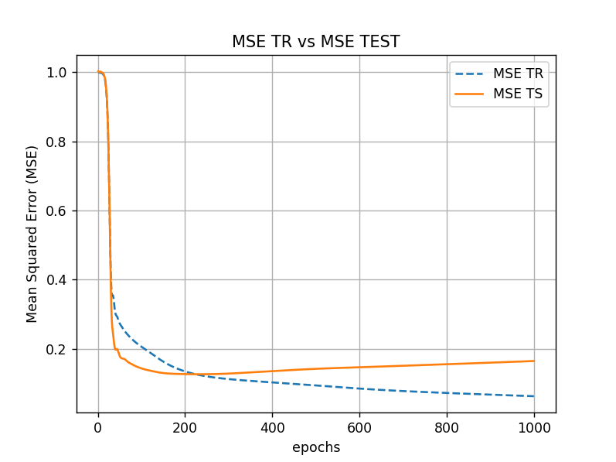
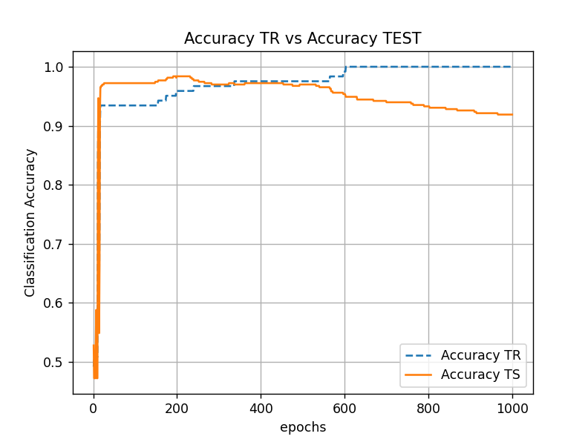
Monk Results – Monk3 no regularization
* no regularization technique, whether implicit (early stopping) or explicit (Ridge/Lasso), is deliberately applied to highlight the onset of overfitting if the model is not appropriately regularized
Figure 3. Plot of MSE and Accuracy for Monk 3 without regularization (Training VS Test)

Slide 11
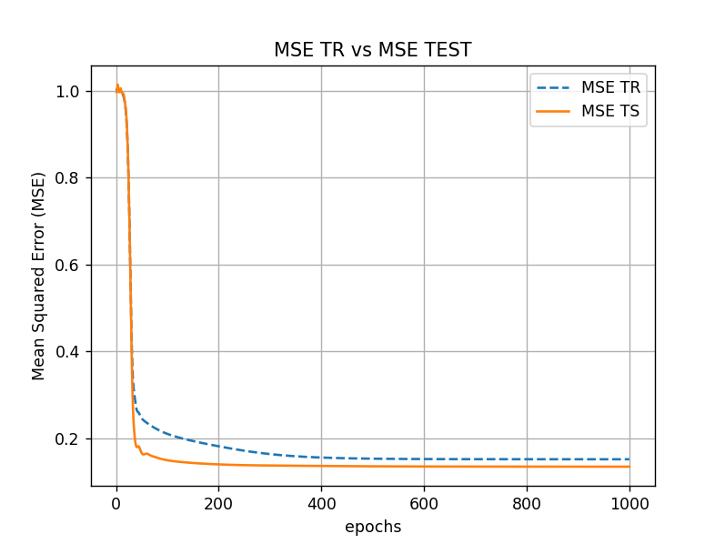
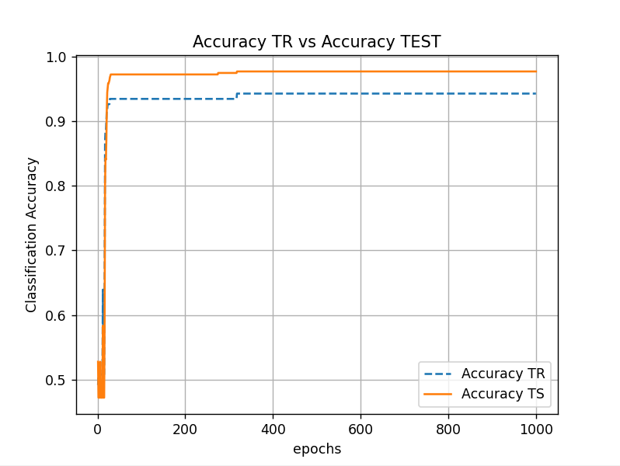
Monk Results – Monk 3 with regularization
Figure 4. Plot of MSE and Accuracy for Monk 3 with Regulatization (Training VS Test)

Slide 12
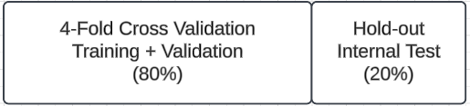
CUP Validation schema: data splitting
hold-out technique to split the entire dataset in Selection Set (Training + Validation, 80% of dataset) and Test set (20% of dataset)
k-fold cross-validation technique (with k=4) to perform the model selection phase on the Selection Set
After model selection → retraining on entire Selection Set (Training + Validation)
After risk assessment → final retraining on the entire Dataset (Training + Validation + Internal Test)
For the final retraining, we did not have a validation set. Hence, the training process was stopped when the training error on the entire dataset closely matched the error achieved by the same model during the training in model selection phase

Slide 13
CUP Validation schema: model selection
In order to choose the best hyperparameter configuration, a grid search was performed:
In each fold, 75% of the records it is used to train the model (Training Set) and the remaining 25% is used to compute the validation error for any possible candidate configuration. Then, for each hyperparameter configuration, the average TR error and VL error is computed across the folds. At this point the selected configuration is the one with the minimum VL error.
First, a coarse-grained grid search was performed, followed by a finer-grained grid search, restricting the search to the most promising ranges of the hyperparameters.
For each hyperparameter a wide range of values ​​was explored. Furthermore, various architectures were tested. In the following, for each tested architecture some significant results.

Slide 14
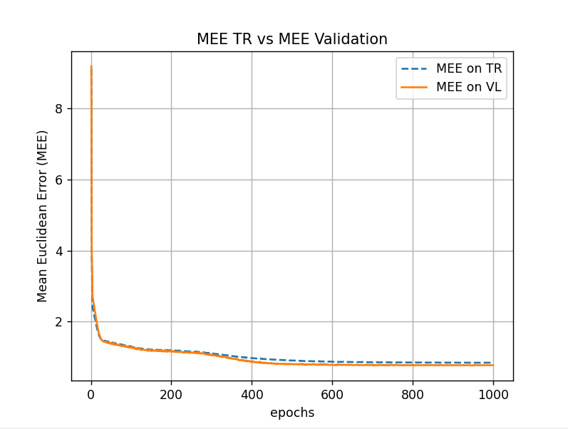
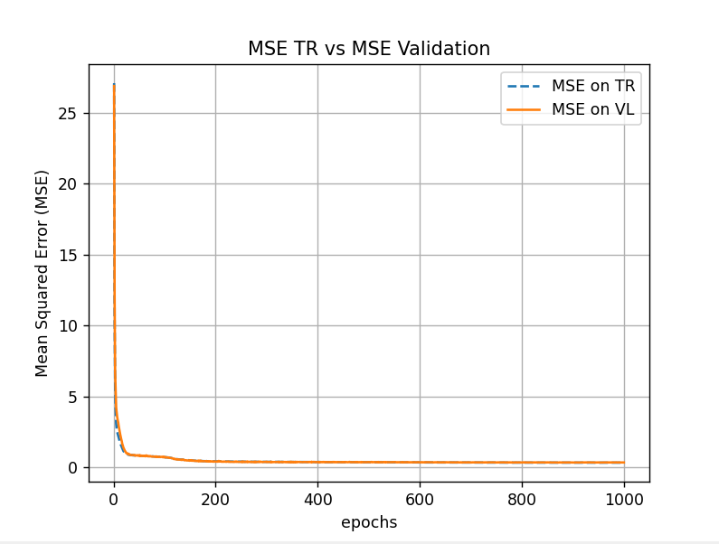
Architecture 1: [12,4,3] / [ELU,Linear]
Table 2. Hyperparameters and TR/VAL error for best models with Architecture 1
Eta0 | EtaFinal | Lambda | Alfa | Weight_Init | Epochs | Restart | Batch | Tau | TR_Error (MSE) | TR_Error (MEE) | VAL_Error (MSE) | VAL_Error (MEE)
0.01 | 0.01 | 0.00001 | 0.6 | xavier | 1000 | 20 | 64 | 1000 | 0.296 | 0.841 | 0.314 | 0.879
0.01 | 0.001 | 0.000001 | 0.6 | xavier | 1000 | 20 | None | 1000 | 0.305 | 0.911 | 0.398 | 0.888
Figure 5. Plot of MEE & MSE for ML Cup, Architecture 1, best result (Training VS Validation)

Slide 15
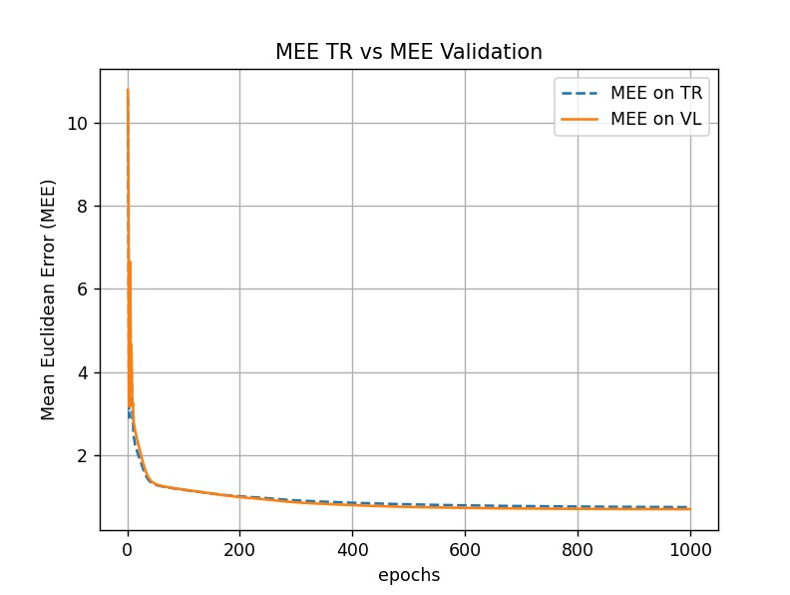
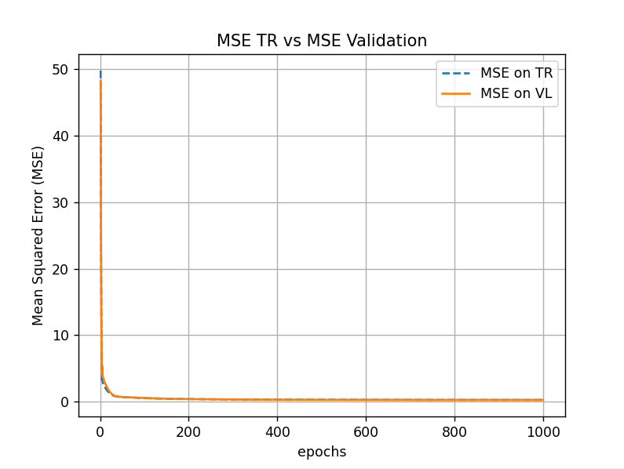
Architecture 2: [12,8,3] / [ELU,Linear]
Table 3. Hyperparameters and TR/VAL error for best models with Architecture 2
Eta0 | EtaFinal | Lambda | Alfa | Weight_Init | Epochs | Restart | Batch | Tau | TR_Error (MSE) | TR_Error (MEE) | VAL_Error (MSE) | VAL_Error (MEE)
0.01 | 0.01 | 0.00001 | 0.5 | xavier | 1000 | 20 | None | 1000 | 0.254 | 0.766 | 0.285 | 0.802
0.01 | 0.01 | 0.0001 | 0.5 | xavier | 1000 | 20 | 64 | 1000 | 0.257 | 0.766 | 0.287 | 0.806
0.01 | 0.01 | 0.00001 | 0.5 | xavier | 1000 | 20 | 32 | 1000 | 0.253 | 0.763 | 0.288 | 0.806
Figure 6. Plot of MEE & MSE for ML Cup, Architecture 2, best result (Training VS Validation)

Slide 16
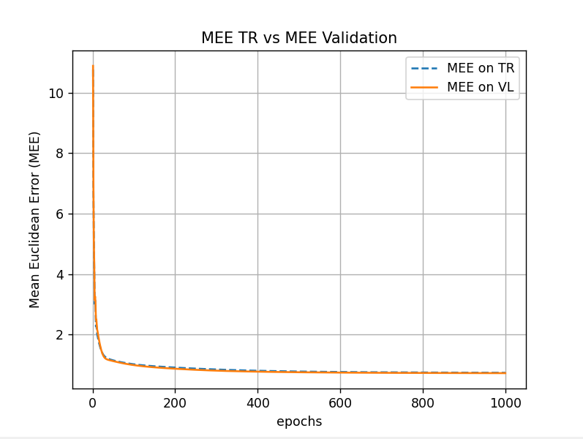
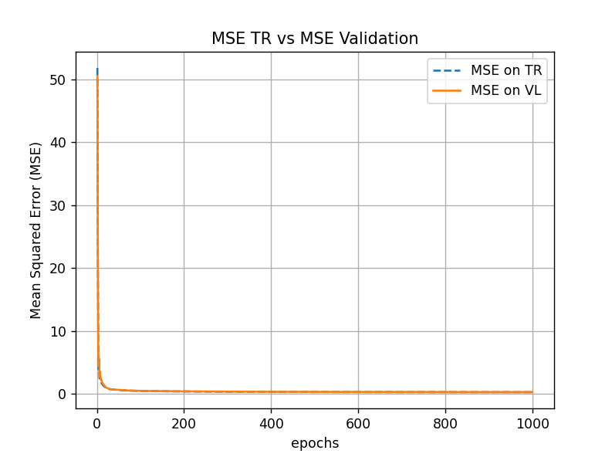
Architecture 3: [12,24,3] / [ELU,Linear]
Table 4. Hyperparameters and TR/VAL error for best models with Architecture 3
Eta0 | EtaFinal | Lambda | Alfa | Weight_Init | Epochs | Restart | Batch | Tau | TR_Error (MSE) | TR_Error (MEE) | VAL_Error (MSE) | VAL_Error (MEE)
0.01 | 0.01 | 0.0001 | 0.5 | xavier | 1000 | 20 | None | 1000 | 0.24 | 0.736 | 0.274 | 0.788
0.01 | 0.01 | 0.0001 | 0.5 | xavier | 1000 | 20 | 64 | 1000 | 0.25 | 0.741 | 0.277 | 0.8
0.01 | 0.01 | 0 | 0.5 | xavier | 1000 | 20 | 32 | 1000 | 0.247 | 0.730 | 0.276 | 0.792
Figure 7. Plot of MEE & MSE for ML Cup, Architecture 3, best result (Training VS Validation)

Slide 17
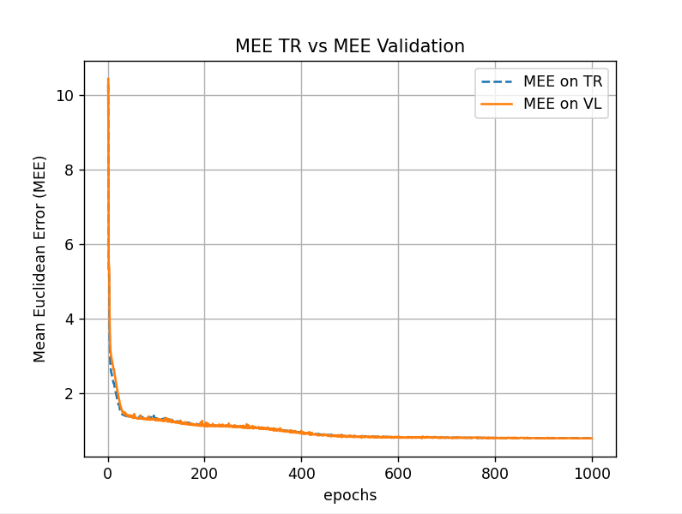
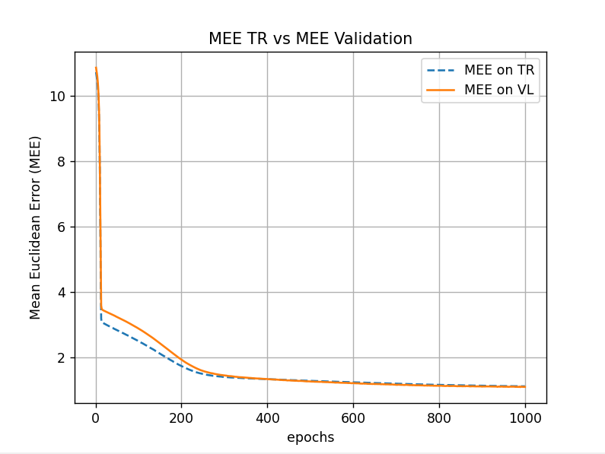
Architecture 4: [12,7,5,3] / [ELU,ELU,Linear]
Table 5. Hyperparameters and TR/VAL error for best models with Architecture 4
Eta0 | EtaFinal | Lambda | Alfa | Weight_Init | Epochs | Restart | Batch | Tau | TR_Error (MSE) | TR_Error (MEE) | VAL_Error (MSE) | VAL_Error (MEE)
0.01 | 0.001 | 0.00001 | 0.6 | xavier | 1000 | 20 | 64 | 1000 | 0.26 | 0.78 | 0.29 | 0.83
0.001 | 0.001 | 0.00001 | 0.6 | xavier | 1000 | 20 | 64 | 1000 | 0.54 | 1.10 | 0.52 | 1.20
Figure 8. Plot of MEE (Training VS Validation) on ML Cup, for two hyperparam. config. with Architecture 4, the one on the left achieves better results but is unstable

Slide 18
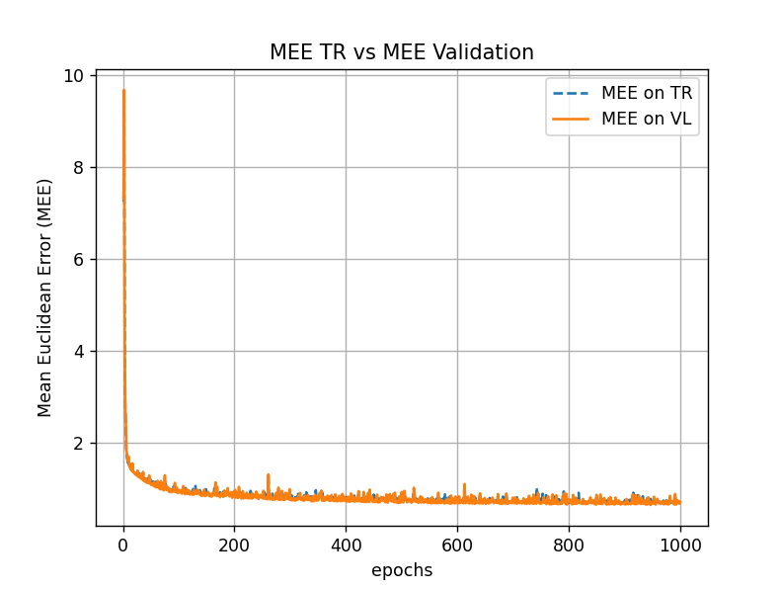
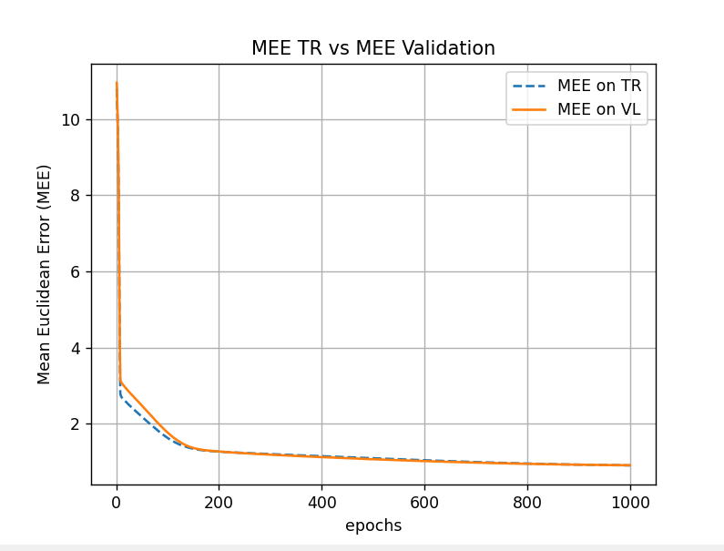
Architecture 5: [12,24,24,3] / [ELU,ELU,Linear]
Table 6. Hyperparameters and TR/VAL error for best models with Architecture 5
Eta0 | EtaFinal | Lambda | Alfa | Weight_Init | Epochs | Restart | Batch | Tau | TR_Error (MSE) | TR_Error (MEE) | VAL_Error (MSE) | VAL_Error (MEE)
0.015 | 0.015 | 0.0001 | 0.6 | xavier | 1000 | 20 | 64 | 1000 | 0.22 | 0.69 | 0.29 | 0.761
0.001 | 0.001 | 0.00001 | 0.7 | xavier | 1000 | 20 | 32 | 1000 | 0.35 | 0.78 | 0.38 | 0.85
Figure 9. Plot of MEE (Training VS Validation) on ML Cup, for two hyperparam. config. with Architecture 5, the one on the left achieves better results but is unstable

Slide 19
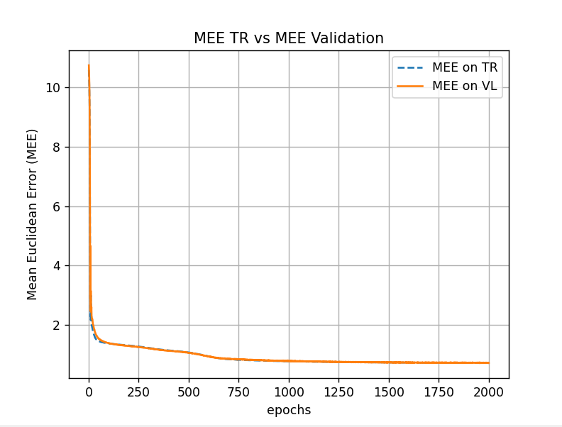
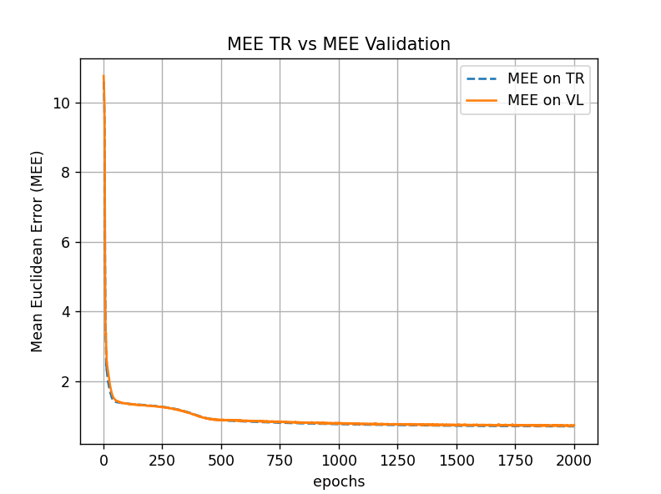
Architecture 6: [12,24,24,24,3] / [ELU,ELU,ELU,Linear]
Table 7. Hyperparameters and TR/VAL error for best models with Architecture 6
Eta0 | EtaFinal | Lambda | Alfa | Weight_Init | Epochs | Restart | Batch | Tau | TR_Error (MSE) | TR_Error (MEE) | VAL_Error (MSE) | VAL_Error (MEE)
0.001 | 0.001 | 0.00001 | 0.9 | xavier | 2000 | 20 | 32 | 2000 | 0.24 | 0.691 | 0.26 | 0.777
0.001 | 0.001 | 0 | 0.9 | xavier | 2000 | 20 | 32 | 2000 | 0.23 | 0.684 | 0.28 | 0.774
Figure 10. Plot of MEE for ML Cup, Architecture 6, two best results (Training VS Validation)

Slide 20
Final Model - [12,24,3] / [ELU,Linear] & Cup Results
Table 8. Hyperparameters and TR/VL/TS error for selected final model
Eta0 | EtaFinal | Lambda | Alfa | Weight_Init | Epochs | Restart | Batch | Tau | TR_Error (MEE) | VL_Error (MEE) | TS_Error (MEE)
0.01 | 0.01 | 0.0001 | 0.5 | xavier | 1000 | 20 | None | 1000 | 0.24 | 0.788 | 0.79
The final model was selected based on achieving the lowest validation error combined with a stable learning curve. While more complex models showed a slightly better validation error, it came at the cost of an unstable learning curve. Given the negligible improvement in performance, we opted for the simpler model.
Risk Assessment: The estimated error on the internal test set is as follows:
Mean Euclidean Error (MEE): 0.79, Mean Squared Error (MSE): 0.33
Training Time: The final model's training time is estimated at 200 seconds, using the following hardware resources:
8 GB RAM, Intel i5 11th Generation Quad-Core @ 2.40 GHz

Slide 21
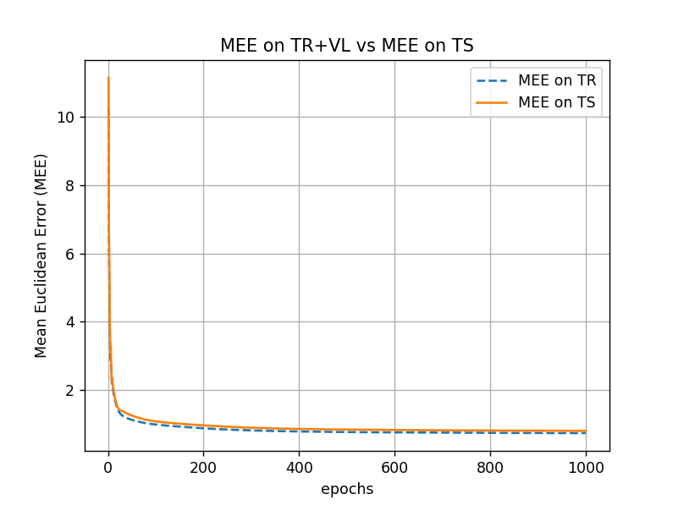
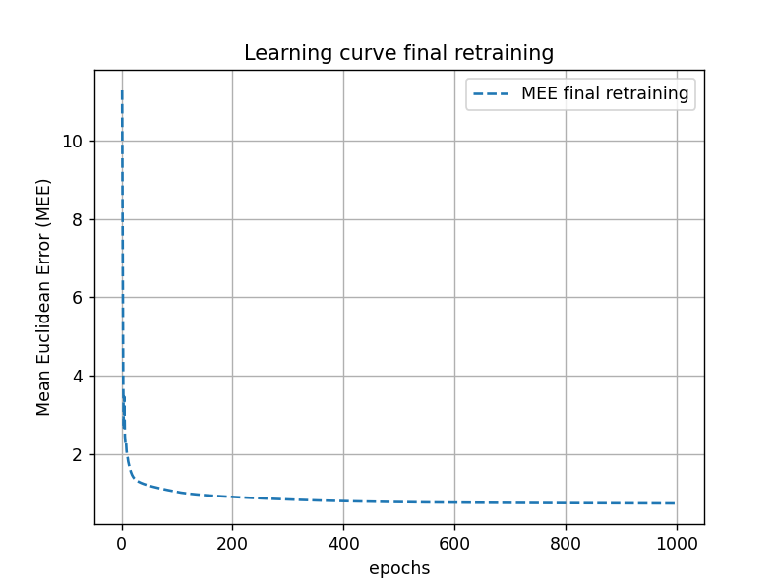
CUP Results
Figure 11. Plot of MEE on Selection Set and Test Set for ML Cup and MEE on final retraining

Slide 22
Discussion & Conclusions
In Monk tasks, using 1-hot encoding for input variables \leads to better results.
In the Monk3 dataset, models without regularization are prone to overfitting.
As shown, in the ML CUP, more complex models do not necessarily yield better results and may also exhibit less stability.
To deal with the presence of local minima, performing multiple restarts is beneficial, and Xavier initialization generally provides better outcomes.
Especially in the ML CUP, selecting an appropriate learning rate is crucial for convergence: setting it too low convergence is slow, setting it too high can lead to instability.
In MLCup, ELU as activation in hidden layers, generally brings to better results
Additionally, conducting multiple grid searches with different levels of granularity, from coarse to fine, can significantly expedite the search process while focusing on the optimal parameters.
Blind Test Results File: LTR_team_ML-CUP24-TS.csv
Team nickname: LTR team

