Slide 1
Exploring angular

Slide 2
agenda
JavaScript & TypeScript
What is Angular?
Modularity
Developer Experience
When Should You Consider Angular?

Slide 3

JavaScript
Loosely typed language – will not catch issues until runtime
Lack of enforcement for consistent patterns
Refactoring can feel painful
Large-scale applications feel chaotic

Slide 4

TypeScript
Superset of JavaScript
All JS is valid TS
Compiles down to plain JS
Works with any modern framework like React, Vue, Angular, etc.
Adds types & interfaces

Slide 5
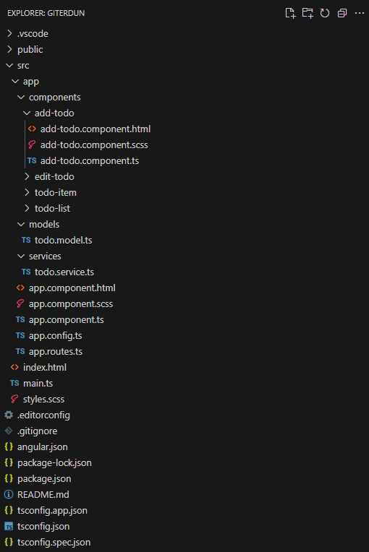
What is Angular?
Maintained by Google
Uses TypeScript out of the box
Emphasizes scalable, structured architecture
Includes routing, state management, forms, HTTP services, testing, and more
Modular by default
Separation of concerns
Components
Services
Models

Slide 6

Core concepts in Angular
Components
Reusable UI building blocks
Interfaces
Services use interfaces/types for data
Services
Share logic and data between components
Allow components to be focused only on UI
Modules
Declarations, imports, service providers, exports
Routing out-of-the-box
Angular is built for TypeScript
Components, services and dependency injection all leverage types
If you inject the wrong service, you get compile-time errors – instead of runtime crashes

Slide 7

SOLID Principles
(S)ingle Responsibility Principle
A class should only do one thing
(O)pen/Closed Principle
Code should be open for extension, but closed for modification
(L)iskov Substitution Principle
Subclasses should be interchangeable with their parent classes
(I)nterface Segregation Principles
Prefer many small interfaces over one large one
(D)ependency Inversion Principle
Depend on abstractions, not concrete implementations

Slide 8

Developer Experience – Why Angular & TypeScript?
Autocomplete & refactoring
your IDE knows your types, properties, functions, etc.
Real-time type checking
As you write code, TypeScript checks if you’re passing the right data types
Built-in best practices
Guides you to structure your application
Enforces separation of concerns
Promotes maintainability/scalability
“If it compiles, it probably works.”

Slide 9
When Should You Consider Angular?
Teams with backend-style developers
Familiar patterns: classes, interfaces, dependency injection
Architecture is closer to backend languages like Java or C#
Codebases requiring maintainability over time
More predictable because of feature isolation
TypeScript improves safety over time
Long-term, large-scale projects
Opinionated structure means developers don’t make architecture decisions, or reinvent architecture
Great for projects that will scale or involve different teams
Projects needing built-in structure
Out-of-the-box modules, routing, services, unit testing, dependency injection, etc.
Less setup, more consistency

Slide 10
Thank you
Andrew Davis
INFT3075-B
W0484847@NSCC.CA

