Slide 1
Balloon Assisted Microgravity: Ground Control
Andrew Geltz, Priscilla Ryan and Luis O’Donnel
Sponsored by Florida Space Institute

Slide 2
Purpose
Create an efficient system for testing microgravity experiments
Continuation of MAE team’s work
Drop aerodynamic capsule from 100,000 feet
Reduce overall cost of experiments

Slide 3
Project Diagram
Ground
Control Station
Weather Balloon
Spool
Platform
Raspberry Pi
Database and
Application Server
Capsule

Slide 4

Design Approach
Easy to set up and use - docker container
Adaptive to design changes - robust database design
Solid platform for expansion - detail oriented REST API

Slide 5







Technologies

Slide 6
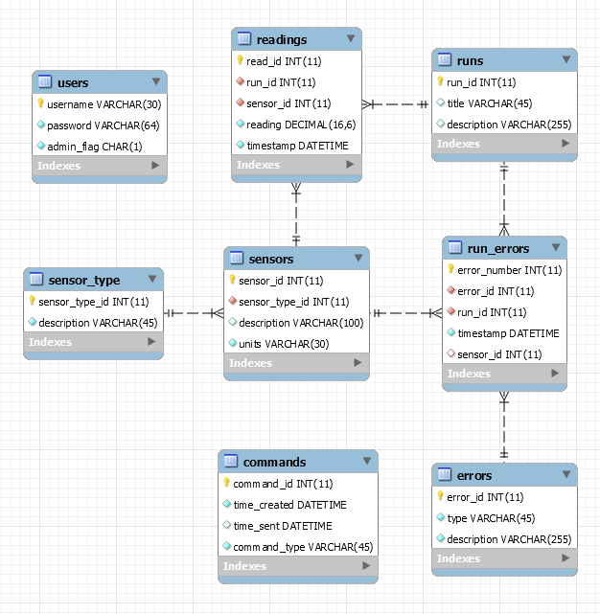
Schema Explained
Foreign keys promote structure
Dynamic sensors and error codes allow adaptation

Slide 7
Work Distribution
Andrew:
Systems Administration
Capsule Communications Interface
API and database procedures
Authentication
Luis:
Database Administration
Priscilla:
Web Design
Raspberry Pi
Database and
Application Server
Ground
Control Station

Slide 8


