Slide 1

Forecasting af volatile danske elpriser
Andreas Skiby Andersen 202107332
Andreas Hyldegaard Hansen 202106123

Slide 2
Introduktion

Slide 3
Data Cleaning

Slide 4
Stationarity

Slide 5
Trend

Slide 6
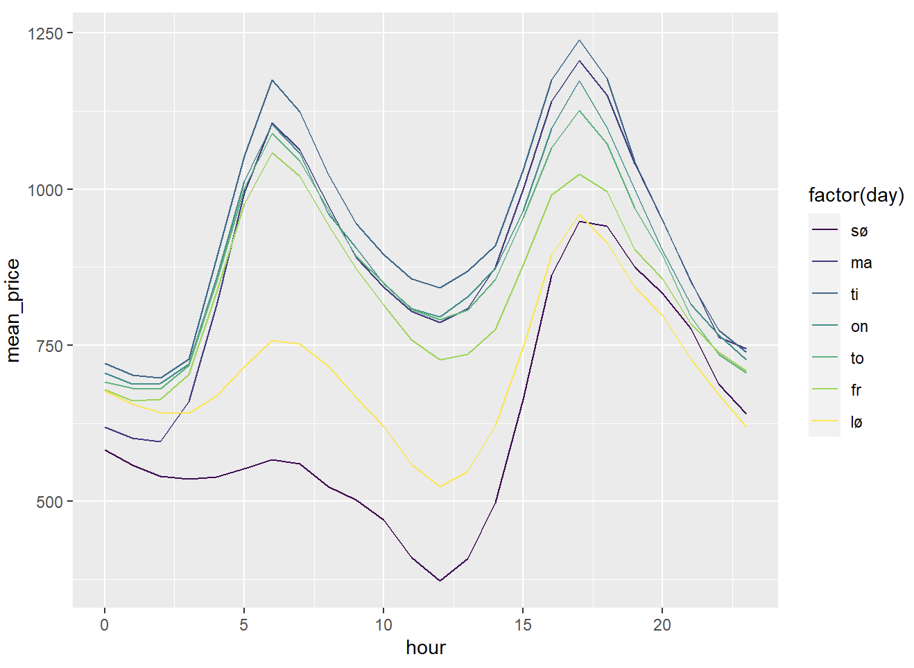
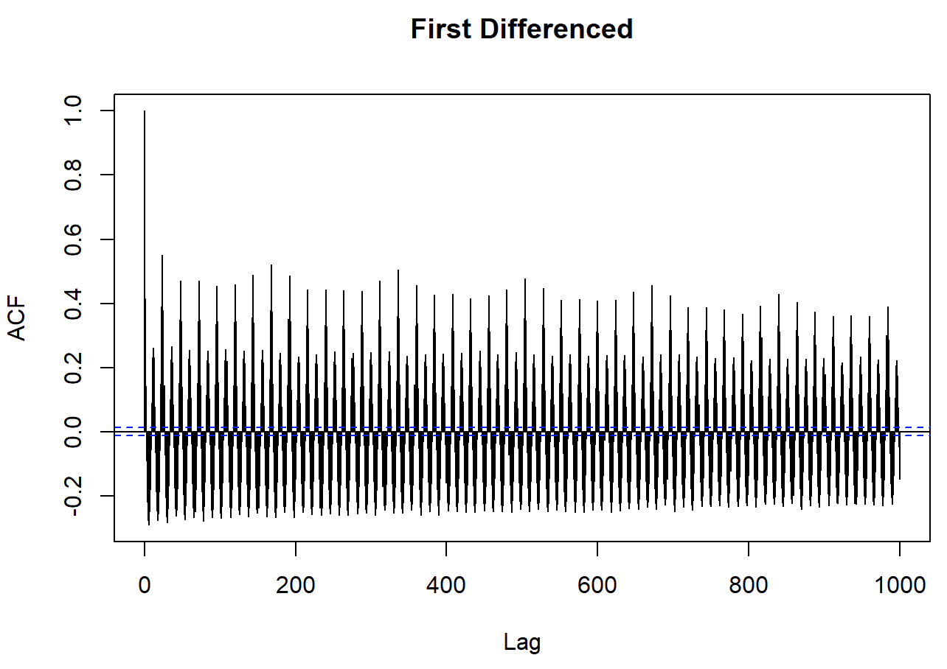
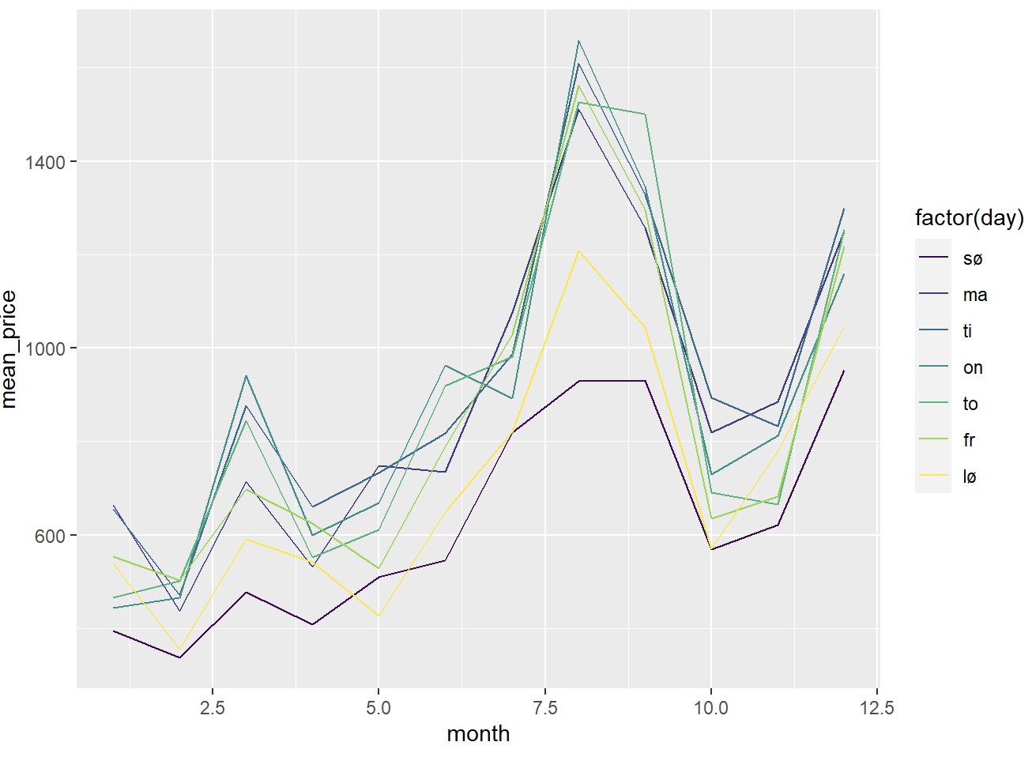
Seasonality
Fjern/fang seasonality for at forbedre prædiktionsevne
Timelig, dagligt, månedligt seasonality

Slide 7
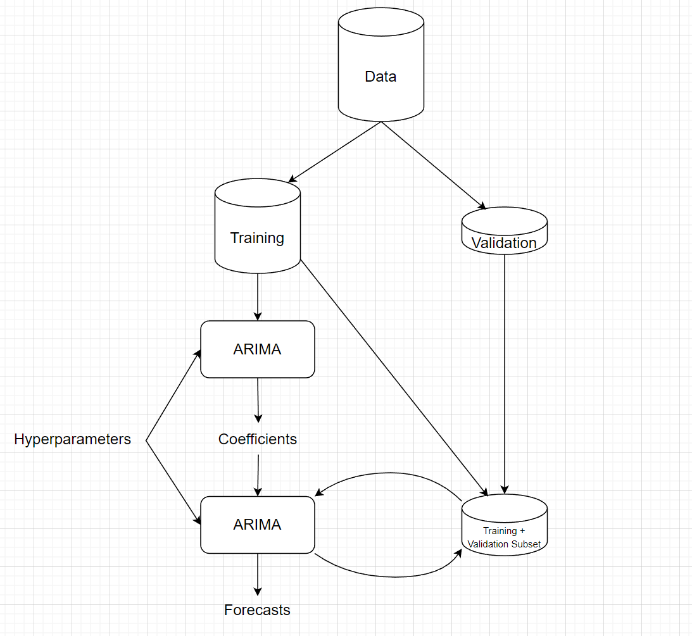
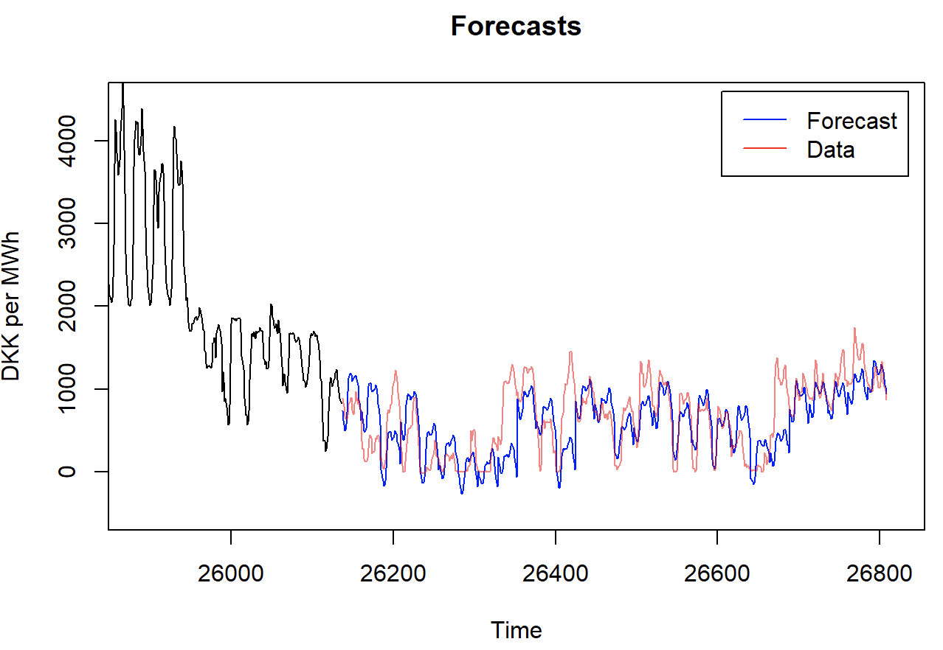
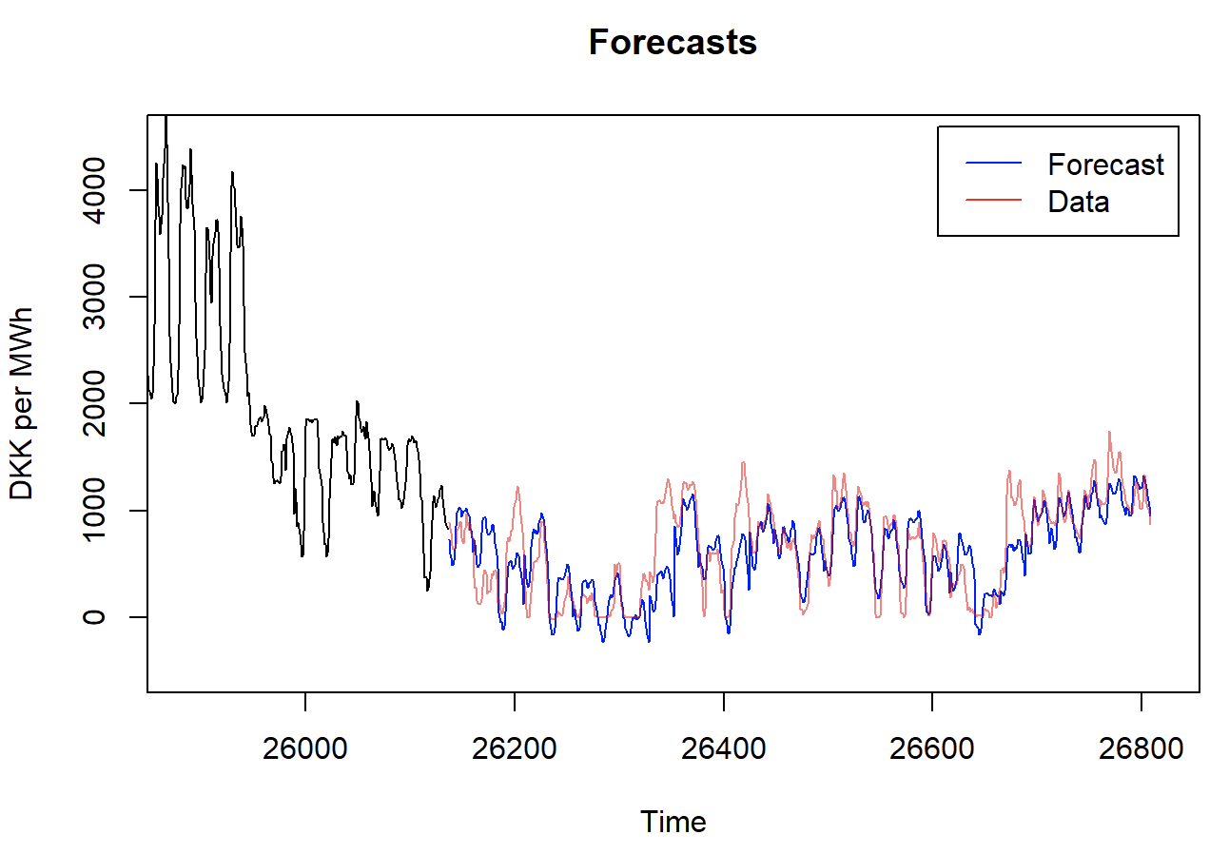
Forecasting
SARIMA(24, 1, 1)(7, 0, 1)(24)
RMSE: 344.0
SARIMA(24, 1, 1)(7, 0, 1)(24) + weekend + vind + fossil + biomasse + affald + handel
RMSE: 263.9

Slide 8
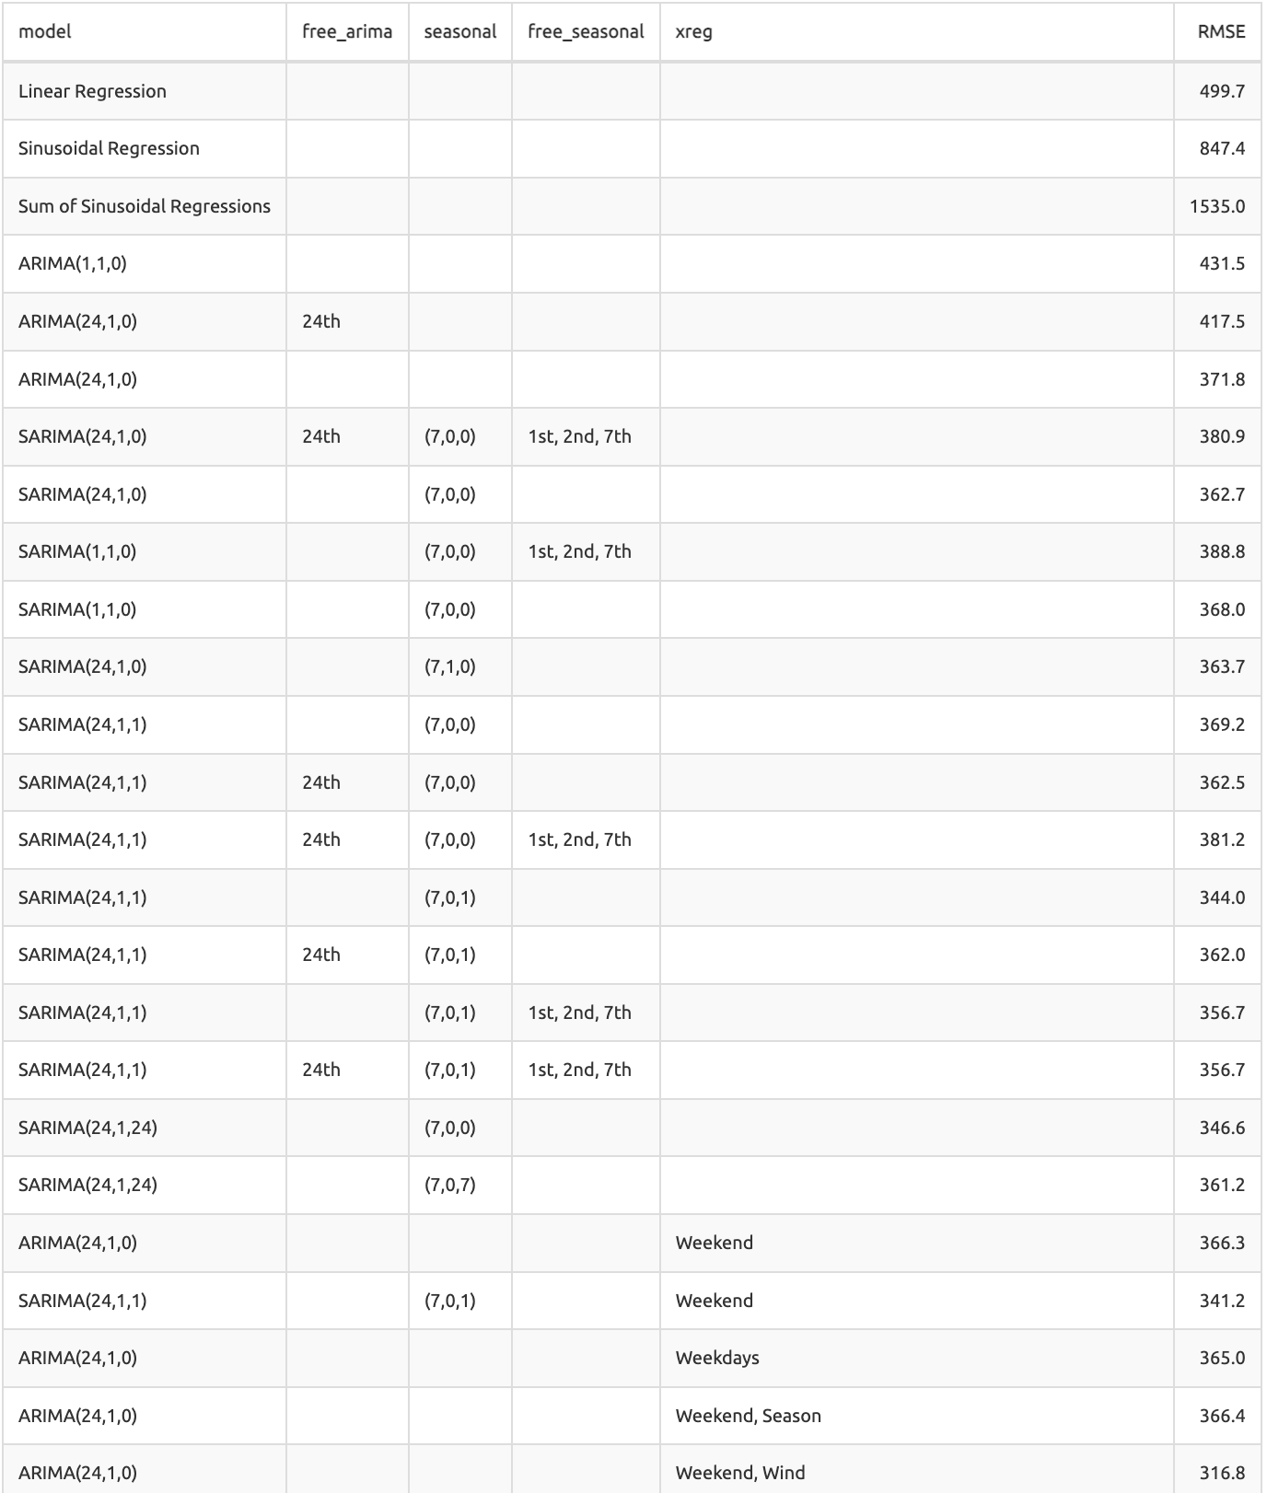
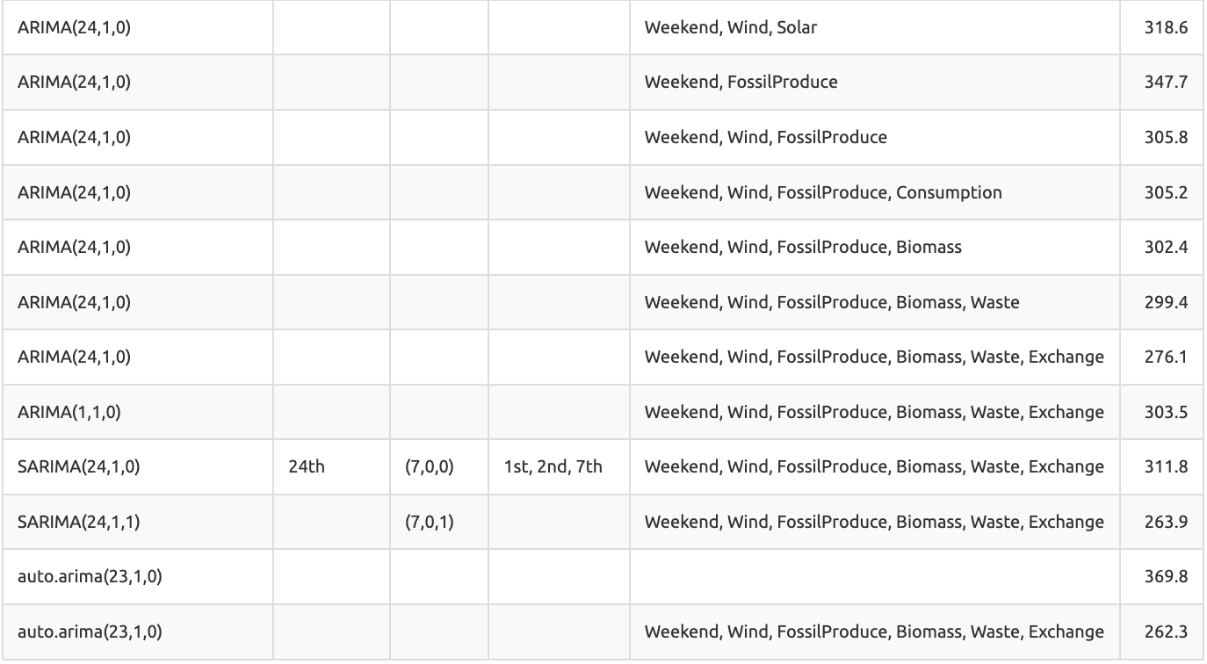
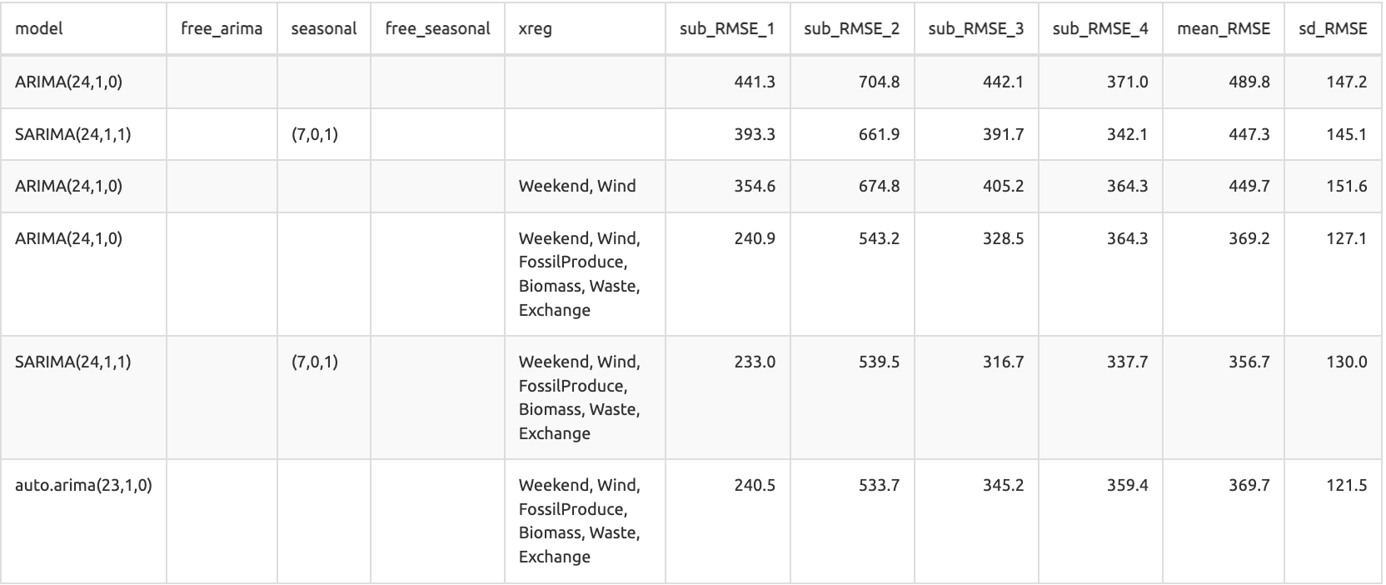
Resultater

