Slide 1
Elektricitet priser
Andreas
Lucas Bagge
Andreas

Slide 2
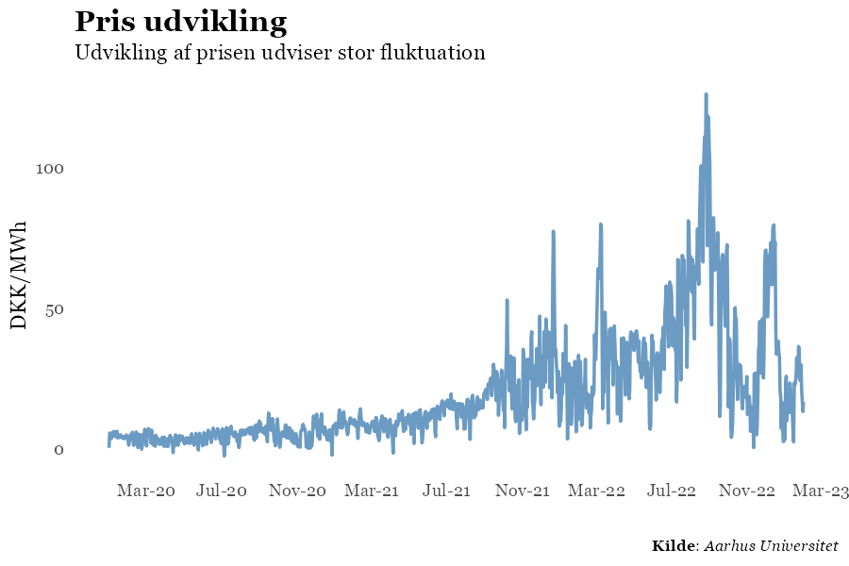
Problemstillingen
Gennem de seneste år er der set en enorm flukturing i elektricitet priser. Det har haft en række konsekvenser på et mikroøkonomisk niveau at folk ikke har haft råd til at bo i deres huse. På de makroøkonomiske niveau har det påvirket inflationen, som påvirker økonomien, men også den enkelte forbruger.
Ved at kunne forstå og prædikterer elektricitet prisen vil gerne økonomien og borgeren.
Notes:
Planning and decision making: Predicting electricity prices allows utilities and energy companies to plan and make informed decisions about the production and distribution of electricity. It helps them to anticipate demand and supply fluctuations, and allocate resources effectively.
Cost management: Accurate predictions of electricity prices can help consumers and businesses to manage their energy costs. They can adjust their consumption patterns and make decisions about when to buy or sell energy in the market.
Market efficiency: Predicting electricity prices is essential for the efficient functioning of electricity markets. Accurate price forecasts help to ensure that supply and demand are balanced, and that prices reflect the true value of electricity.
Renewable energy integration: As renewable energy sources such as wind and solar become more prevalent, predicting electricity prices becomes increasingly important. This is because these sources of energy are intermittent and their availability is difficult to predict. Accurate price forecasts help to ensure that renewable energy is integrated efficiently into the grid.
Risk management: Predicting electricity prices is also important for risk management. Energy companies and investors can use price forecasts to manage risks associated with fluctuations in the energy market and to make informed decisions about investments.

Slide 3
Data
Produktion
Øvrigt data
Forbrug pr. time pr. udbyder
Priser pr. time
Total produktion
Bio masse
Gas
Kul
Olie
Hydro
Sol
Skrald
Landvindmøller
Havvindmøller
Køb og salg til udlandet
Overførsel mellem øst og vest Danmark

Slide 4
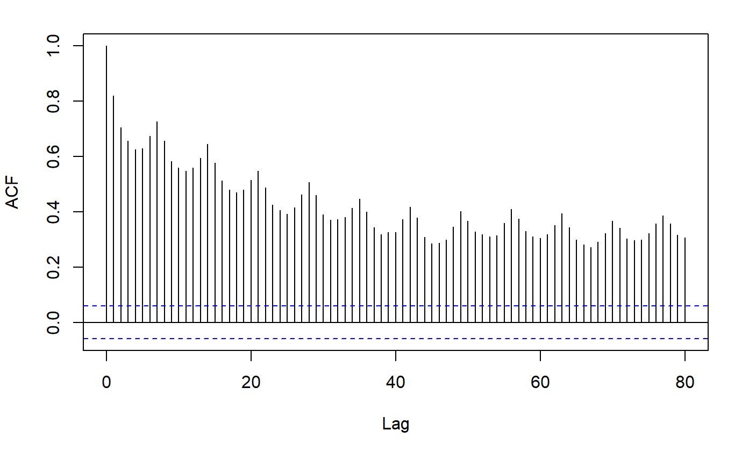
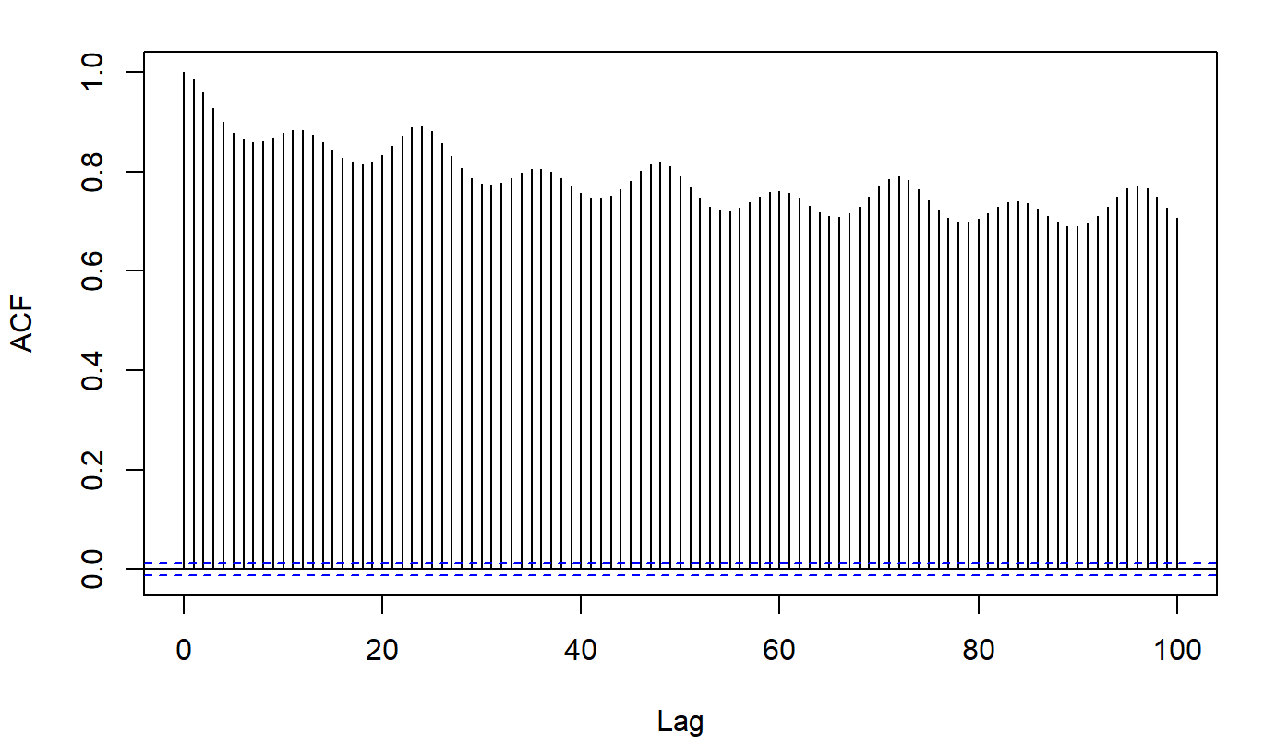
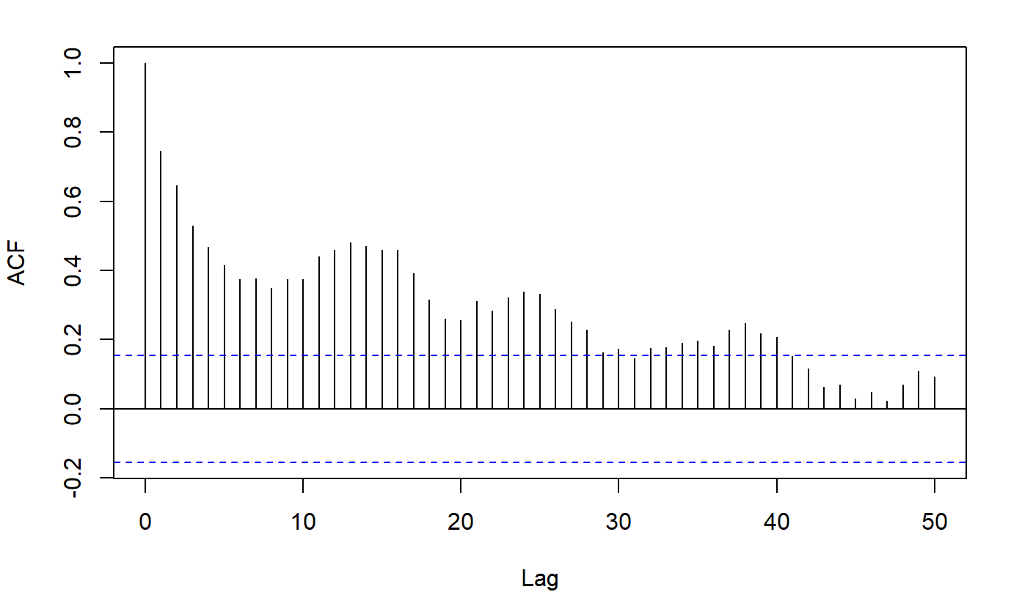
SEasonality
ACF Time
ACF Dag
ACF Uge

Slide 5
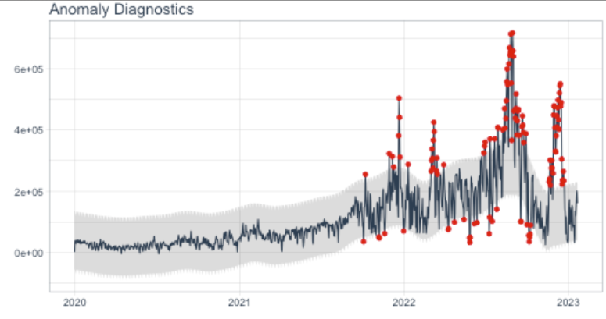
Outliers
Hvorfor er det svært at forecaste elpriser lige nu?

Slide 6
Hvor er vi på vej hen
Transformation af data, https://otexts.com/fpp2/transformations.html
Byg initiale modeller AR, ARIMA
Feature importance
Visualisering af forecasts

