Slide 1

Forecasting af volatile danske elpriser
Andreas Skiby Andersen 202107332
Andreas Hyldegaard Hansen 202106123

Slide 2
Introduktion

Slide 3
Data Cleaning

Slide 4
Trend

Slide 5
Seasonality

Slide 6
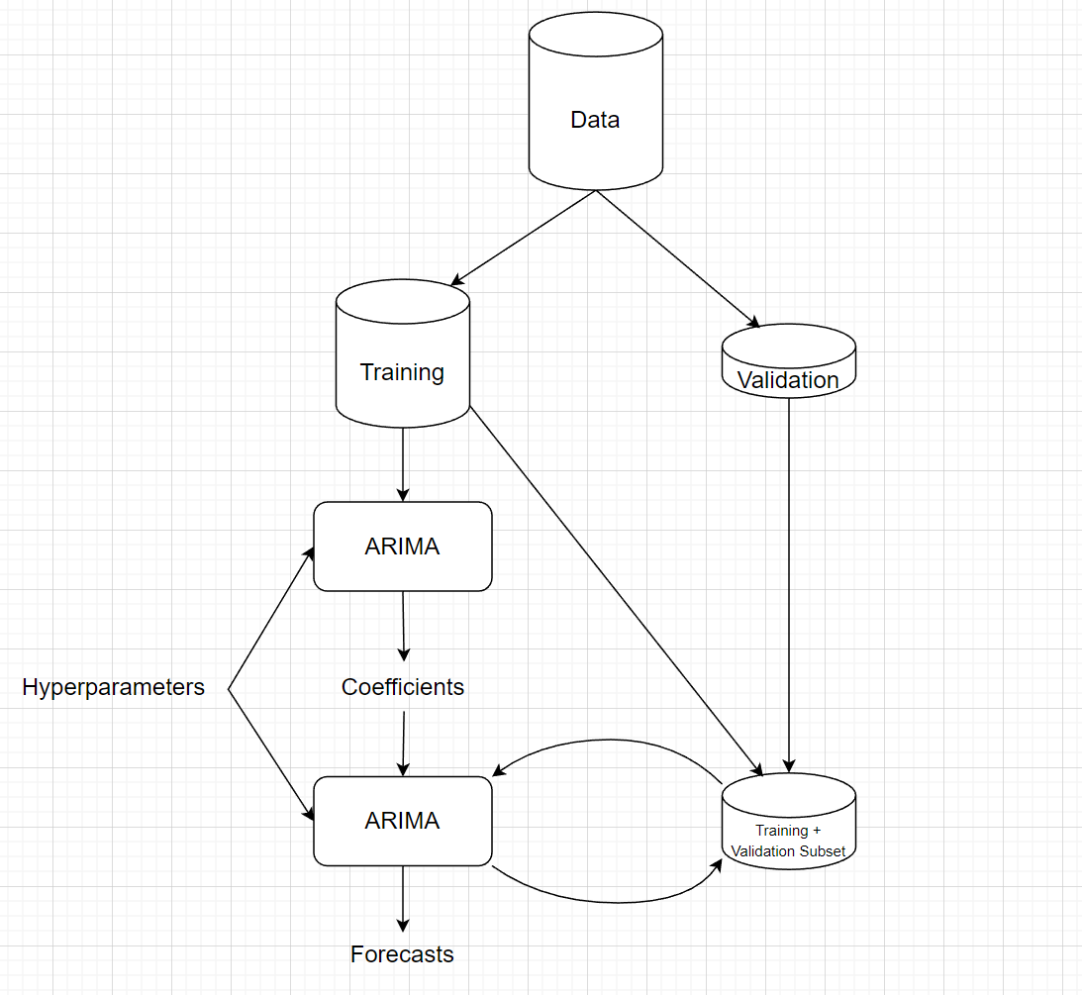
Forecasting

Slide 7
Resultater

