Slide 1
File Downloader
By André Steenhoff Madsen
Assisted by ChatGpt
Reviewed by Simon Baunsgård Ertner

Slide 2
Agenda
Code
Execution
Sequence
Settings
File
Validation
Feedback
Tests
Reports

Slide 3

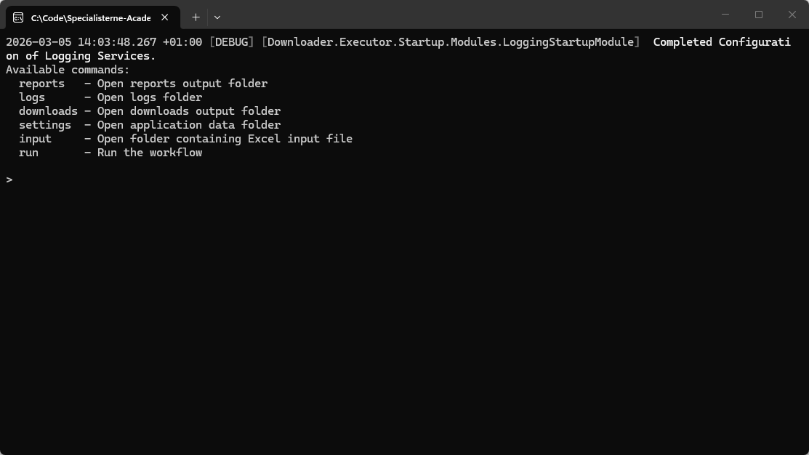
Executor
Console Application
Open folders
Execute Downloads

Slide 4
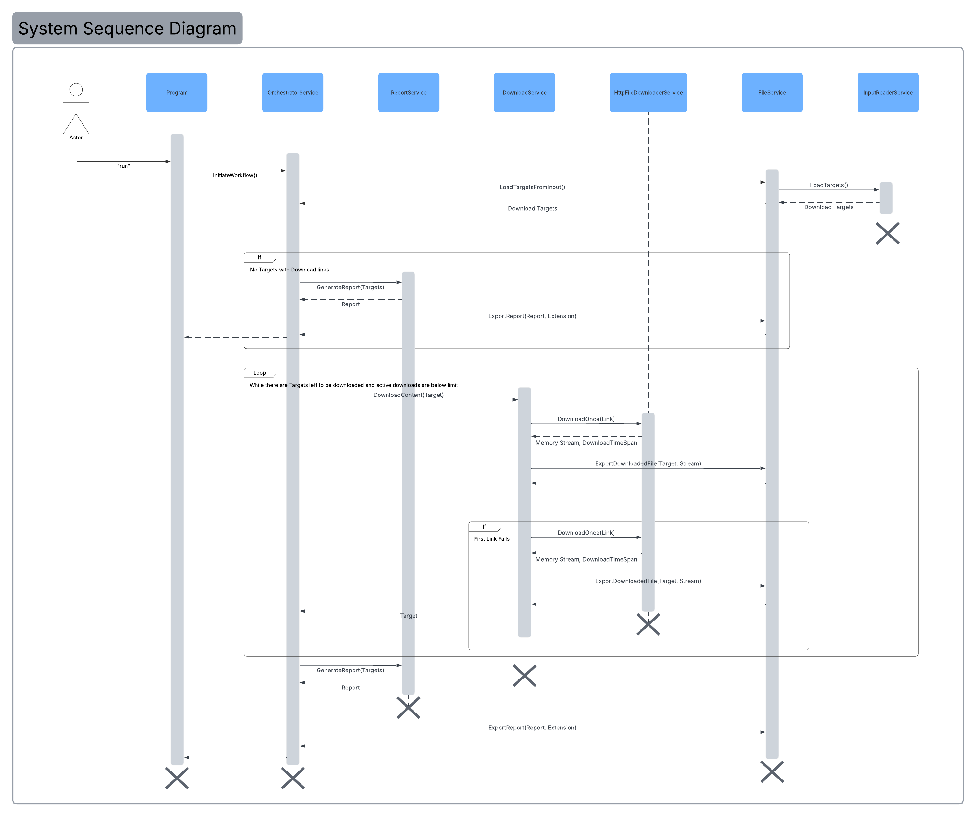
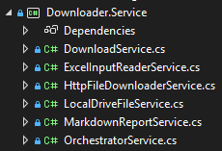
Sequence
Orchestrator Service
Report Service
Download Service
Http File Downloader Service
File Service
Input Reader Service

Slide 5

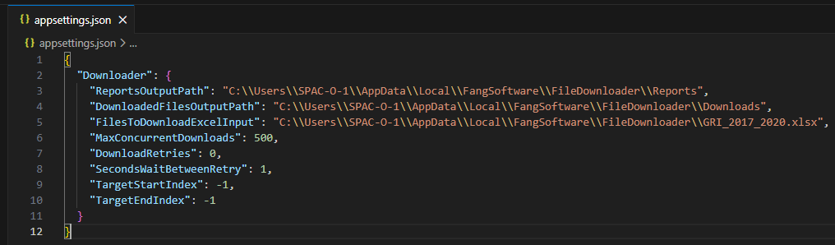



Settings File

Slide 6
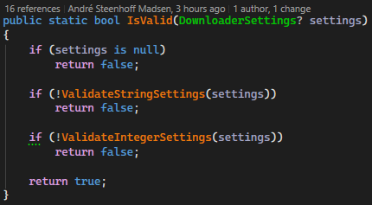
Feedback
Validation Code Location
Single Responsibility Principle
Naming

Slide 7
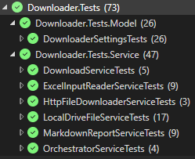
Tests
GitHub Action
Coverage

Slide 8
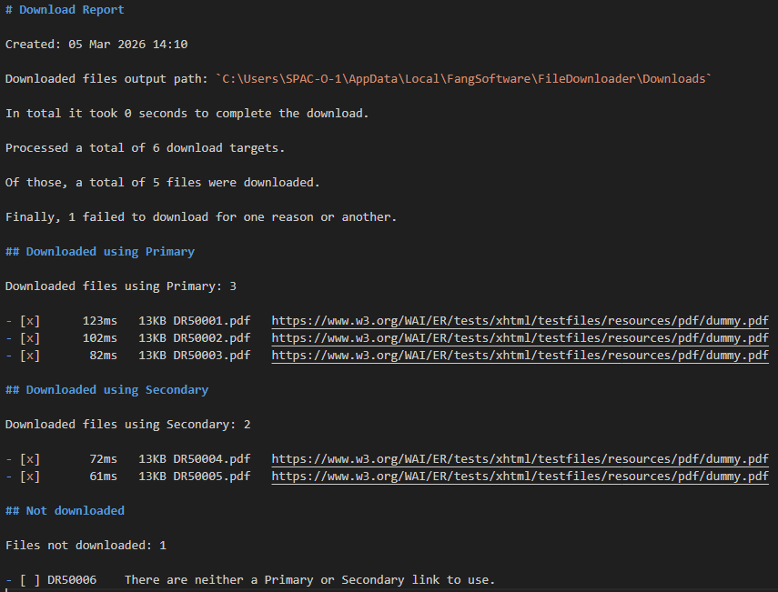
Report
Markdown
Online Displayability

Slide 9
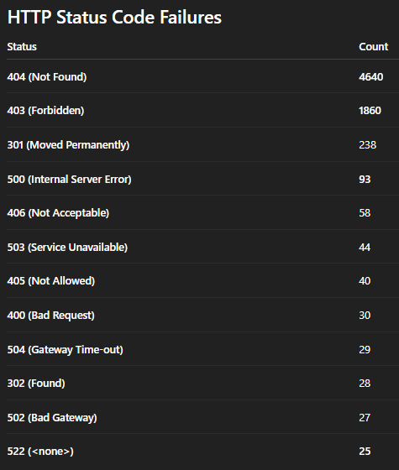
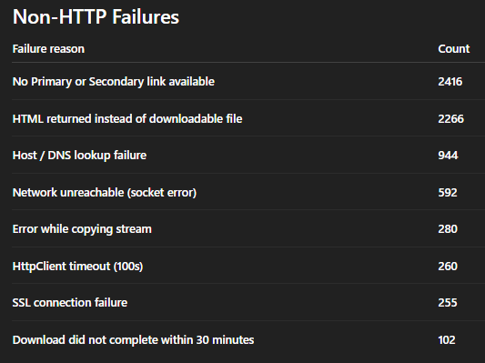
Report
Monster Excel File
Error Counts – By ChatGpt

