Slide 1
Farmer's Market
Price & Sales Tracker
Team No : 20
Gayathri Pingali Roll No : 2620040006
Amogh Andra Roll No : 2620030016

Slide 2

FARMER'S MARKET PRICE AND SALES TRACKER
Abstract
The Farmer's Market Price and Sales Tracker is a simple Java-based console application designed to help a farmer keep track of crop quantity, market price, and sales. The application allows the user to enter crop details, update the market price, record the quantity sold, and calculate the total sales amount and remaining quantity.
The project uses fundamental Java programming concepts including variables, data types, Scanner, arithmetic operators, conditional statements, switch statements, loops, arrays, and methods. A menu-driven approach is used to allow the user to select different operations.
The main objective of the project is to demonstrate how basic Java programming concepts can be applied to create a simple and useful application for tracking agricultural sales.

Slide 3

THE FARMER'S MARKET CHALLENGE
Understanding Problem Statement
Problem Statement
Farmers need to keep track of the quantity of crops available, their current market price, and the quantity sold. Managing these calculations manually can be inconvenient, especially when prices change.
The Farmer's Market Price and Sales Tracker provides a simple Java-based solution that allows the user to enter crop information, update prices, record sales, and calculate the total sales amount and remaining quantity.

Slide 4
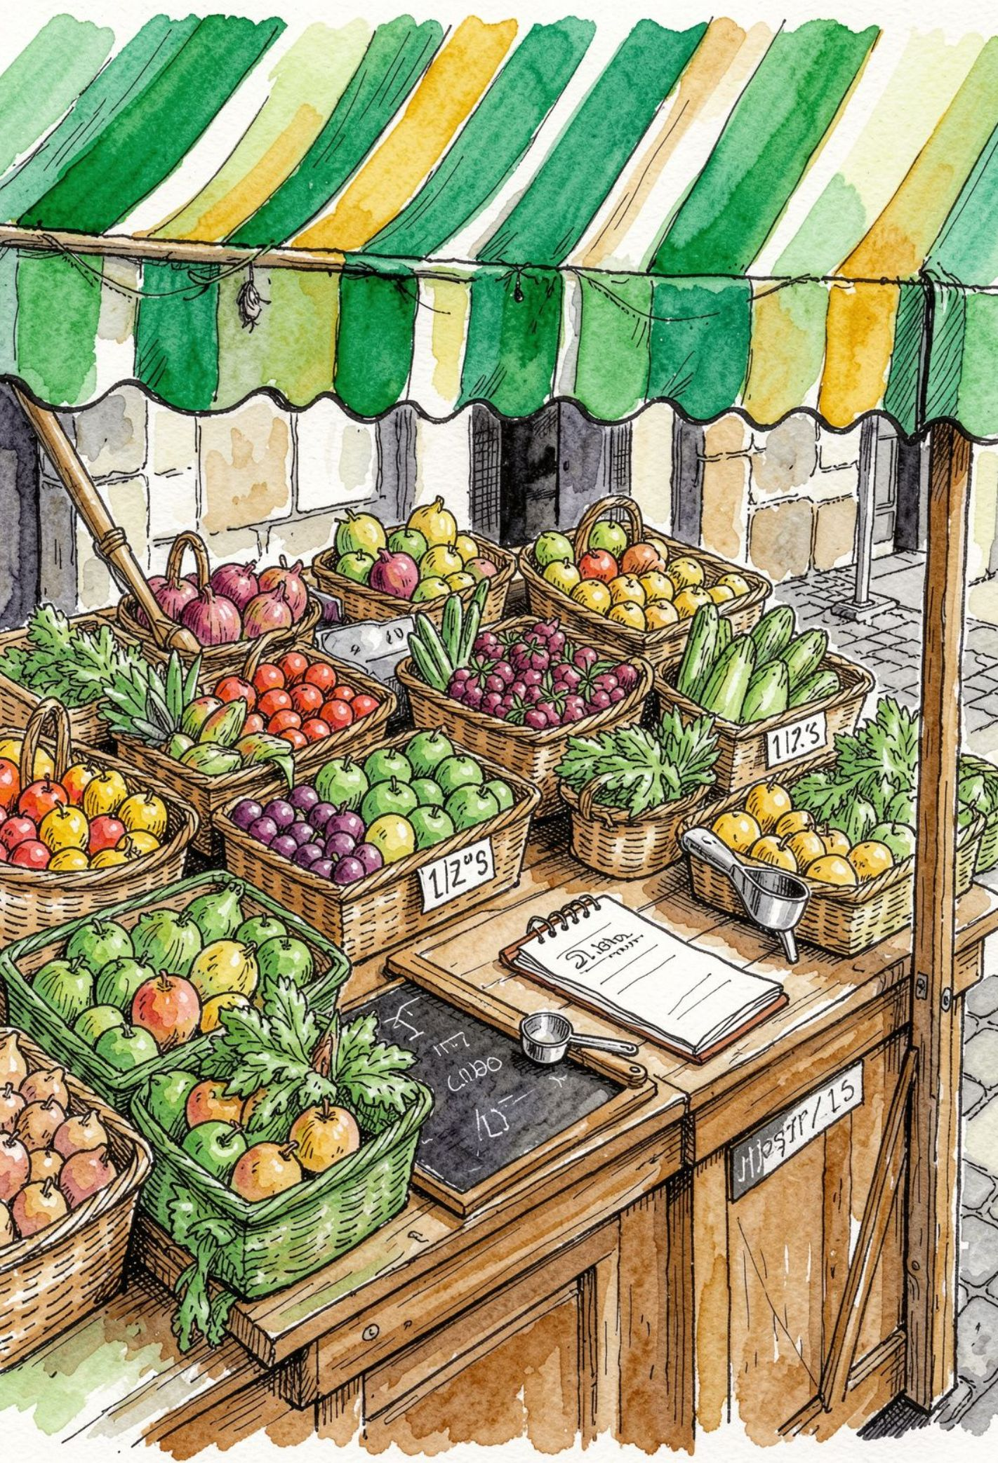
CO 1
CO 1 Topics
Problem Solving
Algorithms & Flowcharts
Java Environment
Java Program Structure
Java Basics
Data Types & Variables
Constants, Identifiers & Literals
Operators
  Arithmetic, Relational, Logical
  Assignment, Ternary, Unary
  Special & Bitwise
Type Casting
Expression Evaluation
  Precedence & Associativity
Console I/O
  Formatted Printing
  Scanner Input

Slide 5

Co 2 TOPICS
Module 2 – Short Topics
Control Flow
Conditional Statements
  if, if-else
  Nested if
  if-else-if
switch
  break, default
Compound Statements
Loops
  while
  do-while
  for
continue
Infinite Loops
Nested Loops

Slide 6
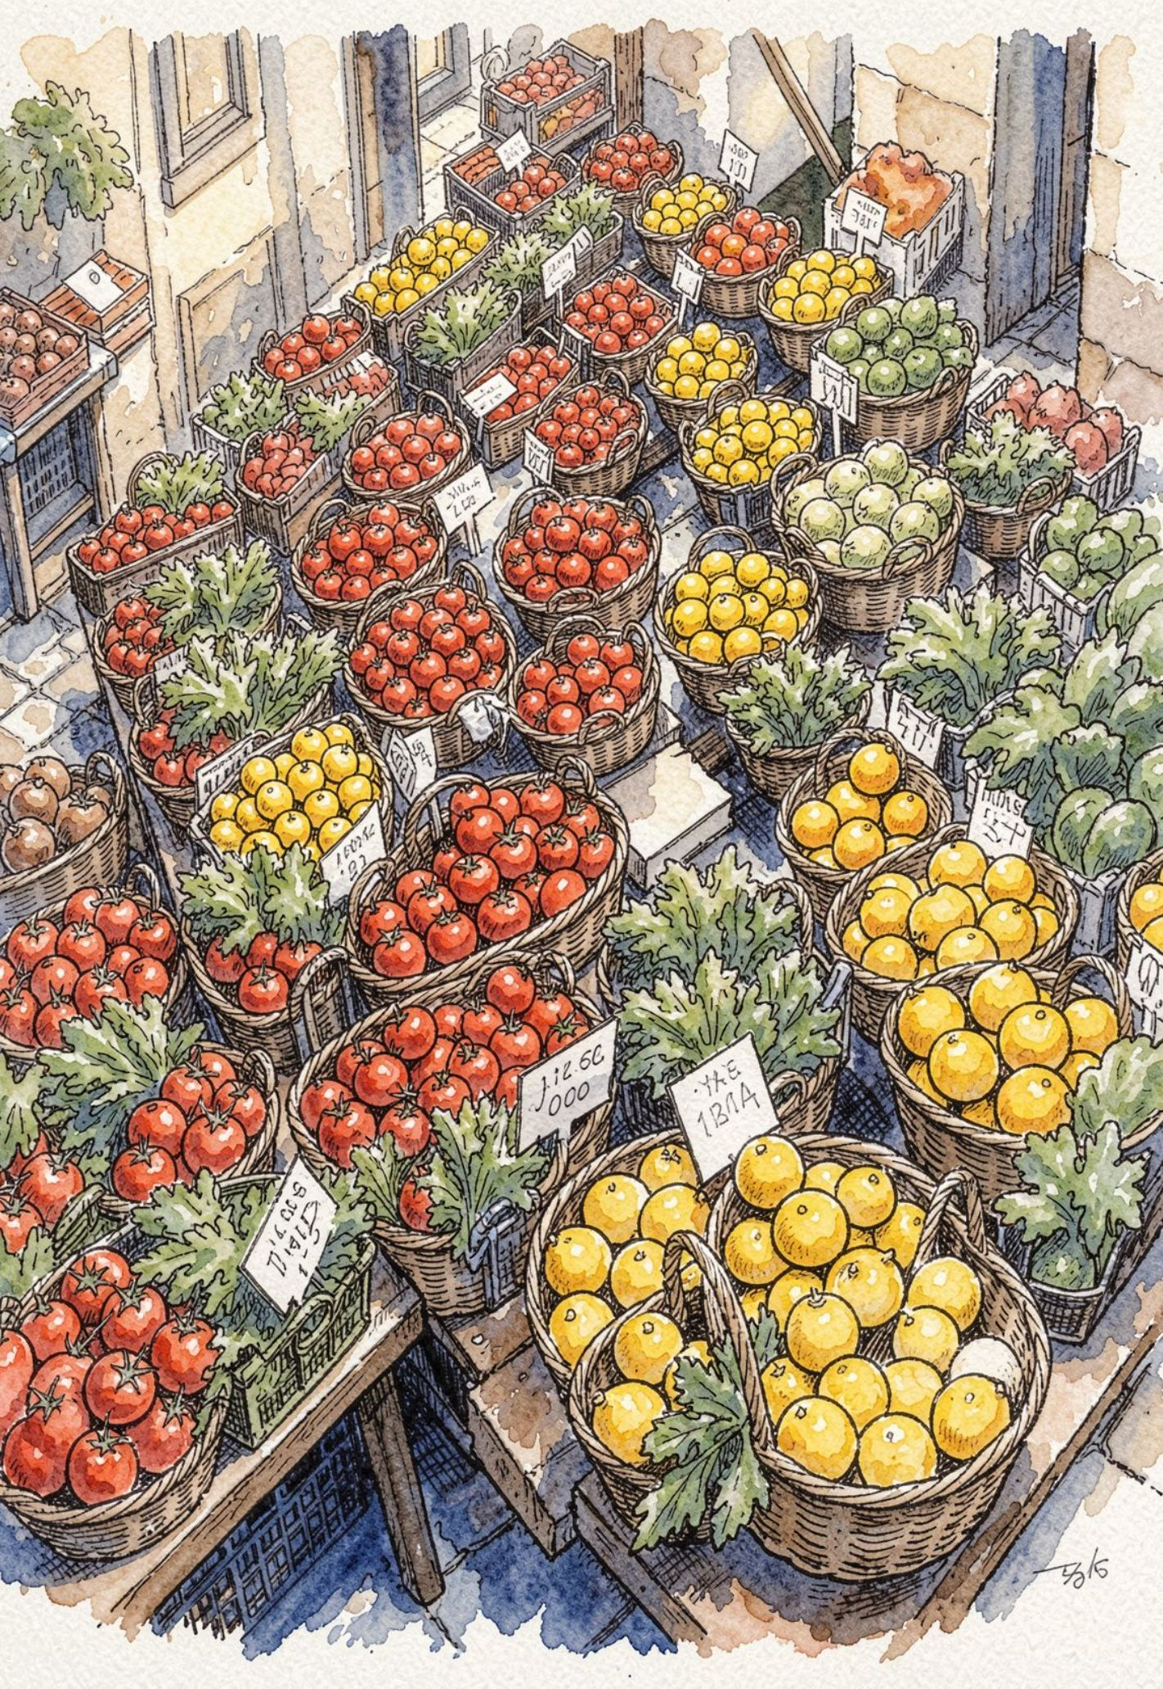
CO 3
CO 3 Topics
Module 3 – Short Topics
Modular Programming
Methods
  Definition & Invocation
  Parameters & Return Values
  Method Overloading
for-each Loop
Recursion
  Base Case
  Recursive Case
1D Arrays
  Traversal
  Searching
  Sum & Average
  Counting
2D Arrays
  Matrix Arithmetic

Slide 7

PROJECT SUBMISSION
Geo Tag Photo and git hub link

