Slide 1


DIGITAL LOGIC DESIGN · FINAL PROJECT DEMONSTRATION
PROJECT TEAM
Batch 1 · Section: ______
4-Bit Binary
Arithmetic Calculator
1
Divya Teja
Roll No. 2620030005
2
Amogh Andra
Roll No. 2620030016
Add and subtract with a single shared adder
Design and Simulation in Logisim
3
Keerthi Sagar
Roll No. 2620030018
4
Siri Samanvitha
KL University
Academic Year 2026–2027
Guide: Kartheek V
Roll No. 2620030134
Notes:
Introduce the project, team members and guide. Fill in the section before presenting.

Slide 2
Introduction and Objective
OBJECTIVES
WHAT IS THIS PROJECT?
Computers store numbers as binary digits. Arithmetic circuits combine these bits to calculate, and they form the heart of a processor’s Arithmetic Logic Unit (ALU).
We built a 4-bit calculator in Logisim that performs A + B and A − B on unsigned values 0–15, using one adder for both operations. Inputs are changed interactively, and the circuit shows the 4-bit result with a carry/borrow flag.
01
Build the circuit
Connect a 4-bit adder, XOR gates and a mode input (SUB) so both operations share one arithmetic path.
02
Explain subtraction
Invert B and add 1 to form the two’s complement; SUB drives both the XOR gates and the carry-in.
4-bit
1
512
Verify the outputs
03
Check zero, equal operands, carry and borrow cases and compare RESULT and flag with the expected answer.
operands 0–15
shared adder
input cases tested
Notes:
Brief introduction and the three objectives.

Slide 3
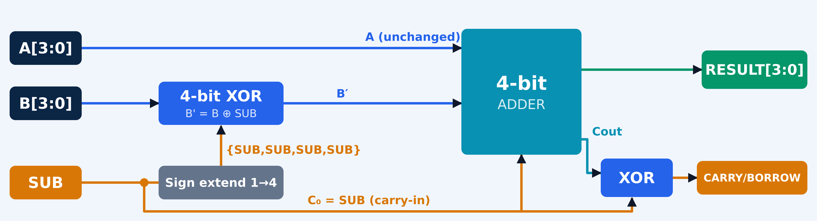
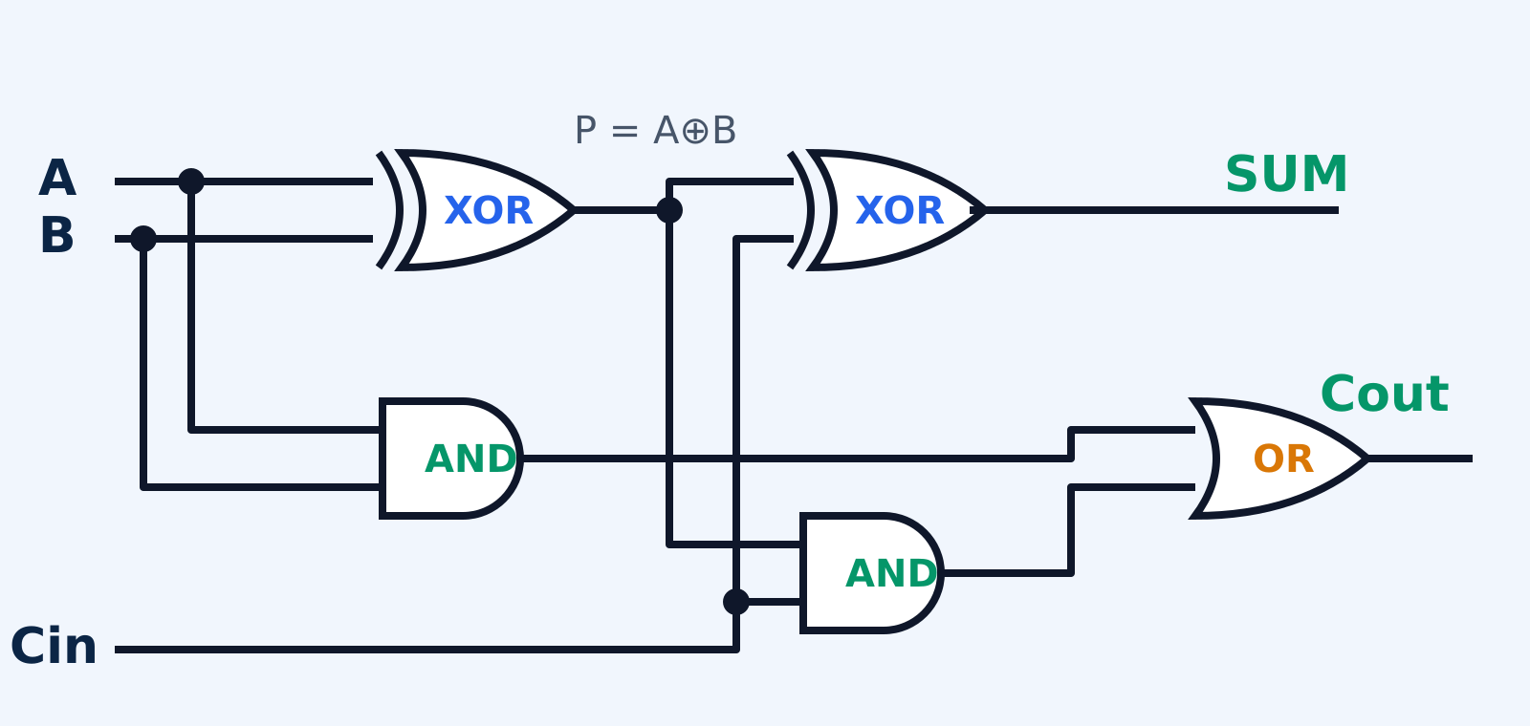
Theory and Logic Circuit
CORE IDEA
BLOCK DIAGRAM (4-BIT DATAPATH)
Subtraction becomes addition using two’s complement:
A − B = A + B̄ + 1
XOR with SUB flips B only in subtract mode, and SUB is also fed in as the carry-in.
LOGIC GATES USED
1-BIT FULL ADDER (REPEATED 4 TIMES)
EQUATIONS
XOR
Conditional invert of B; sum bits; status flag
Sum
S = A ⊕ B′ ⊕ Cin
Carry out
Cout = A·B′ + Cin(A ⊕ B′)
Flag
Cout ⊕ SUB
AND
Generates carry from A·B and P·Cin
OR
Combines the two carry terms into Cout
Notes:
Explain two's complement, then the full adder gate by gate, then how four of them form the 4-bit datapath.

Slide 4
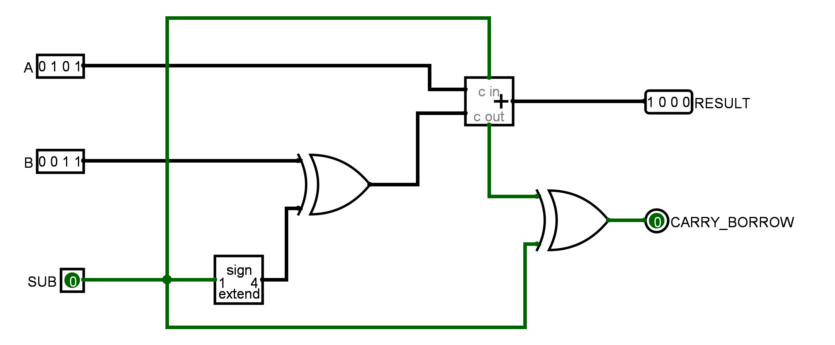
Circuit Design in Logisim
HOW THE CIRCUIT WORKS
5
1
Inputs A, B (4-bit) and SUB (0 = add, 1 = subtract) are set with the Poke tool.
4
2
Sign extender copies SUB into a 4-bit mask: 0000 or 1111.
3
1
6
3
XOR gates pass B unchanged (SUB=0) or invert it (SUB=1).
2
4
Adder computes A + B′ + SUB; SUB is the carry-in.
5
RESULT shows the lower 4 bits of the sum.
4-bit Adder
XOR (4-bit)
Sign Extender
Output pins
Logisim arithmetic library, data bits = 4
Inputs B and extended SUB mask
Widens SUB from 1 to 4 bits
RESULT (4-bit), CARRY_BORROW
6
Cout ⊕ SUB gives carry (add) or borrow (subtract).
RESULT = A + (B ⊕ {SUB,SUB,SUB,SUB}) + SUB
Notes:
Walk through the numbered markers on the screenshot, left to right, matching the six steps on the right.

Slide 5
Simulation Results
SUB = 0 · ADD
FLAG = 0
SUB = 0 · ADD
FLAG = 1
A
0
1
0
1
5 + 3 = 8
A
1
1
1
1
15 + 1 = 16
B
0
0
1
1
B
0
0
0
1
R
1
0
0
0
No carry
R
0
0
0
0
Carry out (16 → 0)
Logisim run: 0101 + 0011 = 1000, flag 0
FULL-ADDER TRUTH TABLE
SUB = 1 · SUB
FLAG = 0
SUB = 1 · SUB
FLAG = 1
A | B′ | Cin | S | Cout
0 | 0 | 0 | 0 | 0
0 | 0 | 1 | 1 | 0
0 | 1 | 0 | 1 | 0
0 | 1 | 1 | 0 | 1
1 | 0 | 0 | 1 | 0
1 | 0 | 1 | 0 | 1
1 | 1 | 0 | 0 | 1
1 | 1 | 1 | 1 | 1
A
1
0
0
1
9 − 3 = 6
A
0
0
1
1
3 − 5 = −2
B
0
0
1
1
B
0
1
0
1
R
0
1
1
0
No borrow
R
1
1
1
0
Borrow (−2 → 14)
All 512 input combinations (16 × 16 × 2 modes) passed RESULT and flag checks
Notes:
Case 1 is the real Logisim screenshot. Flag = carry for addition, borrow for subtraction. R = RESULT.

Slide 6
Conclusion and Applications
OUTCOME
APPLICATIONS
IMPROVEMENTS
One adder performs both A + B and A − B
A single SUB input controls inversion, carry-in and flag meaning
Demonstrates two’s complement and carry/borrow visually
All 512 input combinations verified in Logisim
ALU inside CPUs and microcontrollers
Calculators and embedded controllers
Address and counter calculation in processors
Teaching tool for digital logic and computer architecture
Signed-overflow detection
Wider operands: 8, 16 or 32 bits
Add AND, OR, XOR to form a complete ALU
Seven-segment display and FPGA hardware build
Key takeaway: one XOR row and one carry-in turn a plain adder into an adder–subtractor, the same idea used inside real processors.
Notes:
Summarize results, give applications, then mention future improvements. Thank the audience.

