Slide 1
Database Fundamentals
Pedro Bonilla

Slide 2

Pedro Bonilla
Database Engineer at The Workshop
Before: Operational DBA, Development DBA, DB Developer, Analyst, Developer,…
Certifications: MCSA, MCTS, Microsoft Active Professional,… all about SQL Server
Like movies, music, board games, but also writing, reading and talk about technology, overall SQL Server
  Founding member, Organizer & Speaker on the SQL Server Malaga User Group
  Founding member of PASS SQL Server Malaga, the 2nd PASS Group in Spain
@BoniSQL

Slide 3
Agenda
1
Introduction to Databases
2
Database Types
3
Database Management Systems
4
SQL Basis
5
Basic Queries
6
Transactions
7
The Relational Model, design, normalization

Slide 4
Introduction to Databases
Pedro Bonilla

Slide 5
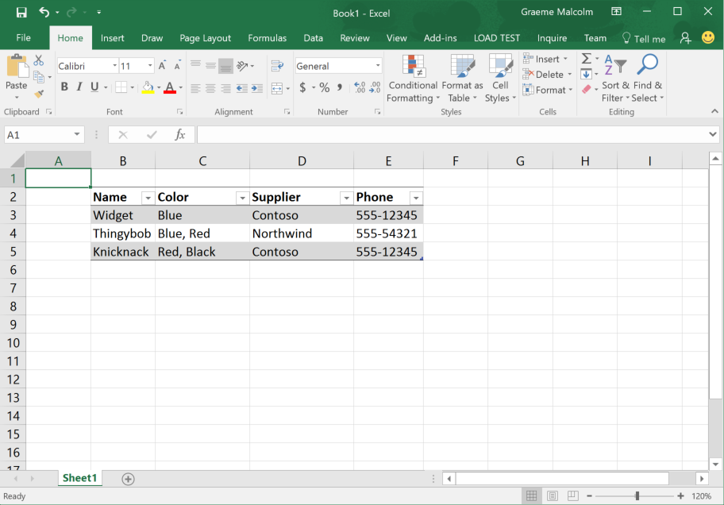

Slide 6
Product |  |  |  |  | Color |  |  | Supplier
ProductID | Name | Phone | Supplier |  | ColorID | Color |  | SupplierID | Supplier
1 | Widget | 555-12345 | 1 |  | 1 | Blue |  | 1 | Contoso
2 | Thingybob | 555-54321 | 2 |  | 2 | Red |  | 2 | Northwind
3 | Knicknack | 555-12345 | 1 |  | 3 | Black
Product |  |  |  |  |  | Supplier
ProductID | Name | Color | Phone | Supplier |  | SupplierID | Supplier
1 | Widget | Blue | 555-12345 | 1 |  | 1 | Contoso
2 | Thingybob | Blue | 555-54321 | 2 |  | 2 | Northwind
3 | Knicknack | Red | 555-12345 | 1
4 | Thingybob | Red | 555-54321 | 2
5 | Knicknack | Black | 555-12345 | 1
Product |  |  |  |  | Color |  |  | Supplier
ProductID | Name | Phone | Supplier |  | ColorID | Color |  | SupplierID | Supplier
1 | Widget | 555-12345 | 1 |  | 1 | Blue |  | 1 | Contoso
2 | Thingybob | 555-54321 | 2 |  | 2 | Red |  | 2 | Northwind
3 | Knicknack | 555-12345 | 1 |  | 3 | Black
 |  |  |  | ProductColor
 |  |  |  | Product |  | Color
 |  |  |  | 1 |  | 1
 |  |  |  | 2 |  | 1
 |  |  |  | 2 |  | 2
 |  |  |  | 3 |  | 2
 |  |  |  | 3 |  | 3
Product |  |  |  | Color |  |  | Supplier
ProductID | Name | Supplier |  | ColorID | Color |  | SupplierID | Supplier | Phone
1 | Widget | 1 |  | 1 | Blue |  | 1 | Contoso | 555-12345
2 | Thingybob | 2 |  | 2 | Red |  | 2 | Northwind | 555-54321
3 | Knicknack | 1 |  | 3 | Black
 |  |  | ProductColor
 |  |  | Product |  | Color
 |  |  | 1 |  | 1
 |  |  | 2 |  | 1
 |  |  | 2 |  | 2
 |  |  | 3 |  | 2
 |  |  | 3 |  | 3
Product
Name | Color | Supplier | Phone
Widget | Blue | Contoso | 555-12345
Thingybob | Blue, Red | Northwind | 555-54321
Knicknack | Red, Black | Contoso | 555-12345
Product
Name | Color | Supplier | Phone
Widget | Blue | Contoso | 555-12345
Thingybob | Blue | Northwind | 555-54321
Knicknack | Red | Contoso | 555-12345
Thingybob | Red | Northwind | 555-54321
Knicknack | Black | Contoso | 555-12345

Slide 7
Product |  |  |  | Color |  |  | Supplier
ProductID | Name | Supplier |  | ColorID | Color |  | SupplierID | Supplier | Phone
1 | Widget | 1 |  | 1 | Blue |  | 1 | Contoso | 555-12345
2 | Thingybob | 2 |  | 2 | Red |  | 2 | Northwind | 555-54321
3 | Knicknack | 1 |  | 3 | Black
 |  |  | ProductColor
 |  |  | Product |  | Color
 |  |  | 1 |  | 1
 |  |  | 2 |  | 1
 |  |  | 2 |  | 2
 |  |  | 3 |  | 2
 |  |  | 3 |  | 3

Slide 8
Getting Started with Databases
Creating a database and performing initial configuration

Slide 9
Databases are used to store data in tables
Usually, we normalize these tables to create a relational schema
The tables are stored on disk, and managed in a database server
Client applications access the database across a network
Increasingly, the database server is hosted in the cloud
Access to data in a database is restricted using firewalls and authentication

