Slide 1
Database Types
Pedro Bonilla

Slide 2
Agenda
1
Database definitions
2
Database types
3
Transactional databases
4
Analytical databases
5
Relational databases
6
NoSQL databases

Slide 3
Database definitions
“A database is an organized collection of data”. Wikipedia
“Databases are used to store data in tables”. (Chapter 1)
“A database (db) is an organized collection of data, typically stored in electronic format. It
allows you to input, organize, and retrieve data quickly. Traditional databases are organized by
fields, records, and files.” MOAC program for Database Fundamentals
Three fundamental characteristics of databases:
They are designed to store billions of rows of data.
They are limited to the computer’s available hard disk space.
They are optimized to use all a computer’s available memory to improve performance.
Other database related concepts:
A query is an inquiry that we do into the database that returns information back.
An index is a data structure that improves the speed of data retrieval operations on a database table.

Slide 4
Database Types
There are several ways to classify databases. We are going to review
some of them:
  Transactional
  Relational
  Analytical
  Non SQL
  Hierarchical
  Flat-Type
  Hybrid
  Mobile

Slide 5
Transactional databases
Also known as Online Transaction Processing (OLTP) systems, are designed
to support applications that are transaction-oriented. Relational databases
are built to handle transactions and matches ACID (Atomicity, Consistency,
Isolation and Durability).
Online transaction processing applications are intense in terms of reads and writes.
These applications are used concurrently by hundreds of users.
The key goals of OLTP applications are availability, speed, concurrency and
Recoverability. The standard language is SQL, Structured Query Language.
Examples?

Slide 6
Analytical databases
Also known as Online Analytical Processing (OLAP) systems, are designed
to support apps for multidimensional analysis (MDA). The main purpose
is managing OLAP cubes.
Databases configured for OLAP use a multidimensional data model, allowing
for complex analytical and ad hoc queries with a rapid execution time.
They borrow aspects of hierarchical and relational databases.
The OLAP are typically optimized for very fast reads.
Notes:
.

Slide 7
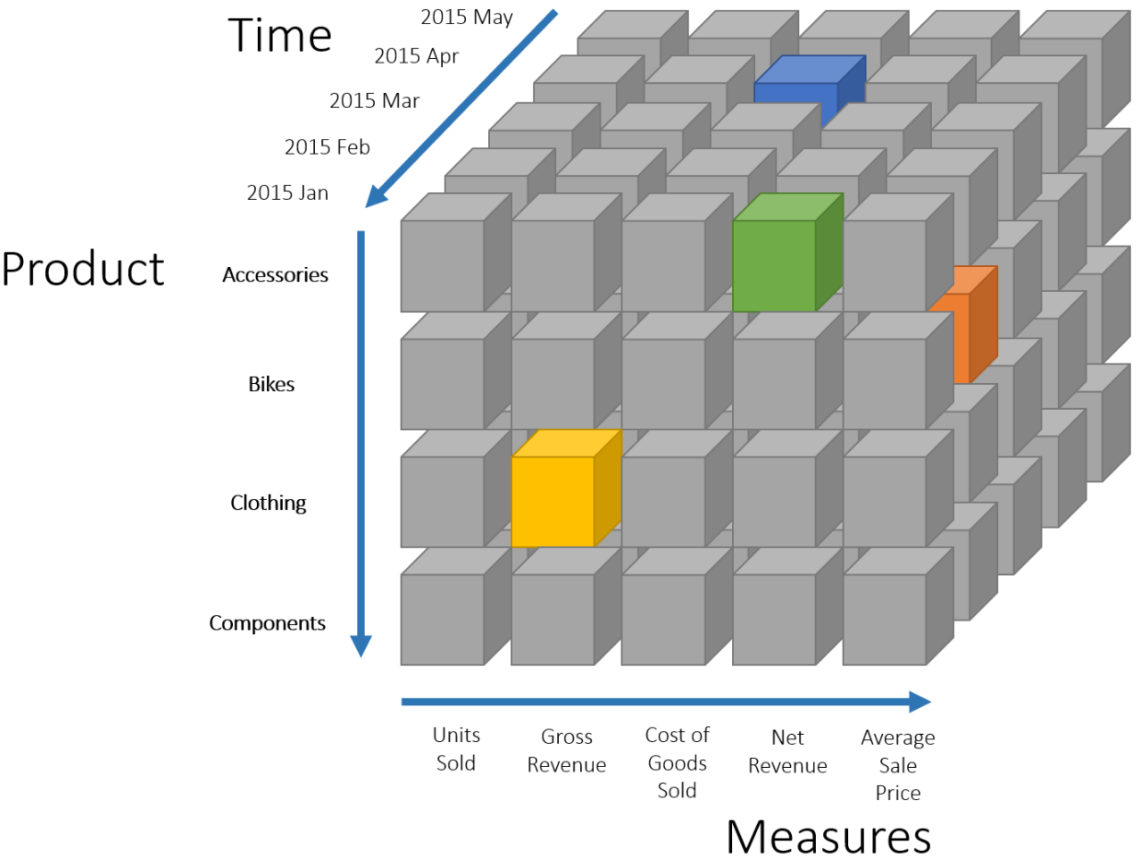
Analytical databases

Slide 8
NoSQL databases
Databases that does not use the Relational Data Model. NoSQL databases are increasingly used in big data and big-scale web applications.
Types: Key-value, Document, Graphs, wide column,…
Why?
ACID is not so important when you are just reading data.
Outside of economic transactions, you don´t need always writes in < 1sec
When is acceptable to get little wrong results for a few minutes.

Slide 9
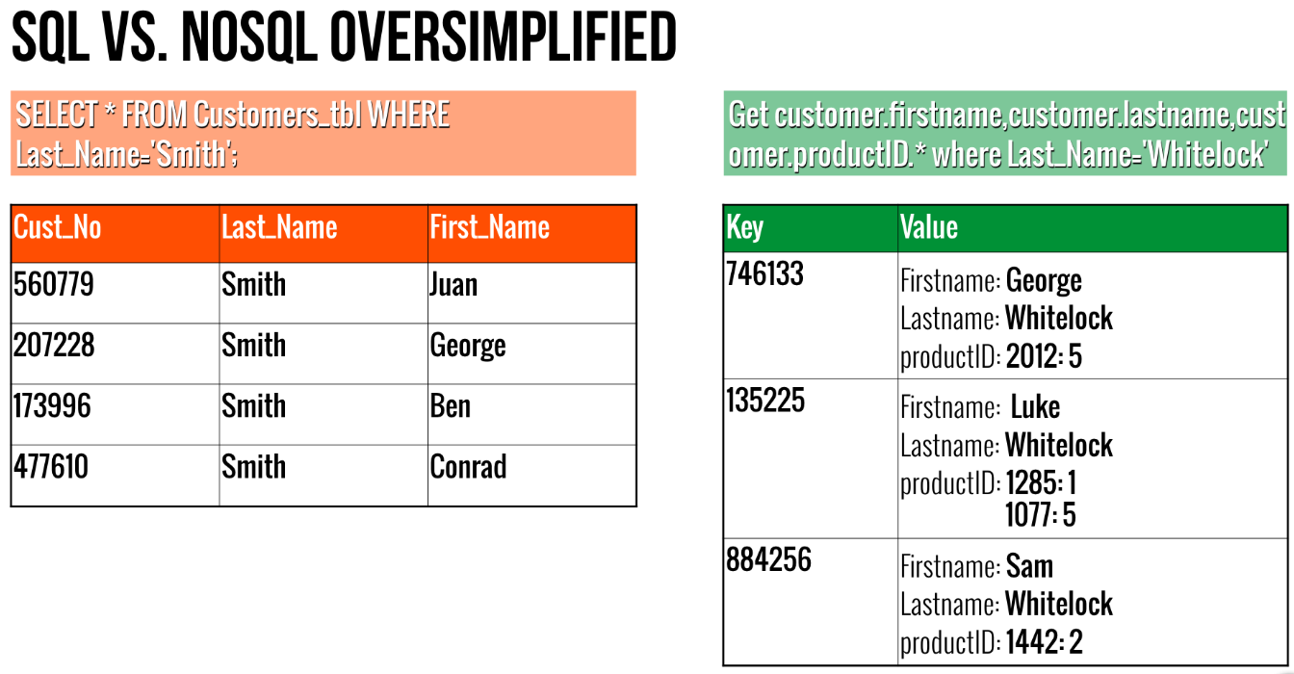
NoSQL databases

Slide 10
There are several database types, depending on their purpose
Relational Model and Transactional databases are bound
OLTP systems need to support high loads of reads & writes
Analytical systems, OLAP, needs to provide high read performance
NoSQL should be Non relational instead
NoSQL is designed for horizontal scalability
Relational & Non relational data models complements each other

Slide 11
Books & references
Books
  Database Systems. Thomas Connolly, Carolyn Begg (ISBN 0-321-21025-5)
  Microsoft Official Academic Course (MOAC) program for Database Fundamentals (ISBN 978-0-470-88916-9)
Web references
  Techniques for dimensional modelling. Kimball
  Oracle Technology Network
  SQL Server Documentation
  https://db-engines.com/en/ranking

