Slide 1
Database Management System MS SQL Server
Pedro Bonilla

Slide 2
Agenda
1
Benchmarks
2
Security
3
History
4
Tools
5
Editions
6
Community

Slide 3
Benchmarks
SQL Server is a trusted platform with industry-leading TPC benchmark results.
The TPC-E Benchmark measures an online transaction processing (OLTP) workload representative of
modern customer environments. The TPC-E benchmark is not designed to take advantage of SQL Server
in-memory OLTP features.
The TPC-H Benchmark measures the performance of a representative data warehouse workload.
The TPC-H benchmark workload utilizes SQL Server updateable in-memory columnstore technology to
achieve excellent query performance.
https://www.microsoft.com/en-us/sql-server/sql-server-benchmarks-industry

Slide 4
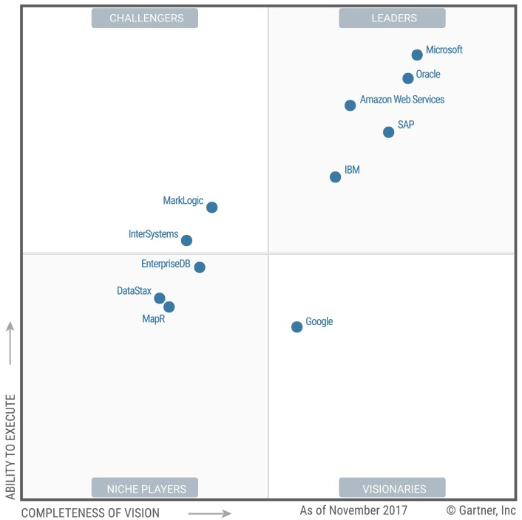
Gartner Magic Quadrant

Slide 5
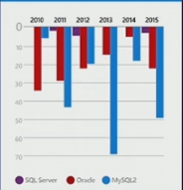
Security
According to the National Institute of Standards and Technology,
SQL Server has had the fewest security vulnerabilities over the past
seven years when compared with other major database vendors
https://nvd.nist.gov/

Slide 6
History
1989: Ashton-Tate, Microsoft and Sybase started a joint venture. The result: SQL Server 1.0
1991: SQL Server 1.1. Coincidiendo con la primera edición de Windows.
1993: SQL Server 4.21. Por primera vez con una GUI, que significó un cambio en la forma de interactuar
de los administradores con el software.
1995: SQL Server 6.0. Introdujo muchas mejoras importantes, y tuvo una gran aceptación por parte de los usuarios.
1997: SQL Server 7.0. Destacó por sus capacidades de flexibilidad, escalabilidad y por modernizar la arquitectura.
2000: SQL Server 2000. No sólo fue un cambio de nomenclatura, fue completamente reescrito como plataforma
de bases de datos. ETL, Reporting, Failover Clustering, BLOB, XML…
2005: SQL Server 2005. Introdujo mejoras significativas para la gestión o para entornos críticos.
Ej: SQL Server Management Studio, particionado, CLR, xQuery, Mirroring,..
2008: SQL Server 2008. Más mejoras importantes como compresión de datos y de backups
2012: SQL Server 2012 destaca por AlwaysOn Availability Groups, índices columnares, búsquedas semánticas,
TSQL: Windows functions, etc.
2014: SQL Server 2014. Buffer Pool extensions, In-Memory OLTP
2016: SQL Server 2016. QueryStore, Cloud integration, query engine improved
2017-8: …

Slide 7


SQL SERVER

Slide 8
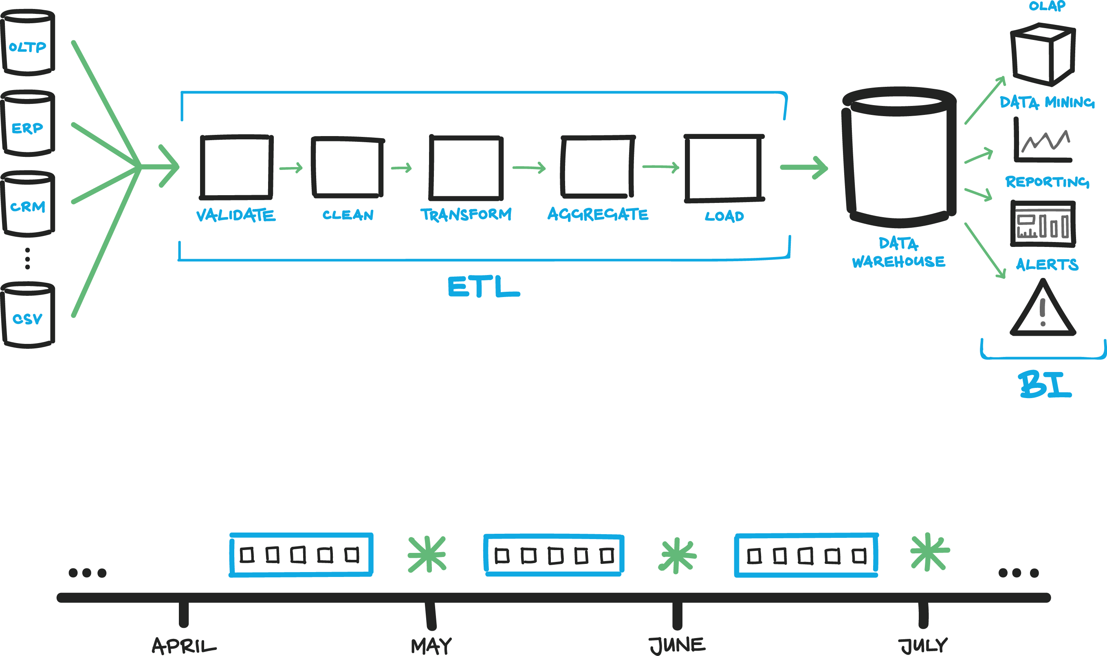
Tools
1 SQL Server
2 SSIS
3 SSAS
4 SSRS
…

Slide 9
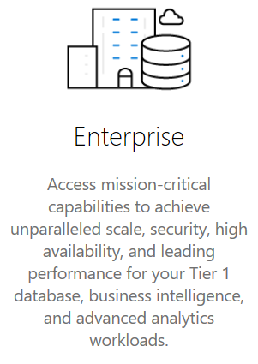
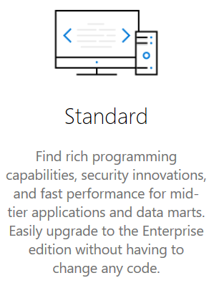
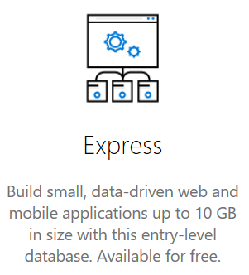
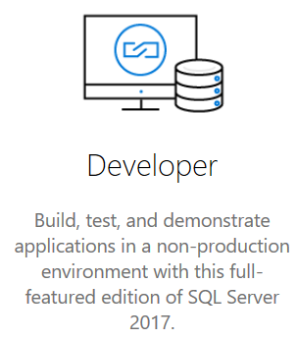
Editions

Slide 10


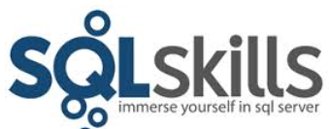







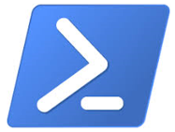






Development Community

Slide 11
It is the DBMS with less security vulnerabilities
Industry Leader with several flexible editions
It has a long history. Almost 30 years now
Very wide ecosystem. Tools included
SQL Server Express & Developer edition are free!
The Development Community is huge
SQL Server performance is awesome!

Slide 12
Books & references
Books
  Database Systems. Thomas Connolly, Carolyn Begg (ISBN 0-321-21025-5)
  Microsoft Official Academic Course (MOAC) program for Database Fundamentals (ISBN 978-0-470-88916-9)
Web references
  www.tpc.org
  SQL Server Documentation
  https://blogs.technet.microsoft.com/dataplatforminsider/2017/11/16/sql-server-2017-a-proven-leader-in-database-performance/
  https://www.microsoft.com/en-us/sql-server/developer-get-started/
  http://www.pass.org/

