Slide 1
TPC-E Benchmark Overview
TPC-PR Subcommittee
Feb 2007
© 2007 TPC

Slide 2
TPC-E Goals
OLTP Database-centric workload
Comparability of results (*)
Familiar business model – easy to understand
Reduce cost/complexity of running benchmark
Enhance schema complexity
Encourage DB uses which are more representative of what customers do
Address aspects of PDG
(*) TPC-E results are intended for OLTP database testing and are not an indicator for past or future market performance, nor should they be used as such.

Slide 3
Business Model – Financial Market
Stock
Exchange
Customers
Customer
Request
Brokerage
Response
Market
Response
Brokerage
Request
Ticker
Feed
Asynchronous Txns
B2B Environment
Send Trade to Market
Receive Trade Result
Synchronous Txns
C2B Environment
Customer Initiated
Request a Trade
Check Status of Trade
Portfolio Summary
Market
Response
Brokerage
Response
Ticker
Feed
Brokerage
House
Customer
Request
Brokerage
Request
Notes:
Txns = Transactions

Slide 4
Business Model – Financial Market
DRIVER
Stock
Exchange
Customers
Customer
Request
Brokerage
Response
Market
Response
Brokerage
Request
Ticker
Feed
SUT
Market
Response
Brokerage
Response
Ticker
Feed
Brokerage
House
Customer
Request
Brokerage
Request

Slide 5
Business Model – Comparison
TPC-C
Wholesale supplier
Organized by
  Warehouses
  Districts
  Customers
TPC-E
Brokerage house
Organized by
  Customers
  Accounts
  Securities
Notes:
TPC-C: Hierarchical – Districts are subsets of warehouses – Customers are subsets of districts.
TPC-E: Customers and accounts are related (Accounts are subsets of customers), but: Securities are orthogonal (independent entity)

Slide 6
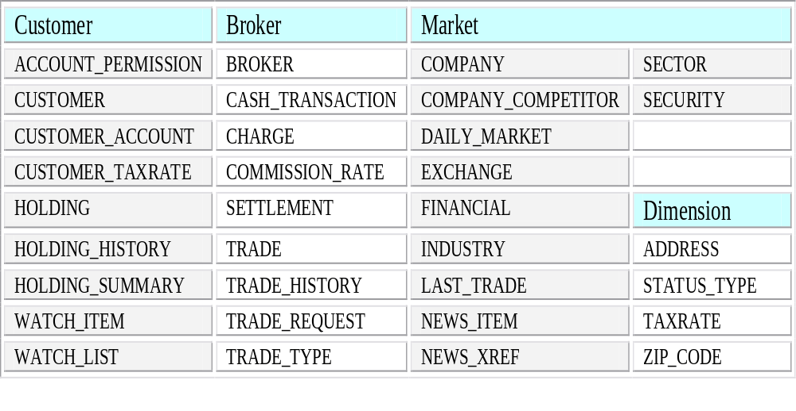
Database Tables

Slide 7
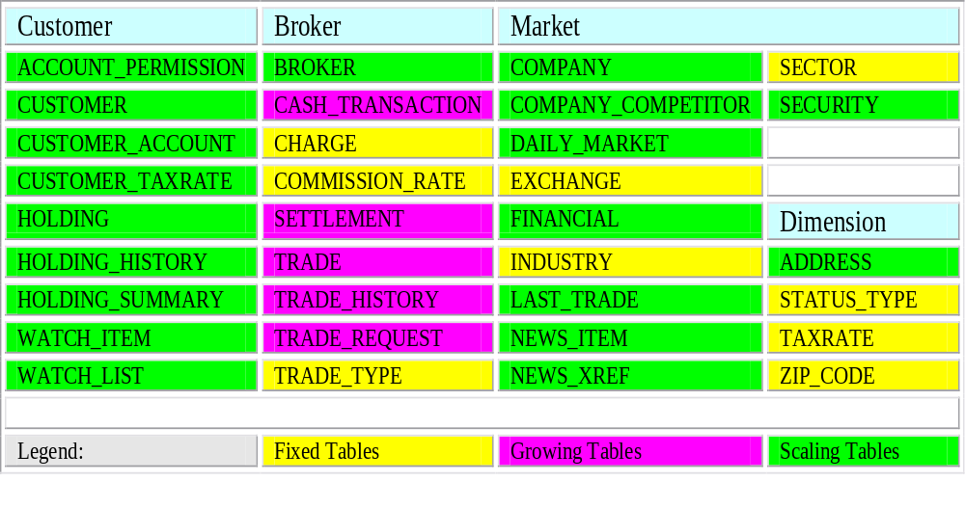
Database Scaling

Slide 8
Database Schema Summary
Characteristic | TPC-E | TPC-C
Tables | 33 | 9
Columns | 188 | 92
Min Cols / Table | 2 | 3
Max Cols / Table | 24 | 21
Data Type Count | Many | 4
Data Types | UID, CHAR, NUM, DATE, BOOL, LOB | UID, CHAR, NUM, DATE
Primary Keys | 33 | 8
Foreign Keys | 50 | 9
Tables w/ Foreign Keys | 27 | 7
Check Constraints | 22 | 0
Referential Integrity | Yes | No

Slide 9
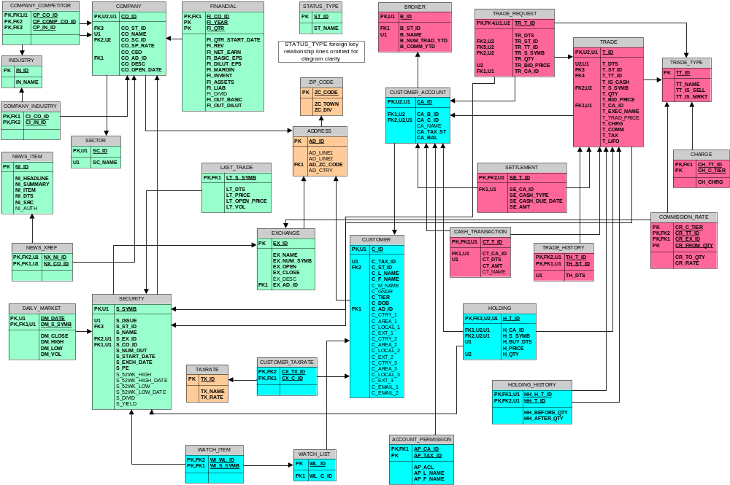
Database – Mile High View
Broker
Customer
Market
Dimension

Slide 10
Database – Content
Populated with pseudo-real data
Distributions based on:
  2000 U.S. and Canada census data (*)
    Used for generating name, address, gender, etc.
    Introduces natural data skew
  Actual listings on the NYSE and NASDAQ
Benefits
  Realistic looking data
  Compressible for backup testing, etc.
  Closer match to actual customer databases
  Anticipate usage well beyond benchmark
(*) only names of 2000 census have been used – all other data are fictional and any similarities are purely coincidental

Slide 11
Database – Content
Sample data from TPC-C CUSTOMER table
C_FIRST | C_MIDDLE | C_LAST | C_STREET_1 | C_CITY
RONpTGcv5ZBZO8Q | OE | BARBARABLE | bR7QLfDBhZPHlyDXs | OmWlmelzIJ0GeP kYM
e8u6FMxFLtt6p Q | OE | BARBARPRI | eEbgKxoIzx99ZTD S | 4V1t1VmdVcXyoTOMwpPz
bTUkSuVQGdXLjGe | OE | BARBARPRES | QCGLjWnsqSQPN D S | jVHBwIGFh2k oTOMwpPz
18AEf3ObueKvubUX | OE | BARBARESE | JnBSg4RtZbALYu S | 5g8XMnlegn oTOMwpPz
mFFsJYeYE6AR bUX | OE | BARBARANTI | MLEwwdy3dXfqngFcE | yVVR4iEtj0ADEwe wpPz
Sample data from TPC-E CUSTOMER table
C_TAX_ID | C_L_NAME | C_F_NAME | C_M_NAME | C_GNDR | C_DOB | C_EMAIL_1
757FI2006HD923 | Mexicano | Courtney | T | F | 1997-11-30 | CMexicano@hotmail.com
922SN3775RQ823 | Udley | Judith | F | F | 1954-09-27 | JUdley@earthlink.com
006GT3444BE624 | Buchanan | John | R | M | 1971-06-13 | JBuchanan@msn.com
181UZ4114LR434 | Soloman | Clinton | D | M | 1938-02-27 | CSoloman@rr.com
355IE4773VF335 | Orner | Harry | P | M | 1974-11-15 | Horner@attbi.com

Slide 12
Database – Content
Database creation is vendor specific, but…
Database population can be vendor neutral
TPC-E includes a data generator for database loading
C++ code to generate data
  MSSQL ODBC interface provided
  Flat file generation provided
  Sponsor is free to customize interface

Slide 13
Transactions - Overview
Name | Symbol | Access | Description
Broker-Volume | BV | RO | DSS-type medium query
Customer-Position | CP | RO | “What am I worth?”
Market-Feed | MF | RW | Processing of Stock Ticker
Market-Watch | MW | RO | “What’s the market doing?”
Security-Detail | SD | RO | Details about a security
Trade-Lookup | TL | RO | Look up historical trade info
Trade-Order | TO | RW | Enter a stock trade
Trade-Result | TR | RW | Completion of a stock trade
Trade-Status | TS | RO | Check status of trade order
Trade-Update | TU | RW | Correct historical trade info

Slide 14
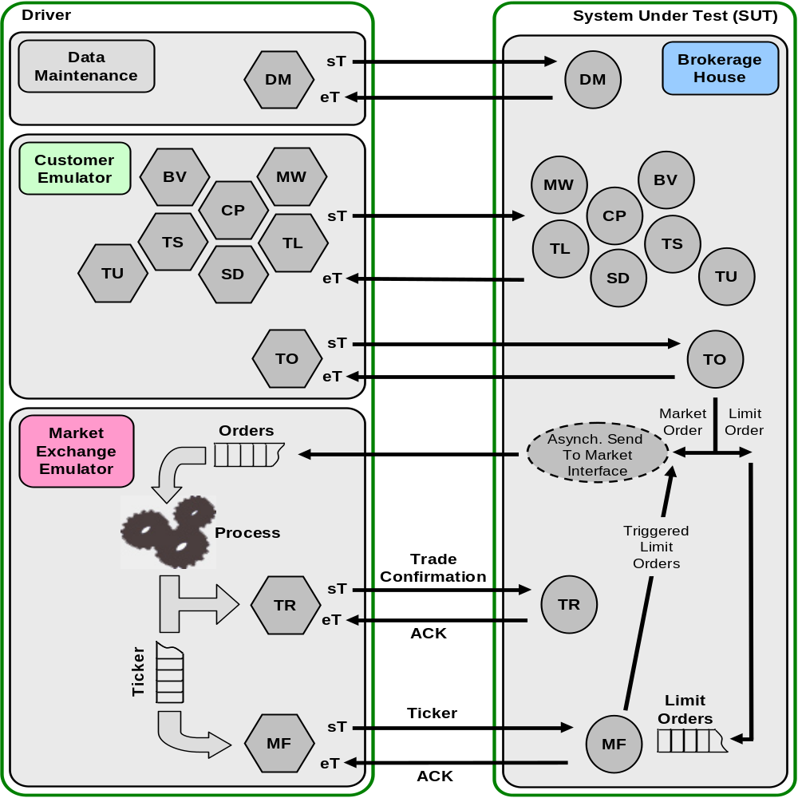
Transactions – Runtime Flow

Slide 15
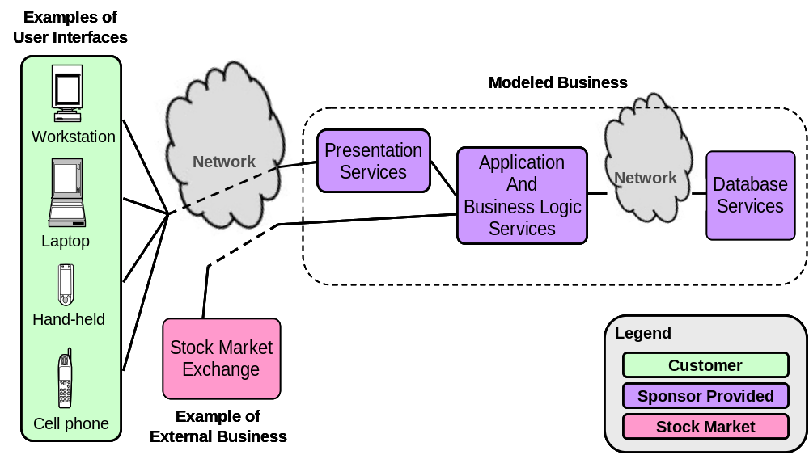
“Real-world” basis for TPC-E

Slide 16
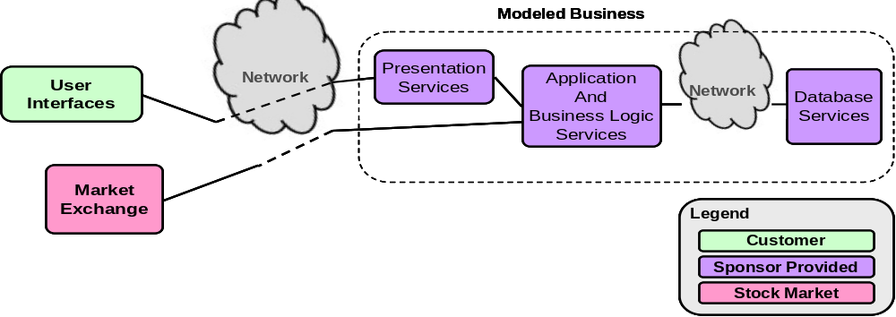
Abstraction of “Real-world”
Points to remember
  Data generator code provide by TPC
  PDG requested User Interface not be present
  Goal: Database-centric workload

Slide 17
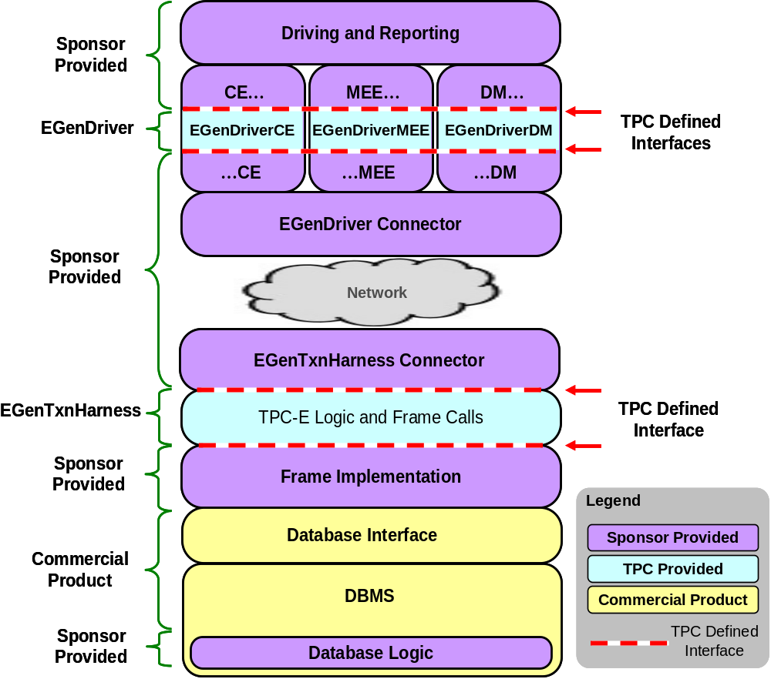
Functional Components of TPC-E

Slide 18
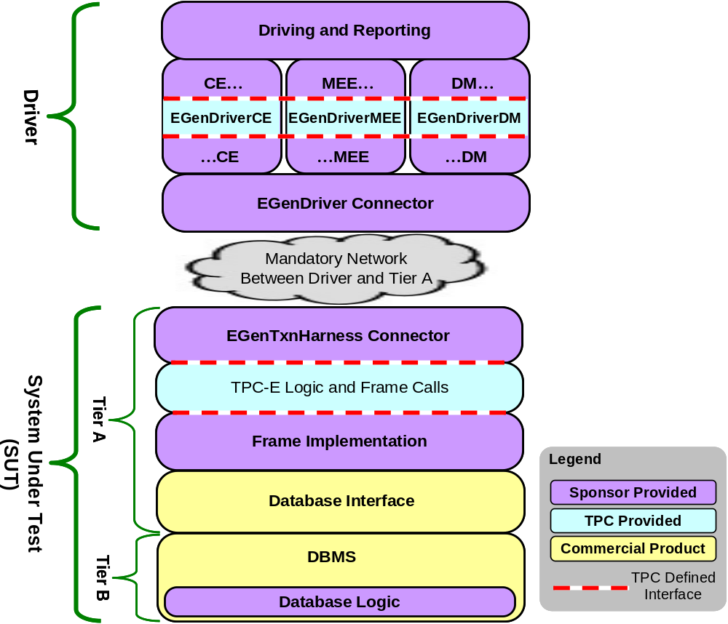
Driver & System Under Test (SUT)

Slide 19
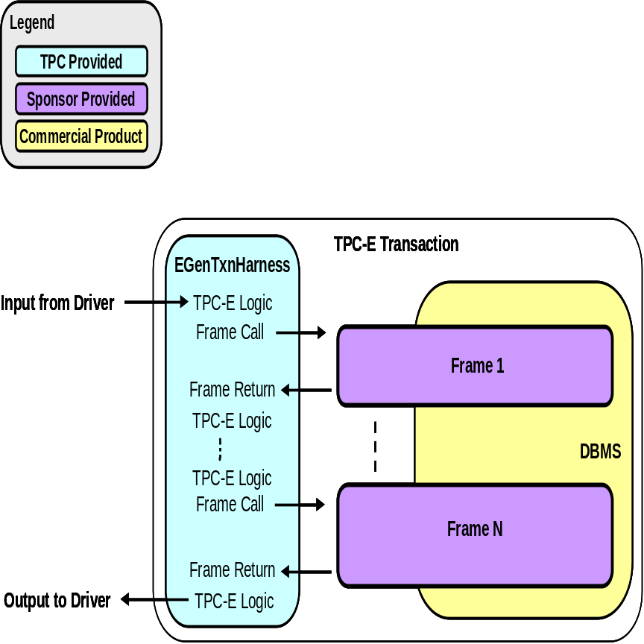
Implementation Details
Transaction Harness
  Transaction pseudo code provided
  C++ class for each transaction
  The Harness defines
    Inputs
    Outputs
    Transaction logic
    “Frames”

Slide 20
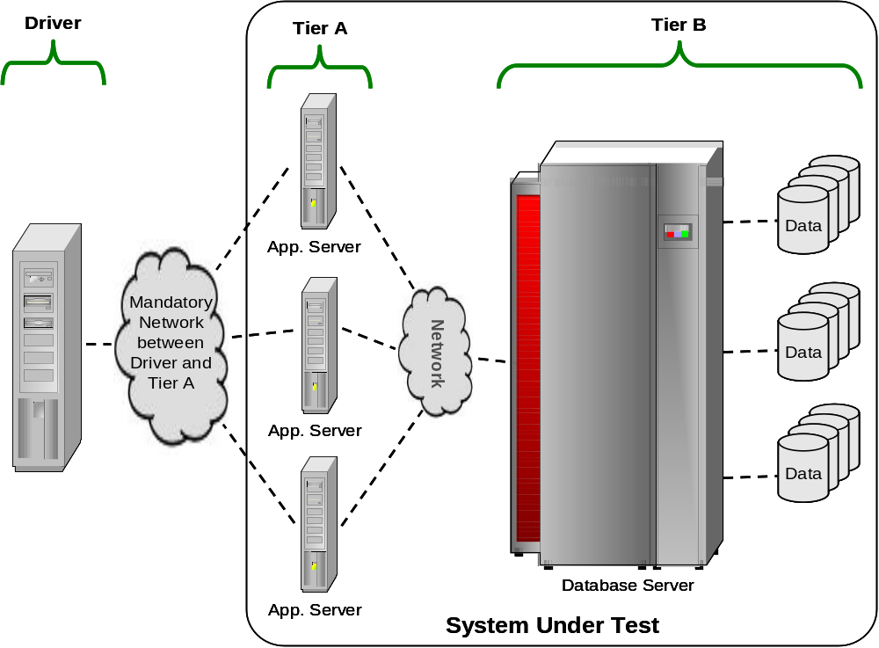
Sample Implementation

Slide 21
Summary - Highlights
Financial business model
Rich transaction set
Major components provided
Diverse, realistic schema
  Extensive use of non-primary key access
  Foreign key relationships
  Complex DML
  Referential integrity
Availability requirements
  Storage media must be fault tolerant
  Practical implication: RAID-1 or RAID-5

Slide 22
Summary - Benefits
Server-centric workload with strong DB focus
Broader coverage: database functions, schema, features
Realistic application transaction model
Ease of benchmarking: quicker startup, lower cost
Reduced I/O requirements
Comparability of results
Realistic database schema, population, and transactions
Learns from TPC history
Specification provides code where sponsor creativity not being tested

Slide 23
Trademarks and Copyright
TPC, TPC Benchmark and TPC-C are trademarks of the Transaction Processing Performance Council. All other materials are © 2007 TPC. All rights reserved.

