Slide 1
Credit Risk Analysis Using SQL
ANDRA FADHIL MARTIN

Slide 2
Background
In the financial industry, particularly within institutions such as banks and credit unions, credit risk management is a critical aspect that affects financial health and sustainability. One of the biggest challenges is accurately predicting the likelihood of loan defaults. The ability to identify these risks early can help financial institutions reduce losses and enhance profitability.

Slide 3
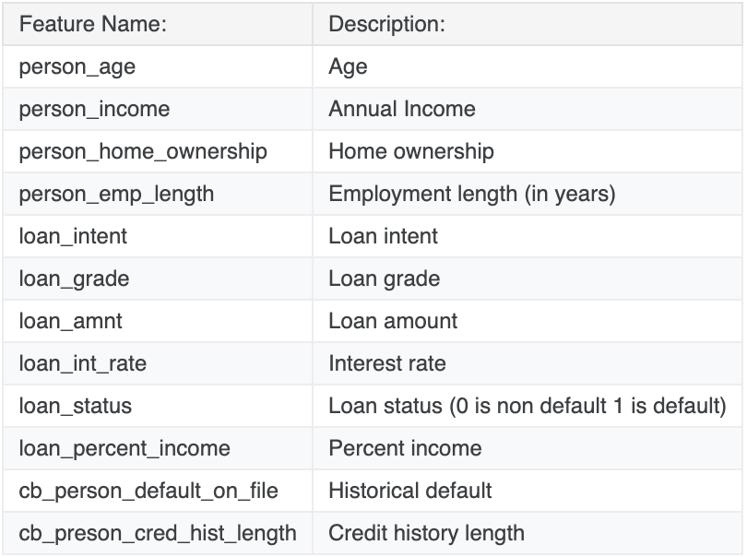
Dataset :
Question :
1. What is the performance distribution of the loan portfolio, in terms of repayment and default?
2. Which age group is most likely to default on their loans?
3. In which income group is the probability of loan default the greatest ?
4. How does homeownership status impact the likelihood of loan default?
5. What is the percentage of loan defaults for each loan category ?
6. What is the correlation between interest rates and the probability of loan defaults?
7. Does length of employment affect the borrower's ability to repay the loan?
8. How likely is a customer with a history of default to default again?

Slide 4
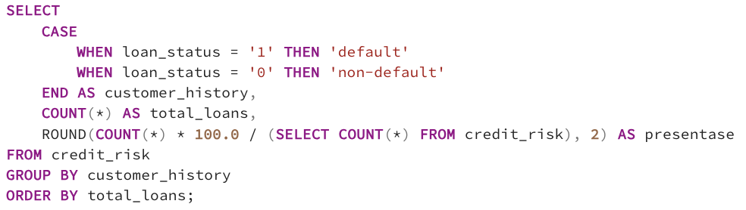
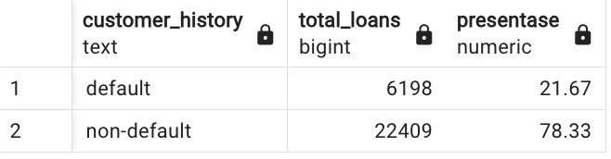
What is the performance distribution of the loan portfolio, in terms of repayment and default ?
SQL Query :
Insight :
Around 21.67% of the total loan portfolio experienced default. This means that almost a quarter of the loans given have not been successfully repaid by customers.
Result :

Slide 5
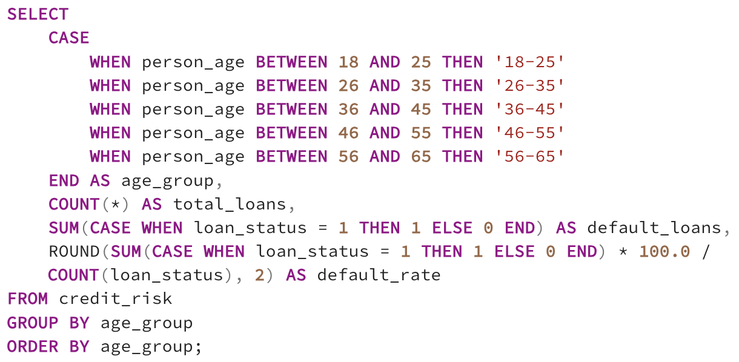
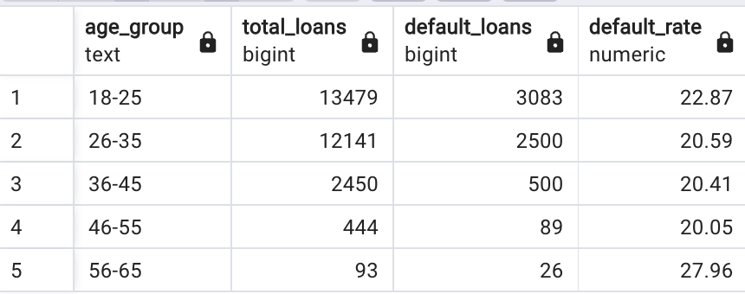
Which age group is most likely to default on their loans ?
SQL Query :
Insight :
Although the 56-65 age group has the highest default rate at 27.96%, the large loan volumes in other age groups also present significant risks. The 18-25 age group has 13,479 loans with a default rate of 22.87%, followed by 26-35 12,141 loans, 20.59%, 36-45 2,450 loans, 20.41%, and 46-55 444 loans, 20.05%. The high volume of loans in the younger age groups is a key concern in managing default risk.
Result :

Slide 6
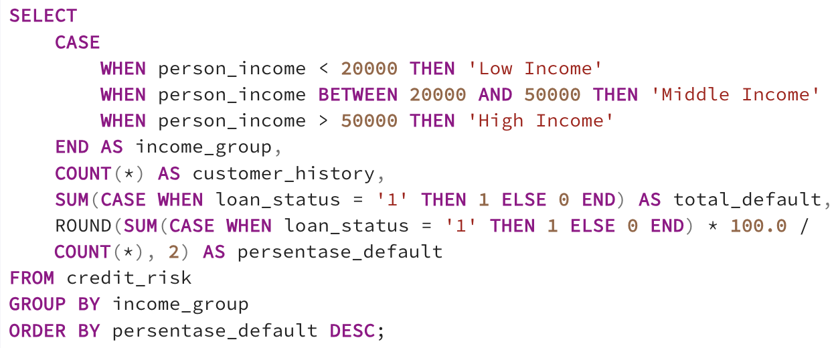
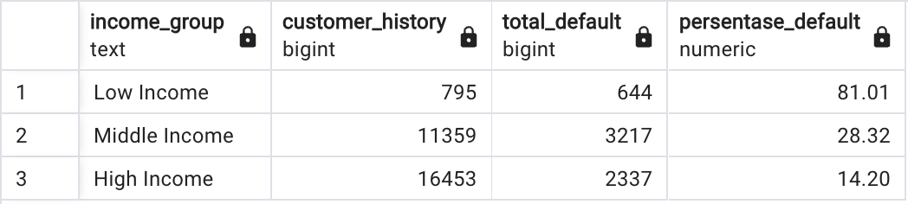
In which income group is the probability of loan default the greatest ?
SQL Query :
Insight :
The income group with the highest probability of loan default is Low Income, with a default rate of 81.01%. This figure is much higher than the default rate in the other two income groups, namely 28.32% for Middle Income and 14.20% for High Income.
Result :

Slide 7
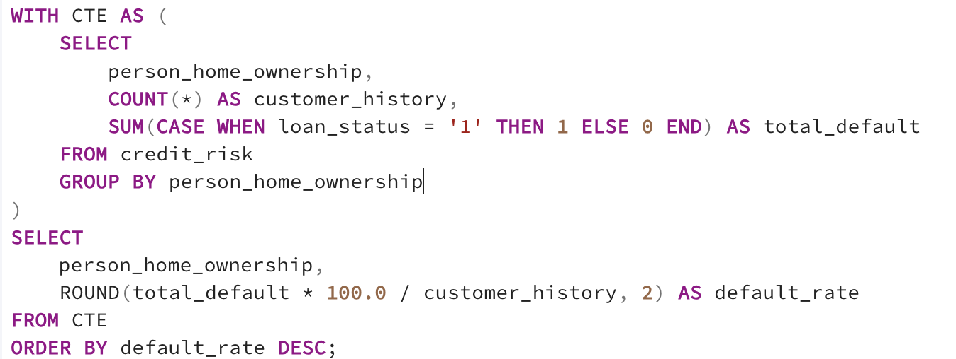
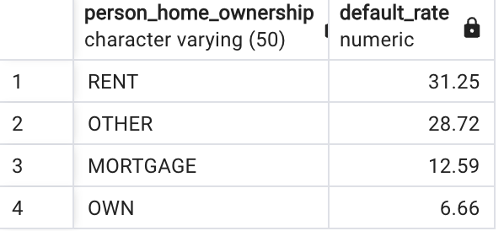
How does homeownership status impact the likelihood of loan default?
SQL Query :
Insight :
Renters have the highest default rate 31.25%, indicating that they are more vulnerable to loan default. Customers with unclear residential status are also at high risk 28.72%. Those who have a home loan have a lower risk 12.59%, while customers who fully own their home have the lowest risk of default 6.66%.
Result :

Slide 8
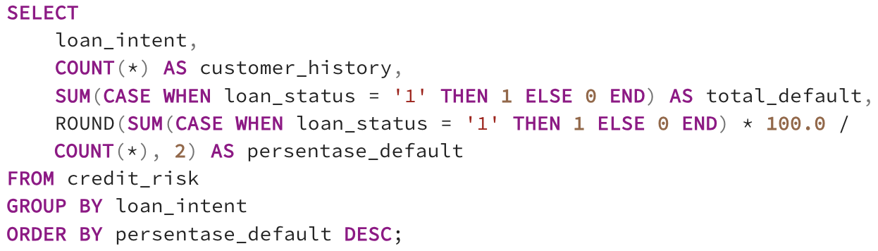
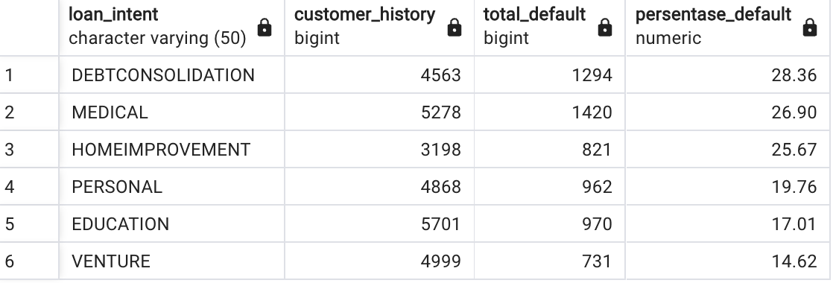
What is the percentage of loan defaults for each loan category ?
SQL Query :
Insight :
With the highest default rate of 28.36%, debt consolidation loans show the most significant risk of default compared to other categories. Medical loans also have quite a high risk 26.90%, followed by home improvement 25.67% and personal 19.76%. In contrast, loans for education 17.01% and venture 14.62% had much lower default rates, indicating more manageable risks.
Result :

Slide 9
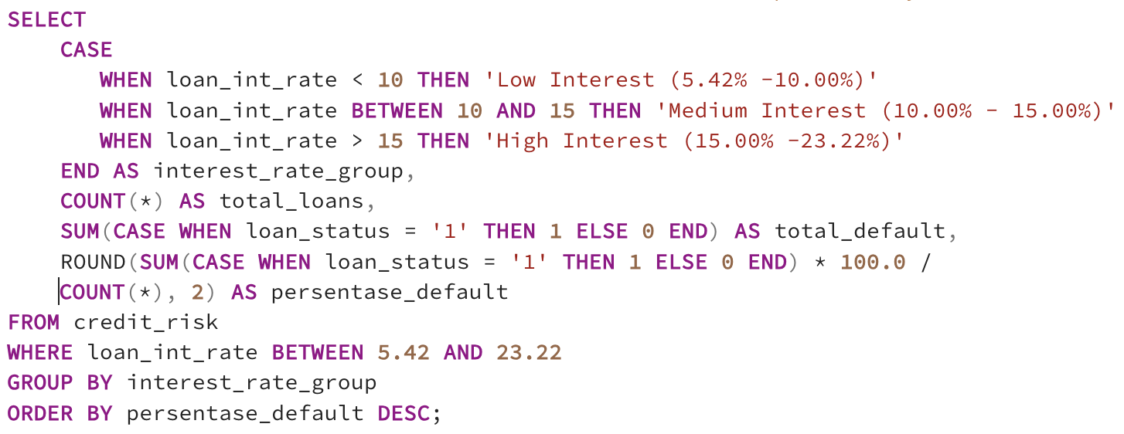
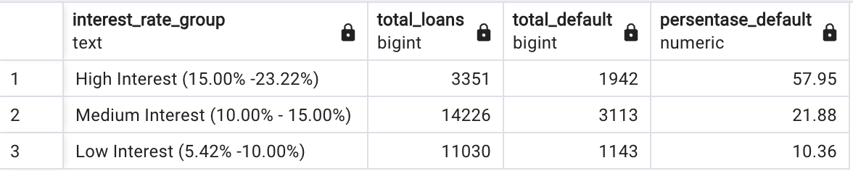
What is the correlation between interest rates and the probability of loan defaults?
SQL Query :
Insight :
The higher the loan interest, the more likely it is that the borrower will not pay the debt. Loans with the highest interest rates of 15.00%-23.22% have a default rate of up to 57.95%. In contrast, loans with the lowest interest rates of 5.42%-10.00% have a much lower default rate, only 10.36%. Loans with medium interest 10.00%-15.00% have a default rate in between, namely 21.88%.
Result :

Slide 10
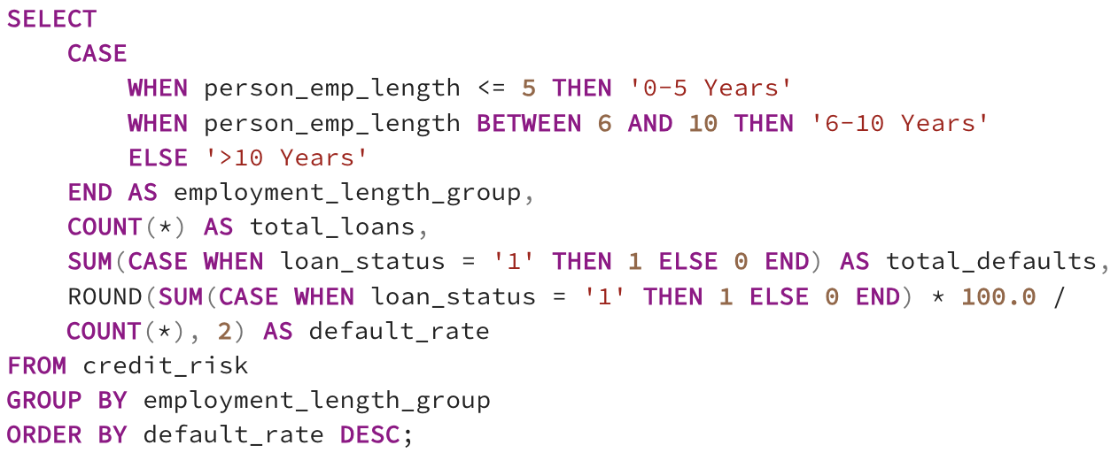
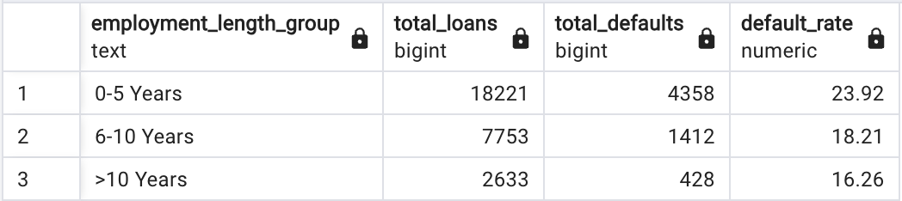
Does length of employment affect the borrower's ability to repay the loan?
SQL Query :
Insight :
The longer a person works, the less likely he or she will default on a loan. People who have just started working 0-5 years have the highest risk of default, around 23.92%. Meanwhile, those who have worked 6-10 years have a lower risk, namely 18.21%. The lowest risk is found in those who have worked for more than 10 years, with a default rate of only 16.26%.
Result :

Slide 11
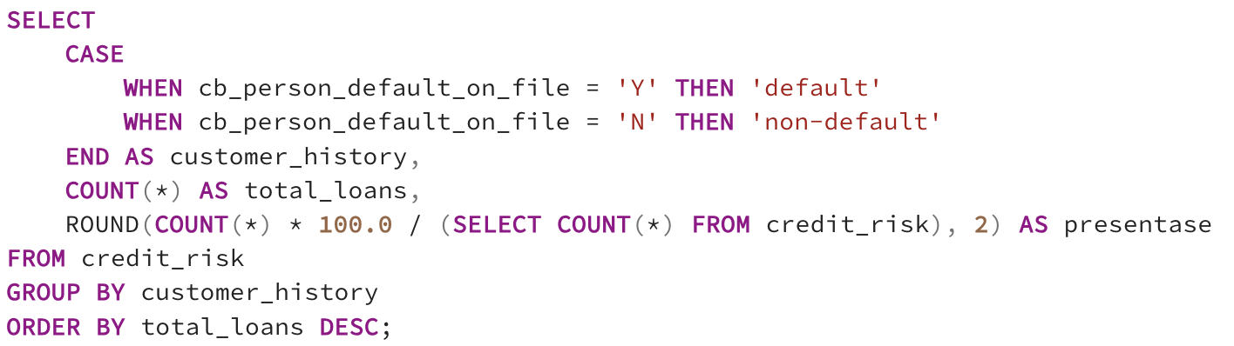
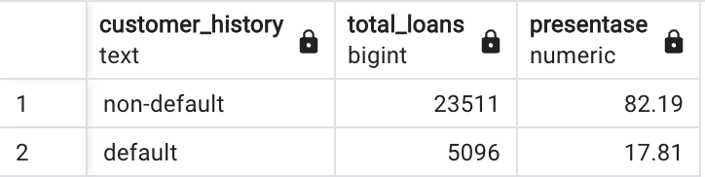
How likely is a customer with a history of default to default again?
SQL Query :
Insight :
It is clear that customers who have previously failed to pay have a higher risk of defaulting again compared to customers who always pay on time. Around 17.81% of customers with a history of default are at risk of experiencing the same problem in the future
Result :

Slide 12
Solution
The elderly and young age groups require special attention because of the high risk of default.
Step up oversight and implement stricter credit policies for low-income segments with a concerning 81.01% default rate.
Focus on borrowers with homeownership and tighten oversight on tenants 31.25% and those with indeterminate housing arrangements.
Provides additional solution and protection options for high-risk debt consolidation 28.36% and medical 26.90% loans.
Offer lower interest rates on high-risk loans, especially for customers with a good credit history, to reduce defaults.
Consider length of work as a major factor in credit, especially for those who have just worked 0-5 years with the highest risk 23.92%.
Implement strict credit policies and additional supervision for customers with a history of default 17.81%.

Slide 13
THANK YOU

