Slide 1
Forget the big mapper, switch to Dapper
Matthew D. Groves

Slide 2
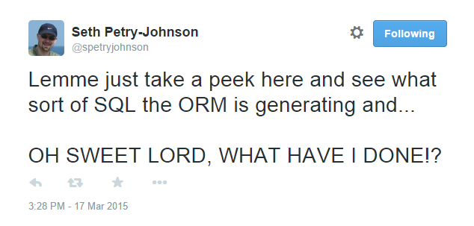
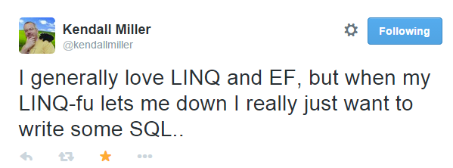
Notes:
This is why I am here, because I too feel the frustration of OR/Ms sometimes.

Slide 3
Use cases for Dapper
Simplicity:
Simple domains, simple API
Less ceremony than plain ADO.NET
Performance critical functionality
CQRS
Dapper for SELECT
OR/M for INSERT/UPDATE
Prototypes

Slide 4

There is no IQueryable
http://commons.wikimedia.org/wiki/File:SpoonCollection.jpg
Notes:
Micro OR/Ms that I’ve used do not implement IQueryable. You can still use Linq, but it will be Linq on in-memory objects. This means you have to write SQL.
Raise your hand if you’ve ever gotten a NotSupportedException. Not trying to rain on your parade: I use IQueryable every day. But it’s a leaky abstraction, tight coupling. It’s a lie—a good lie—but still a lie.

Slide 5
Why Dapper?
Battle-tested by StackOverflow
Works with:
SQL Server
MySQL
SQLite
PostgreSQL
Oracle
All ADO.NET providers
Fastest
Notes:
StackOverflow was originally written with LINQ-to-SQL
As they grew, there found places with LINQ-to-SQL was a hindrance, and started to replace with Dapper. Not sure if they are still using any LINQ-to-SQL, but for a time they were running both an OR/M and Dapper
Your mileage may vary with benchmark, but Dapper appears to be the fastest when compared to other O/RMs. In some cases we’re talking 2 ms difference, in some cases we’re talking 600 ms (over 500 iterations of SELECT)

Slide 6
Start with an IDbConnection
new SQLiteConnection(“Data Source=:memory:”)
Notes:
I’m using SQLite in these demos because it’s fast and easy to do in-memory
Each unit test creates a brand new SQLite database in memory

Slide 7
Dapper is a set of extension methods
Execute
ExecuteReader
ExecuteScalar<T>
Query<T>
QueryMultiple
(plus Async versions of the above)

Slide 8
Execute
myConnection.Execute(
string sql,
object param)
Notes:
SQL is the only thing required
You can parameterize with param, it will map properties to parameters in the SQL string
Transaction if you need it
Timeout if you need it
CommandType if you want to execute a sproc (I won’t show a sproc today because SQLite doesn’t support sprocs, but it can be done)

Slide 9
ExecuteScalar
var returnValue = myConnection.ExecuteScalar<T>(
string sql,
object param)
Notes:
ExecuteScalar is very similar, except it will return first column of the first row
You specify the type, but this is usually going to be a simple type like int, decimal, string

Slide 10
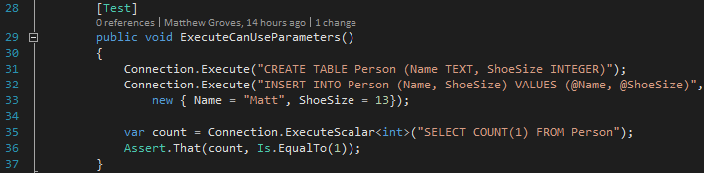
Notes:
Now we’re using parameters.
In this case, I’m using an anonymous object.
But you can use any object, as long as the names match the parameter names in the SQL string

Slide 11
Query
IEnumerable<dynamic> data = myConnection.Query(
string sql,
object param)
Notes:
Here is the first Query extension
Notice that it returns a collection of ‘dynamic’ objects
Takes SQL just like before, this is all that’s required
You can also use parameters, transaction, and some other stuff like buffering, timeout, etc, I won’t cover

Slide 12
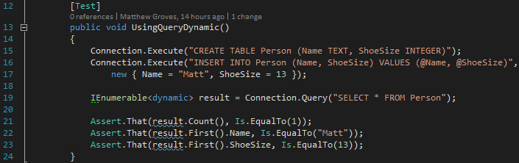
Notes:
Here’s an example of using the Query extension
I’m selecting Name and ShoeSize, so those properties will be valid on the objects in the collection
Side note: behind the scenes, this is using DbReader

Slide 13
Query<T>
IEnumerable<T> data = myConnection.Query<T>(
string sql,
object param)
Notes:
Dynamic is nifty, but we’re in a strongly typed language, so we can also take advantage of strong typing
By using the Query<T> extension
Now it will get a collection of whatever type you specify
And it will (try to) map whatever fields you select in the SQL string

Slide 14
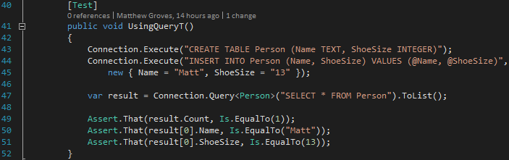
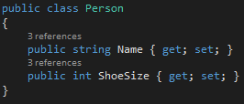
Notes:
Here’s how Query<T> works with the same table and query
But now I’m specifying a Person type

Slide 15
Multi-mapping
Dapper maps every row to one object.
But, Dapper can also map a row to multiple objects, and relate them.
Notes:
What about joins?
We want objects that are related to another object.

Slide 16
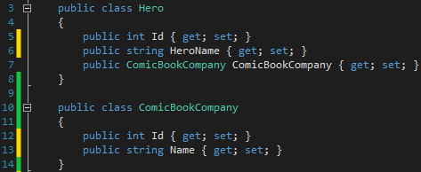
Notes:
Here are the actual entites.

Slide 17
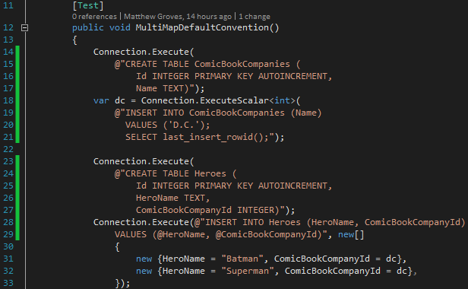
Notes:
This is a longer test, so I’ve broken it into two slides.
Two tables that are related.
Each Hero has a comic book company that it belongs to.
In the actual data, we have Batman and Superman that are both D.C.

Slide 18
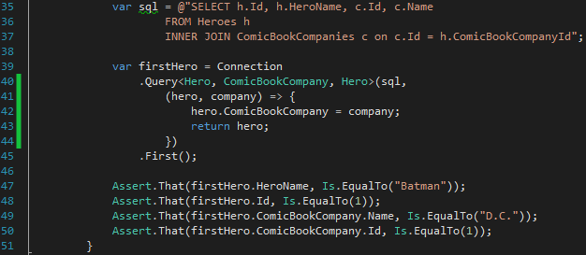
Notes:
The SQL is joining the Heroes table to the Comic Book Companies.
I’m using the Query extension with THREE type parameters.
The first two types are the types of the objects that will be mapped to. Note that now the order of the fields being selected in SQL matter.
The last type is the type that will be returned.
This lambda defines the relationship between the resultant objects.

Slide 19
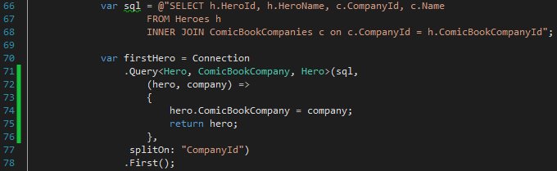
Notes:
Note that dapper will assume that the rows are divided up when it sees a column named “Id”
If you don’t have columns named “Id”, then you can override the convention using “splitOn”

Slide 20
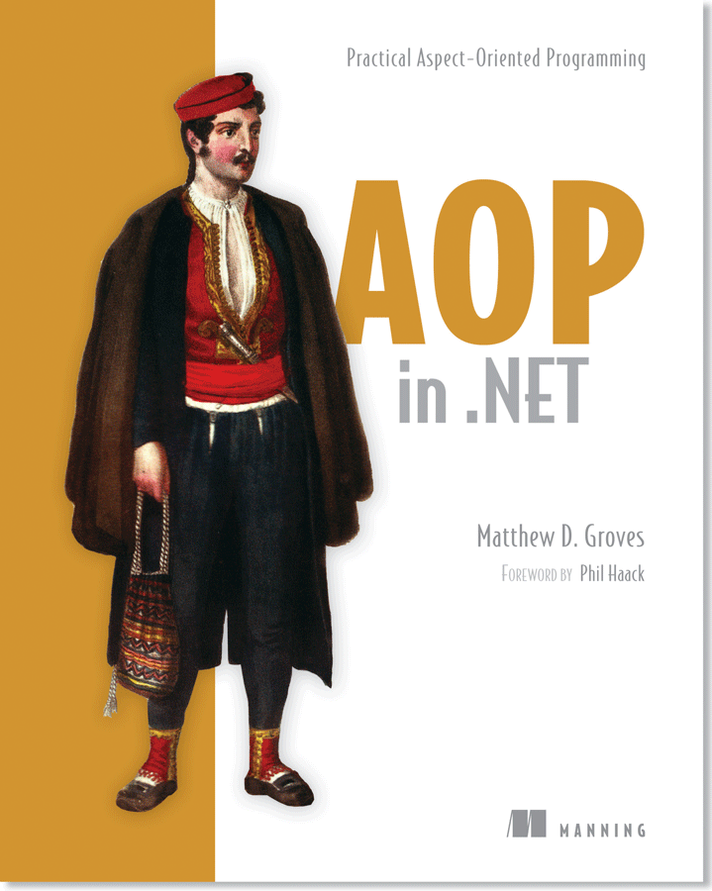
Contact me
http://about.me/mgroves
http://github.com/mgroves
http://crosscuttingconcerns.com
http://manning.com/groves
42% off code: 12mp25

