Slide 1
Forget the big mapper, switch to Dapper
Matthew D. Groves

Slide 2
{ A little about me }
I’ve been writing code since I was 8
I mainly work with .NET, but I also work with PHP and other OSS
BS, MBA, Microsoft MVP
“I am not an expert, but I am an enthusiast!” – Alan Stevens
Buy my book: AOP in .NET (Manning)
Notes:
If you’re looking for a SQL expert, I can introduce you to a few, but none of them are me.
However, I’ve worked with SQL databases my whole career: large and small, complex and simple.

Slide 3
Don’t forget the big mapper
OR/Ms are useful!
Notes:
Sometimes I find myself fighting the OR/M, worrying about performance, configuration, having to use some weird hack to get it to work like I want.
But, OR/Ms are pretty great. They seem to follow the 80/20 rule. 80% of the stuff I do with them is painless and cause few problems.
They aren’t silver bullets!

Slide 4
Don’t switch to Dapper
There are others!
Check out PetaPoco, Massive, Simple.Data
Notes:
Dapper is great but it’s not the only one!

Slide 5

You’re doing it wrong!
OR/M’s are the Vietnam of CS!
https://www.flickr.com/photos/postal67/2909264223/
Notes:
I’m not here to suggest that any one tool is best. Some things a full OR/M does well, some things a micro OR/M does well.
And call me crazy, but maybe we can use a combination of both in the same code base? (like StackOverflow did)
If you’re looking for a cat fight about databases and OR/Ms, this session isn’t for you. I’m just not interested in that fight.

Slide 6
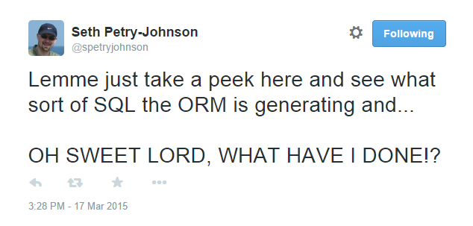
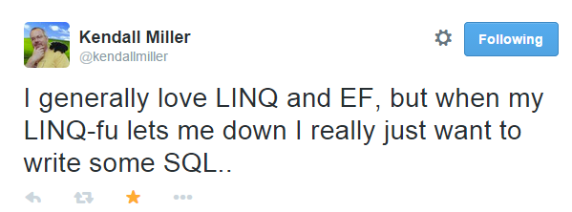
Notes:
This is why I am here, because I too feel the frustration of OR/Ms sometimes.

Slide 7

There is no IQueryable
http://commons.wikimedia.org/wiki/File:SpoonCollection.jpg
Notes:
Micro OR/Ms that I’ve used do not implement IQueryable. You can still use Linq, but it will be Linq on in-memory objects. This means you have to write SQL.
Raise your hand if you’ve ever gotten a NotSupportedException. Not trying to rain on your parade: I use IQueryable every day. But it’s a leaky abstraction, tight coupling. It’s a lie—a good lie—but still a lie.

Slide 8

http://pixabay.com/en/auditorium-classroom-lecture-572776/
Notes:
Okay, now that I’ve scared everyone away.

Slide 9
Why a micro OR/M?
Speed
Simplicity
Avoiding the ceremony of ADO.NET
Notes:
Speed – OR/M means overhead, a micro OR/M performance will be very close to plain ADO.NET. In my experience, data access is very often the performance bottleneck.
YAGNI – OR/Ms ship with a bunch of features that require some extra work that you don’t need, shouldn’t need. OR/Ms often need a significant amount of configuration and setup, especially if you don’t (or can’t) follow conventions. With a Micro OR/M it’s pretty much Install-Package and you’re ready to go.
ADO.NET is (was) pretty great, but it shipped with .NET 1.0, that’s like 15 years ago
In technology terms, it’s as old as the moon. There is so much ceremony with ADO.NET that it’s just intolerable in many (not all) cases

Slide 10
Why Dapper?
Battle-tested by StackOverflow
Works with:
SQL Server
MySQL
SQLite
PostgreSQL
Oracle
All ADO.NET providers
Fastest
Notes:
StackOverflow was originally written with LINQ-to-SQL
As they grew, there found places with LINQ-to-SQL was a hindrance, and started to replace with Dapper. Not sure if they are still using any LINQ-to-SQL, but for a time they were running both an OR/M and Dapper
Your mileage may vary with benchmark, but Dapper appears to be the fastest when compared to other O/RMs. In some cases we’re talking 2 ms difference, in some cases we’re talking 600 ms (over 500 iterations of SELECT)

Slide 11
Show me the code
Notes:
I’m going to show you how to use Dapper with a series of passing unit tests.
At the end, I’ll have a link to get all this code so you can see for yourself and start playing with dapper.

Slide 12
Start with an IDbConnection
new SQLiteConnection(“Data Source=:memory:”)
Notes:
I’m using SQLite in these demos because it’s fast and easy to do in-memory
Each unit test creates a brand new SQLite database in memory

Slide 13
Dapper is a set of extension methods
Execute
ExecuteReader
ExecuteScalar<T>
Query<T>
QueryMultiple
(plus Async versions of the above)

Slide 14
Execute
myConnection.Execute(
string sql,
object param,
IDbTransaction transaction,
int? commandTimeout,
CommandType commandType
)
Notes:
SQL is the only thing required
You can parameterize with param, it will map properties to parameters in the SQL string
Transaction if you need it
Timeout if you need it
CommandType if you want to execute a sproc (I won’t show a sproc today because SQLite doesn’t support sprocs, but it can be done)

Slide 15
ExecuteScalar
var returnValue = myConnection.ExecuteScalar<T>(
string sql,
object param,
IDbTransaction transaction,
int? commandTimeout,
CommandType commandType
)
Notes:
ExecuteScalar is very similar, except it will return first column of the first row
You specify the type, but this is usually going to be a simple type like int, decimal, string

Slide 16
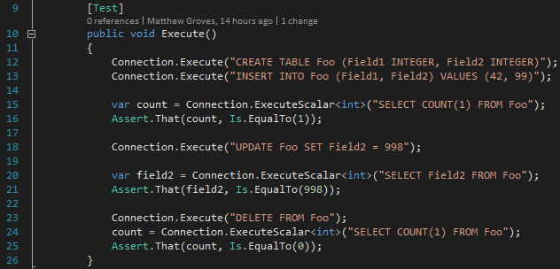
Notes:
Basic usage of Execute and Execute scalar. Just uses SQL

Slide 17
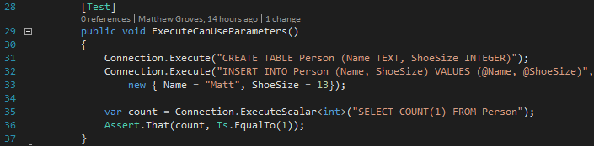
Notes:
Now we’re using parameters.
In this case, I’m using an anonymous object.
But you can use any object, as long as the names match the parameter names in the SQL string

Slide 18
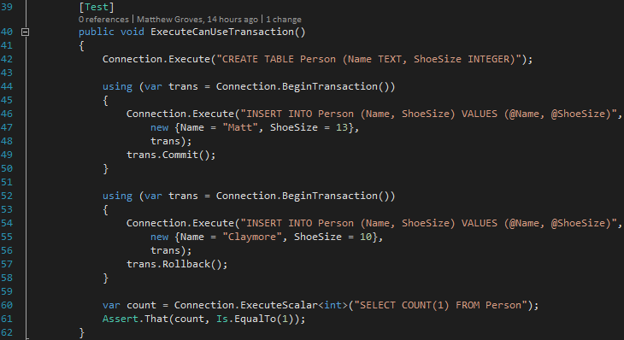
Notes:
Now I’m using a transactions.
To prove it works, I’m committing the first transactions but rolling back the second.

Slide 19
Query
IEnumerable<dynamic> data = myConnection.Query(
string sql,
object param,
IDbTransaction transaction,
…
)
Notes:
Here is the first Query extension
Notice that it returns a collection of ‘dynamic’ objects
Takes SQL just like before, this is all that’s required
You can also use parameters, transaction, and some other stuff like buffering, timeout, etc, I won’t cover

Slide 20
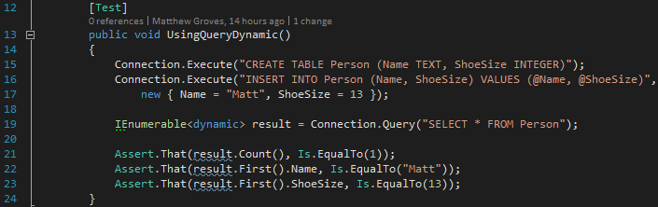
Notes:
Here’s an example of using the Query extension
I’m selecting Name and ShoeSize, so those properties will be valid on the objects in the collection
Side note: behind the scenes, this is using DbReader

Slide 21
Query<T>
IEnumerable<T> data = myConnection.Query<T>(
string sql,
object param,
IDbTransaction transaction,
…
)
Notes:
Dynamic is nifty, but we’re in a strongly typed language, so we can also take advantage of strong typing
By using the Query<T> extension
Now it will get a collection of whatever type you specify
And it will (try to) map whatever fields you select in the SQL string

Slide 22
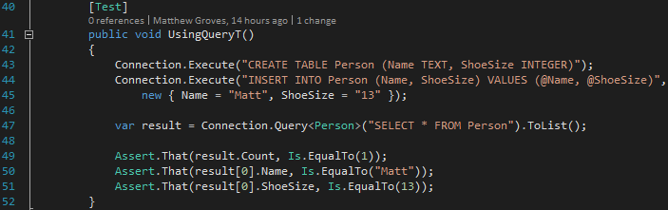
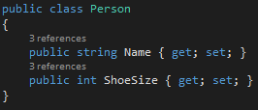
Notes:
Here’s how Query<T> works with the same table and query
But now I’m specifying a Person type

Slide 23
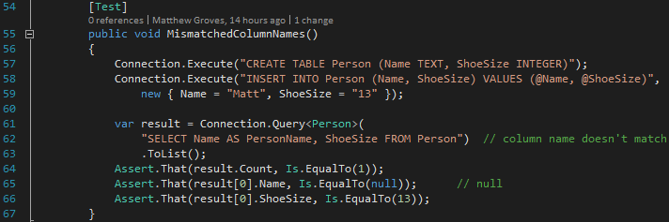
Notes:
Note that Dapper matches up the data to the object property by name
So if the name doesn’t match, it won’t get set

Slide 24
Bulk insert
If the parameters is a collection, then the query will be run once for each parameter in the collection.

Slide 25
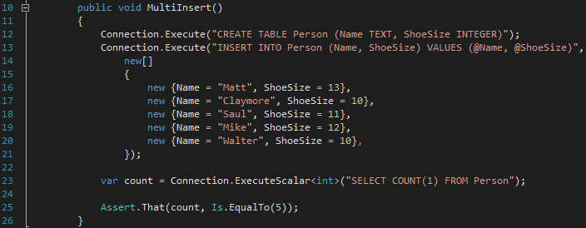
Notes:
The second Execute will insert 5 records.

Slide 26
Using the IN keyword
Is supported with parameterization

Slide 27
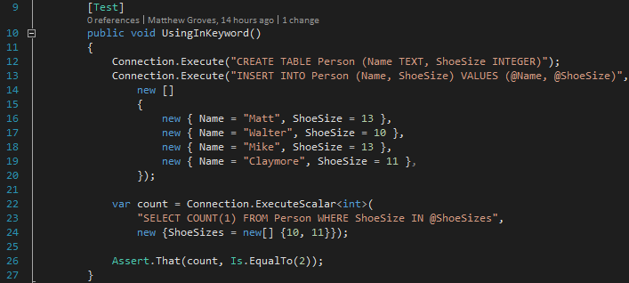

Slide 28
Multi-mapping
Dapper maps every row to one object.
But, Dapper can also map a row to multiple objects, and relate them.
Notes:
What about joins?
We want objects that are related to another object.

Slide 29
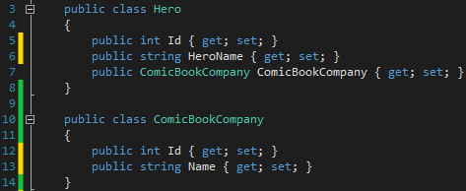
Notes:
Here are the actual entites.

Slide 30
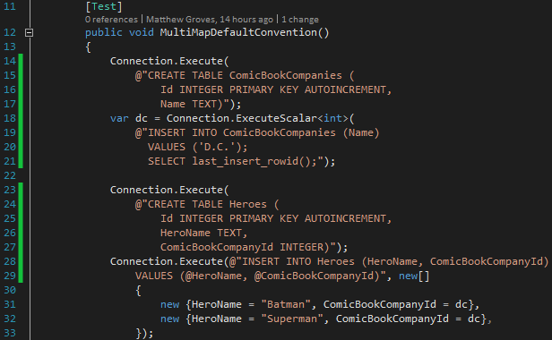
Notes:
This is a longer test, so I’ve broken it into two slides.
Two tables that are related.
Each Hero has a comic book company that it belongs to.
In the actual data, we have Batman and Superman that are both D.C.

Slide 31
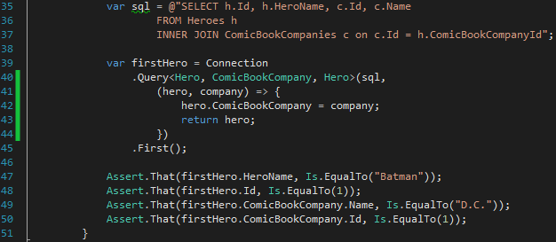
Notes:
The SQL is joining the Heroes table to the Comic Book Companies.
I’m using the Query extension with THREE type parameters.
The first two types are the types of the objects that will be mapped to. Note that now the order of the fields being selected in SQL matter.
The last type is the type that will be returned.
This lambda defines the relationship between the resultant objects.

Slide 32
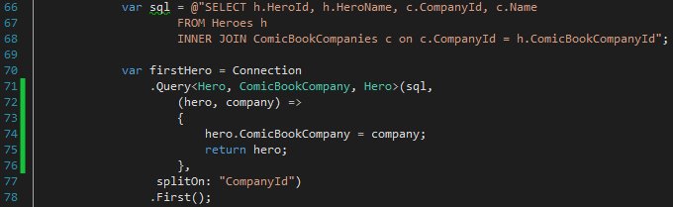
Notes:
Note that dapper will assume that the rows are divided up when it sees a column named “Id”
If you don’t have columns named “Id”, then you can override the convention using “splitOn”

Slide 33
splitOn
By default, Dapper returns one object per row.
When using multi-mapping, it splits each row into multiple objects.
By default, it splits on “Id” columns. With splitOn, you can specify different names.

Slide 34
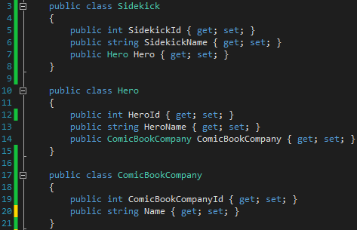

Slide 35
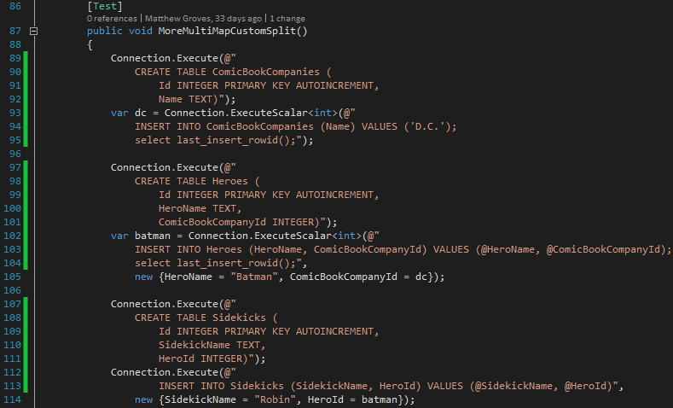
Notes:
This is a lot to take in, but it’s all setup code. I’m creating three tables: ComicBookCompanies, Heroes, and Sidekicks.
Then I’m inserting related data into each. D.C., Batman, Robin.

Slide 36
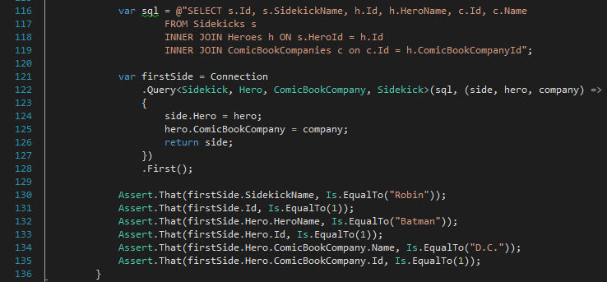
Notes:
Now, I want to select the data back out.
I join all three tables.
I’m asking dapper to split the data up into 3 objects.
For each row, it will give me a Sidekick.
For each sidekick, I specify a lambda to associate the other objects.

Slide 37
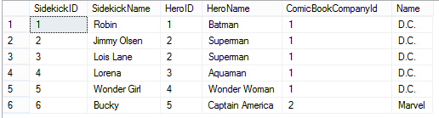
SELECT s.SidekickID, s.SidekickName, h.HeroID, h.HeroName, c.ComicBookCompanyId, c.Name
FROM Sidekicks s
INNER JOIN Heroes h ON s.HeroID = h.HeroID
INNER JOIN ComicBookCompanies c ON h.ComicBookCompanyId = c.ComicBookCompanyId
Notes:
Notice that I used different ID names

Slide 38
Multi-mapping
We saw easy 1-to-1 (parent to child) mapping.
We can also do 1-to-many (parent to children) mapping with some extra effort.

Slide 39
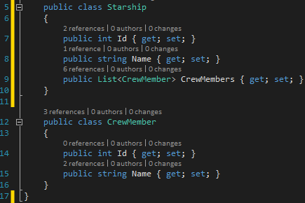
Notes:
Note that this COULD be modeled the other way: CrewMember would have a Starship parent.
But maybe that doesn’t fit your model: maybe crewmembers can be assigned to multiple starships, whatever.
How can Dapper populate that CrewMembers field?

Slide 40

Notes:
Well the answer is “yeah you kinda can, but you probably won’t like it”
And if you need to do this a lot, then you should either a) write some convenience methods or classes to do this for you, or b) consider using a normal OR/M

Slide 41
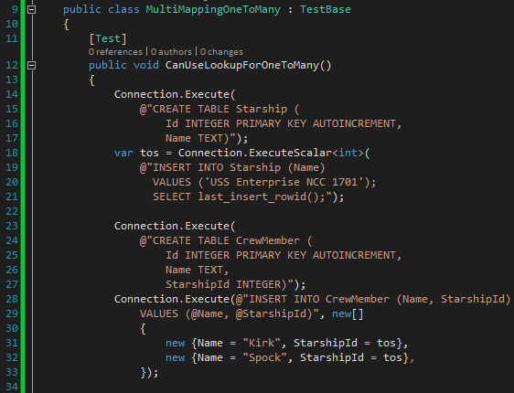
Notes:
Here’s the straightforward stuff. Create the tables and putting stuff in them.
I’m creating one starship enterprise, with Kirk and Spock as crewmembers.

Slide 42
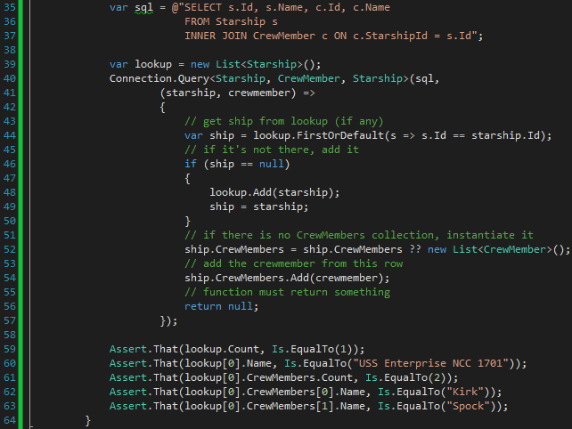
Notes:
There’s the query at the top. As before, this will be a multimap query, so dapper will split on “ID” by convention.
Keep in mind that dapper will return one record PER ROW. So in this case, Dapper would attempt to return two records, but really only want one starship record with TWO crewmembers.
So I have to take some extra steps to get what I want. I’m interested in the FIRST starship only, but EVERY crewmember.
I create a lookup to hold a list of Starships.
So then each time this dapper multimap method runs, I have to lookup to see if I’ve already got that starship, see if its crewmember collection has been instantiated, and then add a crewmember to that collection.
There are other approaches you can take, I’m sure you could write a helper for this, but the bottom line is that it’s extra work.

Slide 43
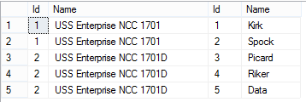

Slide 44
Multiple results
Dapper can handle multiple result sets in a single query.

Slide 45
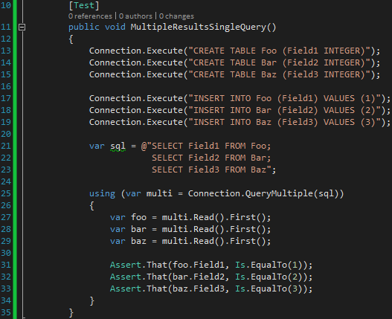
Notes:
Multi is of type GridReader

Slide 46
GridReader
Read
Read<T>
ReadAsync
ReadAsync<T>
Notes:
My test used Read, which returns dynamic, but you can use strong typing and async just like everywhere else

Slide 47
Errors
Since Dapper is just a collection of extension methods on IDbConnection, most exceptions you encounter will come from the IDbConnection implementation itself.
Notes:
There are some exceptions dapper will throw, like with the multimapping.

Slide 48
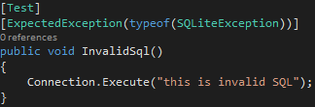
Notes:
Notice the exception type being thrown is of type SQLiteException and not DapperSqlException or anything like that

Slide 49
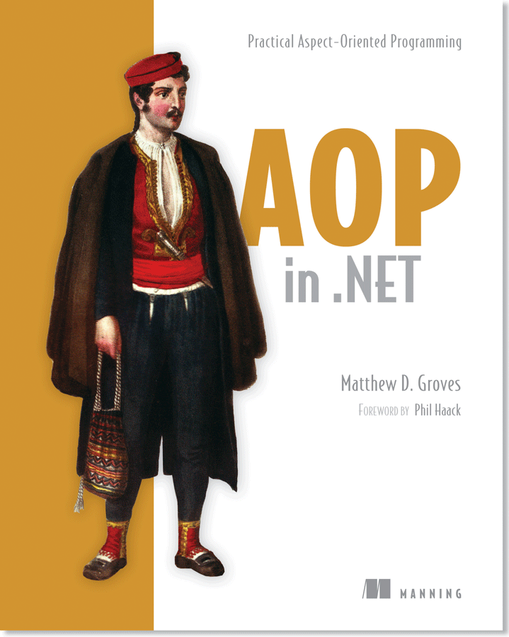
Contact me
http://about.me/mgroves
http://github.com/mgroves
http://crosscuttingconcerns.com
http://manning.com/groves
42% off code: 12mp25

