Slide 1
Introduction to Ansible

Slide 2
Agenda
Introduction
Installation and configuration
Communication framework
Password less Authentication
Ansible command line
Ansible playbooks
Ansible roles
Ansible Vault
Ansible templates
Ansible galaxy

Slide 3
ANSIBLE
Ansible is a simple IT automation platform that makes your applications and systems easier to deploy.
It support configuration management with examples as below.
Configuration of servers
Application deployment
Continuous testing of already install application
Provisioning
Automation of tasks

Slide 4
Why Automation?
Tasks in code
Collaboration
Eliminate errors
Write once
Etc….

Slide 5
Ansible Operational Tasks
provision server
deploy
configure
Monitor
Scale
Secure

Slide 6
Why Ansible
It is a free open source application
Agent-less – No need for agent installation and management
Phython/yaml based
Highly flexible and configuration management of systems.
Large number of ready to use modules for system management
Custom modules can be added if needed
Configuration roll-back in case of error
Simple and human readable

Slide 7
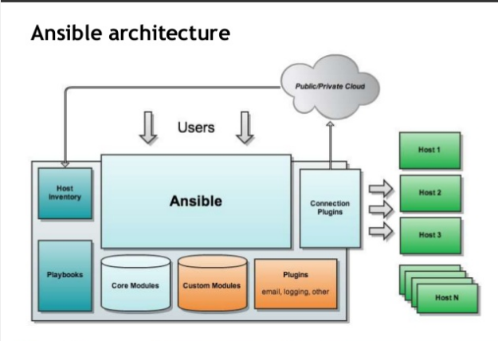
Ansible Architecture

Slide 8
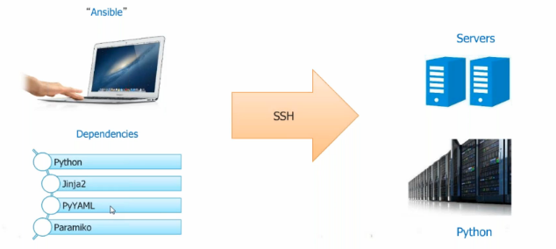

Slide 9
Installation of Ansible
Install packages below on the Server Machine
sudo apt-get install python-yaml python-jinja2 python-paramiko python-crypto python-keyczar Ansible
For redhat you can clone it by using below repository
# git clone git://github.com/Ansible/Ansible.git
Install packages below on the client Machines
sudo apt-get install python-crypto python-keyczar

Slide 10
Create the RSA Key Pair
The first step is to create the key pair on the Server machine
ssh-keygen –t rsa
Once you have entered the Gen Key command, you will get a few more questions:
Enter file in which to save the key (/home/test/.ssh/id_rsa):
Enter no password for the next prompt
Copy the Public Key
ssh-copy-id test@192.168.85.135
Repeat the same process for other machines you wish to login automatically with.
Ensure the test username has sudo access to the remote clients

Slide 11
Configuration of ansible
Do the following on the Server machine
Create the list of client machines you wish to access via this server
vi /etc/ansible/hosts ( And enter the following lines and save file)
[Servers]
192.168.85.135
192.168.85.136
Run the ping command below to see if indeed you are reaching both client nodes
ansible -m ping all

Slide 12
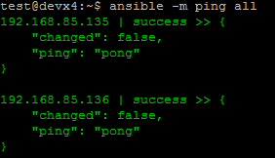
Examples of ansible commands
The output show ping result success as shown below

Slide 13
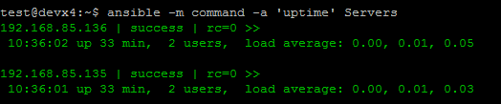
Examples of ansible commands (Cnt)
How to run commands to fetch hard drives utilization
ansible -m command -a 'df -h' Servers
How to run commands to fetch system uptime
ansible -m command -a ‘uptime' Servers

Slide 14
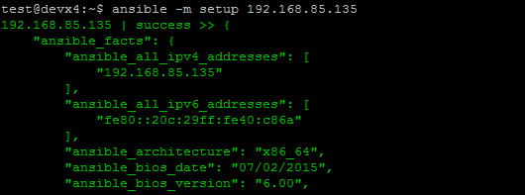
Examples of ansible commands ( Cnt)
The full configuration environment inventory of a particular client machine can be obtain using the command below.
ansible -m setup 192.168.85.135 ( output as shown below)

Slide 15
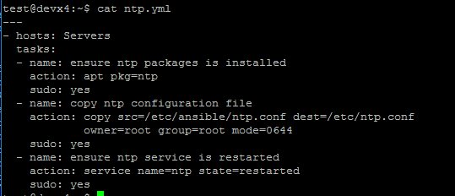
Creating an ansible-playbook template
Create a template to enable the installation of an NTP service with content as shown below and file saved as ntp.yml

Slide 16
Understanding ansible playbook configurations
In order to use ansible with SSH passwords you will need to install the program below
sudo apt-get install sshpass
Ansible-playbook command can be executed to run the ntp.yml file as below
ansible-playbook -k -K ntp.yml
The –k –K switches allow you to be able to use your ssh key and passwordless sudo.
Every playbook configuration begins with triple dash ( ----)
The hosts, tasks, name, action are various instructions commands to help automate your ntp installation process.

Slide 17
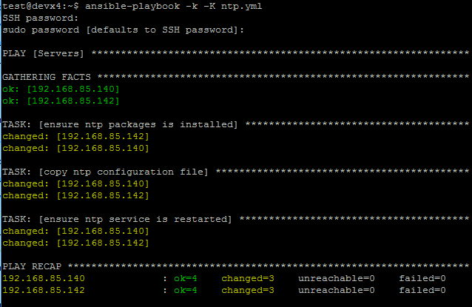
Understanding ansible playbook configurations (cnt)
The output of the ansible-playbook command as below

Slide 18
Ansible Documentations
You can find more explanation in the Ansible Docs.
Ad-hoc commands
Inventories
Variables
Modules
Playbook Roles
Similar tools that does the same function as Ansible are as below.
Puppet
Chef
Salt

