Slide 1


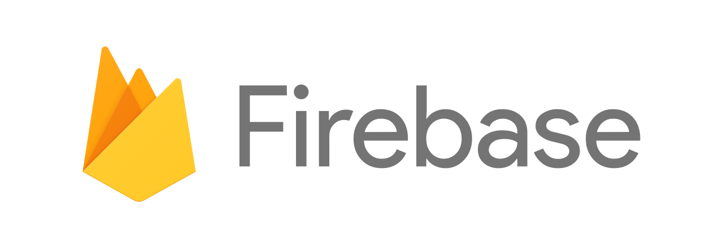

Group Project 1 – Team Baratheon
Project Description
A virtual medicine cabinet to manage your prescription and over-the-counter medications
Project members
Andraya smith, Andrew esquivel, katie Robertson, mike castillo
Project Application programming interfaces (apis)
Openfda drug labeling api
http://open.fda.gov/apis/drug/label/
NLM chemspell web service
https://chemspell.nlm.nih.gov/spell/

Slide 2
Group Project 1 – Team Baratheon
What problem does your app focus on?
The problem that our app focuses on is one of personal medication usage and tracking. While many hospitals, clinics, pharmacies and other health related entities focus on maintaining centralized patient records at the point of service/sale, our app focuses on providing a subset of this functionality for use solely by the patient/end user.
In a nutshell the problem our app addresses is the challenge individuals face when trying to keep track of medications they have used or plan to use, including recalling details about purpose, usage, frequency and duration.

Slide 3
Group Project 1 – Team Baratheon
How does your app solve this problem?
Our app is equivalent to a virtual medicine cabinet, which allows end user to manage their own records regarding prescription and over-the-counter medications.
Our app allows end users to type in a medication name and retrieve details about its purpose and usage.
In addition, current users of a given medication can add a medication to their “cabinet” along with prescription dates and notes in order to save it for future reference.

Slide 4
Group Project 1 – Team Baratheon
What steps did you take to build the app?
Held team discussions
Created a project proposal
Created wireframe concept diagram and ui/ux comps
Created a git hub repo
Created a git hub project with issues listed in a Kanban format
Created a dedicated slack channel
Conducted Lots of research (api, materialize, firebase)
Created development files (Html, css, javascript)
Reviewed git version control procedures
Prepared for presentation

Slide 5
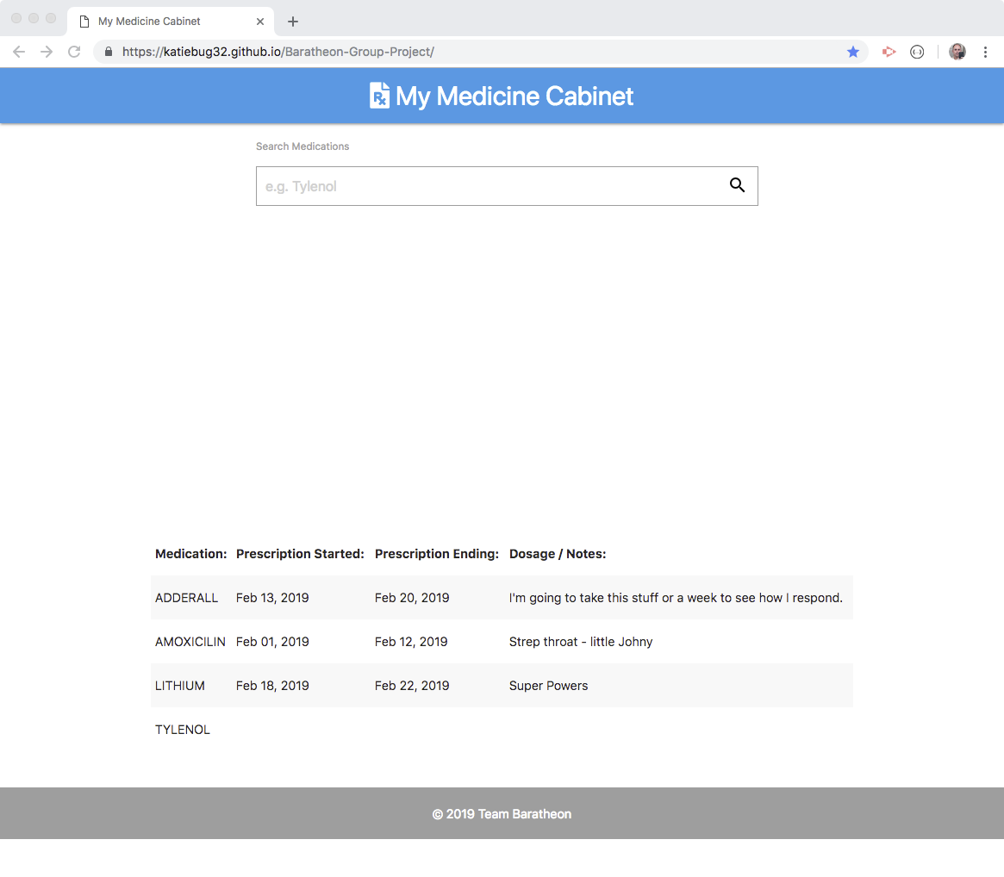
Group Project 1 – Team Baratheon
Demo and proposed updates
https://katiebug32.github.io/Baratheon-Group-Project/

