Slide 1

E-commerce website testing
Author: Andrei Gunta
Date: July 2022

Slide 2
THE PRODUCT
The e-commerce website www.fashiondays.ro is one of the biggest online clothing shops in Romania
Everything started in 2009 on the Romanian market and is present today in Hungary and Bulgaria.
In 2015 became part of the eMAG group, and this partnership contributed even more to the consolidation of the leading position on the e-commerce fashion market in the region.
In 2019 the shopping experience has become simpler, faster, more efficient with delivery to eMAG easybox locks in Bucharest, Ilfov and most major cities.
Fashion Days is the online destination that offers shopping and inspiration, anywhere and anytime, to over 1,500,000 customers in Romania, Bulgaria and Hungary.

Slide 3
The testing strategy
Web application breakdown using mind map
Functionalities identification and review against requirements
Features selection to go under test
Testing types and testing techniques selection
Test scenarios, test cases and test data
Test execution
Bugs overview

Slide 4
Tools used in the testing process
Mind map: Diagrams.net
Test cases: Microsoft Excel
Page speed: Webpagetest.org, pagespeed.web.dev
Ping check: Windows CLI, check-host.net
Accessibility: https://achecker.achecks.ca/checker/index.php, https://wave.webaim.org/
API testing: Postman
Performance testing: Jmeter
Bug tracking: MantisBT

Slide 5
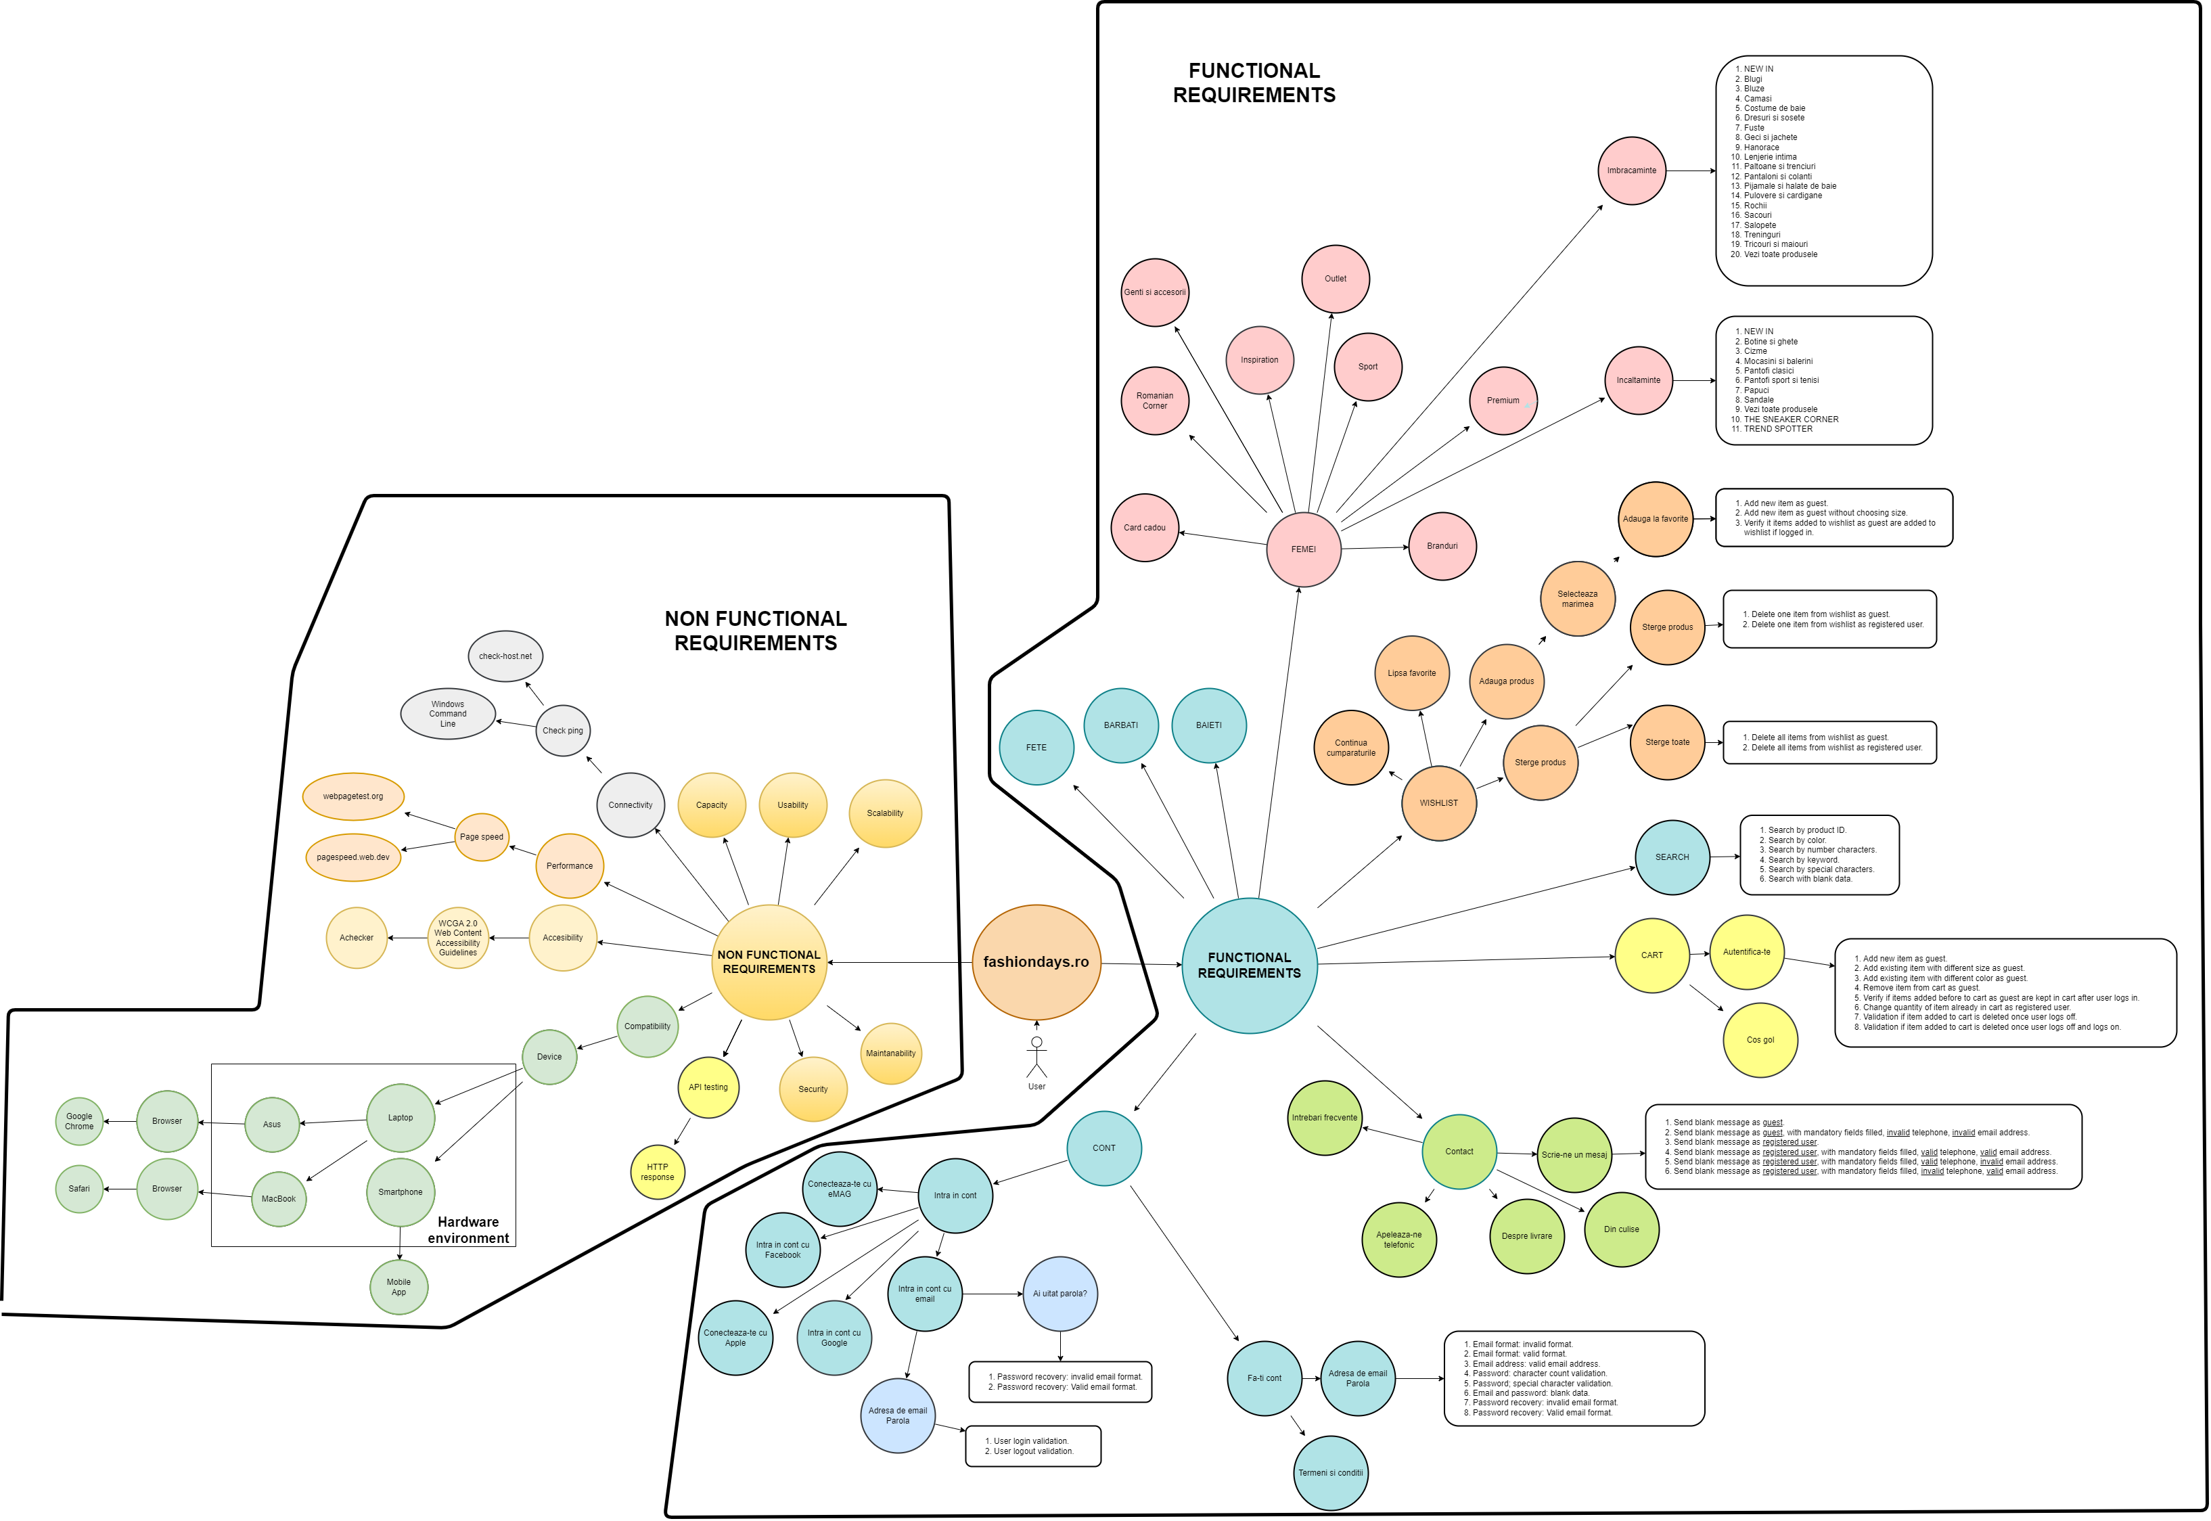
MIND MAP

Slide 6
Testing types
Functional tests:
Smoke test to identify critical bugs in major features
Dynamic UI exploratory testing in happy flows
Non functional tests:
Accessibility – Web Content Accessibility Guidelines 2.0 (WCAG 2.0), WebAIM
Connectivity – Ping check
API testing – HTTP requests
Performance – Page speed tests, response times
Compatibility – Cross platform and cross-browser tests

Slide 7
Test cases and test data
The test cases were designed to validate the main features of the application.
Test Suite Windows-Chrome: 50 test case
Test Suite macOS-Safari: 45 test cases
Test data used in the process:
Valid test data
Invalid test data
Absent test data (no data or blank)

Slide 8
Test cases results 1/2
Windows – Chrome
50 test cases, from which 47 passed and 3 failed, with a pass ratio of 94.33%
macOS – Safari
45 test cases, from which 42 passed and 3 failed, with a pass ratio of 91.90%

Slide 9
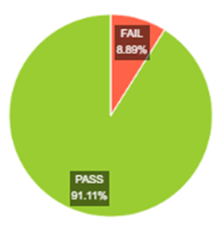
Test cases results 2/2
Postman
GET method and response time: 10 test cases were run with a pass ratio 100%
GET method - status code 200 is OK
GET method – Response time is less than 200 ms
Jmeter
GET method and response time: 900 sample requests, with a pass ratio of 91.11%
Duration assertion 1000 ms
Response assertion status code 200

Slide 10
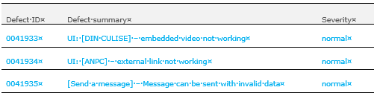
Bugs overview
Bugs overview:
3 bugs were found on Test Suite Windows, each with an identical twin on Test Suite macOS
The severity of the bugs was normal with normal impact on the product’s functionality
The bugs were reported in MantisBT for review

Slide 11
CONCLUSIONS
Following both functional and non-functional testing of the product, the results are:
all the main features are working
good website loading speed
optimal communication between client and server
The product can be improved in terms of accessibility to:
meet the needs of all users
meet legal requirements
improve overall experience

Slide 12
LESSONS LEARNT
Team player – care about helping the team to succeed
Open to feedback – ask and accept constructive feedback
Right attitude – help improving the quality rather than criticizing someone’s work
Constant learning – acquire knowledge to gain new skills and expertise
Understand priority – Test high impact functions first
Get to know the programmers - socialize
Be proud of your job
HAVE FUN ☺

Slide 13
Feedback THANK YOU

