Slide 1
GeoDB-R
An R wrapper for the GEO-DB public API obtaining worldwide data on cities, counties, islands, regions and countries.
http://geodb-cities-api.wirefreethought.com/
https://wirefreethought.github.io/geodb-rest-api-docs/
Group 6:
Andre Gnandt
Manpreet Singh
Yihang Wang

Slide 2
Several API endpoints to gather information:
Places (islands, districts, cities) – Get all data including respective distances, populations, locations and more.
Regions - More detailed data on Regions
Cities – More detailed data on Cities
Countries – Similar data but with more country specific details such as currency.

Slide 3
Most of the API’s are highly user-unfriendly and difficult to use:
Example of an endpoint used to obtain data on all inhabited Islands within a 1200 KM radius of UBC Vancouver Campus that are not within Canada or the United States:
https://wft-geo-db.p.rapidapi.com/v1/geo/places/Q391028/nearbyPlaces?radius=1200&excludedCountryIds=Q16,Q30&minPopulation=1&distanceUnit=KM&type=ISLAND

Slide 4
Some Examples:
Regions, Places and Cities – only accepted as “Wiki data Id” values
Locations – only accepted as a comma delimited string in ISO-6709 longitude and latitude form
Countries – only accepted as a comma delimited list of Wiki data Id’s or codes
Time Zones – only accepted as Wiki Data Id’s
Types of places included in API’s – only accepted as comma delimited strings like “AMD2” for districts
Returns confusing metadata and hard to interpret at first glance

Slide 5
Our Solution
Wrap the API’s into properly named functions for specific API calls providing easy to use parameters
Locations – now accept any address, name of a place or longitude and latitude
Country, City, Region, Place and Time Zone names – now accepted as an array or vector of actual appropriate names, or Id’s
Create separate functions or Boolean parameters for specific types of Regions or Places
Return Data in a clean data frame
Return chart maps for places and population levels

Slide 6
Examples:
The wrapped function for the API endpoint example earlier would be:
GEO.FindIslands.NearPlace(place = “UBC Vancouver”, excludeCountries = c(“Canada”, “United States”), radius = 1200, inhabited = TRUE)
GEO.FindCities(Regions = vector of regions names, nearLocation = name of a place, Countries = vector of countries………………….)
GEO.Distance.Between(from = name of place , to = name of place)
GEO.FindRegions(…………….)
AND MORE!

Slide 7
EXTRAS
Functions to extract the population density of any named place, or any geographical area (not provided by GEO db api)
Charts and maps for visualizing populations, densities and more

Slide 8
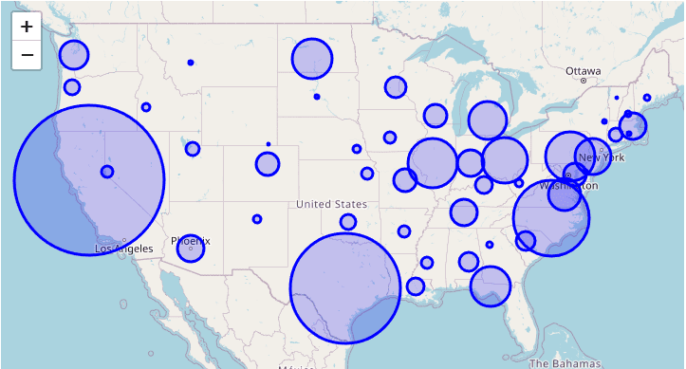
CHARTS

